Slide 1


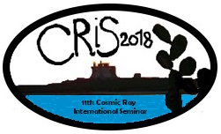
Shaking the World
Virgo Outreach Activities
F. Marion
For the Virgo Collaboration
CRIS 2018 – June 21, 2018

Slide 2
Onsite and Offsite Activities
Production of web resources
Social media
Science nights
Exhibitions and science festivals
Public talks and educational conferences
Virgo guided tours
Open days at EGO and at Virgo collaboration institutes
Classroom visits and guided tours for schools
Special events
  With connection to arts

Slide 3
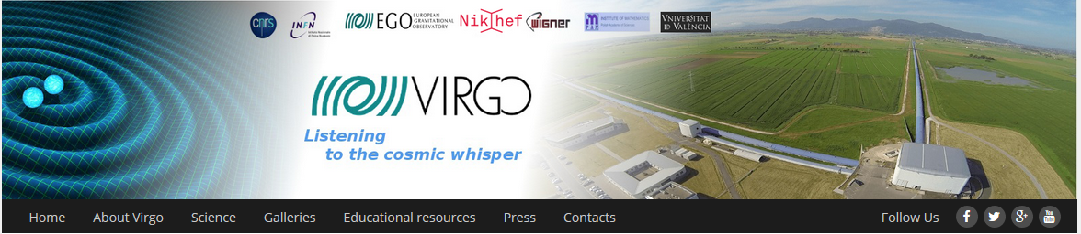
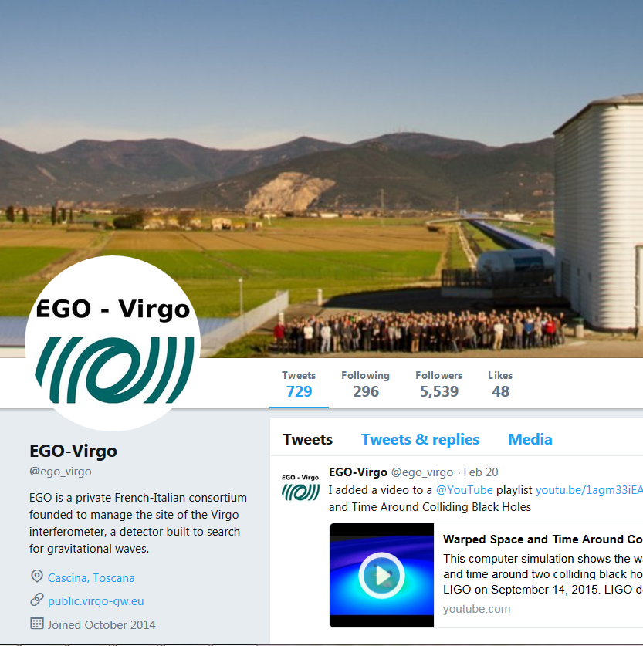
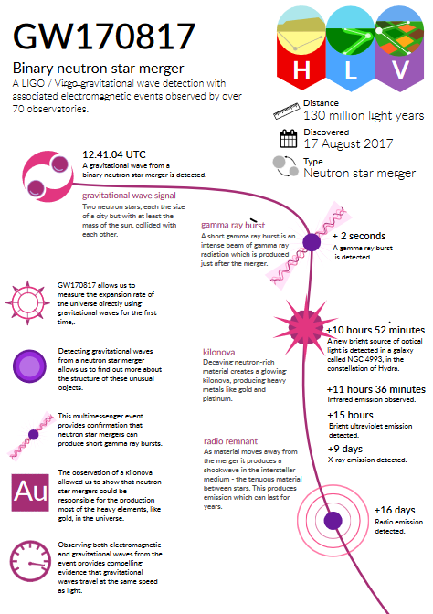
Web and Social Media
Web site
  Background information on GW
  News
  Links to detections
  Science summaries
Providing information in the relevant languages requires some effort
  Virgo = 6 languages + English

Slide 4
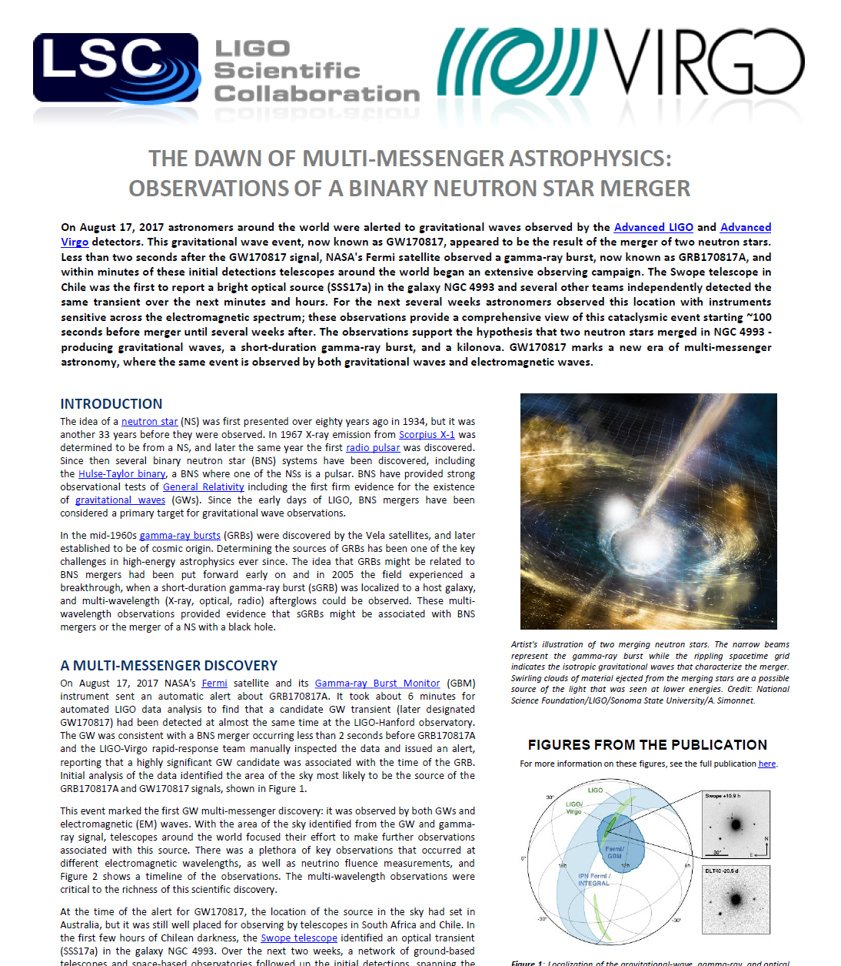

Science Summaries
Accessible web page summaries of published papers
  Joint effort with
Strong commitment and sustained effort
  More than 80 summaries since 2011
Core part of paper writing team responsibilities, assisted by outreach group
Translation challenge

Slide 5
Virgo Guided Tours
> 17,000 visitors since 2005!
Currently ∼400 visitors/month
  40% Tuscany, 40% Italy, 20% abroad
Growth rate becoming difficult to manage
  Long waiting list till 2020!

Slide 6
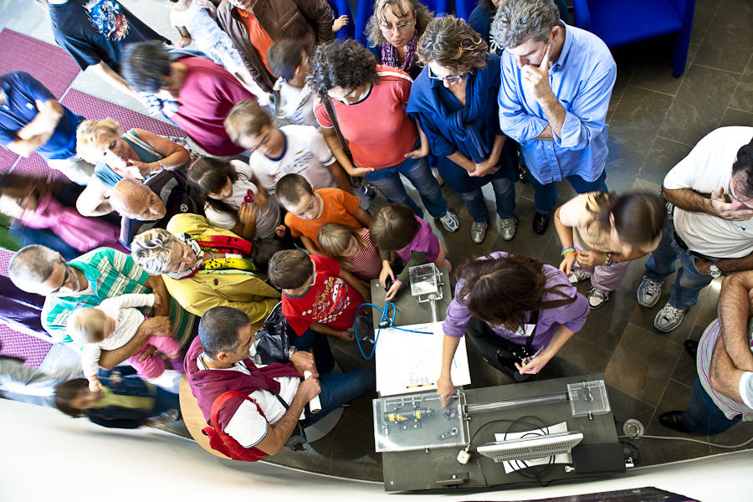
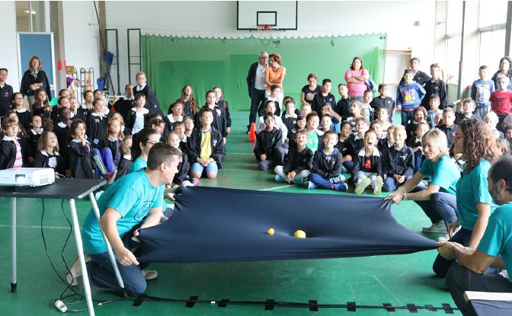
Hands on
Small interferometers to show principle and sensitivity of interference
Rubber tarps are great accessories to illustrate space-time dynamics

Slide 7

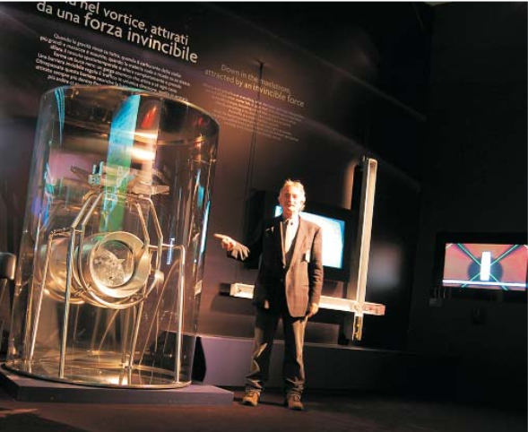

Exhibitions and Science Festivals

Slide 8

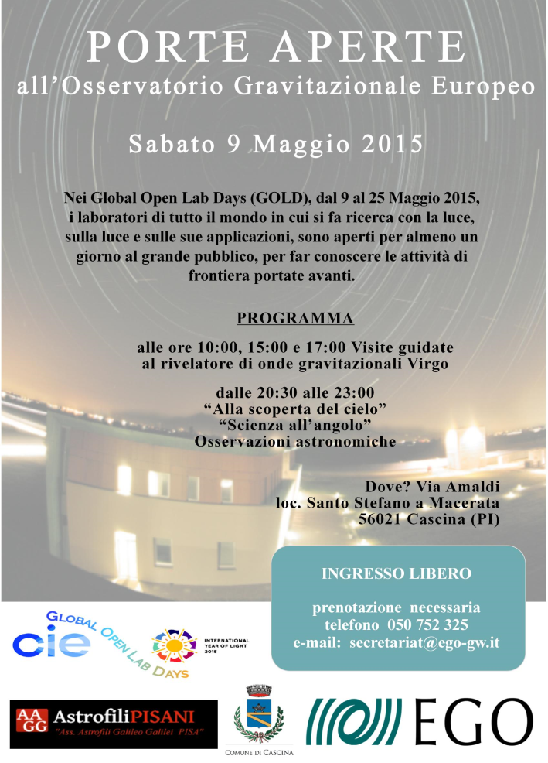
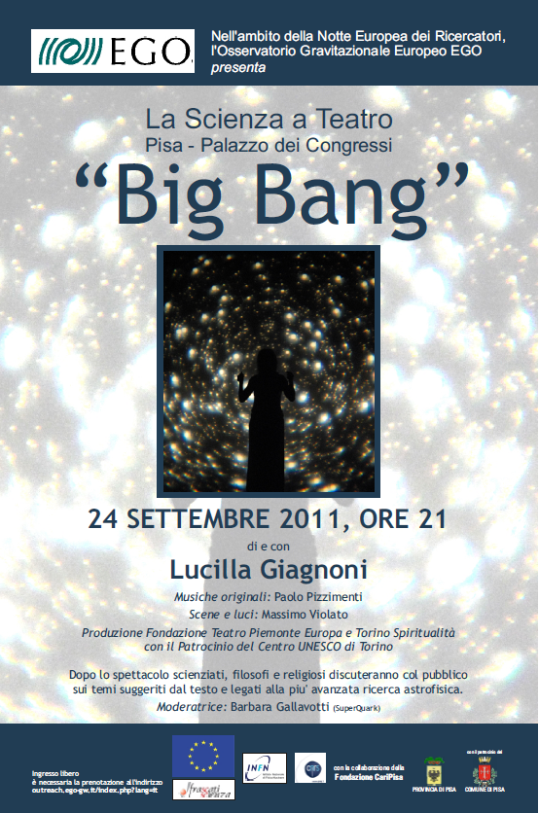
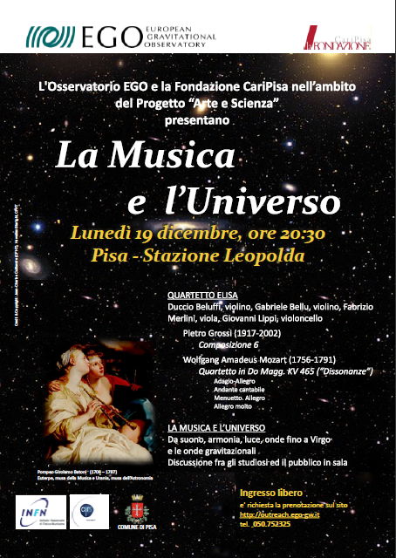


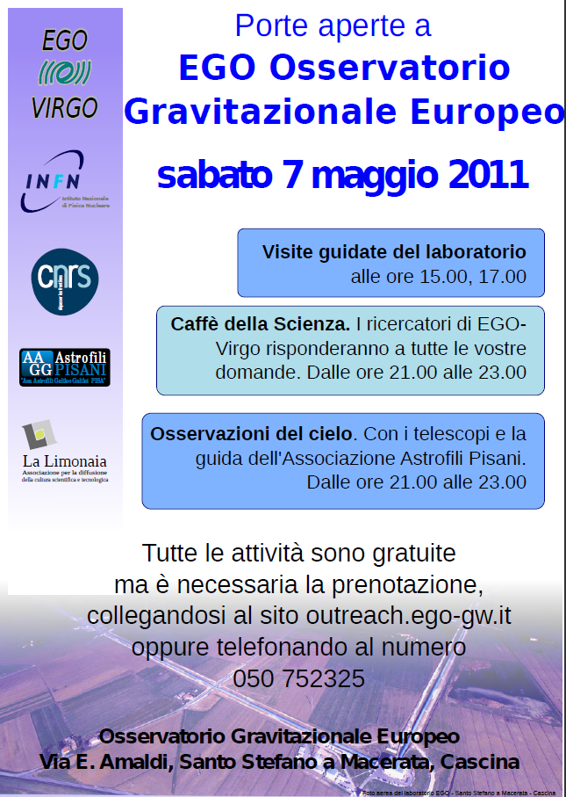
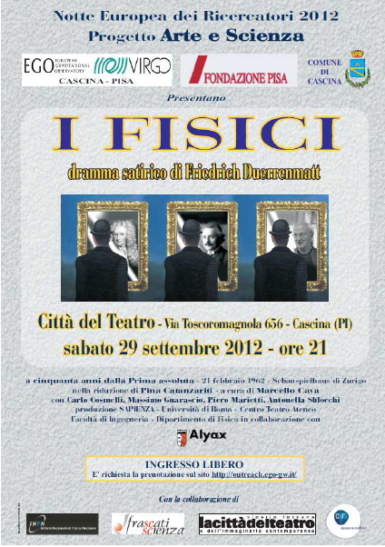
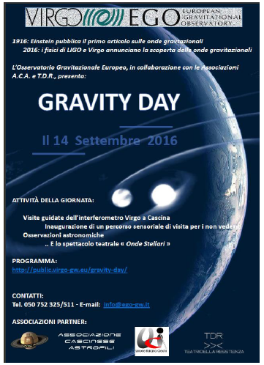
Special Events

Slide 9
A Major Event in France Last Year
Joint initiative of CNRS and SFP to celebrate GW discovery
A live, interactive, multi-site event organized on March 20th, 2017
Budget ∼ 70 k€, 10 months of preparation

Slide 10
Nuit des Ondes Gravitationnelles
Contests organized ahead of event
  Science or art oriented
Free, public event held simultaneously at a dozen sites
  Mostly out of campus
  Common schedule, local animation + global animation broadcasted from Paris
  Sites competing during interactive quiz
Audience ∼5000 people
  Good age and gender mix
  Many students with teachers
Social network coverage

Slide 11
Outlook
Multilingual website
Meet the demand for visits
  Dedicated manpower expected
  Develop virtual visits as the access to the instrument will be very limited
Keep on producing educational and outreach material for future detections
  Expect more than in O2 !
Exhibitions: example of the Virgo payload
In close connection with LIGO

