Slide 1
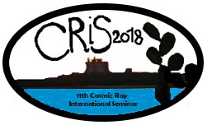
“The Pierre Auger Observatory” a peculiar didactical experience between school and work
11th Cosmic Ray International Seminar
18-22 June 2018
Portopalo di Capo Passero (SR), Italy
Carla Aramo¹, Ilaria Veronesi²
1 INFN Napoli, ITALY
2 Scientific Secondary Upper School “P.S.Mancini” Avellino, ITALY

Slide 2
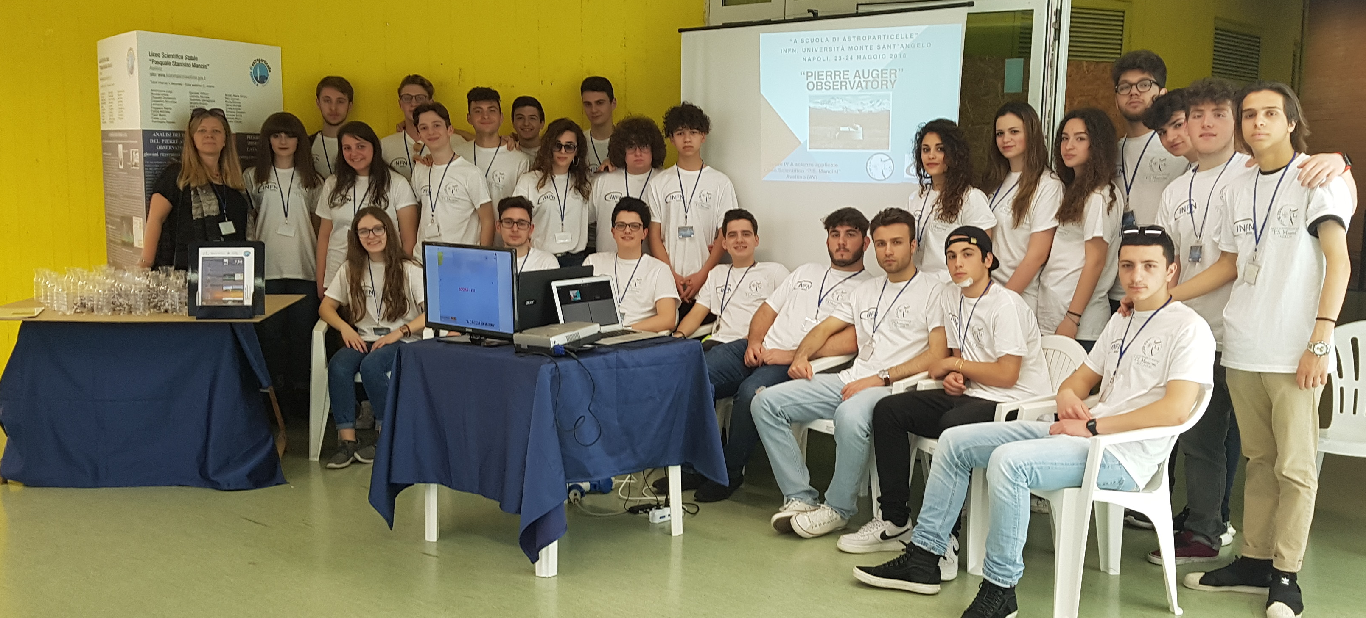
"at school of Astroparticles”
An original educational experience has been conducted with Italian students 17-18 aged attending Scientific Lyceum "P.S. Mancini" of Avellino (Italy) during the participation in the competition "At school of Astroparticles" organized by the National Institute for nuclear physics INFN – Naples

Slide 3
"at school of Astroparticles"
These activities developed in the context of alternating combination between school and work by INFN with high profile professional tutors and teachers in activities at the INFN.
With the “inquiry” methodology students investigate phenomena and acquire knowledge

Slide 4
ALTERNATING SCHOOL AND WORK
School–Work Alternation is an innovative education method
It is addressed to students of upper secondary schools, and
allows them to “alternate” periods of training in the classroom and inside companies
let students become familiar with the world of work, to guide them, and to make schools more effective

Slide 5
An educational practice: the Inquiry Based Science Education (IBSE)
the “inquiry” methodology is a set of related processes through which students ask questions about the natural world and investigate phenomena
In IBSE, laboratories are an integral part of the course that focuses on students' learning rather than on the teacher's "narratives"
understanding in science is much more than knowledge of facts;
Effective learning requires that students be aware and responsible for their work

Slide 6
The Model of the 5 E
Engage: The activities have the intent to create interest, generate curiosity
Explore: students have the opportunity to investigate the model under study through experiences, often concrete
Explain: students focus their attention on particular aspects through the explanation of the concepts
Elaborate: students deepen and reinforce the understanding applying it in new situations
Evaluate: students are encouraged to self-evaluate their understanding, teachers evaluate the progress of learners in achieving educational goals.

Slide 7
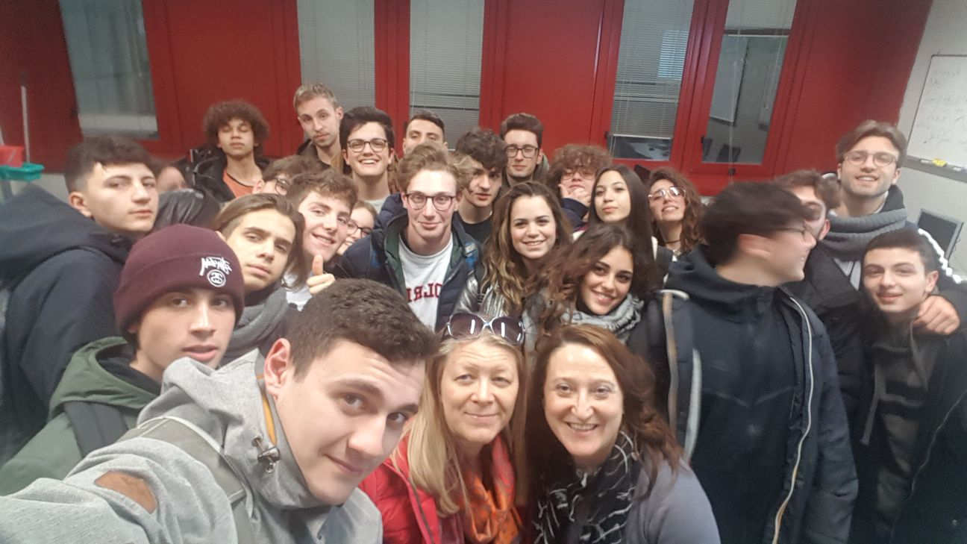
The cooperative learning methodology
is a new pedagogical and didactical metodolgy which uses the group’s emotional and cognitive involvement as a learning tool and an alternative to the traditional frontal lesson
promotes cognitive development as a social process

Slide 8
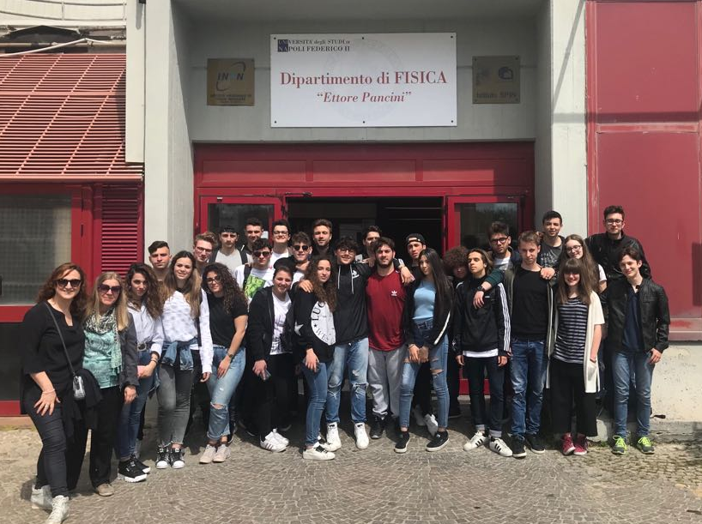
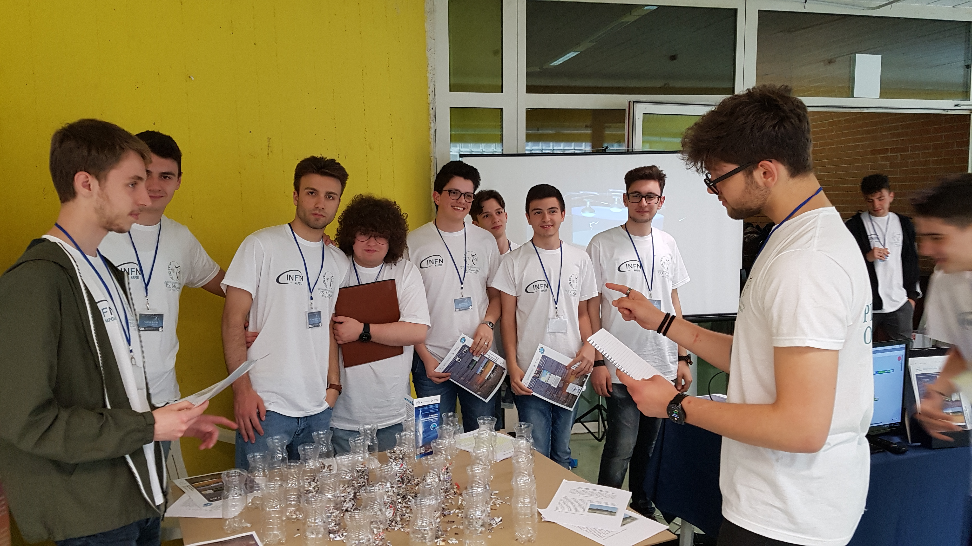
Our activities

Slide 9
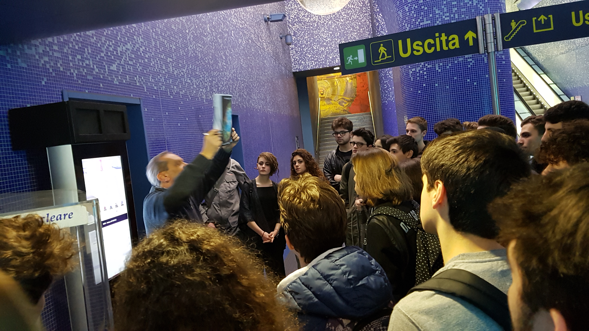
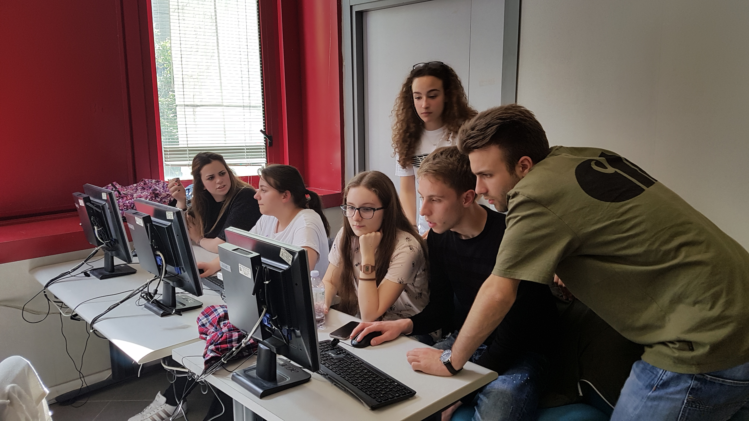
Engage
The first step was
To let the students know about the operations of the telescope located at Toledo Station in Naples’ subway
To visit the INFN laboratories
To see some explanatory videos in English

Slide 10
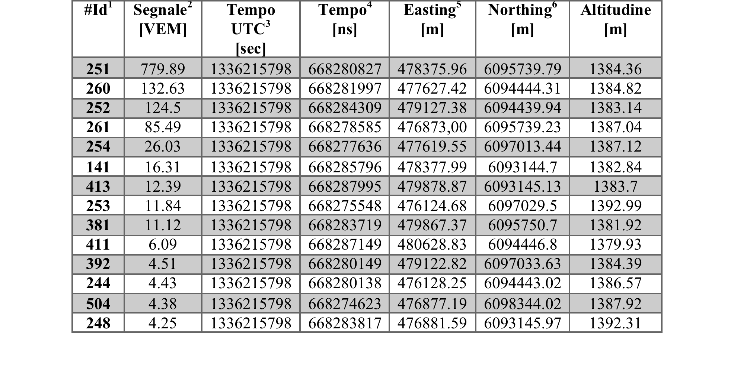
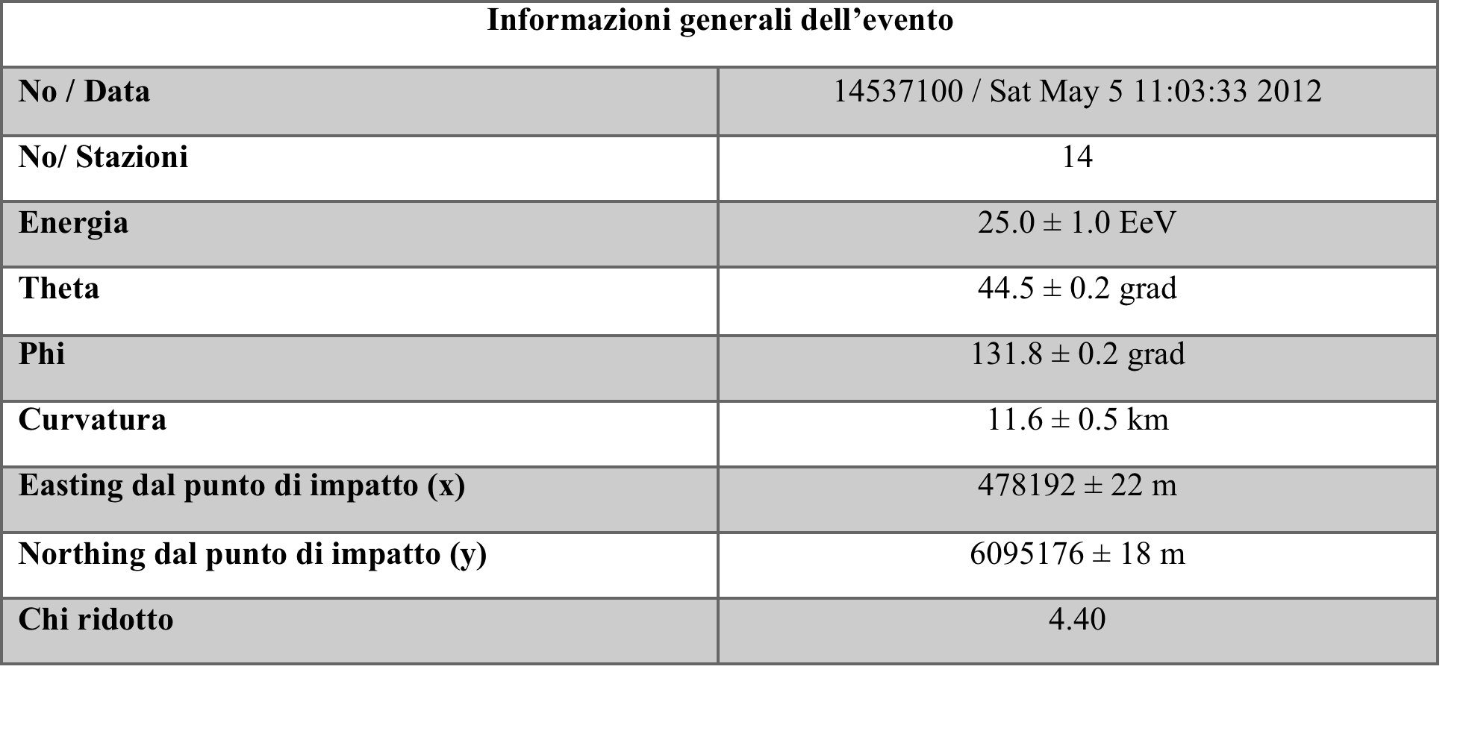
explore
Next, students have deepened the study of:
the history of physics over the past two centuries and its major successes, through the thought and discoveries of scientists
the PAO, the largest experiment for the study of cosmic rays ever built, its tanks and fluorecence telescopes

Slide 11
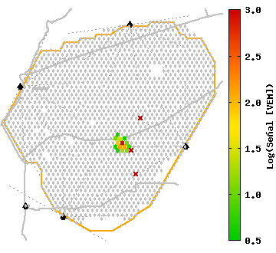
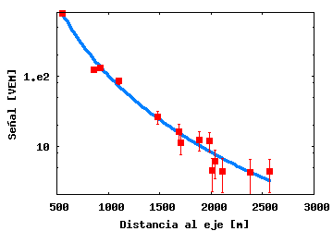
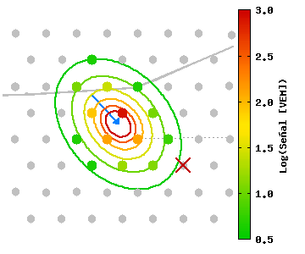
explain
interactive lessons, held by INFN Researchers of Naples about the evolution of particle detectors and the outreach research of data by P.A.O.
Outreach and analysis of the data

Slide 12
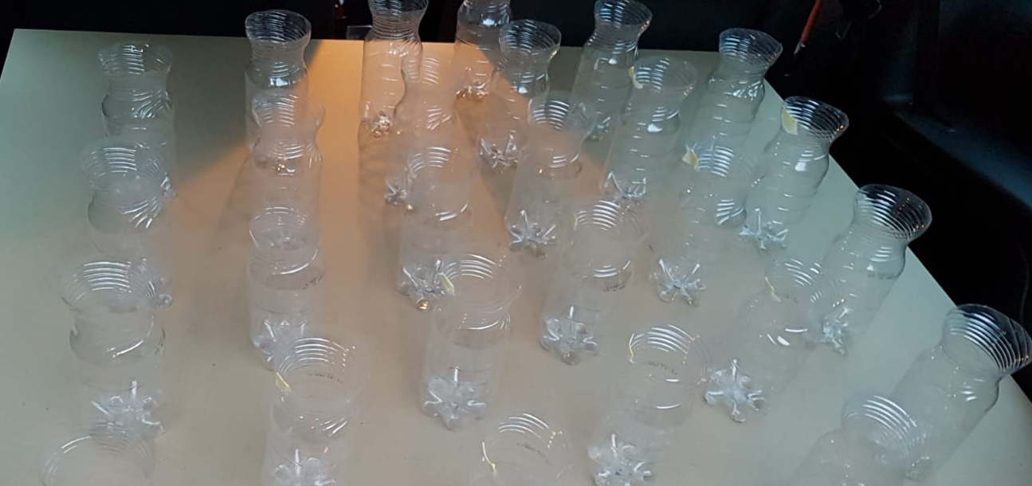
elaborate
Students produced:
An artefact made A video game
of recycled materials

Slide 13
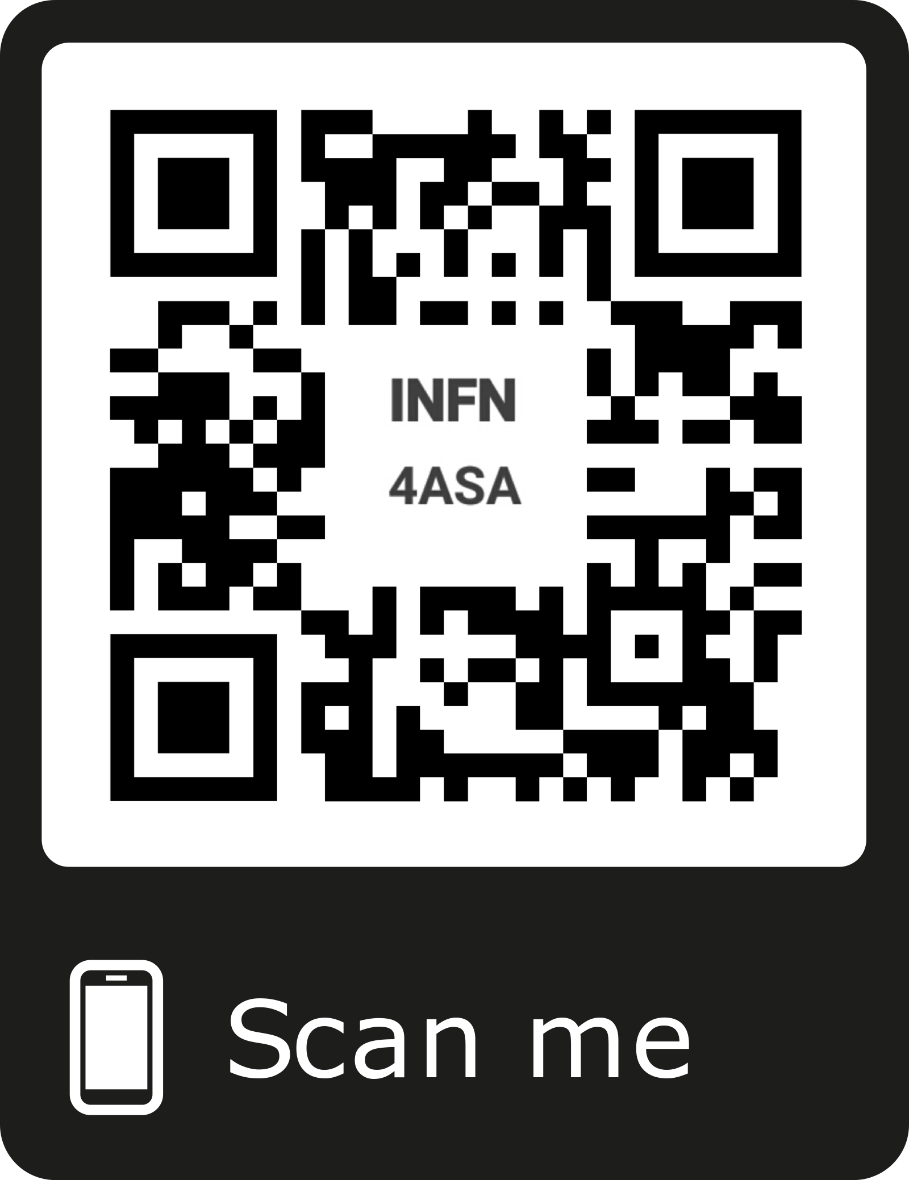
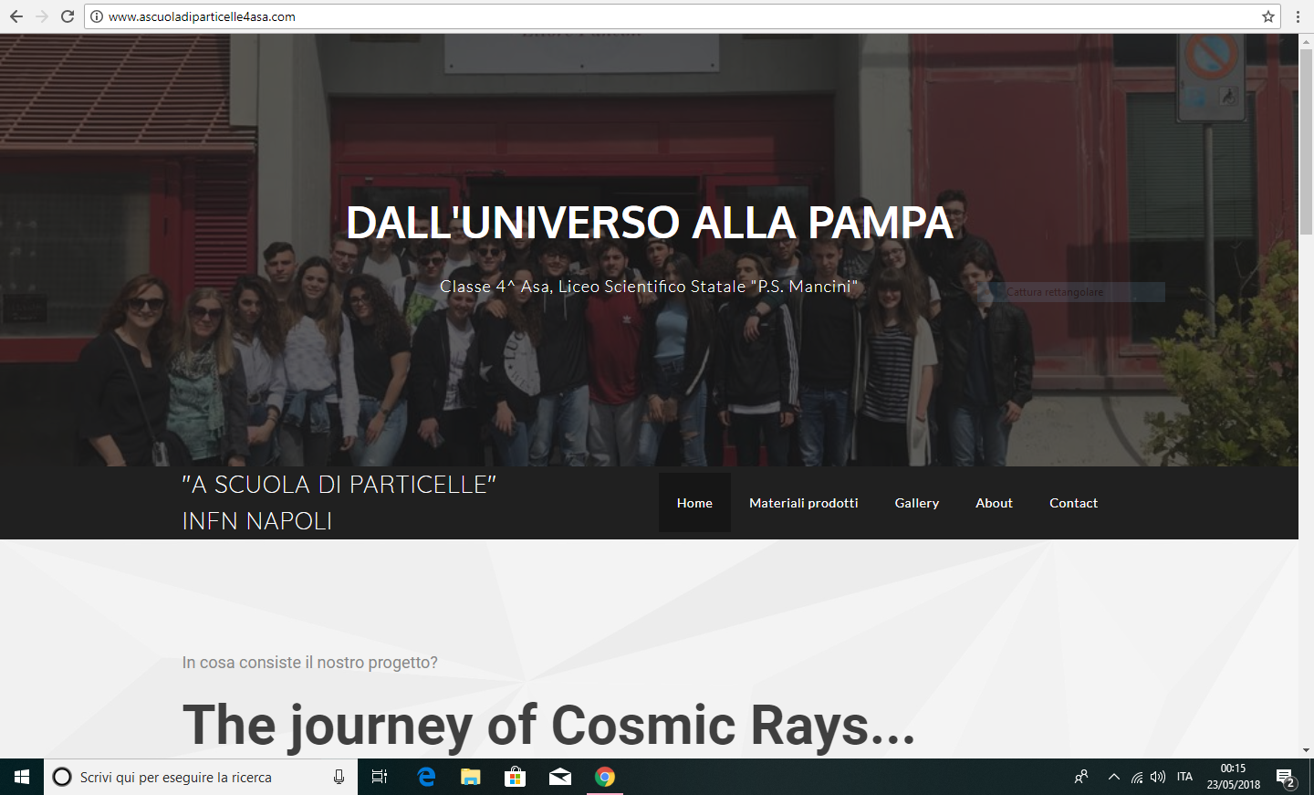
elaborate
Students produced: A Qrcode
A scientific article A website

Slide 14
elaborate

Slide 15
evaluate
auto-cognitive books written by the students
teacher evaluation: skills achieved in checks during the experience

Slide 16
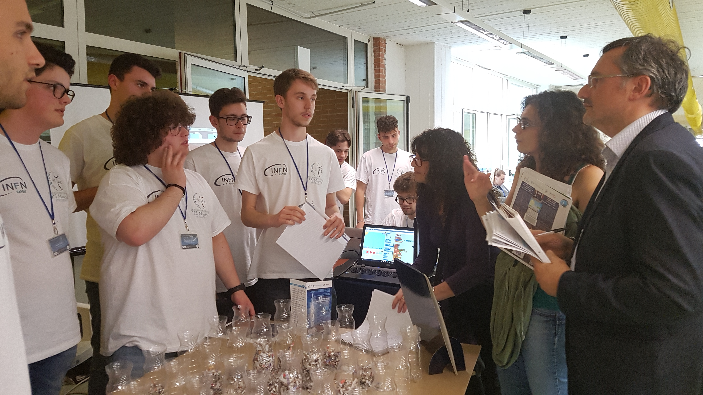
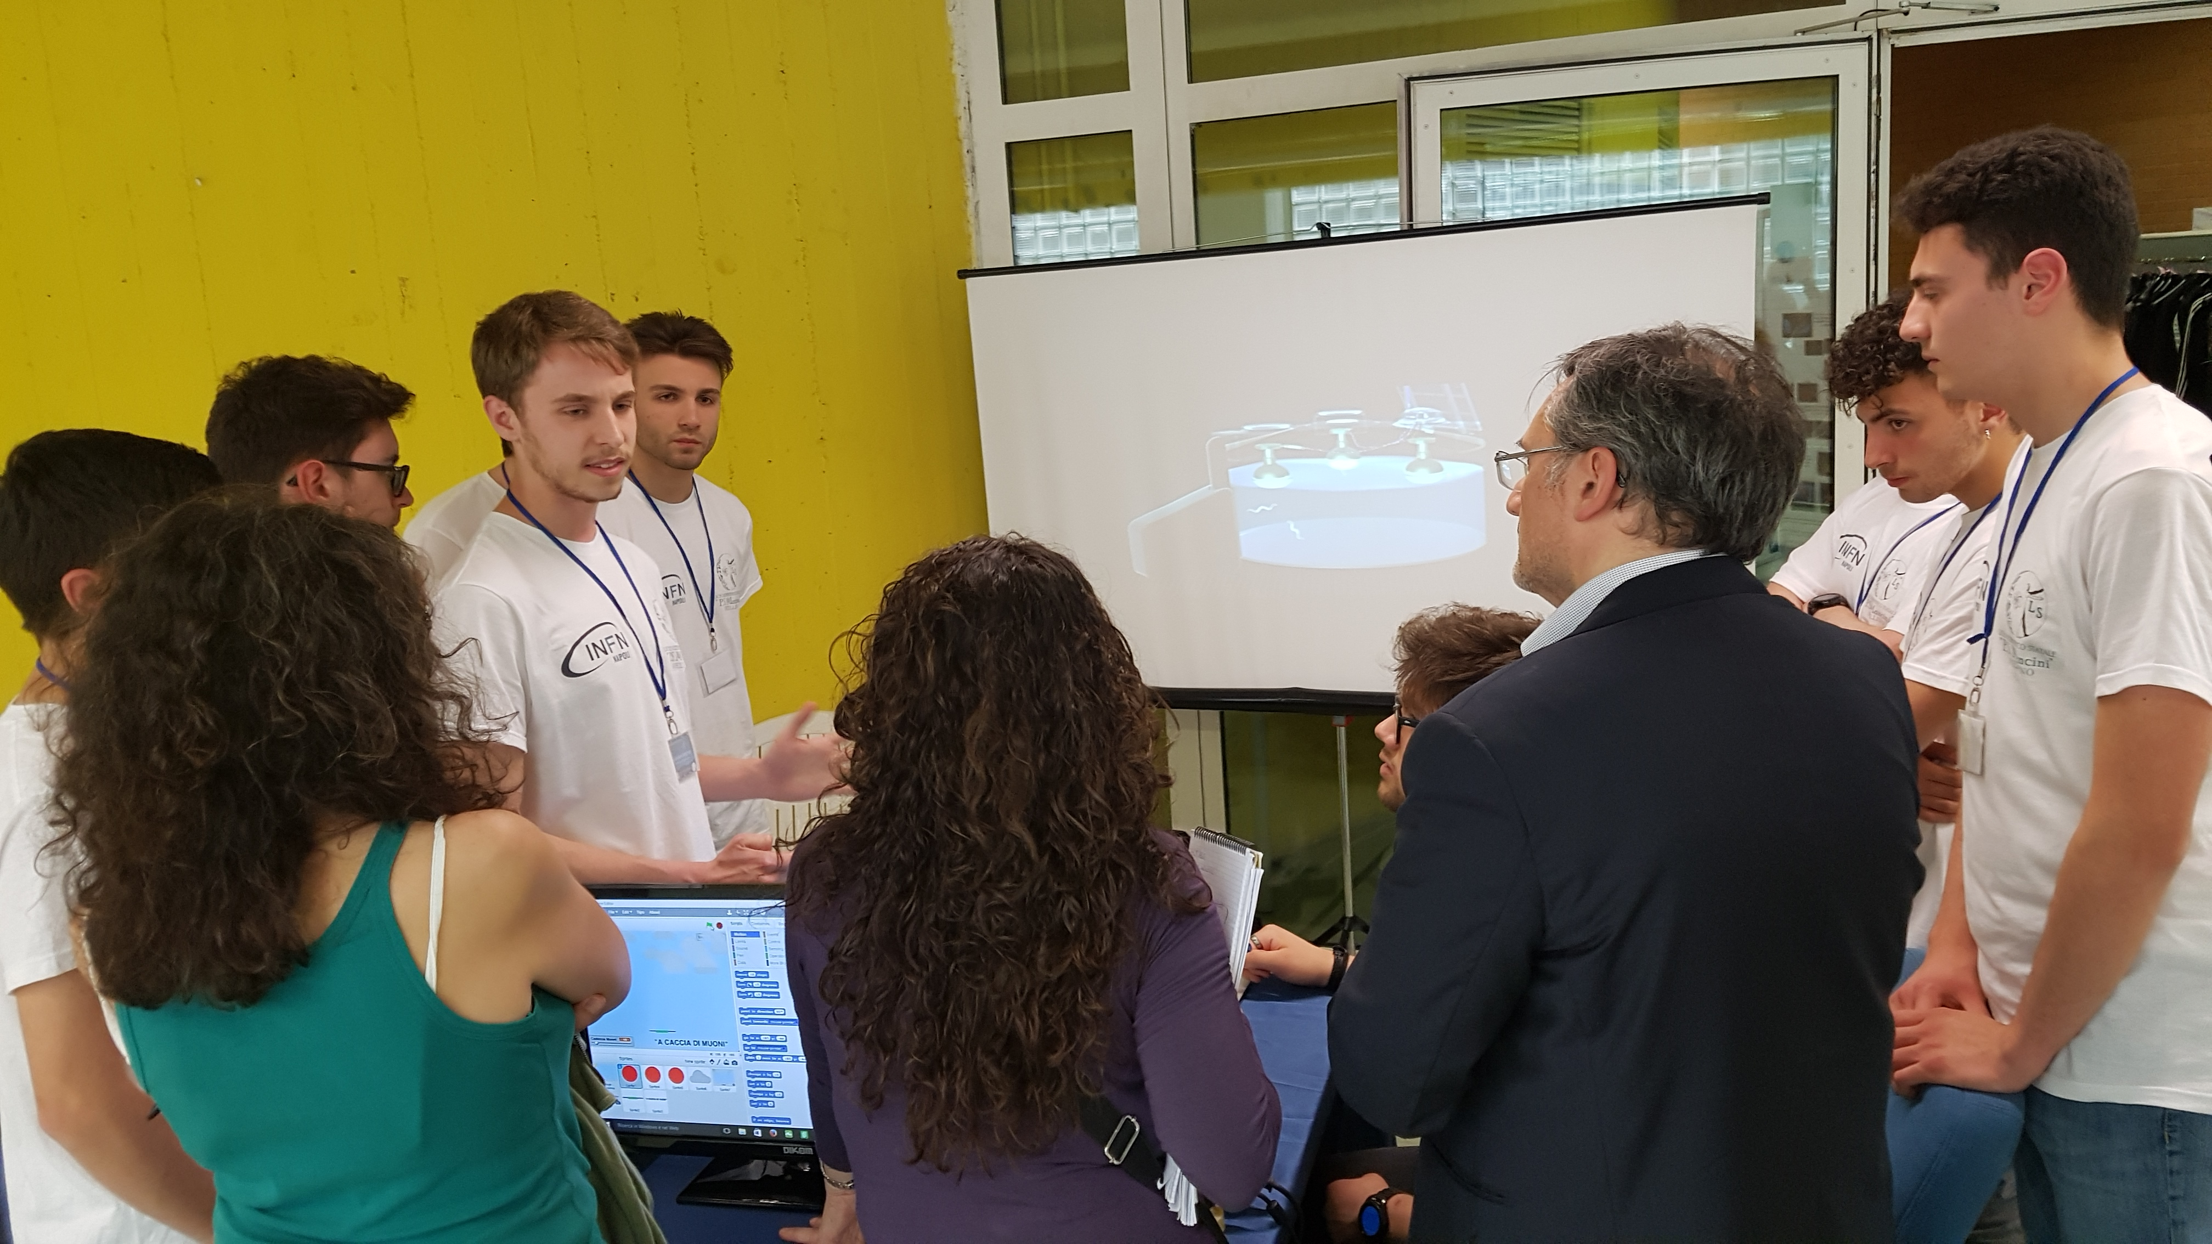
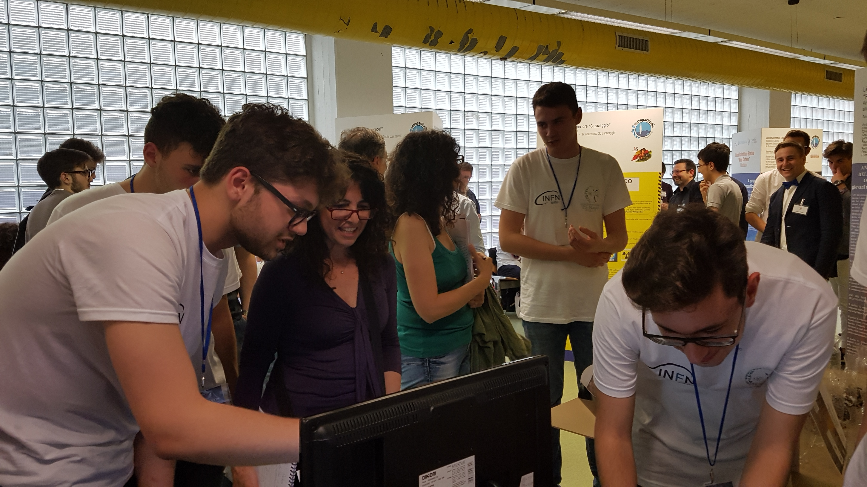
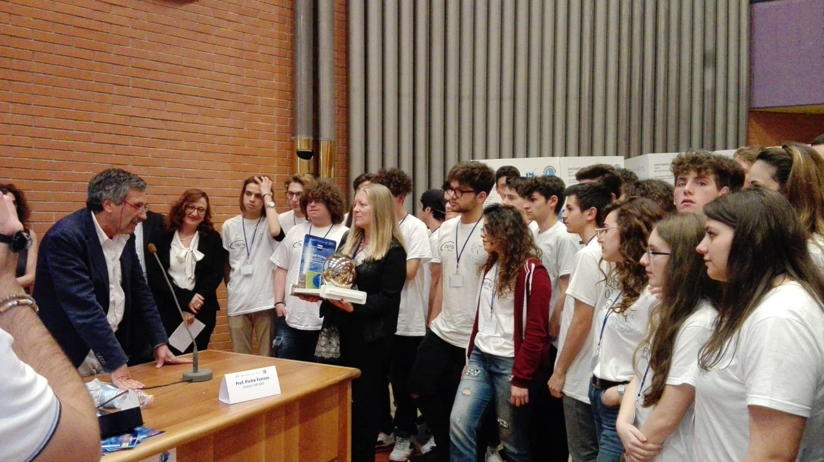
evaluate
the evaluation of the jury of the challenge
WE WON!!!

Slide 17
Effects in education
Educational activities consolidated skills thanks to cooperative learning and peer to peer education, without neglecting the technical aspects of the research. Students have shown an increasing enthusiasm for the study of Physics.
This experience showed them an alternative captivating educational approach, having experienced the excitement of research.

Slide 18
feedback
this experience was one of the most beautiful ever experienced in the school environment
interesting was also the possibility of being hosted in the university and to live the lessons in a different way
we dealt with a very interesting and relevant subject to our school preparation. it was a fantastic, very informative experience
I'm sure that this experience will remain in my mind for a long time, remembering it as one of the most beautiful extracurricular experiences ever made

Slide 19
the alternation between school and work has been object of many discussions in these years ... very often in fact paths are in conflict with curricula subjects and students must follow uninteresting and demotivating lessons. this year we have instead collaborated in the "PAO" project ... and all this has allowed us to re-evaluate the experience of alternation. the possibility to analyse the data of such an important scientific experiment has projected us towards research and the university world

Slide 20
last year I underestimated the alternation school-work, labelling it as a mandatory thing without any purpose or practical utility. after exposing our doubts to more teachers, last year our physics teacher told us this alternating path with the INFN. to tell the truth at the beginning I was very sceptical about it, thinking that this would only be a loss of time would not bring us anything more for practical purposes. but even if with some doubt, I accepted also because it seemed at least a little relevant to my course of study .... the topic at the beginning seemed very challenging but I was very fascinated ... then the topic began to cross topics studied in class. In a while, those particles that pass undisturbed through bodies and objects on earth have become an argument that has allowed us to put into practice the school knowledge.... we began to work by studying a quantity of data that seemed infinite and without any sense, but that after a while it became valuable how to analyse data, to understand properties and characteristics of the shower

Slide 21
the path of alternating school-work has often been criticized for its ineffectiveness, in fact in some cases Italian students have been forced to pursue a path that is not relevant to their interests and their propensities. However, I started to understand all the positive aspects of this law following the path chosen by my class this year: this experience not only allowed us to explore topics already dealt with in daily study, but helped us to know the dynamics of a university and research environment in which everyone collaborates to achieve a single result

Slide 22
Acquiring knowledge is what we considered a preliminary work, necessary to transmit to our peers, to younger children, to non-specialized adults in the scientific sphere, those knowledge that induce people to think, to desire more knowledge and therefore, consequently, to find what represents the concept of freedom.

