Slide 1
Recent Development in photosensing for astroparticle applications
F. Giordano
University and INFN Bari

Slide 2
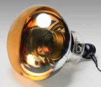
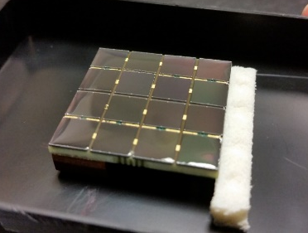
Big Size – PMTs 20’’
Intermediate Size – PMTs 2’’
Small Size – SiPM ¼’’

Slide 3
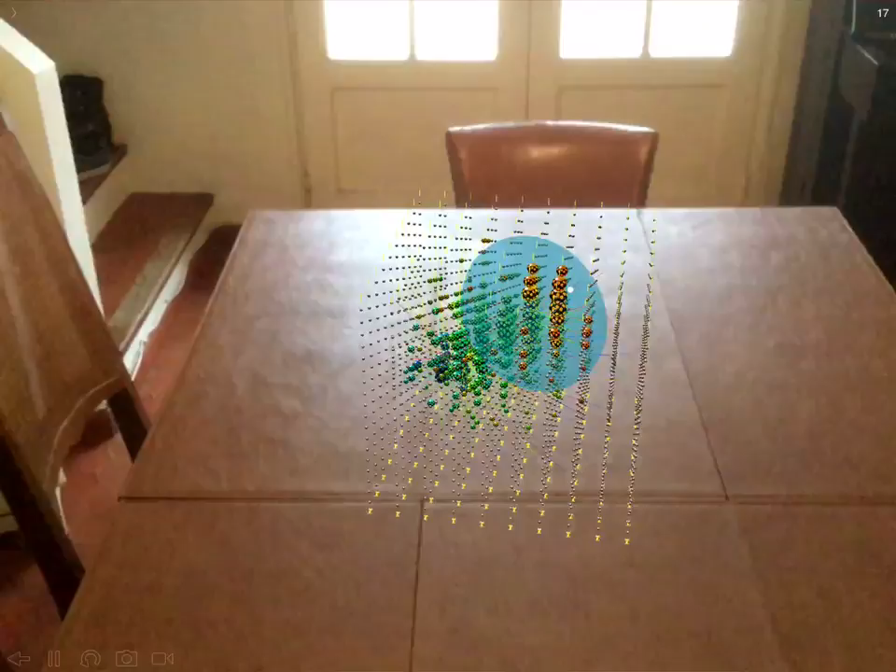
Let’s start from our host

Slide 6
The DCR
The dark counts are random noise pulses that can be measured at the anode of a PMT even in total
darkness.
The most significant source of random noise for a PMT is the spontaneous thermionic
emission of electrons by the photocathode (spe).
The rate at which these pulses are observed is proportional to the photocathode area and
varies considerably depending on the photocathode material. Bialkali photocathodes (as those used
in KM3NeT PMTs) have the lowest ratio per unit area. Another source of dark pulses is the natural
radioactivity in the structure of the PMT itself.
The most important components are usually ⁴⁰K contained in the glass envelope.
Once the PMTs are fed with the tuned HV, dark count rates are monitored for 9 hours. During
this time, the PMT recover from the initial exposure to the light and the dark count rate becomes
stable. The measured rate is the average over the last 100 s of the run for each PMT. The results are
shown in figure 9. The average dark count rate is about 1300 cps, while the fraction of PMTs above
2000 cps is 7.1%. These PMTs were tested again after a longer darkening (48 hours) reducing the
fraction of PMTs not to be integrated in the KM3NeT DOMs to 3.5%. The average dark count rate
of good PMTs is about 700 cps.

Slide 7
Timing

Slide 8

Notes:
PhotoDetector development for Hyper-Kamiokande (20' + 5')
https://indico.hep.anl.gov/indico/contributionDisplay.py?contribId=146&confId=1017

Slide 9
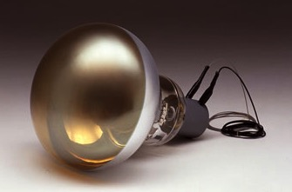
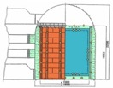
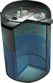
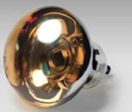
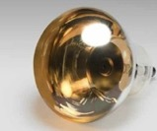
50 cm Photo-Detectors
Development of large aperture photo-detectors is a key to explore neutrino physics.
First 20-inch (50 cm) Photomultiplier Tube (PMT)
For other experiments
Hamamatsu R1449
(Venetian blind dynode)
→ IEEE milestone (2014)
42 cm (17”) Box&Line PMT
For Kamiokande
R7250
(1983-1996)
Supernova ν
observation!
(Box&Line dynode)
with 50 cm bulb
of R3600
1k PMTs
/ 3 kton water
For KamLAND
R3600
(Venetian blind dynode, improved)
50 cm MCP PMT
For Super-Kamiokande (Super-K, SK)
By NNVC, IHEP
(1996- )
(Micro-Channel
Plate)
ν oscillation
discovery!
For JUNO
11k PMTs
/ 50 kton water
Recently
developed
in China
For Hyper-Kamiokande (Hyper-K, HK)
50 cm Box&Line PMT
50 cm Hybrid Photo-Detector (HPD)
R12860-HQE
(Box&Line dynode)
R12850-HQE
(Avalanche diode)
Two types of new
50 cm photo-detectors have been developed since 2011 with
much improvement
for Hyper-Kamiokande.
Developed
→ Photo-detector
in Hyper-K
baseline design
Under development
→ Possible further
improvement of
Hyper-K

Slide 10
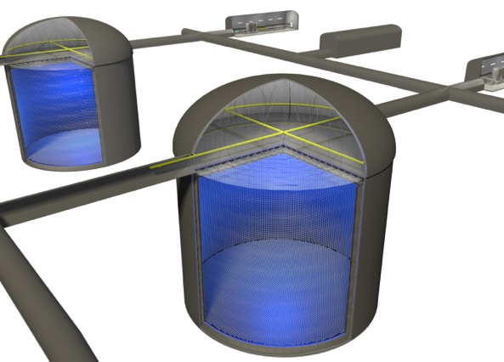

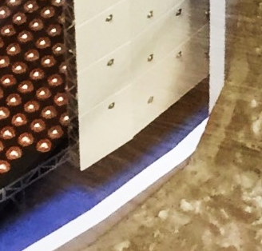
Hyper - Kamiokande
Water Cherenkov detector in Kamioka, Japan
New high-QE 50 cm Box&Line PMT
→
Hyper-Kamiokande (HK)
×2 high pressure bearing for 60 m height
×2 high detection efficiency
and half time&charge resolutions
×40,000
40%
photo-
coverage
(190 kton
Fiducial
Mass)
60 m
compared to Super-K PMT (up to ~40m depth)
260 kton
And 6,700 of 20 cm (8”) PMTs
for Outer Veto Detector
74m φ
for 1 tank
×2 tanks
Requirements
→ Wide dynamic range
→ High time&charge resolutions,
high detection efficiency, ..
→ ~nsec time resolution,
low background
→ Clear photon counting,
→ High rate tolerance
Large aperture photo-detectors are essential for physics sensitivities.

Slide 11
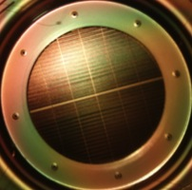
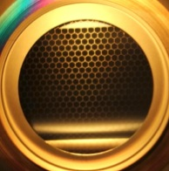
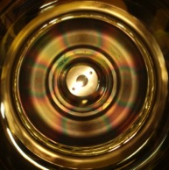
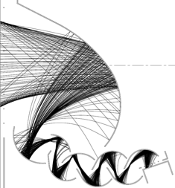
Principle of Amplification
50 cm Φ
Photomultiplier tube (PMT)
Hybrid photodetector (HPD)
Venetian blind dynode
New
Box & Line dynode
New
Avalanche diode (AD)
(Super-K)
high QE
high QE
+2kV, 10⁷gain
+2kV, 10⁷gain
+8kV, 10⁵gain
Venetian blind
Box & Line
20mmΦ
Simple
inside
AD
e⁻
×1600
Line
Box
×100
+ preamp
Electron might miss dynodes → less collection efficiency
Ambiguity of drift path limits charge and time response.
High collection efficiency (CE)
Low cost,
high resolutions
Uniform drift path
→ High charge&time resolutions
Performance evaluation
Validation for a long operation in water
Low cost,
High performance
Reliability
are required.

Slide 13
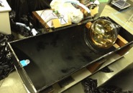
Detection Efficiency
High Quantum Efficiency (QE)
Total Detection Efficiency of 1 PE
Measured at Hamamatsu by point source injection
Measured
HPD → 36%
Box&Line PMT
Measured
×2
Box&Line PMTs
→ 30%
Super-K
22%
at peak
Super-K
(-2016yr)
Collection Efficiency (CE)
Confirmation in relative hit counting
By simulation
In 46cmΦ (50cmΦ)
Relative comparison of single PE
counting compared with SK PMT
by a uniform light injection
Box&Line PMT : 1.91 of SK PMT
HPD : 1.76 of SK PMT
light
pulse
Super-K 67% (61%)
Box&Line PMT 95% (85%)
HPD 97% (80%)
PMT
1m
(1ch 20mmΦAD)
(2ch 20mmΦAD)
(Low due to higher threshold for 1 PE)
Detection efficiency was doubled in both new photo-detectors.

Slide 14
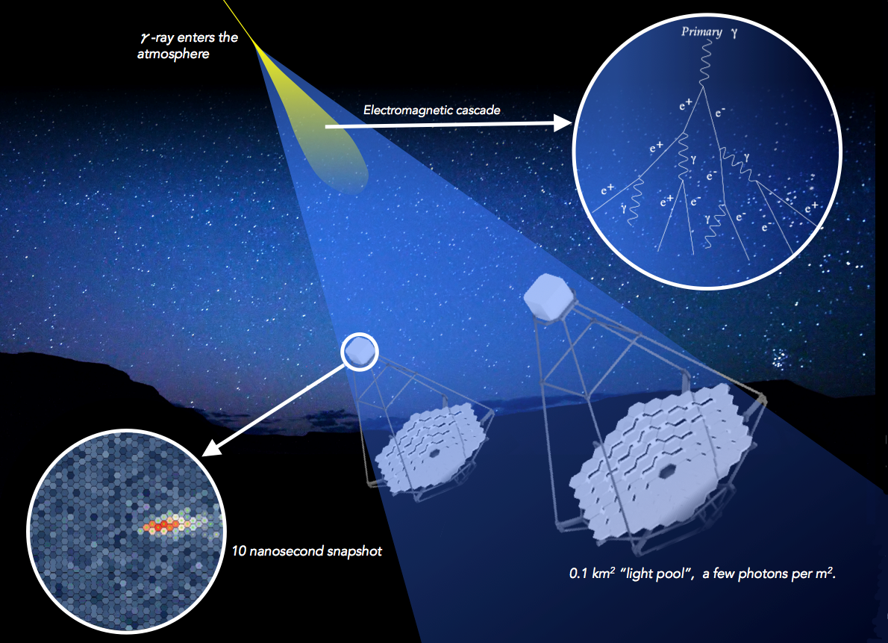
Imaging
Air Cherenkov
Telescopes
(IACTs)
~
https://www.cta-observatory.org

Slide 15
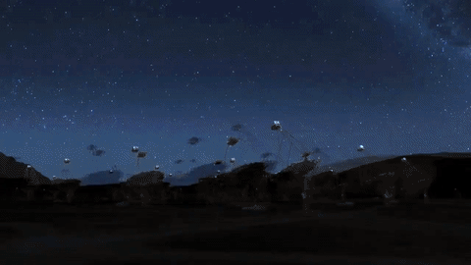
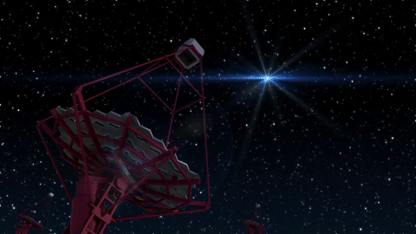
v
Imaging
Air Cherenkov
Telescopes
(IACTs)
~
https://www.cta-observatory.org

Slide 16
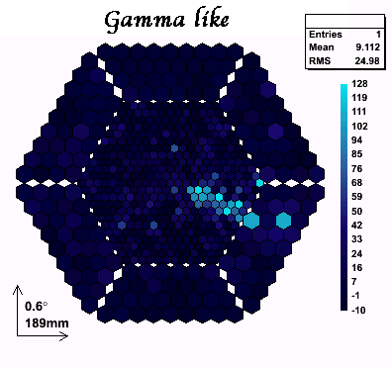
Imaging
Air Cherenkov
Telescopes
(IACTs)
~
© 2017 MAGIC Group
https://www.cta-observatory.org

Slide 17


Slide 18
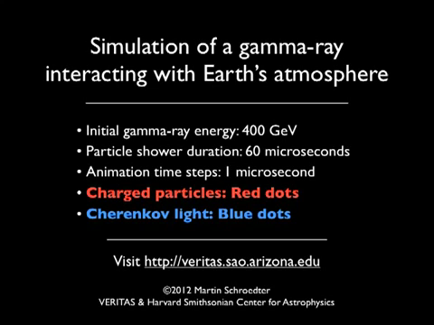

Slide 21
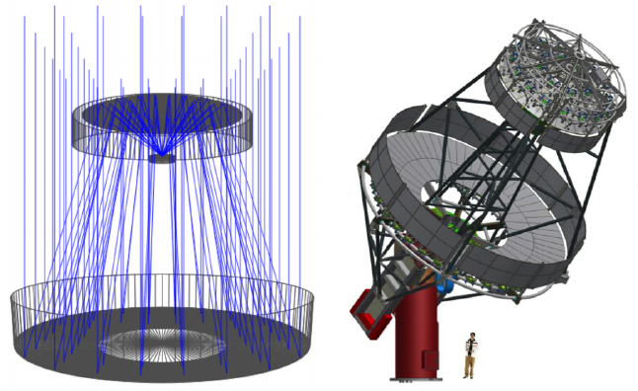
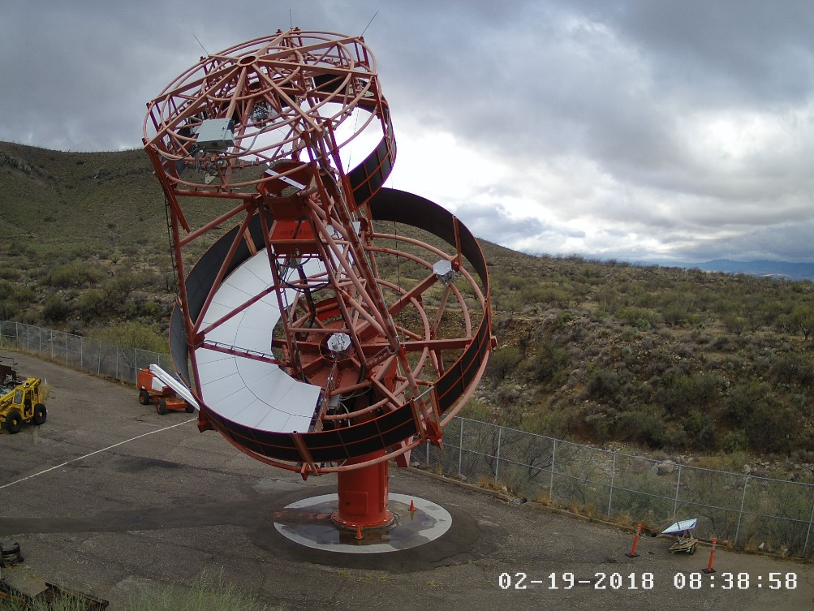

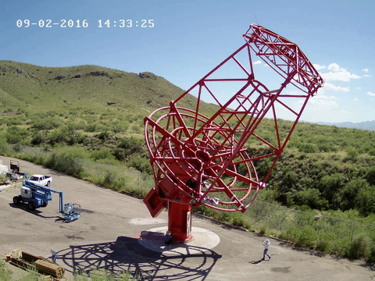
The Schwarzschild-Couder Telescope for CTA
Schwarzschild-Couder dual mirror optics
Medium Size Telescope
  Dual mirror optics designed to cancel aberration and de-magnify images, to be compatible with compact high-resolution SiPM camera
  Improved angular resolution
  Mechanical stability and mirror alignment
  are the main challenges.
First Prototype will be installed at the Veritas site in Arizona in 2018!
http://cta-psct.physics.ucla.edu/

Slide 22
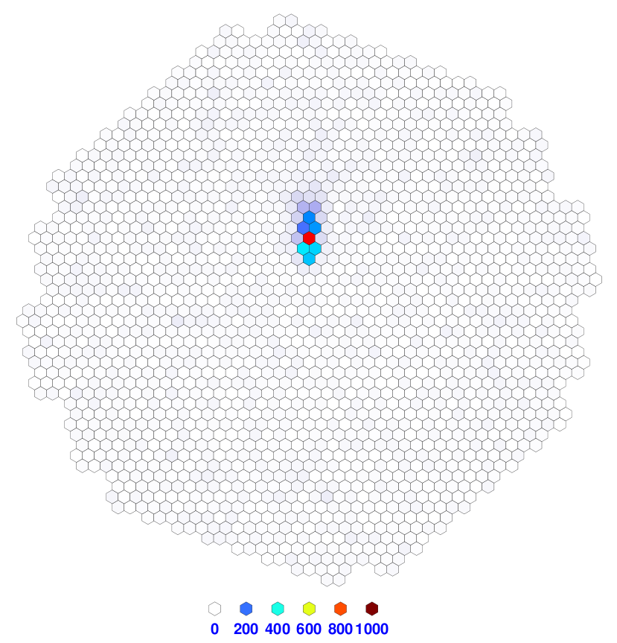
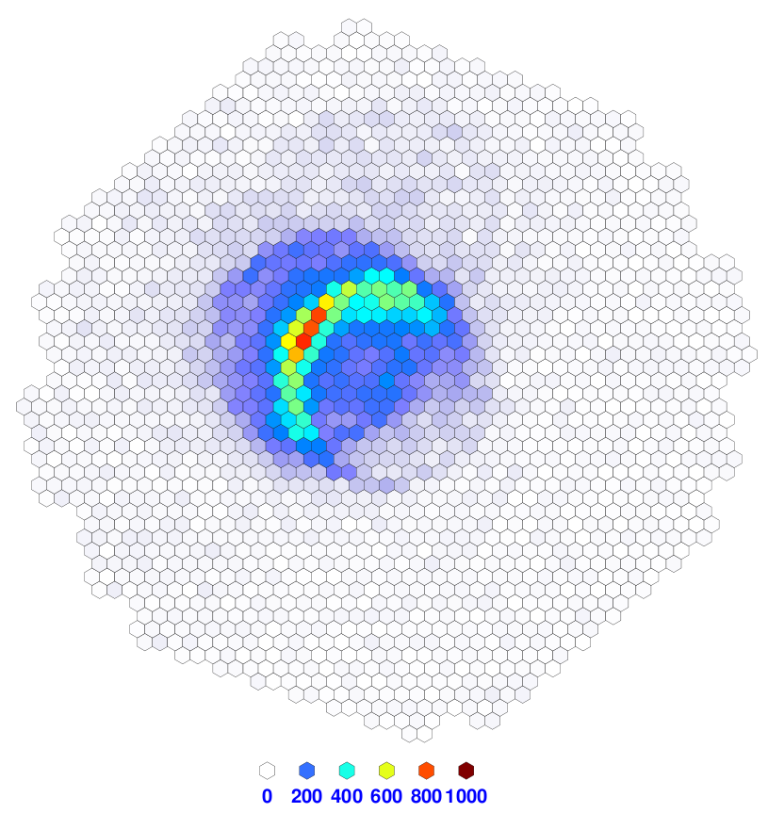
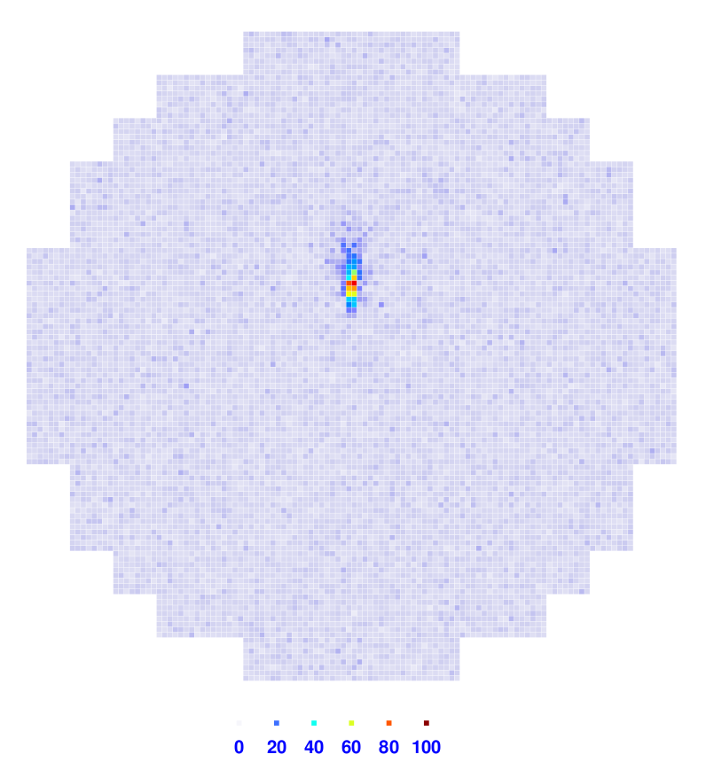
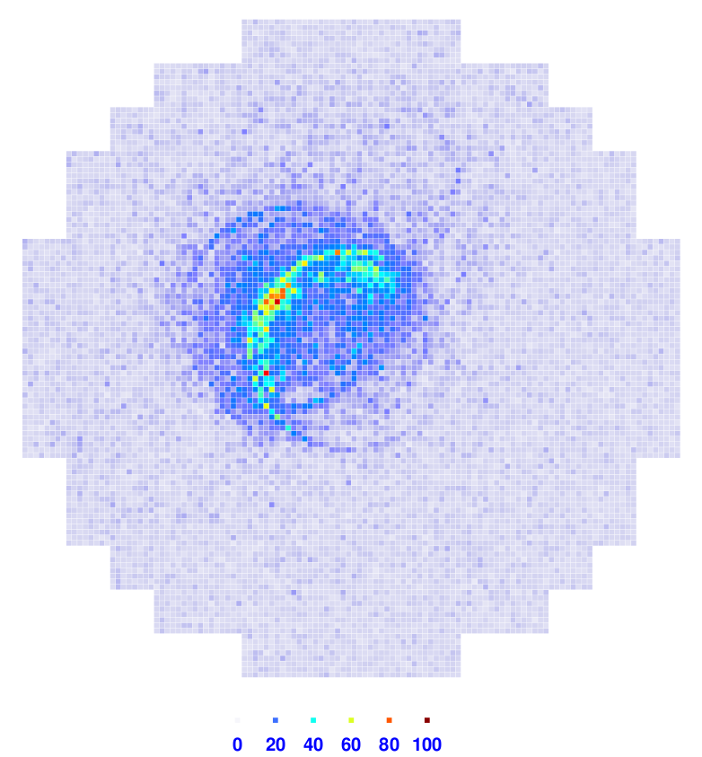
The SCT: Showers Measured Better
Single-Mirror
MST
Images
8° field of view
0.18° pixels
1,570 channels
Signal:
γ-ray Shower
Energy: 1 TeV
Background:
Proton Shower
Energy: 3.2 TeV
Dual-Mirror
SCT
Images
8° field of view
0.067° pixels
11,328 channels

Slide 23
The SCT prototype for CTA
The pSCT Camera
25 modules
Module area: 54x54 mm², divided into 4 matrices composed by 16 SiPMs with an area of 6 x 6 mm²
First module being assembled:
  16 modules equipped with Hamamatsu MPPC
  S12642-0404PA-50(X)
  9 modules equipped with
  FBK HD-3 SiPMs
  (assembled and tested by INFN)
Readout directly behind
the focal plane with TARGET 7
(1 GSa/s, 10 bits effective )
Hamamatsu
FBK
40 matrices produced and tested by INFN
University of Wisconsin – Madison

Slide 24
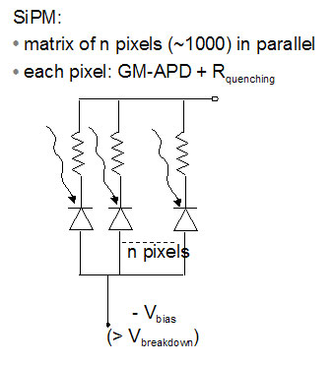
What is a SiPM?
A marix of N p-n junctions in parallel reversed biased
The working point is set beyond the breakdoiwn voltage
Each cell works in Geiger-Mode.

Slide 25
SiPM: The model
N = total number of cells
Rq = quenching resistor
Cq = quenching Capacitance
Cd = single diode capacitance
Cg = Strain Capacitanceof the entire device
(N-1)Gq , Rq/(N-1) e (N-1)Cd = N-1 cells contribution
Iav = Current source (avalance event)

Slide 26
SiPM 3mmx3mm: THE SIMULATION MODEL
N = 3600
Rq = 3.87 MΩ
Cq = 7 fF
Cd = 121 fF
Cg = 10.55 pF
(N-1)Cq = 25.19 pF
Rq/(N-1) = 1.075 KΩ
(N-1)Cd = 453.48 pF
I1 = Current spike 10 ps wide, Rise Time = Fall Time = 1 ps

Slide 27
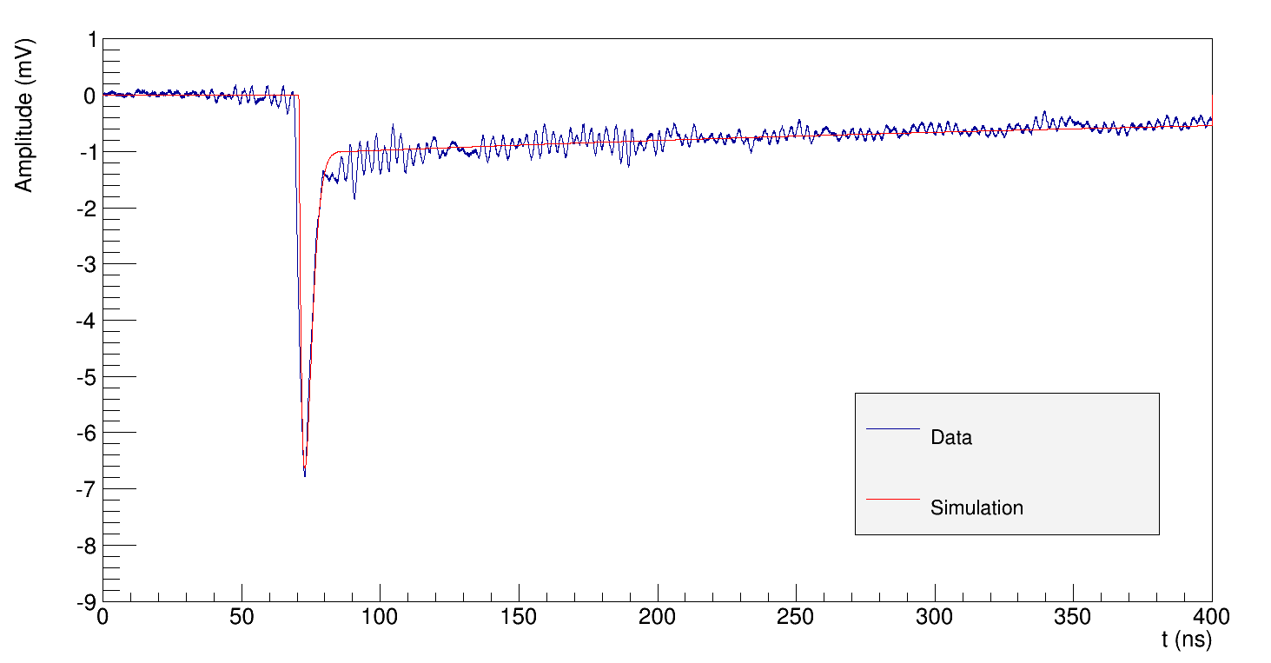
SiPM 3mmx3mm: Sipm & Electronics

Slide 28
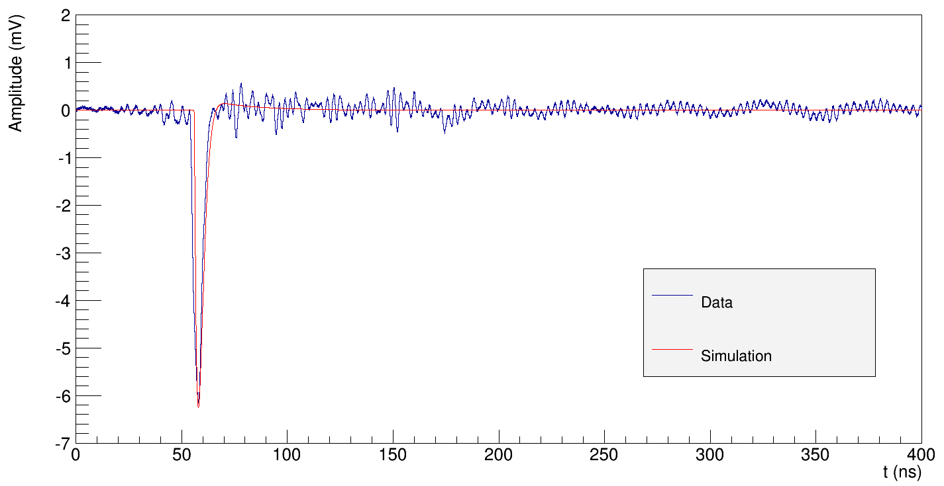
SiPM 3mmx3mm: Cancellazione polo-zero (2)

Slide 29
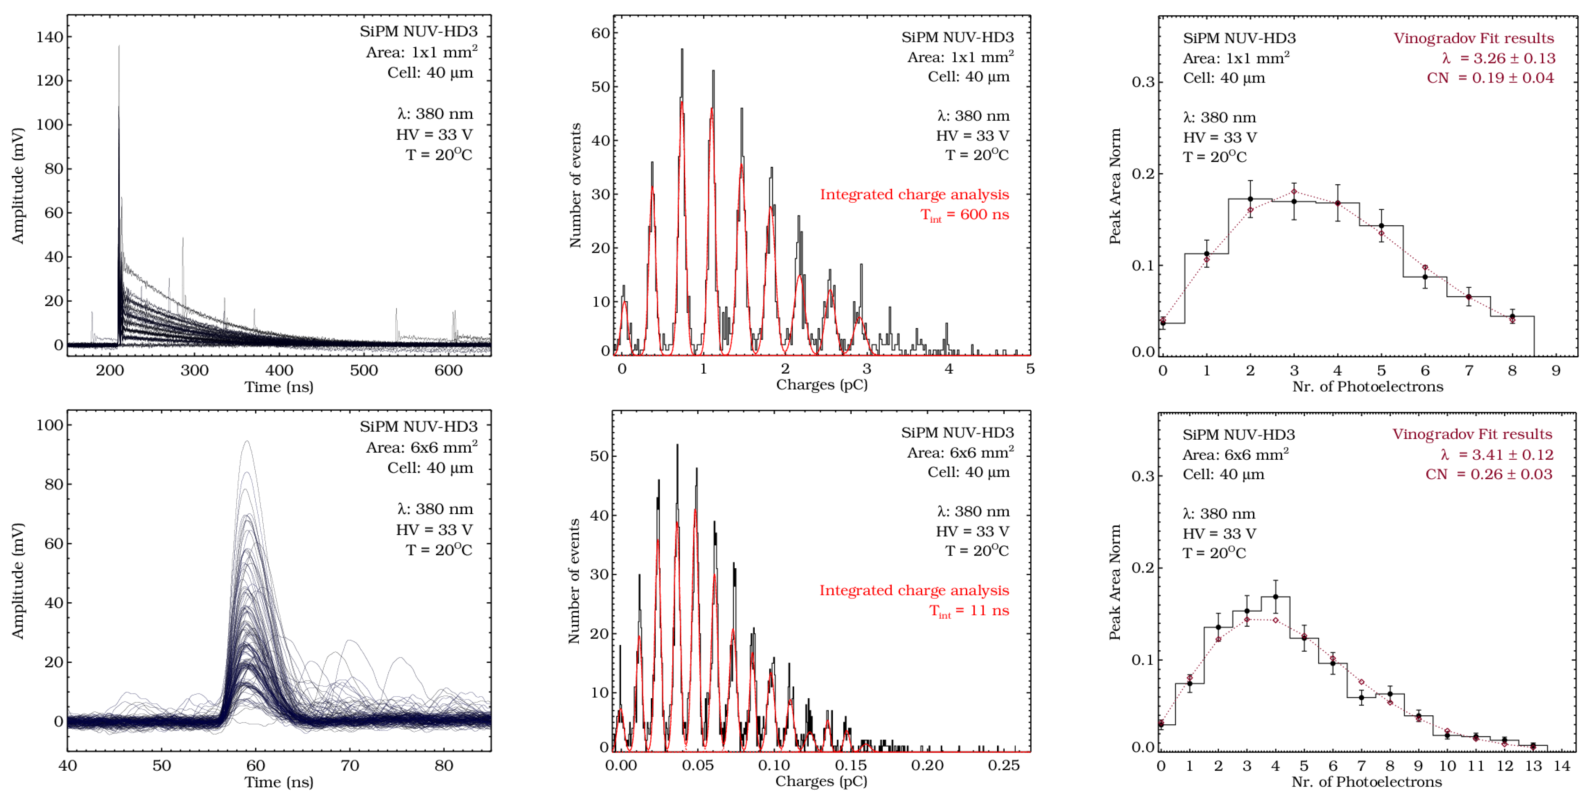

FBK NUV high-density (HD) SiPM sensors
For a full characterization: we tested devices with different active areas read out with different front-end electronics circuits
  1 x 1 mm²
    Study of gain in terms of charge of the single SiPM microcell and dark rate
  6 x 6 mm²
    Study of correlated noise and of
    signal-to-noise ratio (SNR)
Tail
filtering!
LED light @380 nm
Room temperature
HV = 28 – 40 V

Slide 30
FBK NUV high-density (HD) SiPM sensors
Compound Poisson distribution
400

Slide 31
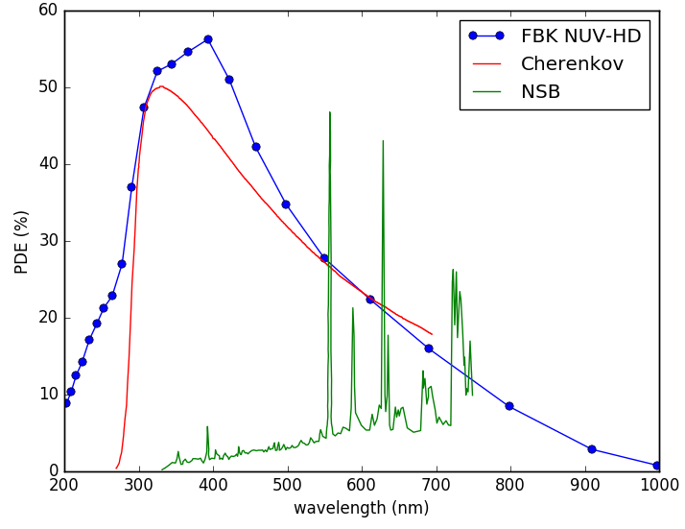
Gain depends on SiPM thecnology
FBK devices extensively characterized at INFN laboratories
High-density Near Ultra-Violet devices (NUV-HD) were chosen
The devices produced in 2016 (NUV-HD3) with 40 x 40 μm² cell size, have improved optical isolation aimed to reduce direct crosstalk and to further increase the fill factor
Gain
Dark count rate
Photon Detection Efficiency
Ambrosi et al., SPIE 2017 Proceedings Vol. 10392 https://spie.org/Publications/Proceedings/Paper/10.1117/12.2272982

Slide 32
Hamamatsu solutions for cta

Slide 34
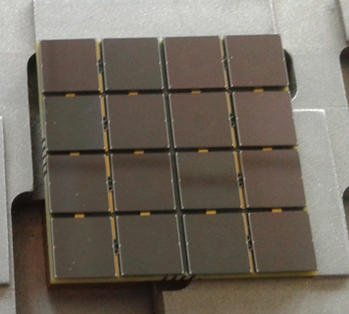

Production details
PCB bonding pad
672 SiPMs on 42 matrices
Two different substrates used (8 HD3-2 and 34 HD3-3)
  Same performances in terms of gain and PDE
  The breakdown voltage is approximately 1 V lower for HD3-2
  The DCR is lower for HD3-3
All matrices covered with epoxy
SiPM bonding pad
500 μm
27x27mm² PCBs are equipped with 16 SiPMs to cover uniformly the exposed area

Slide 36
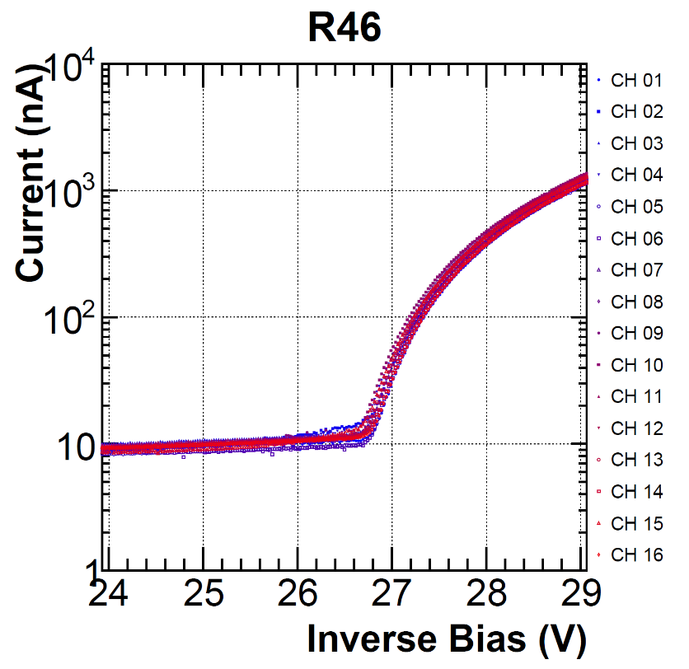
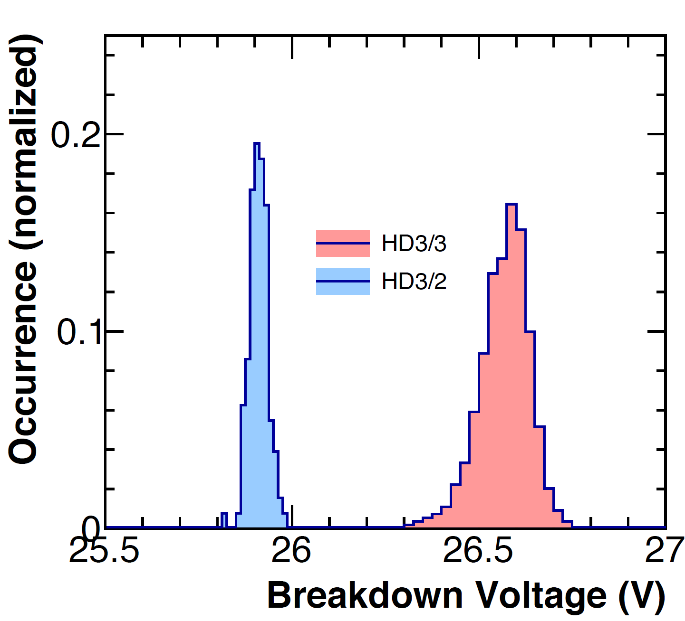
IV measurements
IV measured on all channels after assembly
Breakdown voltage evaluated
Uniform V_{bd} for each of the two SiPM types
  σ/μ = 0.1% for HD3-2
  σ/μ = 0.25% for HD3-3
IV characteristics for matrix R46
V_{bd} distribution for HD3-2 and HD3-3 types

Slide 37
DCR & Test with flasher
Each matrix was illuminated and read-out through a 16-channel amplifier
Caen V792 QDC used to acquire charge signals
Output signal integrated in 30 ns
Matrices tested at V_{bias} between 31 V and 36 V
Gain and signal-to-noise ratio studied from the charge distribution
Charge distribution for matrix R46 at V_{bias}=33 V

Slide 38
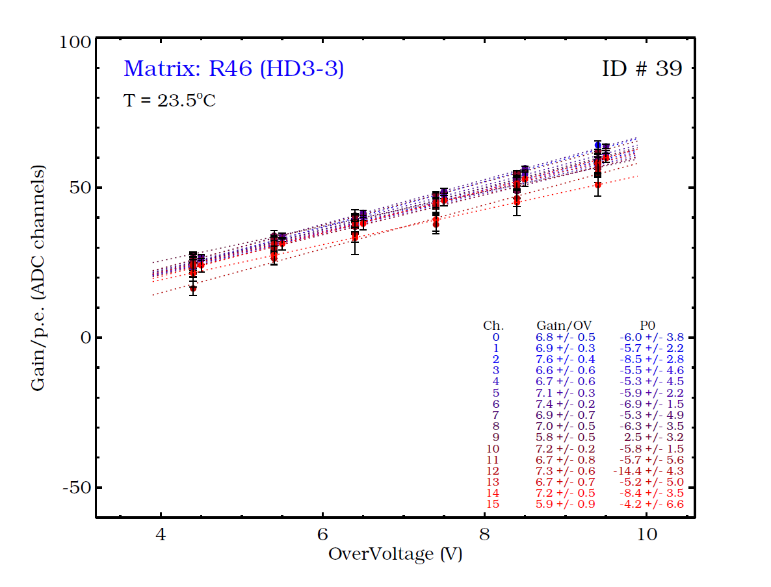
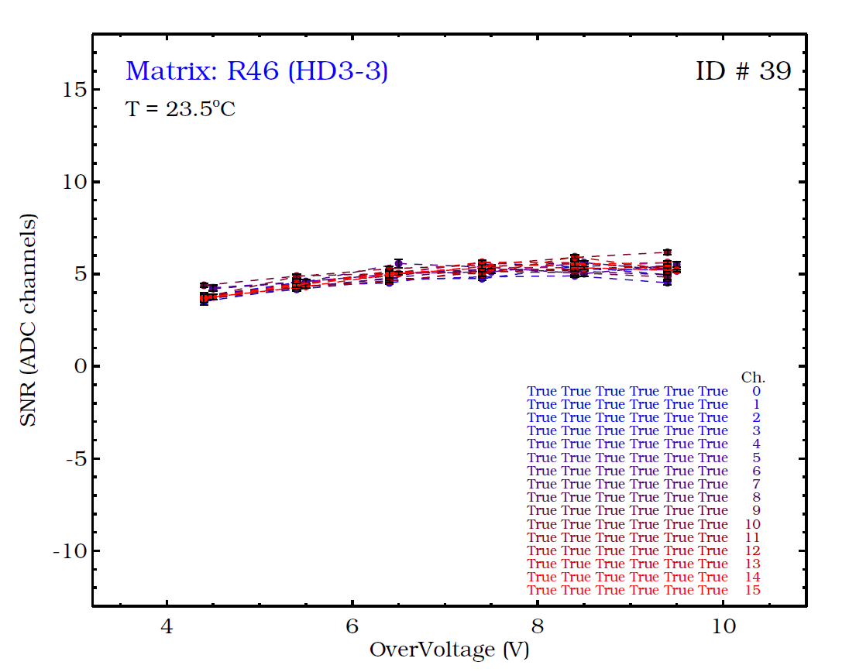
Gain and Signal-to-noise ratio
Gain and signal-to-noise ratio studied from the charge distribution for each matrix
Good uniformity found in general on the matrices
Channels with a not-resolved charge distribution classified as ‘noisy’
Gain (ADC channel/p.e.)
Signal-to-noise ratio

Slide 39
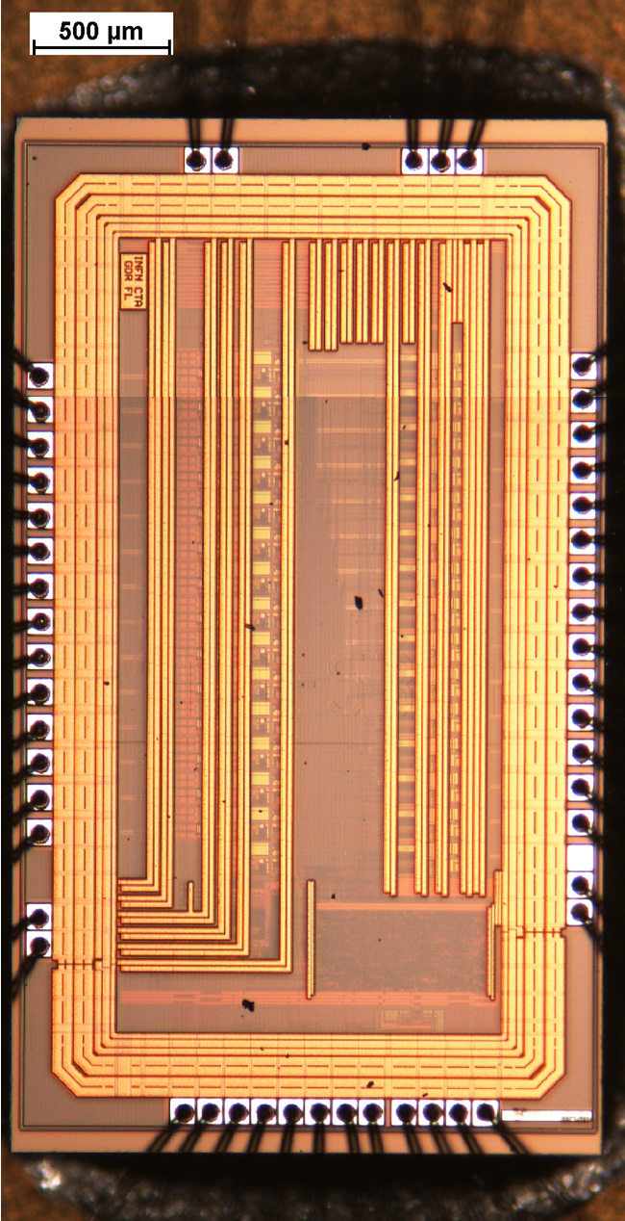
SMART Specifications
Dimensions: 2.1 x 3.9 mm²
Technology node: 0.35um SiGe
16 analog channels
Digital control and readout: LVDS SPI 1Mbps
6 global configuration bits + 8 local bits for each channel
Chip power consumption: from 290mW to 420mW
64 pin CQFP package

Slide 40
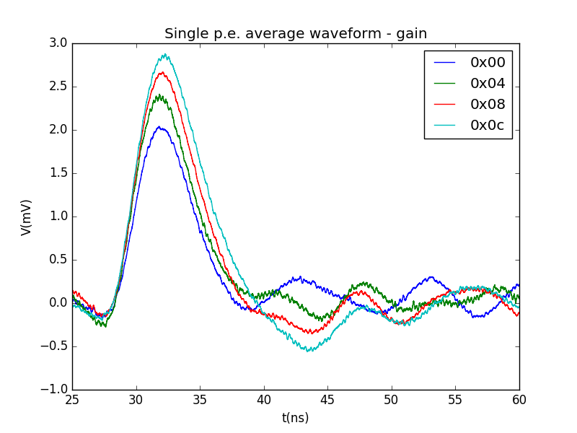
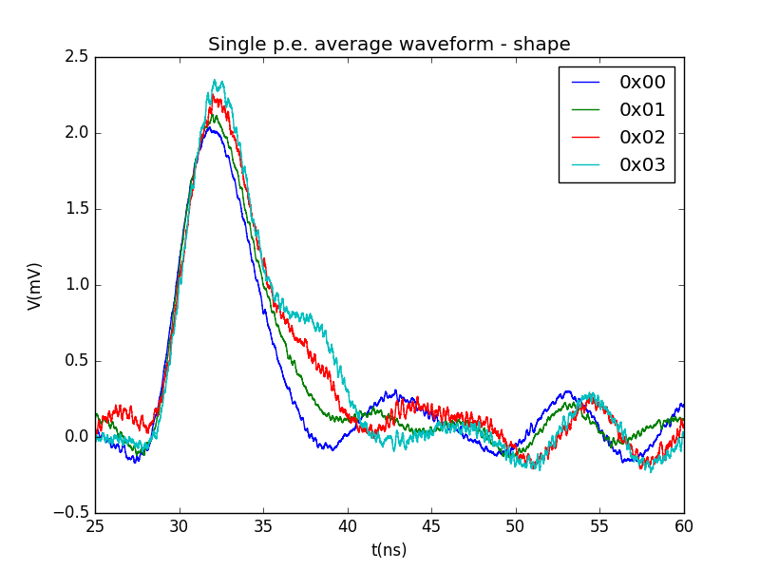
SMART measurements: output pulses
Gain lower than expected:
- 50 Ohm load
- SiPM different from simulation
Single p.e for different gain adj.: Gain ≈ 2-3 mV/p.e.
Single p.e for different shaping adj.: LSB ≈ 0.8ns
Setup:
4x4 NUV-HD3 matrix
  Vbias = 33V (Over Voltage = 6V)
  All channels active; light only on channel 7; channel 7 read.
  50ps FWHM laser pulser

Slide 41
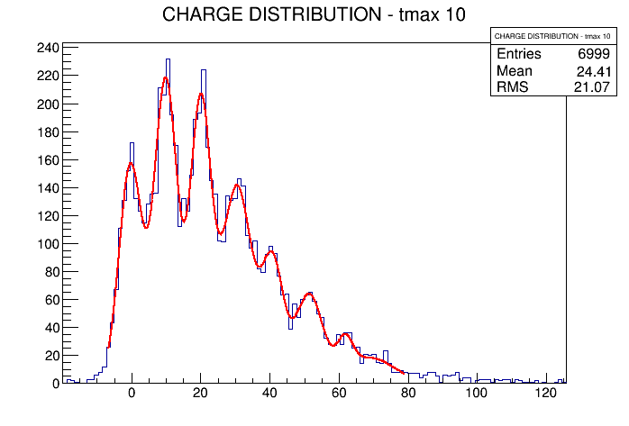
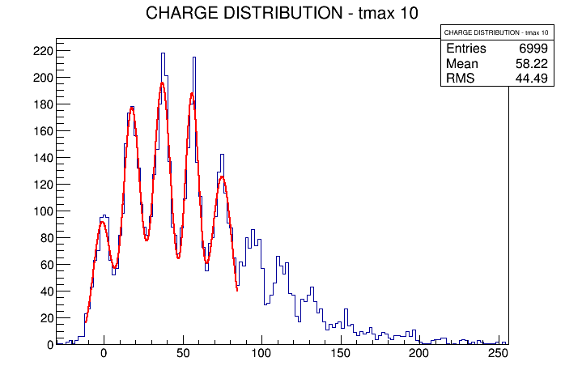
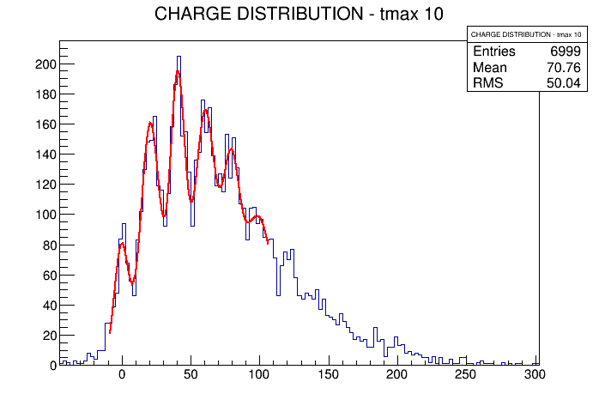
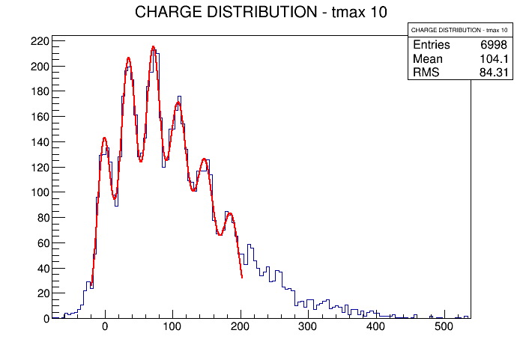
SMART measurements: Charge Finger Plots
Highest Input Z
Lowest gain
Fastest Shaping
Lowest Input Z
Lowest gain
Fastest Shaping
Highest Input Z
Highest gain
Slowest Shaping
Lowest Input Z
Highest gain
Slowest Shaping

Slide 42
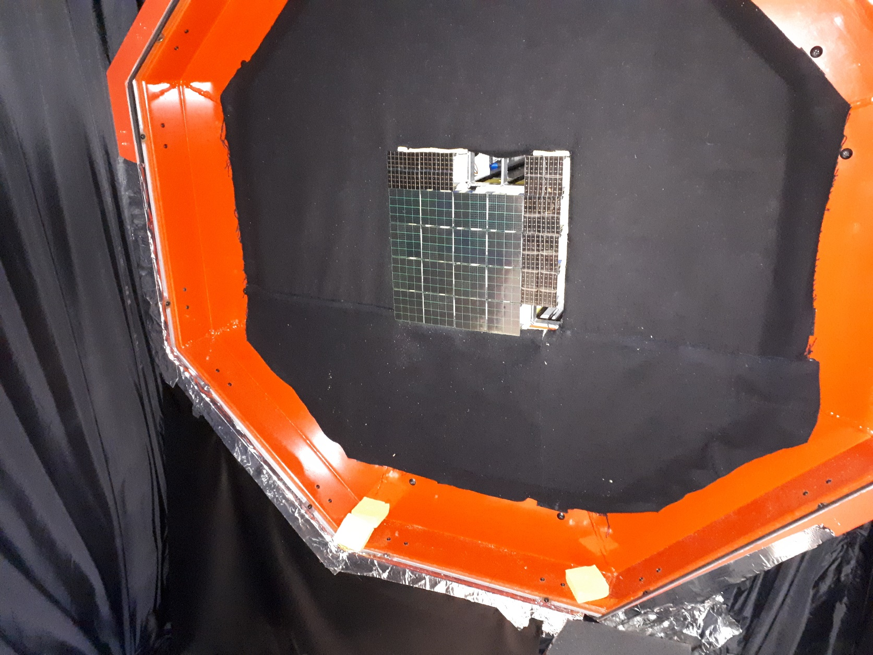
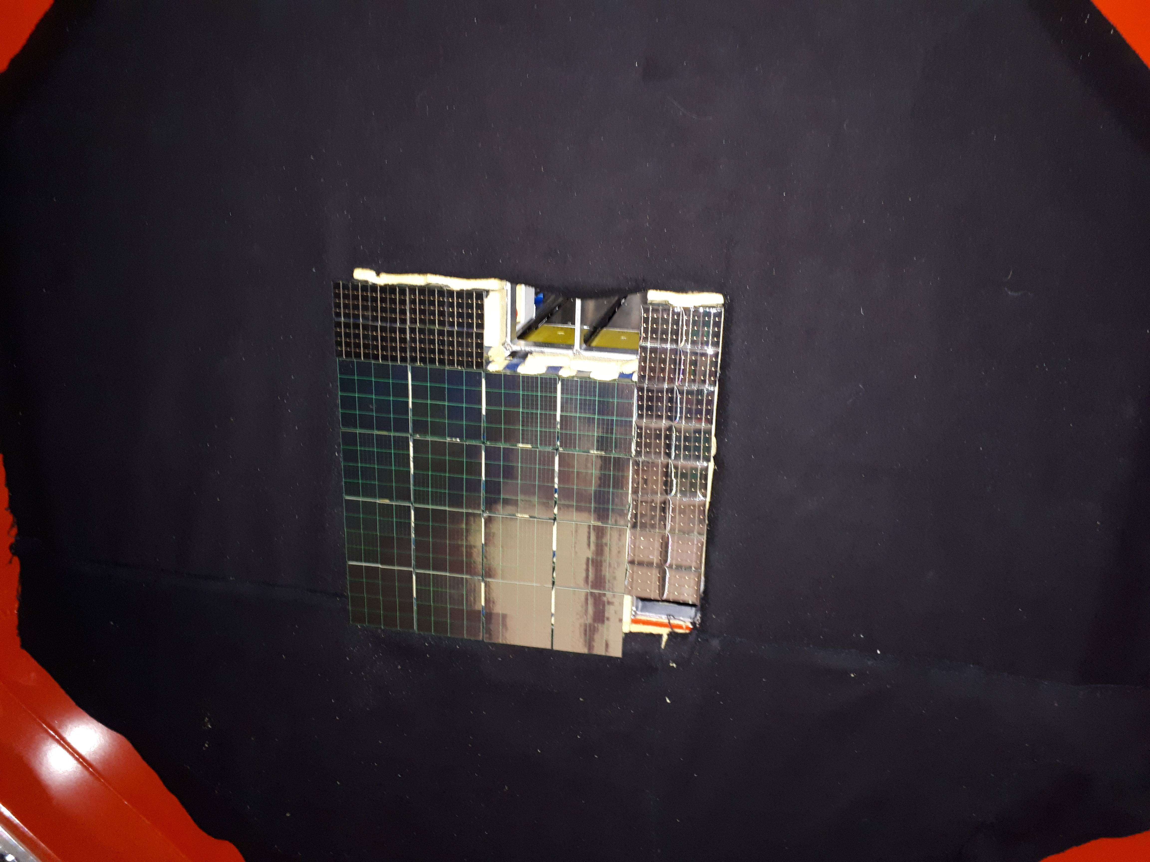
Camera Assembly

Slide 43
What’s in the future for SiPM?
A sipm LST
Herd
LST

