Slide 1
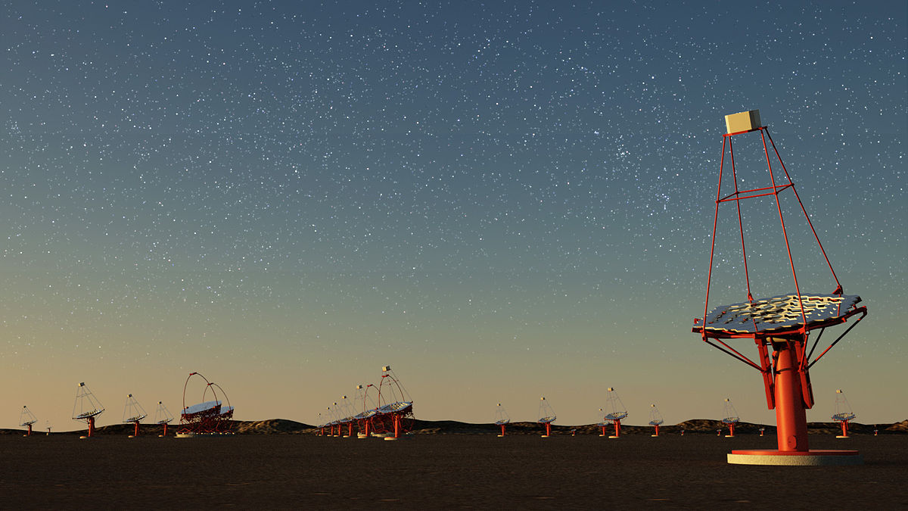


Performance of the FBK NUV HD technology for the realization of a camera prototype based on Silicon Photomultipliers for the
CTA project
G. Ambrosi, M. Ambrosio, C. Aramo, B. Bertucci, E. Bissaldi, A. Boiano, C. Bonavolontà, M. Caprai , L.Consiglio, L. Di Venere, E. Fiandrini, N. Giglietto, F. Giordano, M. Ionica, F. Licciulli, S. Loporchio, V. Masone, R. Paoletti, A. Rugliancich, L. Tosti, V. Vagelli, M. Valentino for the
CTA Consortium

Slide 2
Overview
Cherenkov Telescope Array project
SiPM single device characterization
SiPM matrices quality test and performance

Slide 3
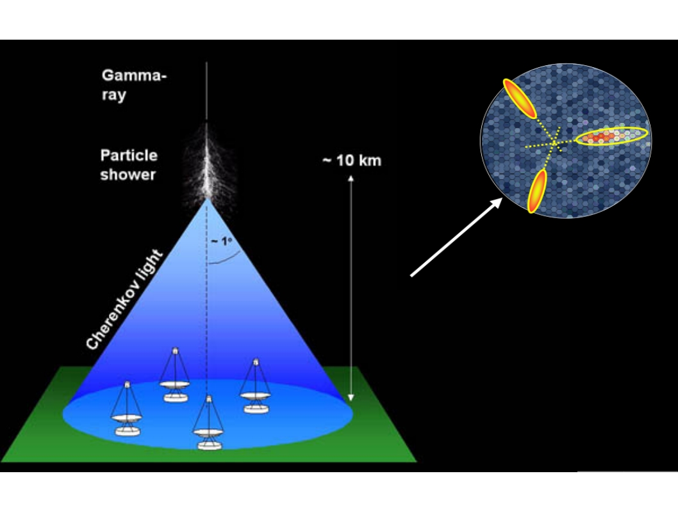
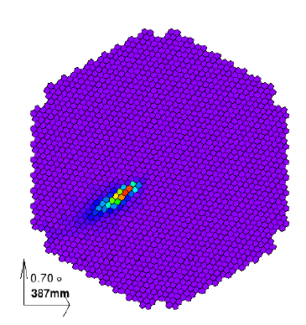
Imaging Air Cherenkov Technique
Imaging Air Cherenkov Technique
UV optical reflecting mirrors focusing flashes of Cherenkov light produced by air-showers onto ns sensitive cameras
140 m

Slide 4
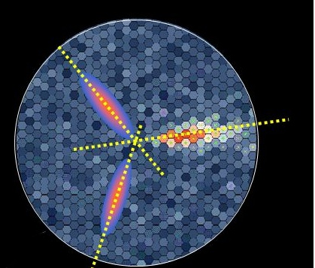
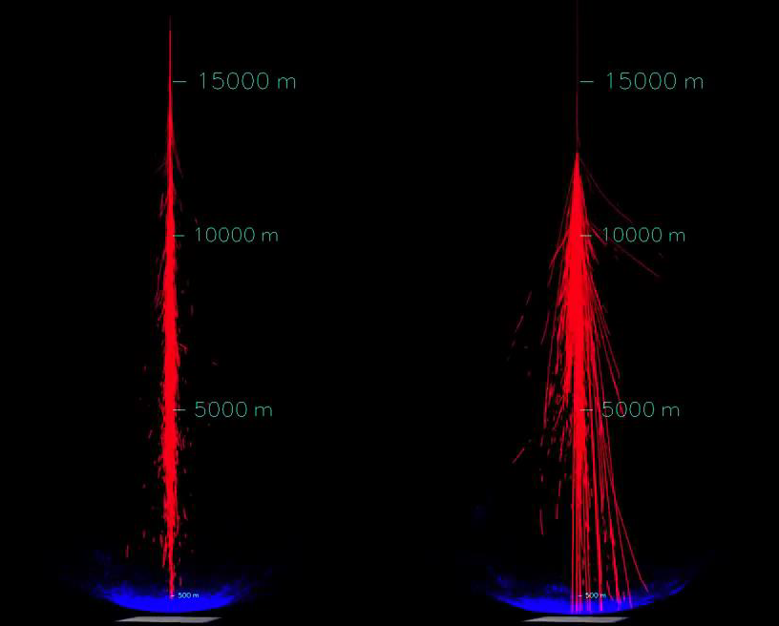
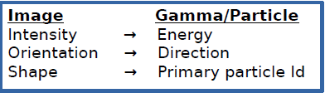
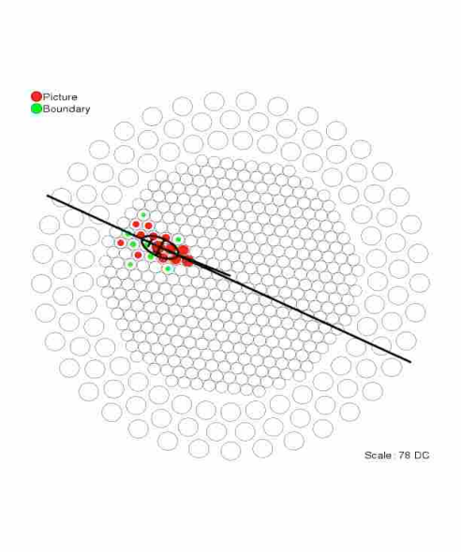
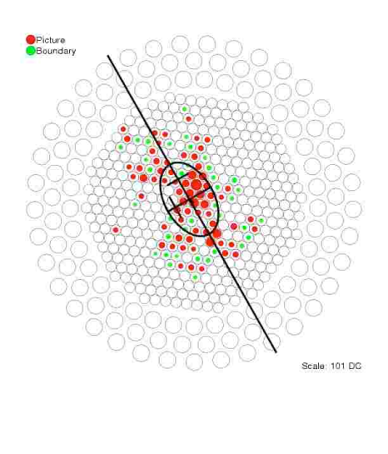
Reconstruction method
Gamma
Proton
Stereoscopic detection:
better background rejection
Better angular resolution
Better energy resolution
Notes:
improved angular resolution • enhanced background suppression • lower energy threshold • improved energy resolutio

Slide 5
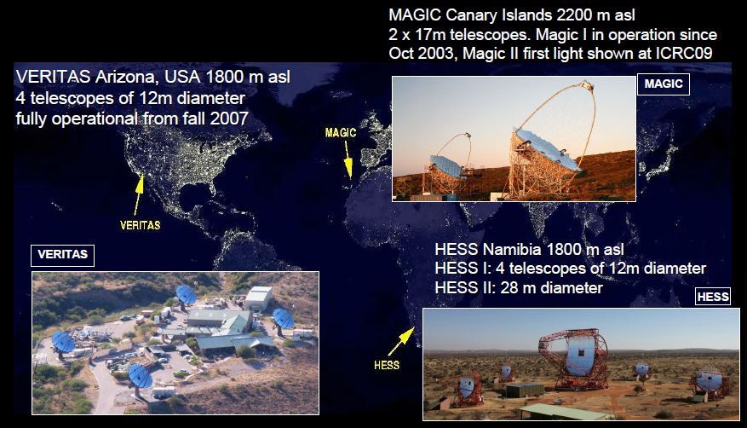
Major IACT instruments

Slide 6
Goals of the CTA project
Respect to the current instruments:
Improve sensitivity by a factor 5 to 20, depending on the energy, w.r.t. current IACTs
Extend energy range : 20 GeV to 300 TeV
Improve energy and angular resolution (factor 2-3)
Wider telescope FoV
Survey full sky in the higher energy photons: galactic plane, galactic centre, CR pevatrons, AGN, clusters of galaxies, fast transient phenomena…
Allow VHE gamma ray astronomy to transit from source discovery to detailed source investigation
Concept implementation
Construction of array of telescopes
Use different telescope sizes
Operation on site in both hemispheres
Improve collection area

Slide 7

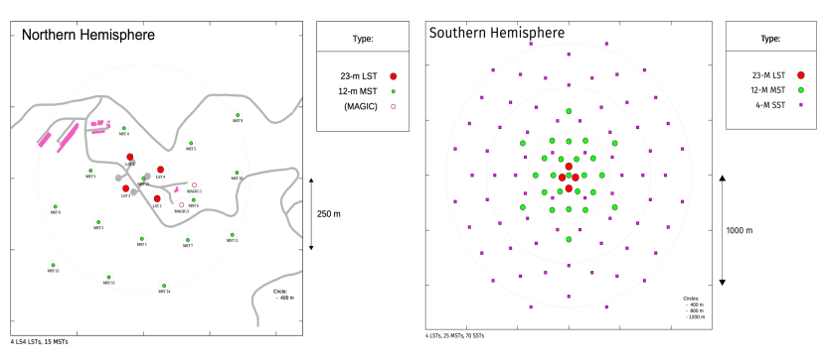
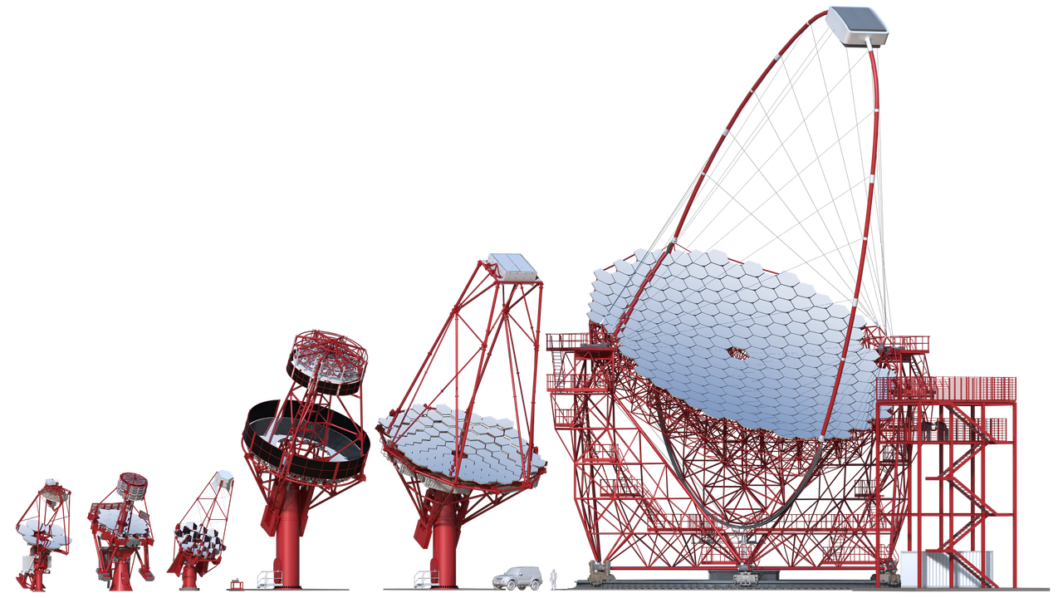
The CTA concept
MSTs 12m (S)
SCT s 10 m (S)
15 MSTs (N)
4 LSTs 23 m
(N & S)
A user facility/proposal-driven observatory on a Northern and
Southern site with more 100 telescopes in total
4 LST 23 m
(N&S)
25MST 12m (S)
24SCT 10 m (S)
15 MST (N)
(150 GeV-5 TeV)
(20-150 GeV)
70 SST 4m (S)
(5 -300 TeV)

Slide 8
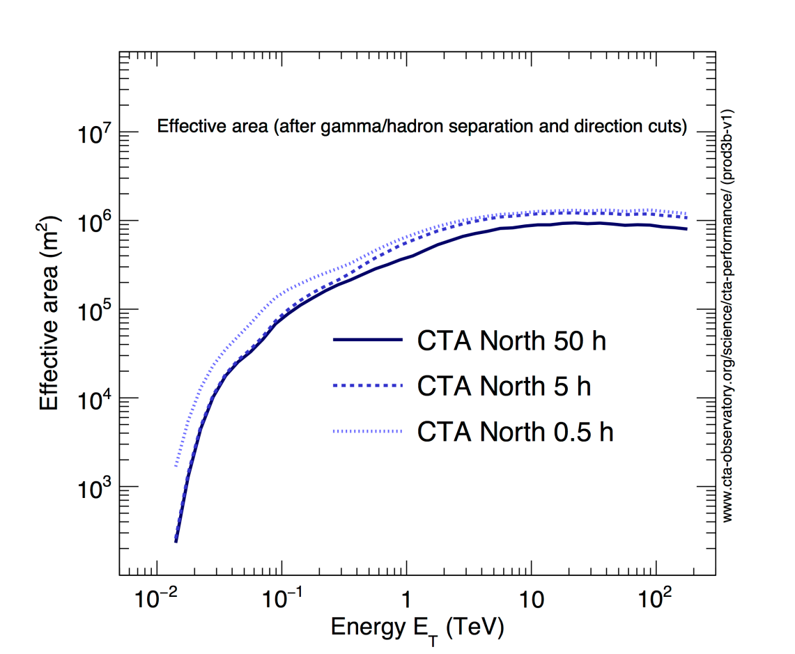
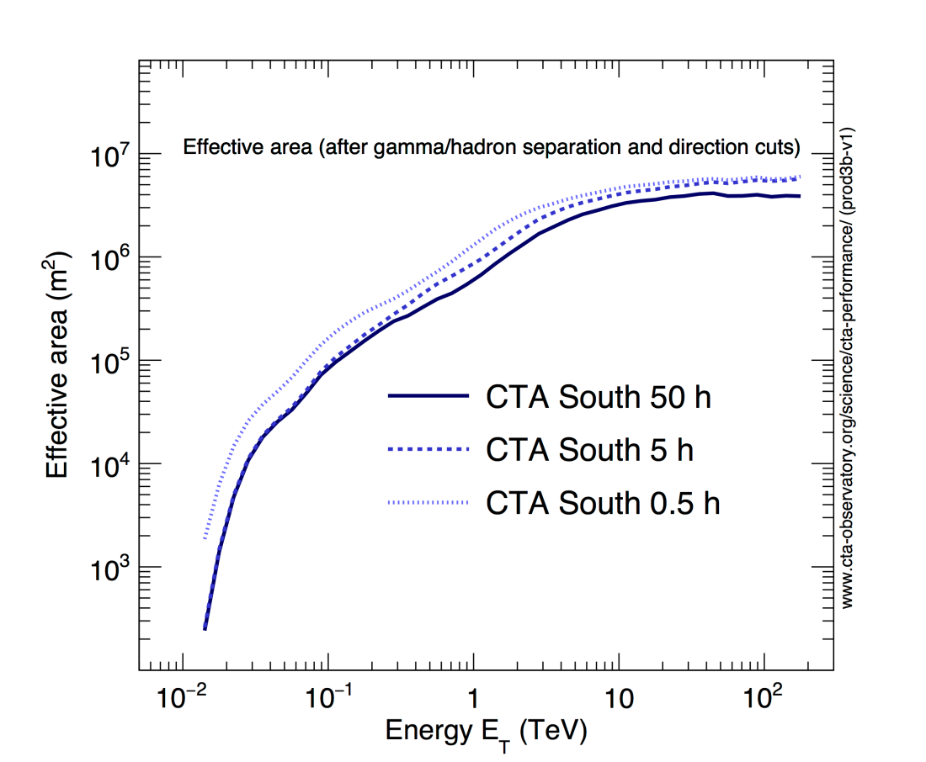
Collection area
Low energy gamma-rays: high rate, low light yield. Small ground surface, large mirror area
High energy gamma-rays: low rate, high light yield. Large ground surface, small mirror area
Notes:
Effective collection area for gamma rays coming from point like source for different cuts in observation time

Slide 9
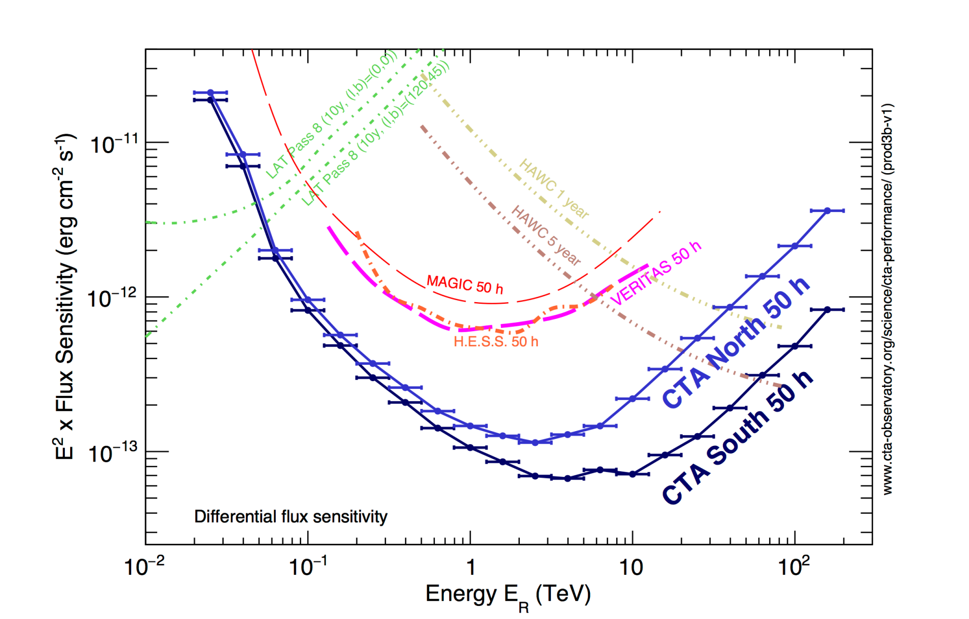
CTA Sensitivity
Sensitivity improved by a factor 5 to 10 in the core energy range, depending on energy, w.r.t. current IACTs

Slide 10
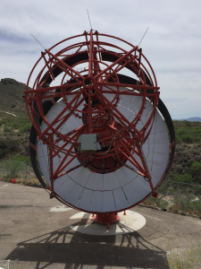
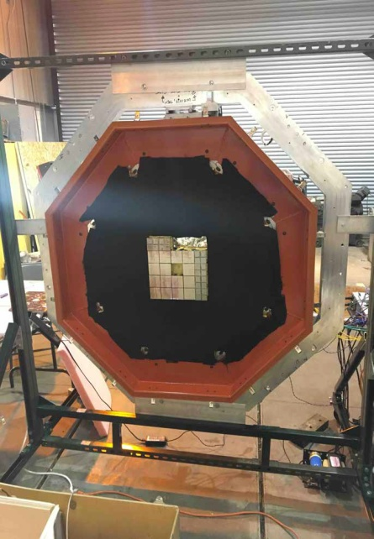
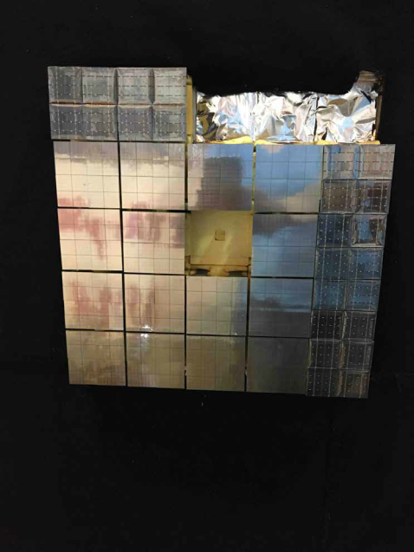
SCT prototype
The dual mirror prototype Schwarzschild-Couder Telescope under construction at the Veritas site completed its primary mirror installation on April 26th and the camera installation in the frame on May 30th.
25 modules each of an area of 54x54 mm², divided into 4 matrices composed by 16
6 x 6 mm² SiPMs
  SiPMs: Hamamatsu
  S12642-0404PA-50(X)
  Readout directly behind
  the focal plane.
Hamamatsu
FBK
FBK SiPMs intended to replace the original Hamamatsu solution for an upgrade of the SCT camera.
INFN contribution: 9 of the 25 modules (~600 SiPMs) will be placed in the pSCT camera. Currently 6 out of 9 have been successfully integrated and tested in the camera focal plane. (V. Vagelli’s talk)
Notes:
The goal of the prototype is to demonstrate the performance of the novel optical system
the mechanical stability and the mirror alignment

Slide 11
Camera photosensors
SiPM requirements for Cherenkov light detection
Small surface (<1 cm²) higher pixel angular resolution
High Photo-Detection Efficiency in the UV range ( 50%)
Fast response O(1-10) ns
Advantages
Not damaged by Moonlight, can be operated
during bright Moon nights increasing the DAQ
duty cycles
Can be operated with bias voltages below 100 V
Low power consumption (~µW)
Light-weight
Drawback
Noisy, dark count rates O(100) KHz/mm² at room temperature, but below the expected average night sky background.

Slide 12
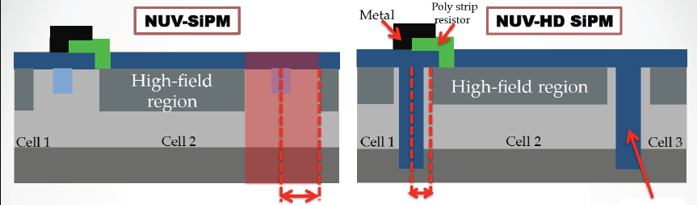
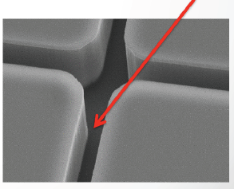
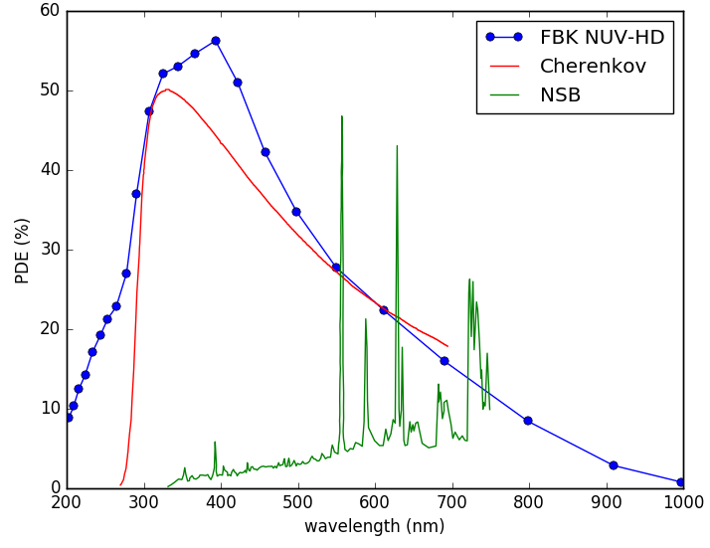
FBK NUV-HD technology
Trench
4.5 µm
2 µm
The Italian National Institute for Nuclear Physics (INFN) together with Fondazione Bruno Kessler (FBK)
is currently involved in the development and testing of SiPMs suitable for Cherenkov light detection in the Near UltraViolet (NUV HD)
Higher Fill Factor due to a reduction of the dead border
region.
Lower Cross Talk for inserting trenches between the cells
NUV-HD technology proved to be successful, (high PDE)
development of improved devices has been carried out

Slide 13
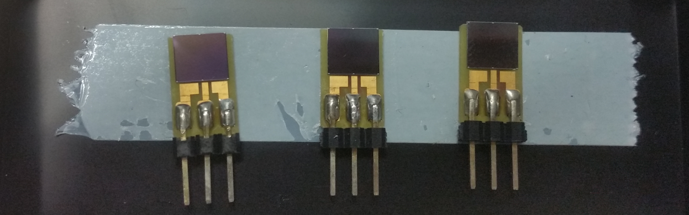
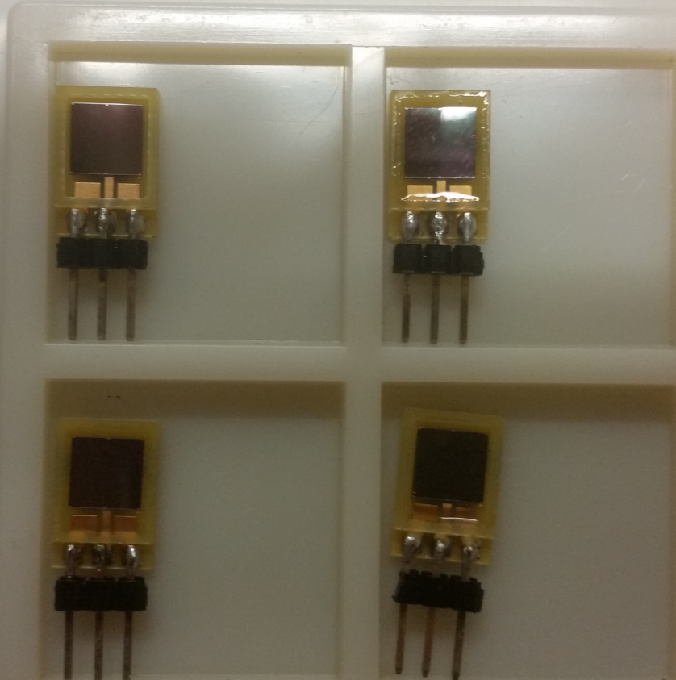
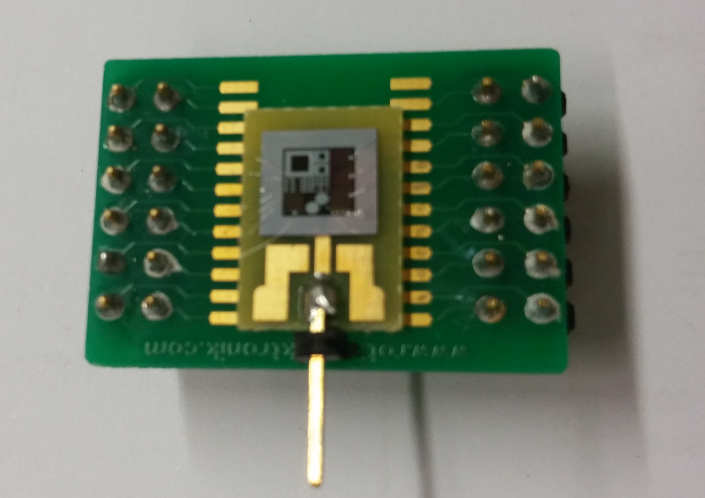
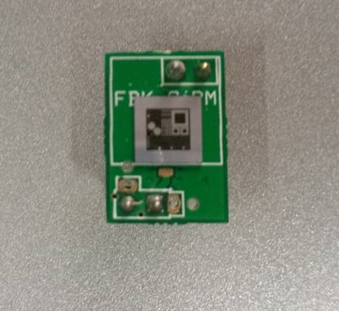
FBK sensor productions
NUV HD-2 6 x 6 mm²
NUV HD3-3/2 6 x 6 mm²
single sensor Cell size: 40 x 40 μm²
sensors with different thicknesses of 2 kind of glue
NUV HD3-3 1 x 1 mm²
NUV HD-3 1 x 1 mm²
Test PCB with SPAD and sensors with cells of different pitch (30-35-40-45 µm)
Single bond substrates (HD3 2/3)
PCB sensors and matrices assembly (Perugia) .
Full characterization: test of single devices (Napoli) with different active areas and different readout electronics
1 x 1 mm² Gain, and crosstalk ; 6 x 6 mm² Dark rate ,PDE vs Overvoltage, PDE vs wavelength
Test of SiPM matrices (Bari).

Slide 14
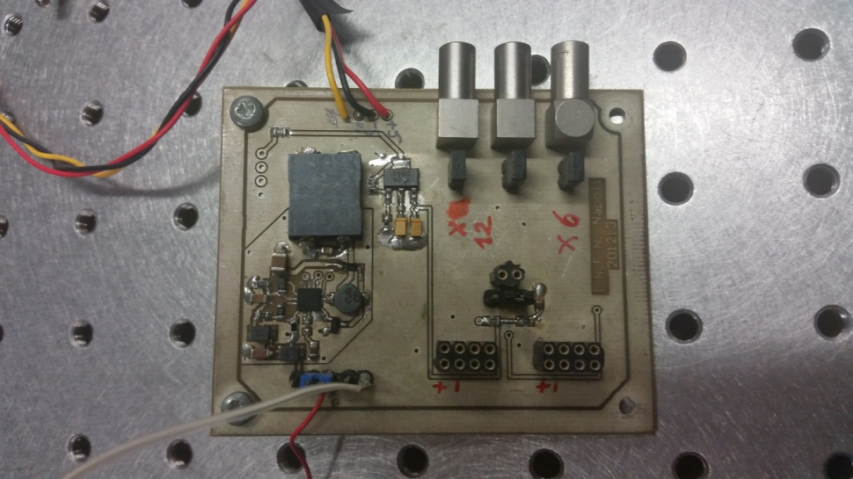
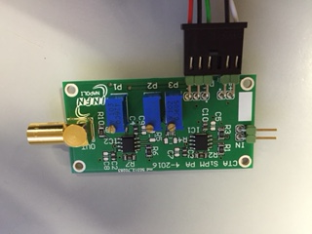
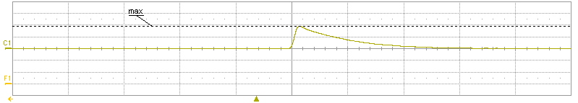
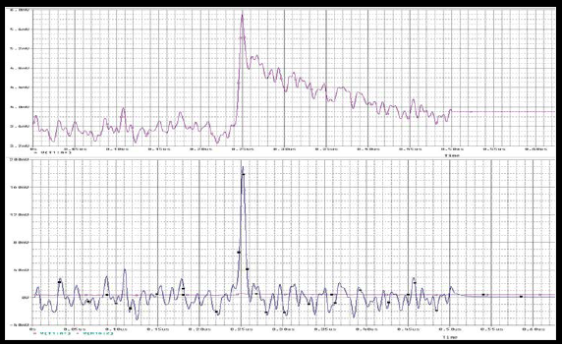


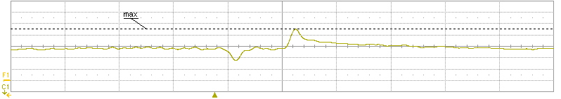


Readout electronics
INFN_NA SiPM_PreAmplifier
PreAmplifier stage (factor 12X)
with ZERO-POLE COMPENSATION
offset
tail
undershoot
3 Trimmer: P1, P2, P3 to change respectively offset, undershoot and tail
Different resistance R values
2 V
Signal from 1 mm²
40 µm
220 ns
7 mV
Signal from SPAD
40 µm
70 ns

Slide 15
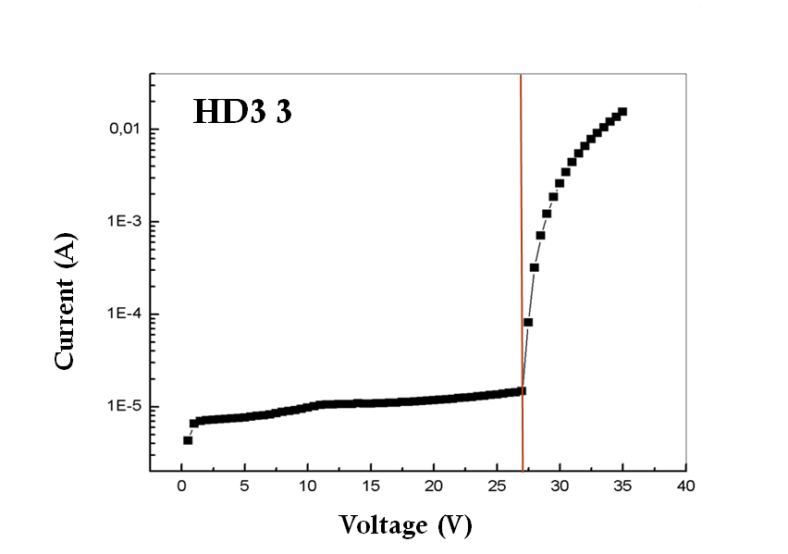
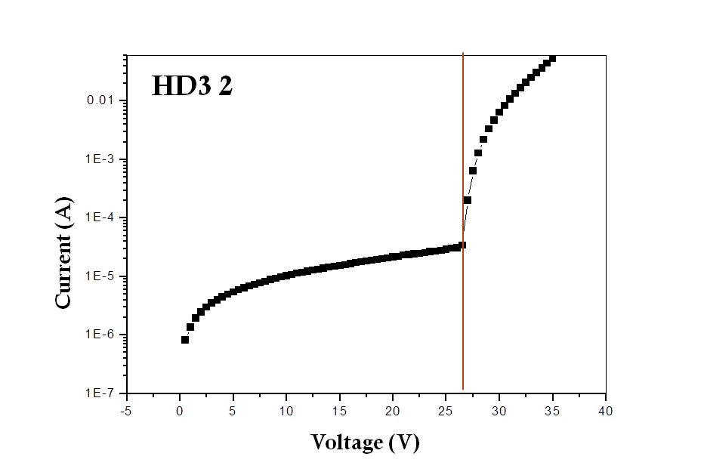
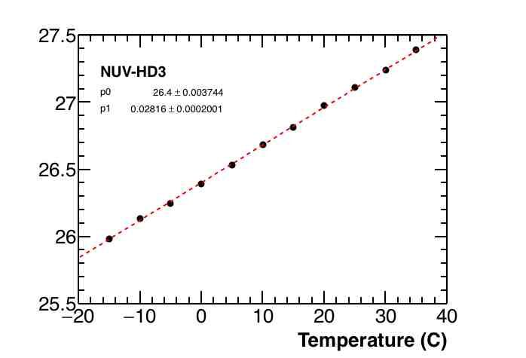
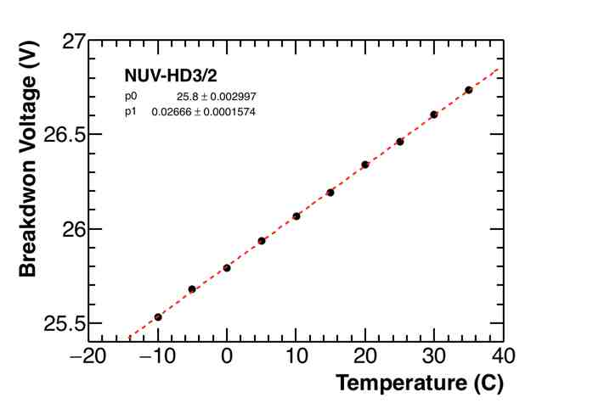
IV characteristics
VBD 26.9 V @T=20º C
VBD 26.4 V
@T=20º C
Current (A)
Current (A)
Inverse Bias (V)
Inverse Bias (V)
Breakdown Voltage (V)

Slide 16
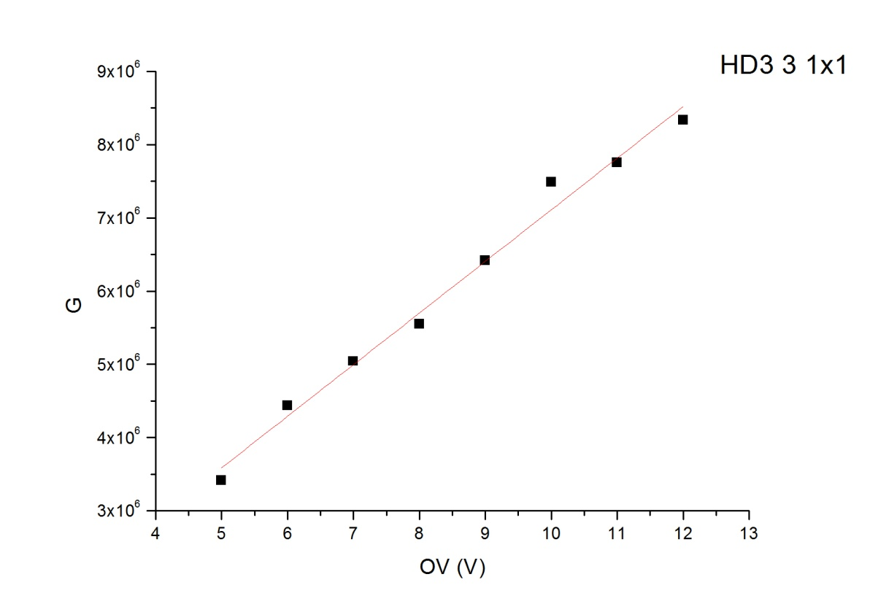
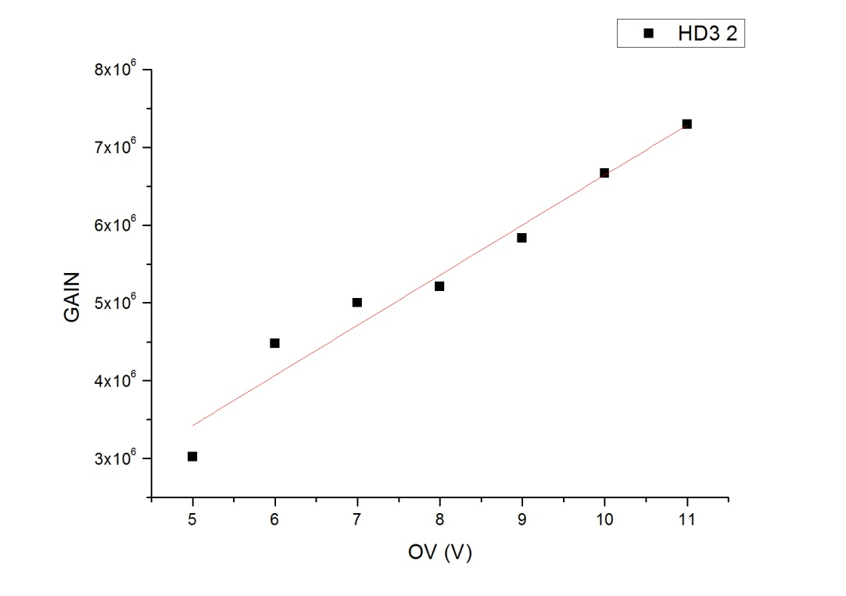
Gain
Dark box
NUV HD3 3 @ 36 V
Port 1
Aperture
Led Flasher
Integrating Sphere
SiPM&readout
Port 2
Signal
Pulse Generator
Oscilloscope
Trigger Line
HD3 3
HD3 2

Slide 17
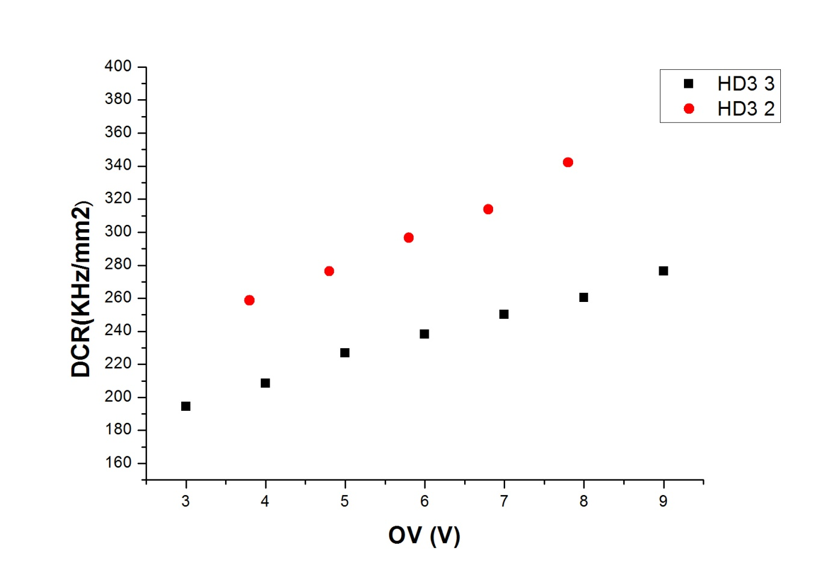
Dark Count Rate
NUV HD3 6x6 mm²: INFN preamplifer + shaper
Trigger oscilloscope @0.5 p.e.
Room temperature 19 º C
DCR = HOLDoff/ΔTrigTime
Notes:
∆ trig time which measures the time interval between two different trigger events. Another feature is the Trigger Holdoﬀ which makes the oscilloscope ignore a certain number N of trigger events. N can be arbitrarily set between 1 and 109. Its value has been set in order to obtain the mean time between two diﬀerent triggers is v 20ms which is a time the oscilloscope can easily measure.

Slide 18
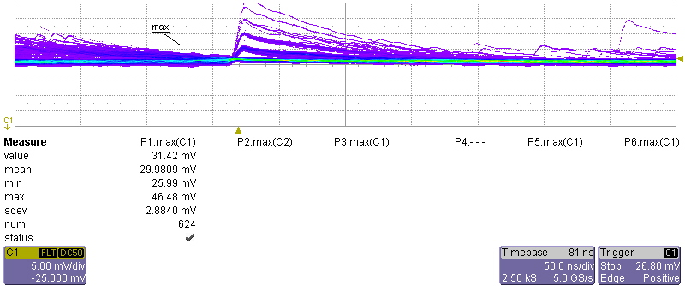
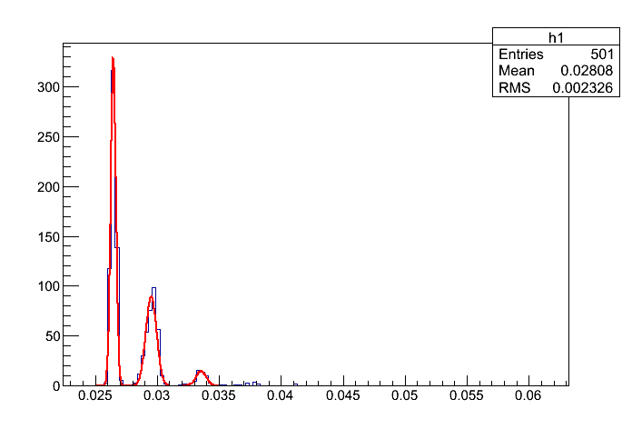
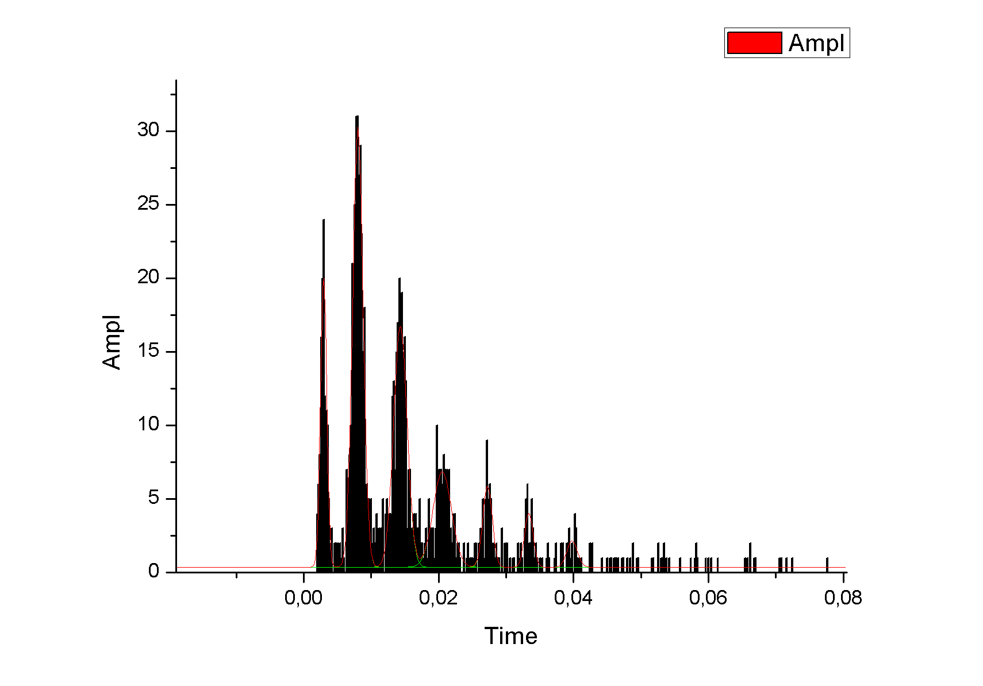
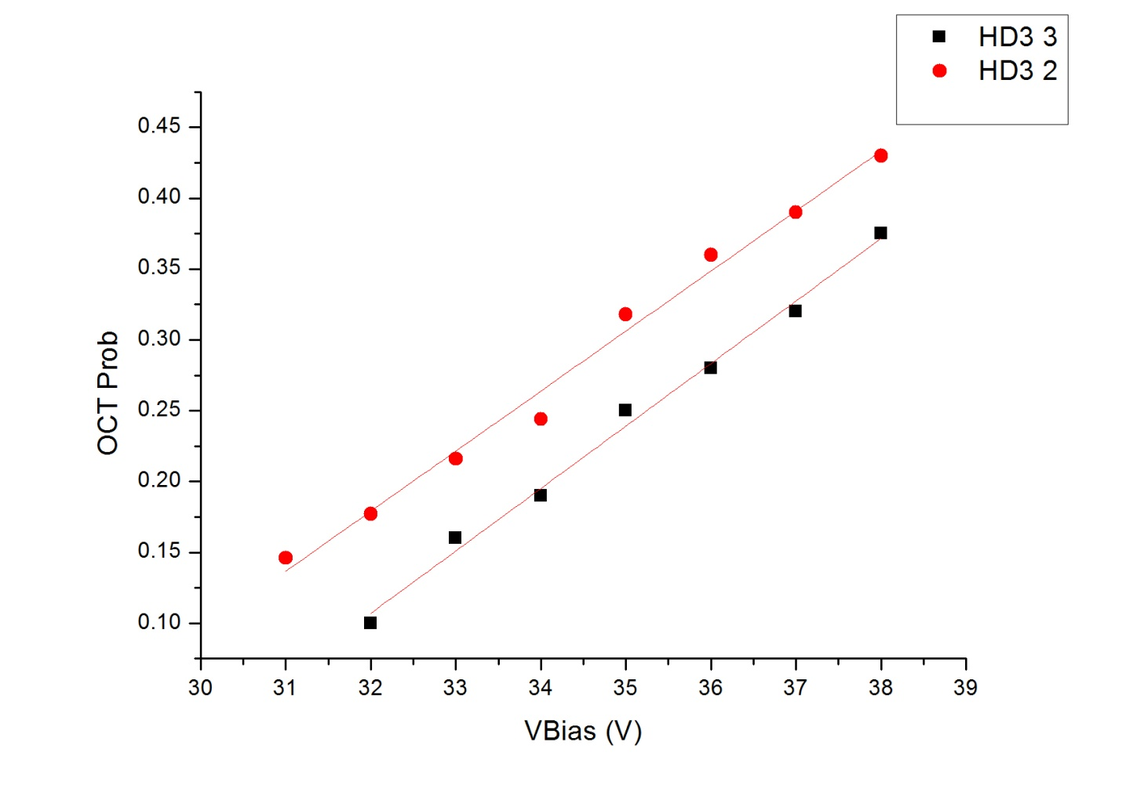
Cross Talk probability
Same DCR set up @ T = 19º C
P_{CT} = (#2+#3+…)/(#1+#2+#3+…)
1 PE
Ped
Counts
2 PE
3 PE
@33 V
1 x 1 mm²

Slide 19
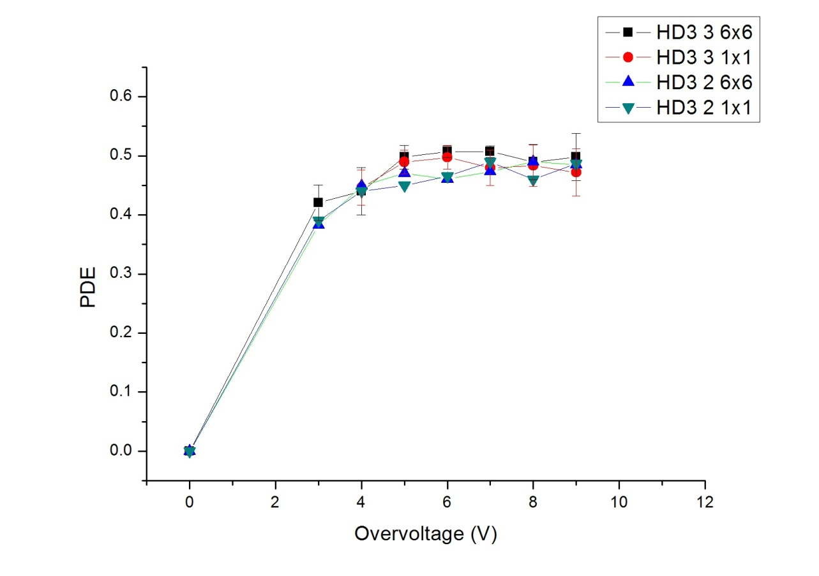

PDE vs Overvoltage
Dark box
LED flasher @400 nm
Pulse width 40 ns
Port 1
A calibrated PMT has been used as reference device.
HV PMT =700 V
Aperture
Led Flasher
Integrating Sphere
SiPM&readout
Port 2
Signal
Pulse Generator
Oscilloscope
Trigger Line

Slide 20
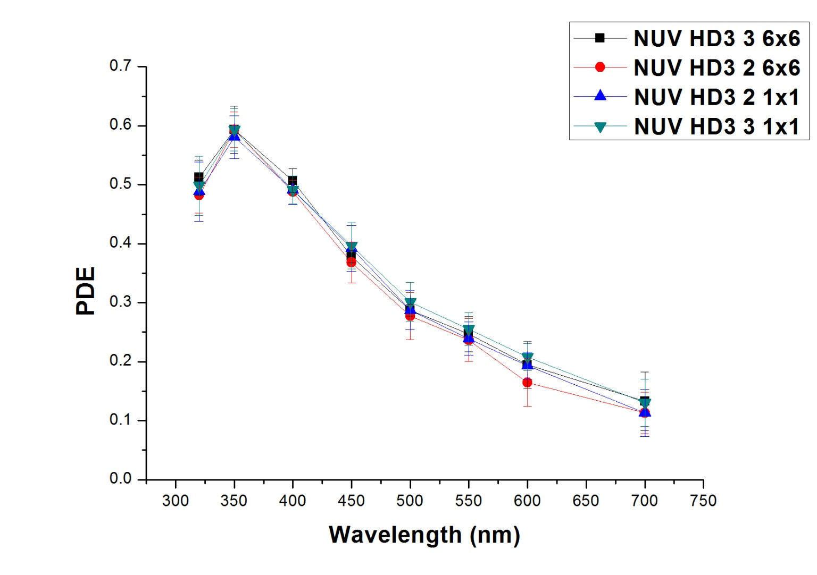

PDE vs wavelength
Dark box
A calibrated PMT has been used as reference device.
HV PMT =700 V
OV SiPM= +6 V
T = 19º C
Calibrated PMT
Port1
Aperture
Optical Passband Filters
SiPM/PMT
Integrating Sphere
Port 2
Signal
Oscilloscope
LOT
Lamp
Trigger Line

Slide 21
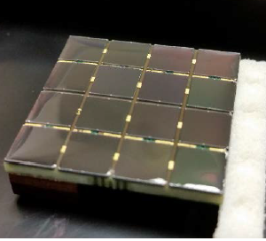
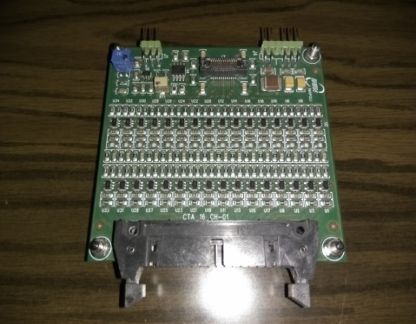
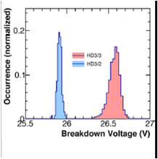
FBK matrices characterization
A section of the pSCT focal plane will be equipped with 9 INFN optical modules each one made of 64 6 X 6 mm² FBK NUV–HD3 (both substrates 2-3) SiPMs arranged into 4x4 matrices. The electronics readout has been performed by means of a trans-impedance preamplifier + a gain stage with 16 channels. Since the devices have a long recovery time a also a shaping stage was added in order
to get rid of the long tail of the output
signal.
Over 50 matrices have been tested to verify the uniformity in terms of gain and SNR. For each channel we measured the VBD finding the mean value of 25.9 and 26.6 V respectively for HD3 2
and HD3 3

Slide 22
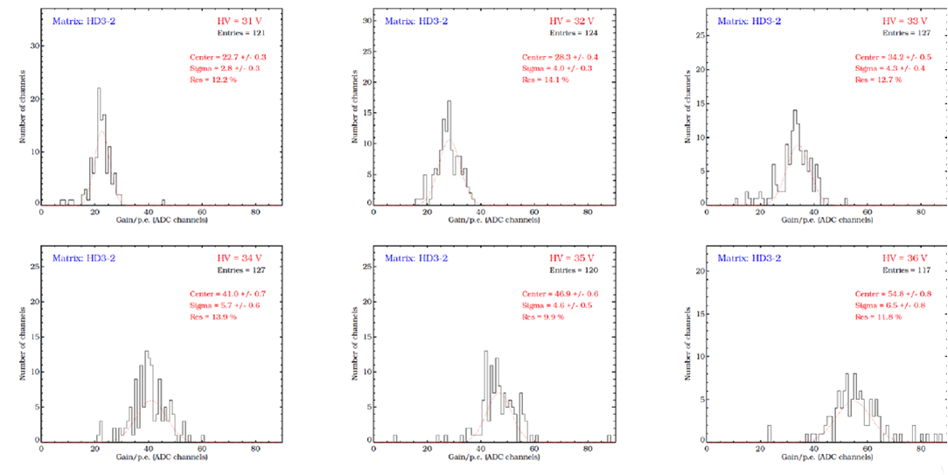
Measurements with a laser@380 nm. Vbias between 31 and 36 V
DAQ: CAEN V792 QDC to measure the charge of the 16 devices with a fixed integration time of 30 ns. FEE 16 channels for signal readout.
Charge distributions have been fitted to derive the integrated charge and the SNR for each channel at different Vbias.
Gain distribution of HD3 2 matrices at different Vbias expressed in ADC channels
Gain uniformity
Distributions follow a gaussian shape with a σ/µ ratio between 10% and 15%

Slide 23
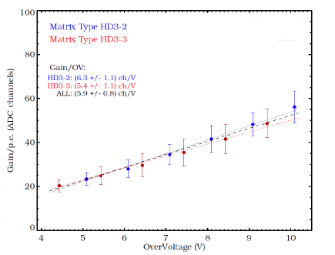
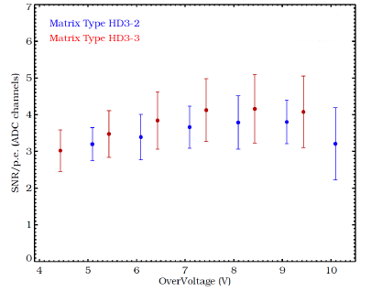
GAIN and SNR of the matrices
Average values of Gain and SNR as a function of over-voltage for both types of matrices
Uniform behavior of the channels.
Similar behavior of the HD3 3 and HD3 2 matrices taking into account the different breakdown voltage.

Slide 24
Conclusions
The results of the test and characterization of the FBK NUV–HD3 (3-2) SiPM technology allow to conclude that the performances are compatible with the requirements of the camera focal-plane of the SCT prototype
Low–bias Voltage
High Gain ~4.5∙10⁶
CT less than 20%
PDE >50% in UV range
DCR around 250 kHz/mm² @+6V OV
Good uniformity in Gain and SNR of the assembled matrices.
36 matrices selected for the coupling to the front-end electronics of the pSCT based on the TARGET-7 ASIC
6 INFN FBK modules integrated in the camera focal-plane and 3 in preparation.

Slide 25

Conclusions
Thank you!

