Slide 1
UHECR : where they come from?
arXiv:submit/2269349 ,
21 May 2018
PoS 2018

Slide 2
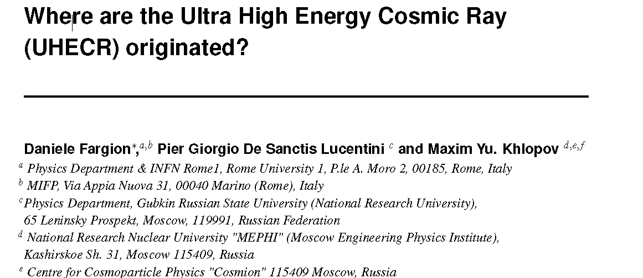
May 2018
Arxiv, POS, 21 May 2018

Slide 3
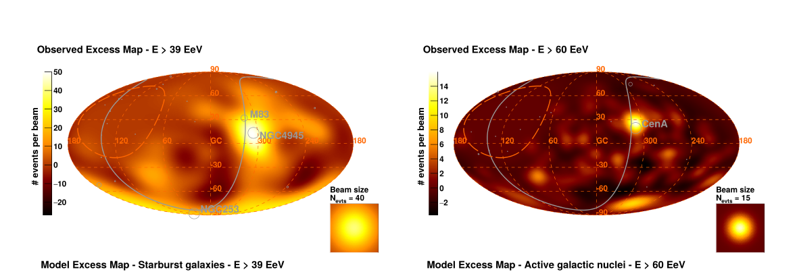
2-2-2018—AUGER _ANISOTROPY

Slide 4
UHECR Anisotropy Summary
We consider the recent results on UHECR (Ultra High Energy Cosmic Ray) composition and their distribution in the sky from ten EeV energy (the dipole anisotropy) up to the highest UHECR energies and their clustering maps: UHECR have been found mostly made by light and lightest nuclei.
We considered a few localized nearby extragalactic sources for most UHECR clustering as CenA, NG 253, M82.

Slide 5
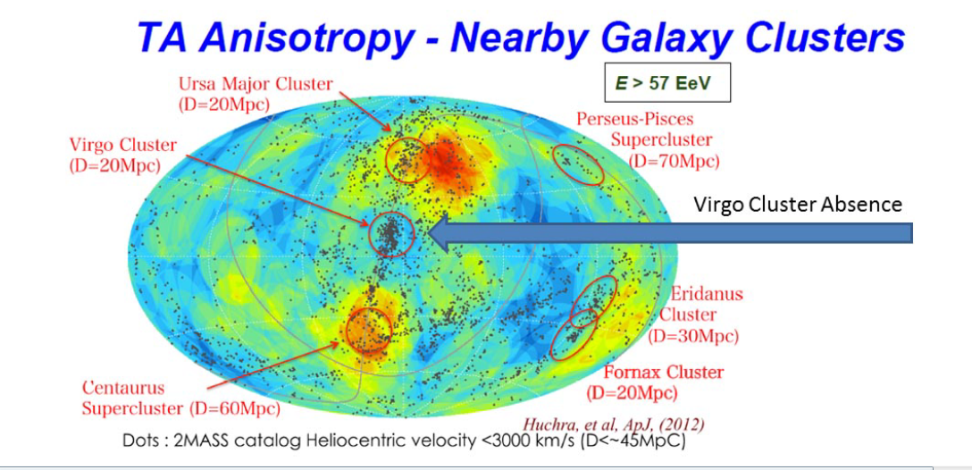
1) The Virgo Absence and the two Hot Spot

Slide 6
Main NON Message by AUGER 2007
NO VIRGO CLUSTERING
From Nearest Largest Mass Galaxy Cluster in GZK volume
NO NARROW CLUSTERING
(3-6 degrees) as expected for UHECR protons

Slide 7
Main YES message by AUGER 2007
Yes Wide Smeared Hot spot (18 degrees size) at Cen A, as for lightest nuclei
Yes From Nucleon-→ Nuclei COMPOSITION hinted in slant depth

Slide 8
Lightest Nuclei are filtered from 20 Mpc
Virgo may be hidden

Slide 9
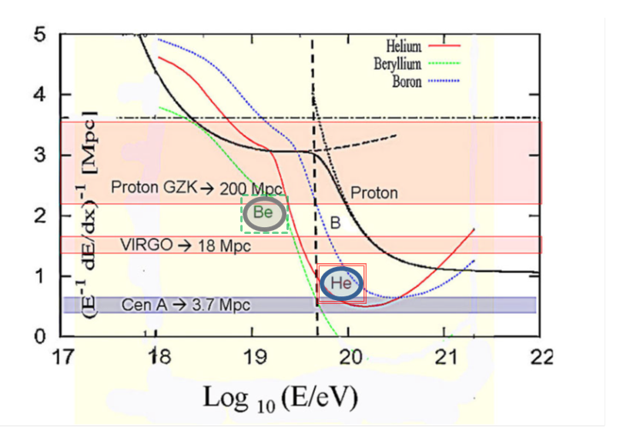
Lightest nuclei nearby GZK

Slide 10
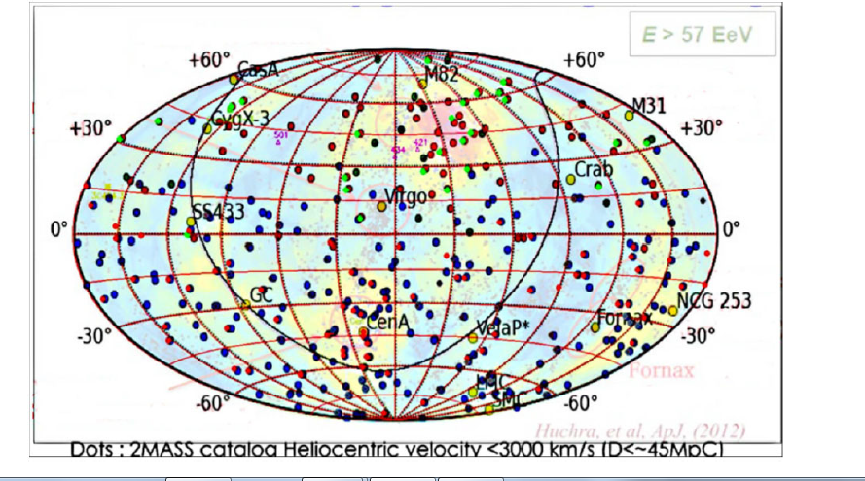
2015 UHECR events and the two hot spots

Slide 11
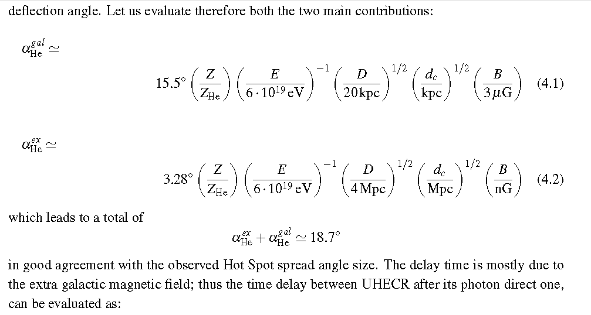
Composition, Deflection, Clustering

Slide 12
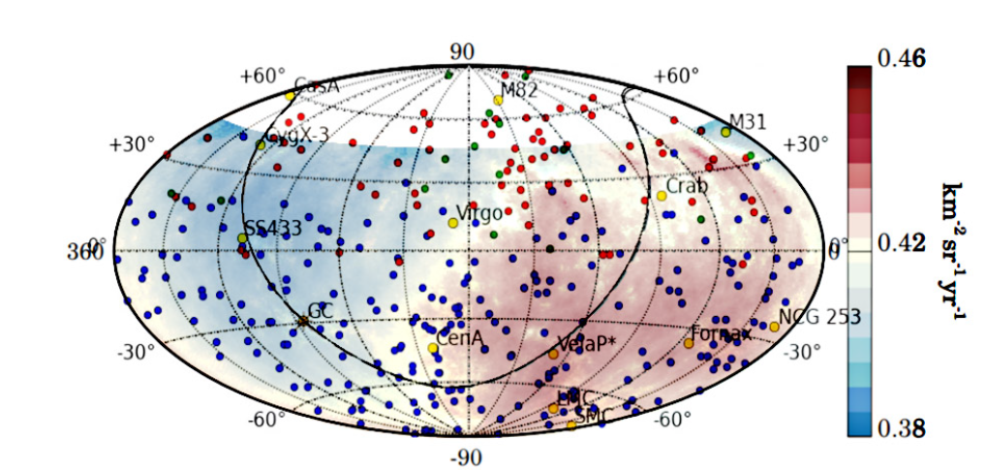
A 5 sigma Dipole 10 EeV UHECR anisotropy: 6 times wider : 90-100 degrees; 6 % value

Slide 13
Proton at 10 EeV come from cosmic edges.
Isotropy up two millipercent guaranteed

Slide 14
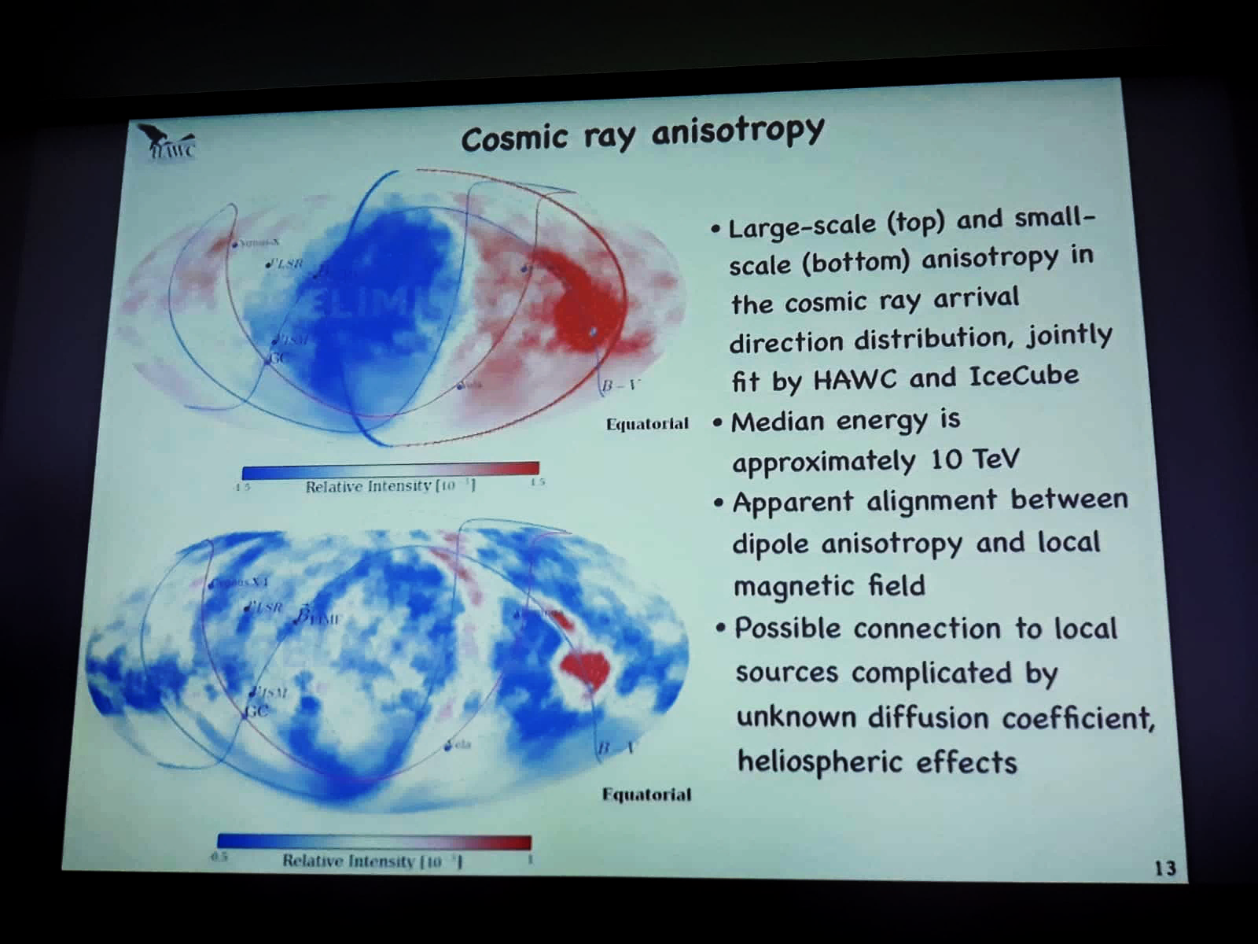
Hawc talk on Dipole Anisotropy at TeVs SAME ANISOTROPY as UHECR one but at 0.1 millipercent! A secondary tail?

Slide 15
UHECR 10 EeV Dipole anisotropy in Galactic Coordinate: 6 percent

Slide 16
Forced Consequences:
There are in gigaparsec volumes, at 10 EeV proton radius flight at least a Billion of galaxies:
No more than 0.01% expected anisotropy.
Observed a UHECR 6 % anisotropy
It must be a very local, almost Galactic origin:
LMC, Vela, Crab, NGC 253
are the best candiates

Slide 17
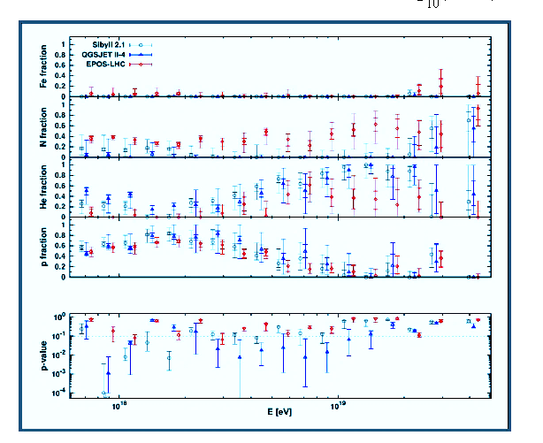
The early→ recent Light Nuclei photo-dissociation confirm and 20 EeV traces

Slide 19
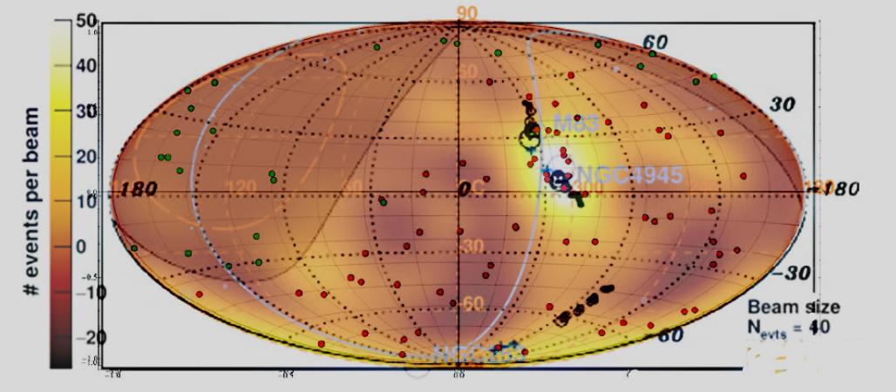
20 EeV Multiplet at Cen A Hot Spot anisotropy foreseen 2009, observed 2011…. Here overlap on 2018 Auger 39 EeV anisotropy

Slide 20
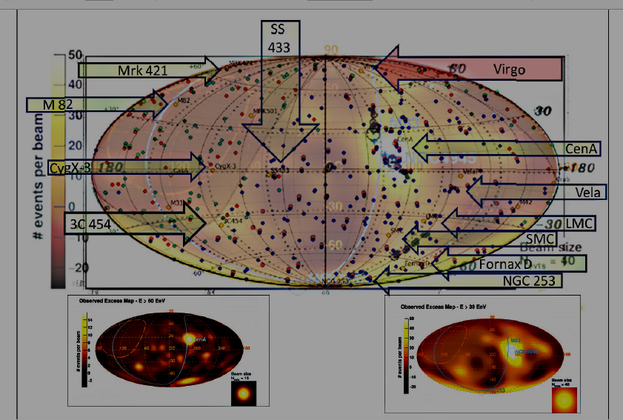
Source names and nearer sources: Cen A, M82, NG 253, Vela, LMC, SS433

Slide 21
Conclusions
Lightest Nuclei are main currier of UHECR
Probable overlapping of the Hawc, ARGO,
Dipole at TeVs with 10 EeV UHECR AUGER Dipole
Interpretation:
A Galactic Role by Vela, LMC, Crab and maybe Extragalactic Fornax D, NGC 253
Rare clustering at 3C454 made by Z-Burst events due to UHE ZeV neutrinos scattering on relic (sterile?) eV neutrinos in hot dark halos.?

Slide 22
Suggestion
UHECR are mostly LIGHTEST NUCLEI by Cen A, M82, NGC 253, but some cases might be NUCLEONS:
TO DISENTANGLE WE NEED A LOCAL
UHECR SPECTROSCOPY:
Composition for each group.

Slide 23
Thank You for the kind attention

Slide 24
UHECR: Also Galactic? Also Cosmic?
We comment also on the possible partial role of a few remarkable galactic UHECR sources at 10 EeV energies.
Finally we revive the eventual role of a relic neutrino eV mass in dark hot halo (hit by ZeV neutrinos) to explain the new UHECR clustering events centered around a very far cosmic AGN sources as 3C 454.

Slide 25
Most Lightest Nuclei..but an apparent clustering to 3c 454 at redshift z=1 !
Z Burst solution based on ZeV neutrino scattering on relic cosmic ones:
UHECR by NUCLEONS and not NUCLEI

Slide 28
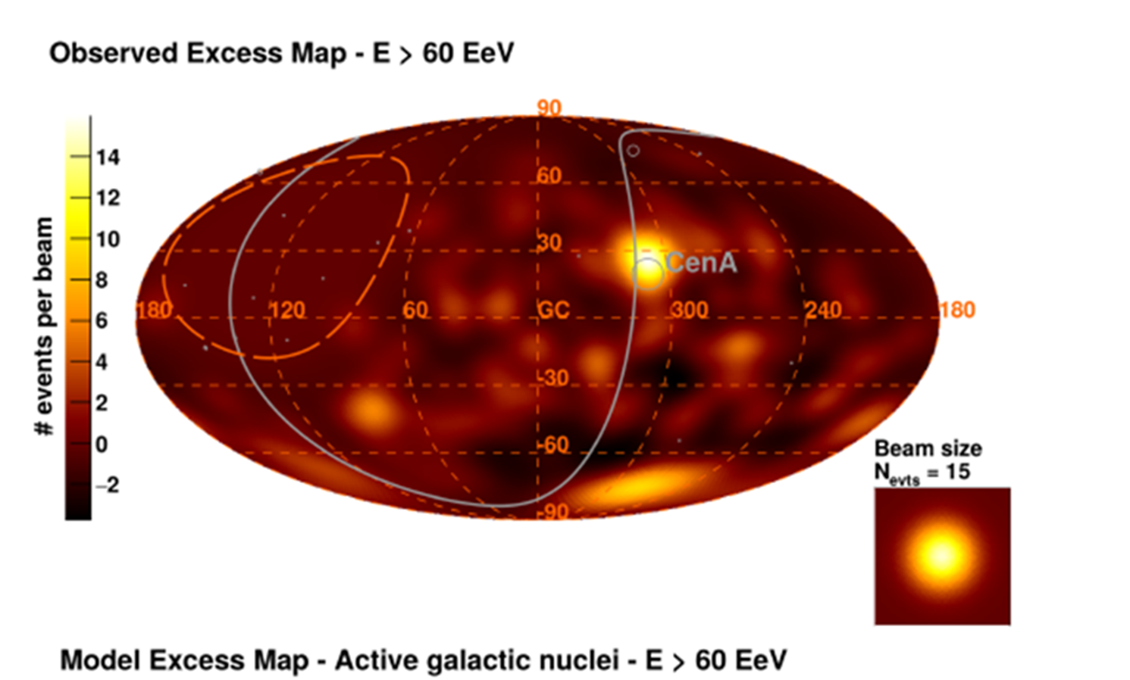
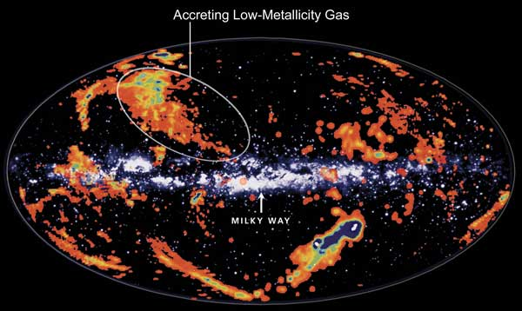
A much local trace?

Slide 29
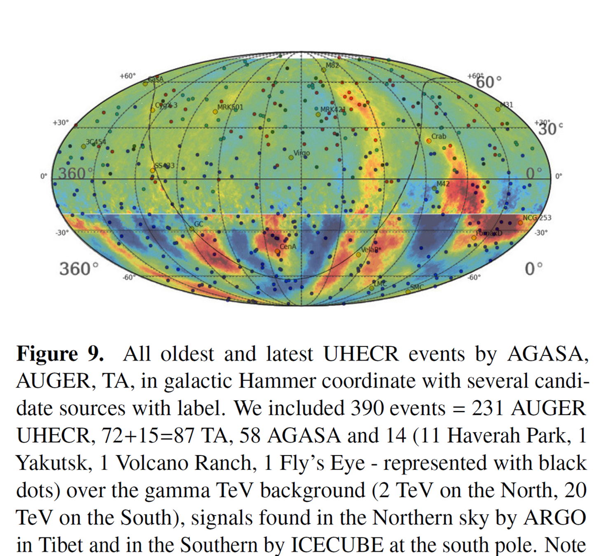

Slide 30
