Slide 1


Novel type of compact satellite borne gamma-ray telescope based on oriented crystals
L. Bandiera INFN Ferrara
bandiera@fe.infn.it
CRIS 2018
Portopalo di Capo Passero
Rome, 06/22/2018

Slide 2
Outlook
Introduction to e.m. processes in oriented crystals;
Radiation length reduction in oriented high-Z crystals;
New study @CERN with a scintillator crystal;
Application of oriented crystals to satellite borne high-energy gamma astronomy;
Summary.

Slide 3
Electromagnetic processes in oriented crystals

Slide 4
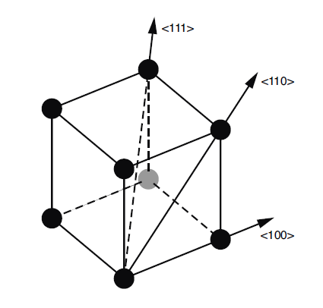
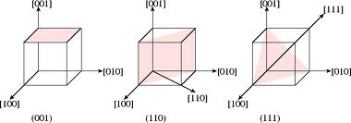
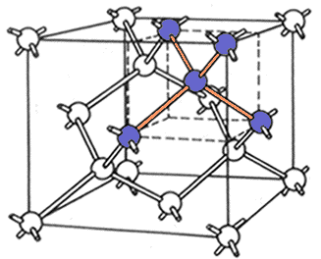
Crystalline solids
A crystal is a solid structure consisting of atoms, molecules or ions having a geometrically regular arrangement, which is repeated indefinitely in the three spatial dimensions, called the crystal lattice.
Diamond or Si crystal

Slide 5
Motion of charged particles in aligned crystals: Channeling
Amorphous or non-crystalline solid
Crystalline solid
(Si, C, Ge, W…)
Atomic crystal plane
e
+
planar channeling
e⁻
Positively-charged particles are repulsed from the nuclei of the axis (plane) and hence can be captured inside the interaxial (interplanar) potential wells.
Negatively-charged particles are attracted towards the positively-charged nuclei of the axis (plane), thus oscillate around the atomic axes (or planes).
Thinner bent crystals are required for efficient deflection of
negative particles

Slide 6
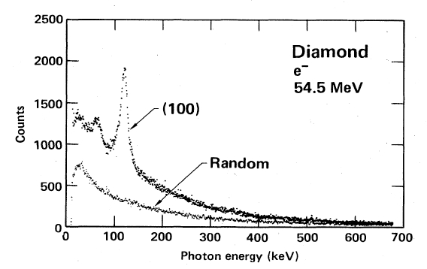
Enhancement of bremsstrahlung in aligned crystals
String of atoms
Single atom
e⁻
e⁻
Channeling Radiation (1976, Kumakhov)
HE
e⁻
Notes:
Crystal-assisted collimation: a curved crystal deviates the halo directly to the primary absorber.
6

Slide 7


… and in nearly aligned crystals (θ_{in} ≤ 1°)
@ Coherent Bremsstrahlung
@ Channeling
Coherent Bremsstrahlung (1950s) Ter-Mikaelian, Ferretti, Dyson-Uberall
$$\frac{1}{γ}$$
Laboratori Nazionali di Frascati, 1960
e⁻ @ 0.4-1.1 GeV
$$lc=\frac{2γ^{2}}{ω}$$
Enhancement
bremsstrahlung
θ<<1
e±
x = ω/E
Notes:
Crystal-assisted collimation: a curved crystal deviates the halo directly to the primary absorber.
7

Slide 8
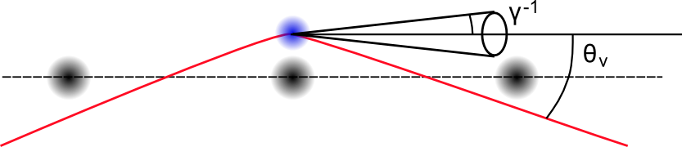
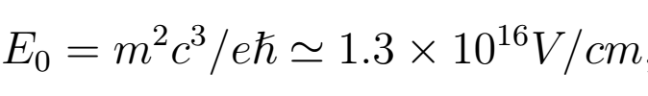
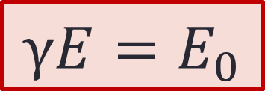
Strong electromagnetic field in oriented crystal
At energies >5-10 GeV (100 GeV) depending on atomic number Z
Relevant for linear colliders, astrophysical objects like magnetars, heavy ion collisions and more. When the magnetic/electric field reaches the
Critical Schwinger QED field:
In the rest frame of the particle, the Lorentz contracted field can be computed as:
$$γE=E_{0}$$
Being the Planar/Axial field E = 10⁹/10¹¹ V/cm
Notes:
B0= 4.41 x 10^9 Tesla

Slide 9
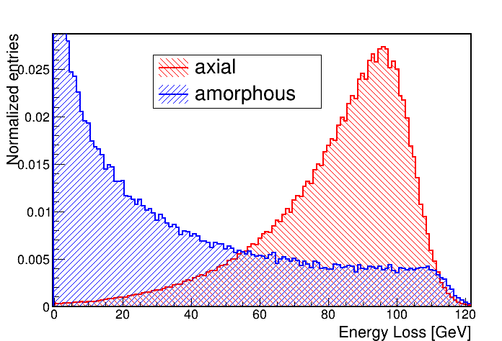
Strong field regime of radiation in oriented crystal
Radiation emission by 120 GeV electrons aligned with <110> Ge crystal axes
Germanium crystal (2.8 mm long)
Angular acceptance of the strong field effect ≈ some mrad for high-Z crystals;
Expected enhancement up to 1° of crystal-to-beam orientation due to Coherent Bremsstrahlung
Strong increase in the energy lost by the primary particle ->
huge reduction of X₀
Emission of hard photons with energy comparable to the primary electron/positron – cannot be treated classically!
Notes:
B0= 4.41 x 10^9 Tesla

Slide 10
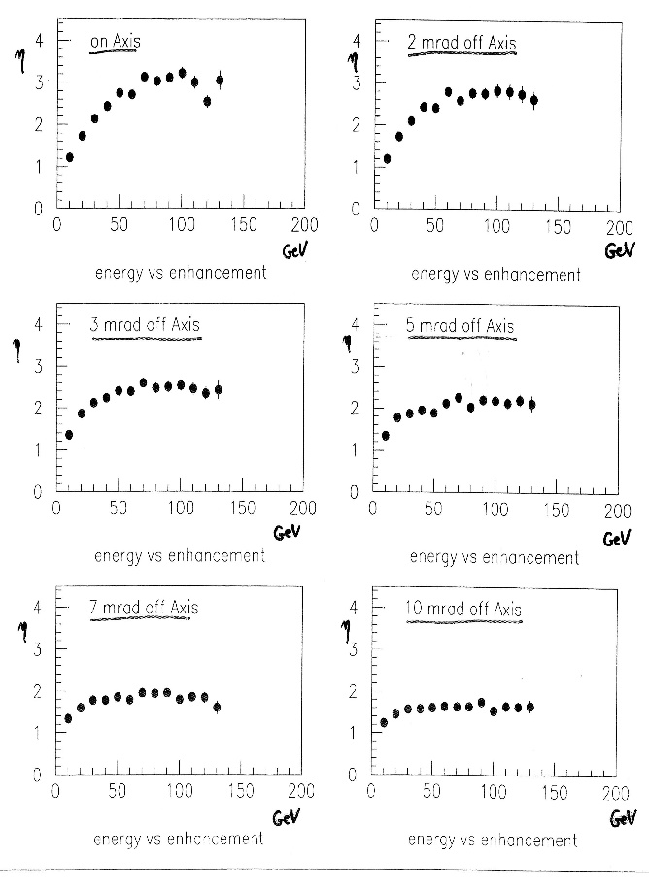
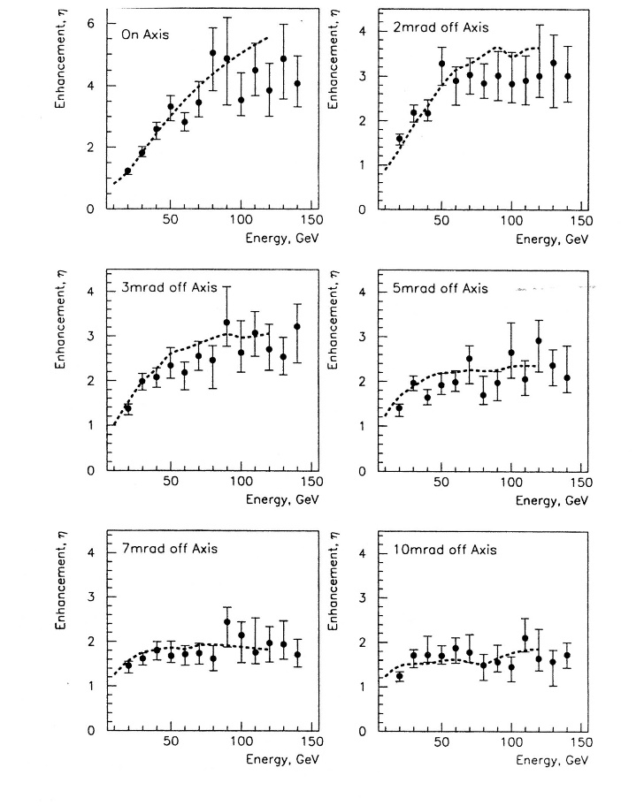
… and also for Pair Production
NA43 and NA48 experiments @ CERN
Iridium
Tungsten
The NA48 experiment at CERN used Ir crystal of 3mm thickness, corresponding to 0.98 X0 which became 1.79 X0 for the aligned crystal, as a high energy photon converter.
A 30% reduction of multiple scattering occurred, when compared to a lead converter with a thickness of 1.33 X0.
From C. Biino, MiniWorkshop on Crystal Collimation @CERN, 2005

Slide 11

New idea….
If we point A telescope towards a gamma-ray source (with 1° or less Precision), we could exploit the X0 reduction in oriented crystals to enhance the sensitivity to photons > GeV
Proposal under evaluation at italian competition PRIN2017
In collaboration with S. Cutini (INFN Perugia and FERMI collaboration) and with V. Tikhomirov (INP Minsk).

Slide 12
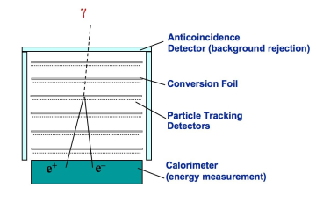
Take the FERMI-LAT tower as an example…
Made of Tungsten
Made of Silicon
Made of CsI scintillator crystals
Notes:
– The tungsten converter foils are divided into two sections. The 12 upper (front) layers are each 0.03 radiation lengths thick (to minimize Coulomb scattering effects that are important at lower energies), while four lower (back) layers have 0.18 radiation length thickness (to provide more converter for high-energy γ rays that are less affected by scattering)

Slide 13
Take the FERMI-LAT tower as an example…
All of these materials have a crystalline structure and can be oriented along some preferred lattice direction
Made of Tungsten
Made of Silicon
Made of CsI scintillator crystals
Notes:
– The tungsten converter foils are divided into two sections. The 12 upper (front) layers are each 0.03 radiation lengths thick (to minimize Coulomb scattering effects that are important at lower energies), while four lower (back) layers have 0.18 radiation length thickness (to provide more converter for high-energy γ rays that are less affected by scattering)

Slide 14
What happen if the tracker-converter is oriented?
The gamma conversion in pairs in an aligned W crystal increases with photon energy in a range from 10 to 150 GeV.
The enhancement is maxial in the case of axial alignment and diminishes slowly as the misalignement between the gamma direction and crystal axes increases.
A measurable enanchement is visible up to 10 mrad (circa 0.6°).
From C. Biino, MiniWorkshop on Crystal Collimation @CERN, 2005

Slide 15
What happen if the tracker-converter is oriented?
In case of pointing gamma sources within 1°, one may substitute the W amorphous foils with crystalline W, leading to:
Possible reduction of tracker length and thereby of multiple scattering, with an improvement of the spatial resolution -> better localization of the source;
Maintaining the same tracker length, it increases the sensitivity to gamma with E > 5-10 GeV.
Proposal under evaluation at italian competition PRIN2017

Slide 16
What happen if the tracker-converter is oriented?
N.B.
The tracker would continue to operate in a standard way in the absence of pointing.
Pair production enhancement possible also for Silicon and for lower energy photons (hundreds of MeV) in case of off-axes orientation due to Coherent Pair Production
Proposal under evaluation at italian competition PRIN2017

Slide 17
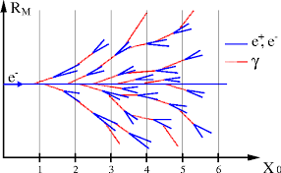
And if the electromagnetic calorimeter is made of oriented crystals?
Using oriented scintillator crystal one may enhance the sensitivity of the telescope above few GeV, with the capability of containing e.m. showers at energies > 100 GeV in a reduced volume/weight;
Cost reduction!!!
The calorimeter would continue to operate in a standard way in the absence of pointing.
Proposal under evaluation at italian competition PRIN2017
Notes:
GAMMA400?

Slide 18
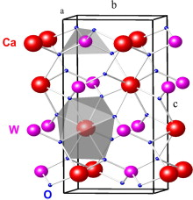
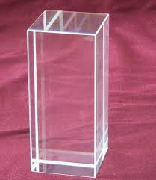
And if the electromagnetic calorimeter is made of oriented crystals?
Using oriented scintillator crystal one may enhance the sensitivity of the telescope above few GeV, with the capability of containing e.m. showers at energies > 100 GeV in a reduced volume/weight;
Cost reduction!!!
The calorimeter would continue to operate in a standard way in the absence of pointing.
.
Pb
Up to now the experiments have been done only with single-element crystals;
We performed an experiment with a scintillator crystal: a lead tungstate (PWO) used in HEP calorimeters, such as CMS;
We expect a similar behaviour aslo for other scintillators.
Notes:
GAMMA400?

Slide 19
Experiment @CERN with 120 GeV electrons
S1-2
PWO
0.45 X₀
e⁺
e⁻
γ
γ-cal
SD1
SD2
SD3
Setup on H4
We selected single events on SD1-2 and collected the emitted photons at the gamma-calorimeter.

Slide 20
Experiment @CERN with 120 GeV electrons
S1-2
PWO
0.45 X₀
e⁺
e⁻
γ
γ-cal
SD1
SD2
SD3
Setup on H4
We selected single events on SD1-2 and collected the emitted photons at the gamma-calorimeter.
Peak at 100 GeV!
Strong reduction of X₀ in the oriented cases.
L. Bandiera et al, ArXiv: 1803.10005, accepted to be published on Phys. Rev. Lett.

Slide 21
Experiment @CERN with 120 GeV electrons
S1-2
PWO
0.45 X₀
e⁺
e⁻
γ
γ-cal
SD1
SD2
SD3
Setup on H4
We selected single events on SD1-2 and collected the emitted photons at the gamma-calorimeter.
Full Monte Carlo Simulation for bremsstrahlung + pair production in agreement with experimental results for:
Random orientation
Axial orientation
Axial effect
X₀= 8.9 mm
X₀= 1.6 mm
L. Bandiera et al, ArXiv: 1803.10005, accepted to be published on Phys. Rev. Lett.

Slide 22
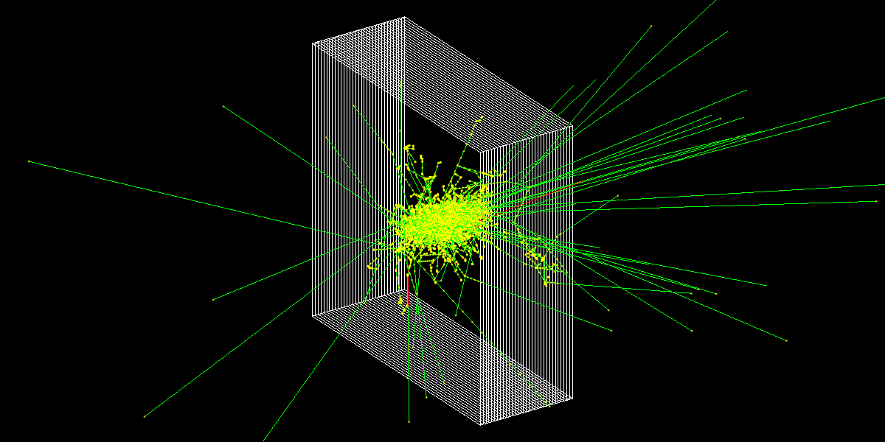
GEANT4 modified simulation for a PWO crystal with reduced X₀
The electromagnetic shower is simulated using the Geant4 toolkit in which the cross sections for bremsstrahlung and pair production are rescaled in agreement with full Monte Carlo.
V.G.Baryshevsky, V.V.Haurylavets, et al., Nucl. Instrum. Methods Phys. Res. B, 402 (2017) 35.

Slide 23
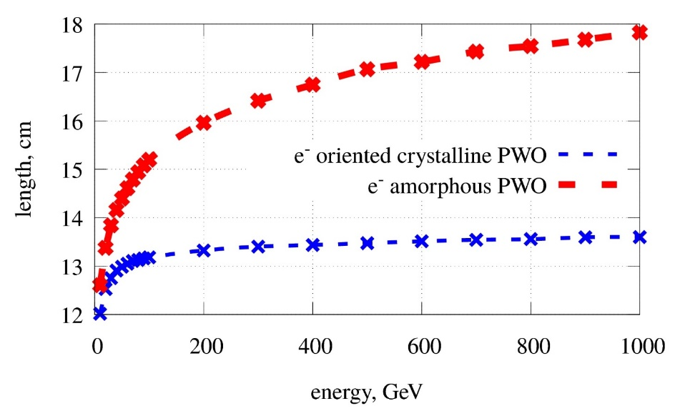
E.m. shower length vs. beam energy
Electromagnetic shower length (defined as 90% of energy deposited inside the crystal) vs. beam energy, for primary electrons. Since the crystalline strong field effect increases with beam energy with a consequent X₀ decreasing, the shower length is almost constant with energy.
L. Bandiera, V.V.Haurylavets, et al. Contribution at the Pisa Meeting for Frontier Detectors ‘18

Slide 24
Is a gamma-satellite based on oriented crystals feasible?
PRO
CON
Higher sensitivity to γ@E > GeV;
Possibility to reduce the converter thickness -> increase of spatial resolution;
Possibility to reduce the calorimeter volume to fully contain shower initiated by γ@E 100 GeV
  -> cost reduction;
…
Check of crystalline quality and orientation;
Mechanical alignment of crystals;
Longitudinal shower development depends on crystal-to-beam orientation.
Etc…

Slide 25
Possible applications
Several fields of the astrophysics could be explored using the pointing strategy, for example:
  observation of unidentified Fermi gamma-ray sources;
  follow-up of flaring/transient and multimessenger sources;
  pointing of the galactic center for the dark matter decay lines detection.
Connection with ground-based astrophysics (IACTs observatories): a more efficient coverage in the energy range from 10 to 100 GeV can be useful for joint strategy of observation.
The idea of an oriented crystals based satellite may be useful in future missions…

Slide 26
Conclusions
We have seen that in oriented crystals the bremsstrahlung and pair production processes are enhanced;
At VHE, the strong crystalline e.m. field leads to a huge reduction of the X₀:
  Possibility to realize compact satellite-borne gamma telescope with a reduced volume w.r.t. the state-of-the-art and increase conversion efficiency for photons above few GeV.
Possibility also in an intermediate energy range [@tens of MeV up to GeV] thanks to Coherent Bremsstrahlung and Pair Production increase.
Early stage idea -> need of a feedback from the astrophysics community!!!

Slide 27
BACKUP

Slide 28
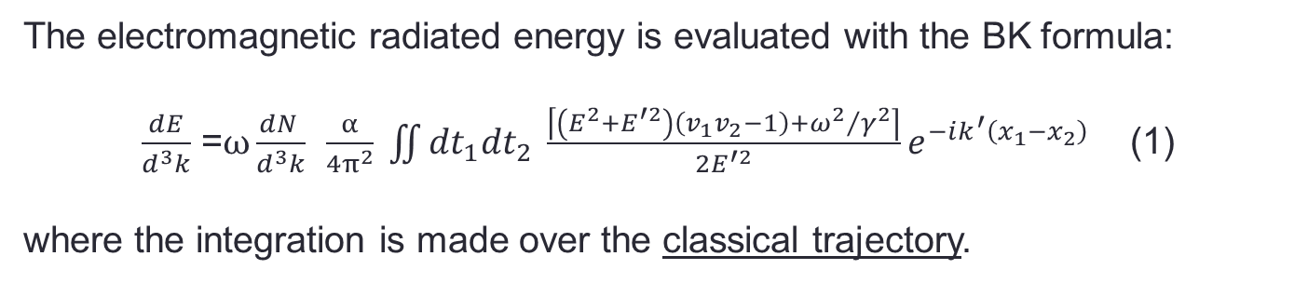
Baier-Katkov quasiclassical operator method (1967-1968)
General method for calculation of radiation generated by e± in an external field
The electromagnetic radiated energy is evaluated with the BK formula:
$\frac{dE}{d^{3}k}$ =$ω\frac{dN }{d^{3}k}$ $\frac{α}{4π^{2}} \iint{{dt}_{1}{dt}_{2} \frac{\left\lceil \left(E^{2}+E^{′2}\right)\left(v_{1}v_{2}−1\right)+{ω^{2}}/{γ^{2}}\right\rceil }{2E^{′2}}e^{−ik^{′}\left(x_{1}−x_{2}\right)}}$ (1)
where the integration is made over the classical trajectory.
Why classical trajectory?
2 types of quantum effects :
the quantization of particle motion ~ℏω₀/E
In crystals: negligible for electron/positron energy >10-100 MeV
the quantum recoil of the particle when it radiates a photon with energy ℏω~E NOT negligible for electron/positron energy >50 GeV
Notes:
This method has the advantage to be applicable in the whole photon energy range, except for the extreme limit where ℏω ∼ ε.
Aggiungi parte sulla formula.

Slide 29
Simulation results for PWO
axial
Simulation for bremsstrahlung + pair production in agreement with experimental results for:
Random orientation
Axial orientation
planar
random
Simulation for pure bremsstrahlung .
In axial case, X₀ is decreased from 8.9 to 1.6 mm
Axial effect
X₀= 8.9 mm
X₀= 1.6 mm
L. Bandiera et al, ArXiv: 1803.10005, under minor revision on Phys. Rev. Lett.

Slide 30
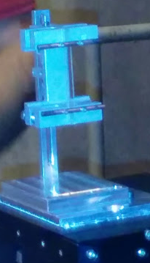
Experiment @120 GeV electrons
.
A 2x55x4 mm³ strip-like PWO crystal with the largest faces oriented parallel to the (100) planes was selected for the experiment. 4 mm length along the beam direction corresponds to about 0.45 X₀.
Notes:
Crystal quality unkhown.

Slide 31
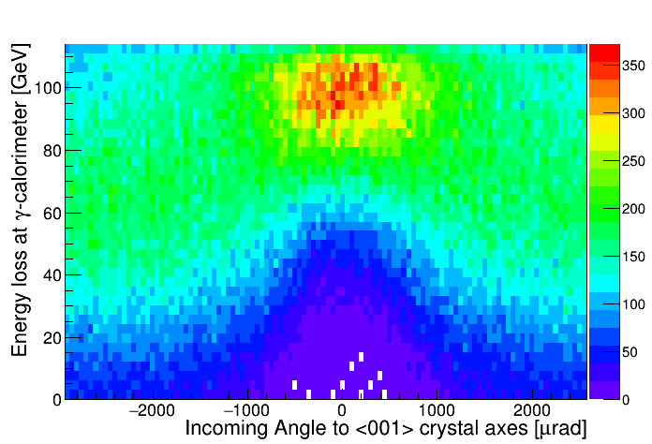
Angular acceptance of radiation enhancement
The axial influence is strong in ±1 mrad angular range and it is maintained up to almost ±2 mrad (±0.1 deg). Due to Coherent PP, one expects a contribution up to 0.5°-1°.

