Slide 1
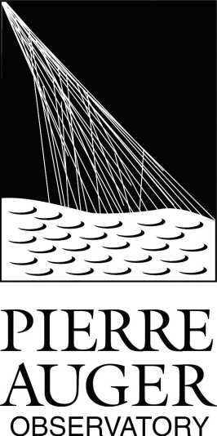
Using reference stars to verify the end-to-end absolute calibration and for the long term monitoring of the Fluorescence Detector telescopes at the Pierre Auger Observatory
Segreto
for the Pierre Auger Collaboration
CRIS 2018, 18-22 Jun. 2018, Portopalo, Italy

Slide 2
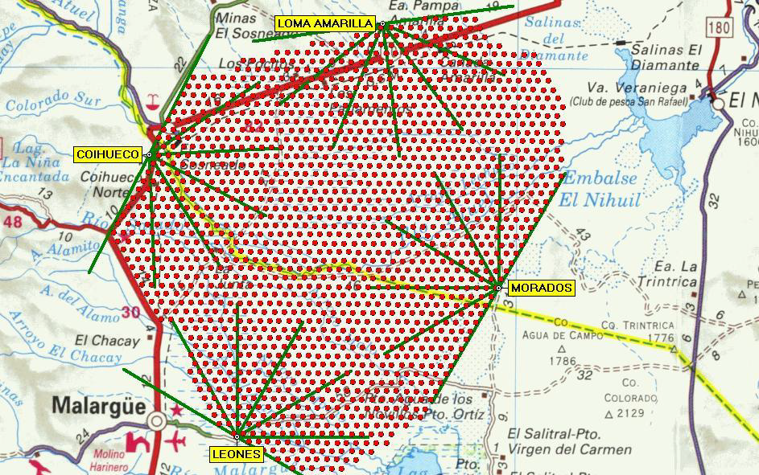
The Pierre Auger Observatory
~65 km
The Pierre Auger Observatory, covering an area of ~3000 km², is the largest cosmic-ray observatory in the world
Its main goal is to study Ultra-High Energy Cosmic Rays
It is located in Malargue, Argentina at 1400 m above sea level

Slide 3
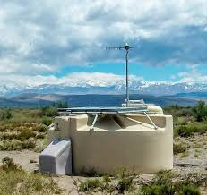
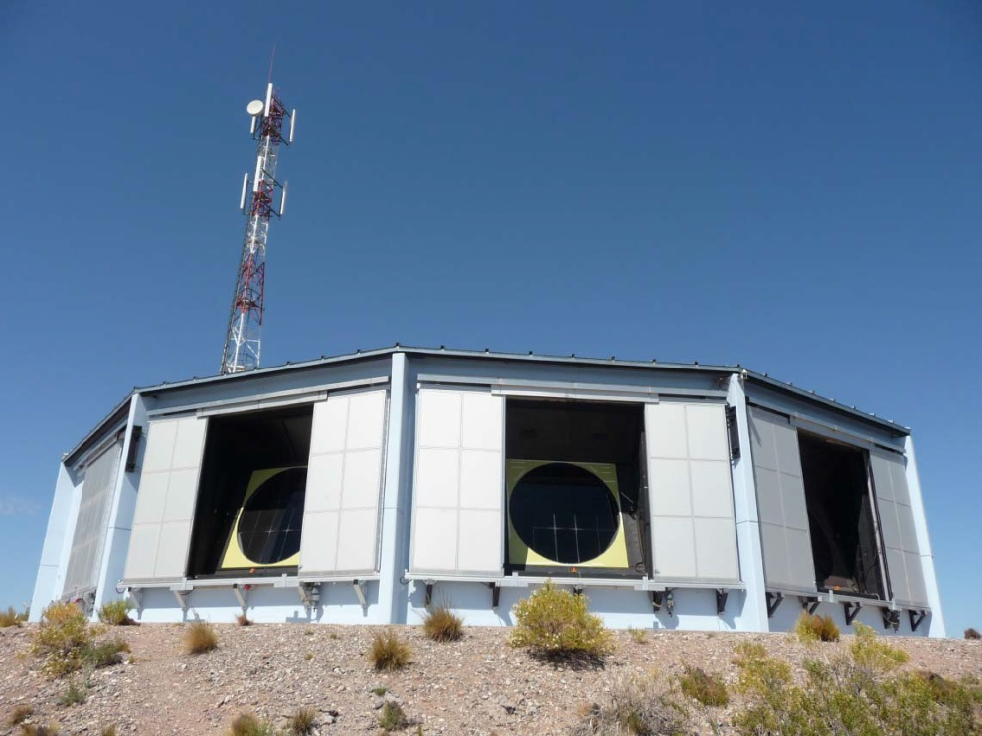
Main Detector types
Surface Detectors (SD)
1660 water Cherenkov stations
operated night and day, independently on weather conditions
100 % duty cycle
Fluorescence Detectors (FD)
27 telescopes @ 4 sites
operated only during moonless and clear nights
≈ 15 % duty cycle
Hybrid detector: two complementary measurement techniques
FD has lower duty cycle, but its energy scale (with lower systematic uncertainties) is used to calibrate the data from the SD array

Slide 4
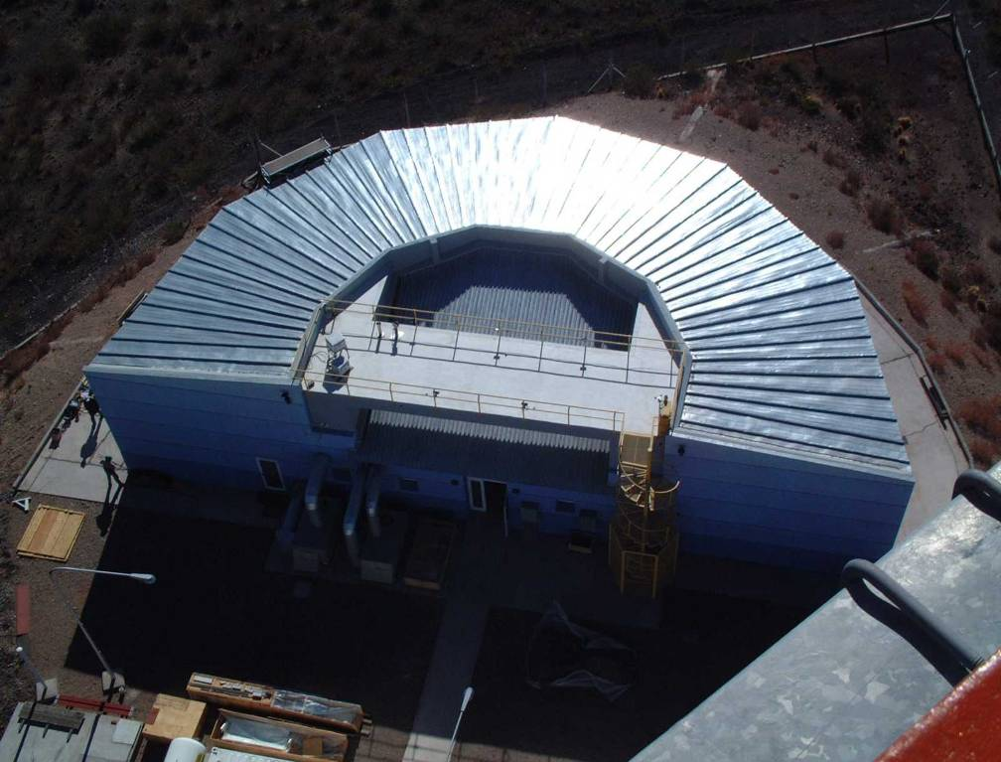
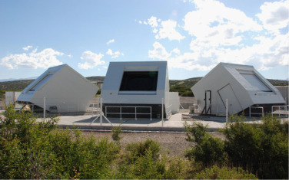
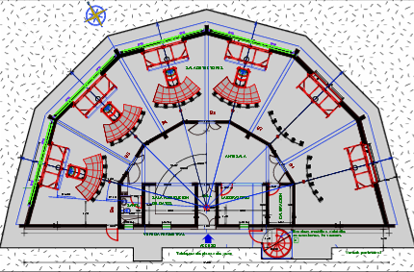
The Fluorescence Detector
27 FD telescopes with a 30° x 30° field of view
24 FD telescopes are grouped in 4 buildings (in widely separated locations) and point the sky at an elevation angle centered at ≈ 15°
3 additional telescopes (HEAT) point to the sky at an elevation angle centered at ≈ 45°
HEAT (High Elevation Auger Telescopes)

Slide 5
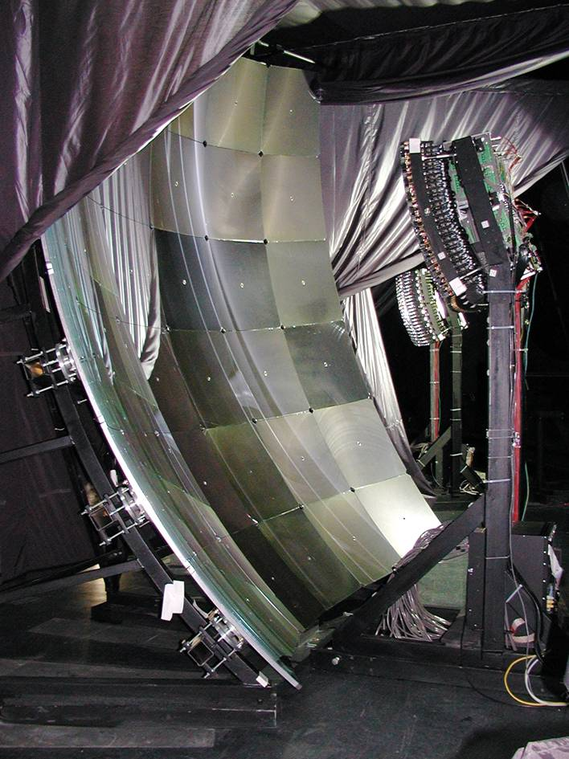
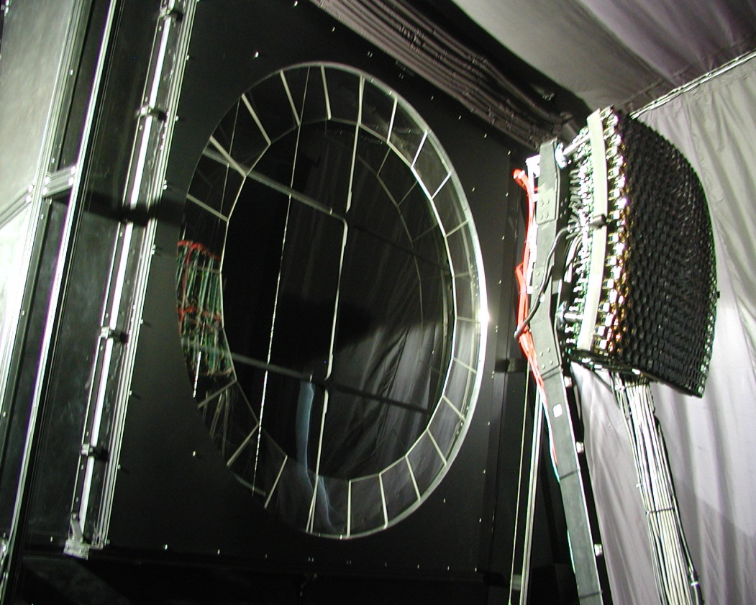
The Fluorescence Detector optical system
Aperture stop and optical filter
Camera with 440 PMTs(1.5° per pixel)
3.4 meter diameter
segmented mirror
To obtain the overall telescope response there are two alternative methods:
calibration (in lab.) of its individual components (i.e. mirror reflectivity, efficiency of camera PMTs, filter transmission) and then taking into account the optical system geometry by performing a Monte Carlo simulation
“end to end” calibration: illuminate the detector with a reference light source and record its response. Advantage: no need to know the contribute of individual elements, and lower systematic uncertainty

Slide 6
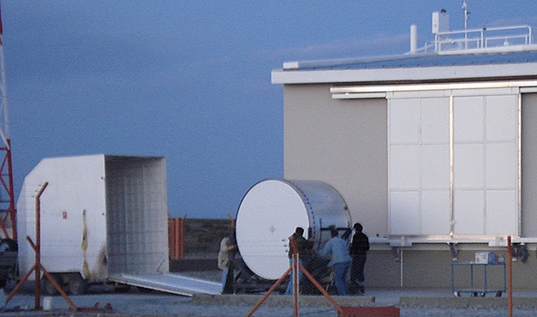
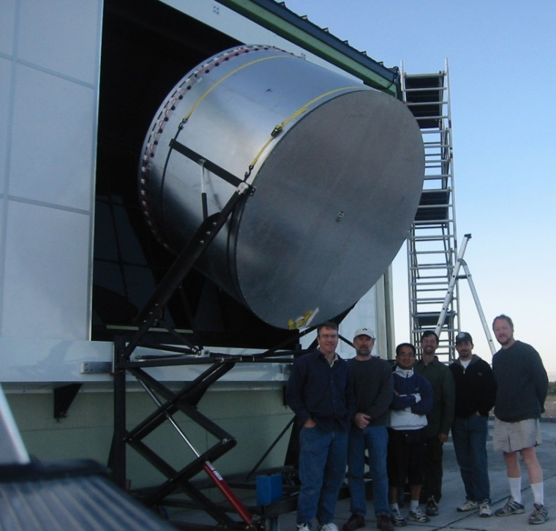
The Drum
The FD end-to-end calibration technique involves a portable light source that mounted at the aperture of each telescope to uniformly illuminate its camera
The “portable” light source, referred to as the Drum because of its appearance, is a cylinder 1.4 m deep with a 2.5 m diameter
The ratio between the known flux from the light source and the response of the camera PMTs gives the required “end to end” calibration factor
However, due to its complexity, only a few campaigns have been performed to calibrate the whole array of FD telescopes

Slide 7
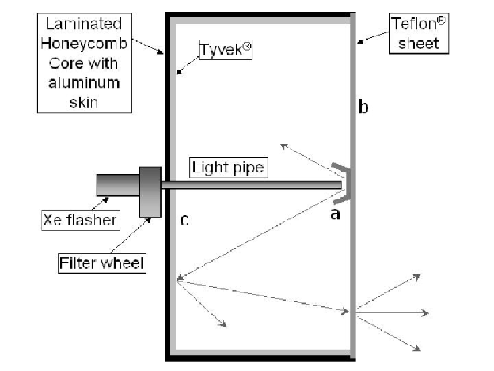
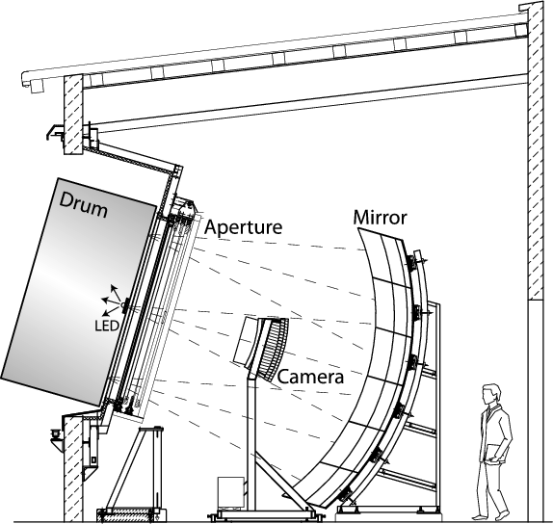
… but the Drum needs to be calibrated
The Drum is a complex device and needs itself to be accurately calibrated every time it is used.
A ray-tracing program is used to calculate corrections for small non-uniformities that are measured in lab. Another small correction for internal reflections has also to be taken into account.
The Drum operation is rather complex and can't be done too often. A relative calibration system is used to track the calibrations between Drum campaigns.
It is desirable to have a totally independent method to verify and monitor frequently the FD absolute calibration

Slide 8
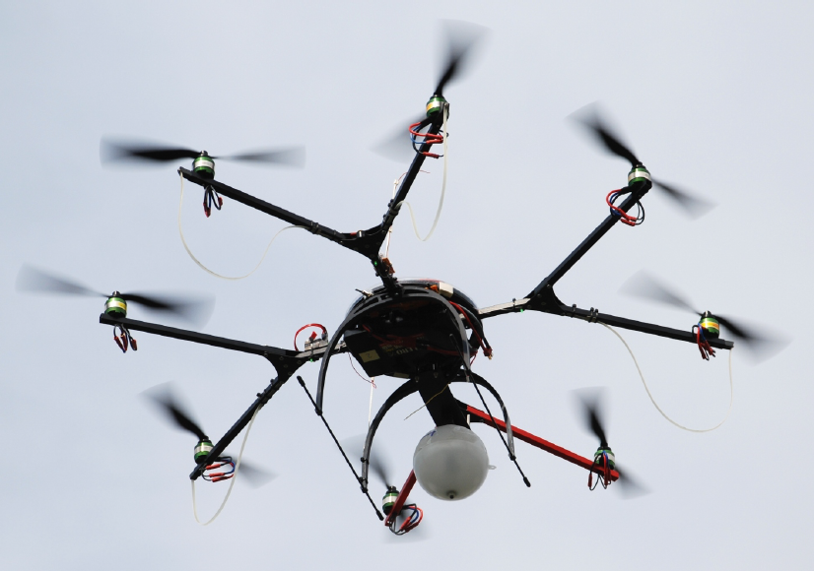
Calibration with flying light sources
Several calibration campaigns using calibrated source on a flying platform, the octocopter, have been performed to study, in particular the point spread function of the FD telescopes
Main limitation of the method is the reduced flying time that allows to calibrate only a few pixels/night

Slide 9
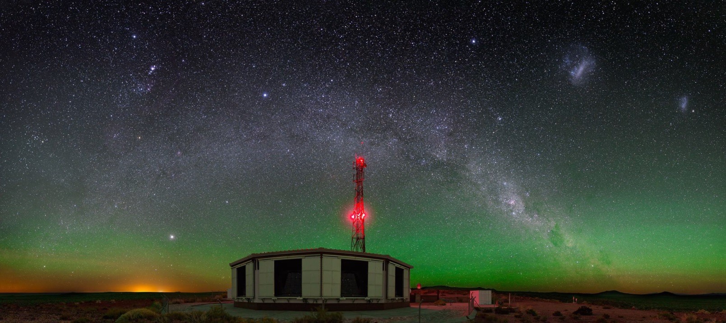
What about using reference stars?
The calibration of astronomical optical telescopes is frequently verified by observing stable reference stars
Why not use a similar method to verify the absolute calibration of the FD telescopes?
… not that easy because FD electronics is optimized to detect the very fast (few μsec) signals produced by cosmic rays initiated showers but it is (almost) blind to the (slowly varying) night sky background flux!

Slide 10
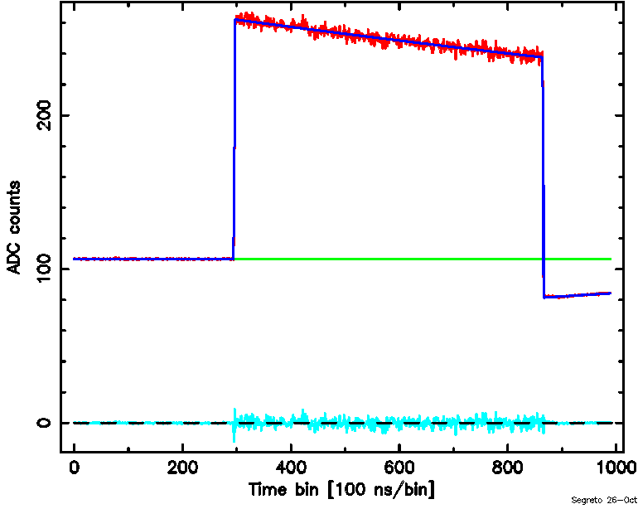
FD response to calibration pulses
UV LED ON
dark
50 μsec
dark
electronic noise
electronic + “photon” noise
electronic noise
a square pulse illumination (from the internal calibration system) generates in the FD electronics a signal whose amplitude, notwithstanding the constant photon flux, decreases rapidly in time
due to its quantum nature, the light pulse induces also an increment of the signal noise proportional to the number of detected photons
In case of long lasting (> 1 msec) illumination, the amplitude of the electronic signal vanishes, but the fluctuations due to the “photon noise” remain stable!

Slide 11
Night sky reconstructed from “variance”
stars
Malargue city lights
clouds
Elevation: 30°
Azimuth: 180°
The statistical analysis of the noise in each PMT signal has been implemented in the FPGA logic on the FD electronic boards (no additional hardware resources used!)
For each FD telescope a “variance” (square of the standard deviation) image of its field of view is periodically recorded (usually every 30 sec, but can be reduced to 5)
The wide-field NSB image shows the excellent inter calibration status of the six telescopes in a same building
… how much accurate can be the absolute photon flux indirectly obtained from measurements of a detector noise?

Slide 12
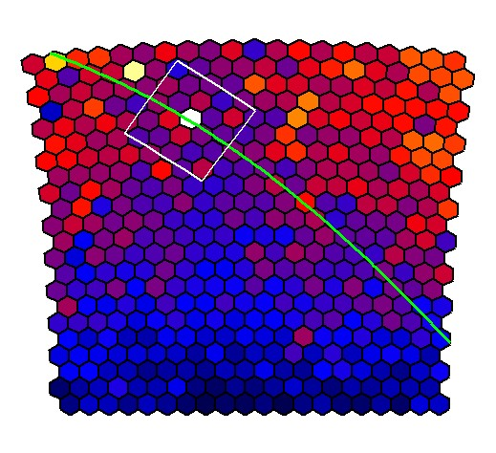
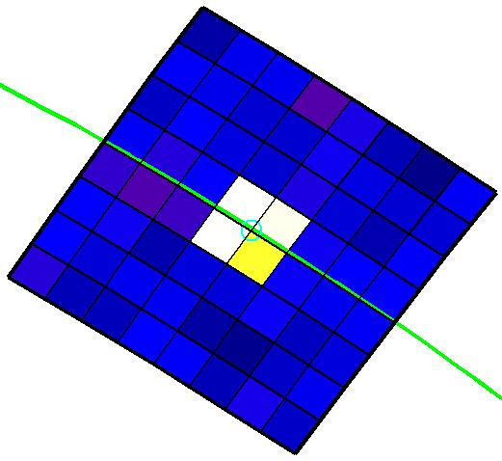
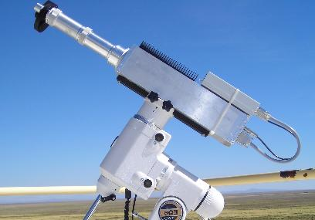
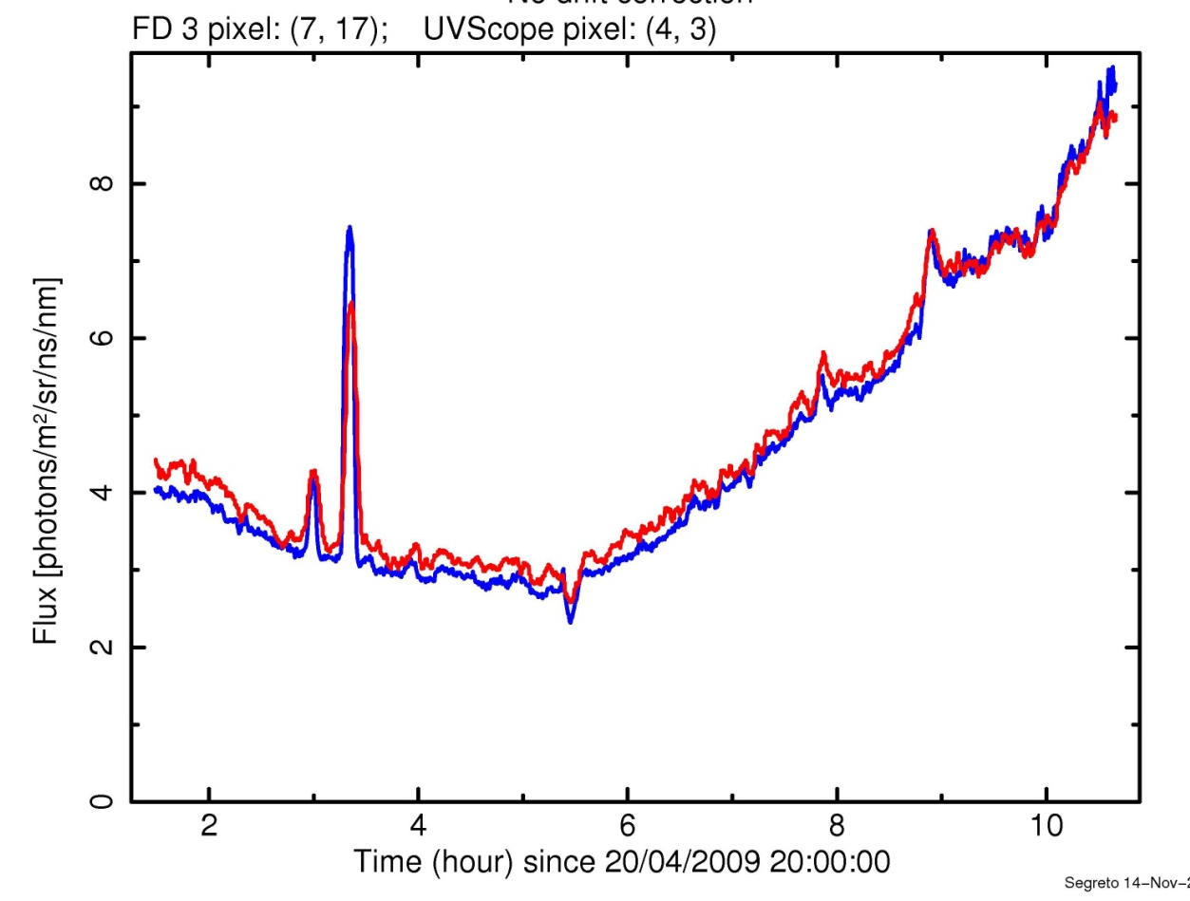
Fluorescence Detector vs. UVscope
UVscope field of view
Fluorescenze Telescope: ${σ^{2}}_{ADC}$
Arcturus
Elevation
UVscope
Azimuth
On April 2009 the 1st measurement campaign was performed to compare the NSB fluxes measured by a “single-photon” counting instrument (UVscope) to the values obtained, in the same direction, by the “statistical method” (FD variance)

Slide 13
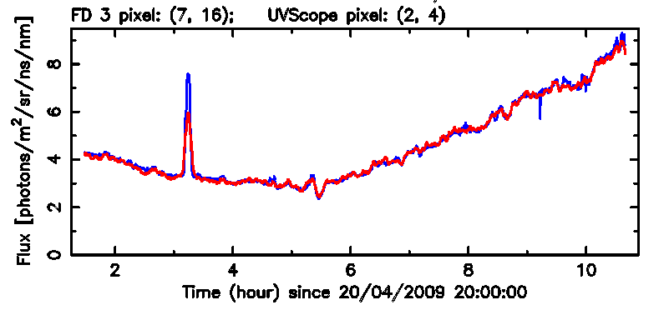
single photon counting” vs. “variance
FD pixel (7, 16) UVscope pixel (2, 4)
Arcturus
UVscope (single photon counting)
FD (variance)
Flux [photons/m²/sr/ns/nm]
Time (hour) since 20/04/2009 20:00:00
… excellent (quite surprising) result: “Variance” (i.e. noise) is as good as “photon counting” to measure the night sky background flux!
Minor differences are due to different geometrical pixels shape (square vs. hexagonal)
… now we need to compare the star fluxes obtained from the FD “variance” to the values that are expected from a well known reference star

Slide 14
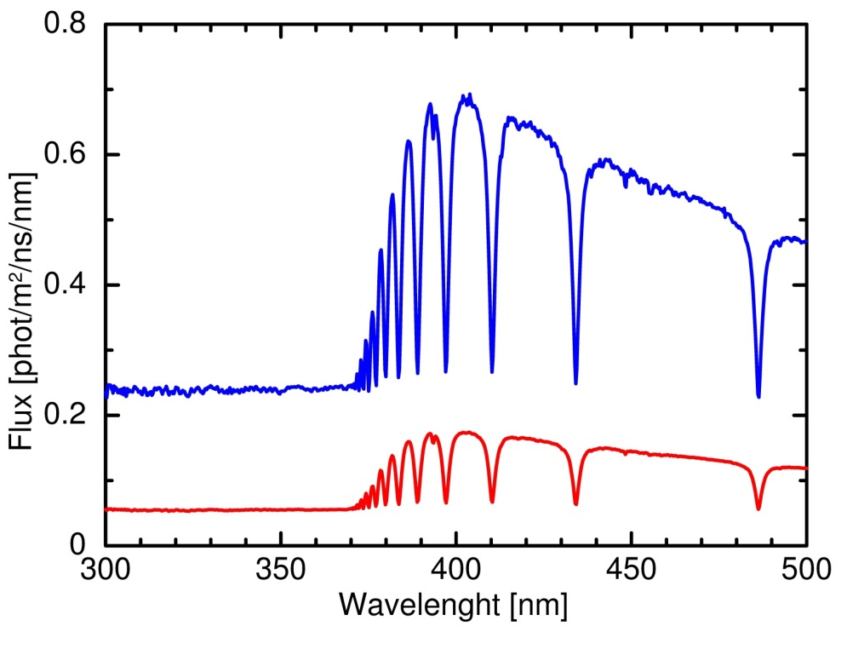
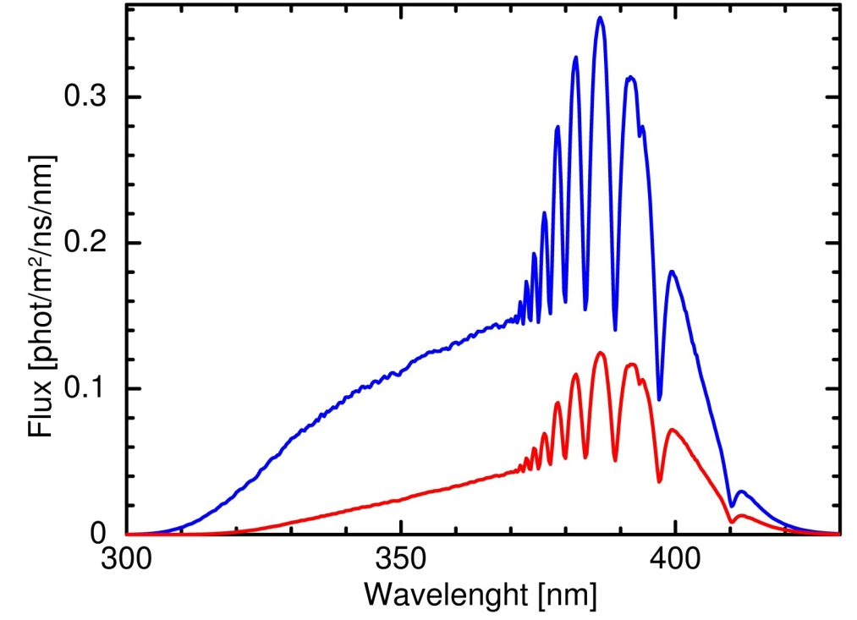
How to analyse signals from stars?
outside Earth atmosphere
ground observed spectra
$$Δλ=2.5 nm$$
Sirius
photons/(m²∙ns∙nm)
photons/(m²∙ns∙nm)
Sirius
at 60° alt.
Vega
at 15° alt.
spectral distribution of detected photons
(including typical atmosphere attenuation
and FD spectral response)
intrinsic star spectral distribution
To use a star as a “reference source”, its absolute calibrated spectrum “on top of the Earth atmosphere” must be retrieved from astronomical data bases
The primary reference star for absolute astronomical photometry is Vega, however, in the Southern Hemisphere, Sirius is preferred as it can be observed at higher elevation angles
The ground observed spectra are altered by the detector spectral response and atmospheric attenuation (dependent on star elevation)

Slide 15
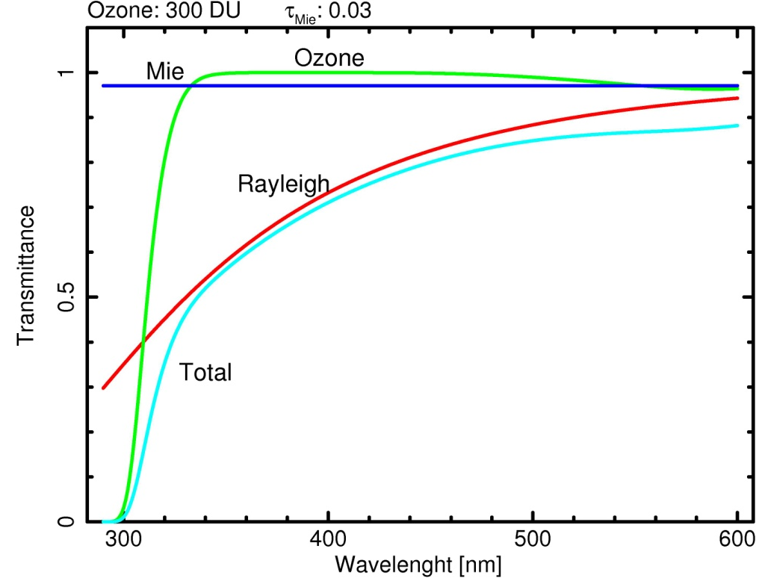
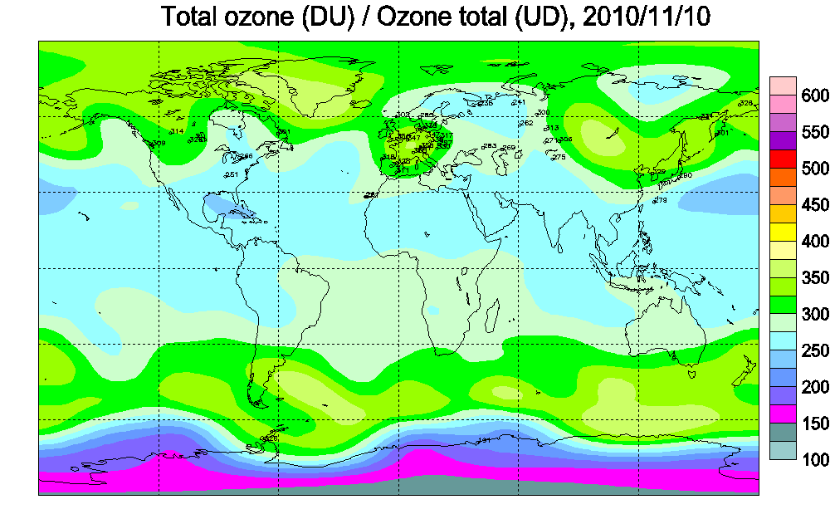
Atmospheric attenuation
overhead ozone maps
Total atmosphere transmission
Groud measured star fluxes must always be corrected for the attenuation of light during its propagation in the atmosphere:
Ozone absorption: < 320 nm; daily ozone thickness maps are on the web
Molecular (Rayleigh) scattering: can be matematically computed from the local barometric pressure
Aerosol scattering: highly variable from night to night, depends on local, unpredictable, aerosol density and composition therefore must be accurately measured!

Slide 16
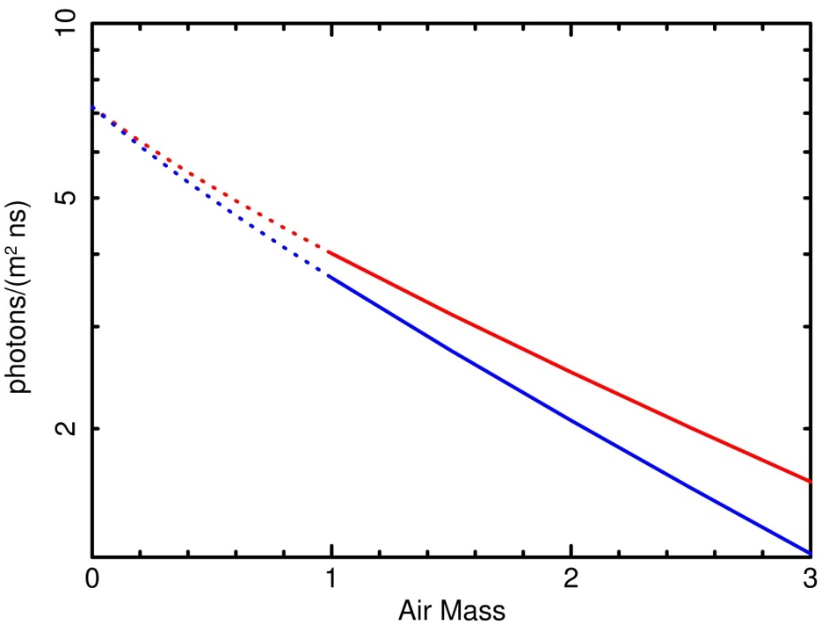
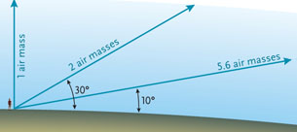
The Langley plot method
top of the atmosphere
zenith
extrapolation ground measurements
log (flux)
no aerosol
Earth
aerosol
The “air mass” is the path length through the Earth's atmosphere relative to the path length at zenith
airmass
A standard method used in astronomy to correct ground based measured star fluxes for the atmospheric attenuation, is to plot the logarithm of the star signal as a function of the amount of “air mass” traversed by the light
A fit to the measured data provides both the total atmosphere attenuation (the slope), and (its extrapolation to zero air mass) the star flux as it would be measured if the instrument were placed on top of the atmosphere

Slide 17
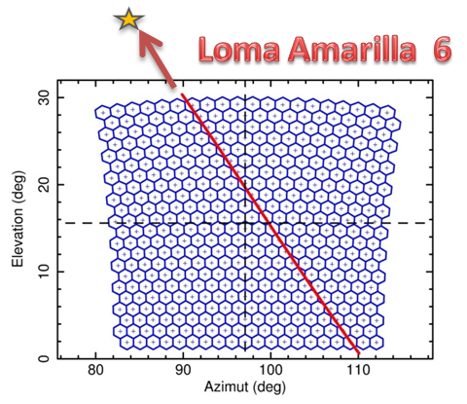
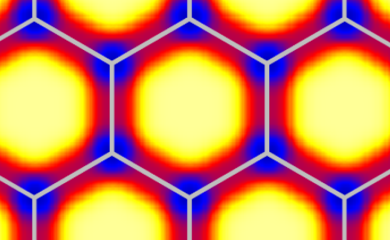
Star tracks in the FD telescopes
Sirius
The detection efficiency map reproducing the reduced photon collection efficiency observed when a star crosses the pixel boundaries
air mass = 2
air mass = 10
Stars crossing the FD field of view are observed for an air-mass interval large enough to apply the Langley plot method
The non uniform spatial response of the PMTs, introduces an additional modulation along the star track that has been included in data analysis

Slide 18
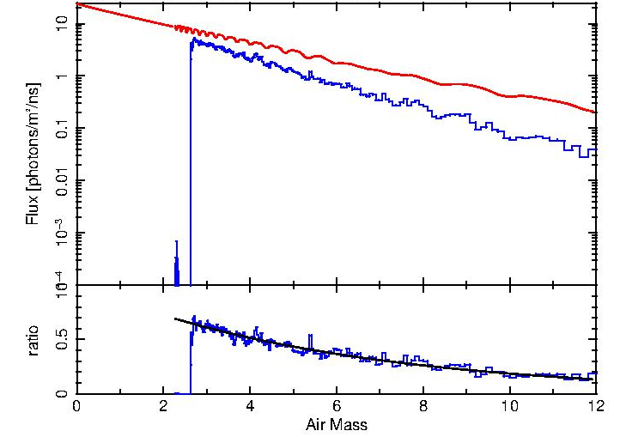
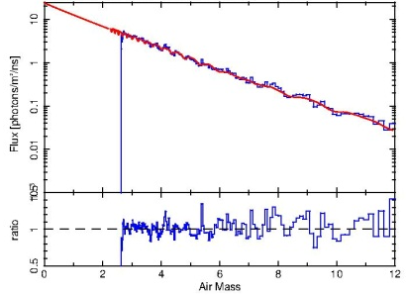
Check of absolute calibration with Sirius
model without aerosol
model after fit
Sirius
photons/(m²∙ns)
FD variance data
Fit parameters:
N = 1.01 +/- 0.02
τ_{aer} = 0.169 +/- 0.006
ratio=data/model$\sim N∙e^{{−τ}_{aer}∙X}$
ratio
$$air mass$$
$$air mass$$
The aereosol optical depth and a corrective normalization factor are obtained by fitting the simulated star flux to the values obtained from the FD variance data
A normalization factor consistent, within statistical uncertainty, with a unitary value, is an independent verification of the absolute calibration of the FD telescope obtained from the Drum measurements

Slide 19
Summary
The Fluorescence Detectors of the Pierre Auger Observatory are the first telescopes of this kind that, thanks to measurements of detector noise (variance), are able to monitor continuously the night sky background flux
Results obtained by analyzing the signals induced by reference stars traversing the FD field of view provide an independent proof of the telescopes absolute calibration
The features of this method makes it a perfect tool for the long term monitoring of the FD absolute calibration
CRIS 2018, 18-22 Jun. 2018, Portopalo, Italy

