Slide 1
Overview of the Geant4-DNA extension of the Geant4 Monte Carlo simulation toolkit
http://geant4-dna.org
Sébastien INCERTI
CNRS / IN2P3 / CENBG / Bordeaux U.- France
representing the efforts of the Geant4-DNA Collaboration
15th Seminar on Software for Nuclear, Sub-nuclear and Applied Physics Porto Conte, Alghero (Italy), 27 May - 1 June, 2018

Slide 2
Contents
Context of the Geant4-DNA project
Simulation of interactions of radiation with biological targets (e.g. DNA)
Physical stage
Physico-chemical & chemical stages
Geometrical models of biological targets
Early damage prediction
Where to find more information ?
See Geant4-DNA publication … (link)

Slide 3
1) CONTEXT

Slide 4
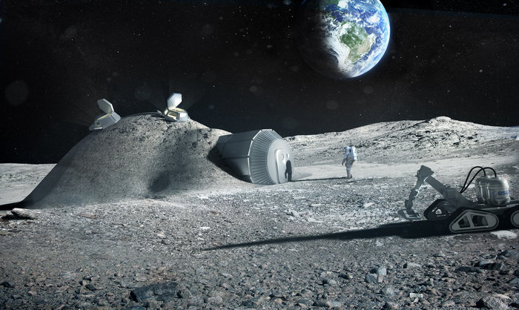
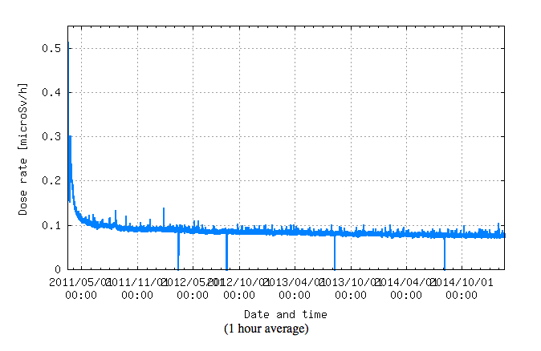
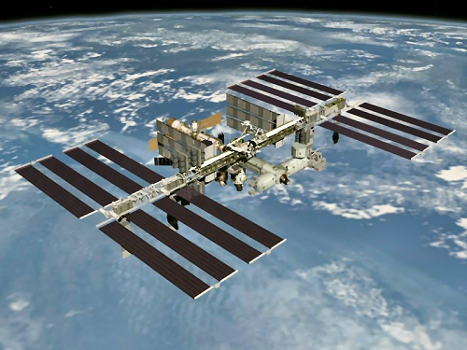
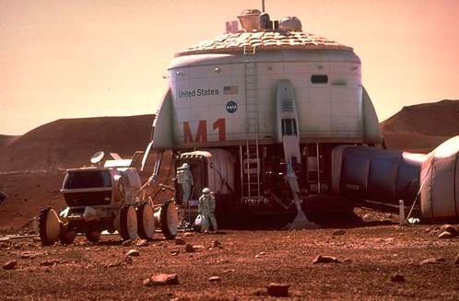
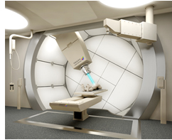
Modelling biological effects of ionising radiation remains a major scientific challenge
Chronic exposure
Fukushima
Diagnosis
Moon
village
Space missions
http://rcwww.kek.jp/norm/index-e.html
ISS
Space exploration
Proton & hadrontherapy
« A major challenge lies in providing a sound mechanistic understanding of low-dose radiation carcinogenesis »
L. Mullenders et al.
Assessing cancer risks of low-dose radiation
Nature Reviews Cancer (2009)
Mars
NCC

Slide 5
The Monte Carlo approach
Can « reproduce » with accuracy the stochastic nature of particle-matter interactions
Many Monte Carlo codes are already available today in radiobiology for the simulation of TRACK STRUCTURES at the molecular scale in biological medium
E.g. PARTRAC, KURBUC, MC4*, RETRACKS/RITRACKS, TRAX, …
Include physics & physico-chemistry processes, detailed geometrical descriptions of biological targets down to the DNA size, DNA and chromosome damage simulation and even repair mechanisms…
Usually designed for very specific applications
Not always easily accessible
Is it possible to access the source code or even the executable code ?
Are they adapted to recent OSs ?
Are they extendable by the user ?
« To expand accessibility and avoid ‘reinventing the wheel’, track structure codes should be made available to all users via the internet from a central data bank» H. Nikjoo, IJRB 73, 355 (1998)

Slide 6
Geant4 for radiobiology ?
Can we try to extend Geant4 to model biological effects of radiation ?
LIMITATIONS prevent its usage for the modelling of biological effects of ionising radiation at the sub-cellular & DNA scale
Condensed-history approach
No step-by-step transport on small distances, a key requirement for micro/nano-dosimetry
Low-energy limit applicability of EM physics models is limited
« Livermore » Low Energy EM models can technically go down to 10 eV but accuracy limited < 250 eV
100 eV for « Penelope 2008 » Low Energy EM models, accurate down to 1 keV
No description of target molecular properties
Liquid water, DNA nucleotides, other ?
Only physical particle-matter interactions
At the cellular level, physical interactions are NOT the dominant processes for DNA damage at low LET...
Volume ∅ < track length
Biomed. Phys. Eng. Express 4 (2018) 024001 (link)

Slide 7
Geant4-DNA timeline
Main objective
Extend the general purpose Geant4 Monte Carlo toolkit for the simulation of interactions of radiation with biological systems at the cellular and DNA level in order to predict early and late DNA damage in the context of manned space exploration missions (« bottom-up » approach).
C++ extension designed to be developed and delivered in a FREE software spirit under the Geant4 license, easy to upgrade and improve.
2001
Initiated at the European Space Agency/ESTEC by Petteri Nieminen
2007
First prototypes of physics models for liquid water added to Geant4 9.1
2008
Development coordinated by CNRS/IN2P3
(physics, chemistry, geometries)
2014
Chemistry stage extension ready for end users in Geant4 10.1
2015-17 New alternative models for electron tracking & geometries
10.2 – 10.4
W. Friedland
D. Emfietzoglou M. Dingfelder

Slide 8
How Can Geant4-DNA model early DNA damage ?
Physical stage
step-by-step modelling of physical interactions of incoming & secondary ionising radiation with biological medium (liquid water mainly)
Excited water molecules
Ionised water molecules
Solvated electrons
Physico-chemical/chemical stages
Radical species production
Diffusion
Mutual chemical interactions
Geometrical models
DNA strands, chromatin fibres, chromosomes, whole cell nucleus, cells…
DIRECT DNA damage
INDIRECT DNA damage
REPAIR
t=0
t=10⁻¹⁵ s
t=10⁻⁶ s

Slide 9
PHYSICAL STAGE

Slide 10
Overview of discrete physics models for liquid water
Geant4 10.4
December 2017
Fully included in Geant4
Electrons
Elastic scattering
Screened Rutherford and Brenner-Zaider below 200 eV
Updated alternative version by Uehara
Independent Atom Method (IAM) by Mott et al. & VLE data in ice from CPA100 TS code
Partial wave framework model by Champion et al., 3 contributions to the interaction potential
Ionisation
5 levels for H₂O
Dielectric formalism & FBA using Heller optical data up to 1 MeV, and low energy corrections, by Emfietzoglou et al.
Improved alternative version by Emfietzoglou and Kyriakou
Relativistic Binary Encounter Bethe (RBEB) by Terrissol from CPA100 TS code
Electronic excitation (*)
5 levels for H₂O
Dielectric formalism & FBA using Heller optical data and semi-empirical low energy corrections, , derived from the work of Emfietzoglou et al.
Improved alternative version by Emfietzoglou and Kyriakou
Dielectric formalism by Dingfelder from CPA100 TS code
Vibrational excitation (*)
Michaud et al. xs measurements in amorphous ice
Factor 2 to account for phase effect
Dissociative attachment (*)
Melton xs measurements
Protons & H
Excitation (*)
Miller & Green speed scaling of e⁻ excitation at low energies and Born and Bethe theories above 500 keV, from Dingfelder et al.
Ionisation
Rudd semi-empirical approach by Dingfelder et al. and Born and Bethe theories & dielectric formalism above 500 keV (relativistic + Fermi density)
Charge change (*)
Analytical parametrizations by Dingfelder et al.
Nuclear scattering
Classical approach by Everhart et al.
He⁰, He⁺, He²⁺
Excitation (*) and ionisation
Speed and effective charge scaling from protons by Dingfelder et al.
Charge change (*)
Semi-empirical models from Dingfelder et al.
Nuclear scattering
Classical approach by Everhart et al.
Li, Be, B, C, N, O, Si, Fe
Ionisation
Speed scaling and global effective charge by Booth and Grant
Photons
from EM « standard » and « low energy »
Default: « Livermore » (EPDL97)
Med. Phys. 37 (2010) 4692 (link) Appl. Radiat. Isot. 69 (2011) 220 (link)
Med. Phys. 42 (2015) 3870 (link)
Phys. Med. 31 (2015) 861 (link)
Nucl. Instrum. and Meth. B 343 (2015) 132 (link)
Phys. Med. 32 (2016) 1833 (link)
PhD theses of H. N. Tran (2012), Q. T. Pham (2014), J. Bordes (2017)
(*) only available in Geant4-DNA

Slide 11
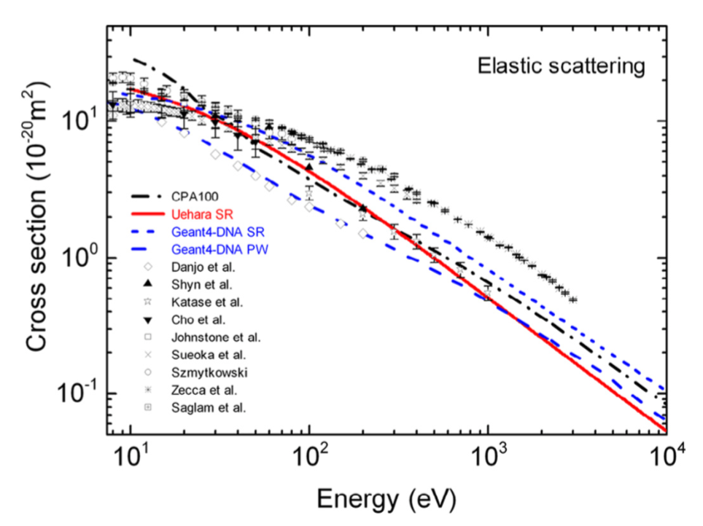
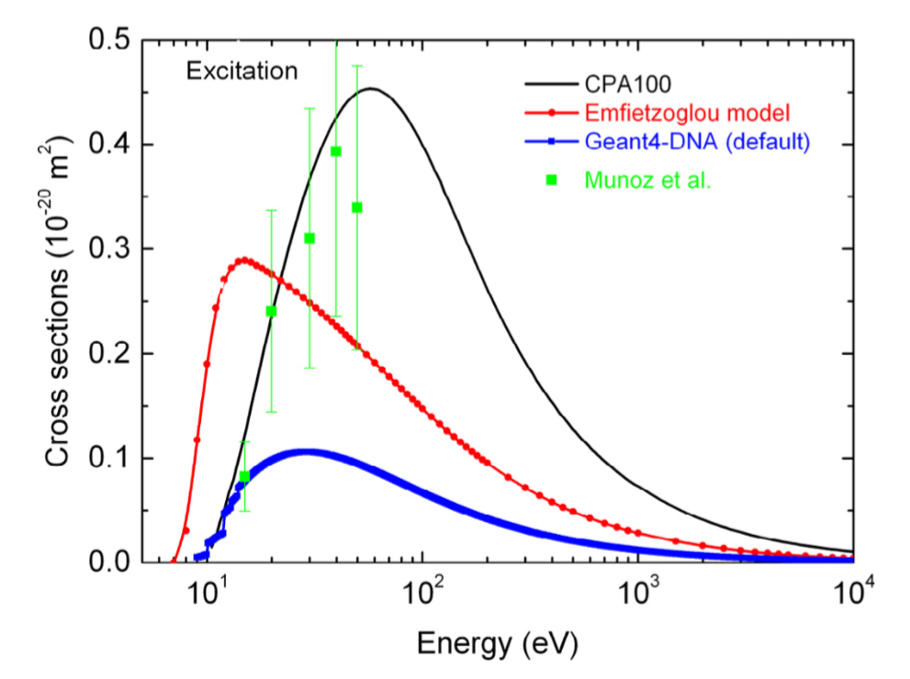
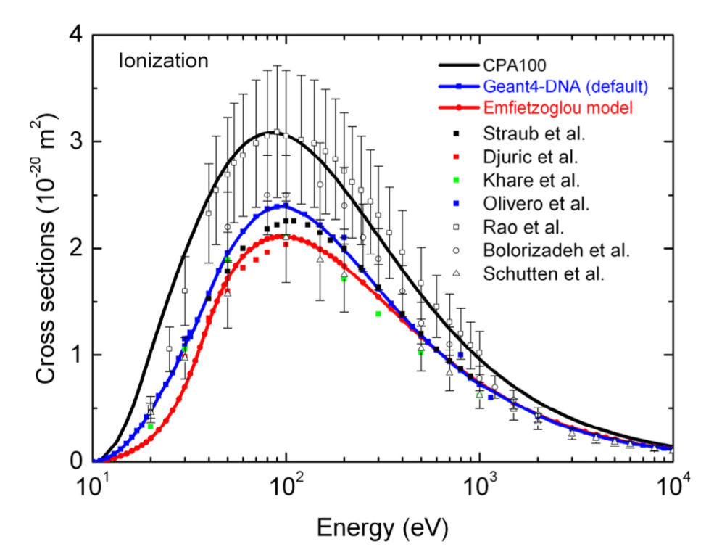
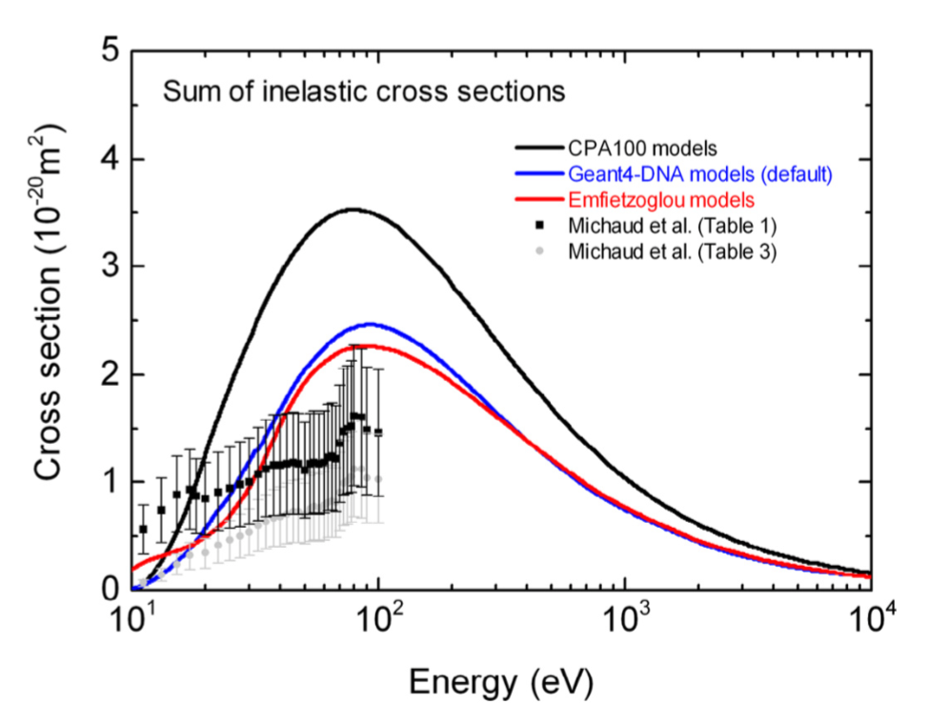
Cross section models for electrons in liquid water
Excitation
Elastic
Ionization
Sum of inelastic
Phys. Med. 31 (2015) 861 (link)

Slide 12
Geant4-DNA « physics constructors » for liquid water
3 recommended constructors
Geant4 constructor name | Electron model content
G4EmDNAPhysics (< 1 MeV) | Default models, first set historically available in Geant4-DNA (9.1) - Inelastic model from Emfietzoglou DRF parameterization (2003) with Coulomb-field & Mott like-exchange corrections, - Elastic model from PW calculations
G4EmDNAPhysics_option1 (beta) | Same as G4EmDNAPhysics but uses multiple scattering model G4LowEWentzelVIModel
G4EmDNAPhysics_option2 (< 1 MeV) | Same as default G4EmDNAPhysics but faster (usage of CDCS for ionisation processes)
G4EmDNAPhysics_option3 (<1 MeV) | Same as G4EmDNAPhysics (historical)
G4EmDNAPhysics_option4 (< 10 keV) | - Inelastic models by Ioannina team: improvement of the parameterization of the DRF and low energy exchange corrections - Elastic model from SR with vapor screening parameter
G4EmDNAPhysics_option5 (<10 keV) (beta) | Same but faster (usage of CDCS)
G4EmDNAPhysics_option6 (<255 keV) | CPA100 models: excitation from the DRF of Dingfelder (1999), ionisation from RBEB, elastic from partial wave calculations (IAM)
Electron thermalization (or killing) performed by the G4DNAElectronSolvation process (3 models)
Include ion nuclear scattering
No production cuts: all secondaries are simulated !
All are located in
$G4INSTALL/source/physics_lists/constructors/electromagnetic

Slide 13
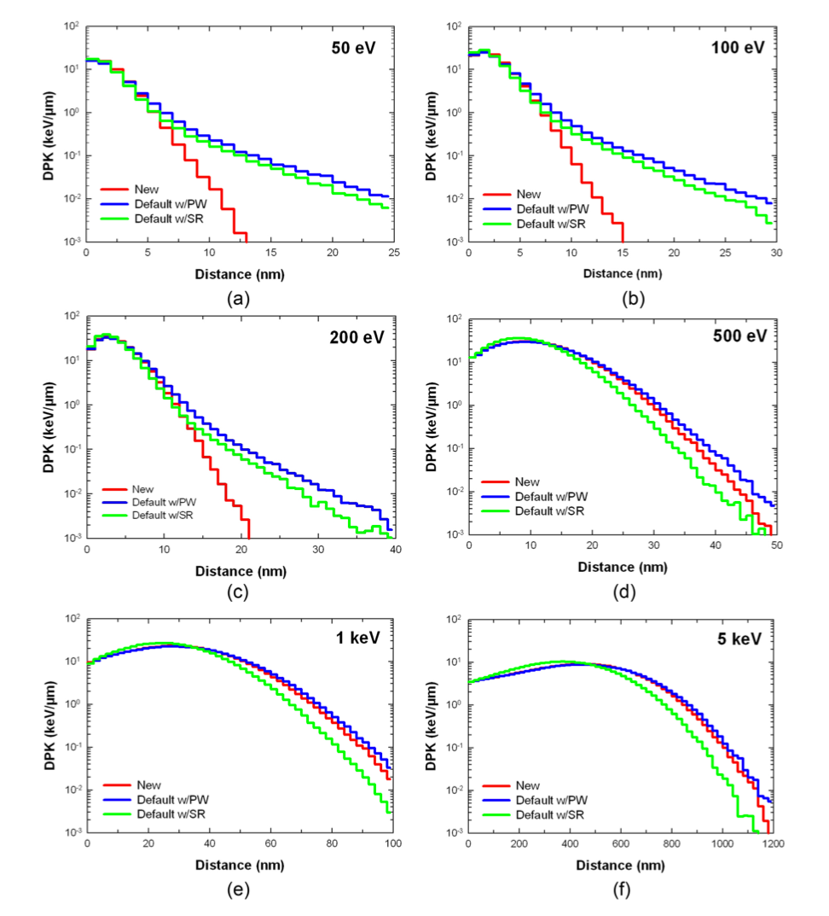
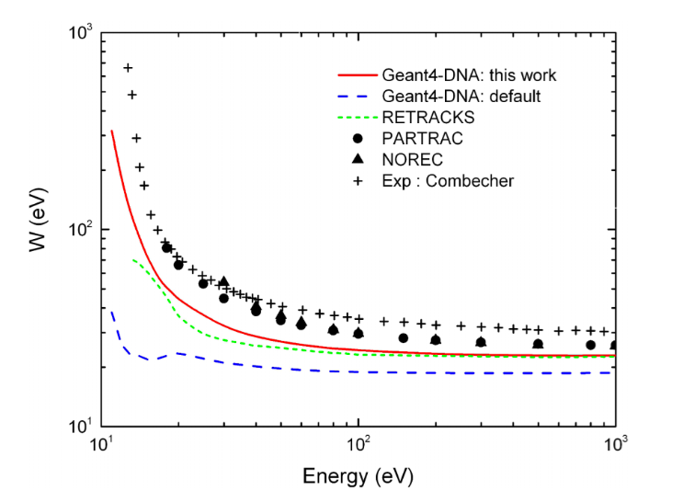
New « Ioannina U. » electron models
Example of verification & validation in liquid water
Dose Point Kernels
W-value (mean energy to create an ion pair)
e⁻
e⁻
e⁻
DPK (MeV/nm)
The new Ioannina inelastic models get closer to other reference data
Much less diffusive DPKs with the new inelastic model.
Med. Phys. 42 (2015) 3870 (link)
J. Appl. Phys. 32 (2016) 119, 194902 (link)

Slide 14
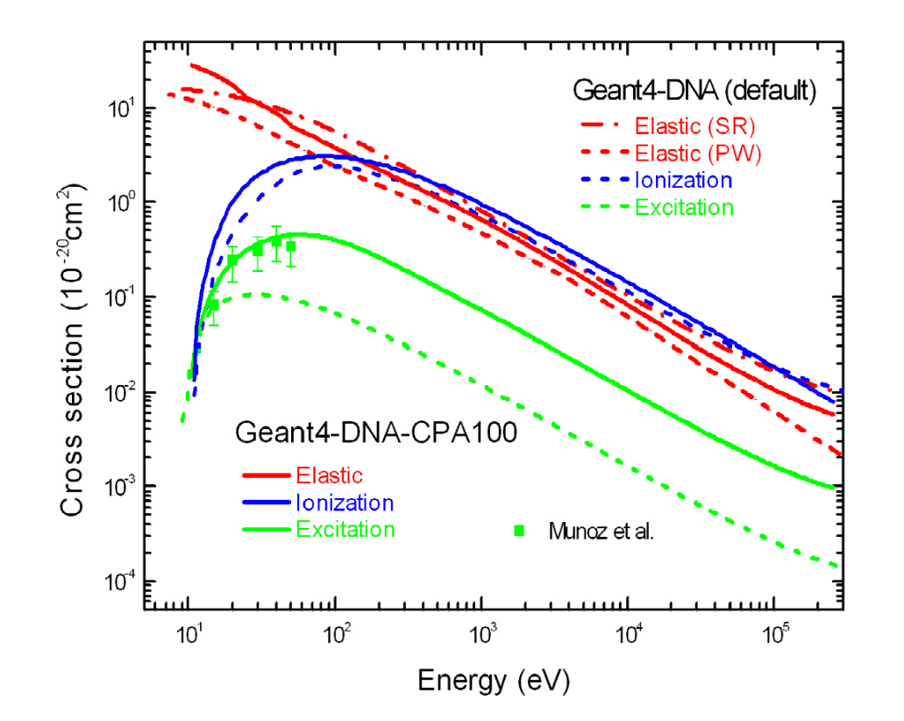
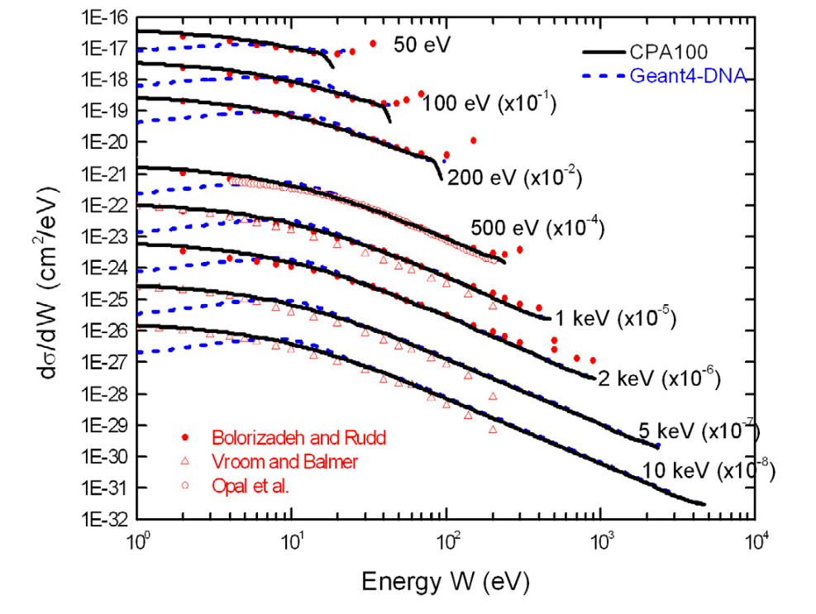
New « CPA100 » electron models
Phys. Med. 32 (2016) 1833 (link)
Software preservation
An alternative set of models for electrons (10 eV – 255 keV) from the CPA10 Track Structure code (M. Terrissol, M. C. Bordage, Toulouse U. , France)
Integral cross sections for electrons
Differential ionisation cross section
good agreement between data and CPA100 cross sections, especially at low ejected kinetic energies (where the differential cross section is the largest).
main differences between Geant4-DNA default model and the experimental data are observed at ejected electron energy W lower than 10 eV.
CPA100 excitation model is in better agreement with the only experimental data in the gaseous water

Slide 15
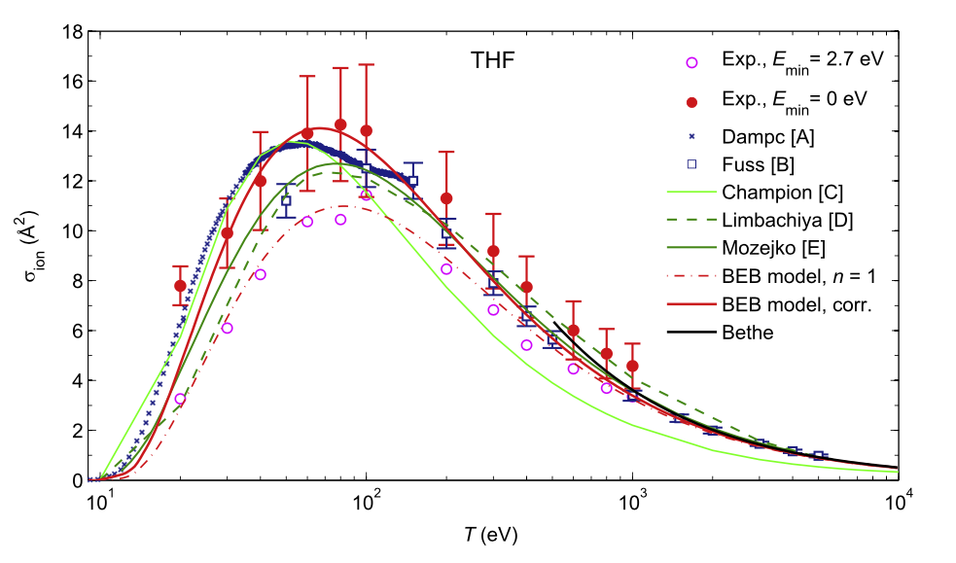
Other bio-materials
Part of the effort to extend Geant4-DNA models to other materials than liquid water
Cross sections for biological materials are proposed since Geant4 10.4, applicable to DNA constituents
tetrahydrofuran (THF), trimethylphosphate (TMP), pyrimidine (PY) and purine (PU)
serving as precursors for the deoxyribose and phosphate groups in the DNA backbone as well as for the pyrimidine nucleobases, respectively
For the following incident particles
electrons (12 eV-1keV, elastic + excitation + ionisation) : from measurements @ PTB, Germany
protons (70 keV-10 MeV, ionisation) from the HKS approach
Eg. integral electron
ionisation cross section in THF
More details in
Rad. Phys. Chem. 130 (2017) 459–479

Slide 16
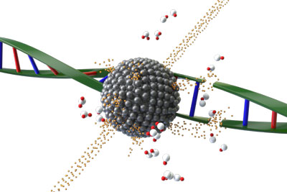
Investigation of radiotherapy sensitization using high-Z nanoparticles
Coming soon
Graphic: Sébastien Tribot
"Hot" topic: high-Z NP internalized in cells could boost energy deposition and increase the efficacy of radiotherapy
Well established for photon beams (photoelectric effect), more investigation needed for proton beams…
Still a challenge to perform mechanistic simulations
We initiated a specific Geant4-DNA activity on the subject in 2015
Simulation of physics + physico-chemistry + chemistry around GNP of diam. 50 nm (using Livermore for Gold)
Eg. Radiolysis Enhancement Factor as a function of distance from GNP compared to WNP
Underlined the necessity to extend Geant4-DNA models to high-Z metals
Nucl. Instrum. Meth. B 373 (2016) 126 (link)

Slide 17
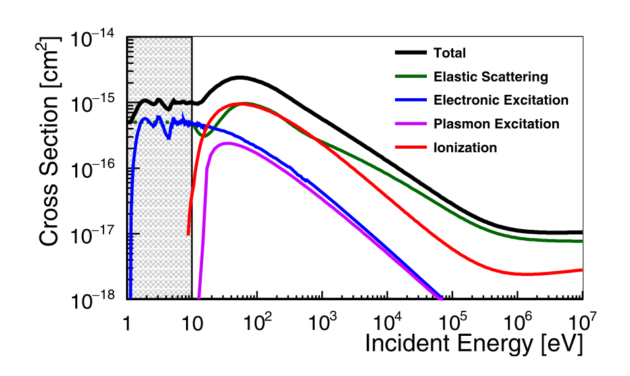
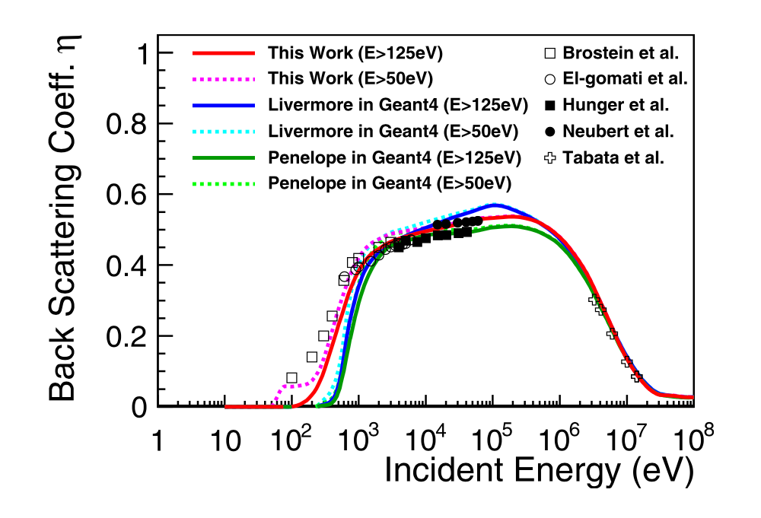
High-Z materials : gold
Coming soon
Extension of Geant4-DNA for the modelling of radiosensitization from gold nanoparticles
Activity initiated in 2016 by D. Sakata (Bordeaux U., France)
Discrete processes for electrons: elastic (ELSEPA), ionization (modified RBEBV), electronic (4 channels) and bulk plasmon (Quinn's) excitation
Models will be delivered in the near future (probably Dec. 2018)
J. Appl. Phys. 120 (2016) 244901 (link)
Integral cross sections for electrons
Eg. of validation: backscattering from gold plate

Slide 18
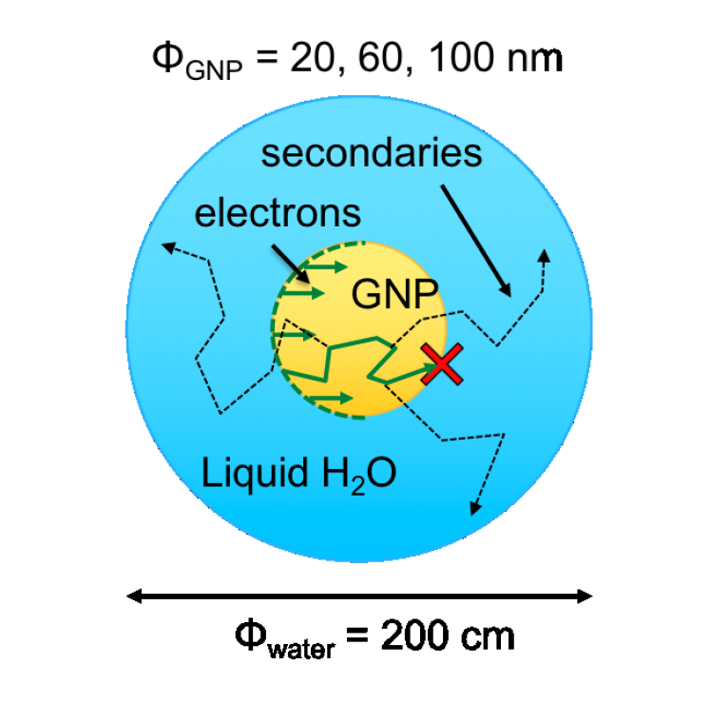
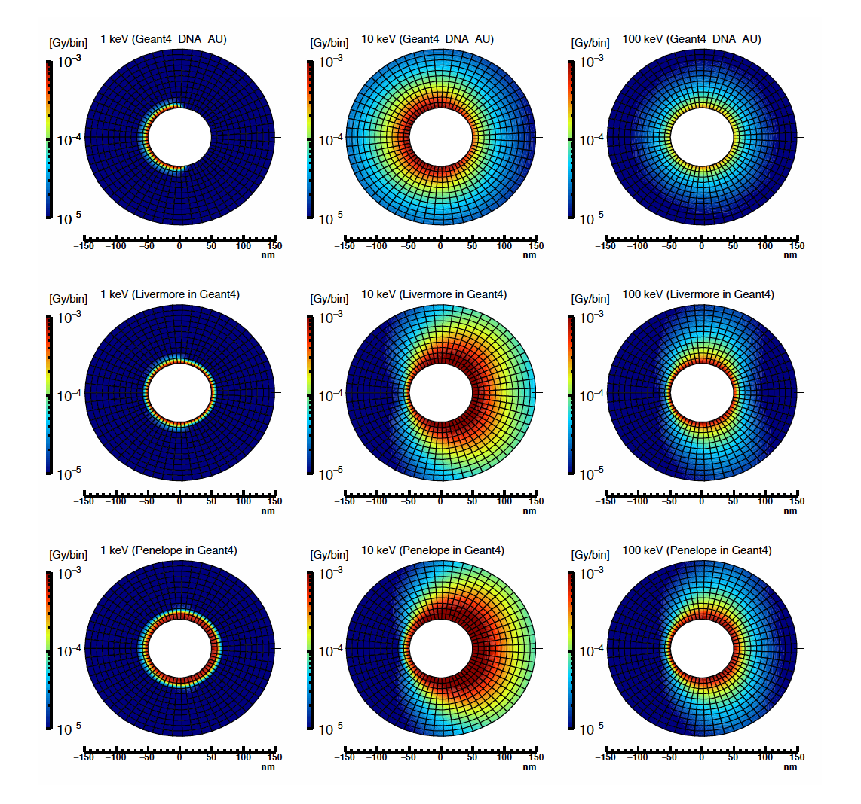
Geant4-DNA versus Geant4 CH models for gold
Coming soon
Geant4-DNA
Strong backsc.
Uniformbacksc.
Largest energy deposit
GNP irradiated with monoenergetic electrons
Two dimensional absorbed dose in a 1 nm thick sampling plane, around the GNP
3 incident energies: 1 keV, 10 keV and 100 keV
3 physics sets for Gold: Geant4-DNA, Livermore, and Penelope
Livermore
Penelope
Med. Phys. (2018) 2230-2242 (link)

Slide 19
Multiscale combination of EM processes
Thanks to a unified software design, users can easily combine Geant4-DNA processes and models with existing Geant4 physics such as:
Geant4 photon processes and models
Photoelectric effect, Compton sc., Rayleigh sc., pair production
Livermore (EPDL97) included by default in all Geant4-DNA constructors
Geant4 alternative electromagnetic processes and models for charged particles
Ionisation, bremsstrahlung, etc…
Electrons, positrons, ions, etc…
Geant4 atomic deexcitation (fluorescence + Auger emission, including cascades)
EADL97 by default, Bearden
activated by default in all Geant4-DNA constructors
…and also Geant4 hadronic physics

Slide 20
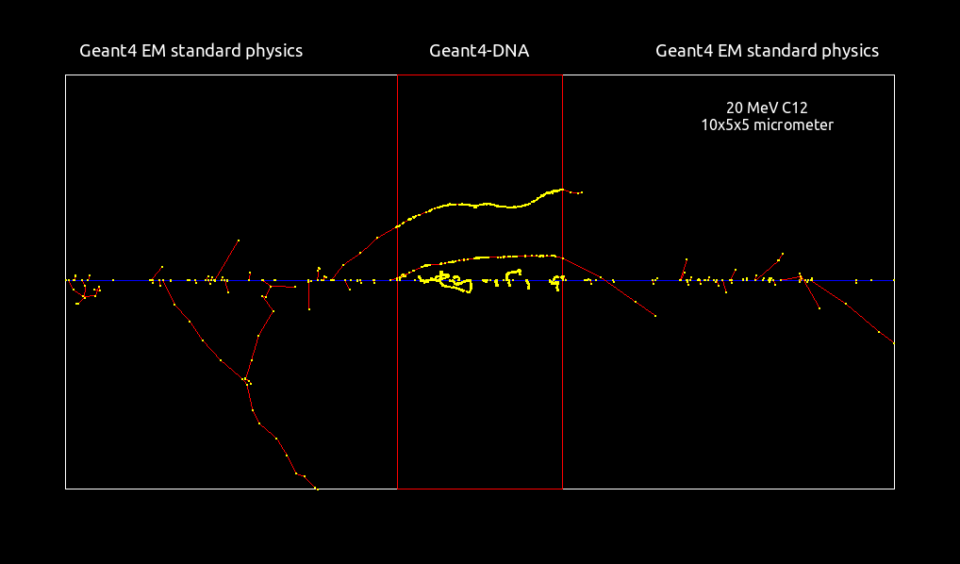
Mixed physics lists in geometrical regions: the « dnaphysics » extended example
/gps/particle ion
/gps/ion 6 12 6
/gps/energy 240 MeV
Courtesy of V. Stepan (CENBG)
See extended/medical/dna/dnaphysics example
Nucl. Instrum. and Meth. B 273 (2012) 95 (link)
Prog. Nucl. Sci. Tec. 2 (2011) 898 (link)

Slide 21
Overview of verification activities
Phys. Med. 31 (2015) 861 (link)
Quantity | Incident particle | References
Cross sections | electron, proton, alpha particle | Phys. Med. 31, 861 (2015) Med. Phys. 37, 4692 (2010)
Dose Point Kernels | electron | Nuclear Inst. and Methods in Physics Research B 398, 13 (2017) Appl. Radiat. Isot. 83, 137 (2014)
Frequency of energy deposition | electron, proton, alpha particle | Nuclear Inst. and Methods in Physics Research B 306, 158 (2013)
Ionization cluster size | electron | Eur. Phys. J. D 60, 85 (2010)
Lineal energy | proton | Appl. Radiat. Isot. 69, 220 (2011)
Mean energy deposition | proton | Appl. Radiat. Isot. 69, 220 (2011)
Radial doses | proton, alpha particle, ions | Nuclear Inst. and Methods in Physics Research B 333, 92 (2014) Phys. Med. Biol. 59, 3657 (2014)
Range | electron, proton, alpha particle | Nuclear Inst. and Methods in Physics Research B 269, 2307 (2011)
S-values | electron | Nuclear Inst. and Methods in Physics Research B 319, 87 (2014) Med. Phys. 42, 3870 (2015)
Slowing down spectrum | electron | Nuclear Inst. and Methods in Physics Research B 397, 45 (2017) Phys. Med. Biol. 57, 1087 (2012)
Stopping power or stopping cross section | electron, proton, alpha particle, C, O, Si, Fe | Med. Phys. 37, 4692 (2010) Phys. Med. Biol. 57, 209 (2011) Nuclear Inst. and Methods in Physics Research B 269, 2307 (2011) Nuclear Inst. and Methods in Physics Research B 397, 45 (2017)
W-value | electron | Phys. Med. Biol. 57, 1087 (2012) Med. Phys. 42, 3870 (2015)

Slide 22
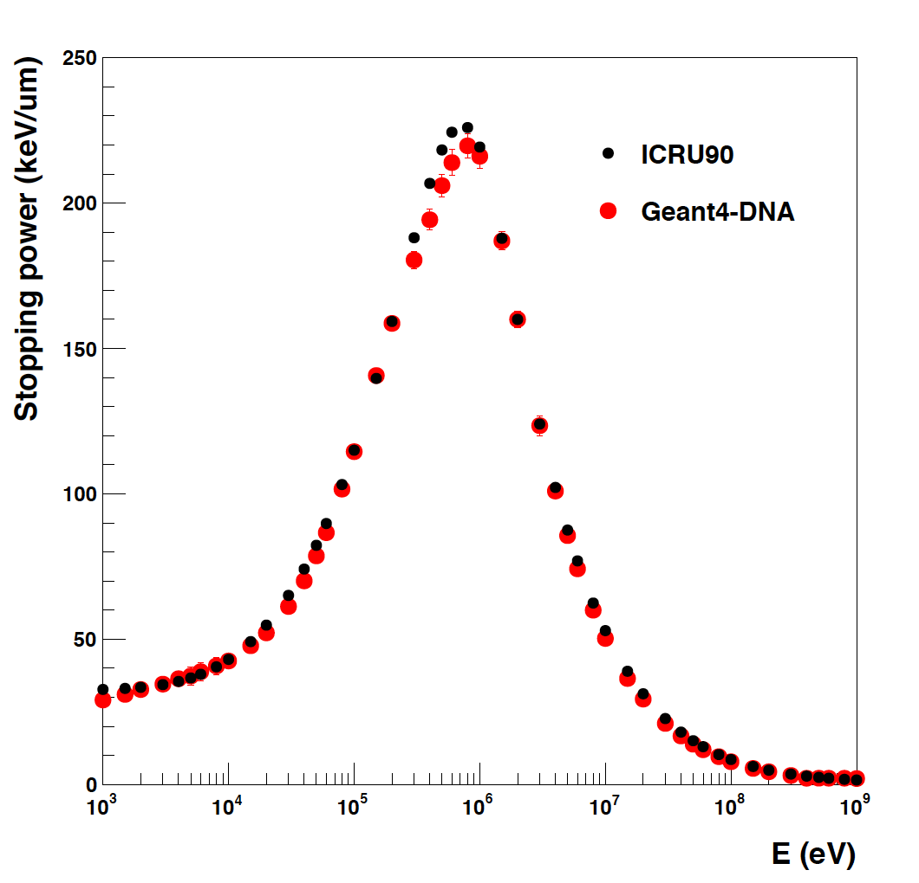
Verification (1): stopping power
a reliable test to evaluate the accuracy of the code
Geant4-DNA does not use SP tables
users usually try to simulate SP by dividing energy loss over step length but forget to select stationnary regime
(alternative analytical calculation is always possible from differential ionisation cross sections)
we provide specific « frozen-velocity » Geant4-DNA physics constructors for liquid water which activate a stationary regime in all inelastic models
Helium²⁺
dE/dx
dE/dx
dE/dx
dE/dx
Nucl. Instrum. Meth. B 397 (2017) 45 (link)
See extended/medical/dna/spower example

Slide 23
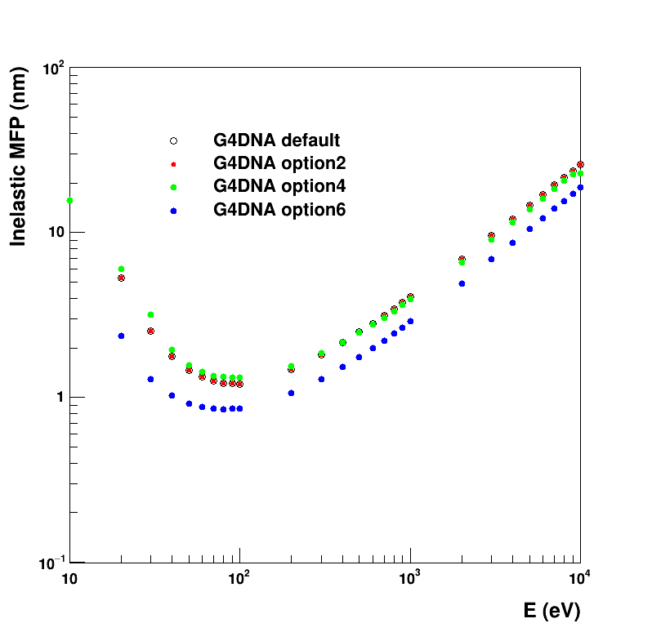
Verification (2): MFP
another test to evaluate the accuracy of the code compared to other TS codes
the user can simulate MFP activating processes of his/her choice
inelastic
full
with or without sub-excitation processes
Inelastic for electrons
mean step length of first interaction
Electron
(Energy E)
See extended/medical/dna/mfp example

Slide 24
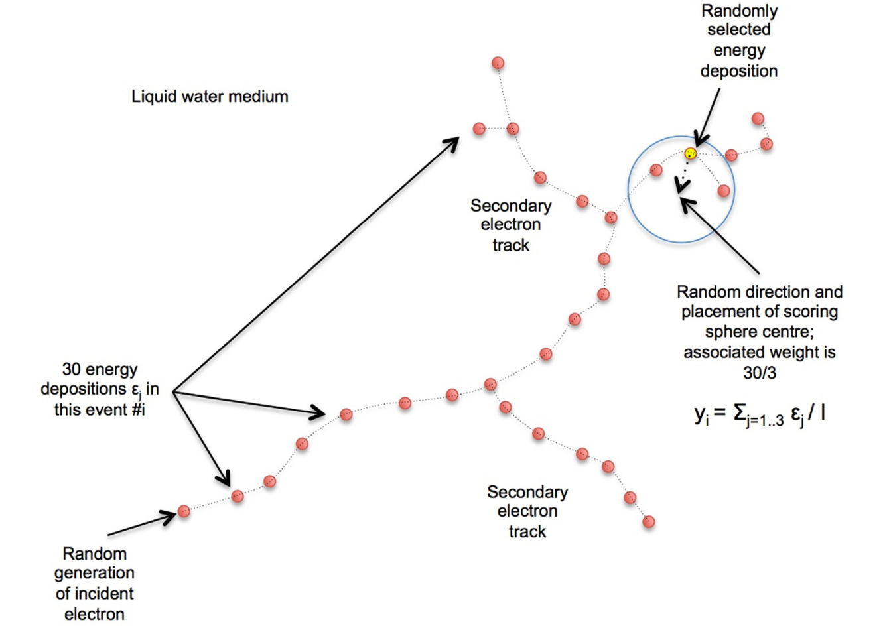
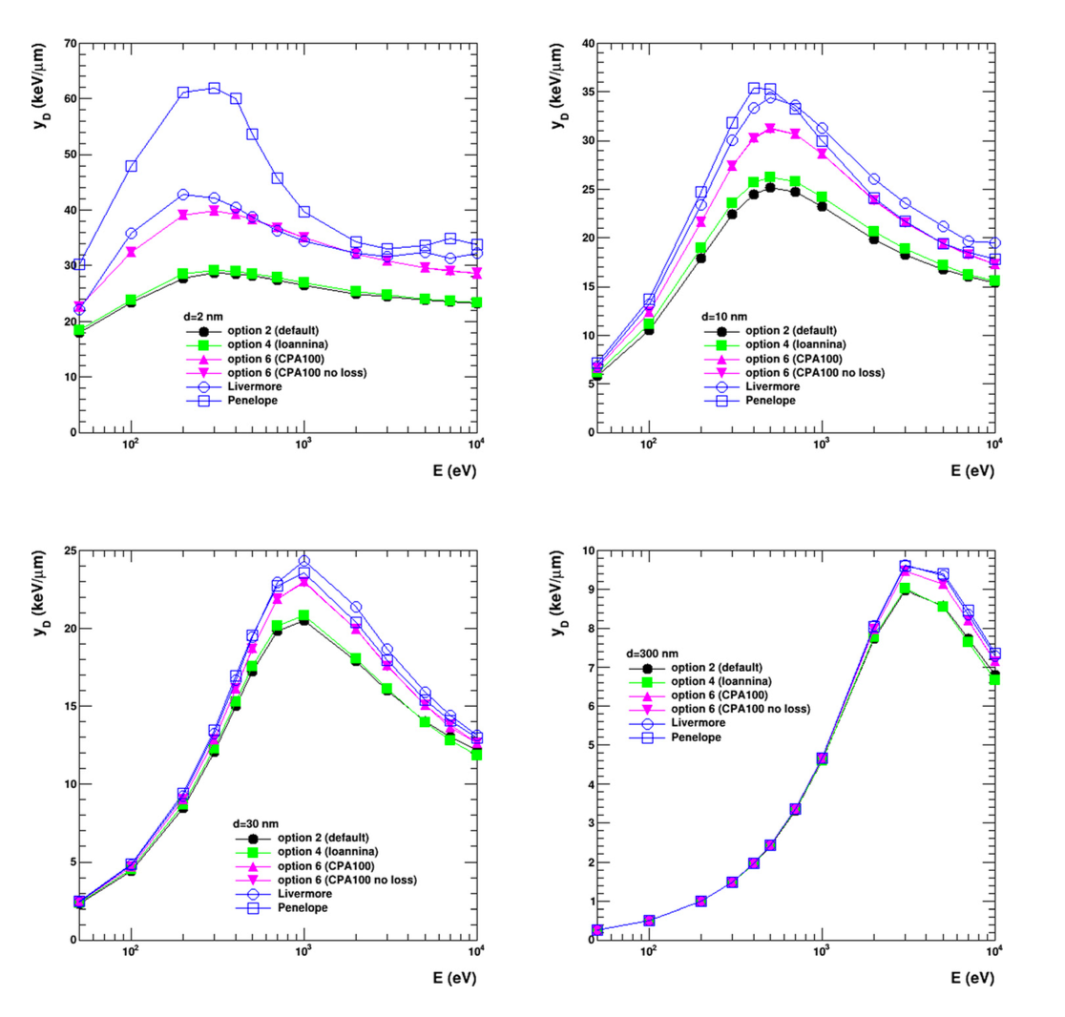
Verification (3): microdosimetry
J. Appl. Phys. 122 (2017) 024303 (link)
we also provide an extended example capable of simulating microdosimetry spectra: lineal energy (y), specific energy (z), frequency-mean lineal energy, dose-mean lineal energy, frequency-mean specific energy, dose-mean specific energy
energy scored in spheres of selected radius
particular care for weighting of energy scoring...
2 nm
10 nm
30 nm
300 nm
See extended/medical/dna/microyz example

Slide 25
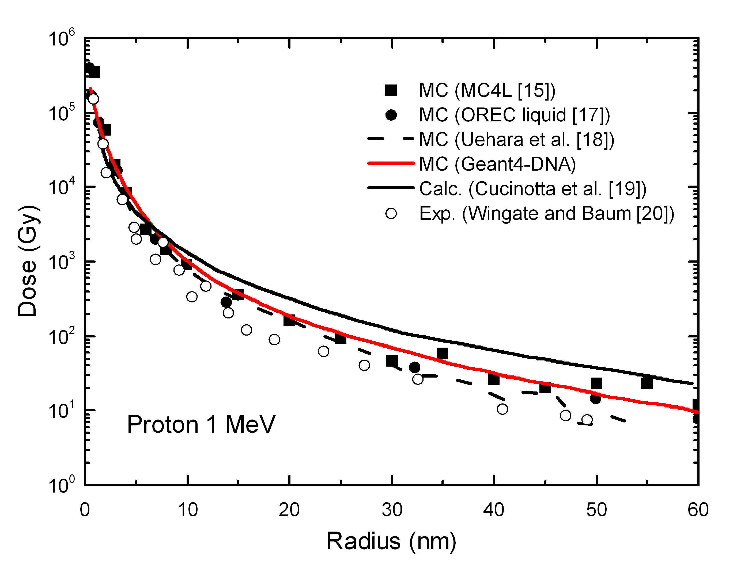
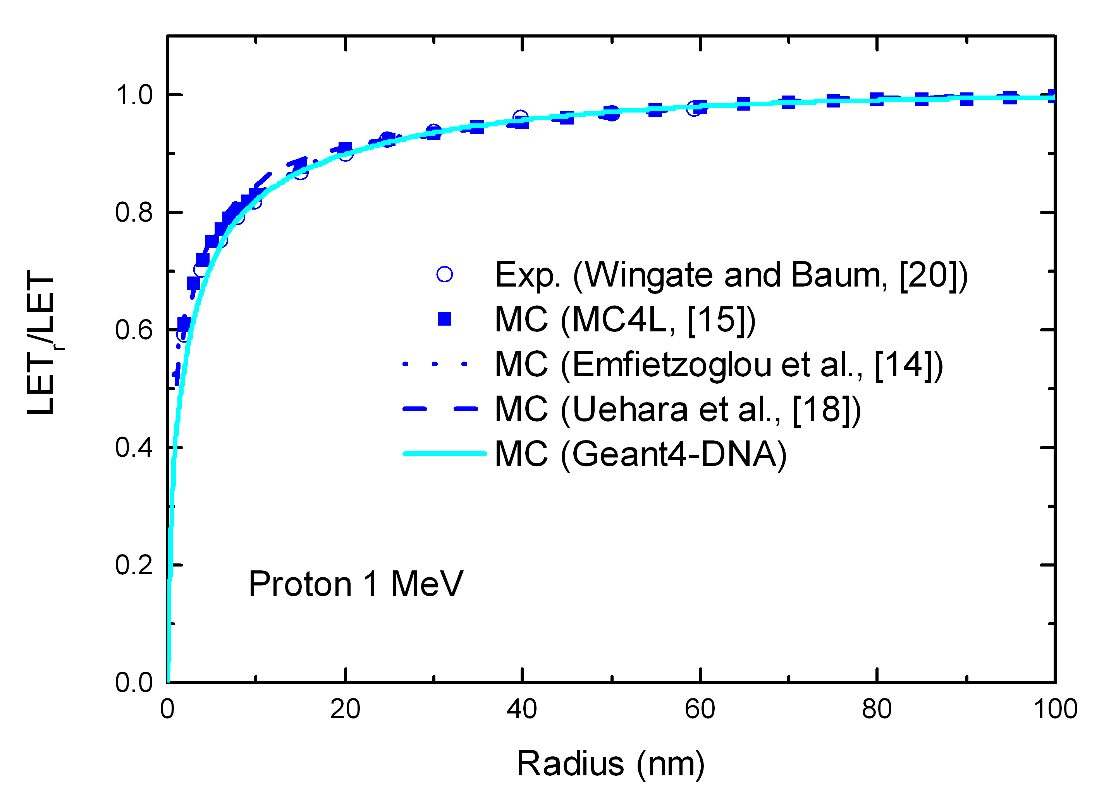
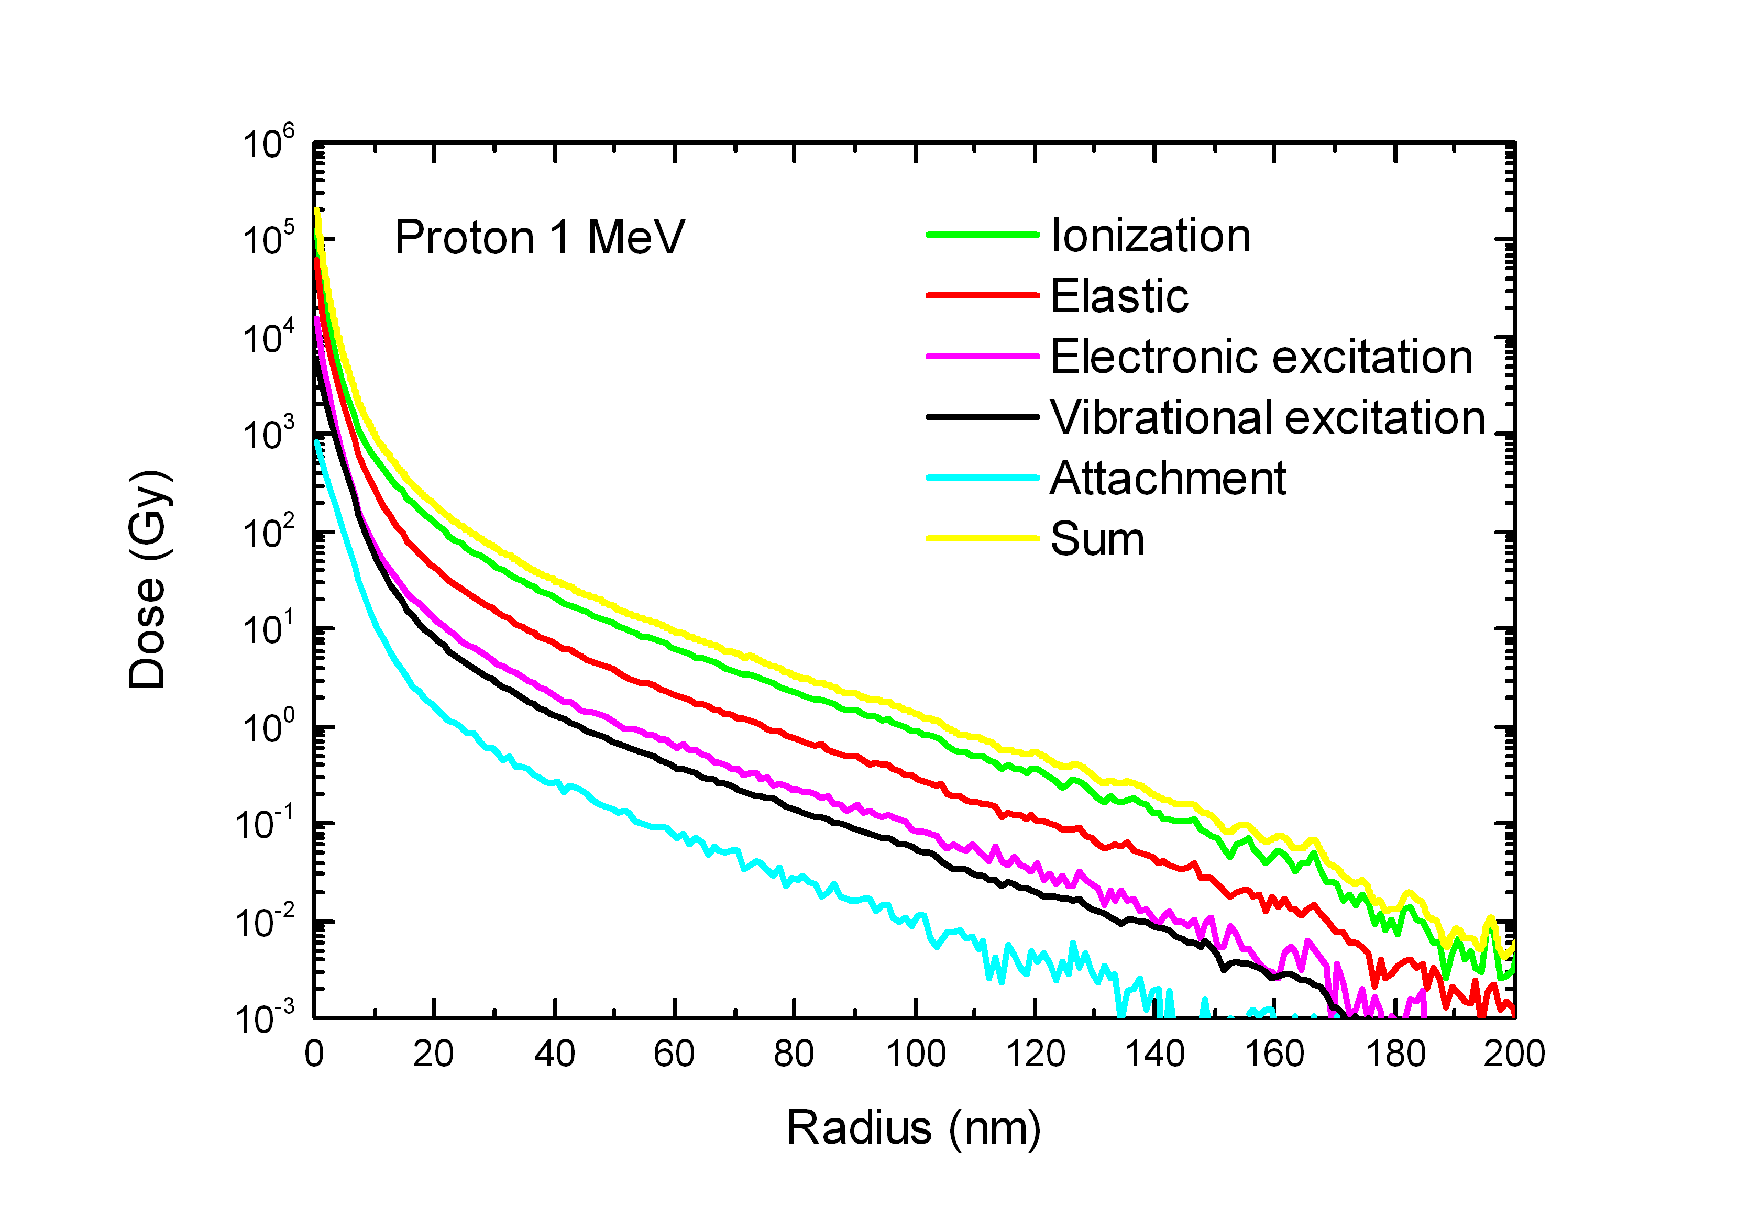
Verification (4): radial doses
Dose profile
Investigation of Geant4-DNA performance for radial dose distribution around ion tracks
Protons, alphas, C, O, Fe
MeV–GeV range
General good agreement of dose profiles with a variety of literature data
Selection of results for 1 MeV protons
Restricted LET
Process contribution
Nucl. Instrum. and Meth. B 333 (2014) 92 (link)

Slide 26
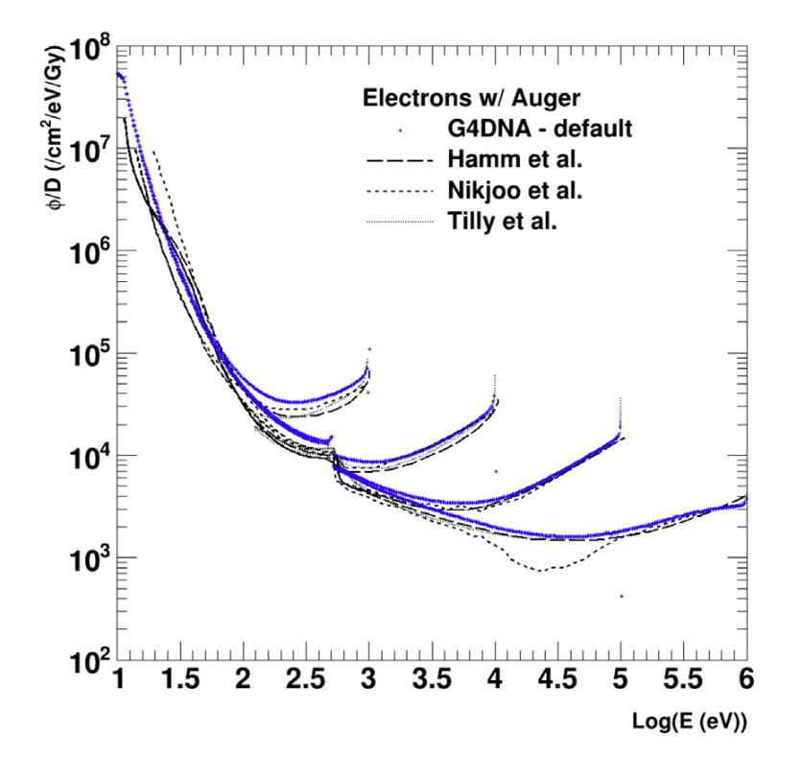
Verification (5): electron slowing down spectra
e⁻
a reliable test to evaluate the performance of track structure codes
represent the fluence distribution (differential in energy) of both the primary and all subsequent generations of secondary electrons generated through the full slowing-down process
∅(E)dE is the total distance travelled by electrons while their energy is in the interval E, E+dE (Vassiliev, 2012)
method: we record for each simulation step the kinetic energy of each electron undergoing a Geant4-DNA inelastic process in a log-binned histogram, setting for each record a statistical weight equal to the size of the step.
small influence of sub-excitation processes at low energy; Auger electron production from O should be considered.
1 keV
10 keV
100 keV
1 MeV
Nucl. Instrum. Meth. B 397 (2017) 45 (link)
See extended/medical/dna/slowing example
Notes:
Each histogram bin is normalized to its energy width (in eV) and the full histogram was normalized to the number of primary electrons

Slide 27
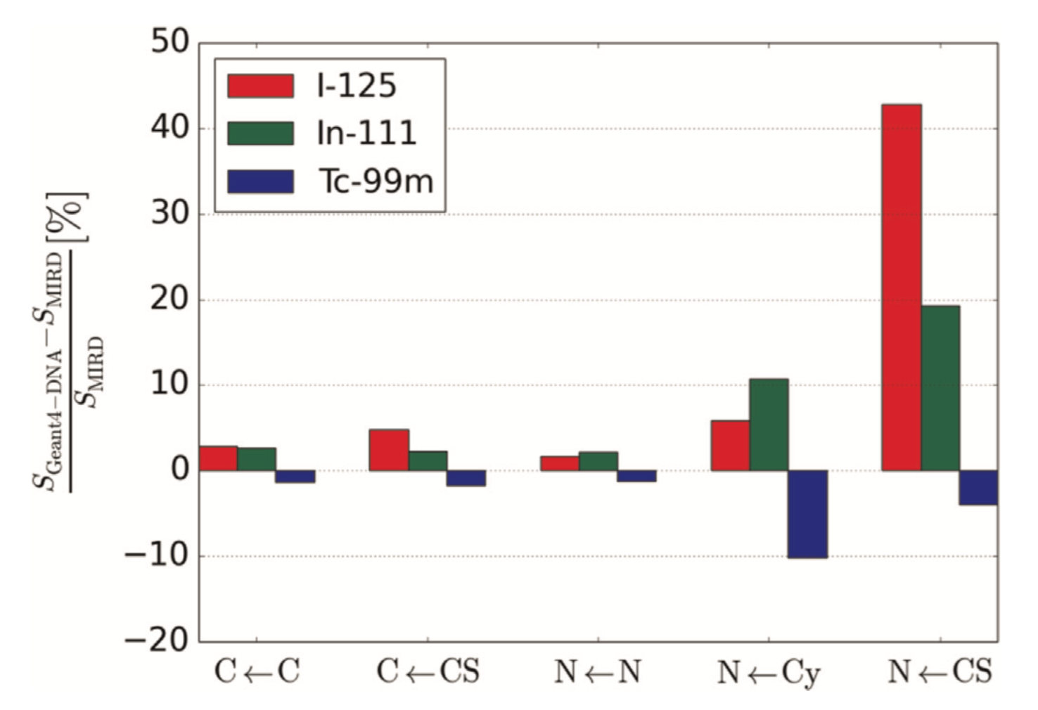
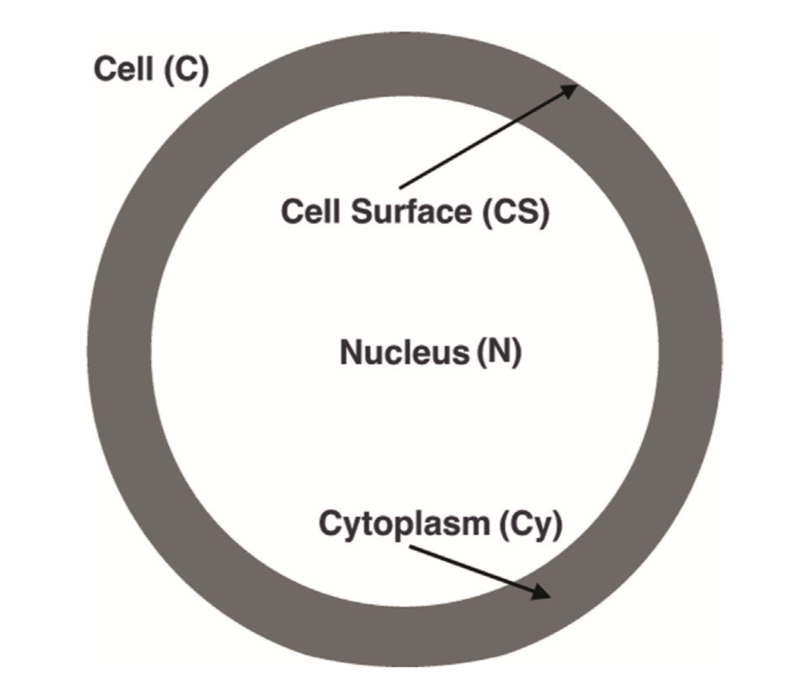
Verification (6): S-values
Cell radius: 5 um
Nucleus radius: 4 um
a benchmark of Geant4-DNA models against Committee on Medical Internal Radiation Dose (MIRD) data for S-values for several radionuclides
also investigated cellular morphology dependence
see extended/medical/dna/svalue example
Appl. Radiat. Isot. 104 (2015) 113 (link)

Slide 28
PHYSICO-CHEMICAL & CHEMICAL STAGE

Slide 29
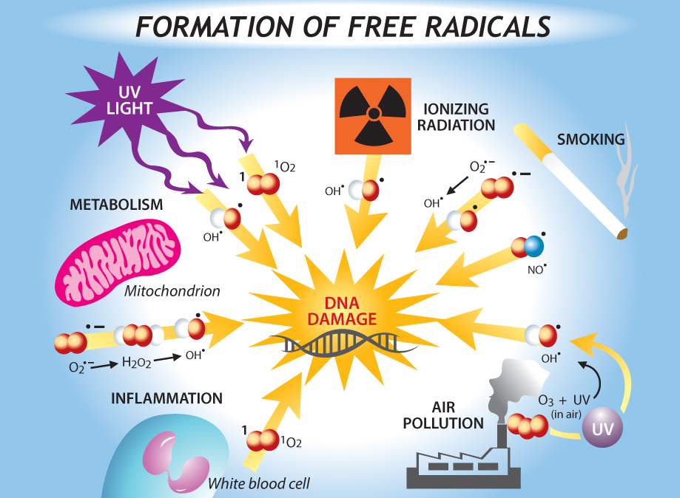
http://sphweb.bumc.bu.edu

Slide 30
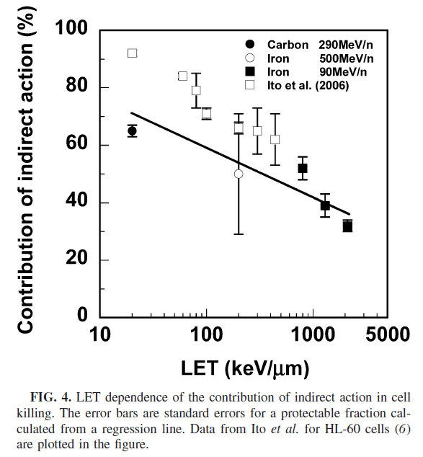
Contribution of indirect effects
Survival vs Dose with different DMSO concentrations
Contribution of indirect effects VS LET
Hirayama et al, 2009

Slide 31
Modelling water radiolysis
PhD thesis of M. Karamitros (2012)
Water radiolysis = dissociation of water molecules by ionising radiation
Creation of oxydative species
They can interact chemically with one another or with the « biological medium » (« non-direct effects ») and interfere with the normal functioning of cells
Stage 1 : Physico-chemistry stage we start from water molecules which underwent changes in their electronic configuration from physical processes occuring during the « Physical stage »
Electronic excitation, ionisation
The electronic rearrangement may lead to their dissociation
We use branching ratios and positioning of dissociation products, which can be modified by the user

Slide 32
Modelling water radiolysis
PhD thesis of M. Karamitros (2012)
Stage 2 : Chemistry stage the dissociative products can recombine to form new chemical species
A new stepping algorithm was developed to handle this recombination and more generally manage collisions between tracks
Requires the synchronization of tracks during simulation
All tracks are transported simultaneously during dynamic or fixed « time steps »
A table of chemical reactions and their reaction rates must be provided
All parameters are provided through a « Chemistry list » as Geant4 users would do with a « Physics list »
G4EmDNAChemistry
Note that the chemistry can be started as a standalone application
Input user defined « physics » phase space
Parameters can be changed by the user

Slide 33
Physico-chemical stage
t=10⁻¹⁵s
t=10⁻¹²s
During this stage, water molecules
Dissociate if ionized
Relax or dissociate if excited
J. Comput. Phys. 274 (2014) 841 (link)
Electronic state | Dissociation channels | Fraction (%)
All single ionization states | H₃O ⁺ + •OH | 100
Excitation state A1B1: (1b1) → (4a1/3s) | •OH + H• H₂O + ΔE | 65 35
Excitation state B1A1: (3a1) → (4a1/3s) | H₃O ⁺ + •OH + e⁻_{aq} (AI) •OH + •OH + H₂ H₂O + ΔE | 55 15 30
Excitation state: Rydberg, diffusion bands | H₃O ⁺ + •OH + e⁻_{aq} (AI) H₂O + ΔE | 50 50
Dissociative attachment | •OH + OH⁻ + H₂ | 100
Products thermalize down to their energy of diffusion at equilibrium

Slide 34
Chemical stage
t=10⁻¹⁵s
t=10⁻¹²s
t=10⁻⁶s
Reactions (9) | Reaction rate (10⁷ m³ mol⁻¹ s⁻¹)
H₃O⁺ + OH⁻ → 2 H₂O | 14.3
•OH + e⁻_{aq} → OH⁻ | 2.95
H• + e⁻_{aq} + H₂O→ OH⁻ + H₂ | 2.65
H₃O⁺ + e⁻_{aq} → H• + H₂O | 2.11
H• + •OH → H₂O | 1.44
H₂O₂ + e⁻_{aq} → OH⁻ + •OH | 1.41
H• + H• → H₂ | 1.20
e⁻_{aq} + e⁻_{aq} + 2 H₂O→ 2 OH⁻ + H₂ | 0.50
•OH + •OH → H₂O₂ | 0.44
Species | Diffusion coefficient D (10⁻⁹ m² s⁻¹)
H₃O ⁺ | 9.0
H• | 7.0
OH⁻ | 5.0
e⁻_{aq} | 4.9
H₂ | 5.0
•OH | 2.8
H₂O₂ | 1.4
H₂O | 2.0
We propose by default the set of parameters published by the authors of the PARTRAC software (Kreipl et al., REB 2009). However, these parameters can be modified by the user.
J. Comput. Phys. 274 (2014) 841 (link)

Slide 35
Radicals from excitation states
by M. Karamitros
H₂O*→H₃O ⁺ + •OH + e⁻_{aq}
H₃O⁺
°OH
e⁻_{aq}

Slide 36
How to use Geant4-DNA for radiation chemistry ?
Four examples are available in Geant4 in the « extended examples/medical/dna » category of Geant4 examples
chem1: activating chemistry
chem2: how to set minimum time step limits
chem3: user interactivity and visualization
chem4: extraction of radiochemical yields (G) in a range of deposited energy
Note
Examples can be run in MultiThreading mode
Chemistry works in with G4_WATER material

Slide 37
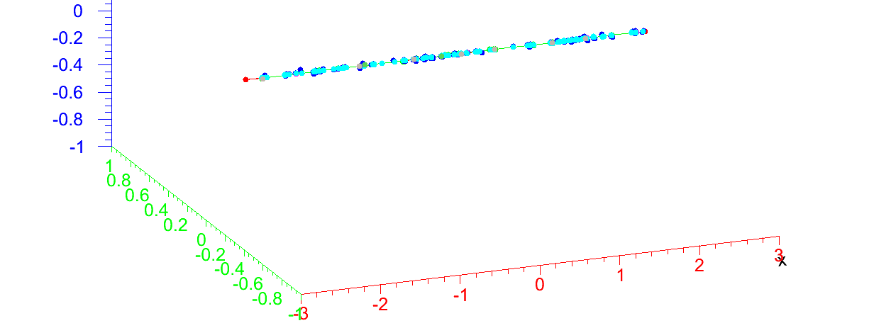
Situation at 1 picosecond
A proton of 50 MeV…
μm

Slide 38
Situation at 1 microsecond
A proton of 50 MeV…
μm

Slide 39
Chem3
Geant4-DNA generated track of 1 keV electron, followed up to 100 ns during chemical stage. Using pre-release Geant4 10.1 code.
First, the physical stage is modeled, using Geant4-DNA physics: the 1 keV electron track is fully slowed down and thermalized in a 150 nm sphere of liquid water. Yellow points correspond to interaction events in liquid water.
Next, the physico-chemical /chemical stage is simulated for the first 100 ns. Individual radical species diffusing in space and reacting with each other are shown as colour trails, the color coding chemical species type.
http://dx.doi.org/10.6084/m9.figshare.978887

Slide 40
Definition of radiochemical yield G
Number of molecules of a given species for 100 eV of deposited energy
Number of molecules at time t
Time-dependent radiochemical yield
Deposited energy scaling to 100 eV
An observable quantity commonly used to evaluate chemistry modeling accuracy…
Precautions for comparisons between codes
scoring volume
deposited energy
species, reaction rates, diffusion constants
compare all yields, not only one species...

Slide 41
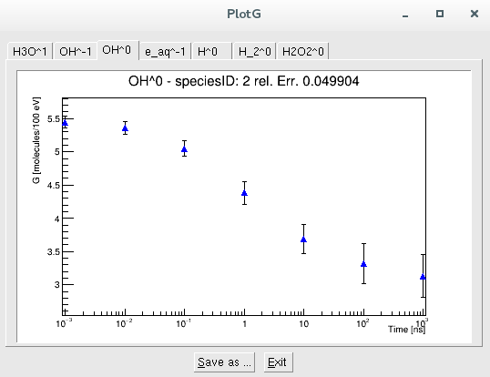
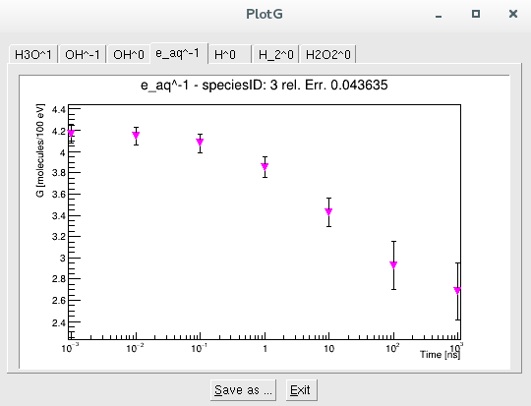
chem4 : easy simulation of G-values
Settings of chem4
infinite volume
two thresholds
The primary is killed once it has deposited more energy than a selectable minimum threshold, T1
When the primary particle looses more energy in few interaction steps than a maximum allowed threshold, T2, the event is aborted
this allows to calculate G-values on the deposited energy range [T1,T2]
can be set using UI commands : /primaryKiller/eLossMin 1 keV # primary is killed if deposited E is greater than this value
/primaryKiller/eLossMax 2 keV # event is aborted if deposited E is greated than this value
Can run in MT mode
Results are stored in ROOT format and can me vizualised using a dedicated ROOT interface (plotG)
10 keV
Eg. : species by 10 incident electrons of 100 keV (beam.in)
•OH radicals
e-_{aq}

Slide 42
GEOMETRICAL MODELS

Slide 43
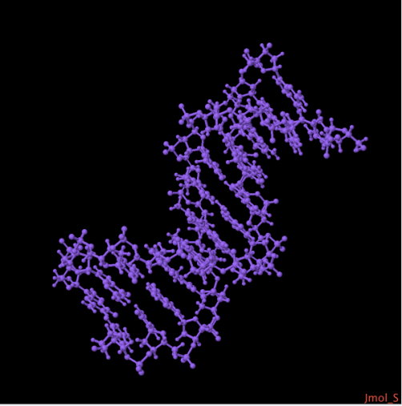
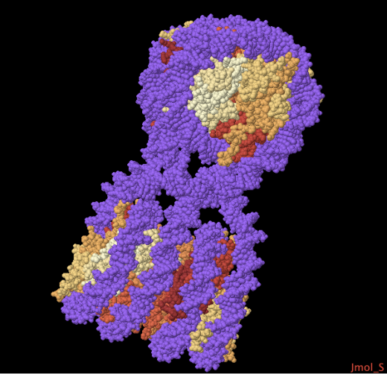
Molecules: realistic geometries using an interface to PDB
http://pdb4dna.in2p3.fr
http://geant4-dna.org
PDB : Protein Data Bank http://www.rcsb.org/pdb/
3D structure of molecules
Proteins
Nucleic acids
Description of DNA molecules, eg.
1FZX.pdb
Dodecamer
12 DNA base pairs
(2,8 x 2,3 x 4,01 nm³)
1ZBB.pdb
Tetranucleosome
(9,5 x 15,0 x 25,1 nm³)
HEADER STRUCTURAL PROTEIN/DNA 08-APR-05 1ZBB
TITLE STRUCTURE OF THE 4_601_167 TETRANUCLEOSOME
...
ATOM 1 O5' DA I 1 70.094 16.969 123.433 0.50238.00 O
ATOM 2 C5' DA I 1 70.682 18.216 123.054 0.50238.00 C
ATOM 3 C4' DA I 1 69.655 19.289 122.776 0.50238.00 C
...
TER 14223 DT J 347
...
HELIX 1 1 GLY A 44 SER A 57 1 14
HELIX 2 2 ARG A 63 ASP A 77 1 15
...
SHEET 1 A 2 ARG A 83 PHE A 84 0
SHEET 2 A 2 THR B 80 VAL B 81 1 O VAL B 81 N ARG A 83
1FZX.pdb
1ZBB.pdb

Slide 44
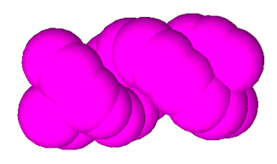
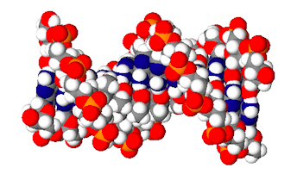
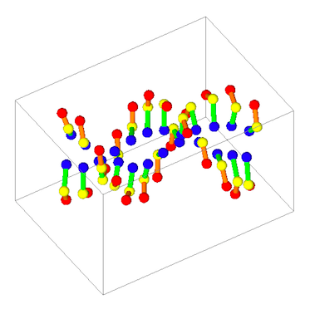
« pdb4dna » extended example
http://pdb4dna.in2p3.fr
http://geant4-dna.org
1) A C++ library
Reading of PDB files
Build bounding box from atom coordinates
Search for closest atom from a given point
Geometry and visualization : 3 granularities
(1) Barycenter of nucleotides only
(2) Atomistic
(3) Barycenter of nucleotide components
2) A Geant4-DNA example
Water box surrounding the molecule
The output results consists in a ROOT file, containing for each event:
energy deposit in bounding boxes
number of single strand breaks (SSB)
number of double strand breaks (DSB)
Available on-line under Geant4 license
(1)
(2)
(3)
Comput. Phys. Comm. 192 (2015) 282 (link)

Slide 45
Bacteria: modeling E. coli...
fulld
"integral approach" :
geometry implementation,simulation & scoring of early damage fully driven by Geant4 UI commands
1.9 mm x 0.8 mm, 4.63 Mbp
PhD thesis of N. Lampe (2017)

Slide 46
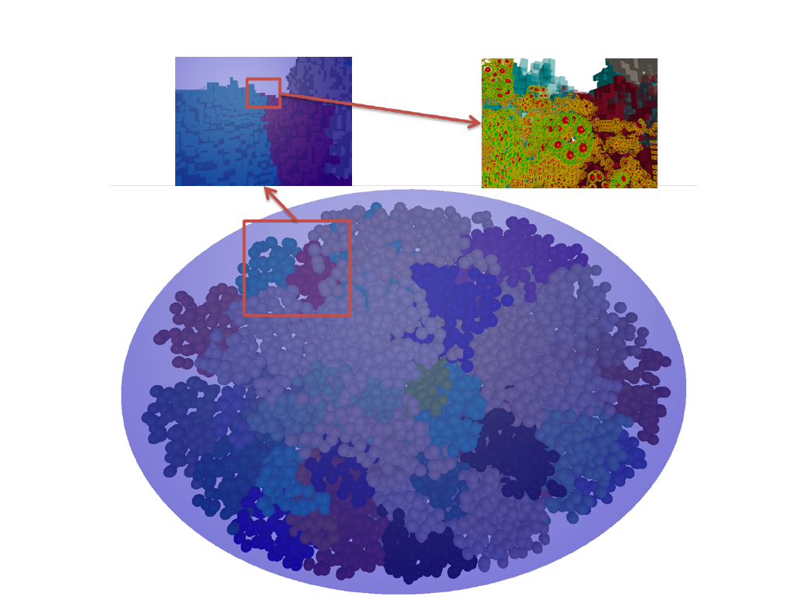
Up to cell: the first relaxed human fibroblast
Alternative approach :
using the « DNAFabric » external software
PhD thesis of S. Meylan (2016)

Slide 47
PhD thesis of S. Meylan (2016)

Slide 48
…based on the « DNAFabric » software
Comput. Phys. Comm. 204 (2016) 159 (link)
DNAFabric: C++ software : generation, modification and 3D geometries that can be exported to Geant4
Choice of shape (ellipsoid, sphere, elliptical cylinder…) and nucleus size.
Generation of an empty nucleus phantom.
Choice and placement of the genome inside the nucleus in a condensed form.
Relaxation step allowing a modelling of the genome domains in G0/G1 phase of the cell cycle.
Filling step of the genome domains with different voxels containing chromatin fibers with molecular DNA components.
Export of the nucleus geometry towards the simulation chain based on Geant4-DNA

Slide 49
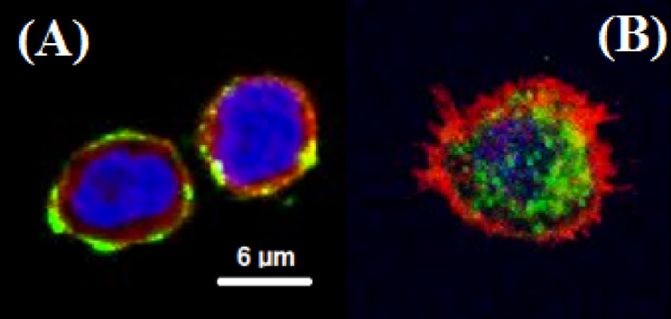
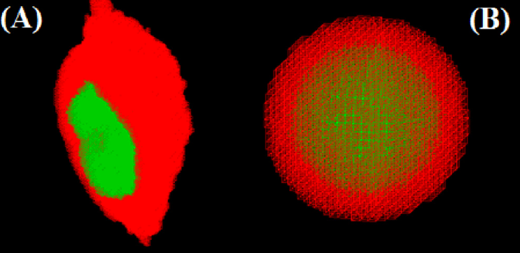
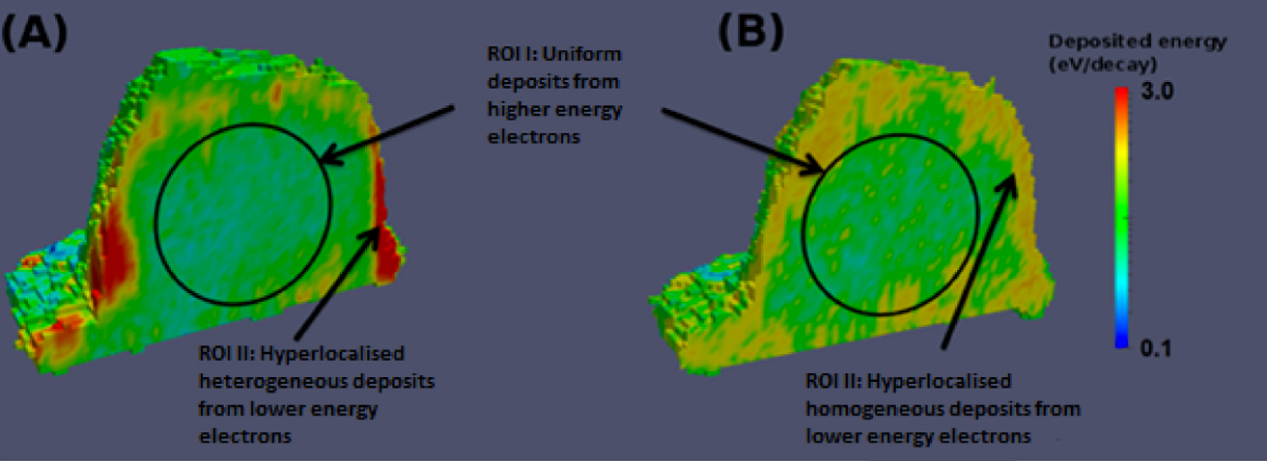
More geometries: cellular phantoms
Nucl. Instrum. and Meth. B 366 (2016) 227 (link)
35A7 non-internalizing (A) or m225 internalizing (rigB)
Spherical equivalent cell
Vulvar squamous carcinoma A-431 cells treated with non-internalizing and internalizing antibodies labelled with Auger emitter I-125
Geant4: Livermore based + Coulomb scattering + « microbeam » adv. example (« cellular phantom »)
Simulation of the distribution of energy deposition in the cell model for non-uniform (A – from fluorescence signal) and uniform (B) emission probabilities from I-125 electrons with 35A7 non-internalizing antibodies (logarithmic colour scale).

Slide 50
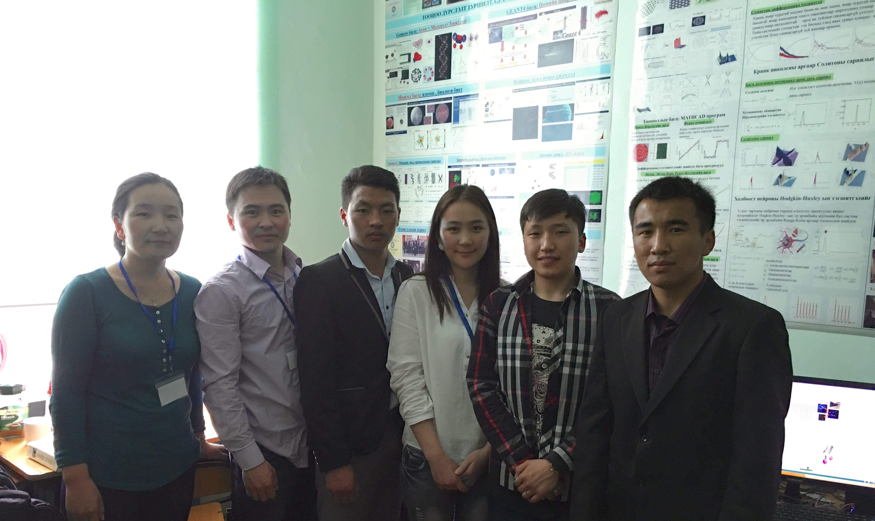
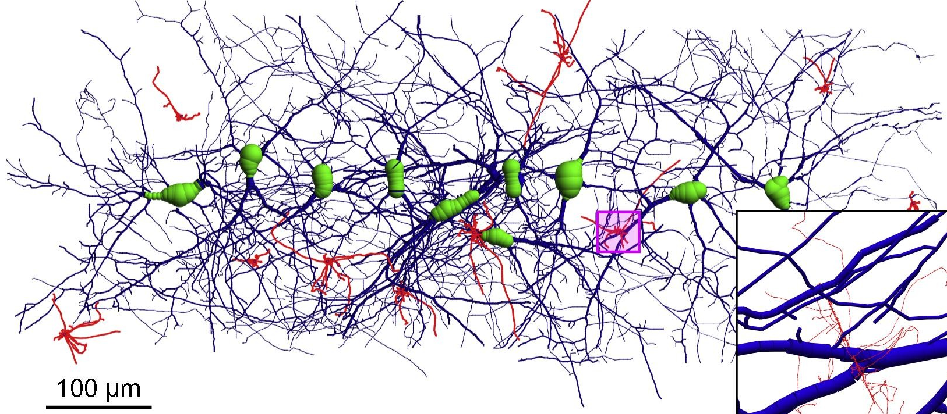
More geometries: neurons
A new activity in Geant4-DNA initiated by Dr Oleg Belov, JINR, Dubna, in collaboration with B. Munkhbataar and the National Univ. of Mongolia.
Radiation damage to the central nervous system is an active research domain in relation to brain radiotherapy and radiation protection for astronauts during space travel.
Now it becomes possible to investigate early biological damage induced by ionizing radiations in a simple neural network by means of modelling physico-chemical processes occurring in the medium after exposure, thanks to Geant4-DNA.
« neuron » extended example released in Geant4 10.4 Beta
Pr Oidov Lkhagva
Phys. Med. 32(12) 1510–1520 (2016) (link)
National University of Mongolia, Oulan Baator, June 2016

Slide 51
EARLY DAMAGE

Slide 52
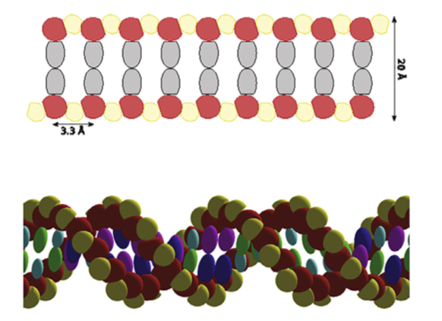
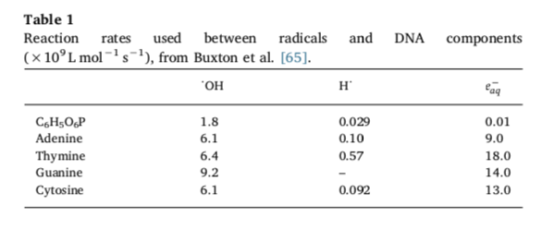
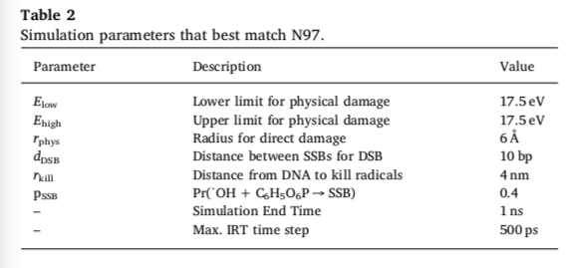
1) E. coli: simulation parameters
Phys. Med. 48, 135-145 (2018) (link)
A test geometry, consisting of 200,000 randomly oriented rectangular boxes (100 × 30 × 30 nm), each containing a straight 216 bp segment of DNA (inspired from Nikjoo et al., Int J Radiat Biol, 71 (1997), pp. 467–483)
Electrons are randomly shot from an inner sphere of radius 500 nm
P, D, bases
Reaction rates for •OH , H• and e⁻_{aq} with DNA components
« Best » set

Slide 53
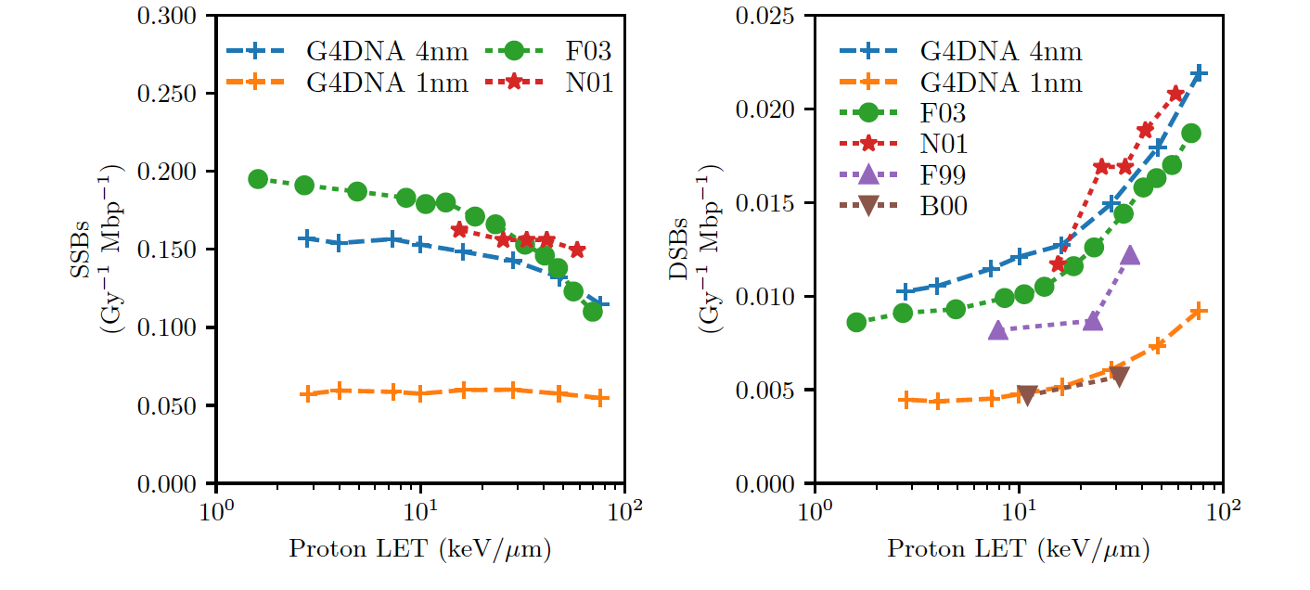
E. coli: DNA damage from proton irradiation
Phys. Med. 48, 146-155 (2018) (link)
SSB and DSB yields from proton damage simulated using Geant4-DNA, compared to results from the PARTRAC (F03) and the KURBUC (N01) simulation codes.
Experimental DSB yields are indicated by F99 for human fibroblast cells, and B00 for V79 Chinese Hamster cells.
Experimental ratios are for plasmids.
Coming soon
Suggests a major influence of scavenging…

Slide 54
2) Fibroblast: simulation parameters
Geometry: about 2 millions of voxels for the whole nucleus, using 5 types of voxels: straight, up, down, right, left
Direct effects:
17.5 eV cumulated in the backbone region to induce a direct SSB
At least 2 SSBs on opposite strands to form a DSB
Non-direct effects:
Histone proteins (spheres) absorb radicals
•OH radicals interacting with DNA induce base damage and 40% of •OH radicals interacting with 2-deoxyribose are registered as indirect SSB
Chemistry duration of 2.5 ns
Damage:
the DBSCAN clustering algorithm is used to merge direct and non-direct SSBs for DSB prediction
only fragments > 10⁴ bp are kept for comparison to pulse electropheresis
Sc. Rep. 7 (2017) 11923 (link)

Slide 55
Fibroblast: early DNA damage
Coming soon
Sc. Rep. 7 (2017) 11923 (link)

Slide 56
3) Where to find more information ?

Slide 57
Geant4-DNA website
http://geant4-dna.org

Slide 58
Geant4-DNA examples included in Geant4 (23)
G4 10.4
Dec. 2017
Example code name | Purpose | Location
dnaphysics | Usage of Geant4-DNA Physics processes Automatic combination of Standard EM with Geant4-DNA Physics processes variable density | $G4INSTALL/examples/extended/medical/dna
microdosimetry | "Hand" combination of Standard EM or Low Energy EM processes with Geant4-DNA Physics processes | $G4INSTALL/examples/extended/medical/dna
range | Range simulation | $G4INSTALL/examples/extended/medical/dna
spower | Calculation of stopping power | $G4INSTALL/examples/extended/medical/dna
mfp | Mean Free Path | $G4INSTALL/examples/extended/medical/dna
wvalue | W values | $G4INSTALL/examples/extended/medical/dna
svalue | S values | $G4INSTALL/examples/extended/medical/dna
microyz | Microdosimetry spectra (y, z) | $G4INSTALL/examples/extended/medical/dna
slowing | Electron slowing down spectra | $G4INSTALL/examples/extended/medical/dna
clustering | Clustering code | $G4INSTALL/examples/extended/medical/dna
icsd | Usage of alternative bio-materials | $G4INSTALL/examples/extended/medical/dna
splitting (*) | Acceleration of processes | $G4INSTALL/examples/extended/medical/dna
chem1, chem2, chem3, chem4 | Usage of Geant4-DNA chemistry | $G4INSTALL/examples/extended/medical/dna
wholeNuclearDNA | Cell nucleus | $G4INSTALL/examples/extended/medical/dna
pdb4dna | Interface to PDB database | $G4INSTALL/examples/extended/medical/dna
neuron | 3D neural network | $G4INSTALL/examples/extended/medical/dna
microbeam | 3D cellular phantom | $G4INSTALL/examples/advanced
TestEm5 | Atomic deexcitation tagging | $G4INSTALL/examples/extended
TestEm12 | DPK | $G4INSTALL/examples/extended
TestEm14 | Extraction of cross sections | $G4INSTALL/examples/extended
Useful to compare Geant4-DNA with literature data...

Slide 59
Geant4 Virtual Machine
http://geant4.in2p3.fr
A virtual Linux PC with Geant4 and tools fully installed
WindowsTM
MacTM
LinuxTM
Full free access
Follows Geant4 releases
Twitter
@Geant4VM

Slide 60
« Social » networks
Twitter
@Geant4-DNA
@Geant4VM
Facebook
Geant4-DNA

Slide 61
Perspectives
Physics
Inclusion of alternative or improved cross section models for electrons and ions
Liquid water + DNA-like materials + gas materials for nanodosimeters + metals
Physico-chemistry/chemistry
Alternative approach for the simulation of radiolysis (IRT)
Addition of scavenger species and reactions
Biology
Multi-scale geometrical models of biological targets, including « deformable » geometries, from DNAFabric and Geant4 UI messengers
Prediction of direct and non-direct DNA simple & complex damages in plasmids and realistic cells
Time evolution of damage: repair processes for the simulation of late damage
Comparison to experiments: ion microbeam facilities (eg. @ CENBG)
Computing acceleration: GPU for chemistry
Verification (with other codes) and validation (with experimental data)
All these developments take time – once published, they are delivered publicly in Geant4

Slide 62
Thank you for your attention …and a special thank you to
Our users !
Our main developers
Marie-Claude Bordage (INSERM, France)
Ziad Francis (St Joseph U., Lebanon)
Susanna Guatelli (Wollongong U., Australia)
Vladimir Ivantchenko (G4AI Ltd, UK)
Mathieu Karamitros (Bordeaux, France)
Ioanna Kyriakou (Ioannina U., Greece)
Nathanael Lampe (Melbourne, Australia)
Sylvain Meylan (Paris, France)
Shogo Okada (Kobe U., Japan) Dosatsu Sakata (Wollongong U., Australia) Wook-Geun Shin (Bordeaux U., France) – PhD on-going
Nicolas Tang (IRSN, France) – PhD on-going
Hoang N. Tran (CEA, Saclay & Ton Duc Thang U., Vietnam)
Carmen Villagrasa (IRSN, France)
Alumni
J. Bordes, CRCT/INSERM/UPS, Toulouse, France
M. Bug, PTB, Germany
E. Delage, LPC Clermont/IN2P3/CNRS, France
M. Dos Santos, IRSN, France
A. Ivantchenko, G4AI Ltd., UK
A. Mantero, SwHaRD srl, Italy
H. Payno, LPC Clermont/IN2P3/CNRS, France
Y. Perrot, LPC Clermont/IN2P3/CNRS, France
Theory & MC experts
Michael Dingfelder (ECU, USA) Dimitris Emfietzoglou (Ioannina U., Greece) Werner Friedland (Helmholtz Z., Germany)
Francesc Salvat (Barcelona U., Spain)
http://geant4-dna.org
If you use Geant4-DNA, please be kind to cite in your work our two collaboration papers
Phys. Med. 31 (2015) 861-874 (link)
Med. Phys. 37 (2010) 4692-4708 (link)

Slide 63
2018 Geant4 International User Conference
at the Physics - Medicine - Biology frontier
29-31 October 2018, Bordeaux, France
Topics
imaging, classical radiotherapy, including brachytherapy and targeted radioimmunotherapy, protontherapy, hadrontherapy, radiobiology (Geant4-DNA), detector development, computing
under the auspices of the Geant4 Collaboration
peer reviewed regular papers in EJMP / Physica Medica (Elsevier) in open access
http://geant4.in2p3.fr/2018
Registration is open

