Slide 1
Thunderstorm and Lightning Observations with the LOFAR Radio Telescope
Brian Hare
J. R. Dwyer, and the LOFAR C.R. Key Science Project

Slide 2
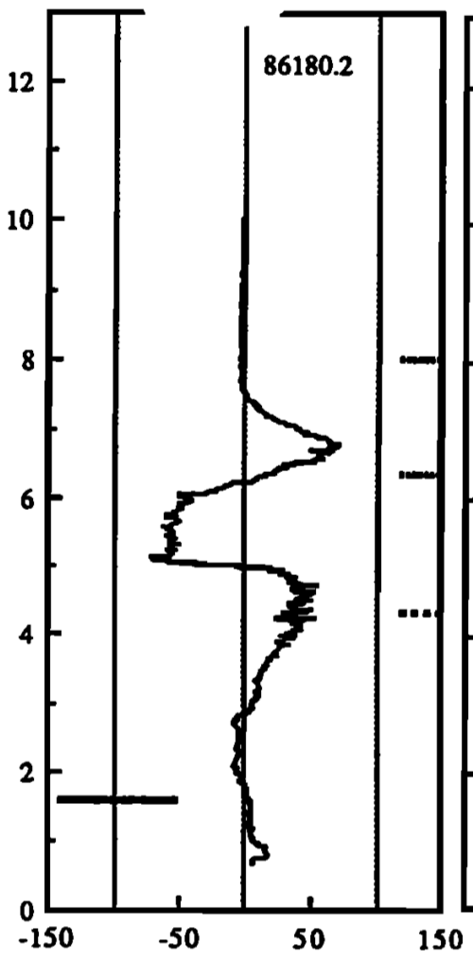
Balloon-borne electric field measurements
Marshal and Rust, 1991, Alabama
MacGorman et al., 2013, Florida
8
6
Altitude (km)
4
2
0
-100
0
100
Vertical electric field (kV/m)

Slide 3
3D Lightning Mapping
0
20
40
60
80
100
120
140
Lightning is often mapped in 3D
Uses timing of radio pulses in 30 – 80 MHz
Have accelerated understanding of lightning
Small ( 1 – 10 m) scale is a complete mystery

Slide 4
Outline
LOFAR radio telescope
Cosmic rays during thunderstorm environment
Detailed 3D maps of lightning

Slide 5
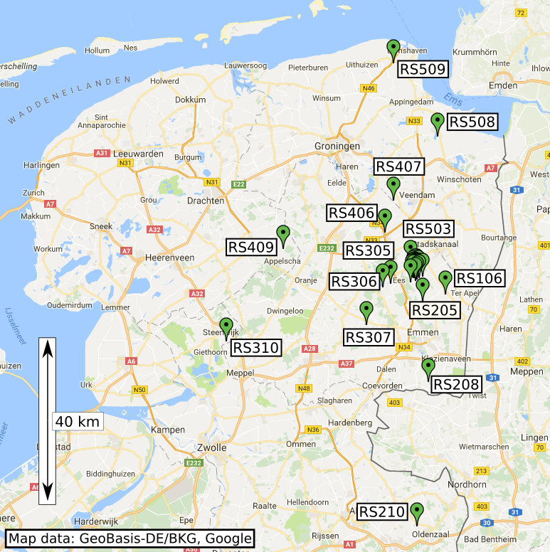
LOFAR
24 “core” stations
14 “remote” stations
Per Station:
96 low-band antennas
10 – 90 MHz
20 high-band antennas
110-250 MHz

Slide 6
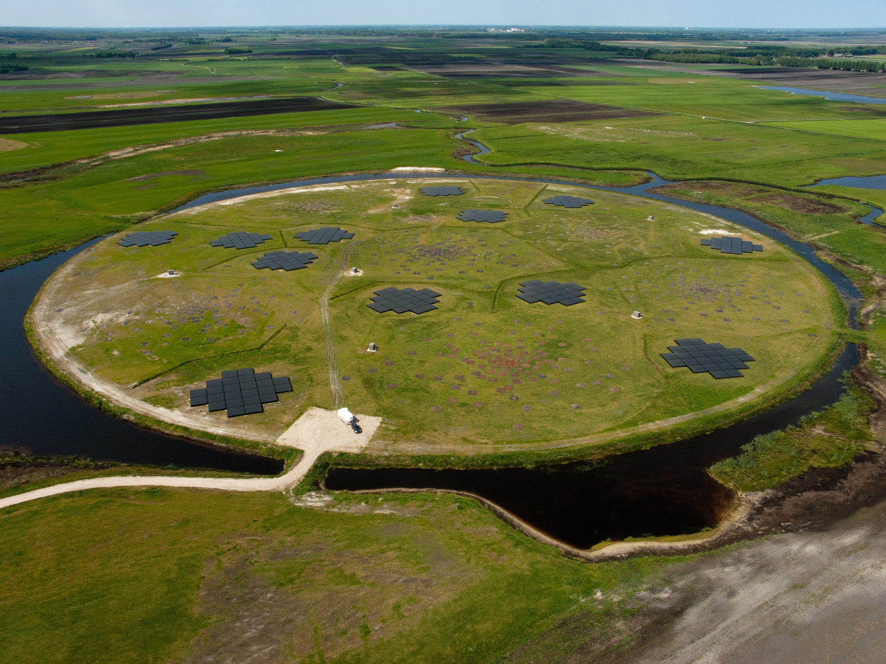

Slide 7
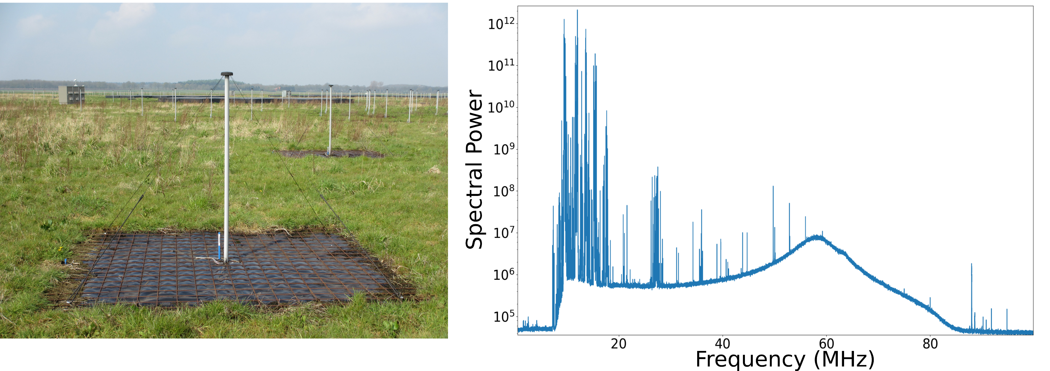

Slide 8
Bandpass RFI filter

Slide 9
Outline
LOFAR radio telescope
Cosmic Rays during thunderstorm environment
Detailed 3D maps of lightning

Slide 10
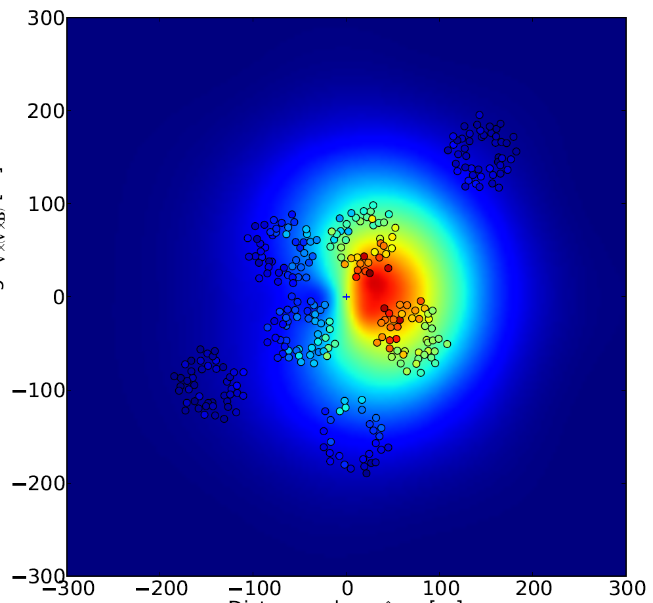
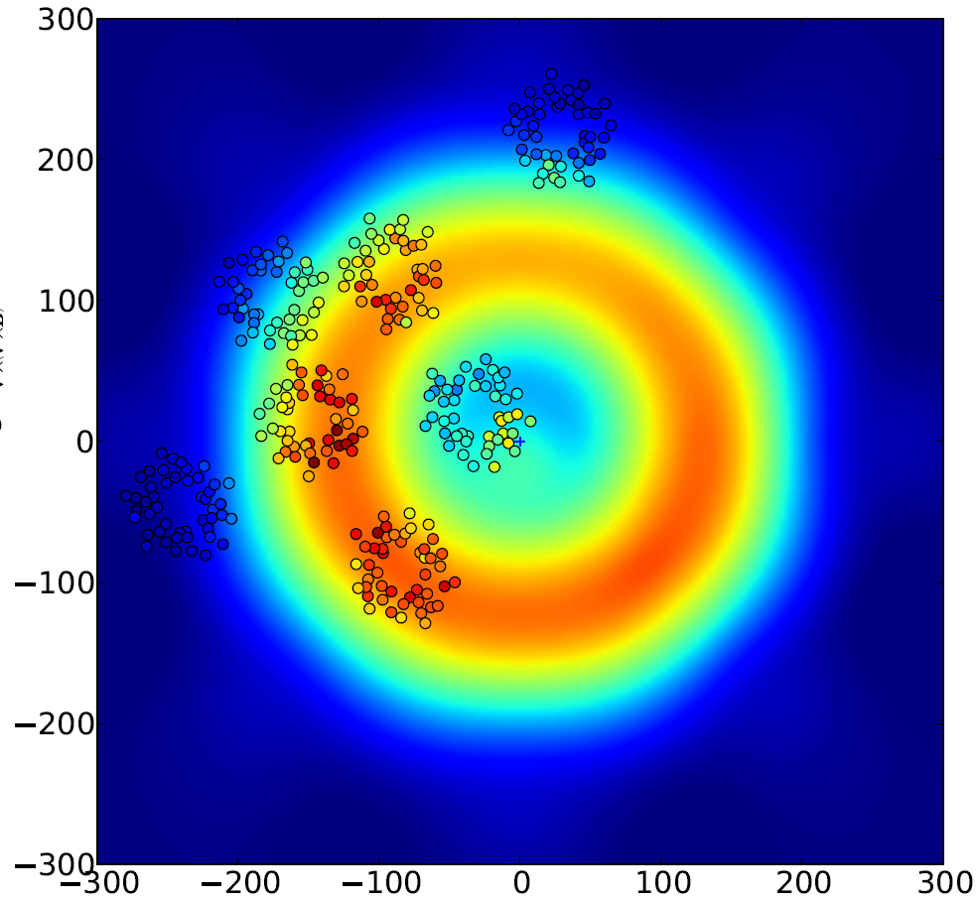
Cosmic Ray Air Shower Intensity Footprint
Fair-Weather
Thunderstorm
ID 83687299
zenith 24 deg
325 antennas
$χ^{2}$/ndf = 3.1
S. Buitink et al.
(PRD 90, 082003 (2014))
P. Schellart, T.N.G. Trinh et al.
(PRL 114, 165001)

Slide 11
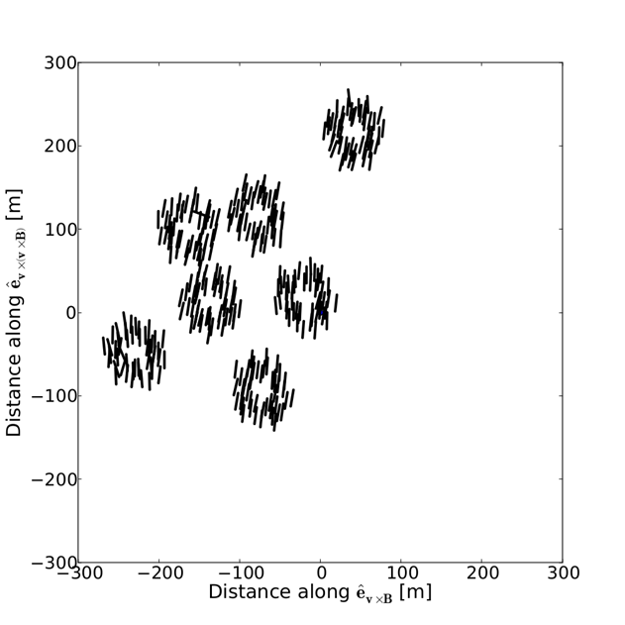
Polarization Footprint
Fair weather events are polarized in V x B direction

Slide 12
Polarization Footprint
Direction of atmospheric electric field
Fair weather events are polarized in V x B direction

Slide 13
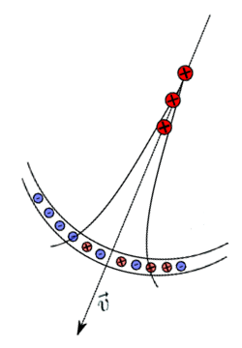
Radiation Mechanism
$${\vec{E}}_{⊥}$$
Deflects e⁻ and e⁺
Dominant effect between 10-90 MHz
$${\vec{E}}_{//}$$
Separates e⁻ and e⁺

Slide 14
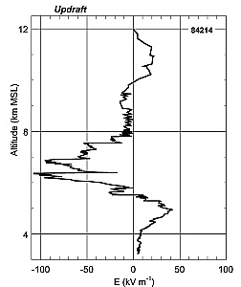
Algorithm to Extract Thunderstorm Electric Fields
12
Choose electric field model
Altitude (km MSL)
8
4
-100
-50
0
50
100
E (kV/m)
Notes:
Add a Balloon Picture

Slide 15
Algorithm to Extract Thunderstorm Electric Fields
12
Choose electric field model
Three layer model
H₃
Altitude (km MSL)
8
H₂
H₁
4
-100
-50
0
50
100
E (kV/m)

Slide 16
Algorithm to Extract Thunderstorm Electric Fields
12
Choose electric field model
Three layer model
Insert into air shower model
e.g. CORSIKA and CoREAS
H₃
Altitude (km MSL)
8
H₂
H₁
4
-100
-50
0
50
100
E (kV/m)

Slide 17
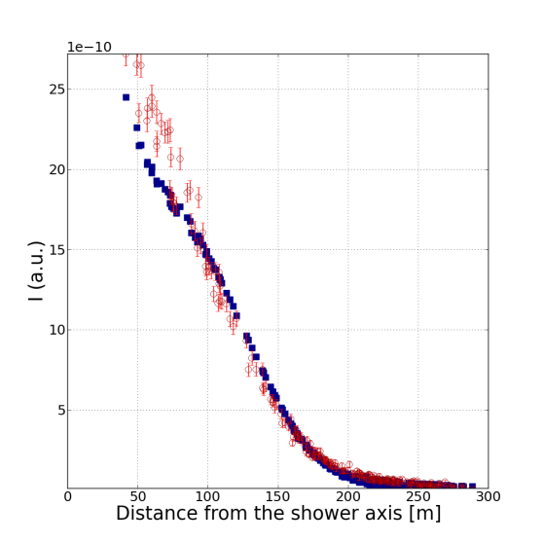
Algorithm to Extract Thunderstorm Electric Fields
1
Choose electric field model
Three layer model
Insert into air shower model
e.g. CORSIKA and CoREAS
Fit to Stokes Parameters
I = intensity
V = circular polarization
3. U+Q = total linearly polarized
4. U/Q = linear polarization angle
I (uncalibrated)
V/I
0
0
150
300
-1
0
150
300
1
1
U/I
0
Q/I
0
-1
-1
0
150
300
0
150
300
Distance from Shower Axis (m)
Notes:
Fix Stokes Params

Slide 18
Results (for one event)
Layer | 1 | 2 | 3
Height (km) | 8-5 | 5-2 | 2-0
E_{vxz} (kV/m) | 46 | 13 | 4
E_{vx(vxz)} (kV/m) | -22 | -9 | 8
Every event is unique, must be fit separately
Strong Horizontal Electric fields ( > 50 kV/m)
Unexpected
Strong electric fields in non-thunderstorm clouds
Notes:
Fix table
Add only one event, each event is unque

Slide 19
Outline
LOFAR radio telescope
Cosmic Rays during thunderstorm environment
Detailed 3D maps of lightning

Slide 20
RF pulses observed by LOFAR from lightning
Uncalibrated Amplitude
0
100
200
Time (μs)

Slide 21
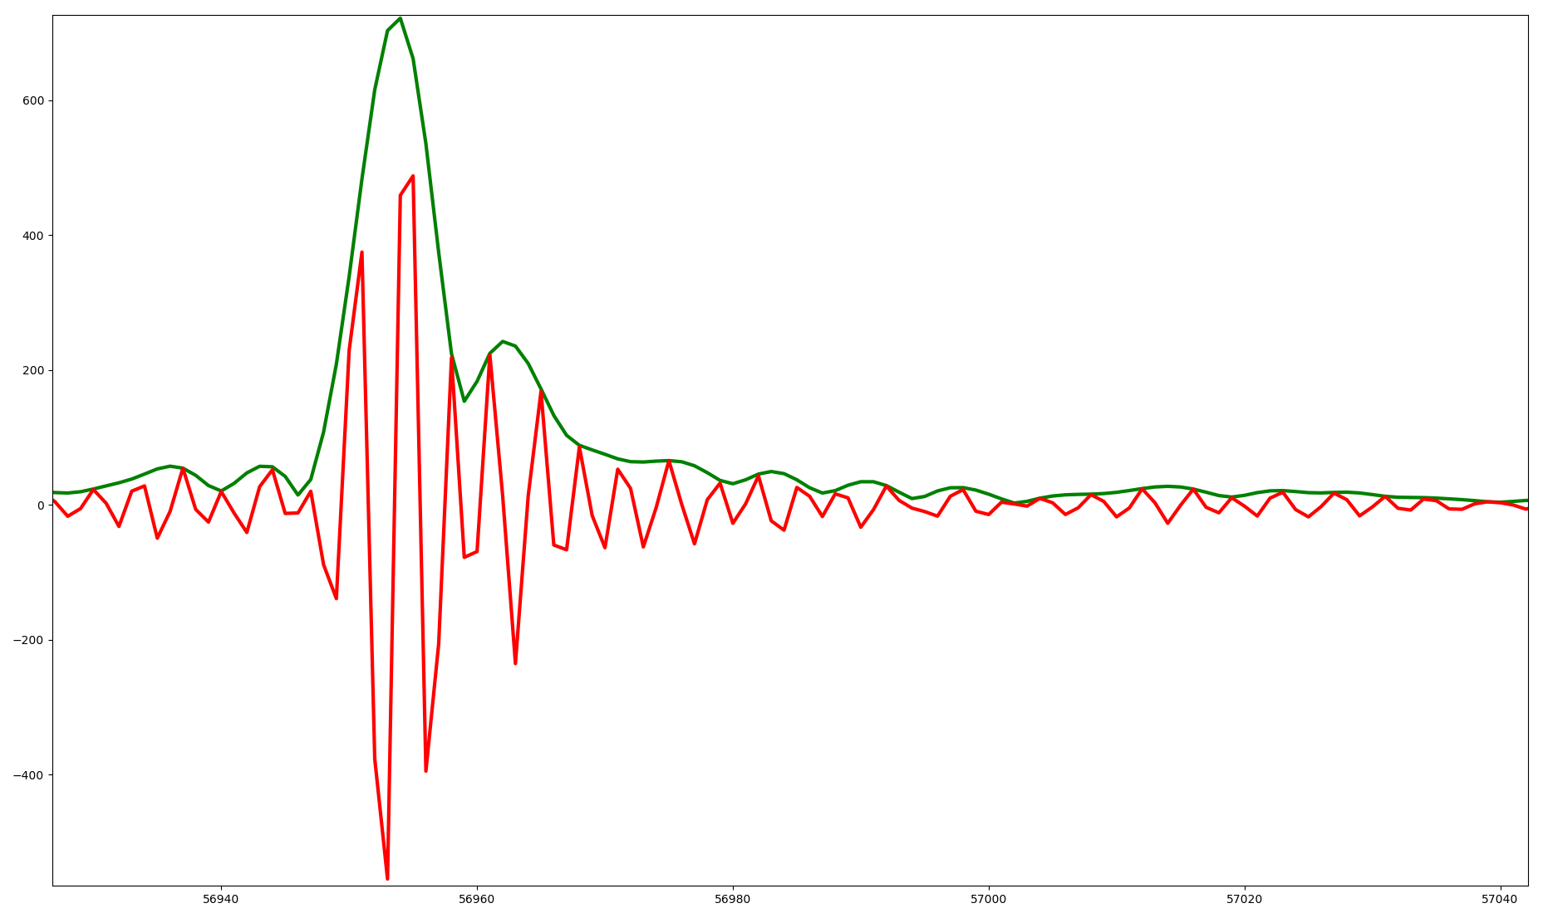
RF pulses observed by LOFAR from lightning
Over 100,000 pulses per flash
Complex shapes belie breakdown physics
Also have polarization information
Uncalibrated Amplitude
0
0.2
0.4
Time (μs)
0
100
200
Time (μs)

Slide 22
Time-of-Arrival mapping
Lightning plasma channel
C² (t-t_{i})² = (X-X_{i})² + (Y-Y_{i})² + (Z-Z_{i})²
( X_{i}, Y_{i}, Z_{i}, t_{i})

Slide 23
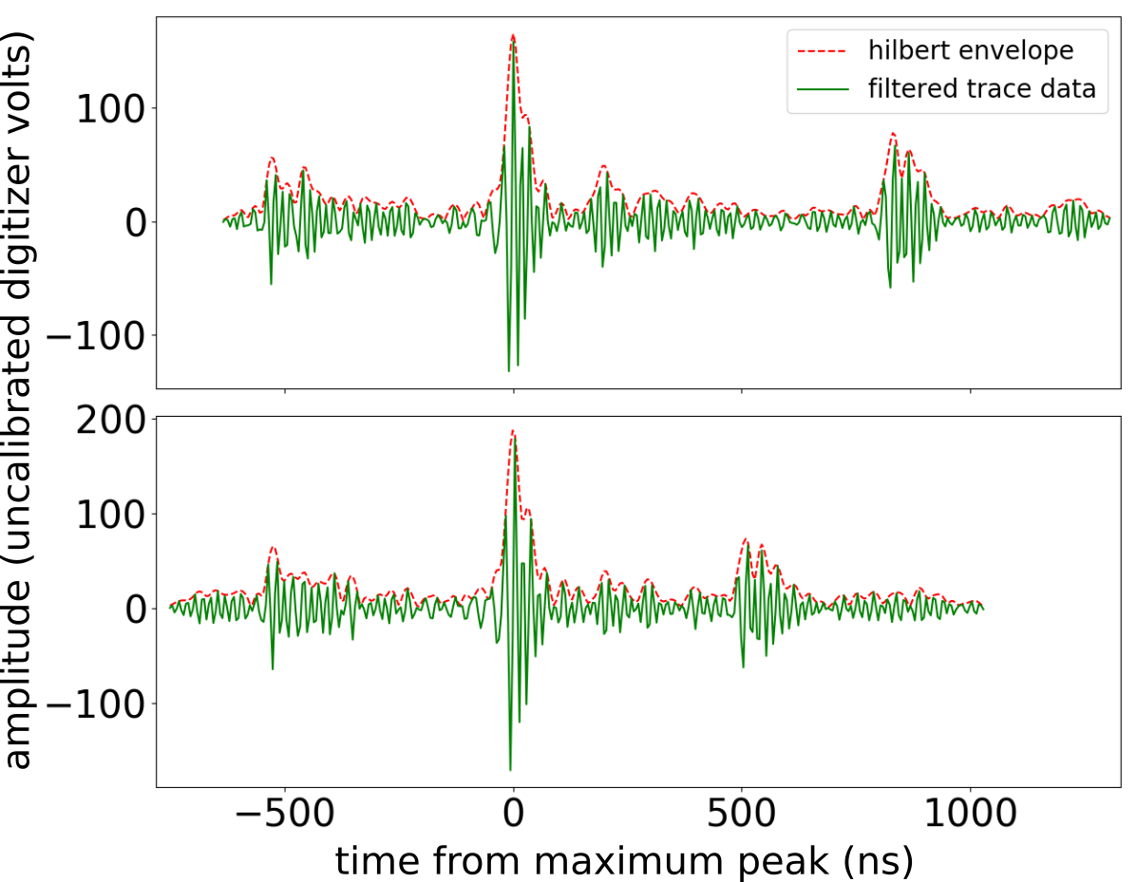
The Difficulty

Slide 24
The Difficulty
The largest pulses are easy to sort

Slide 25
The Difficulty
The largest pulses are easy to sort
?
?
But the smaller pulses are harder to sort
Note: order and shape of pulses changes between stations

Slide 26
The Difficulty
The largest pulses are easy to sort
But the smaller pulses are harder to sort
Note: order and shape of pulses changes between stations
Have developed new algorithm to sort pulses

Slide 28
3D Lightning Mapping
0
20
40
60
80
100
120
140

Slide 29
3D Lightning Mapping
0
20
40
60
80
100
120
140
Zoom into positive leader

Slide 30
Positive Leader
5.2
altitude (km)
4.8
70
80
90
time (ms)
2.4
2.2
north – south (km)
2.0
1.8
2.1
2.3
2.5
2.7
east – west (km)

Slide 31
Positive Leader
5.2
altitude (km)
4.8
70
80
90
time (ms)
2.4
2.2
zoom in
north – south (km)
2.0
1.8
2.1
2.3
2.5
2.7
east – west (km)

Slide 32
Needle on Leader Branch
Positive Leader
4.88
5.2
altitude (km)
altitude (km)
4.8
4.82
70
80
90
70
80
90
time (ms)
time (ms)
2.36
2.4
2.2
zoom in
2.34
north – south (km)
north – south (km)
2.0
2.32
2.20
2.24
1.8
east – west (km)
2.1
2.3
2.5
2.7
east – west (km)

Slide 33
Needle on Leader Branch
General Properties
Propagate away from positive leader body
30 – 100 m long
Each needle can re-excite multiple times
Around 5 ms between re-excitations
Occur all along leader channel, not just at tip
4.88
altitude (km)
4.82
70
80
90
time (ms)
2.36
2.34
north – south (km)
2.32
2.20
2.24
east – west (km)

Slide 34
Conclusion
Two new operational modes for LOFAR:
Measure electric fields with cosmic rays
3D lightning mapping
Can map smaller structures then any other instrument
See new structures that develop on positive lightning channels
LOFAR measures strong horizontal electric fields
Even in storms not actively producing lightning

Slide 35
Negative Leader
Positive Leader
3.0
5.2
altitude (km)
altitude (km)
2.6
4.8
0
10
20
70
80
90
time (ms)
time (ms)
1.5
2.4
1.0
2.2
north – south (km)
north – south (km)
0.5
2.0
1.8
0.0
0.0
0.5
1.0
2.1
2.3
2.5
2.7
east – west (km)
east – west (km)

Slide 36
Propagation of Positive Leaders
LMA observation of an upward positive leader
6
4
Altitude (km)
2
0
0
20
40
60
Time (ms)
Adapted from Hare et al. 2016

