Slide 1
Atmospheric Monitoring
for UHECR Space-based Missions
Simon Mackovjak, Anna Anzalone
for the JEM-EUSO collaboration

Slide 2
Abstract
The JEM-EUSO (Joint Experiment Missions for Extreme Universe Space Observatory) program has the ambition to observe Extensive Air Showers (EAS) induced by Ultra High Energy Cosmic Rays (UHECR) from the Space. For this purpose, the study of the night Earth's atmosphere with respect to the EAS detection is obligatory. A such study needs to address the estimation of the future main instrument performance in various atmospheric conditions as well as the development of the space-based system for direct atmospheric monitoring. The preparation of the methods for the data analysis and their fusion is also a topic that needs to be addressed. The conjuncted operation of LIDAR, Airglow Monitor, Infrared Cloud Camera and Global Light System of ground-based laser stations would provide complex information of the atmospheric conditions from the top of the atmosphere to the ground. The systems for atmospheric monitoring employed in JEM-EUSO pathfinder missions are presented and the consequences of atmospheric changes for the main instrument operation are discussed.

Slide 3
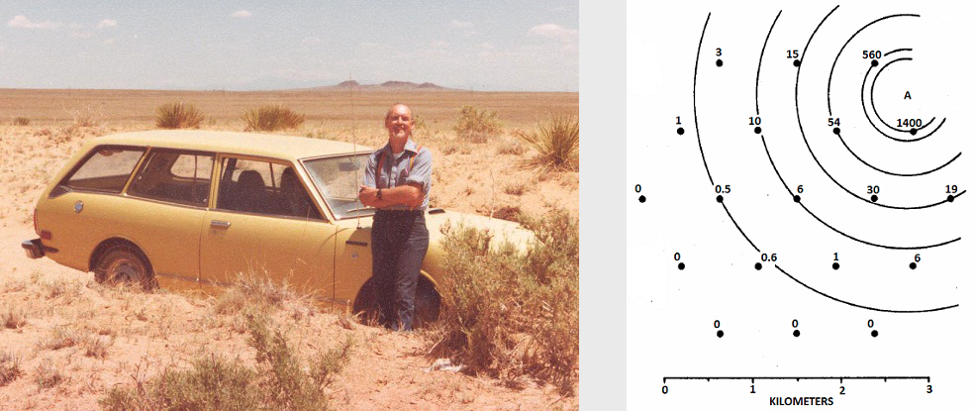
John Linsley
1962 - he observed an air shower created by a primary particle with an energy greater than 10²⁰ eV -> not all cosmic rays are confined within the Galaxy, as had been previously supposed
1979 - he proposed detecting the fluorescence created by ultra high energy cosmic rays (UHECR) in the atmosphere through the use of a space-based observatory
1998 - EUSO (Extreme Universe Space Observatory) has begun to be continuation of this idea

Slide 4
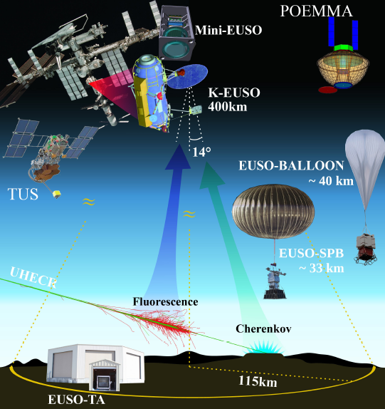
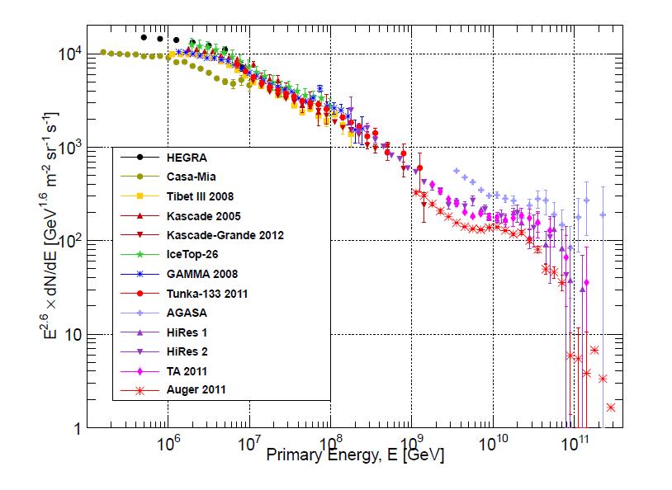
JEM-EUSO is a program towards space-based observatory that will utilize the Earth’s atmosphere as a detector of UHECR
(Gaisser et al., 2013)

Slide 5
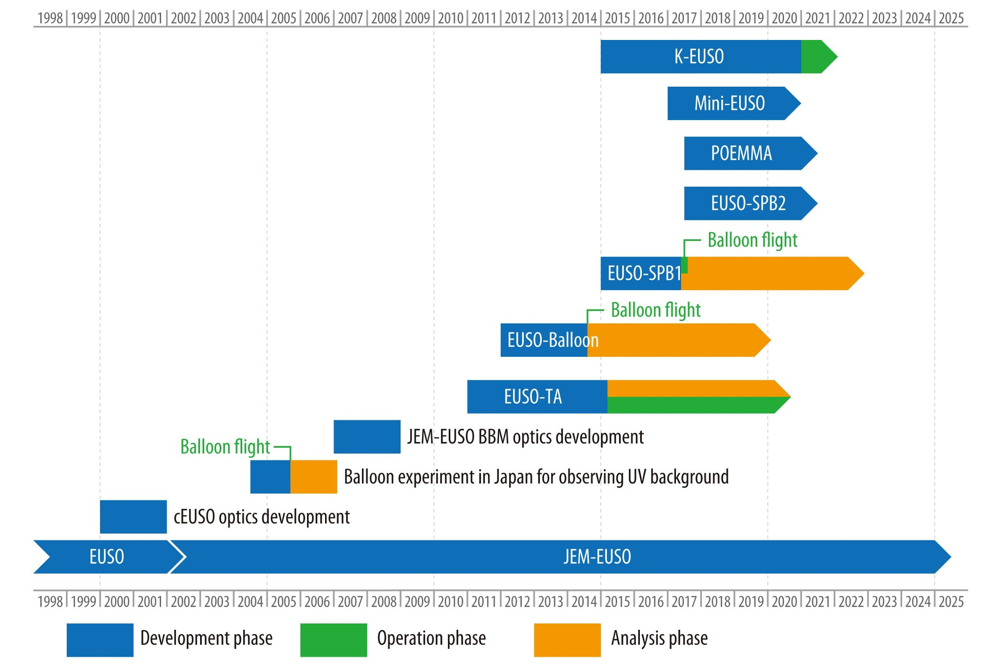

Slide 6
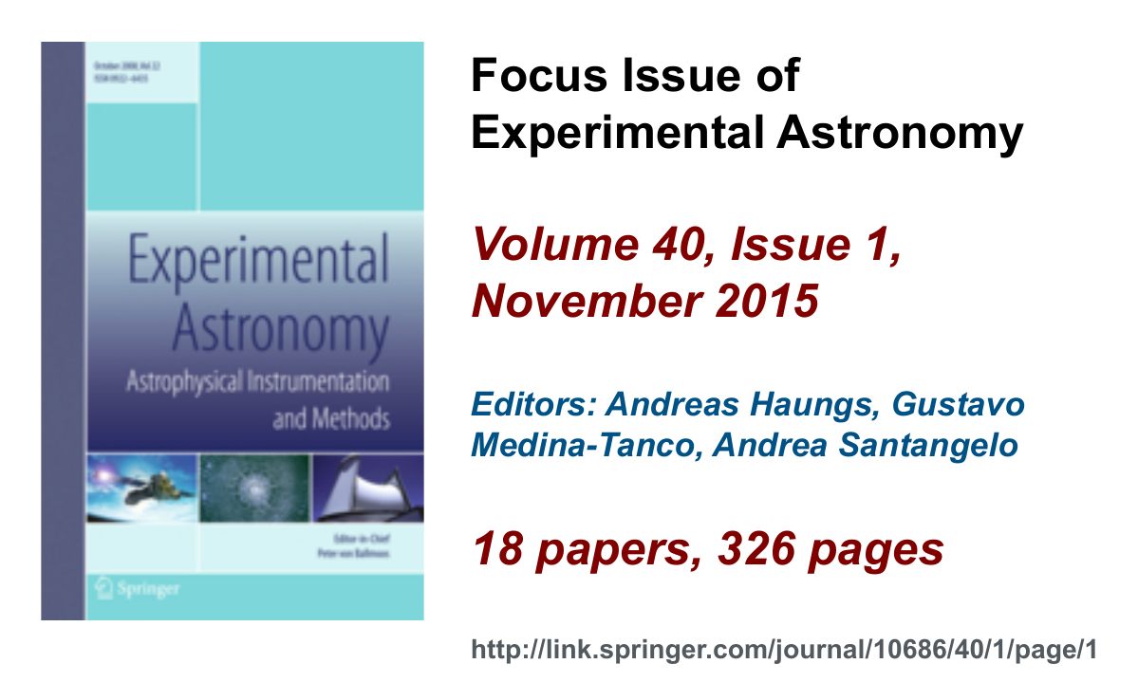
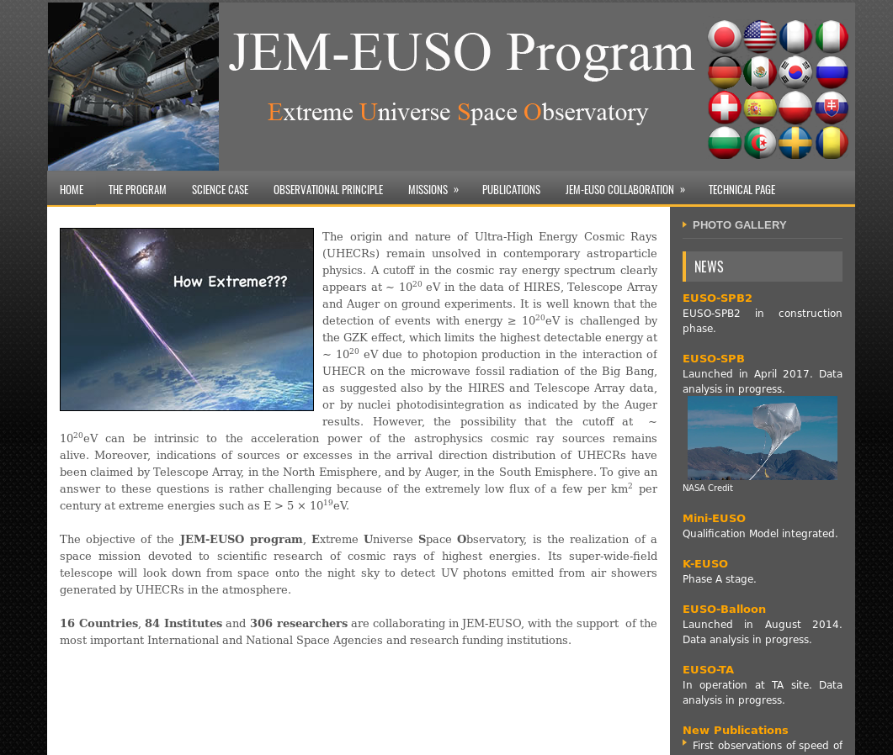
More info about JEM-EUSO program:
http://jem-euso.roma2.infn.it

Slide 7
Goals of the night Earth's atmosphere study
estimation of the future main instrument performance in various atmospheric conditions
development of the space-based systems for direct monitoring of atmospheric conditions from the top of the atmosphere to the ground
Airglow Monitor
Infrared Cloud Camera
LIDAR
Global Light System of ground-based laser stations
Slow mode of the main instrument
development of methods for these systems and implementation of Global atmospheric model from meteorological data

Slide 8
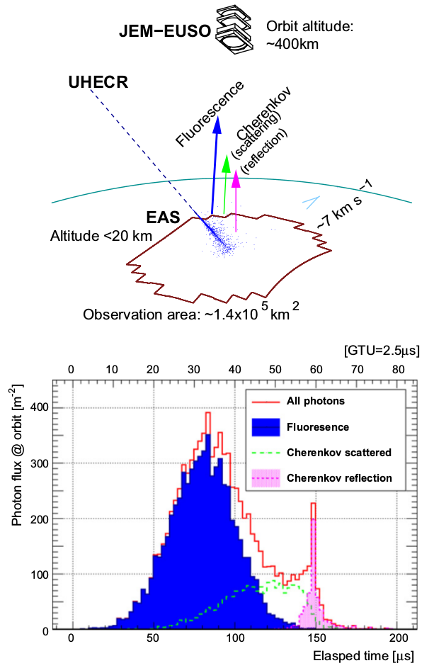
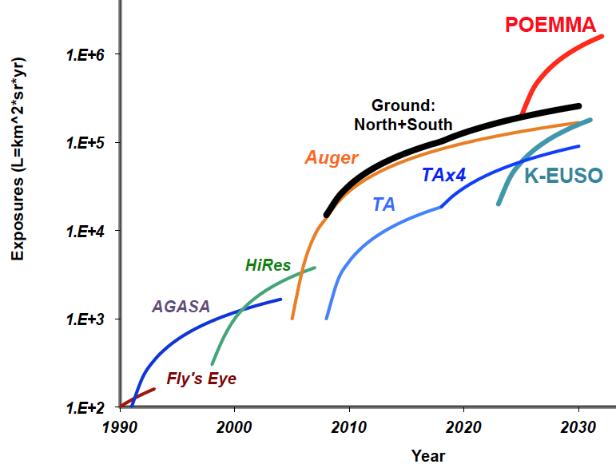
Instrument Performance
K-EUSO - construction phase leaded by Russia
POEMMA (Probe Of Extreme Multi-Messenger Astrophysics) - design phase founded by NASA
JEM-EUSO: 2013, Astropart Phys, 44, 76–90

Slide 9
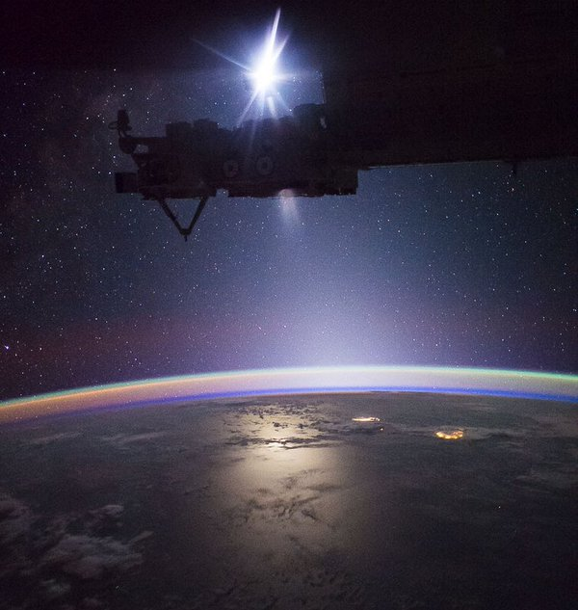
Atmospheric light contribution
ISS
Moon
The sum of any light in observable band with wavelengths λ∼250 – 500 [nm] seen in the direction downwards earth through the atmosphere.
It is composed of permanent sources:
Airglow +
Starlight
Zodiacal light
and temporary sources:
Sun, Moon, Man-made lights, Lightning, Aurora
Stars
Zodiacal light
Airglow
Man-made lights
Moon’s reflection
(Image by: Dan Burbank, NASA astronaut, 2016)

Slide 10
For estimation of airglow influence we need:
Selection of spectral band
we are interested in very wide spectral bands (300 - 500 nm, 500 - 700 nm)
measurements are usually done by narrow band filters only
Inclusion of all effects that cause the airglow variation
solar activity & space weather
atmospheric tides & terrestrial weather
Understanding of airglow production geometry
nadir and tilt mode - looking to layer light source

Slide 11
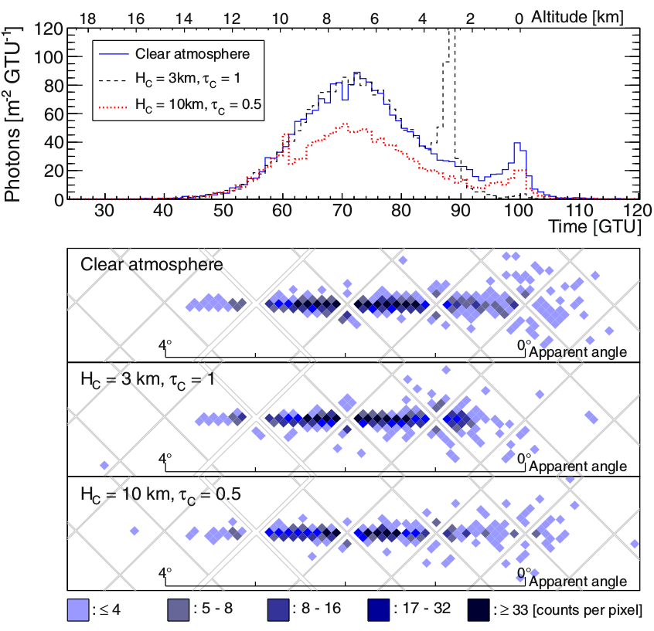
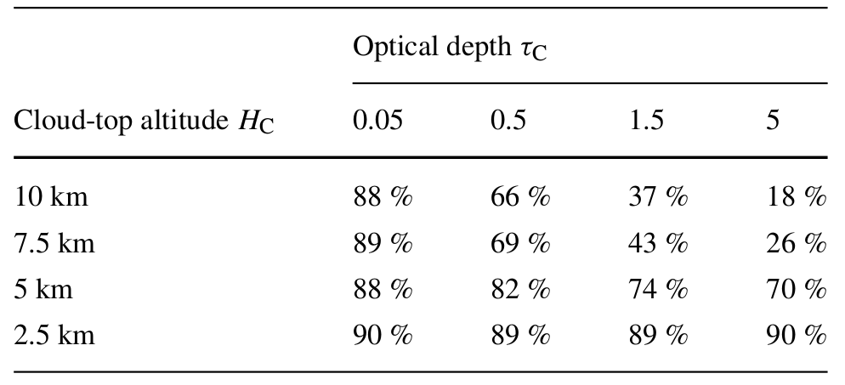
Performance in cloudy conditions
JEM-EUSO: 2015, Exp Astron, 40, 135–152

Slide 12
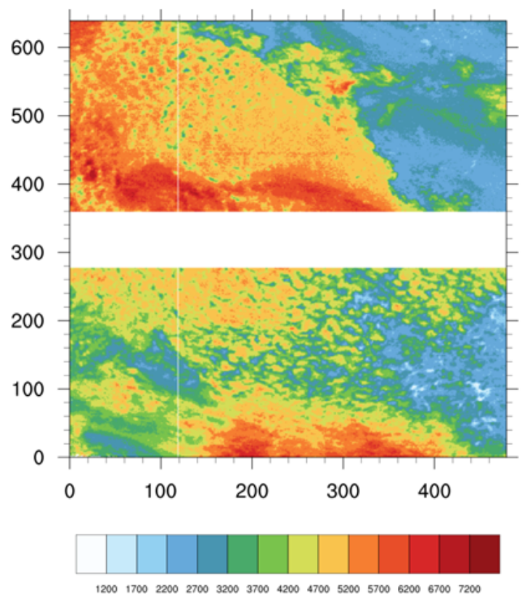
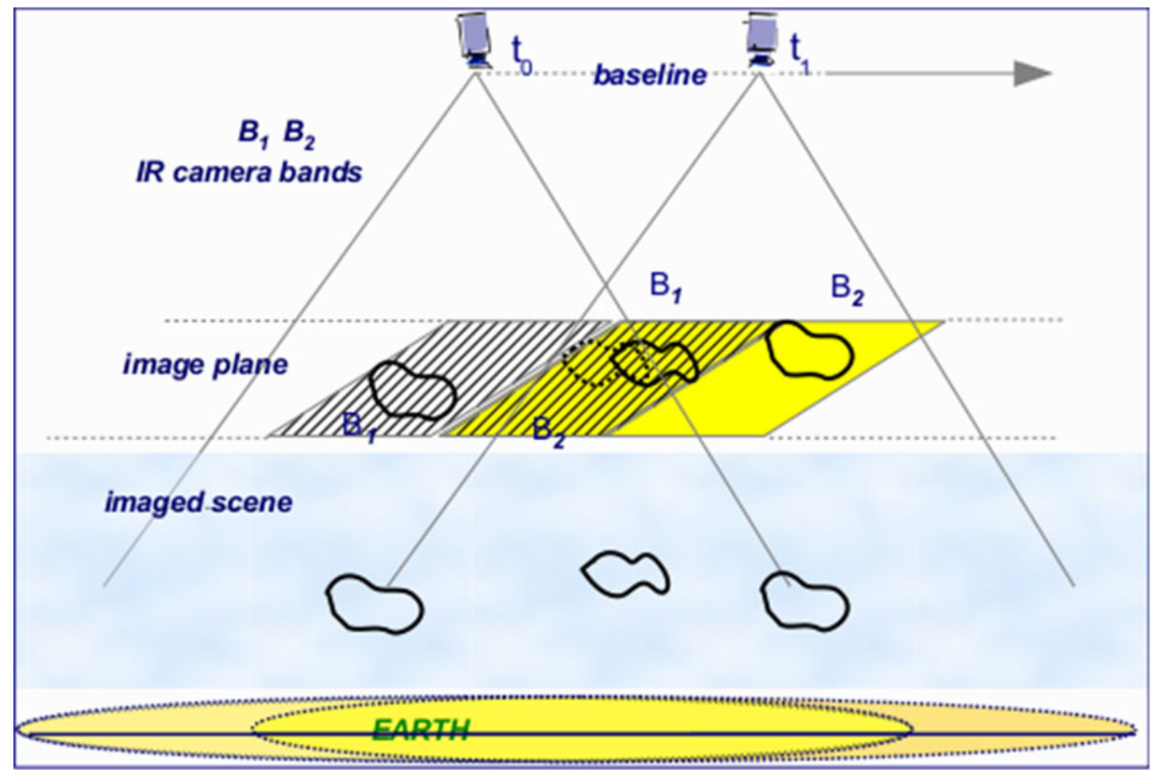
IR camera - atmospheric conditions are needed for the EAS reconstruction
Cloud coverage
Cloud-Top Height
CTH estimation from IR cam on EUSO-Balloon
Merino et al.: 2015, 34th ICRC
JEM-EUSO: 2015, Exp Astron, 40, 61-89

Slide 13
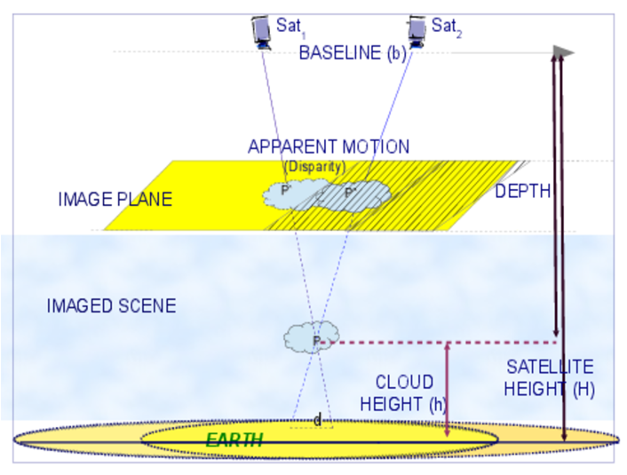
Methods for the IR data analysis: CTH retrieval
Radiative Transfer-based Method
Stereo Vision-based Method
it uses pairs of images of the same cloudy scene
it is independent from atmosphere and cloud parameters

Slide 14
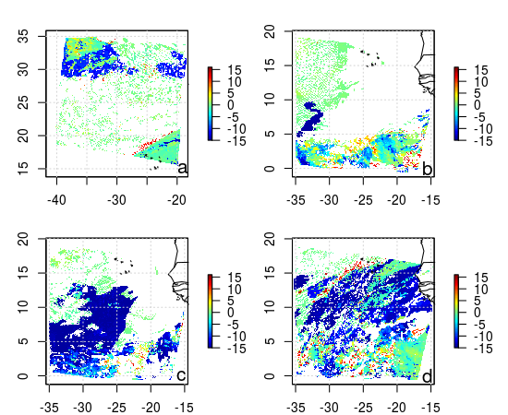
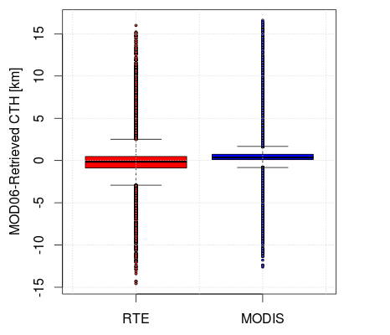
Verification of CTH retrieval methods
NWP Modell/WRF CF Method
Radiative method
CTH estimation from IR satellite images
Anzalone et al.: 2018, Methods to Retrieve the Cloud-Top Height in the Frame of the JEM-EUSO Mission, IEEE Transactions on Geoscience and Remote Sensing, doi:10.1109/TGRS.2018.2854296
Stereo Method

Slide 15
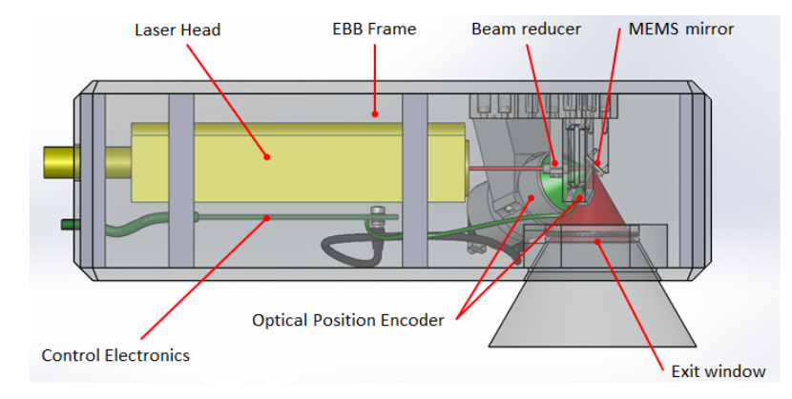
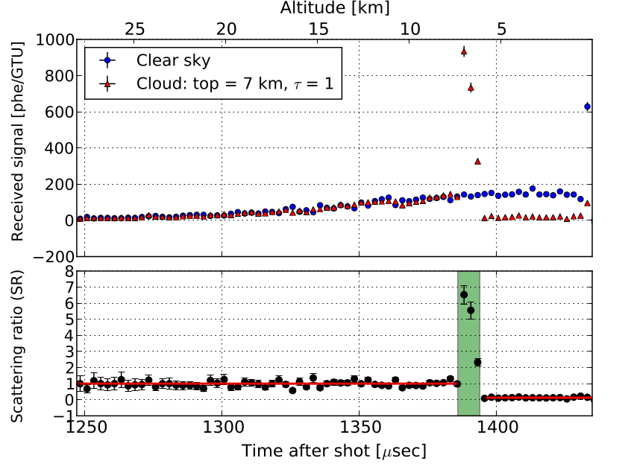
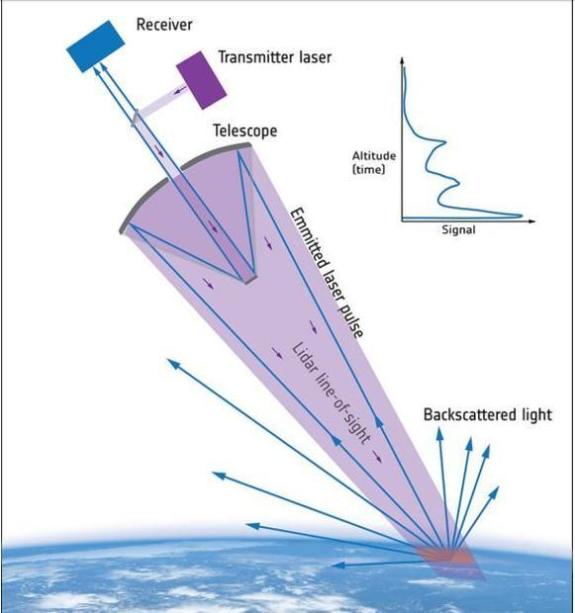
LIDAR - measurements of atmosphere properties between EAS and UV telescope
Nd:YAG laser and a pointing mechanism to steer the laser beam in the direction of EAS
AEOLUS / ESA
JEM-EUSO: 2015, Exp Astron, 40, 45-60
355 nm
532 nm
CALIPSO / NASA (Cloud-Aerosol Lidar and Infrared Pathfinder Satellite Observation) / 7 June 2006

Slide 16
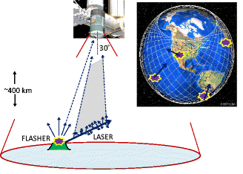
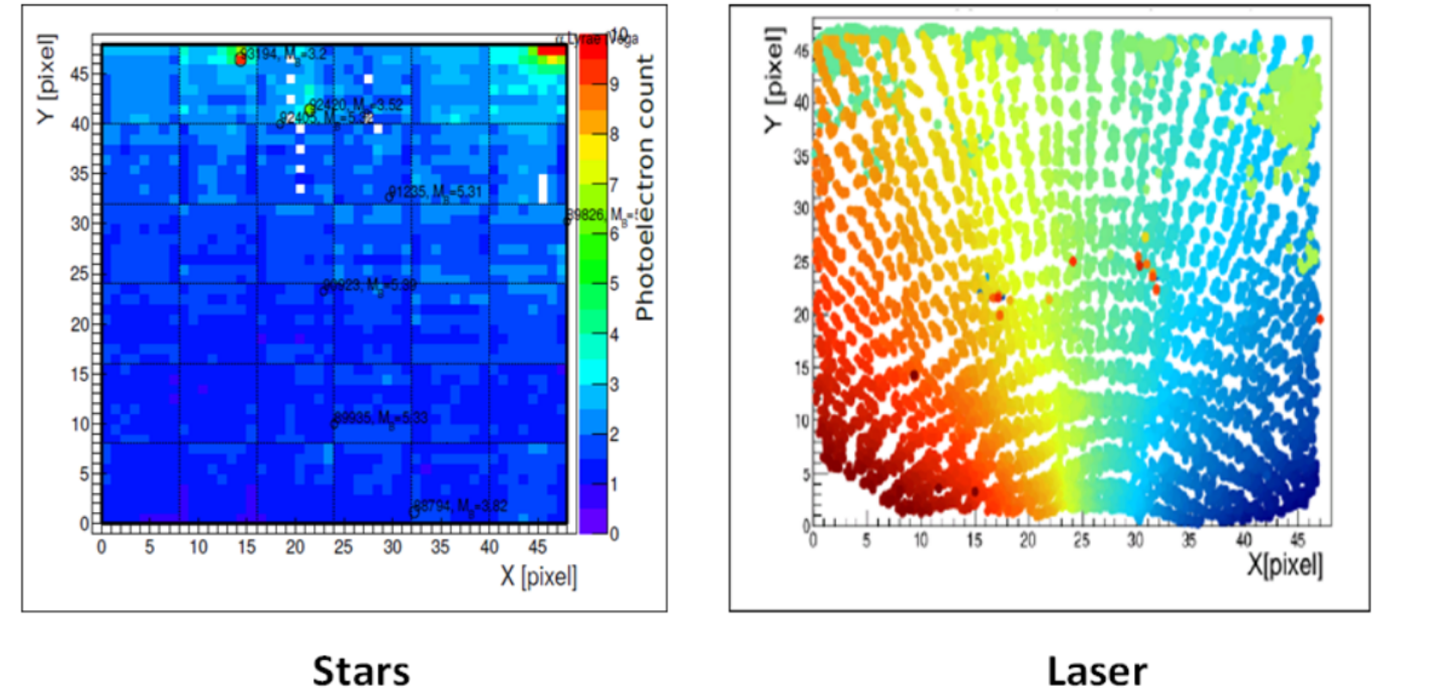
Global Light System of ground-based stations
calibrated xenon flashers
UV lasers
EUSO-Balloon:
flight over
Helicopter
(1s in video ~ 25 µs in reality)
EUSO-SPB1: field tests
JEM-EUSO: 2015, Exp Astron, 40, 91-116
JEM-EUSO: 2017, 35th ICRC

Slide 17
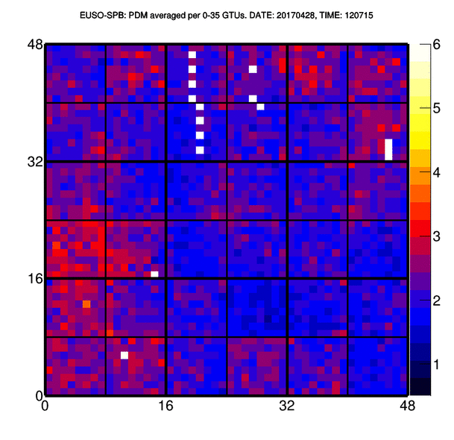
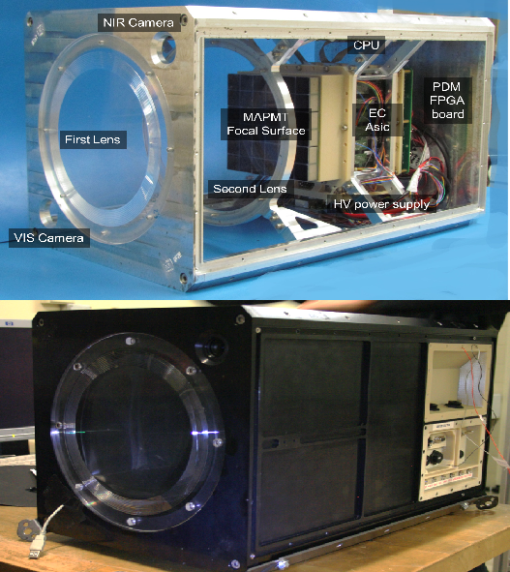
Slow mode - detection of atmospheric conditions by main instrument
EUSO-SPB (2017)
mini-EUSO (2019 - )

Slide 18
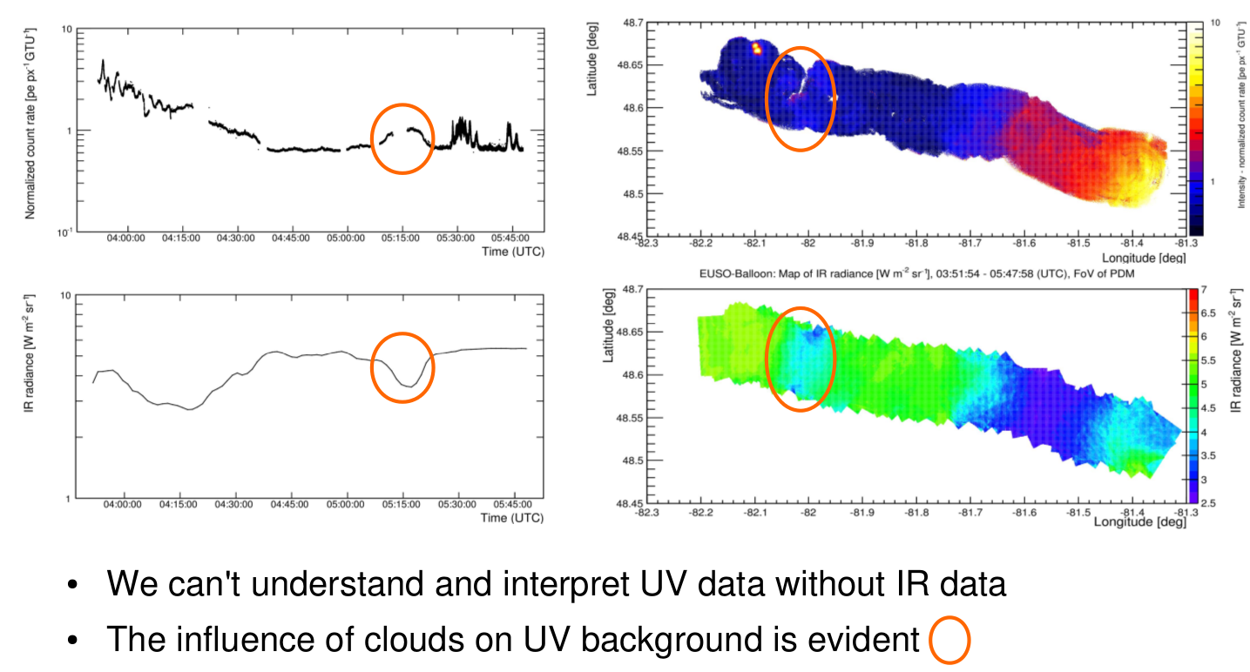
EUSO-Balloon (2014): UV telescope and IR camera
Mackovjak et al. for JEM-EUSO: 2015, ICRC 685

Slide 19
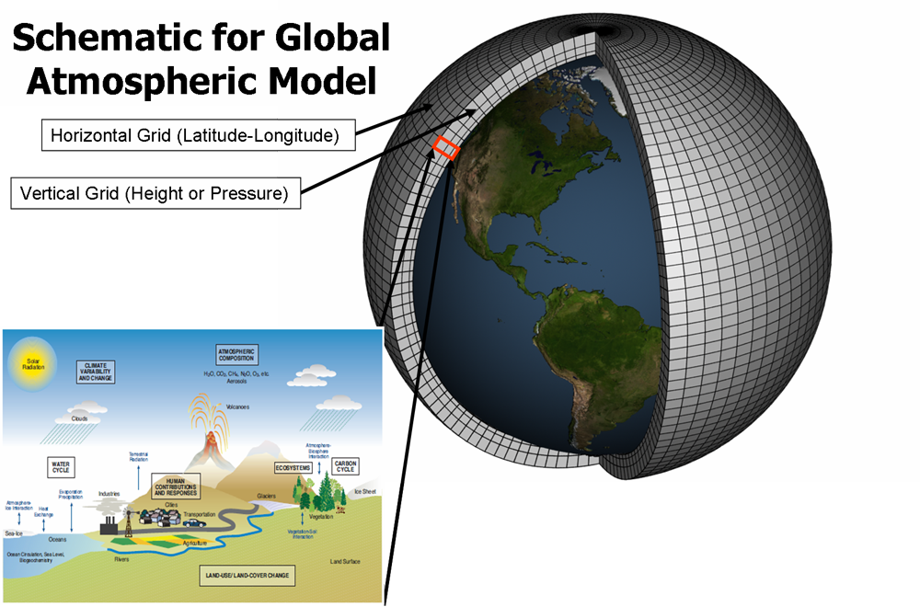
Global Atmospheric model
Implementation of global models of atmospheric conditions would be beneficial for EAS events reconstruction
-> GDAS - Global Data Assimilation System -> 3D grid of temperature, pressure, humidity
-> NWP - Numerical Weather Prediction models -> retrieve CTHs independently from any IR-sensor

Slide 20
Conclusions
Space-based missions (K-EUSO, POEMMA) should be the important part of High Energy Astrophysics and UHECR science roadmap
The first pathfinders (EUSO-TA, EUSO-Balloon, EUSO-SPB) demonstrated the technological level of development process
Atmospheric monitoring is an integral part of whole this effort
New collaborations are welcomed:
Instrumentation and data analysis - > EUSO-SPB2, Mini-EUSO
Simulations -> K-EUSO, POEMMA
[contact: mackovjak@saske.sk]

