Slide 1
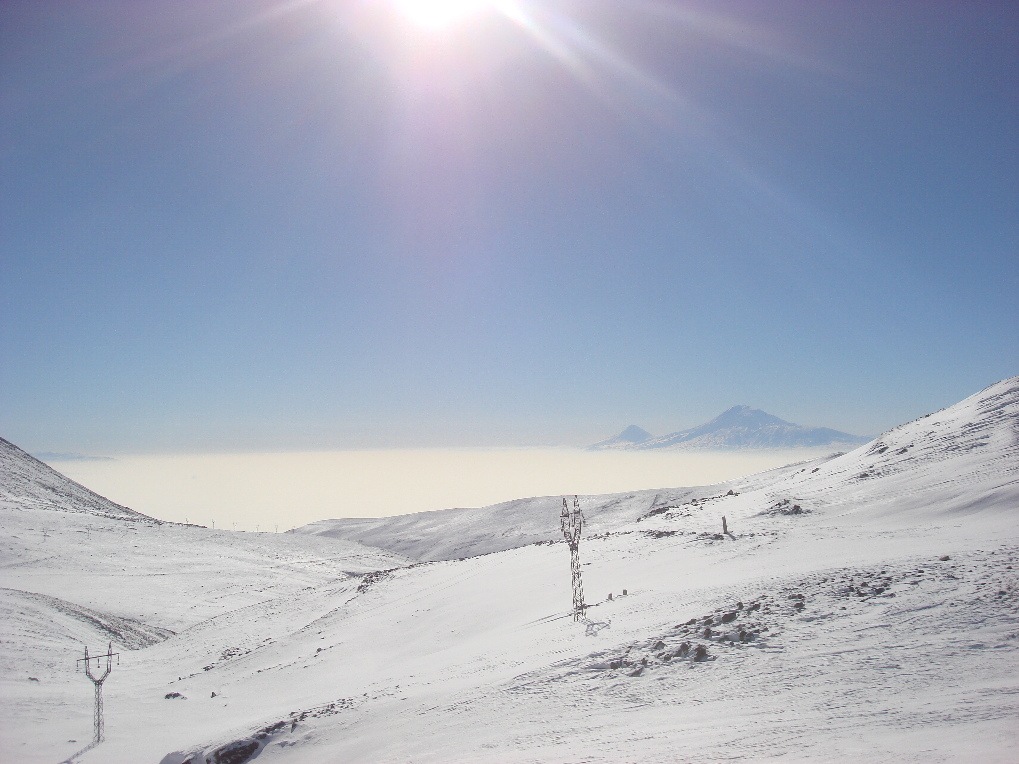

Monitoring of the atmospheric electric field and cosmic ray flux for the interpretation of results in high-energy astroparticle physics experiments
Ashot Chilingarian
Yerevan Physics Institute

Slide 2
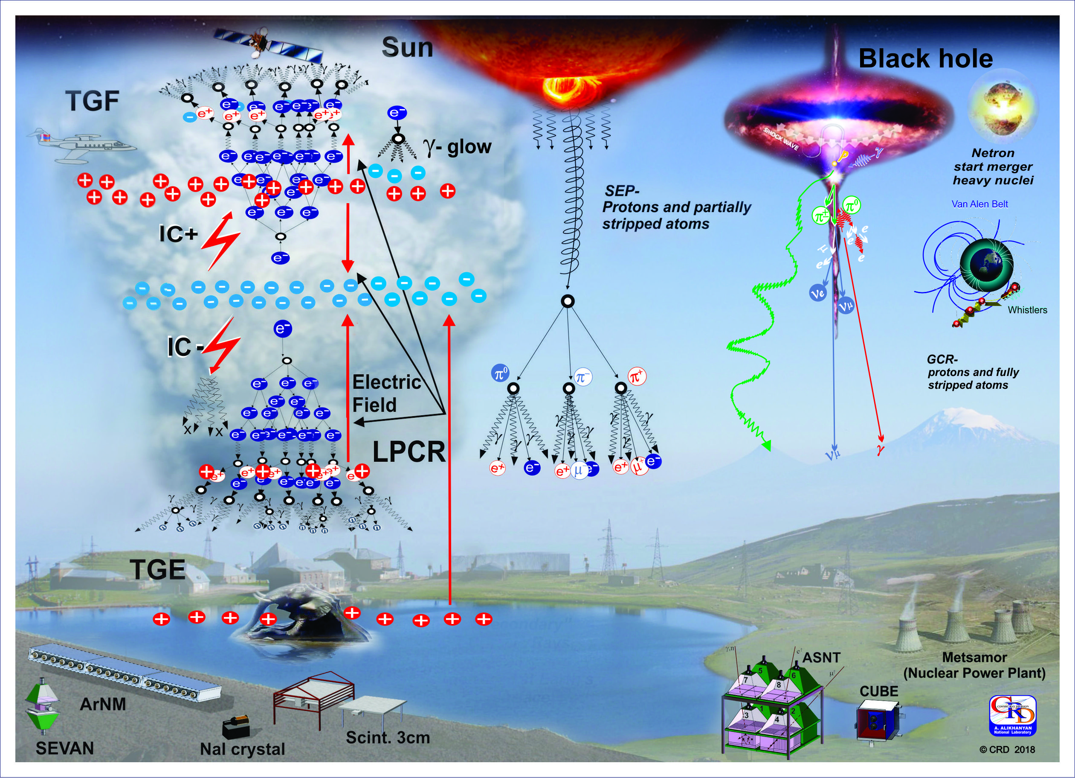

Slide 3
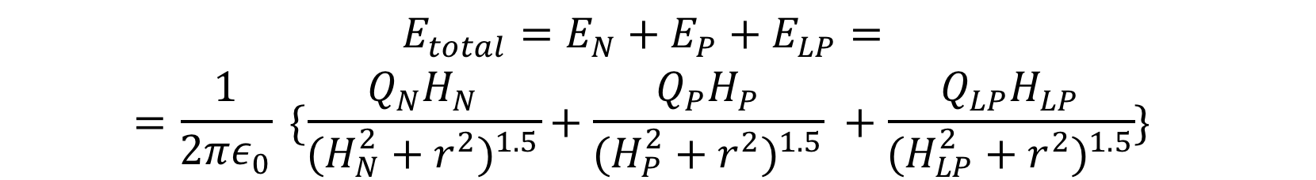
Tripole model of cloud charge structure: electric field at the ground is superposition of fields from the 3 charges above

Slide 4
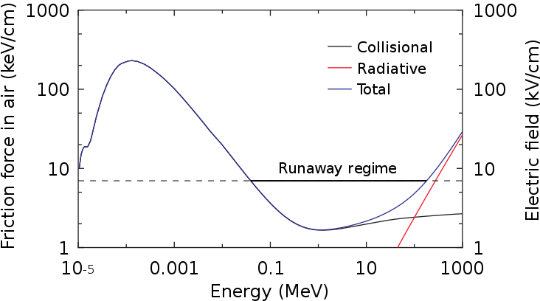
Electron energy losses in the atmosphere and energy gain from the intracloud electric field: RB/RREA process
Cold runaway, fields above 100kV/cm required
^{E} ⁼ ^{2.83kV/cm (sea level)•0,6 =}
^{1.7kV/cm (5000 m asl)}
^{F} ^{= 2,76 keV/cm(sea level} ^{threshold)•0,6}
⁼ ^{1.66} ^{keV/cm (5000 m asl)}
Gurevich et al., (1992), Symbalisty et al. (1998), Babich et al. (1998), Dwyer (2003), Chilingarian (2014)

Slide 5
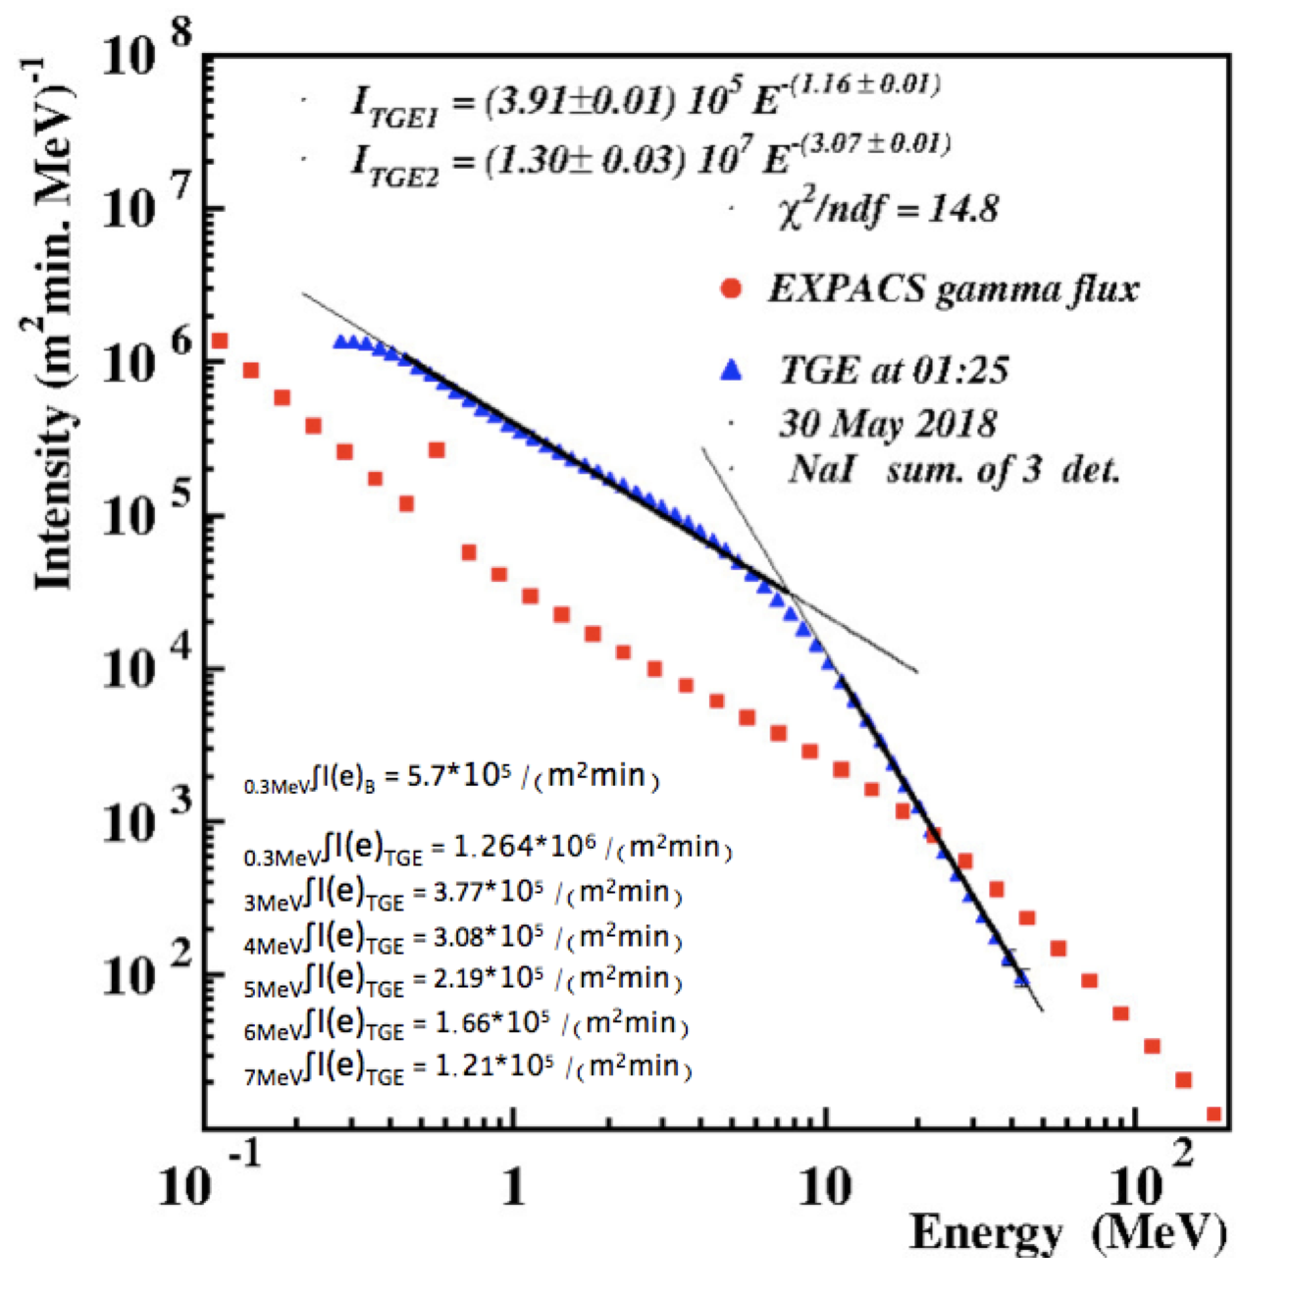
CR background spectrum and TGE spectrum observed on 30 May 2018. In the left bottom corner - values of integral spectrum calculated for different energy thresholds.

Slide 6
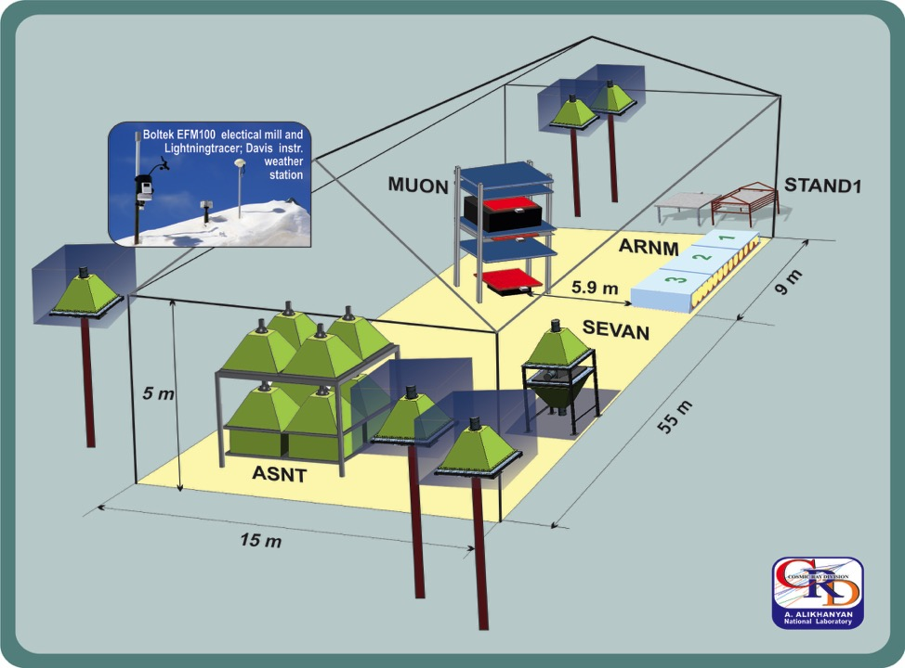
Particle detectors located in MAKET experimental hall on Aragats 3200 m above sea level

Slide 7
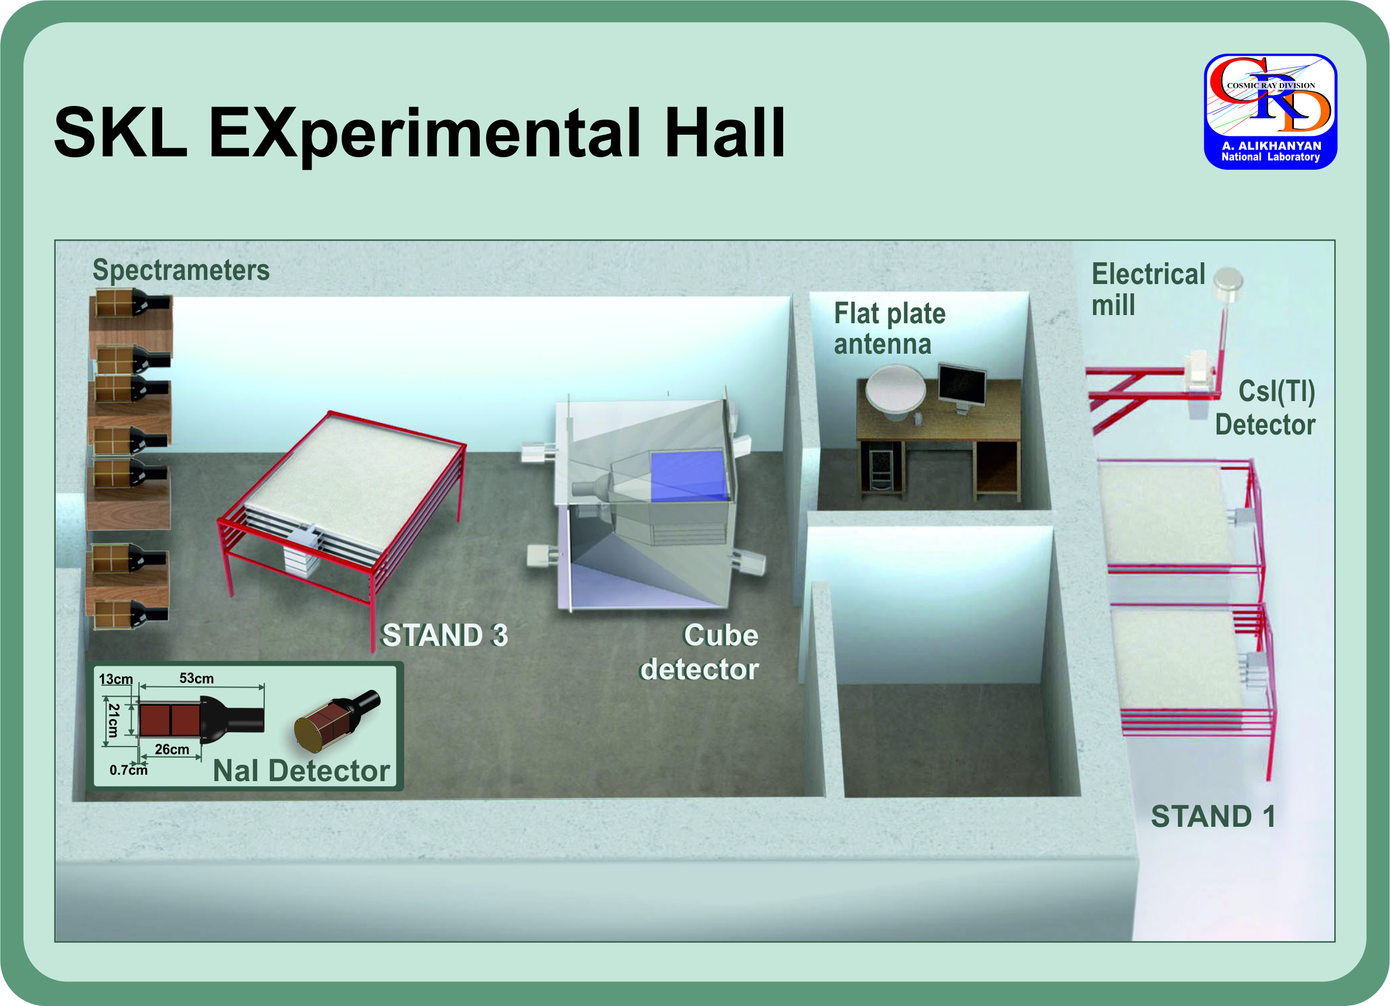

Slide 8
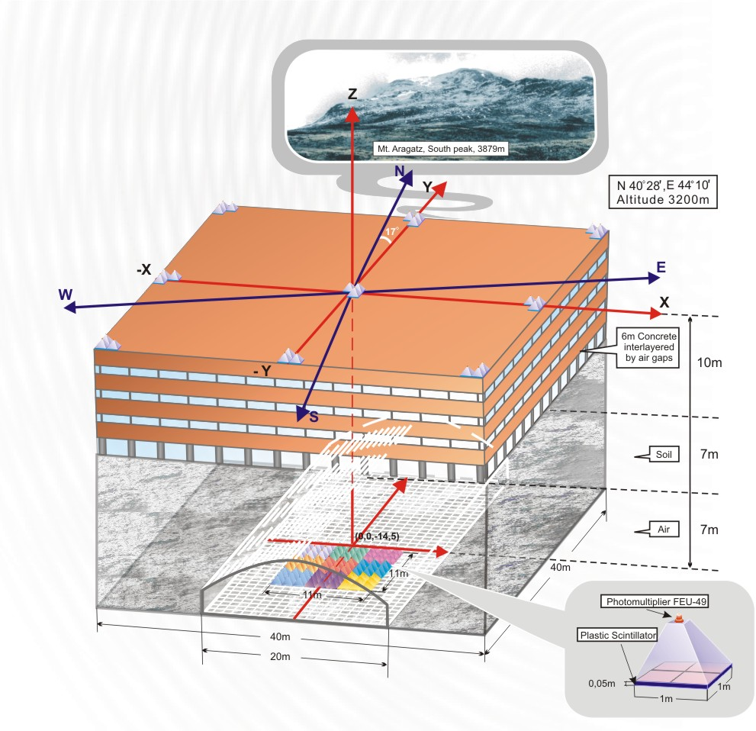

Slide 9
Thunderstorm observation: origin of lightning flashes and high energy particle bursts. Is it correlation only or causal relation?

Slide 10
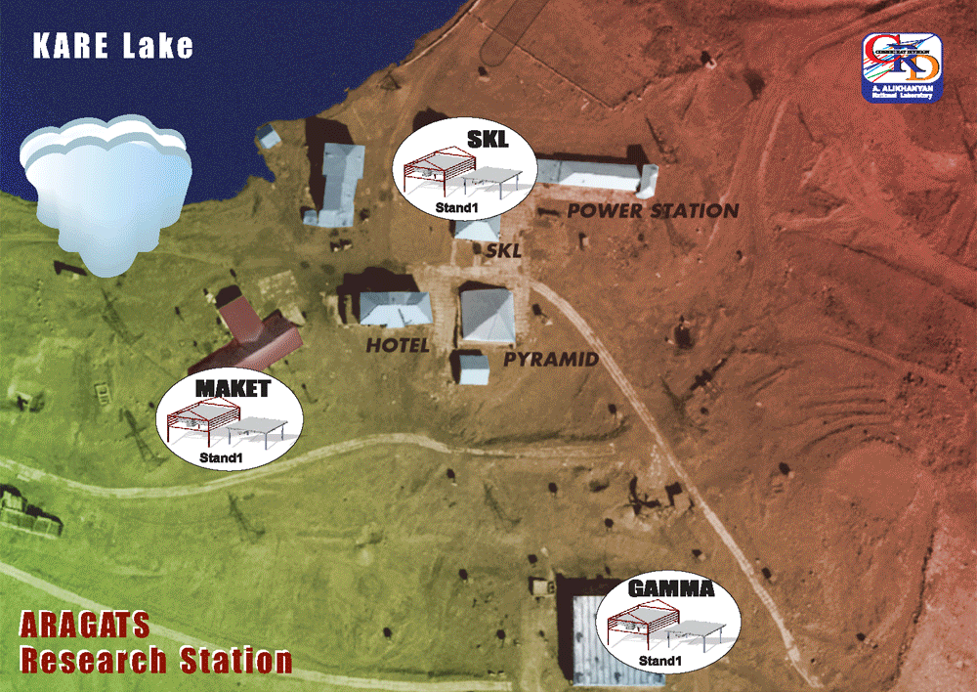

Slide 11
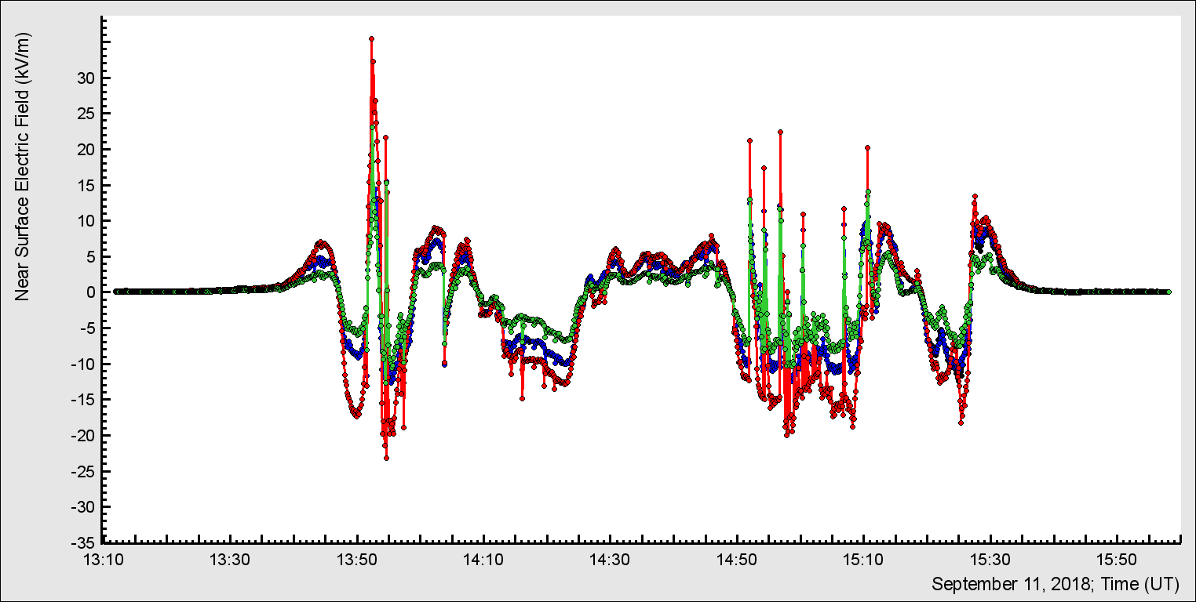
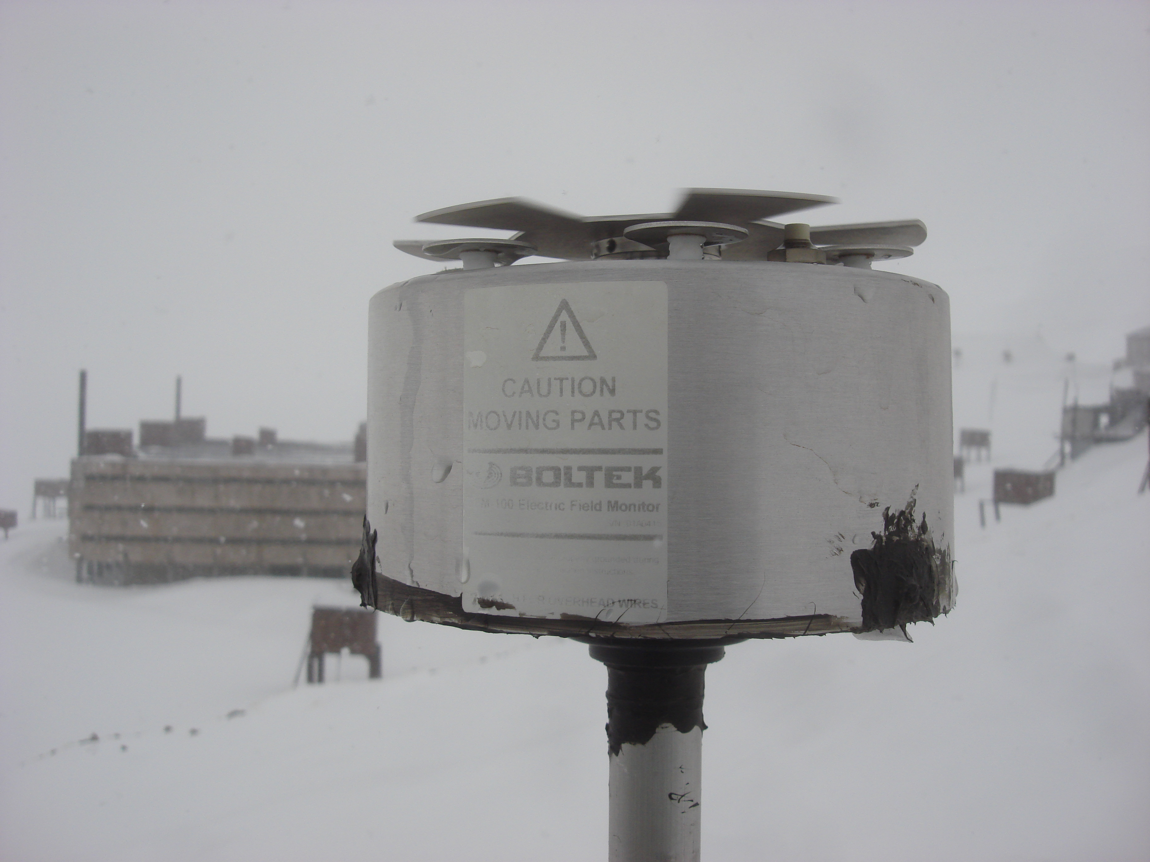
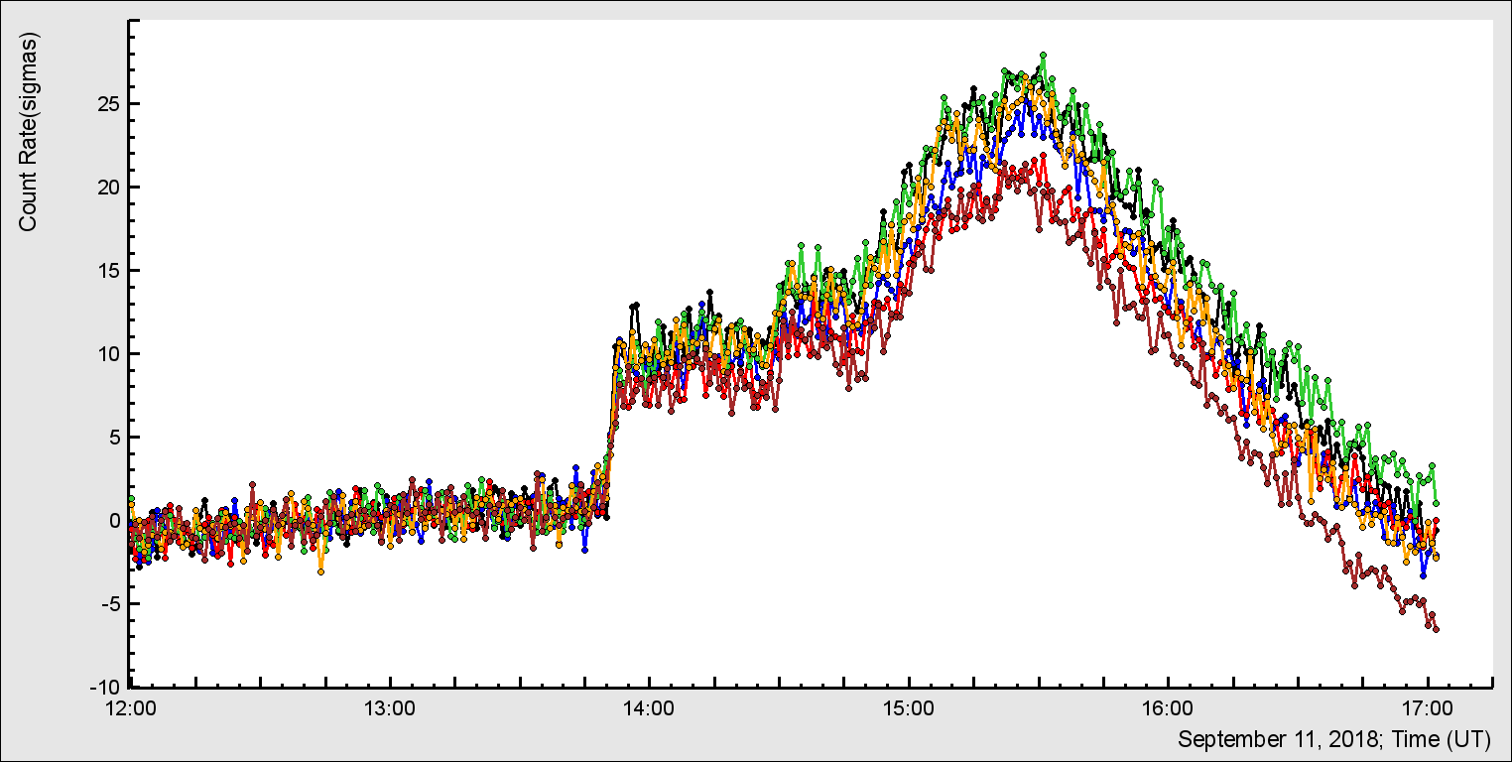
EFM-100 network
NaI network

Slide 12
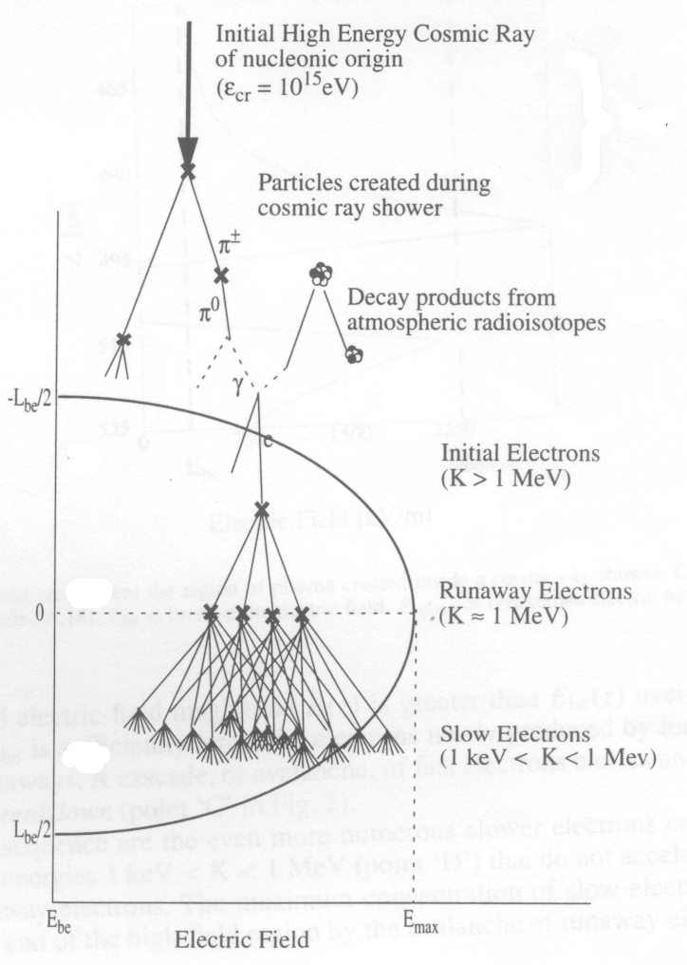
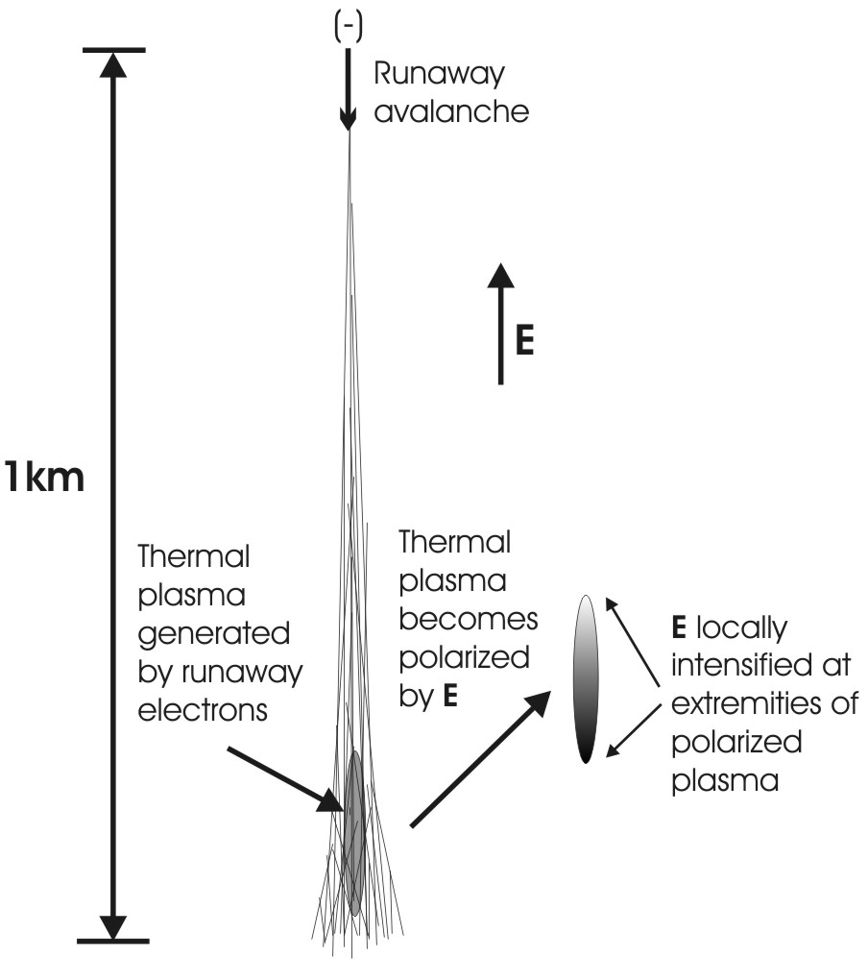
ECS and EAS
10-20 km

Slide 13
In situ detection of EAS and ECS at Aragats
at fair weather and during the minute
of the maximal particle flux (TGE).
Random ECS initiation
In strong intracloud electric field from CR seeds

Slide 14
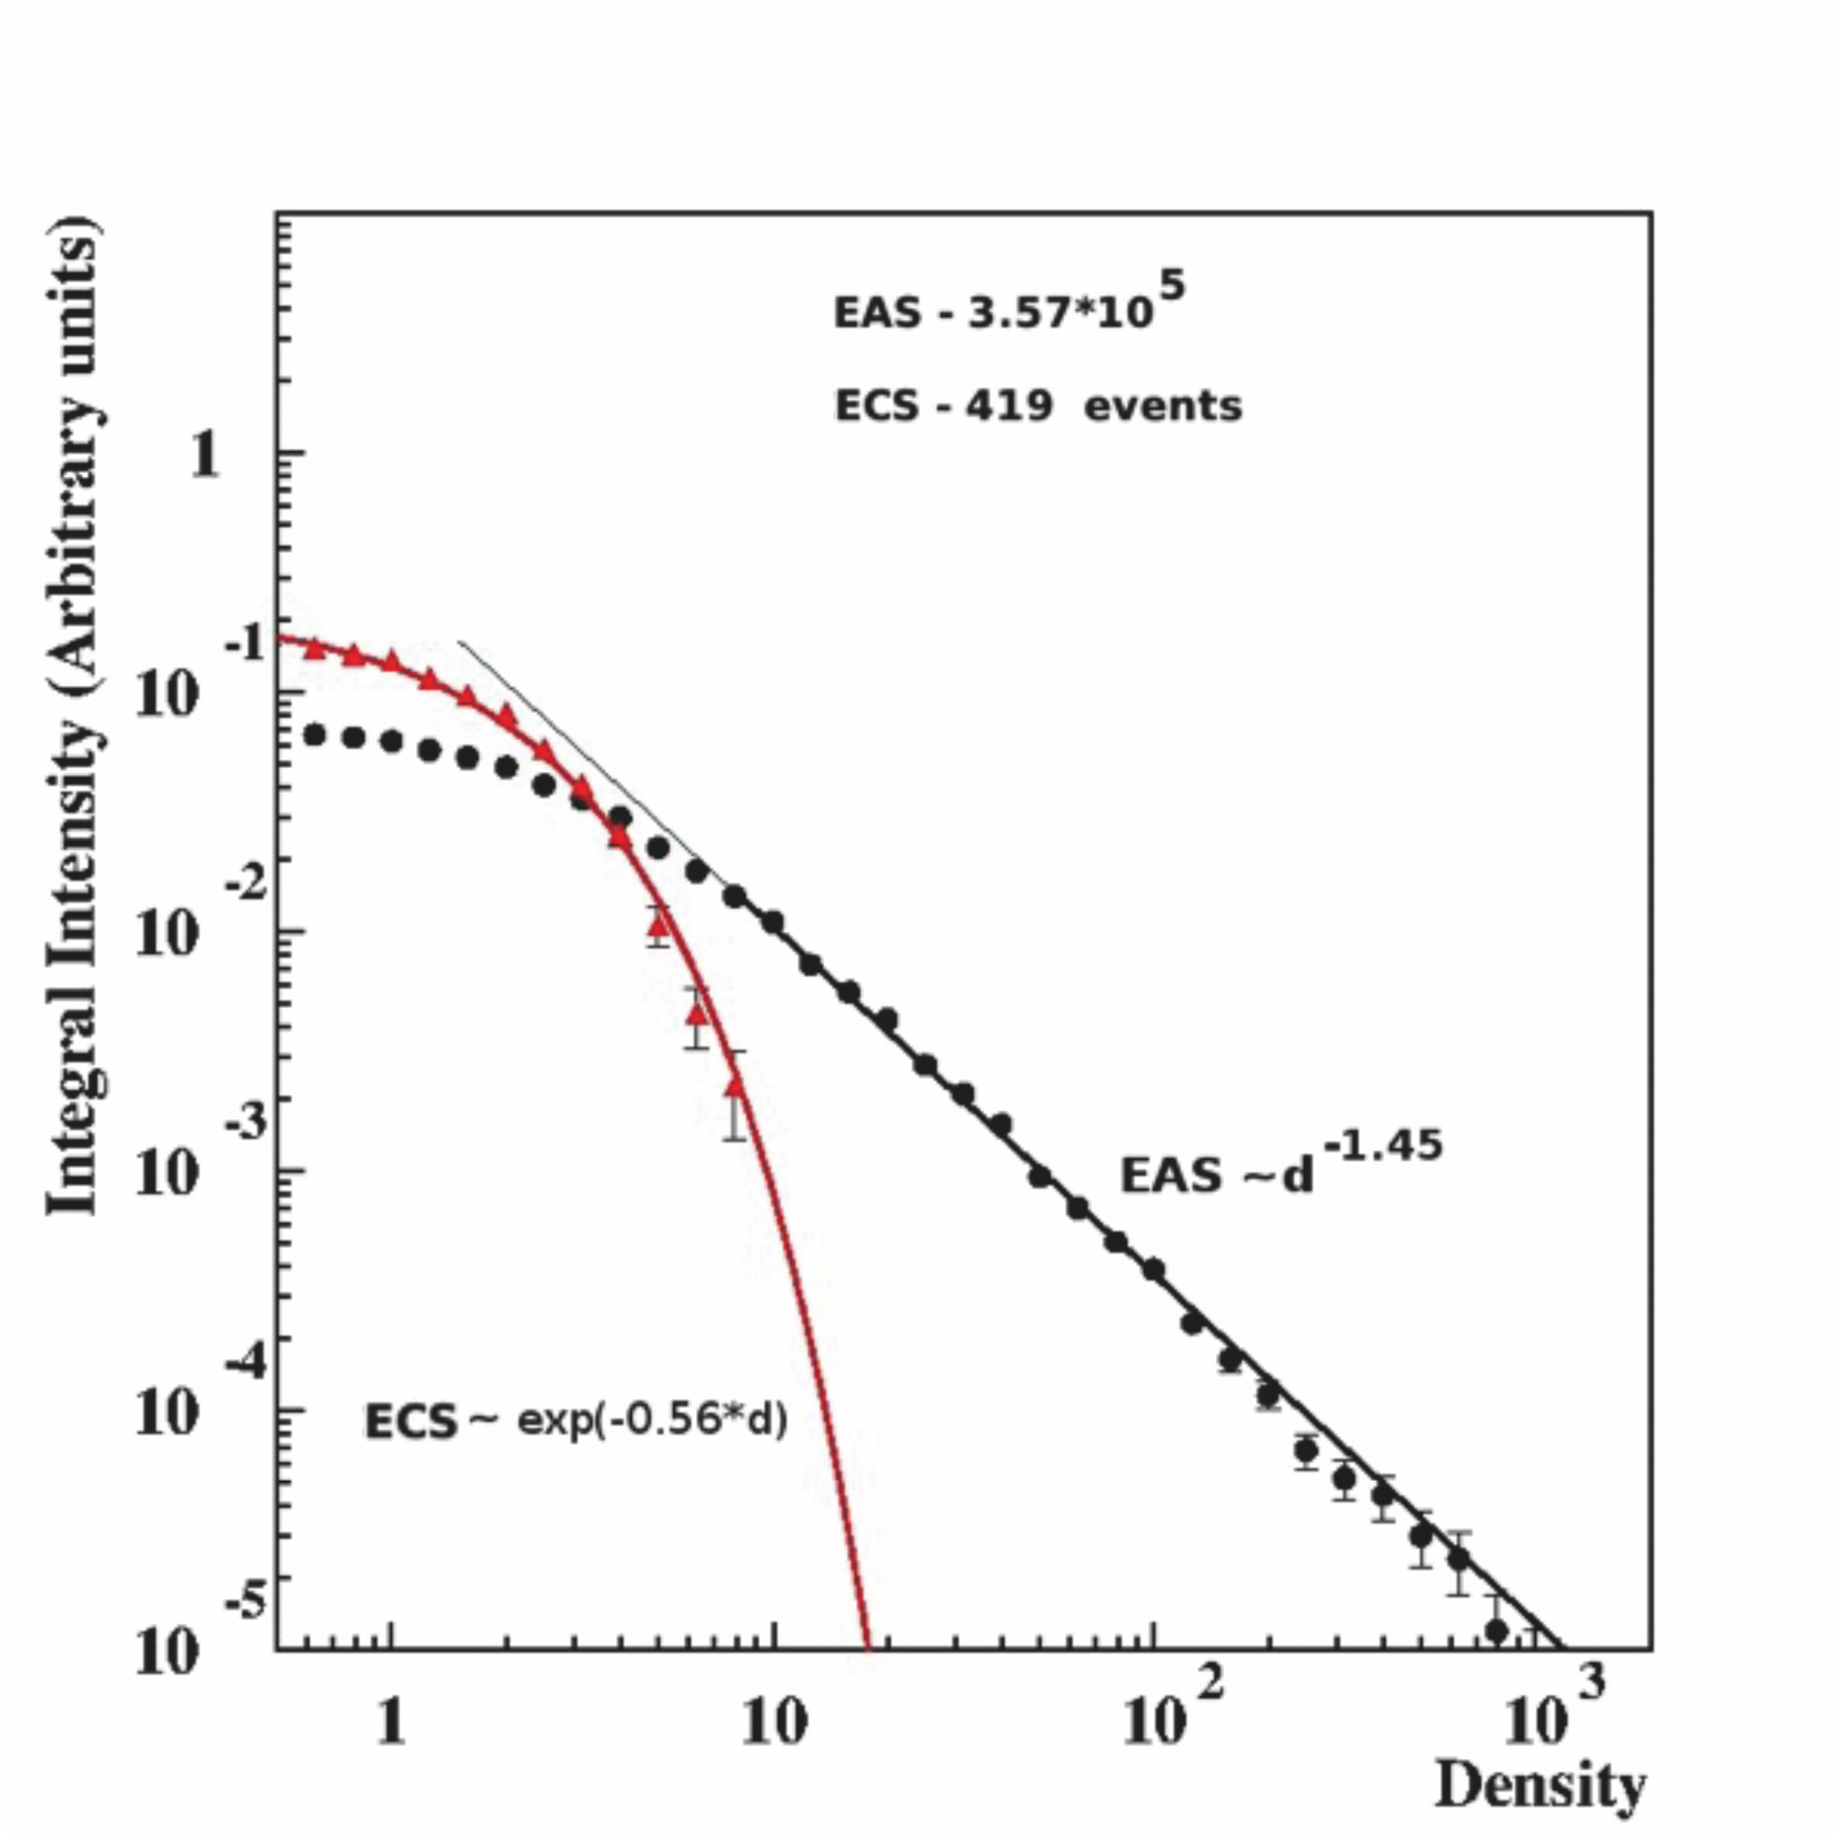
Extensive cloud showers (ECSs) are systematically different from Extensive air showers (EASs). Density spectra of 2 particle showers: ECS (red, with ~20% EAS contamination) and pure EAS

Slide 15
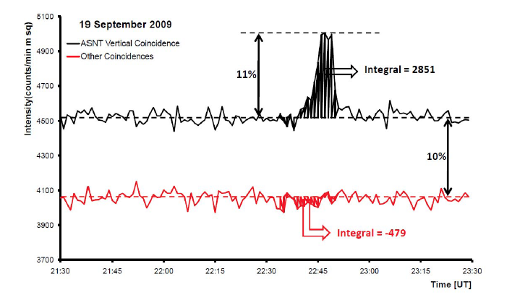
TGE is vertical!

Slide 16
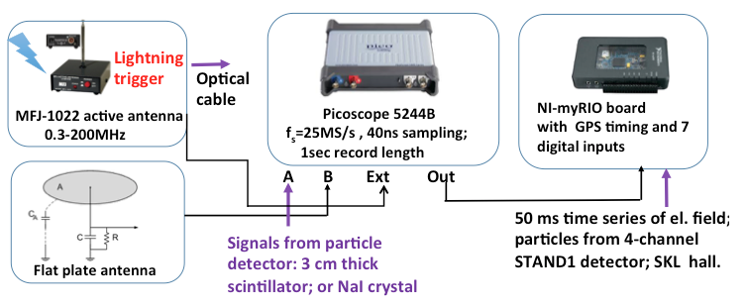
The fast Data acquisition system for the research of particle flux - lightning relations

Slide 17
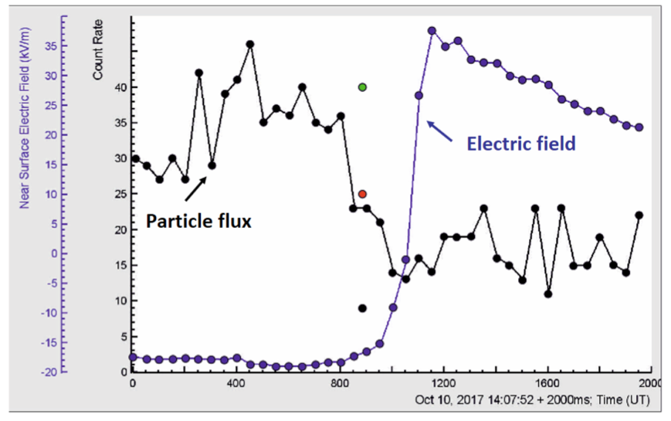
The 50 ms time series of particle fluxes and electrostatic field change produced by negative lightning flash

Slide 18
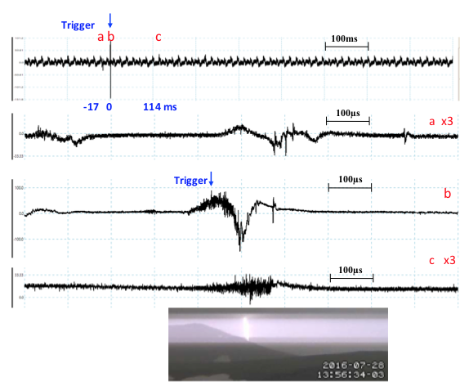
Detection of atmospheric discharges (down to few nanosecond time resolution) and lightning photos (30 Hz)

Slide 19
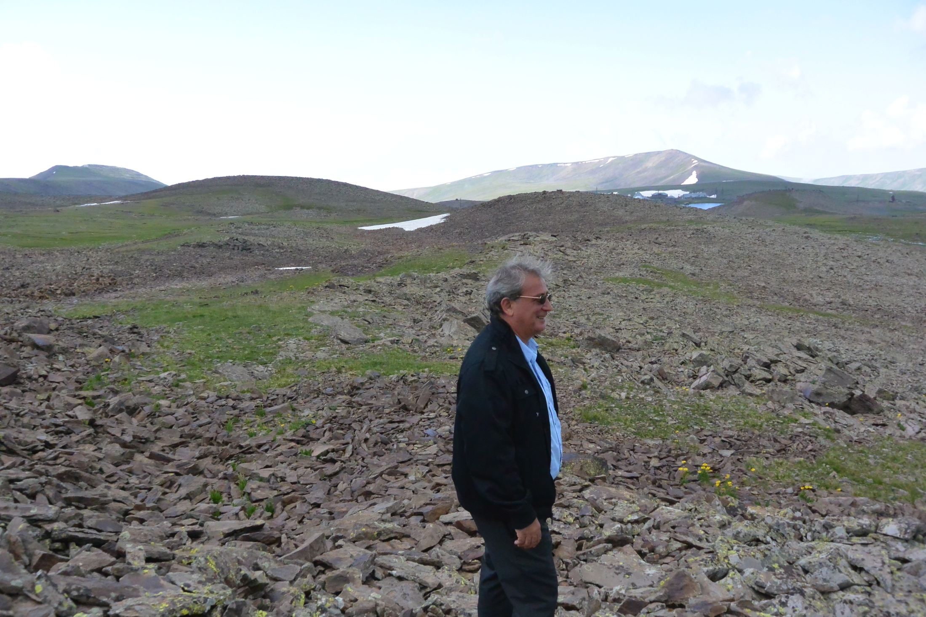
RAZ-200 – device for measuring near-surface electric field

Slide 20
Origin of particle fluxes from thunderclouds?
Structures of intracloud electric fields?
RB/RREA: Runaway breakdown, Relativistic Runaway Electron Avalanches
MOS Modification of the CR electrons energy spectra;
Long Lasting TGE research on Aragats 2018

Slide 21
On the structures of the intracloud electric field supporting origination of Long Lasting Thunderstorm Ground Enhancements (LL TGE), Phys. Rev.D, 2018
Discovered in 2017 Long Lasting TGEs prove that two independent mechanisms are responsible for bursts of high-energy particles and prolonged emissions of low energy gamma rays.
HEP TGEs mostly occurred when the near-surface electric field is in the deep negative domain and when the cloud base is 25-50 m above earth’s surface. The maximal energy of electrons in the RB/RREA avalanches can reach and exceed 40 MeV. Prove of the runaway process is the abrupt declining of the HEP bursts after the lightning flash, reestablished several seconds later when electric field within lower dipole again enhance the “runaway” threshold and inverted intracloud flashes abruptly terminated particle flux.
Hours prolonged low energy gamma ray flux can be explained by the MOS process (modification of the cosmic ray electron energy spectra) in rather weak electric fields not triggering RB/RREA process (low strength field originated between the main negative layer and its mirror on the earth’s surface).
LL TGE started with small intensity low energy gamma ray fluxes originated in week electric fields between mature main negative region charge region in the middle of the cloud and its mirror on the earth’s surface. After several tens of minutes or faster with emerging of LPCR above the detector site the cumulative field surpasses the runaway threshold in the atmosphere and RB/REEA avalanches started in the cloud. If the cloud base is close to the earth’s surface (the case of Aragats storms in Spring and Autumn) TGE intensity can reach very high levels exceeding the background radiation many times and maximal energy of electrons and gamma rays reaches 40 MeV and more. Because the size of the LPCR is much smaller than the main negative region, the high-energy phase of TGE prolongs only a few minutes changing again to the low energy gamma ray flux that can last for several hours.

Slide 22
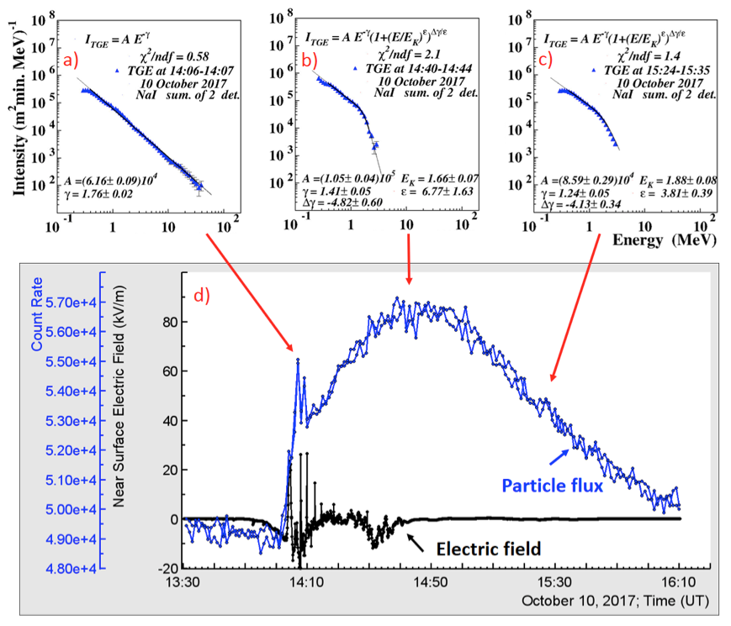

Slide 23
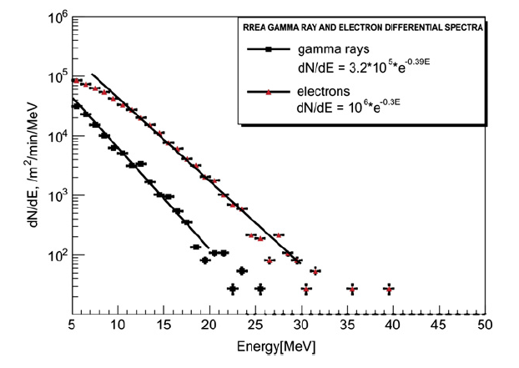
The electron and gamma energy spectra obtained in the uniform electric field of
1.8 kV/m prolonged from 5000 till 3400 m with 1 MeV electron as seeds.

Slide 24
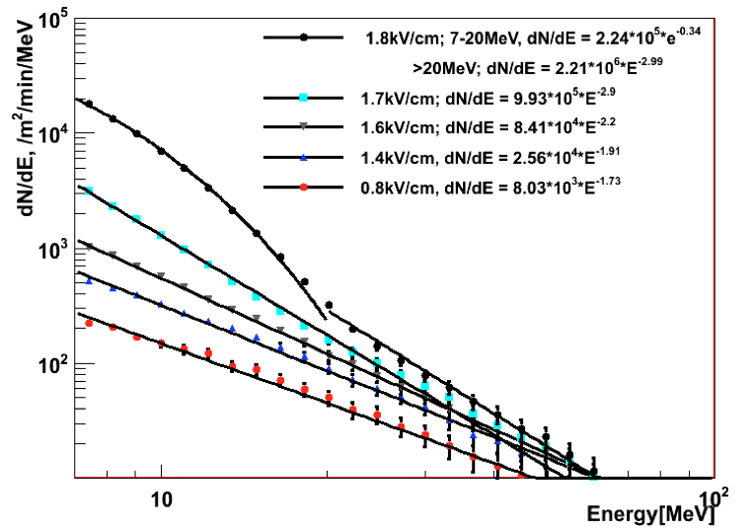
RB/RREA and MOS simulations

Slide 25
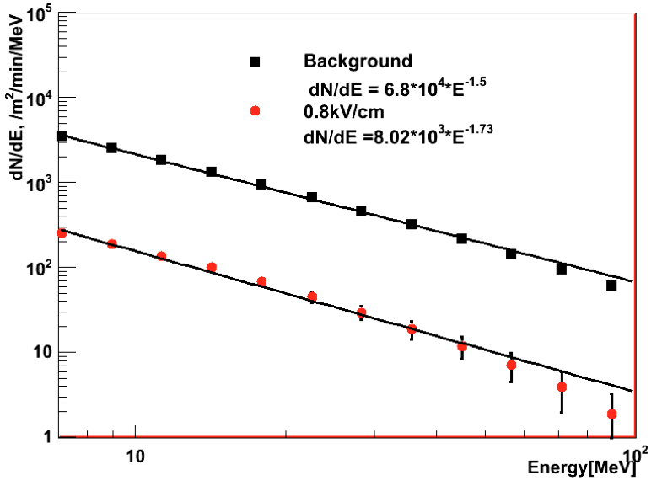
MOS process is one order of magnitude weaker than CR background, however it can prolong to 100 MeV

Slide 26
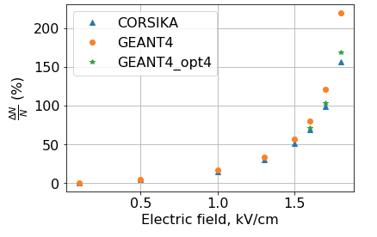
MOS and RB/RREA
RB/RREA threshold on 4000m ≈1.7 kV/m

Slide 27
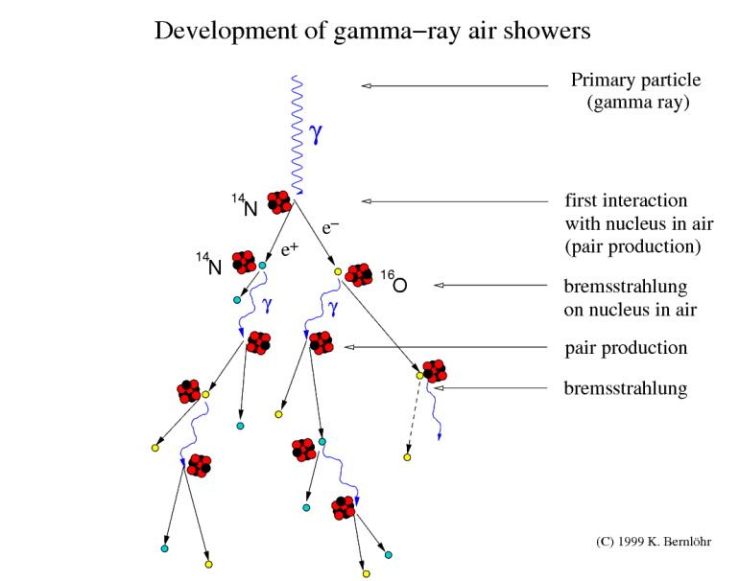
Electromagnetic interactions are treated by the EGS4 (Electron Gamma Shower) code
developed at SLAC package for the Monte Carlo simulation of the coupled transport of electrons and photons
At high energies
bremsstrahlung e → e +γ and
pair production γ ∗ → e ⁻ +e ⁺ dominate.
EGS4 accounts for the following processes:
- Bremsstrahlung production
- Positron annihilation in flight and at rest
- Moliere multiple scattering
- Continuous energy loss applied to
charged particle tracks
- Pair production.
- Compton scattering
- Photoelectric effect

Slide 28
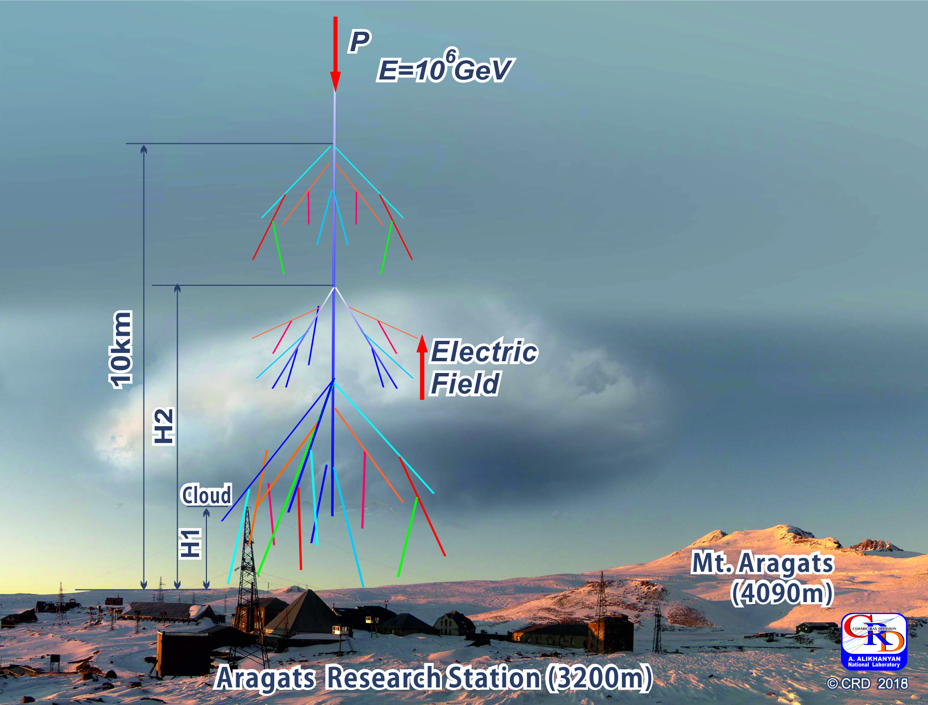
The simplest electric field configuration is used in the CORSIKA code subroutine elfield.c - Ez≠ 0 between H₁ and H₂.

Slide 29
To run a simulation one needs to define parameters of the simulation in the input file.
Simulation Setup:
Primary particle: proton,
Primary energy: Eo = 10⁶ GeV
Starting height: top of atmosphere
Observation level: H_{obs}= 3.2 km
Low energy cut-off of secondary particles:
E_{h,µ} = 300 MeV
E_{γ,e} = 3 MeV
Number of events: N=100 events

Slide 30
Effect of near-earth electric field on the intensity of secondary cosmic rays
 | Ez=0 | Ez=1.8 kV/cm at 3250m <H<4250m | Ez=1.8 kV/cm at 4200m<H<5200m | Ez=1.0 kV/cm at 4200m<H<5200m
N_{e} | 4.03 E+05 | 7.25 E+05 | 4.34 E+05 | 4.08 E+05
N_{µ} | 11.48 E+03 | 11.73 E+03 | 12.09 E+03 | 11.70 E+03
N_{ɣ} | 1.91 E+06 | 2.86 E+06 | 2.26 E+06 | 1.95 E+06
 | Ez=1.8 kV/cm at 3250m <H<4250m | Ez=1.8 kV/cm at 4200m<H<5200m | Ez=1.0 kV/cm at 4200m<H<5200m
∆Ne/Ne (%) | 80 | 8 | 1
∆Nµ/Nµ (%) | 2 | 5 | 2
∆N_{ɣ}/N_{ɣ} _{(%)} | 50 | 18 | 2

Slide 31
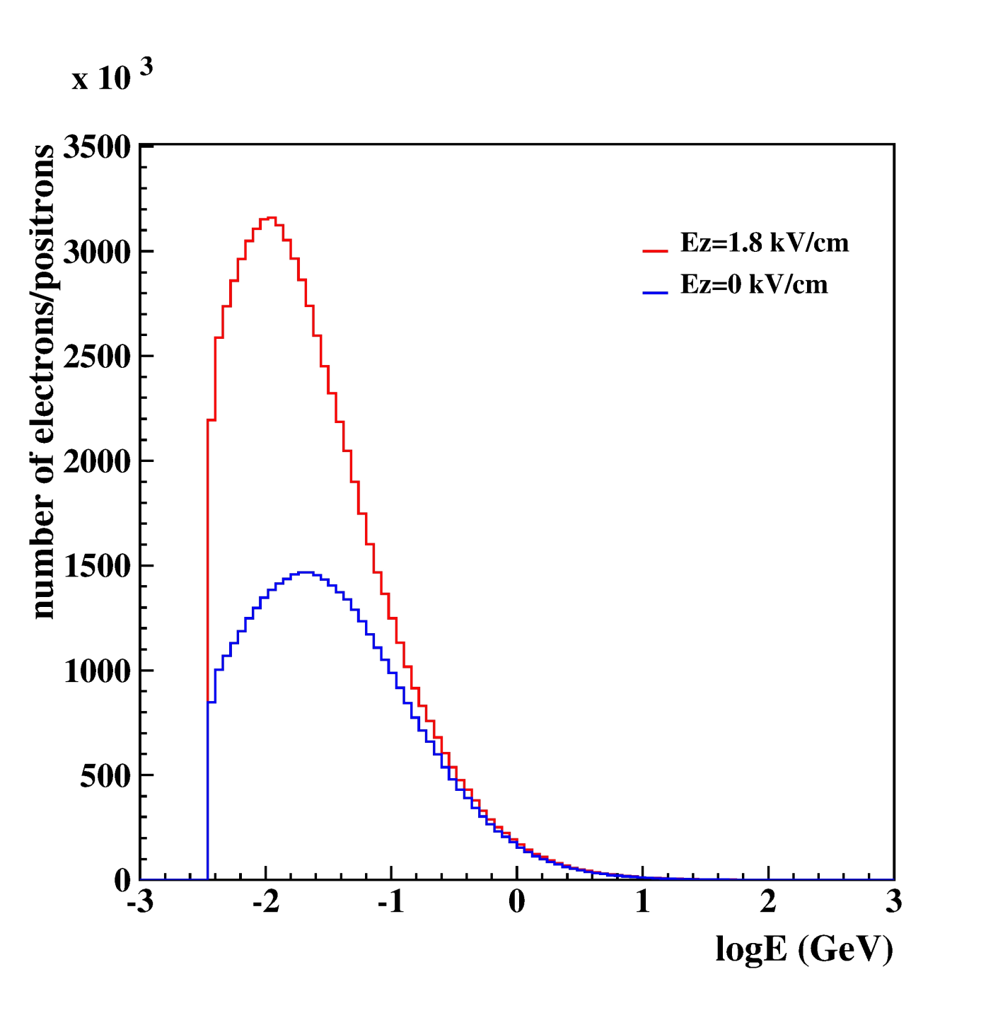
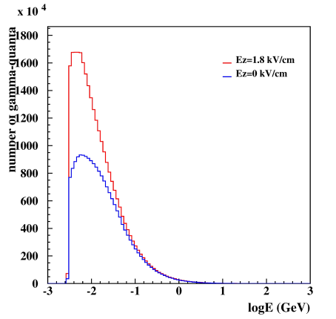
Secondary particle energy spectra with and without atmospheric electric field
Gamma rays
Electrons/
positrons

Slide 32
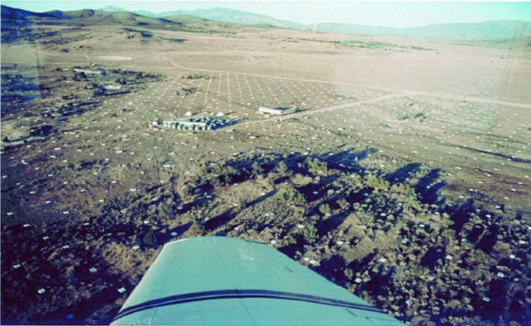
The initial particle energy estimation by EAS measurements E_{0(sim)} = 10⁶ GeV
Estimated primary particle energy: logE₀ = 1.03 * log(N_{e}+ 25N_{µ})
 | Ez=0 | Ez=1.8 kV/cm at 3250m <H<4250m | Ez=1.8 kV/cm at 4200m<H<5200m | Ez=1.0 kV/cm at 4200m<H<5200m
E_{est} | 10⁶ GeV | 1.54 10⁶ GeV | 1.1 10⁶ GeV | 1.05 10⁶ GeV
The CASA-MIA (10¹⁴ - 10¹⁶ eV) experiment: measuring
Nμ and Ne

