Slide 1


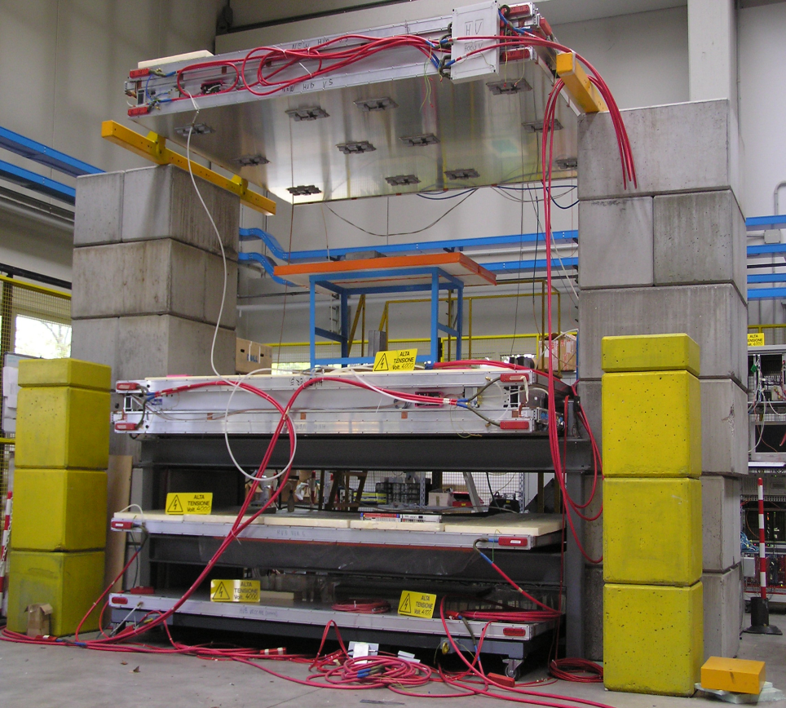
Muon Tomography in Padova (+ Genova)*
M. Benettoni,G. Bettella, G. Calvagno, P. Checchia,G. Cortelazzo, E. Conti, l. Cossutta, M. Furlan, F. Gonella, G. Nebbia , M. Pegoraro, S. Pesente, A. Rigoni Garola, S. Vanini, G. Viesti , G. Zumerle Univ. & INFN Padova, Italy
P. Calvini, S. Squarcia Univ. & INFN Genova, Italy
*+ Bs

Slide 2

Outline
Scientific activity
Related projects and partners
Future plans

Slide 3
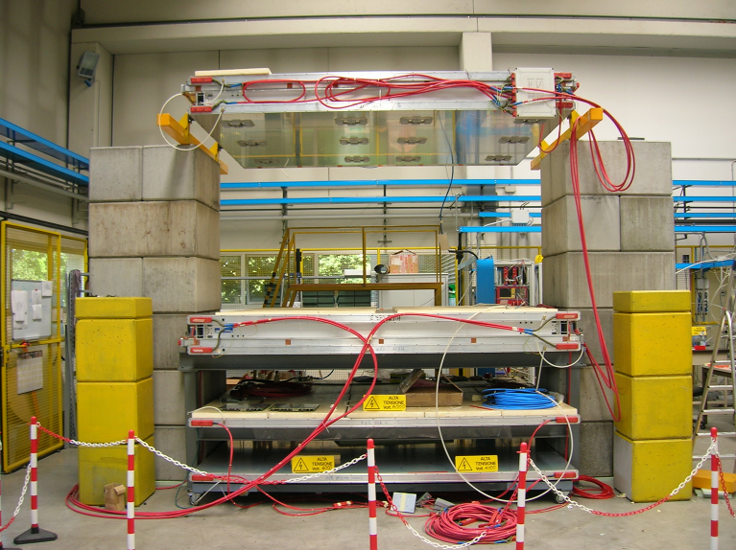
Experimental Setup (2005)
At the INFN National Laboratory of Legnaro (Padova) an apparatus for the study of muon radiography has been assembled using two spare Muon Chambers Detectors produced for CMS.
Two Drift Chambers 2.5x3.0 m²
Gap between chambers: 160 cm
vol. ≈ 11.5 m³
2 extra planes to measure p;
Fe p-filter
Trigger: upper chamber (events
“pointing” from upper to lower
chamber)
Acquisition rate: 350 Hz

Slide 4
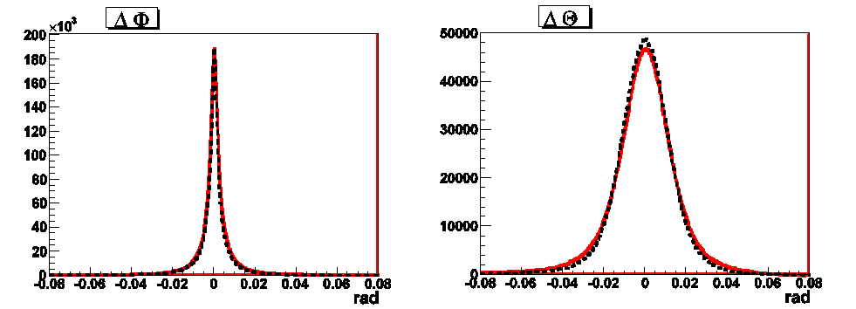
Experimental Setup
Drift chambers
Drift cell
Chamber layout
- -
- -
- -
- -
Planes of 4 layers of cells (SuperLayers); 2 SL (up to 8 points) measure angle and position in one direction (Φ); 1 SL (4 points) measures the orthogonal direction (Θ)
Given the high lever arm the direction is much better determined in Φ (>1.2 mrad) than in Θ (>10 mrad)
Data
MC
Data
MC
Good agreement: reliable simulation

Slide 5
Reconstruction Techniques
Basic (POCA)
Simplest method: Single Scattering Approximation (SSA). In space: Point Of Closest Approach (POCA) of 2 straight lines
It tends to fail in presence of several scattering centers
See dedicated presentation
Detector
Detector
Detector
Detector

Slide 6

Reconstruction Techniques
Tomographic (Maximum Likelihood Expectation Maximization)*
Define linear scattering density LSD for a material:
the average square deviation expected for a particle i crossing L
λ=1/X₀
Detector
If the material is not homogeneous the volume can be divided into N cubic voxels and
See dedicated presentation
where {λ_{k} ; k=1,…N} are N unknowns
unknowns
with {s_{i}²=Δθ_{i}² ; i=1,…M} M measurements.
given the Gaussian p.d.f.
with an iterative optimization algorithm (MLEM) applied to a Maximum Log-likelihood functional the system can reach reasonably approximate values of λ_{k}
Detector
* Other algorithms: see ref. list

Slide 7
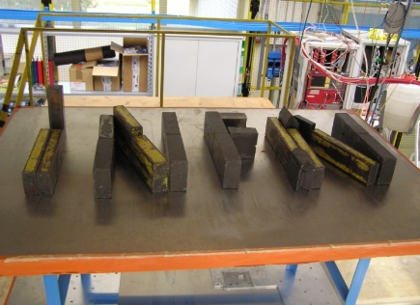
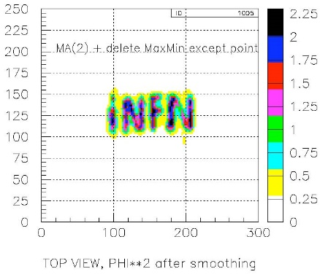
Results
Shape Reconstruction
Pb (left) and Fe (right) bricks at different height
MLEM
POCA
Pb 10x10x10 cm³
Fe 10x20x10 cm³
MLEM

Slide 8
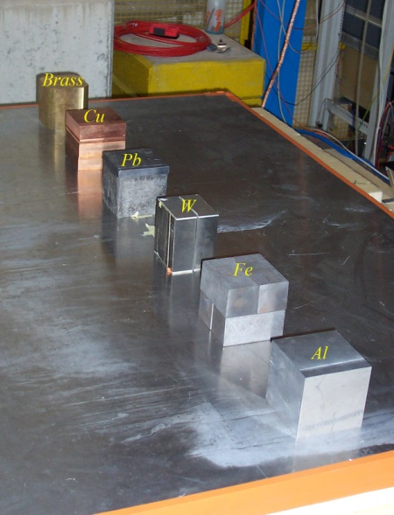
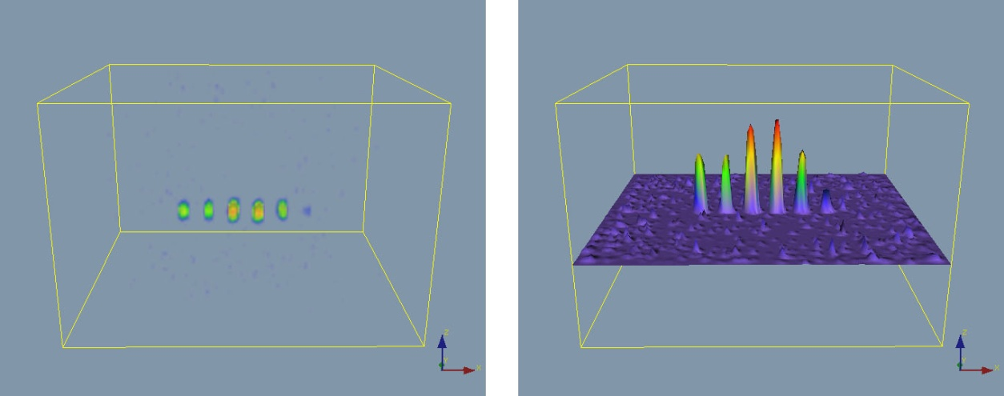
Results
Material Discrimination
Blocks of different material
MLEM
 | density (g/cm³) | X₀ (cm) | λ₀ (cm⁻¹) | σ_{ΔΦ} (mrad)
Al | 2,7 | 8.9 | 0,11 | 14
Fe | 7,9 | 1,76 | 0,57 | 35
Brass | 8.5 | 1.49 | 0,67 | 38
Cu | 8,9 | 1,43 | 0,70 | 39
Pb | 11,3 | 0,56 | 1.8 | 64
W (sintered) | 18.1 | 0.37 | 2.7 | 79
Clear “saturation effect”

Slide 9
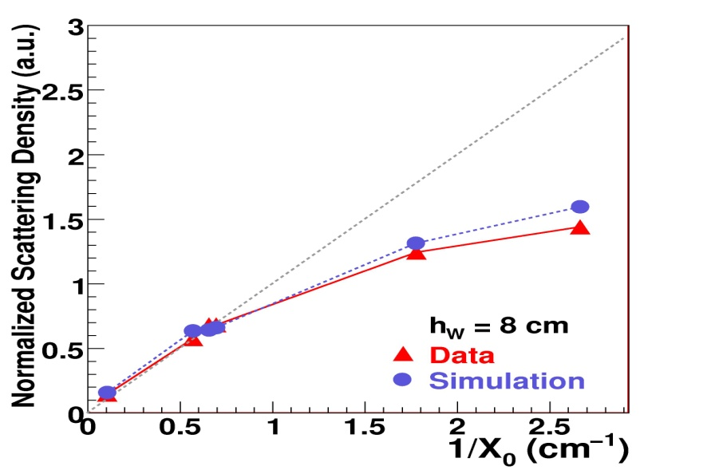
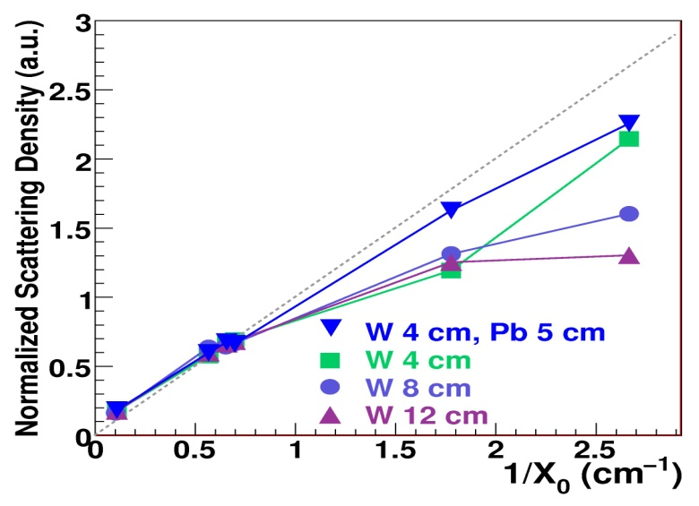
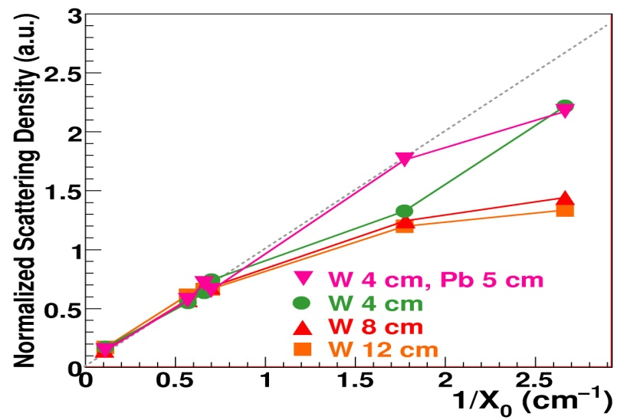
Results
Material Discrimination
measured
Effect confirmed by simulation!
W
Pb
Effect related to the total thickness rather than to the material scattering density
known
simulation
W
W
real data
Pb
Pb

Slide 10
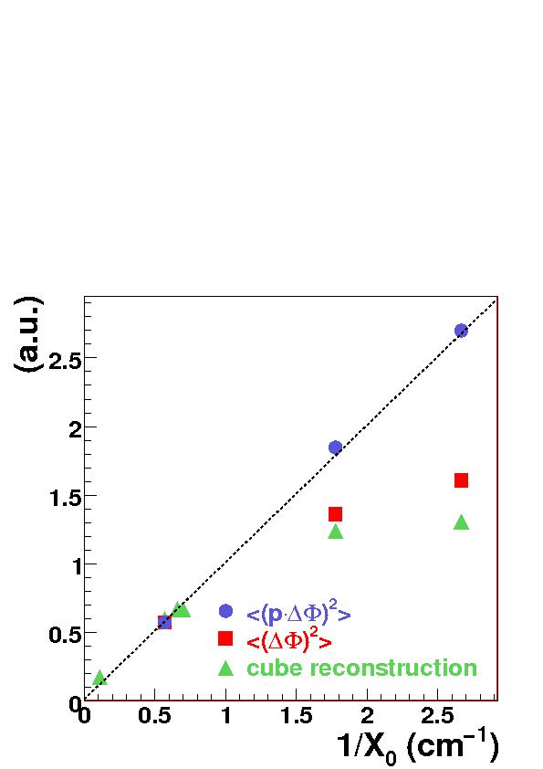
Results*
*NIM A 604 (2009) 738
Momentum effect
without momentum evaluation the basic relation is
Given the scattering length
Traversing the sample material, the low momentum component of the muon spectrum is absorbed, to an extent depending on the sample nature and thickness.
~same non linearity (MLEM20% difference for W)
perfectly linear
simulation
simulation 10 cm
This effect can be responsible for non-linearities
MLEM

Slide 11
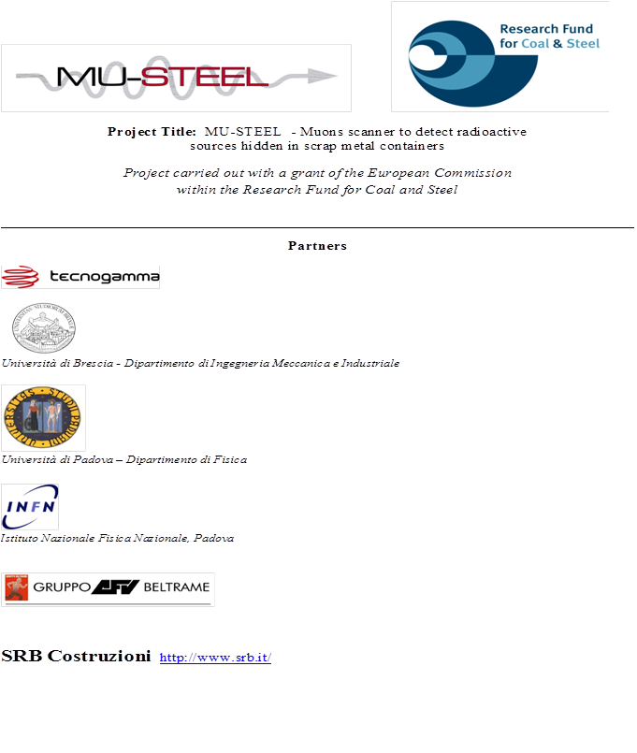
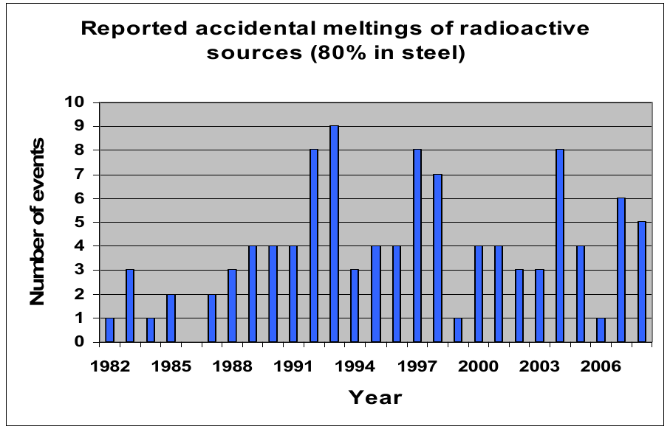
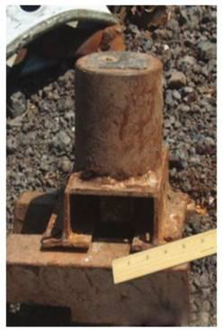
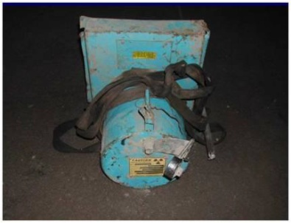
Mu Steel
The problem: orphan sources in scrap metal
All over the world, radioactive sources are sometimes present in scrap metal used for steel recycling.
In some cases, when the radiation source is well shielded by its heavy metal transportation cask and by the scrap metal itself, it is not detected by radiation portals and is melt, with serious consequences for the plant and public.
MuSteel project: study and design a portal capable to detect the heavy metal shield of the radiation source. NB: in a short (~ 5 min) time
In conjunction with radiation detectors, this system will be capable to intercept every source

Slide 12
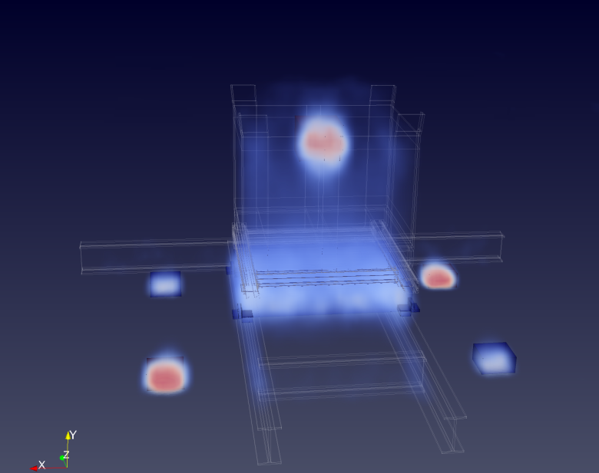
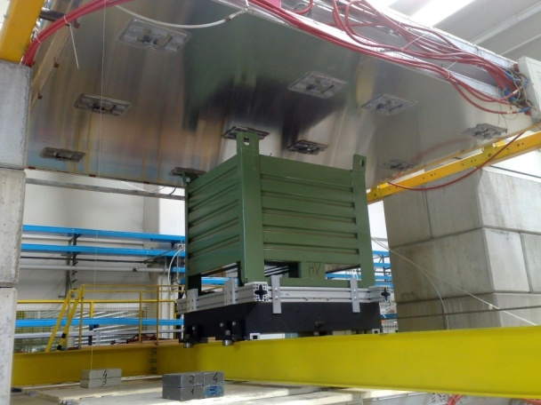
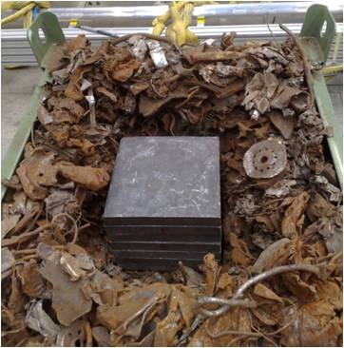
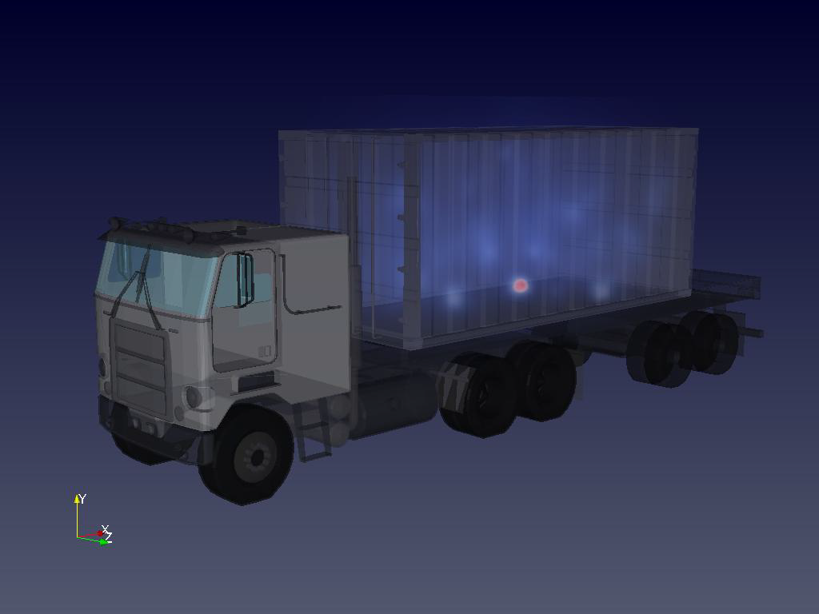
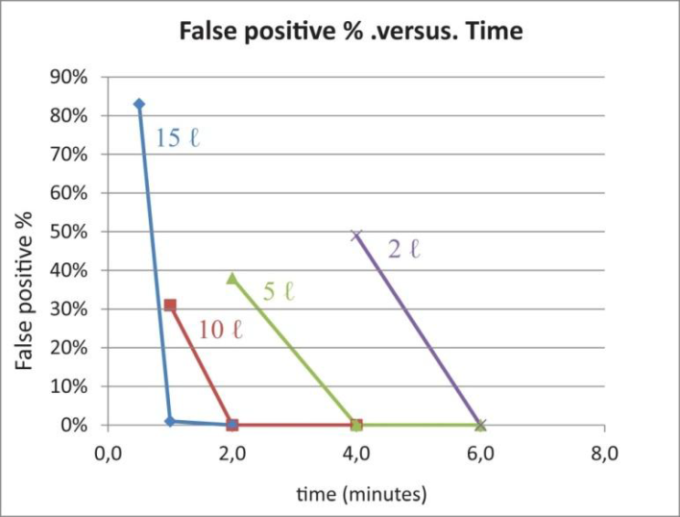
Cosmic Muon Tomography in transport control
Results:the program was successfully completed:
Reproducing a similar situation in the Demonstrator
M. Benettoni et al2013
JINST 8 P12007 [arXiv:1307.6093].
2 l Pb shield
Simulating a real situation in a full scale Portal
7 min data taking
https://ec.europa.eu/research/industrial_technologies/pdf/rfcs/summaries-rfcs_en.pdf.

Slide 13
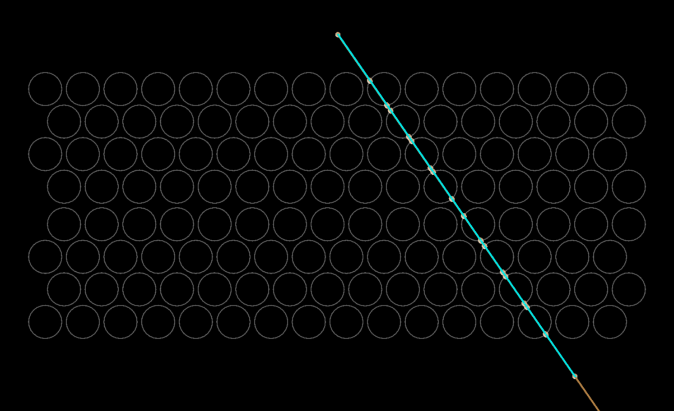
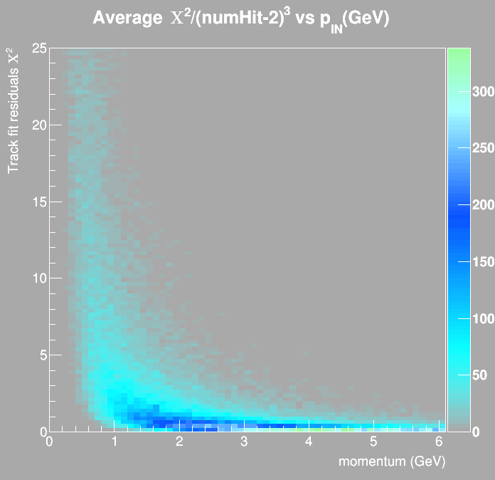
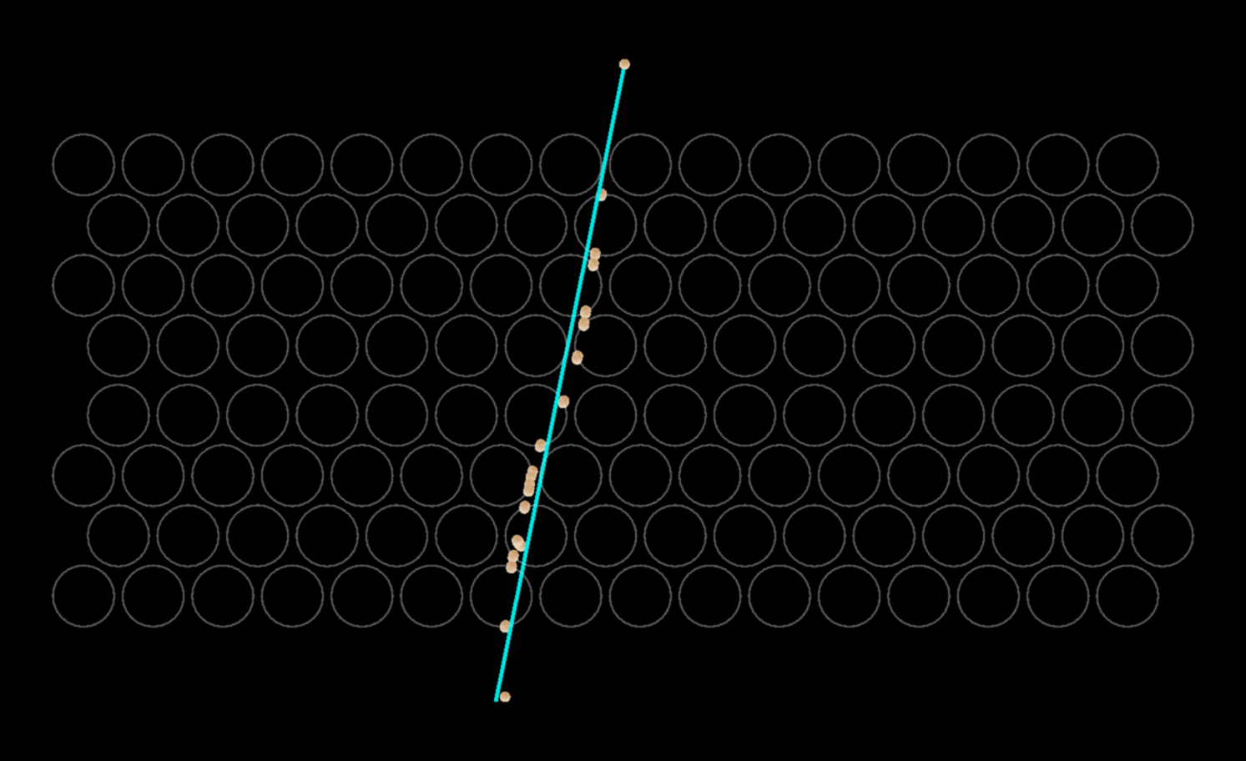
Example of rough momentum estimation
Momentum Estimation from muon chamber track fit
10 GeV muon tracked by drift tube chamber
80 MeV muon tracked by drift tube chamber

Slide 14
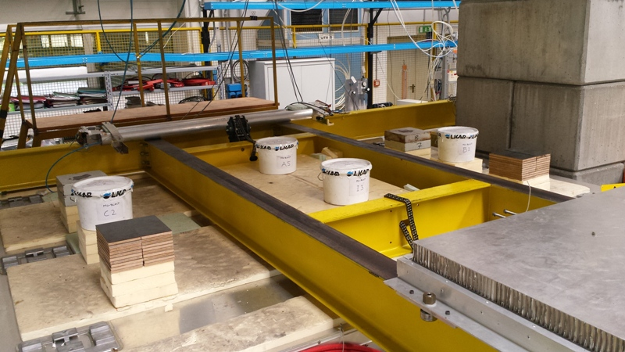
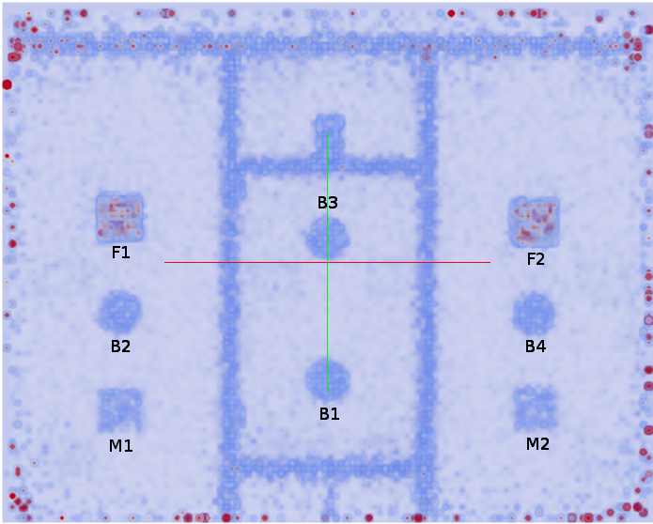
Precision measurements
Is it possible to make precision measurements with MCS tomography?
Iron blocks
Despite several difficulties due to
calibration and saturation effects...
Mock-up for normalization
(with known LSD)

Slide 15






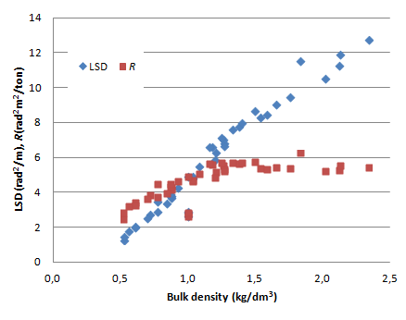
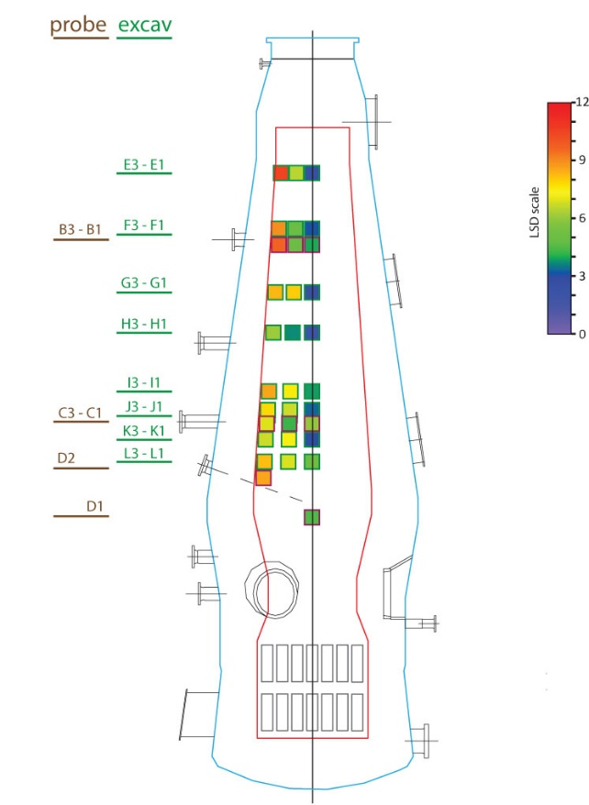
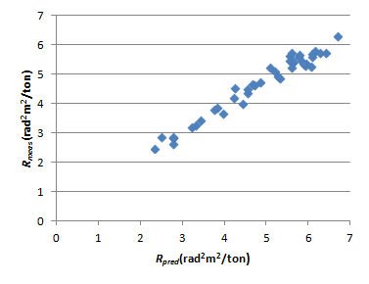
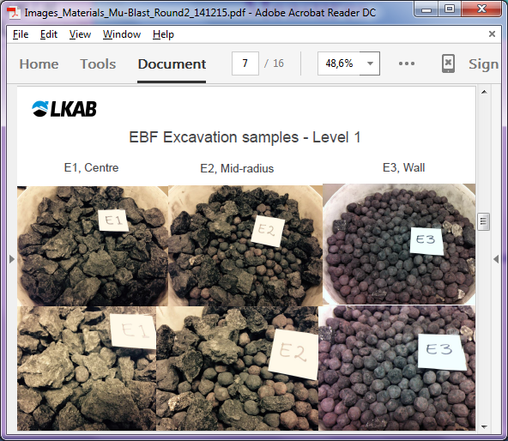
Precision measurements*
an important output of Mu-Blast project*:
Several materials collected from a furnace with a wide
range of LSD or R
Yes!
Good correspondence of measured R=λ/ρ with predicted values
Expected precision 7-10% ΔR=R_{meas}/R_{pred}-1
Measured :
mean ΔR= -3.1% with r.m.s. of 4.8%
density
R measured
R predicted
*E. Åström et al., 2016 JINST 11 P07010

Slide 16

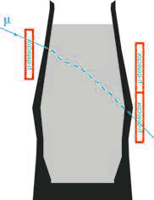
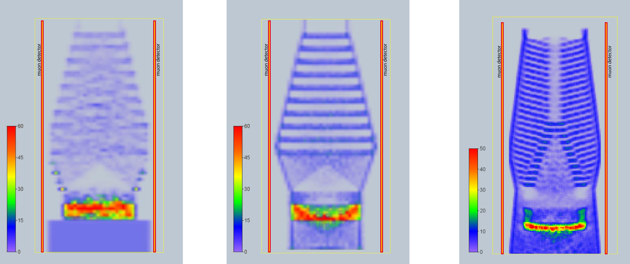
Industrial application Cosmic Muon Tomography in Blast furnace control
Mu-Blast: European project to characterize the inner status of a Blast furnace (RFSR-CT-2014-00027)
Blast furnace imaging
Monitor the density profile of the materials. The spatial distribution of the three main components ( ore , coke and partially reduced metal) can be monitored profiting of their different densities.
Simple BF model
before sw changes
Simple BF model
after sw changes
Realistic BF model
after sw changes

Slide 17
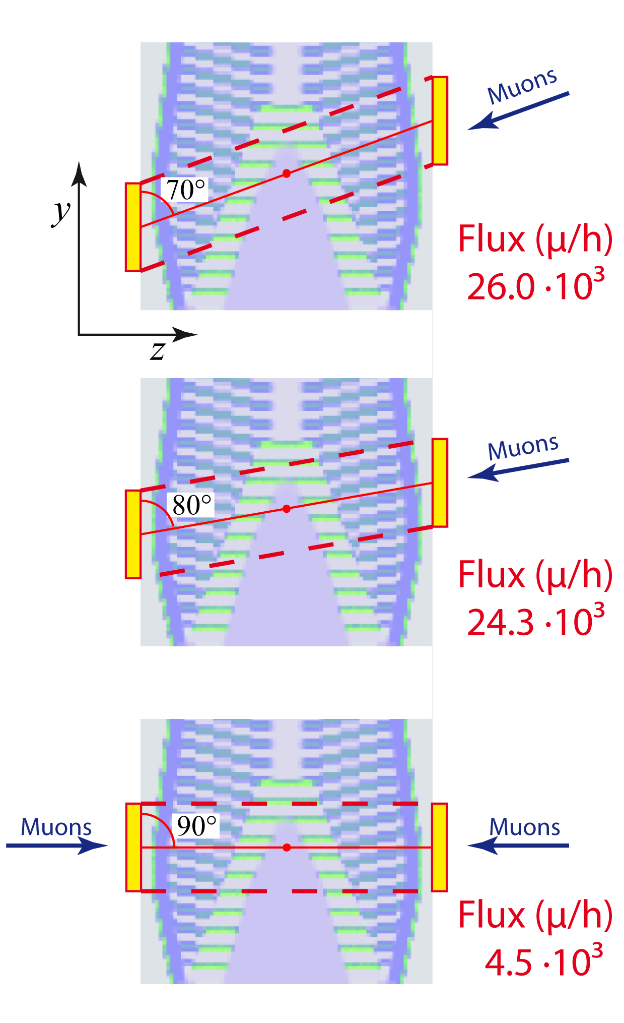
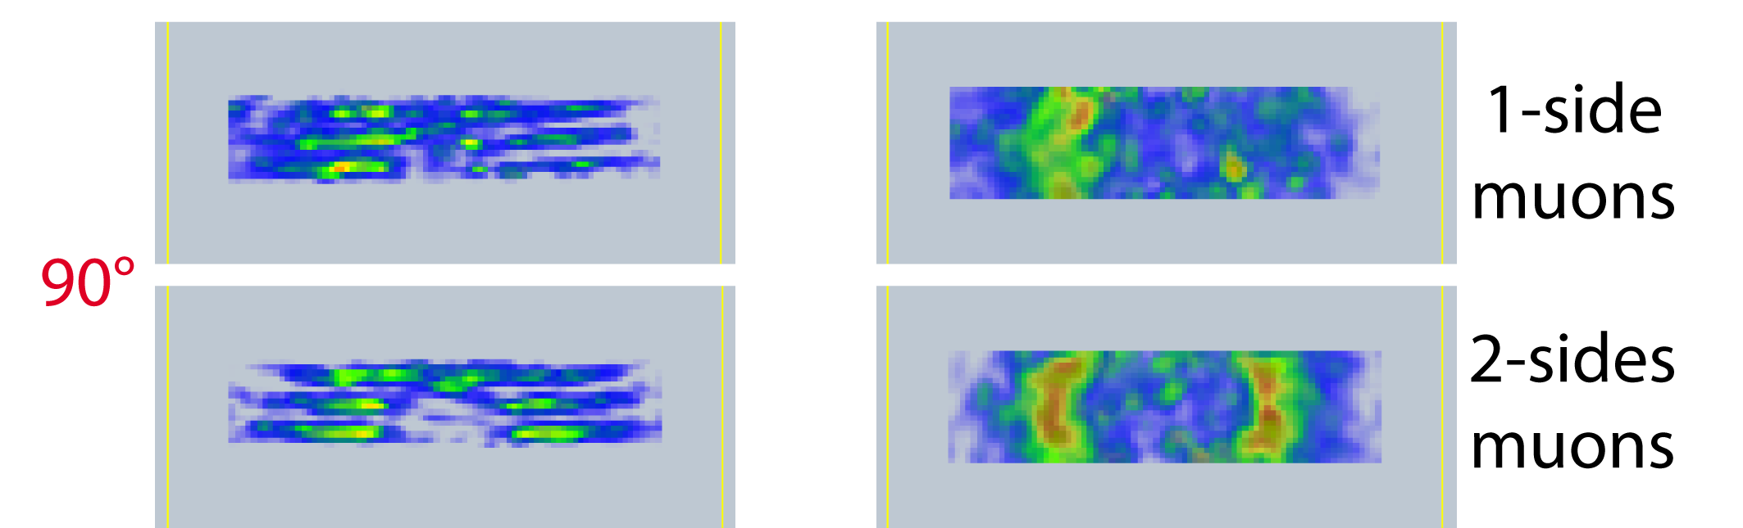
Industrial application Cosmic Muon Tomography in Blast furnace control
Study the capability of a realistic (~small) detector: two detectors with 5m x 5m surface
Mu-Blast:
Images obtained using the true momentum value of each muon, as given by the simulation data, averaged over the muon path.

Slide 18
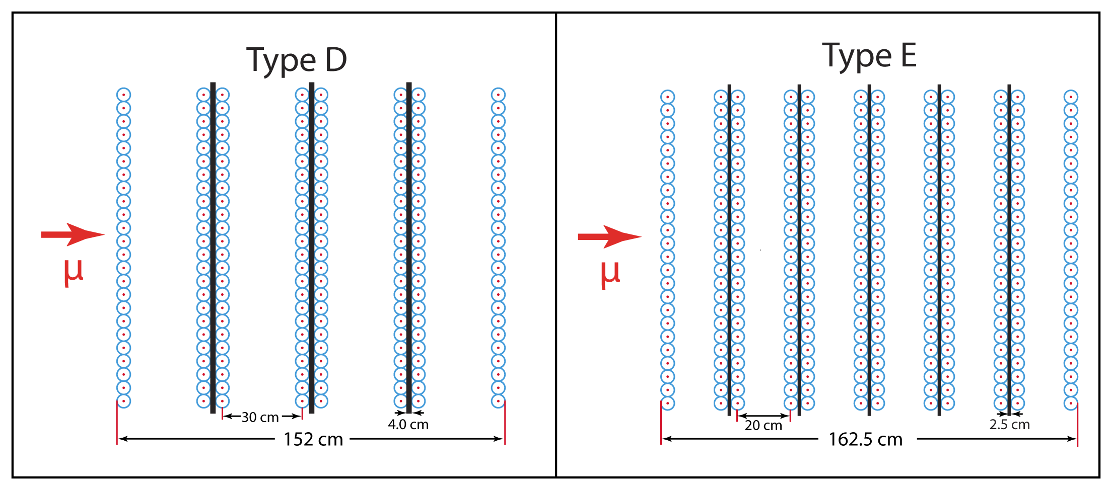
The muon momentum challenge
Previous results cannot be reproduced without the knowledge of the individual muon momentum. Simulations show that to have good images the momentum value must be known with a precision better than 50%.
It is necessary to design detectors capable of measuring the muon momentum. We base the design on the measurement of the muon scattering through materials of known composition and thickness.
Two of the many schemes explored are the following.

Slide 19
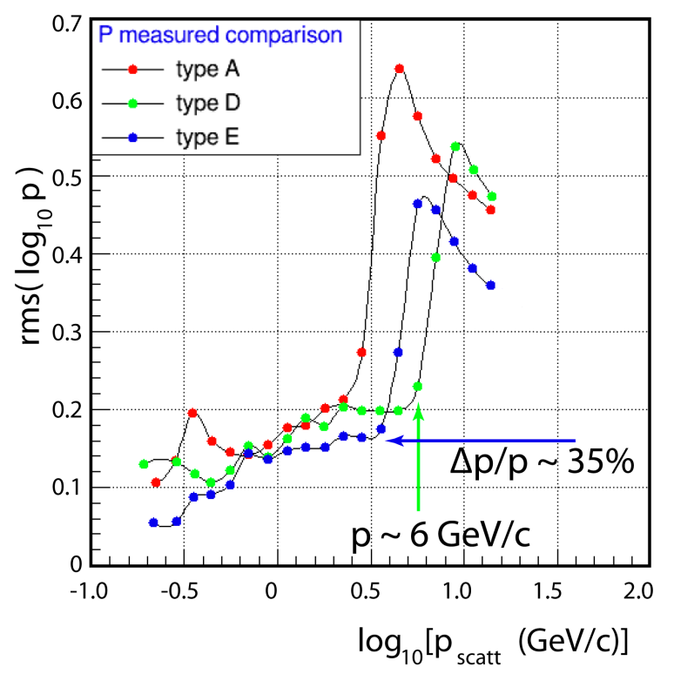
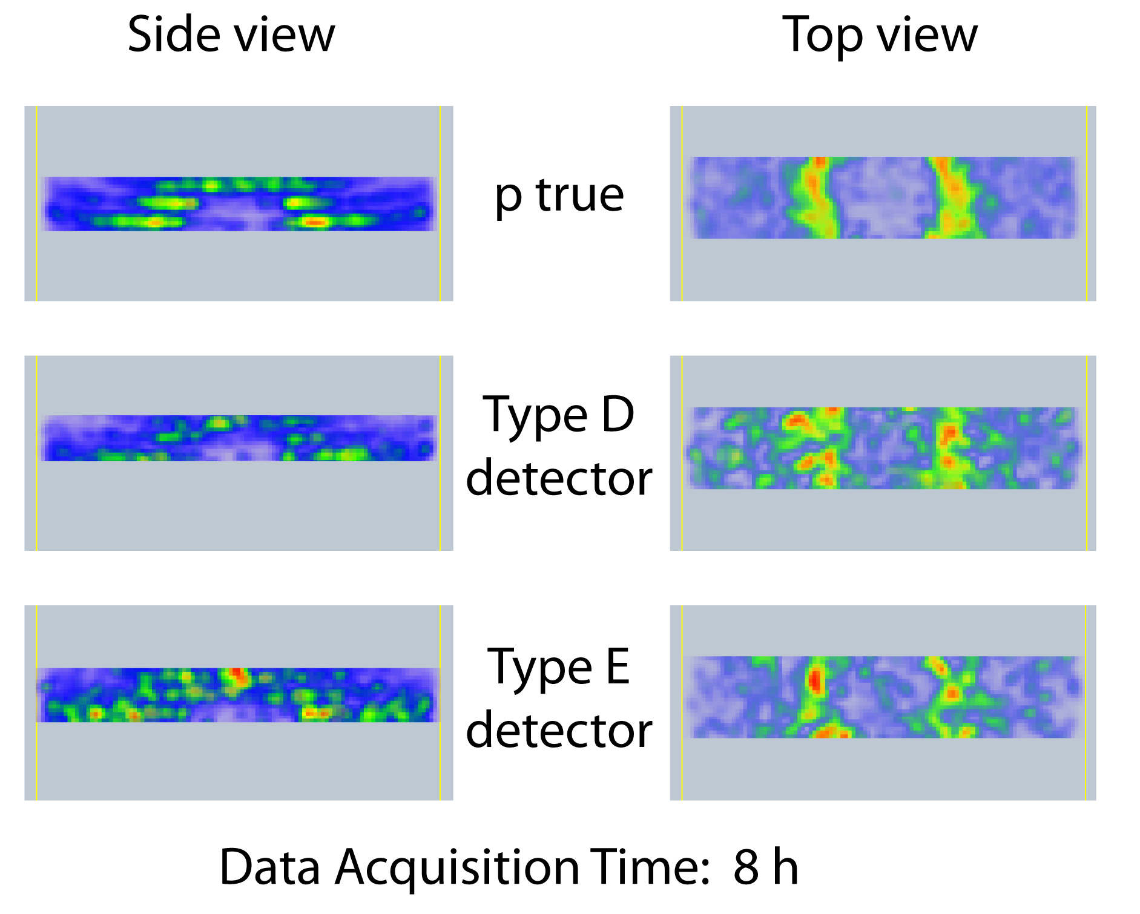
Results with measured momentum
A detector space resolution of 300 μm (as obtained in Mu-Steel) has been assumed. Using such detectors the density structures in the BF materials are visible, though with long Data Acquisition (DAQ) times and with significant statistical noise.
Comparison with the true momentum results shows that important improvements in image quality could be achieved by improving the detector design, for instance improving the space resolution.

Slide 20
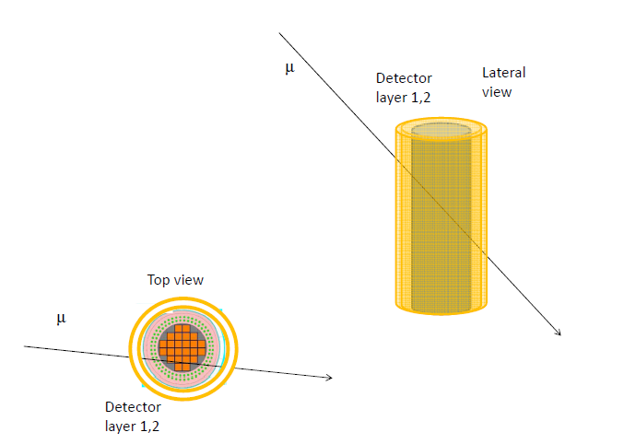
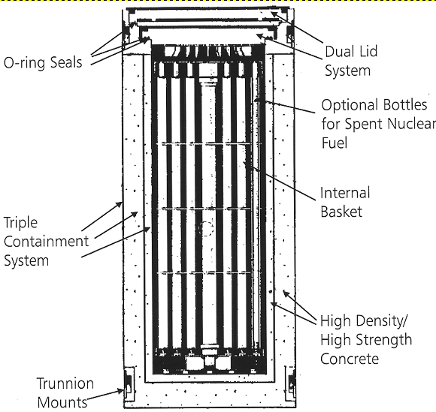
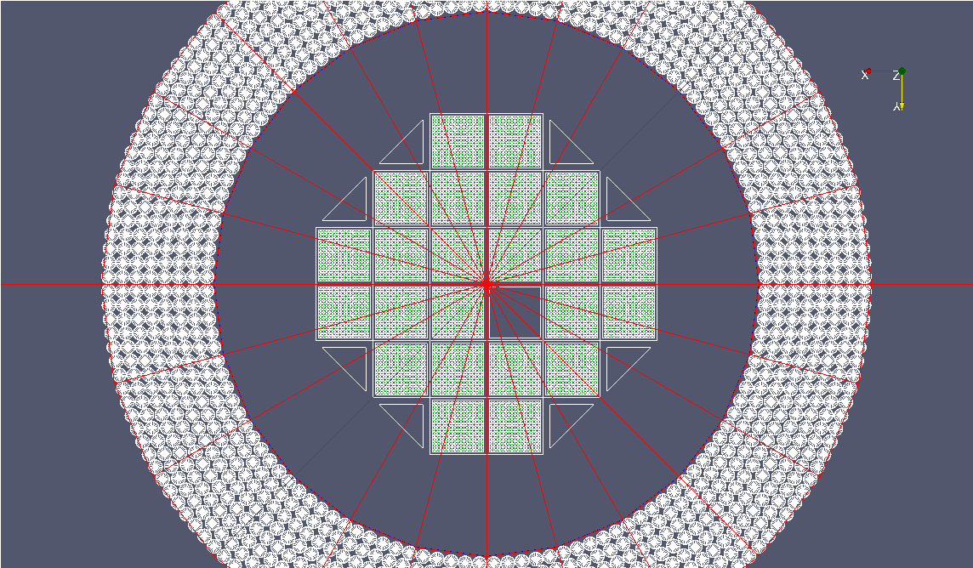
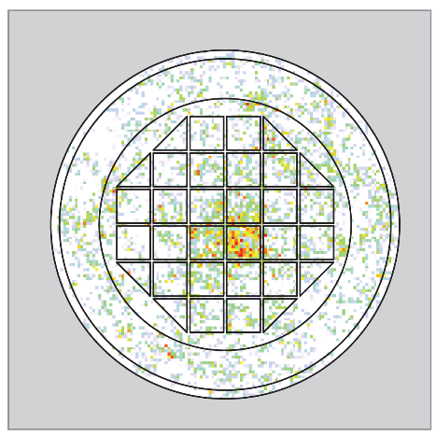
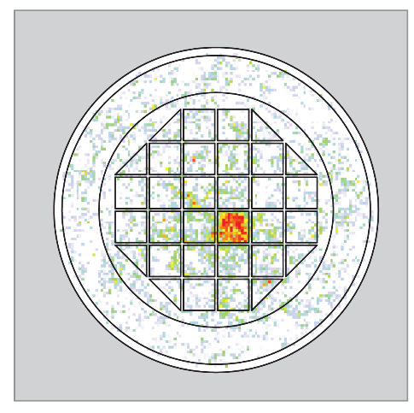
Spent nuclear fuel control*
No validated methods to verify the content of storage containers without opening Possibilities: neutron radiography or muon radio/tomography.
Detectors positioned around the container ⇒ Absorption, Transmission and MCS
*ESARDA BULLETIN, No. 54, June 20
https://esarda.jrc.ec.europa.eu/images/Bulletin/Files/B_2017_054.pdf
Realistic simulation of the detector with one fuel bar removed from the CASTOR
S. Vanini, P. Peerani, A.Rigoni, G. Zumerle, P.C.
μ absorbed μ crossing
Additional information from MCS not included (yet) …

Slide 21
Related projects and partners
2006/2008 (UNIPD Progetto d’Ateneo): Muon radiography: the use of cosmic rays in the contrast of the Nuclear Material illicit trafficking.
2009/2011 (Mobilità sostenibile Industria 2015) SLIMPORT Sicurezza, Logistica, Intermodalità Portuale. Sottosistema SLIMCHECK: OTO-MELARA (coord.),CAEN, C.I.E.L.I. INFN
2009/2010 (UNIPD Progetto d’Ateneo): Decision algorithms for the muon tomography
2010/2012 (RFCS: RFSR-CT-2010-00033) Mu-Steel
next step: a prototype portal (no resources)
2014/2016(RFCS: RFSR-CT-2014-00027) Mu-Blast
next step: a “small” detector for
radiographic inspection (no partners)

Slide 22
Future perspectives
Spent nuclear fuel control: a radioactive environment
How much does radioactivity emitted by nuclear material stored inside Canisters interfere with the detector response?
Is the (low) cosmic-ray intensity (~.1 μSv/h) compatible with the noise induced by radioactivity?
We make just a work hypotheses: 150 μSv/h
From independent (unpublished) measurements that activity corresponds to a hit rate of ~ 40 Hz/cm² in a drift tube
is that affordable? Does it still allow to see muon tracks?
Our evaluation: Yes (see below) but the best (too many unknowns and approximations) is to prove it with a test…

Slide 23
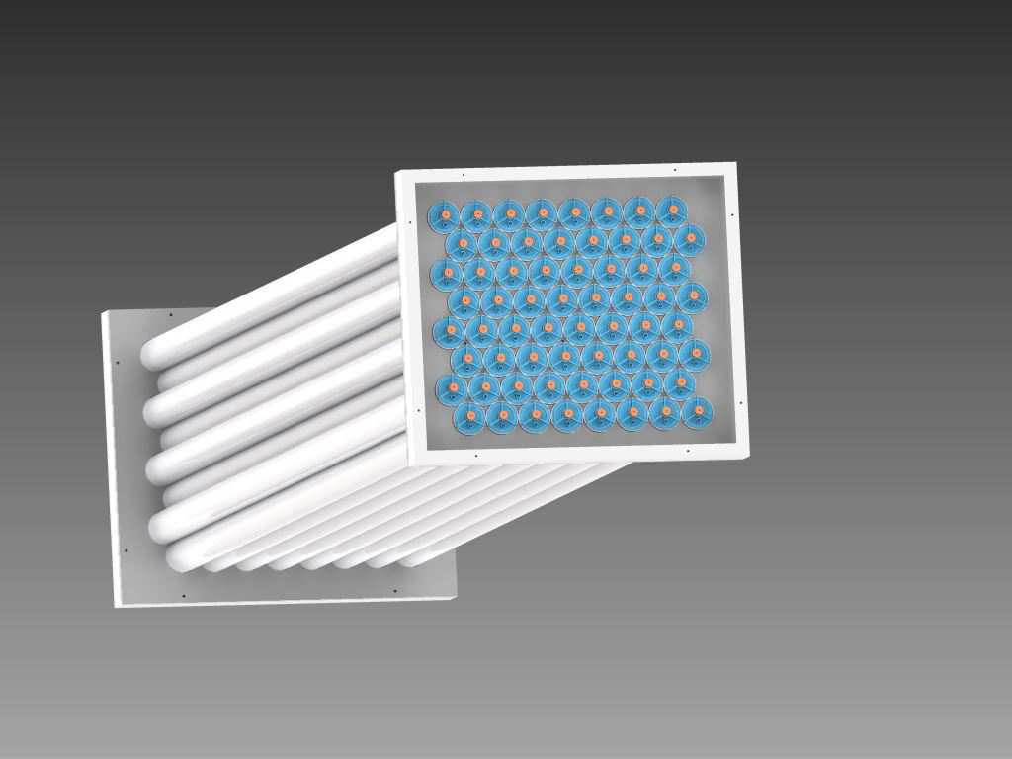
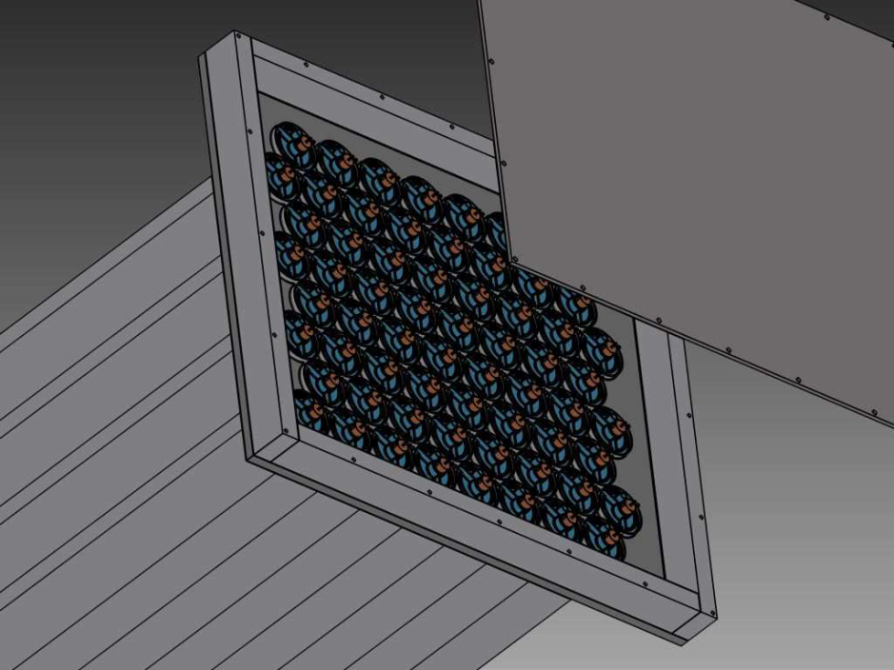
A test proposal
Produce a small prototype: 8 layers of 8 tubes
Each Al tube: 50 mm diameter, 1.5 mm thickness, 2 m long, central 100 μm anode wire (+3000 V)
Signal processed by FE electronics (amplification and shaping) and RO chain (time digitization, trigger and remote transmission). Both available from CMS experiment production
Total size: 0.6 m x 0.5m x 2 m, total mass ~100 kg
Easy to move and to handle
~0.60 m
~0.50 m
~2 m

Slide 24
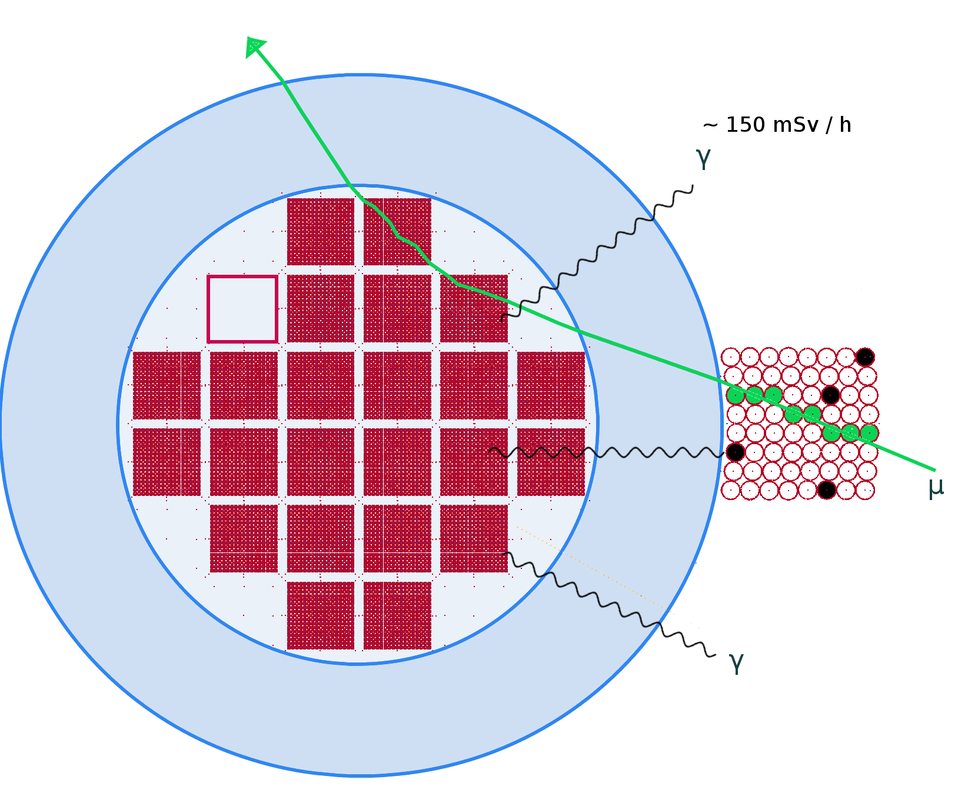
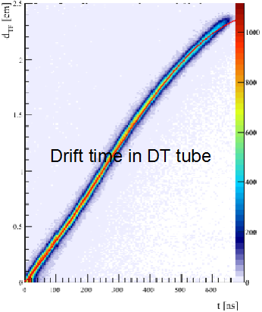
A test proposal
Example of muon event with radioactivity noise
Expected from previous assumption:
when a muon crosses a tube,
in a 1μs time ( >> drift time)
0.04 hit/tube (at 150 μSv/h)
~ 2.5 hits in total due to noise
But the test will prove definitely if the technique works in a storage environment

Slide 25
Backup

Slide 26
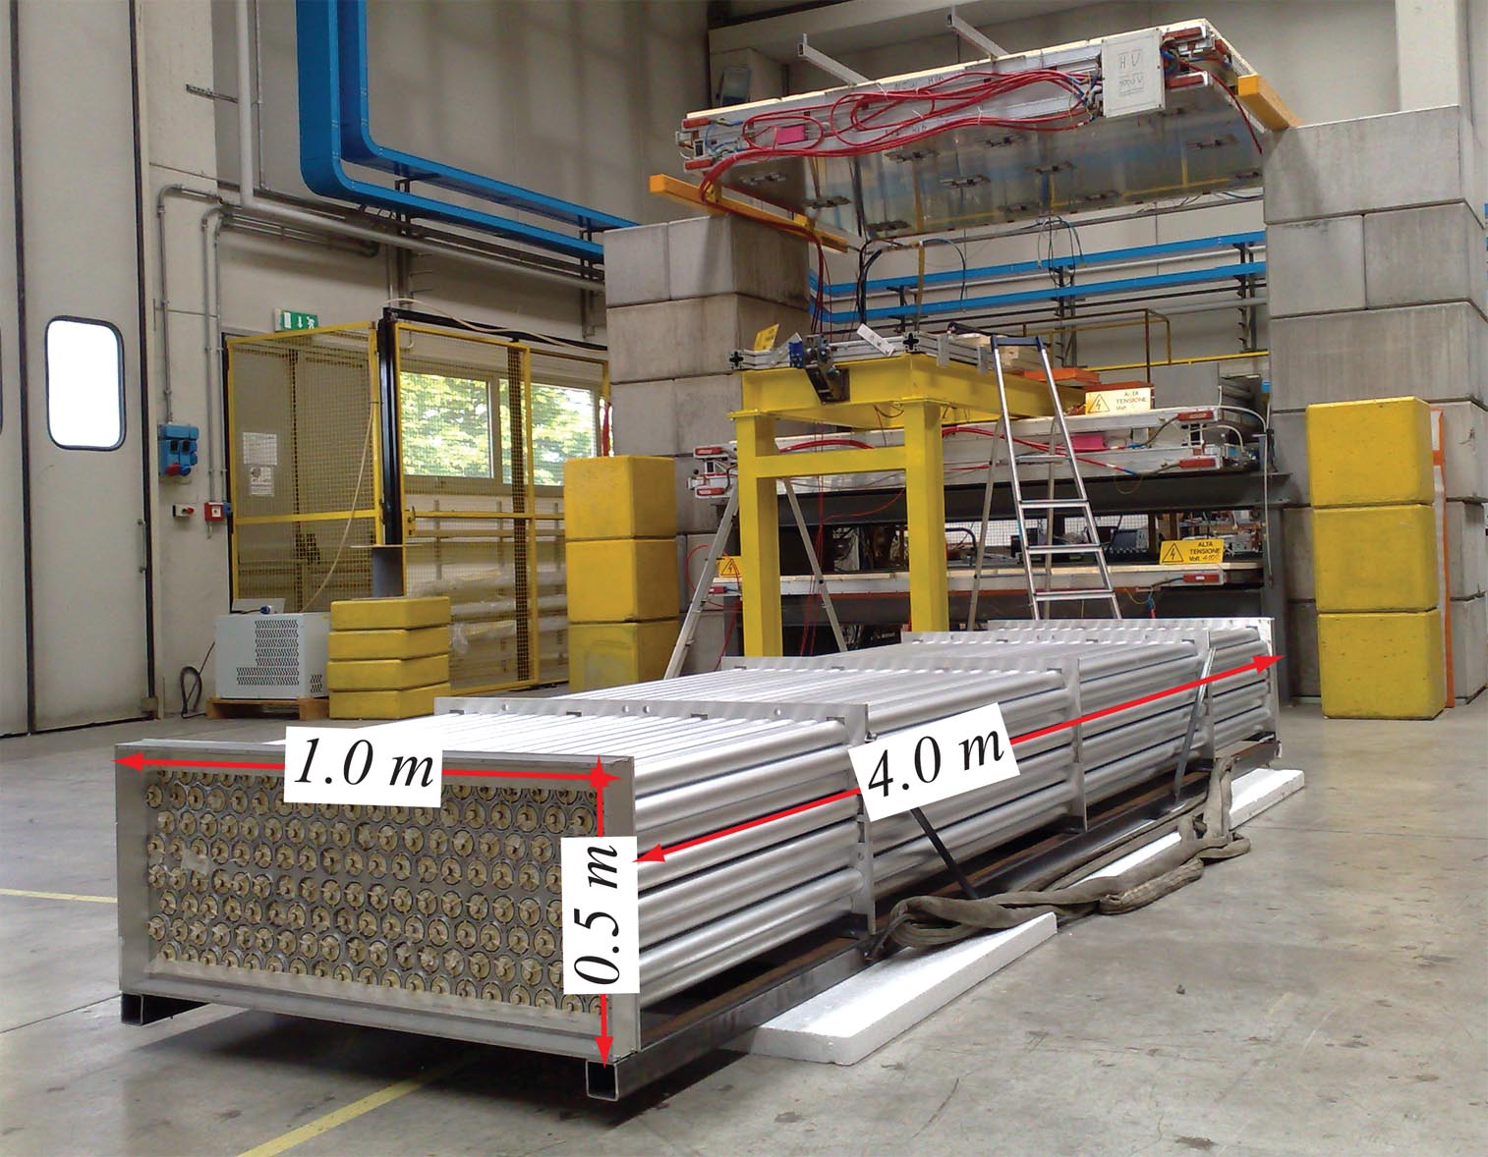
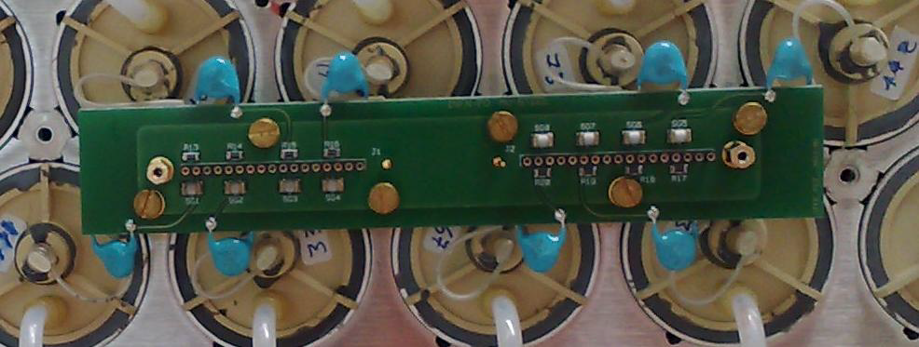
Muon detector prototype
Realised for MU-Steel project
Drift tubes technique suitable for industrial production

Slide 27
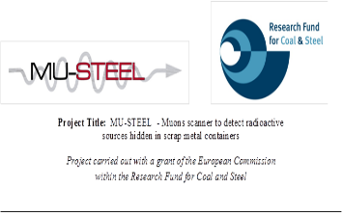
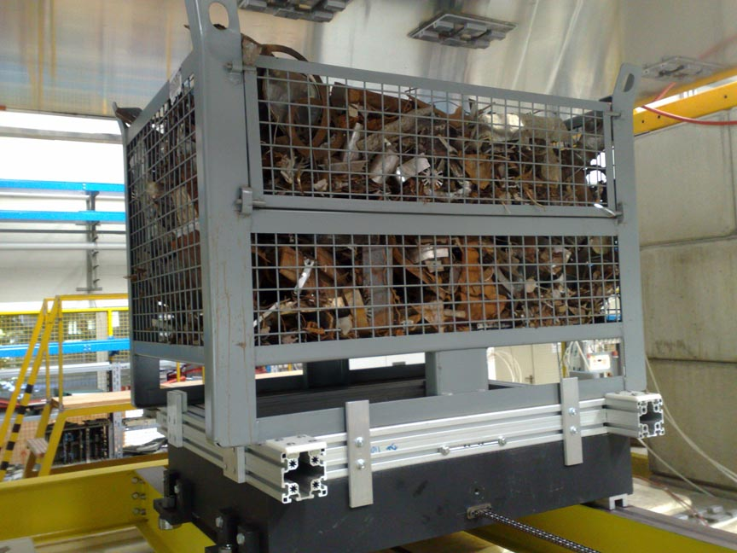
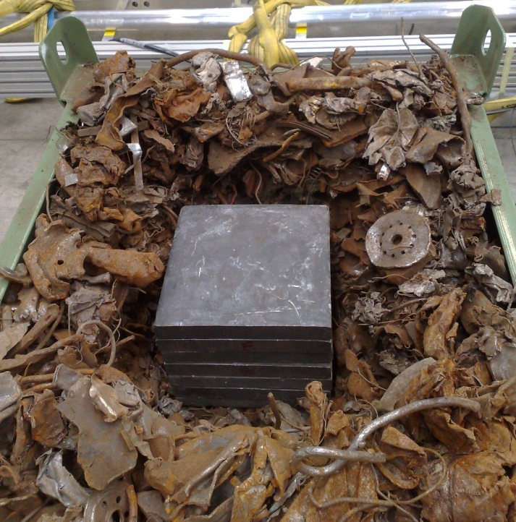
A realistic test
Test case:
  Pb block (~10 dm³) buried into scrap metal over a solid iron slab
  Total Fe thickness equivalent to 2.5 m of scrap iron
Time to recostruct a sample of
  500 k-muons
  500 k-voxels
Old package: ~15 min.
Present package: ~30 sec

Slide 28

Cosmic Muon Tomography in transport control
Evolution with iterations (400).
The realistic case : 250 k μ (~8 min exposure time)
NB: TEST DATA

Slide 29

Cosmic Muon Tomography in transport control
Full portal
NB:
SIMULATION
Simulation validated by the test data!!

Slide 30
Reconstruction Techniques
Tomographic (List Mode Iterative Algorithm)
In our case considering the volume between the chambers
s=ΔΦ and
N~0.5·10⁶ voxels of 3 cm side
M~ 20·10⁶ μ
~ 40 iterations
reconstruct the material distribution with scattering in the Φ-view alone, the Θ-view only to determine the muon trajectory in the orthogonal plane.
no momentum evaluation ⇒ assume an average value <1/p²> for (1/p_{i})²

