Slide 1
Mitigation of collective effects by optics optimization
H. Bartosik, L. Carver, G. Iadarola, K. Li, E. Métral, N. Mounet, Y. Papaphilippou, G. Rumolo, B. Salvant, M. Schenk, E. Shaposhnikova, C. Zannini

Slide 2
Outline
Beta functions
Standard optics knobs to control beam stability
Linear coupling
Momentum compaction (slip factor)
Summary and conclusions

Slide 3
Beta functions
When studying beam instabilities due to impedances it is convenient to consider that all impedance sources are concentrated at a single location
The total impedance of a machine is obtained by summing the contributions of all impedance sources
  When lumping the transverse impedances to a single location of the machine, each impedance contribution has to be weighted by the respective beta function
  There is no impact of the phase advance between different impedance sources
How to minimize effect of transverse impedances on the beam?
  Naively one would minimize the beta functions at locations with high impedance
  However the impedance can depend on the aperture (e.g. resistive wall) and therefore a more complicated optimization might be required …
here the impedances are lumped at a location with average beta function

Slide 4
Beta functions
Example: study of optimizing optics at LHC collimators (N. Mounet)
  Transverse impedance depends on the collimator half-gaps, which themselves depend on the beta functions (for a given sigma-cut)
  At high frequencies (in particular those that matter in single-bunch, i.e. from ~100 MHz to several GHz in the LHC), transverse impedance goes as (here: example of horizontal collimator with half-gap b):
  Optics functions at the different collimators cannot be modified individually (plus phase advance constraints) – “global” optimization requires to compute a total ”impedance scaling factor” for collimation section (IP7), which is then minimized
in the plane of collimation
in the other plane
despite the factor 1/2, this component can be large (e.g. horizontal collimator with small β_{x} & high β_{y})

Slide 5
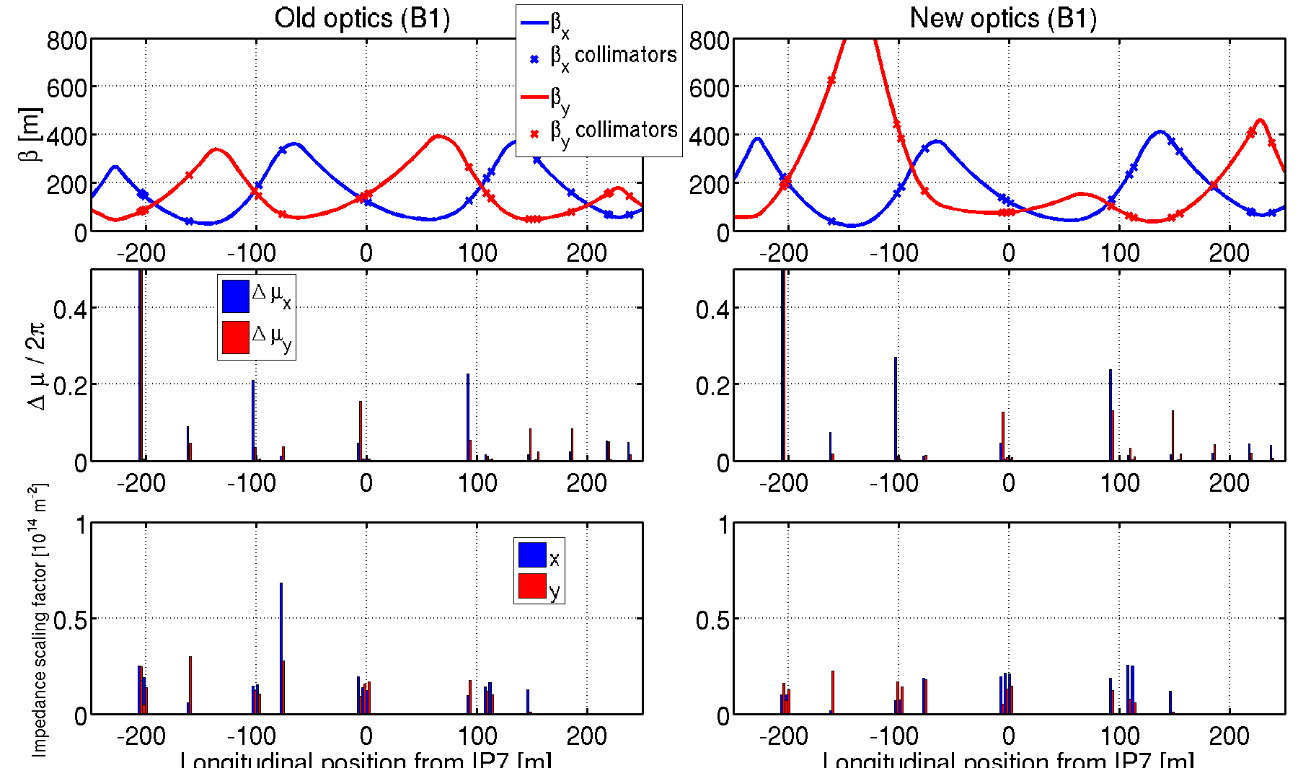
Beta functions
Example: study of optimizing optics at LHC collimators (N. Mounet)
Phase advance between successive collimators
”Impedance” per collimator

Slide 6
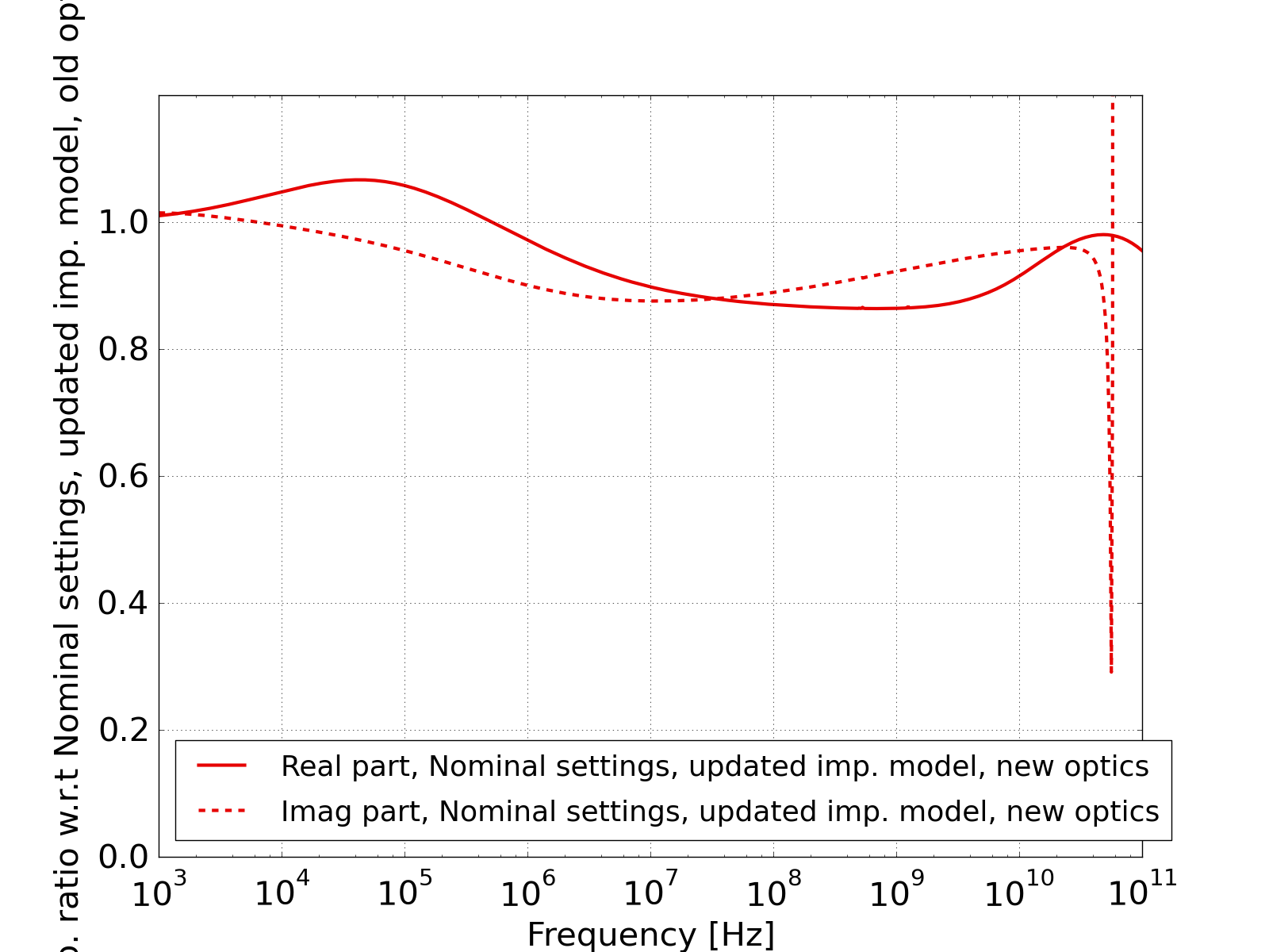
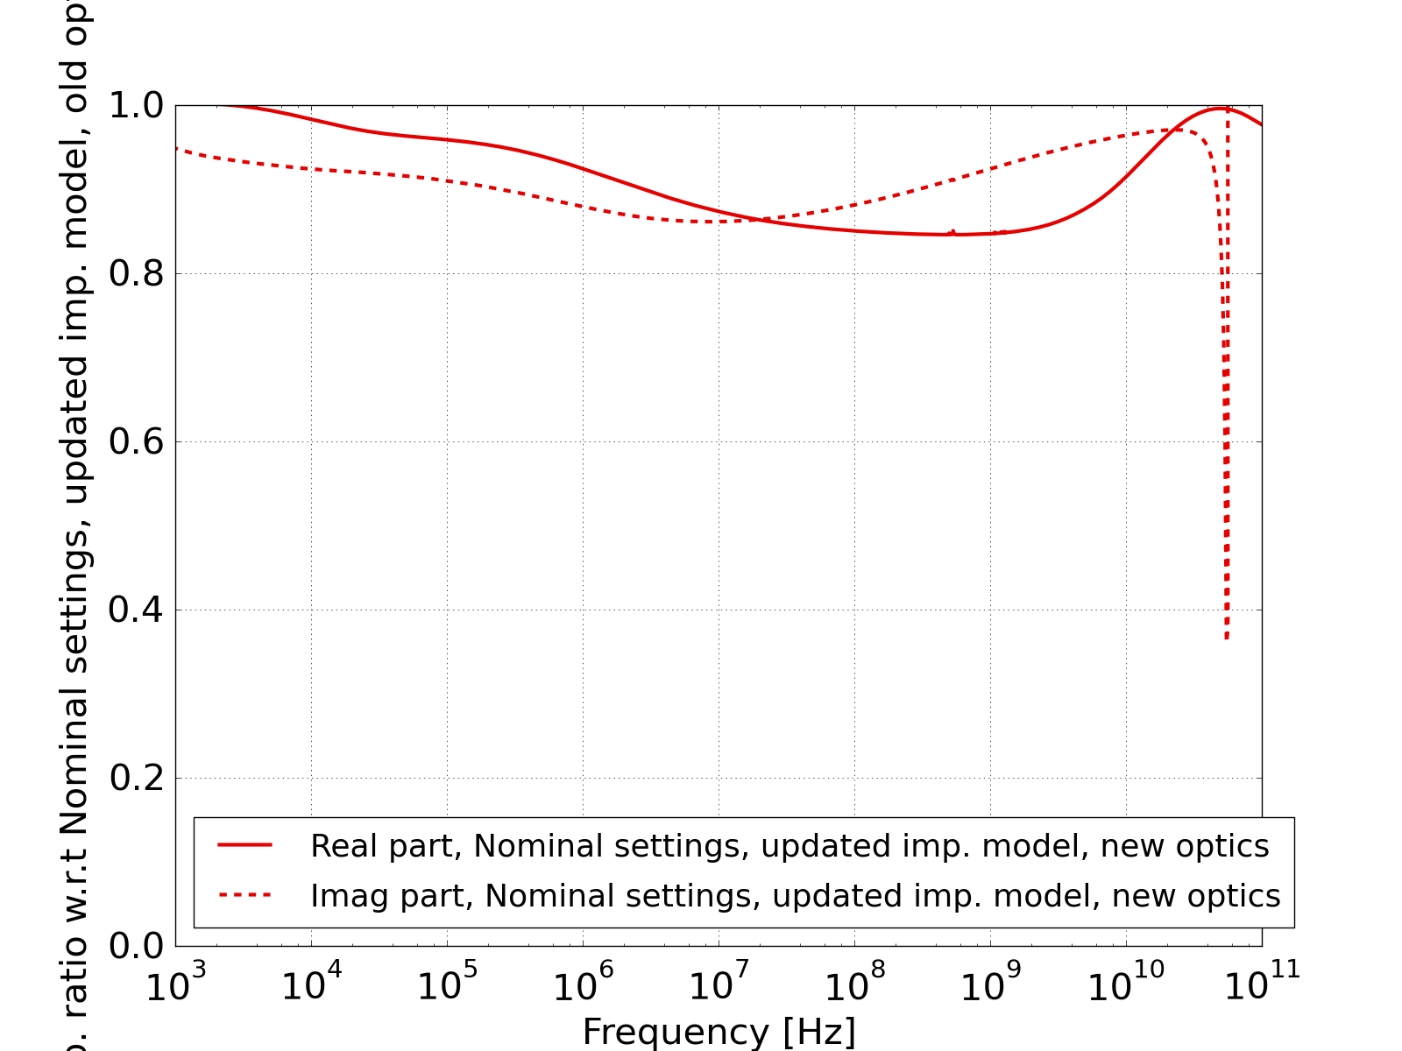
Beta functions
Example: study of optimizing optics at LHC collimators (N. Mounet)
  Gain up to ~15% on the total impedance budget (at high frequency)
  At low frequency, due to the different scaling of the impedance with the collimator half gaps, the impedance is on the contrary increased but impact on beam stability is expected to be minimal (coupled-bunch, taken care of by damper)
Horizontal
Vertical
Impedance ratio wrt. nominal optics
Impedance ratio wrt. nominal optics

Slide 7
Standard optics knobs to control beam stability
Amplitude dependent tune spread
  Provides Landau damping (presentations of O. Boine Frankenheim and V. Kornilov)
  Typically the tune spread is generated by octupoles (limited by dynamic aperture)
Chromaticity Q’
  Couples the betatron and synchrotron motions
  Betatron phase shift between head and tail is physical origin of head tail instability
  Chromatic frequency shift of bunch modes determines stability of head tail modes - above transition mode 0 becomes unstable for Q’<0 while all other modes can be unstable for Q’>0, opposite below transition (presentation of Y. H. Chin)
  Chromaticity can stabilize TMCI and e-cloud instabilities
Betatron tunes
  In case of long range wake fields (i.e. multi-turn, coupled-bunch) the impedance is sampled at betatron sidebands of multiples of the revolution frequency
  Stable and unstable modes exist – beam stability depends on fractional tunes (e.g. rigid beam instability due to resistive wall impedance: stable for fractional tunes below half integer, unstable otherwise → preferred to operate below half integer)

Slide 8
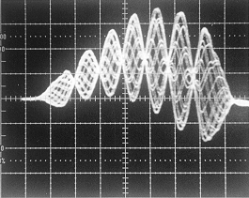
Linear coupling: beneficial effect
Linear coupling is interesting in case there is an asymmetry between the 2 transverse planes (i.e. different impedances and/or different chromaticities and/or different tune spreads) and one plane is unstable without coupling
Transfer beam stability from one plane to the other (R. Cappi and D. Mohl)
  Share the instability growth rates and/or the tune spreads between the two planes
  Theory of coupled Landau damping (E. Métral)
Example: CERN PS (E. Métral et al.)
  Horizontal m=6 headtail instability
  at injection with natural chromaticity
Sacherer’s formula
Measured horizontal beam position
instability growth rate [1/s]
headtail mode number m

Slide 9
Linear coupling: beneficial effect
Linear coupling is interesting in case there is an asymmetry between the 2 transverse planes (i.e. different impedances and/or different chromaticities and/or different tune spreads) and one plane is unstable without coupling
Transfer beam stability from one plane to the other (R. Cappi and D. Mohl)
  Share the instability growth rates and/or the tune spreads between the two planes
  Theory of coupled Landau damping (E. Métral)
Example: CERN PS (E. Métral et al.)
  Horizontal m=6 headtail instability
  at injection with natural chromaticity
  … stabilised by linear coupling operationally from ~ 2000 till now
linear
coupling

Slide 10
Linear coupling: beneficial effect
Linear coupling is interesting in case there is an asymmetry between the 2 transverse planes (i.e. different impedances and/or different chromaticities and/or different tune spreads) and one plane is unstable without coupling
Transfer beam stability from one plane to the other (R. Cappi and D. Mohl)
  Share the instability growth rates and/or the tune spreads between the two planes
  Theory of coupled Landau damping (E. Métral)
Example: CERN PS (E. Métral et al.)
  Horizontal m=6 headtail instability
  at injection with natural chromaticity
HEADTAIL simulations
ξ_{x} = -0.5
ξ_{y} = -1.0
(B. Salvant)

Slide 11
Linear coupling: beneficial effect
Linear coupling is interesting in case there is an asymmetry between the 2 transverse planes (i.e. different impedances and/or different chromaticities and/or different tune spreads) and one plane is unstable without coupling
Transfer beam stability from one plane to the other (R. Cappi and D. Mohl)
  Share the instability growth rates and/or the tune spreads between the two planes
  Theory of coupled Landau damping (E. Métral)
Beneficial effect on TMCI threshold predicted (E. Métral and G. Rumolo)
SPS simulation: without linear coupling
SPS simulation: with optimum linear coupling

Slide 12
Linear coupling: beneficial effect
LANL-PSR (from B. Macek)
  “Operating at or near the coupling resonance with a skew quad is one of the most effective means to damp our 'e-p' instability”
BNL-AGS (from T. Roser)
  “The injection setup at AGS is a tradeoff between a 'highly coupled' situation, associated with slow loss, and a 'lightly coupled' situation where the beam is unstable (coupled-bunch instability)”
CERN-SPS (from G. Arduini)
  “A TMCI in the vertical plane with lepton beams at 16 GeV is observed. Using skew quads ('just turning the knobs'), gains in intensity of about 20-30%, and a more stable beam, have been obtained”
CERN-LEP (from A. Verdier)
  “The TMCI in the vertical plane at 20 GeV sets the limit to the intensity per bunch. The operation people said that it's better to accumulate with tunes close to each other”

Slide 13
Linear coupling: detrimental effect
Could linear coupling be a problem for beam stability?
  Coherent tunes are shifted by linear coupling differently compared to the incoherent tunes due to the nonlinear fields (from octupoles to create tune spread)
  In some cases (e.g. both planes symmetric) coupling can be detrimental, leading to instabilities due to a loss of Landau damping (observations at HERA, E. Métral et al)

Slide 14
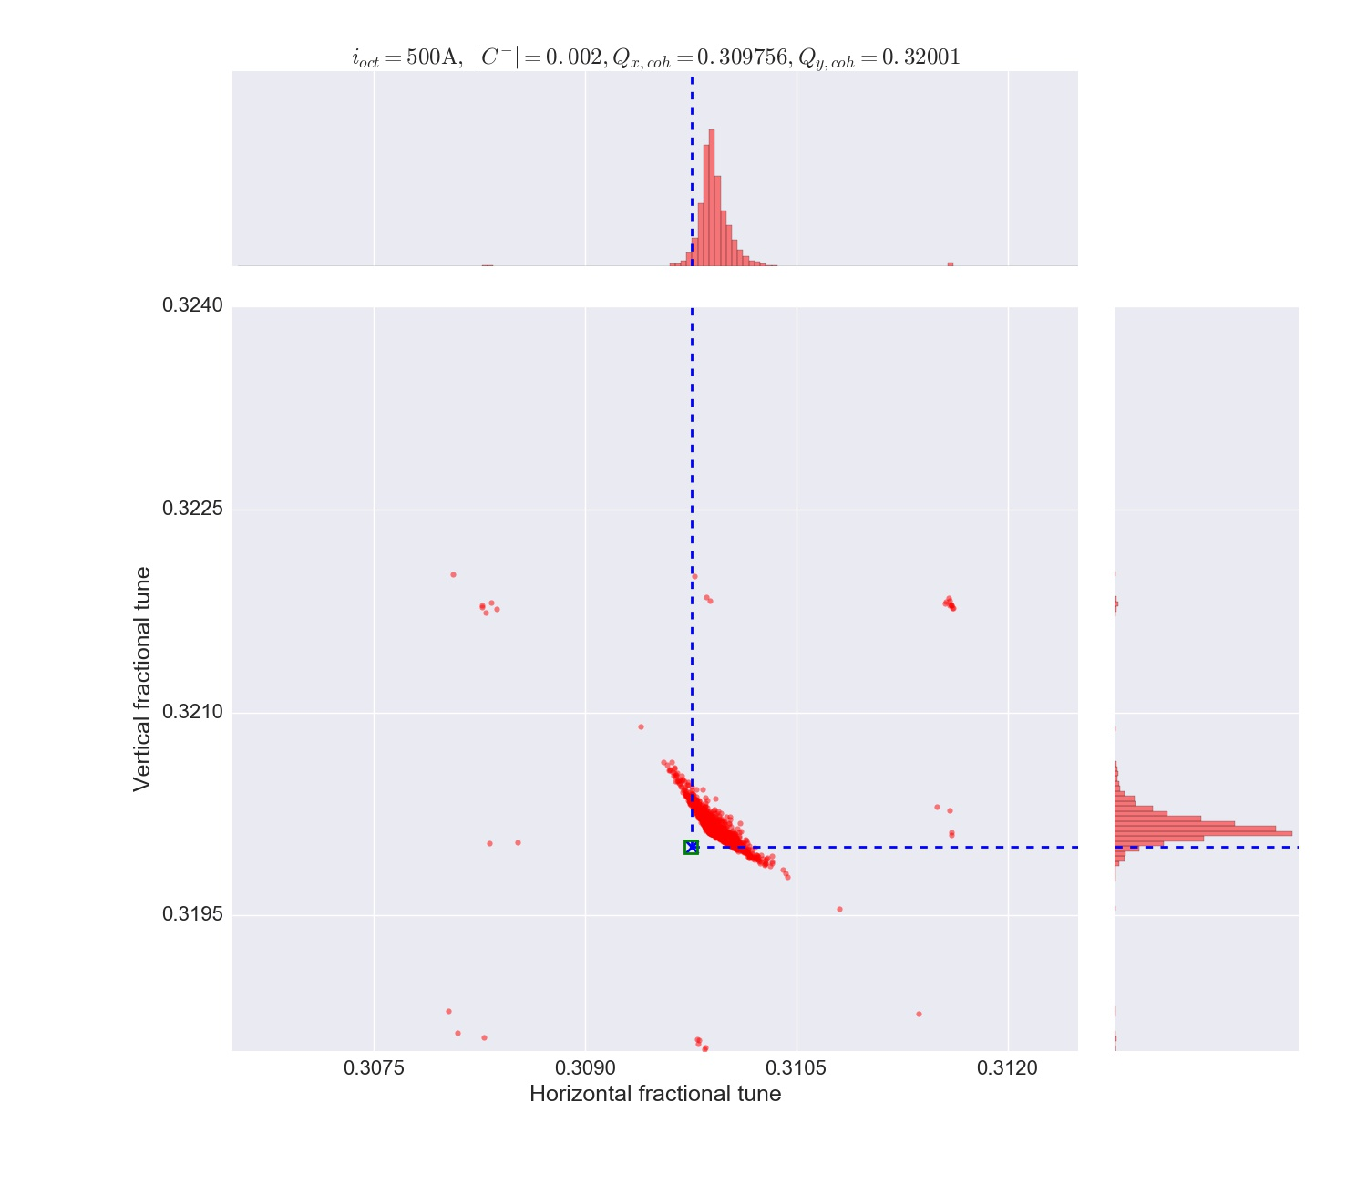
Linear coupling: detrimental effect
L. Carver et al.
Could linear coupling be a problem for beam stability?
  Coherent tunes are shifted by linear coupling differently compared to the incoherent tunes due to the nonlinear fields (from octupoles to create tune spread)
  In some cases (e.g. both planes symmetric) coupling can be detrimental, leading to instabilities due to a loss of Landau damping (observations at HERA, E. Métral et al)
Landau damping is lost (coherent tune outside tune spread)
Landau damping
(coherent tune inside
tune spread)
Coherent tunes (shifted due to impedance & chromaticity & ADT)

Slide 15
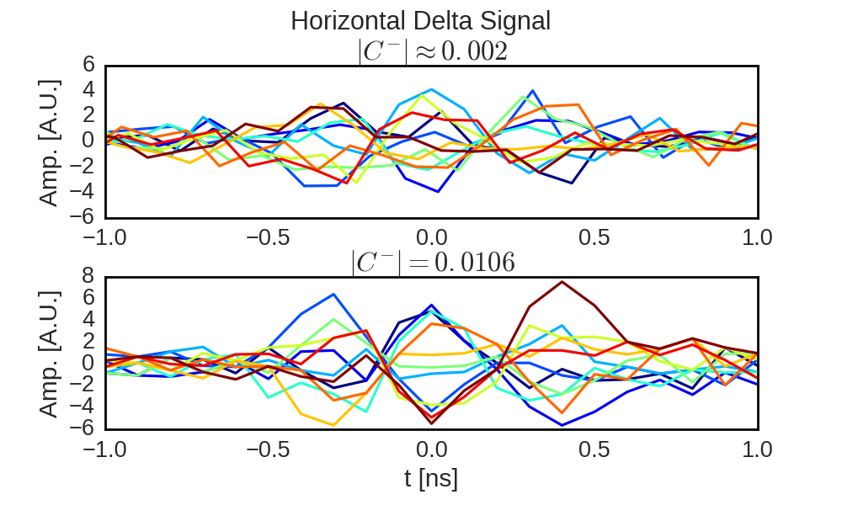
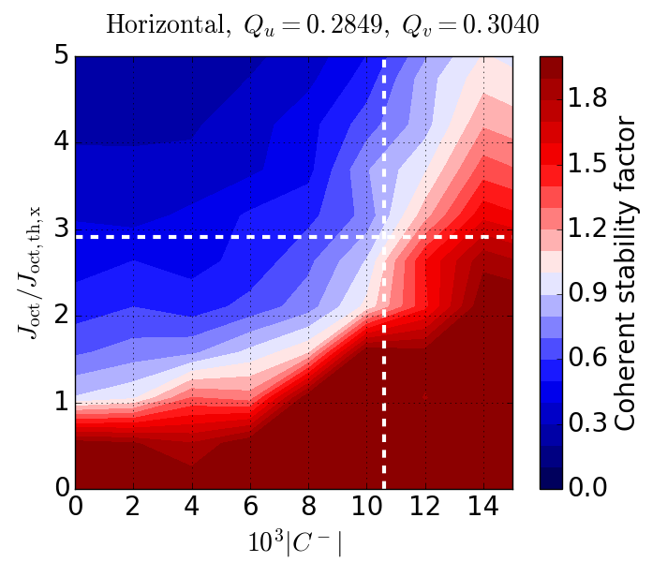
Linear coupling: detrimental effect
Could linear coupling be a problem for beam stability?
  Coherent tunes are shifted by linear coupling differently compared to the incoherent tunes due to the nonlinear fields (from octupoles to create tune spread)
  In some cases (e.g. both planes symmetric) coupling can be detrimental, leading to instabilities due to a loss of Landau damping (observations at HERA, E. Métral et al)
Example: LHC single bunch (N_{b} ≈ 1.2x10¹¹, ε = 1.5 um, Q′ = 9/8, 6.5 TeV)
L. Carver et al.
model prediction
with |C⁻| ≈ 0.002:
measured threshold
101 A in octupoles
factor ≈ 2.8
with |C⁻| ≈ 0.0106:
measured threshold
283 A in octupoles

Slide 16
Momentum compaction (slip factor)
Intensity threshold of Transverse Mode Coupling Instability scales with
slip-factor η and thus depends on momentum compaction factor (1/γ_{t}²)
  Threshold is increasing when getting further away from transition energy
Example: low γ_{t} optics for SPS proton beam to increase TMCI threshold
( )
measurements in original optics
HEADTAIL simulations

Slide 17
Momentum compaction (slip factor)
Intensity threshold of Transverse Mode Coupling Instability scales with
slip-factor η and thus depends on momentum compaction factor (1/γ_{t}²)
  Threshold is increasing when getting further away from transition energy
Example: low γ_{t} optics for SPS proton beam to increase TMCI threshold
( )
η relative to original SPS optics
original SPS optics
original optics

Slide 18
Momentum compaction (slip factor)
Intensity threshold of Transverse Mode Coupling Instability scales with
slip-factor η and thus depends on momentum compaction factor (1/γ_{t}²)
  Threshold is increasing when getting further away from transition energy
Example: low γ_{t} optics for SPS proton beam to increase TMCI threshold
( )
η relative to original SPS optics
low γ_{t} SPS optics
low γ_{t} optics
original optics

Slide 19
Momentum compaction (slip factor)
Intensity threshold of Transverse Mode Coupling Instability scales with
slip-factor η and thus depends on momentum compaction factor (1/γ_{t}²)
  Threshold is increasing when getting further away from transition energy
Example: low γ_{t} optics for SPS proton beam to increase TMCI threshold
( )
η relative to original SPS optics
Minor change of beta functions
Significant increase of dispersion function in arcs leads to reduction of γ_{t}
At 26 GeV/c expect about 2.5 times higher threshold (taking change of beta functions into account)
low γ_{t} optics
original optics

Slide 20
Momentum compaction (slip factor)
Intensity threshold of Transverse Mode Coupling Instability scales with
slip-factor η and thus depends on momentum compaction factor (1/γ_{t}²)
  Threshold is increasing when getting further away from transition energy
Example: low γ_{t} optics for SPS proton beam to increase TMCI threshold
( )
original SPS optics
low γ_{t} SPS optics
4.0e11
x2.5
1.6e11
measurements confirm 2.5 times higher threshold!

Slide 21
Momentum compaction (slip factor)
Intensity threshold of Transverse Mode Coupling Instability scales with
slip-factor η and thus depends on momentum compaction factor (1/γ_{t}²)
Single bunch e-cloud instability scales with synchrotron tune and thus also with slip-factor
HEADTAIL simulation
(for matched longitudinal beam parameters)

Slide 22
Momentum compaction (slip factor)
Intensity threshold of Transverse Mode Coupling Instability scales with
slip-factor η and thus depends on momentum compaction factor (1/γ_{t}²)
Single bunch e-cloud instability scales with synchrotron tune and thus also with slip-factor
Longitudinal instability thresholds also scale with slip-factor
  Microwave instability
  Loss of Landau damping
(for matched longitudinal beam parameters)

Slide 23
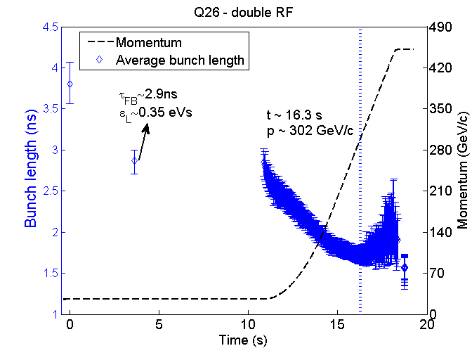
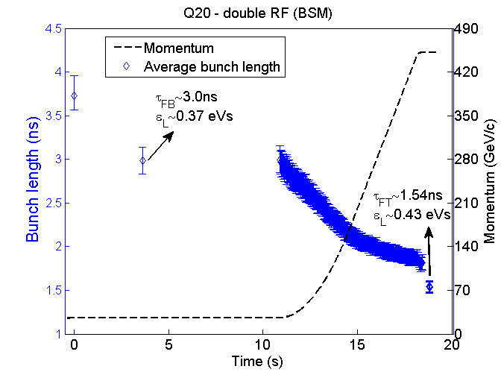
Momentum compaction (slip factor)
Intensity threshold of Transverse Mode Coupling Instability scales with
slip-factor η and thus depends on momentum compaction factor (1/γ_{t}²)
Single bunch e-cloud instability scales with synchrotron tune and thus also with slip-factor
Longitudinal instability thresholds also scale with slip-factor
  Microwave instability
  Loss of Landau damping
Example: Loss of Landau damping in SPS (scaling like |η|/Ε)
(for matched longitudinal beam parameters)
original SPS optics (measurements)
low γ_{t} SPS optics (measurements)

Slide 24
Momentum compaction (slip factor)
Intensity threshold of Transverse Mode Coupling Instability scales with
slip-factor η and thus depends on momentum compaction factor (1/γ_{t}²)
Single bunch e-cloud instability scales with synchrotron tune and thus also with slip-factor
Longitudinal instability thresholds also scale with slip-factor
  Microwave instability
  Loss of Landau damping
Optimizing the momentum compaction factor has the potential to significantly increase various instability thresholds
  In some cases even without hardware changes (like in SPS)
  Higher |η| requires more RF voltage for same bunch characteristics – compromise might need to be found (e.g. SPS optics with intermediate γ_{t} is presently studied)
  Ideally already taken into account at design stage
(for matched longitudinal beam parameters)

Slide 25
Summary and conclusions
Optics play a key role for coherent instabilities
  Sensitivity to localized impedance sources (beta functions)
  Control of instabilities with tunes, chromaticity, octupoles, linear coupling, …
  Strong impact of momentum compaction (slip factor) on various instabilities
Optimization of optics is a powerful tool to maximize performance
  Requires good modelling and understanding of limiting instabilities (e.g. in some cases linear coupling has beneficial and in others detrimental effect)
  Ideally the optimization of optics for collective effects is already done in the design phase (e.g. for the anticipated performance limitations)

Slide 27
Stability diagram: Q26
Measured onset of instability linear in ε_{l}
  As expected, slower losses (lower growth rate) slightly above threshold
Linear dependence reproduced in HEADTAIL
  Only slightly higher threshold compared to measurements → still missing a small part of impedance
measurements
HEADTAIL simulations
nominal
1.6x10¹¹ p/b
@ 0.35 eVs
ε_{l} measured in the PS …

Slide 28
Mode coupling and rise time: Q26
Transverse mode coupling between azimuthal modes -2 and -3?
Slightly lower threshold in the measurements, but same slope of growth rate as function of intensity in simulation and measurements!
ε_{l} ≈ 0.3 eVs
Instability onset

Slide 29
Intra-bunch motion: Q26
Simulated intra-bunch pattern is very similar to measurement, but
  concentrated in the tail of the bunch in the measurement (only for Q26, to be understood …)
  longitudinally centered in the simulation
measurements
HEADTAIL simulations

Slide 30
Stability diagram: Q20
Two regimes of instability in measurements
  Fast instability threshold with linear dependence on ε_{l}
  Slow instability for intermediate intensity and low ε_{l}
Excellent qualitative agreement with HEADTAIL simulations
  Slightly lower threshold in simulation (amplitude detuning or space charge?)
measurements
HEADTAIL simulations
nominal
Island of slow instability
4.5x10¹¹ p/b
@ 0.35 eVs

Slide 31
Mode coupling and rise time: Q20
Slow instability due to overlap of azimuthal modes 0 and -1
Fast instability due to coupling of modes -2 and -3? (-1 also involved?)
Similar growth rates for slow instability in simulations and measurements
ε_{l} ≈ 0.3 eVs
onset of
fast Instability
Not possible to determine growth rate (issues with Q-meter due to intensity)
slow
instability

Slide 32
Intra-bunch motion: Q20 (I)
Example for slow instability
  Clear indication for mode 1 in measurement
  Good agreement with HEADTAIL simulation
measurements
HEADTAIL simulations

Slide 33
Intra-bunch motion: Q20 (II)
Example for fast TMC instability
  Excellent agreement between measurements and simulation
  Travelling wave pattern clearly visible
measurements
HEADTAIL simulations

