Slide 1
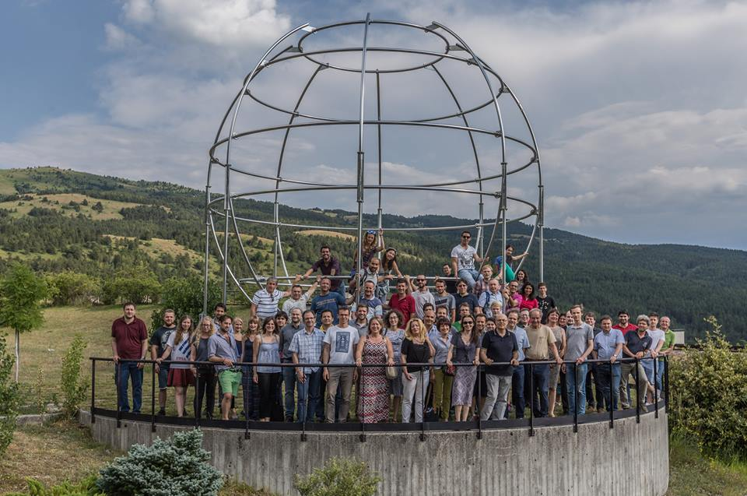
Experimental measurement of solar neutrinos
with scintillator detectors:
new results from Borexino
Barbara Caccianiga on behalf of the Borexino collaboration

Slide 2
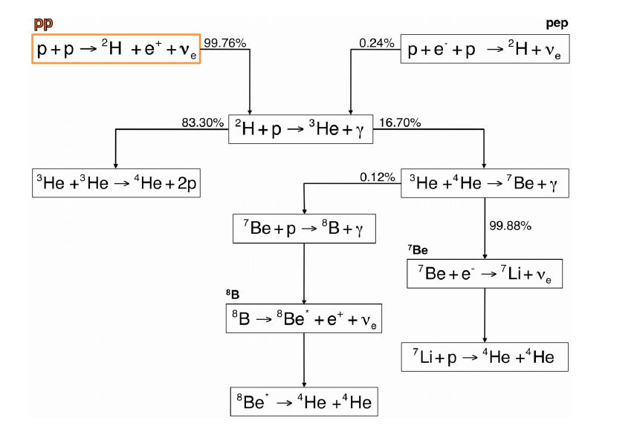
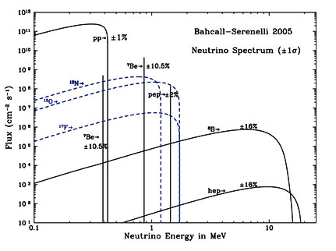

Studying Solar Neutrinos
pp CHAIN:
~99% of the Sun energy
4 p → α +2 e⁺ +2ν (E released ~ 26 MeV)
Barbara Caccianiga (BX collaboration) ``New results from Borexino’’

Slide 3
Studying Solar Neutrinos
The glorious past
Astrophysics
Original motivation of the first experiments on solar ν was to test Standard Solar Model (SSM);
Solar neutrino problem
Particle physics
Breakthrough! The solar neutrino problem provided one of the first hints towards the discovery of neutrino oscillations;
Study of the details of ν flux
Barbara Caccianiga (BX collaboration) ``New results from Borexino’’

Slide 4
Studying Solar Neutrinos
The challenging present
Astrophysics
Still open issues on our Sun;
Metallicity problem
CNO neutrinos?
Non Standard Interactions of neutrinos
Particle physics
open issues on neutrino oscillations;
Both astrophysical and particle physics can greatly profit from a detailed knowledge of the solar neutrino spectrum
Barbara Caccianiga (BX collaboration) ``New results from Borexino’’

Slide 5
Studying Solar Neutrinos
FLUX | B16-GS98 | B16-AGSs09met | DIFF. (HZ-LZ)/HZ
pp (10¹⁰ cm⁻² s⁻¹) | 5.98(1±0.006) | 6.03(1±0.005) | -0.8%
pep (10⁸ cm⁻² s⁻¹) | 1.44(1±0.01) | 1.46(1±0.009) | -1.4%
⁷Be (10⁹ cm⁻² s⁻¹) | 4.94(1±0.06) | 4.50(1±0.06) | 8.9%
⁸B (10⁶ cm⁻² s⁻¹) | 5.46(1±0.12) | 4.50(1±0.12) | 17.6%
¹³N (10⁸ cm⁻² s⁻¹) | 2.78(1±0.15) | 2.04(1±0.14) | 26.6%
¹⁵O (10⁸ cm⁻² s⁻¹) | 2.05(1±0.17) | 1.44(1±0.16) | 29.7%
¹⁷F(10⁶ cm⁻² s⁻¹) | 5.29(1±0.20) | 3.261±0.18) | 38.3%
Astrophysics: metallicity puzzle
Measuring with high precision the flux of ⁷Be, ⁸B or CNO neutrinos could provide an experimental answer to the puzzle;
Particle physics: NSI
Study of the Pee at different energies;
Study of the shape of recoil e⁻ after interaction with neutrinos;
For more details, see poster from A.Formozov ‘’The study of NSI with Borexino’’
Barbara Caccianiga (BX collaboration) ``New results from Borexino’’

Slide 6
Performing a complete study of the solar ν spectrum
SuperK,SNO
Homestake
Gallex/SAGE
Borexino
Barbara Caccianiga (BX collaboration) ``New results from Borexino’’

Slide 7
Borexino
Core of the detector: 300 tons of liquid scintillator (PC+PPO) contained in a nylon vessel of 4.25 m radius;
1st shield: 1000 tons of ultra-pure buffer liquid (pure PC) contained in a stainless steel sphere of 7 m radius;
2214 photomultiplier tubes pointing towards the center to view the light emitted by the scintillator;
2nd shield: 2000 tons of ultra-pure water contained in a cylindrical dome;
200 PMTs mounted on the SSS pointing outwards to detect light emitted in the water by muons crossing the detector;
Barbara Caccianiga (BX collaboration) ``New results from Borexino’’

Slide 8
Borexino: the long story..
PHASE-I
PHASE-II
2007
2010
2012
2017
Calibrations
Preparation
Purifications
Towards SOX
PHASE 1 (2007-2010)
Solar neutrinos
⁷Be ν : 1st observation+ precise measurement (5%); Day/Night asymmetry;
pep ν: 1st observation;
⁸B ν with low treshold;
CNO ν: best limit;
Other
geo-ν Evidence > 4.5σ
Limit on rare processes
Study on cosmogenics
PHASE 2 (2012-2017)
Solar neutrinos
pp neutrinos (Nature 2014)
seasonal modulations (2017)
NEW RESULTS (this talk)
``First simultaneous precision spectroscopy of pp, 7Be and pep solar ν with Borexino Phase-II’’
New results on ⁸B neutrinos (see Davide Franco’s talk)
6 cycles of water extraction
Barbara Caccianiga (BX collaboration) ``New results from Borexino’’

Slide 9
Borexino: essential ingredients (1)
For each scintillation event, we record
Number of collected photons (~ 500 p.e./MeV)
Energy
Time of arrival of collected photons @ each PMT
Position
Pulse-shape discrimination
α, β⁻, β⁺
Barbara Caccianiga (BX collaboration) ``New results from Borexino’’

Slide 10
Borexino: essential ingredients (1)
For each scintillation event, we record
Number of collected photons (~ 500 p.e./MeV)
Actually much more complicated than this:
Energy reconstruction is affected by non-linearities (for example, quenching effect) ; also it depends on position and on particle type;
σ(E) has non-Poissonian dependencies from E and also depends on position;
Position reco and resolution are also energy and position dependent;
It is crucial to be able of modeling correctly these effects (either analytically or with MonteCarlo simulations)
!
Time of arrival of collected photons @ each PMT
Barbara Caccianiga (BX collaboration) ``New results from Borexino’’

Slide 11
Borexino: essential ingredients (2)
Borexino detects neutrinos through scattering on electrons
ν_{x} + e⁻ → ν_{x} + e⁻
So, what we see is only the energy carried away by the electron NOT the total neutrino energy
dN/dE
E
Barbara Caccianiga (BX collaboration) ``New results from Borexino’’

Slide 12
Borexino: essential ingredients (2)
pep ν
⁷Be ν
pp ν
CNO ν
So, what we see is only the energy carried away by the electron NOT the total neutrino energy
dN/dE
E
Barbara Caccianiga (BX collaboration) ``New results from Borexino’’

Slide 13
Borexino: essential ingredients (3)
Relatively high light yield
(with respect, for example, to Cerenkov detectors)
pros
Number of photons larger than random instrumental noise →
Low energy threshold is possible
Hardware threshold~ 50 keV
Relatively good energy resolution →
Possibility to distinguish contributions from different signal/background in the energy spectrum;
Barbara Caccianiga (BX collaboration) ``New results from Borexino’’

Slide 14
Borexino: essential ingredients (4)
Scintillator light is not directional
cons
Signal cannot be separated from background using correlation with the Sun position
Extreem radiopurity needed!
Barbara Caccianiga (BX collaboration) ``New results from Borexino’’

Slide 15
Borexino: the quest for the radiopurity Grail
Requirements
The expected rate of solar neutrinos in BX is at most ~ 50 counts/day/100t which corresponds to ~ 5 10⁻⁹ Bq/Kg;
Just for comparison:
  Natural water is ~ 10 Bq/Kg in ²³⁸U, ²³²Th and ⁴⁰K
  Air is ~ 10 Bq/m³ in ³⁹Ar, ⁸⁵Kr and ²²²Rn
  Typical rock is ~ 100-1000 Bq/m³ in ²³⁸U, ²³²Th and ⁴⁰K
BX scintillator must be 9/10 order of magnitude less radioactive than anything on Earth!
Barbara Caccianiga (BX collaboration) ``New results from Borexino’’

Slide 16
Borexino: the quest for the radiopurity Grail
15 years of work
Internal background: contamination of the scintillator itself
(²³⁸U, ²³²Th, ⁴⁰K, ³⁹Ar, ⁸⁵Kr, ²²²Rn)
  Solvent purification (pseudocumene): distillation, vacuum stripping with low Argon/Kripton N2 (LAKN);
  Fluor purification (PPO): water extraction, filtration, distillation,N₂ stripping with LAKN;
  Leak requirements for all systems and plants < 10⁻⁸ mbar· liter/sec;
External background: γ and neutrons from surrounding materials
  Detector design: concentric shells to shield the inner scintillator;
  Material selection and surface treatement;
  Clean construction and handling;
Barbara Caccianiga (BX collaboration) ``New results from Borexino’’

Slide 17
Borexino: the quest for the radiopurity Grail
Achievements
Internal background: contamination of the scintillator itself
  Contamination from ¹⁴C ~ 2x10⁻¹⁸ ¹⁴C/¹²C
  Contamination from ²³⁸U chain ~10⁻¹⁷ g/g and ²³²Th chain ~5x×10⁻¹⁸ g/g; More than one order of magnitude better than specifications!
  Contamination from ⁴⁰K not observed;
  Contamination from ⁷Be (cosmogenic) not observed;
  Contamination from ³⁹Ar <<1 cpd/100t
  Some backgrounds out of specifications:²¹⁰Po, ⁸⁵Kr, ²¹⁰Bi, ¹¹C)
External background: γ and neutrons from surrounding materials
  Contribution in the relevant energy window ~3 counts/day/100t
OK!
OK!
OK!
OK!
OK!
See later
Barbara Caccianiga (BX collaboration) ``New results from Borexino’’

Slide 18
Borexino: the quest for the radiopurity Grail
The fight against background is not over...
Even in these high radiopurity conditions, we still have background events contaminating our solar neutrino signal;
We need to apply software cuts to data, in order to remove as much background as possible;
Barbara Caccianiga (BX collaboration) ``New results from Borexino’’

Slide 19
Borexino: data selection
¹⁴C
All data no cuts
1 MeV
Barbara Caccianiga (BX collaboration) ``New results from Borexino’’

Slide 20
Borexino: data selection
¹⁴C
All data no cuts
Where are neutrinos?
1 MeV
Barbara Caccianiga (BX collaboration) ``New results from Borexino’’

Slide 21
Borexino: data selection
¹⁴C
All data no cuts
1 MeV
Barbara Caccianiga (BX collaboration) ``New results from Borexino’’

Slide 22
Borexino: data selection
CUT 1
μ rejected with the external water cerenkov veto and exploiting the fact that muon pulse are not point-like
μ daughter rejected by vetoing 300 ms after each muon
¹⁴C
CUT 1
μ and μ-daughter
1 MeV
Barbara Caccianiga (BX collaboration) ``New results from Borexino’’

Slide 23
Borexino: data selection
CUT 1
μ rejected with the external water cerenkov veto and exploiting the fact that muon pulse are not point-like
μ daughter rejected by vetoing 300 ms after each muon
¹⁴C
CUT 1
μ and μ-daughter
1 MeV
Barbara Caccianiga (BX collaboration) ``New results from Borexino’’

Slide 24
Borexino: data selection
¹⁴C
CUT 2
the innermost region of the scintillator is selected to reject external background
R<2.8 m
-1.8 m<z<2.2 m
CUT 2
FV cut
1 MeV
Barbara Caccianiga (BX collaboration) ``New results from Borexino’’

Slide 25
Borexino: data selection
¹⁴C
CUT 2
the innermost region of the scintillator is selected to reject external background
R<2.8 m
-1.8 m<z<2.2 m
CUT 2
FV cut
1 MeV
Barbara Caccianiga (BX collaboration) ``New results from Borexino’’

Slide 26
Borexino: data selection
¹⁴C
CUT 2
the innermost region of the scintillator is selected to reject external background
R<2.8 m
-1.8 m<z<2.2 m
CUT 2
FV cut
Where are neutrinos?
⁷Be ν’s
1 MeV
Barbara Caccianiga (BX collaboration) ``New results from Borexino’’

Slide 27
Borexino: data selection
¹⁴C
CUT 2
the innermost region of the scintillator is selected to reject external background
R<2.8 m
-1.8 m<z<2.2 m
CUT 2
FV cut
²¹⁰Po
⁷Be ν’s
¹¹C
⁸⁵Kr
²¹⁰Bi
1 MeV
Barbara Caccianiga (BX collaboration) ``New results from Borexino’’

Slide 28
Borexino: data selection
Residual backgrounds
¹⁴C: irreducible background in an organic scintillator. It decays β⁻ with an end-point of 156 keV. It affects the low energy region (pp neutrinos);
pile-up of events: it especially affects low-energies (pp neutrinos);
⁸⁵Kr: present in air. Decays β⁻ with an end-point of 687 keV (pp, ⁷Be neutrinos);
²¹⁰Bi: comes from ²¹⁰Pb not in equilibrium with ²³⁸U chain. It decays β⁻ with an end-point of 1160 keV (pp, ⁷Be, pep neutrinos);
²¹⁰Po: belongs to the ²³⁸U chain. Not in equilibrium with the ²³⁸U chain nor with ²¹⁰Pb; it decays with its livetime of ~ 200 days) (pp, ⁷Be, pep neutrinos);
¹¹C: produced by μ. It decays in 30 minutes → cannot be eliminated with the μ-daughter cut (pep neutrinos);
reduced in Phase-II by purifications
reduced in Phase-II by purifications
reduced in Phase-II by natural decay
Barbara Caccianiga (BX collaboration) ``New results from Borexino’’

Slide 29
Borexino: Phase-II
Comparison between Phase-I and Phase-II data
PHASE-I
Barbara Caccianiga (BX collaboration) ``New results from Borexino’’

Slide 30
Borexino: Phase-II
Comparison between Phase-I and Phase-II data
Significant reduction of three important backgrounds;
The scintillator has never been so clean!
PHASE-I
PHASE-II
⁸⁵Kr: reduced by a factor 4.6;
²¹⁰Bi: reduced by a factor 2.3;
²¹⁰Po: reduced by more than an order of magnitude (by natural decay)
Barbara Caccianiga (BX collaboration) ``New results from Borexino’’

Slide 31
New results of Borexino Phase-II
Barbara Caccianiga (BX collaboration) ``New results from Borexino’’

Slide 32
New Phase-II results
Summary of improvements with respect to Phase-I
Improved radiopurity, because of the purification campaign;
Increased statistics (x 1.6 exposure of published Phase-I data);
Increased stability of the detector;
Better comprehension of the details of the energy scale and detector response;
Barbara Caccianiga (BX collaboration) ``New results from Borexino’’

Slide 33
New Phase-II results
4 main results on solar neutrinos from Phase-II data
First measurement of the pp rate (Nature, Vol. 512 2014) with a dedicated analysis of the low energy portion of the spectrum;
Seasonal modulations of the ⁷Be solar neutrino signal (Astr.Phys. 92 (2017) 21);
First Simultaneuos Precision Spectroscopy of pp, ⁷Be and pep Solar Neutrinos (arXiV:1707.09279);
Updated ⁸B results (see Davide Franco’s talk)
NEW!
NEW!
NEW!
Barbara Caccianiga (BX collaboration) ``New results from Borexino’’

Slide 34
‘’Seasonal modulation of the ⁷Be solar neutrino rate in Borexino’’
Astr.Phys. 92 (2017) 21
Barbara Caccianiga (BX collaboration) ``New results from Borexino’’

Slide 35
Seasonal modulations
Search for the seasonal variations of the neutrino interaction rate due to the varying distance L(t) between Sun and Earth during the year;
September
December
June
L₀= 1 a.u.
T=1 year
ε=0.0167
March
Barbara Caccianiga (BX collaboration) ``New results from Borexino’’

Slide 36
Seasonal modulations
Search for the seasonal variations of the neutrino interaction rate due to the varying distance L(t) between Sun and Earth during the year;
Events between 215-715 keV
Muon and muon daughter cuts
FV cut: r<3m + paraboloidal cuts at the vessel poles;
New alpha/beta cut (MLP) to reject ²¹⁰Po alpha’s;
September
December
June
March
Barbara Caccianiga (BX collaboration) ``New results from Borexino’’

Slide 37
Seasonal modulations
Search for the seasonal variations of the neutrino interaction rate due to the varying distance L(t) between Sun and Earth during the year;
September
December
June
Fit to the evolution of the rate in time (bin of 30 days)
ε = (1.74 ± 0.45)%
T = (367 ± 10) days
Φ = (-18 ± 24) days
March
Measurement of the astronomic year with solar neutrinos!
Barbara Caccianiga (BX collaboration) ``New results from Borexino’’

Slide 38
Seasonal modulations
Search for the seasonal variations of the neutrino interaction rate due to the varying distance L(t) between Sun and Earth during the year;
This analysis greatly benefits from the reduced background and from the improved stability in time of the detector with respect to Phase-I;
September
Consistent results are obtained using the Lomb-Scargle and the Empirical Mode Decomposition techniques;
December
June
Lomb-Scargle periodogram
March
Barbara Caccianiga (BX collaboration) ``New results from Borexino’’

Slide 39
‘’First simultaneous precision spectroscopy of pp, ⁷Be and pep Solar Neutrinos with Borexino Phase-II’’
(arXiV:1707.09279)
Barbara Caccianiga (BX collaboration) ``New results from Borexino’’

Slide 40
First simultaneous precision spectroscopy of pp,⁷Be and pep
Previous analysis have been performed in limited energy range:
Phase-I Be7 and pep analysis between ~250-1500 keV;
Barbara Caccianiga (BX collaboration) ``New results from Borexino’’

Slide 41
First simultaneous precision spectroscopy of pp,⁷Be and pep
Previous analysis have been performed in limited energy range:
Phase-I Be7 and pep analysis between ~250-1500 keV;
pp analysis between ~170-600 keV;
Barbara Caccianiga (BX collaboration) ``New results from Borexino’’

Slide 42
First simultaneous precision spectroscopy of pp,⁷Be and pep
We have now improved our knowledge of the detector energy scale and response over a wide energy range (including non linearities, non uniformities..)
We are now able of performing the analysis on an extended energy range
between 190-2930 keV
Barbara Caccianiga (BX collaboration) ``New results from Borexino’’

Slide 43
First simultaneous precision spectroscopy of pp,⁷Be and pep
Extracting the neutrino signal from data
The presence of residual backgrounds (¹⁴C, pile-up, ⁸⁵Kr, ²¹⁰Bi, ²¹⁰Po, ¹¹C) makes it complex to extract the neutrino signal from our data;
A multivariate fit is performed including in the likelihood
Energy spectrum (TFC-tagged and TFC-subtracted)
Pulse-shape distribution PS-L_{PR} ;
Radial distribution;
to improve the fit capability to disentangle ¹¹C
to improve the fit capability to disentangle external background
Barbara Caccianiga (BX collaboration) ``New results from Borexino’’

Slide 44
First simultaneous precision spectroscopy of pp,⁷Be and pep
Extracting the neutrino signal from data
Energy spectrum
Two methods to determine the reference spectral shapes of signal and background;
MonteCarlo arXiV:1703.02291
Full simulation of all processes: energy deposition, light production (scintillator and Cerenkov), propagation and collection;
All known materal properties included;
Known time variations of the detector included (for example, number of live PMTs and electronics channels);
Tuned on calibration data of Phase-I;
Free parameters in the fit: only the rates of signal and background;
Analytical Phys.Rev.D 89, 112007 (2014)
energy scale and response described analytically (including cerenkov, quenching);
Spatial dependence of reconstructed E and σ(E);
some parameters determined from calibrations and fixed in the fit (Birk’s quenching factor..);
Free parameters in the fit: the rates of signal and background + 6 parameters of the response function (L.Y., 2 resol. parameters, ²¹⁰Po peak position and width, starting point of ¹¹C spectrum;
Barbara Caccianiga (BX collaboration) ``New results from Borexino’’

Slide 45
First simultaneous precision spectroscopy of pp,⁷Be and pep
Extracting the neutrino signal from data
Two methods to determine the reference spectral shapes of signal and background;
MonteCarlo arXiV:1703.02291
pros
Tuning of the MC parameters is done on calibration data which is completeley independent from the data to be analyzed;
Agreement between MonteCarlo and calibration data is at sub-percent level;
cons
it cannot take into account unkown variations of the detector properties
Analytical Phys.Rev.D 89, 112007 (2014)
pros
More flexibility in case of unknown variations of the detector;
Less problems in modeling ¹⁴C (MC has problems due to the very high statistics to be simulated);
cons
More free parameters → more prone to correlations
The two methods are complementary and provide internal cross-check to the analysis
Barbara Caccianiga (BX collaboration) ``New results from Borexino’’

Slide 46
First simultaneous precision spectroscopy of pp,⁷Be and pep
to improve the fit capability to disentangle ¹¹C
The Three-fold Coincidence technique (TFC)
¹¹C is produced by muons together with neutron(s);
μ + ¹²C → μ +¹¹C + n
Muon
Spherical cut
around 2.2 γ
¹¹C → ¹¹B + e⁺ + ν_{e}
t~30min
n + p → d + γ
τ∼260μs
n
Cylindrical cut
Around μ-track
The likelihood that a certain event is ¹¹C is obtained using:
Distance in space and time from the μ-track;
Distance from the neutron;
neutron multiplicity;
Muon dE/dx and number of muon clusters in an event;
¹¹C
The data-set is divided in two samples: one depleted in ¹¹C (TFC-subtracted) and one enriched in ¹¹C (TFC-tagged) which are simultaneously fit;
Barbara Caccianiga (BX collaboration) ``New results from Borexino’’

Slide 47
First simultaneous precision spectroscopy of pp,⁷Be and pep
The pulse-shape variable PS-L_{PR}
to improve the fit capability to disentangle ¹¹C
¹¹C decays β⁺
The probability density function (PDF) of the scintillation time profile is different for e⁻ and e⁺ for two reasons:
in 50% of the case e⁺ annihilation is delayed by ortho-positronium formation (τ~3ns);
e⁺ energy deposit is not point-like because of the two annihilation gammas;
New discrimination parameter based on the output likelihood of the pos-reco alghoritm;
to improve the fit capability to disentangle external background
The radial distribution
The residual external background which is able of penetrating even inside the FV can be disentangled from events uniformly distributed in the volume by their radial distribution;
Barbara Caccianiga (BX collaboration) ``New results from Borexino’’

Slide 48
First simultaneous precision spectroscopy of pp,⁷Be and pep
Sensitivity studies and toy-MonteCarlo
The analysis is very complex and we need a way to validate it;
We have created a tool which can generate many ‘’fake’’ data-sets (same statistics of Phase-II) starting from the MonteCarlo PDFs for each signal and neutrino species;
By performing the fit on all the simulated data-sets, we can study possible biases, correlations and sensitivity of the method;
Barbara Caccianiga (BX collaboration) ``New results from Borexino’’

Slide 49
First simultaneous precision spectroscopy of pp,⁷Be and pep
An important issue: the similarity between ²¹⁰Bi, pep and CNO spectral shapes
Simulation of signal and background spectra
It critically affects our capability to measure the pep neutrino rate and to set a limit on the CNO neutrino rate, because it induces strong correlations in the fit;
Barbara Caccianiga (BX collaboration) ``New results from Borexino’’

Slide 50
First simultaneous precision spectroscopy of pp,⁷Be and pep
An important issue: the similarity between pep, CNO and ²¹⁰Bi spectral shapes
It critically affects our capability to measure the pep neutrino rate and to set a limit on the CNO neutrino rate, because it induces strong correlations in the fit;
N.B.: ⁷Be and pp ν measurement are not (or weakly) affected by this correlation
correlation between ²¹⁰Bi and pep
correlation between ²¹⁰Bi and CNO
correlation between pep and CNO
Barbara Caccianiga (BX collaboration) ``New results from Borexino’’

Slide 51
First simultaneous precision spectroscopy of pp,⁷Be and pep
An important issue: the similarity between pep, CNO and ²¹⁰Bi spectral shapes
Analysis strategy
To reduce correlations, we put a constraint to the CNO rate following the theoretical predictions
correlation between ²¹⁰Bi and pep
correlation between ²¹⁰Bi and CNO
correlation between pep and CNO
CNO-HZ: (4.92±0.56) cpd/100t
CNO-LZ: (3.52±0.37) cpd/100t
Barbara Caccianiga (BX collaboration) ``New results from Borexino’’

Slide 52
First simultaneous precision spectroscopy of pp,⁷Be and pep
Results on data
Data-set: Dec 14th 2011- May 21st 2016;
Total exposure: 1291.51 days x 71.3 tons;
Fit range: (0.19-2.93) MeV;
CNO rate constrained to HZ-value (and to LZ-value);
Fit performed both with the MonteCarlo and the Analytical methods;
Fit performed in different conditions (range, energy variable, binning, with or without Kr constraint..);
The final numbers are the average values obtained in different conditions;
Differences are quoted as systematic error;
Barbara Caccianiga (BX collaboration) ``New results from Borexino’’

Slide 53
First simultaneous precision spectroscopy of pp,⁷Be and pep
Energy spectrum (TFC subtracted)
Energy spectrum (TFC tagged)
Example using the MC approach
Results on data
Energy estimator= N_{hits}
PS_L_{Pr} distribution
Radial distribution
Barbara Caccianiga (BX collaboration) ``New results from Borexino’’

Slide 54
First simultaneous precision spectroscopy of pp,⁷Be and pep
Zoom to the low energy region (200-830) keV
Results on data
Example using the analytical approach
Energy estimator= npmts_dt2
Barbara Caccianiga (BX collaboration) ``New results from Borexino’’

Slide 55
First simultaneous precision spectroscopy of pp,⁷Be and pep
Systematic errors
Two methods to take into account pile-up:
Effects of non perfect modelling of the detector response;
Uncertainty on theoretical input spectra (²¹⁰Bi);
⁸⁵Kr constrained to be <7.5cpd/100t(95% C.L.) (from Kr-Rb delayed coincidences)
Barbara Caccianiga (BX collaboration) ``New results from Borexino’’

Slide 56
First simultaneous precision spectroscopy of pp,⁷Be and pep
Borexino results and comparison with the theoretical predictions
Neutrino rates
Neutrino fluxes Φ
*oscillation parameters from: I.Esteban, MC.Gonzalez-Concha, M.Maltoni, I.Martinez-Soler and T.Schwetz, Journal of High Energy Physics 01 (2017)
**neutrino fluxes from: N.Vinyole,A.Serenelli, F.Villante, S.Basu, J.Bergstrom,M.C.Gonzalez-Garcia, M.Maltoni, C.Pena-Garay, N.Song, Astr.Jour. 835,202 (2017)
Barbara Caccianiga (BX collaboration) ``New results from Borexino’’

Slide 57
First simultaneous precision spectroscopy of pp,⁷Be and pep
Comparison with previous results from Borexino
All rates are fully compatible with and improve the uncertainty of the previously published Borexino results;
 | Previous BX results (cpd/100t) | This work (cpd/100t) | Uncertainty reduction
pp | 144±13±10 | 134±10⁺⁶ ₋₁₀ | 0.78
⁷Be(862 keV) | 46.0±1.5^{+1.6} _{-1.5} | 46.3±1.1^{+0.4} _{-0.7} | 0.57
pep | 3.1±0.6±0.3 | (HZ) 2.43±0.36^{+0.15} _{-0.22} (HZ) 2.65±0.36^{+0.15} _{-0.24} | 0.61
Barbara Caccianiga (BX collaboration) ``New results from Borexino’’

Slide 58
First simultaneous precision spectroscopy of pp,⁷Be and pep
Borexino results on background rates
Background species | Rate (cpd/100t)
¹⁴C (Bq/100t) | 40.0±2.0
⁸⁵Kr | 6.8±1.8
²¹⁰Bi | 17.5±1.9
¹¹C | 26.8±0.2
²¹⁰Po | 260.0±3.0
Ext ⁴⁰K | 1.0±0.6
Ext ²¹⁴Bi | 1.9±0.3
Ext ²⁰⁸Tl | 3.3±0.1
Factor 4.6 reduction with respect to Phase-I
Factor 2.3 reduction with respect to Phase-I
Statistical and systematical errors added in quadrature
Barbara Caccianiga (BX collaboration) ``New results from Borexino’’

Slide 59
First simultaneous precision spectroscopy of pp,⁷Be and pep
Implications of the new BX results: pep ν measurement
>5σ evidence of pep signal (including systematic errors)
Applying stringent cuts on FV and on the pulse-shape variable PS_L_{PR} we can actually see the pep ν shoulder!
Barbara Caccianiga (BX collaboration) ``New results from Borexino’’

Slide 60
First simultaneous precision spectroscopy of pp,⁷Be and pep
Implications of the new BX results: metallicity issue
The new Borexino results on ⁷Be neutrino rate seem to give an hint towards the High Metallicity hypothesis
  p-value (HZ)= 0.87
  p-value (LZ)= 0.11
We are now largely dominated by the theoretical error;
Global fit to all solar + Kamland data (including the new ⁷Be result from BX)
Barbara Caccianiga (BX collaboration) ``New results from Borexino’’

Slide 61
First simultaneous precision spectroscopy of pp,⁷Be and pep
Implications of the new BX results: probing solar fusion
From the pp and ⁷Be flux measurements it is possible to determine the ratio R between the rate of ³He-³He e ⁴He-³He;
It is an important experimental test of the solar fusion
Theoretical predictions *
From the pp and ⁷Be flux new measurement
  R(HZ)= 0.18 ± 0.01
  R(LZ)= 0.16 ± 0.01
* Private communications C.Pena-Garay
R = 0.18 ± 0.02
Barbara Caccianiga (BX collaboration) ``New results from Borexino’’

Slide 62
First simultaneous precision spectroscopy of pp,⁷Be and pep
Implications of the new BX results: survival probability P_{ee}
*oscillation parameters from: I.Esteban, MC.Gonzalez-Concha, M.Maltoni, I.Martinez-Soler and T.Schwetz, Journal of High Energy Physics 01 (2017)
From the measured interacton rates and assuming HZ-SSM fluxes we get:
P_{ee}(pp)=0.57±0.10
P_{ee}(⁷Be,862keV)=0.53±0.05
P_{ee}(pep)=0.43±0.11
⁸B point still from the old BX measurement PRD 82 033006 (2010)
Barbara Caccianiga (BX collaboration) ``New results from Borexino’’

Slide 63
What about CNO neutrinos?
An important issue: the similarity between pep, CNO and ²¹⁰Bi spectral shapes
correlation between ²¹⁰Bi and pep
It critically affects our capability to measure the pep neutrino rate and to set a limit on the CNO neutrino rate, because it induces strong correlations in the fit;
correlation between ²¹⁰Bi and CNO
correlation between pep and CNO
Barbara Caccianiga (BX collaboration) ``New results from Borexino’’

Slide 64
What about CNO neutrinos?
An important issue: the similarity between pep, CNO and ²¹⁰Bi spectral shapes
Analysis strategy
To reduce correlations, we put a constraint to the pp/pep flux ratio following the theoretical predictions
correlation between ²¹⁰Bi and pep
correlation between ²¹⁰Bi and CNO
correlation between pep and CNO
R(pp/pep): (47.7±1.2)
Barbara Caccianiga (BX collaboration) ``New results from Borexino’’

Slide 65
What about CNO neutrinos?
An important issue: the similarity between pep, CNO and ²¹⁰Bi spectral shapes
Analysis strategy
To reduce correlations, we put a constraint to the pp/pep flux ratio following the theoretical predictions
Toy-MonteCarlo study
injected CNO-HZ: (4.92±0.56) cpd/100t
R(pp/pep): (47.7±1.2)
Sensitivity study with toy-MC: distribution of CNO results including systematics
From the toy-MonteCarlo study:
  <9 cpd/100t (95% C.L.) (LZ)
  <10 cpd/100t (95% C.L.) (HZ)
Barbara Caccianiga (BX collaboration) ``New results from Borexino’’

Slide 66
What about CNO neutrinos?
Results on data
including systematic error
Likelihood profile resulting from the multi-variate fit
 | Borexino results (cpd/100t) | Expected HZ (cpd/100t) | Expected LZ (cpd/100t)
CNO ν | <8.1 (95% C.L.) | 4.91±0.56 | 3.62±0.37
In Phase-I we have published a limit of 7.9 cpd/100t (95% C.L.)
Barbara Caccianiga (BX collaboration) ``New results from Borexino’’

Slide 67
CONCLUSIONS
Borexino has been originally designed to study solar neutrinos from the ⁷Be reaction in the Sun;
Thanks to its exceptional radiopurity, Borexino has gone well beyond its original goal providing a complete study of solar neutrinos from the entire proton-proton chain;
With Phase-II data we entered the era of precision spectroscopy of solar neutrinos;
The newest results feature
First simultaneaus extraction of pp, pep and ⁷Be neutrino rate from the same multivariate fit;
Improved precision in all flux measurements (notably ⁷Be precision is now 2.7%);
>5σ evidence of the pep neutrino signal;
Hint towards the High Metallicity hypothesis coming from the ⁷Be ν measurement;
First experimental determination of the ratio R between the ³He-⁴He and ³He-³He reactions in the Sun;
Barbara Caccianiga (BX collaboration) ``New results from Borexino’’

Slide 68
CONCLUSIONS
For extra details on the Borexino analysis described in this talk also look at the posters session
"Analytical Multivariate Fit with GooStats in the Borexino Solar Neutrino Analysis"- O.Penek
"Data selection strategy for the Borexino Phase-II solar neutrino analysis"- S. Caprioli
""Analytical response function for the Borexino solar neutrino analysis" Z.Bagdasarian
"Identification of the cosmogenic ¹¹C background in Borexino’’ A.Porcelli
Barbara Caccianiga (BX collaboration) ``New results from Borexino’’

Slide 69
Thank you!
Barbara Caccianiga (BX collaboration) ``New results from Borexino’’

Slide 70
Backup slides
Barbara Caccianiga (BX collaboration) ``New results from Borexino’’

Slide 71
What about CNO neutrinos? Perspectives for the future
The similarity between pep, CNO and ²¹⁰Bi spectral shapes prevents a measurement of CNO neutrinos;
Setting a constraint on pep ν rate is not enough: the correlation between CNO ν and ²¹⁰Bi remains and is too large;
Possible way out: constrain the ²¹⁰Bi rate to the value obtained independently from the ²¹⁰Po rate;
²¹⁰Pb → ²¹⁰Bi + β⁻ (τ=33y)
²¹⁰Bi → ²¹⁰Po +β⁻ (τ=7d)
²¹⁰Po → ²⁰⁶Pb +α (τ=200d)
Difficulties: we see the ²¹⁰Po rate fluctuating in time, when convective motions caused by temperature variations bring the ²¹⁰Po of the vessel inside the fiducial volume;
Barbara Caccianiga (BX collaboration) ``New results from Borexino’’

Slide 72
What about CNO neutrinos? Perspectives for the future
Need for a stabilization in temperature of the detector;
Insulation of the detector with a 20cm-thick layer of rock wool (work completed in dec 2015
TOP
BOTTOM
Barbara Caccianiga (BX collaboration) ``New results from Borexino’’

