Slide 1
Fundamental Physics and applications
S. Dell’Agnello, A. Mastroberardino, M. Schioppa, G. Susinno

Slide 2
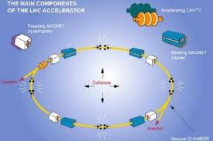
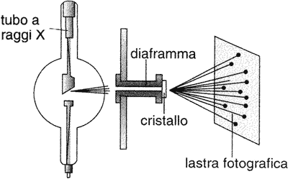
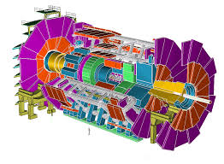
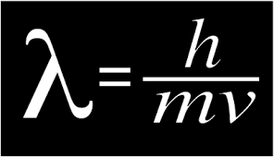
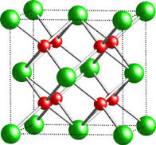
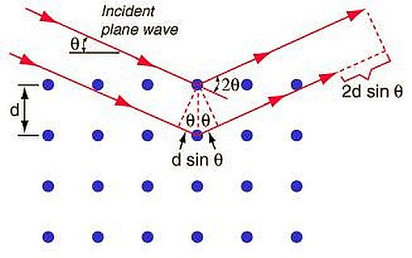
Fundamental Physics Experiments
The smaller the object to investigate the larger the apparatus to use: accelerators + detectors
Crystallography
Sub-Nuclear Physics
source
beam
beam
target
target
detector
detector
nλ = 2dsinθ

Slide 3
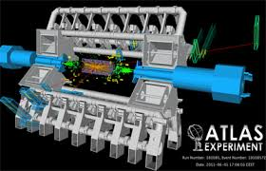
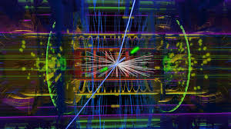
Particle Physics Experiments
To take this kind of picture we need particle detectors with the following characteristics
Radiation hard
High spatial resolution
Sensitivity to charge and neutral particles
High time resolution
Low cost

Slide 4
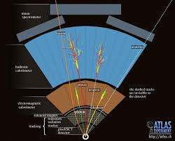
Detectors
Position (resolution better than 100um)
Energy
Momentum
Time of flight (resolution better than 1ns)
Trigger
Selection of the interesting events
Tracking
Pattern recognition and reconstruction of the particle track

Slide 8
Metrologia del posizionamento per esperimenti di fisica e satelliti, con enfasi su tecnologie laser
Simone Dell’Agnello
Coordinator of Technological and Interdisciplinary Research
Commissione Scientifica Nazionale 5 (CSN5) INFN-LNF/Cosenza
Italian National Institute for Nuclear Physics, Laboratori Nazionali di Frascati (INFN-LNF)
Via Enrico Fermi 40, Frascati (Rome), 00044, Italy

Slide 9
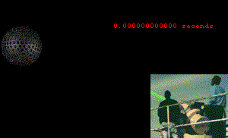
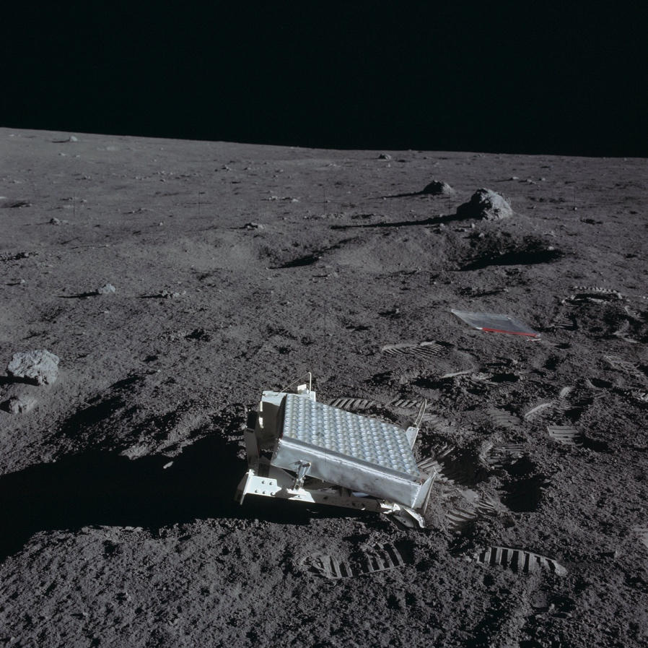
SLR/LLR examples
LAGEOS (h ~ 6000 km): ToF ~ 0.05 sec
S
L
R
Apollo LRA
Lunar Laser Ranging:
ToF ~ 2.5 sec

Slide 10
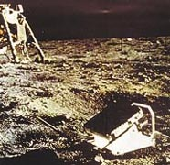
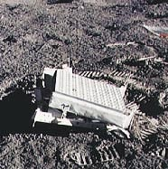
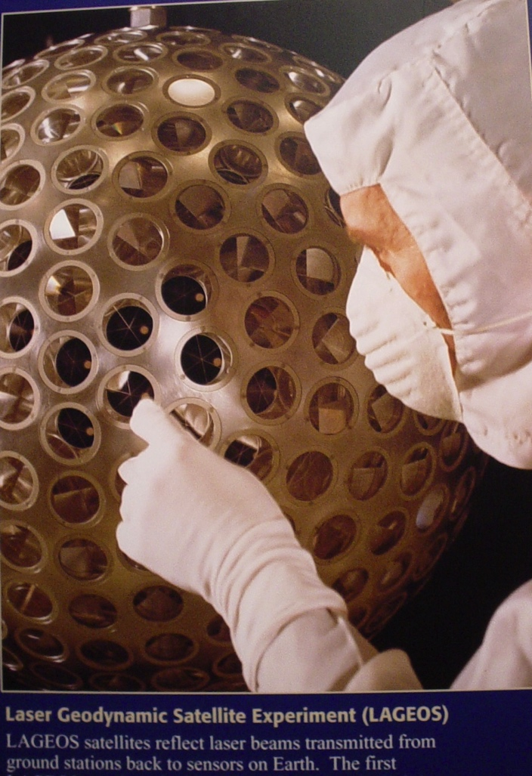
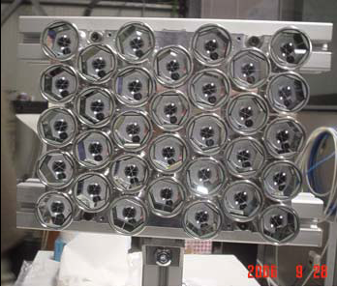
APOLLO 11, 14, 15
Apollo 11: 100 CCRs
Flight payload for GPS-2 @INFN-LNF:
32 CCRs (property of Univ. Maryland)
LAGEOS I (‘76; NASA),
LAGEOS II (‘92; NASA/ASI)
COPERNICUS
RETROREFLECTOR
ARRAY
(for Earth Observation)

Slide 11
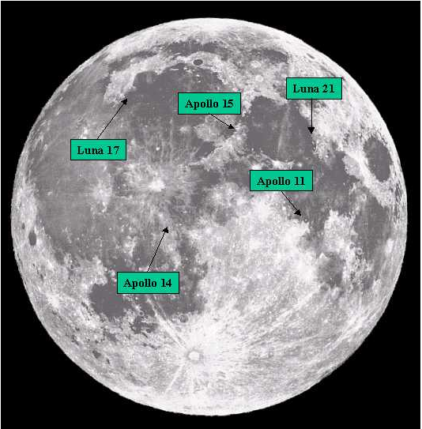
Locations of
1st Gen. Lunar
Retroreflector Arrays
Lunar Laser Ranging: accurate at ~ 10⁻¹¹ of Earth-Moon distance
Relative sizes and separation of the Earth–Moon. An LLR pulse takes 1.255 sec for the mean orbital distance.

