Slide 1
Oscar Straniero – INAF Open problems in Nuclear Astrophysics Silver Moon 2016, December 1-2

Slide 2
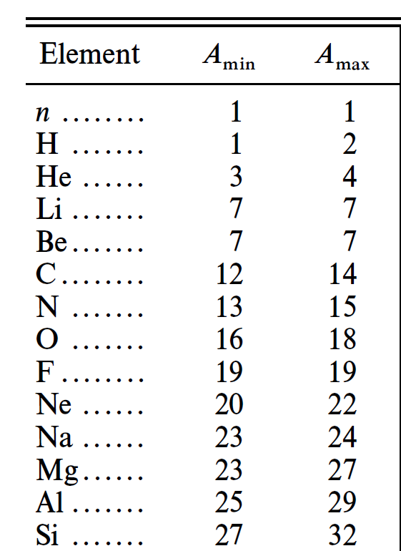
The Key Role of the ¹²C+¹²C
²⁰Ne+α
¹²C+¹²C
²³Na+p
²²Ne+α
²⁵Mg+n
s process (weak)
(¹³C+α
¹⁶O+n)

Slide 3
Stellar evolution: THE END
Massive stars undergo a collapse of the iron core. Sometime, this process implies a successful bounce of the in-falling envelope and, in turn, a Supernova Event (Sne II, Ib,Ic). The collapse produces a compact object, i.e., a neutron star (NS) or a black hole (BH)

Slide 5
Crab Nebula
Rest of a core-collapse SNe (type II or EC), observed by Chinese and Arab astronomers in 1054
Nebula mass: 4.6±1.8 M☉.
Pulsar period and mass: 33 ms and ~1.4 M☉
Progenitor mass : 10±3 M☉

Slide 6
Stellar evolution: THE END
Low- and intermediate-mass stars skip the C ignition, enter the Asymptotic Giant Branch (AGB) phase, during which they lose the envelope, and end their life as compact White Dwarfs (WDs). In close binaries, WDs may accrete more mass, attaining the Chandrasekhar limit. Then, a C-burning starts, which induces a Thermonuclear Runaway (SNe Ia)

Slide 7
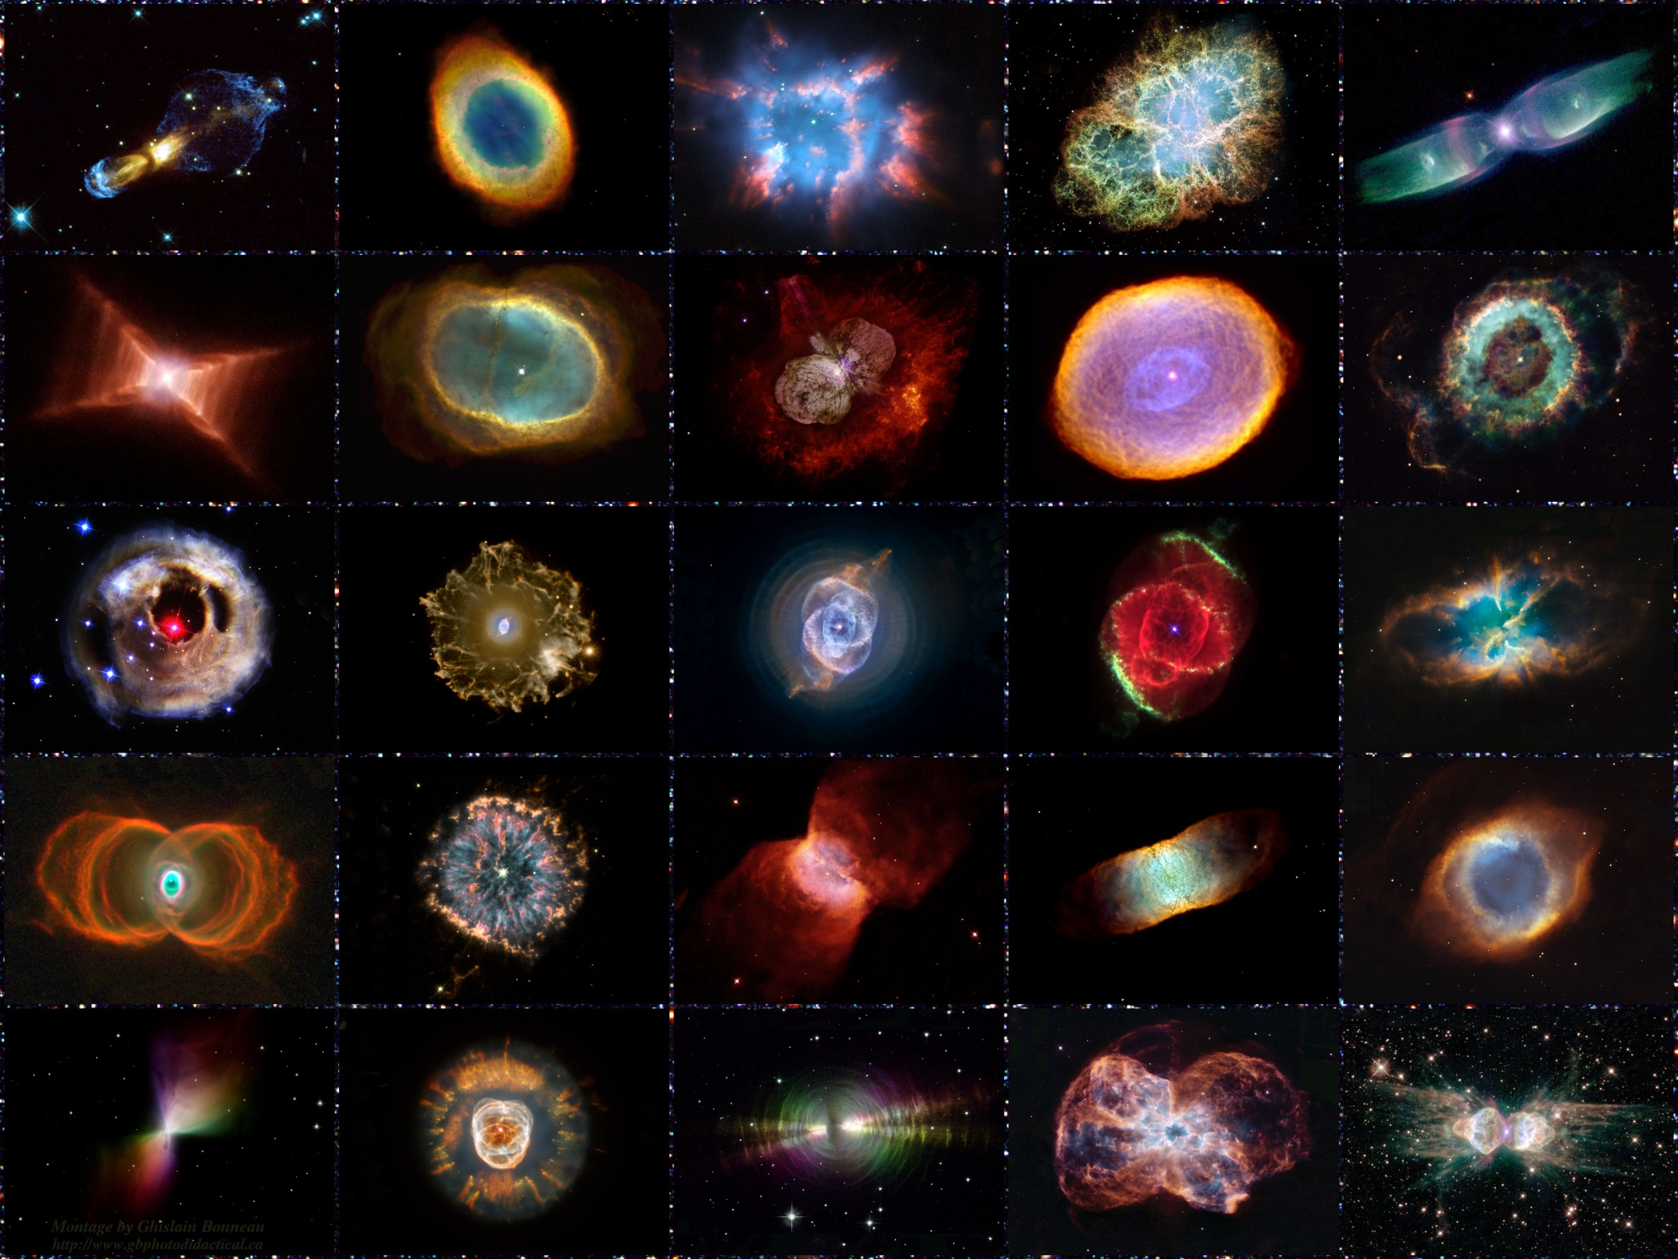

Slide 8
SNe Classification
Based on Spectra and Light Curve morphologies
Type II
II p, II N, II L…
H
Core collapse & bounce of massive stars
SNe
I b
He
I c
no Si
no He
no H
Type I
Thermonuclear explosion of WDs
strong Si
I a

Slide 9
Stellar evolution
Stars are self-gravitating objects in thermal and hydrostatic equilibrium.
They evolve because the energy loss (due to radiation and/or neutrinos) and the change of molecular weight due to nuclear processes. The energy lost in this ways is replaced either throughout a core contraction (and the consequent release of gravitational energy) or the activation of thermonuclear reactions.

Slide 10
Core contraction and Virial Theorem
Hydrostatic eq.
if γ=5/3, a perfect non-relativistic gas, 50% of the gravitational energy released during the contraction is transformed into heat (internal energy), the rest radiates away, as photons or neutrinos.

Slide 11
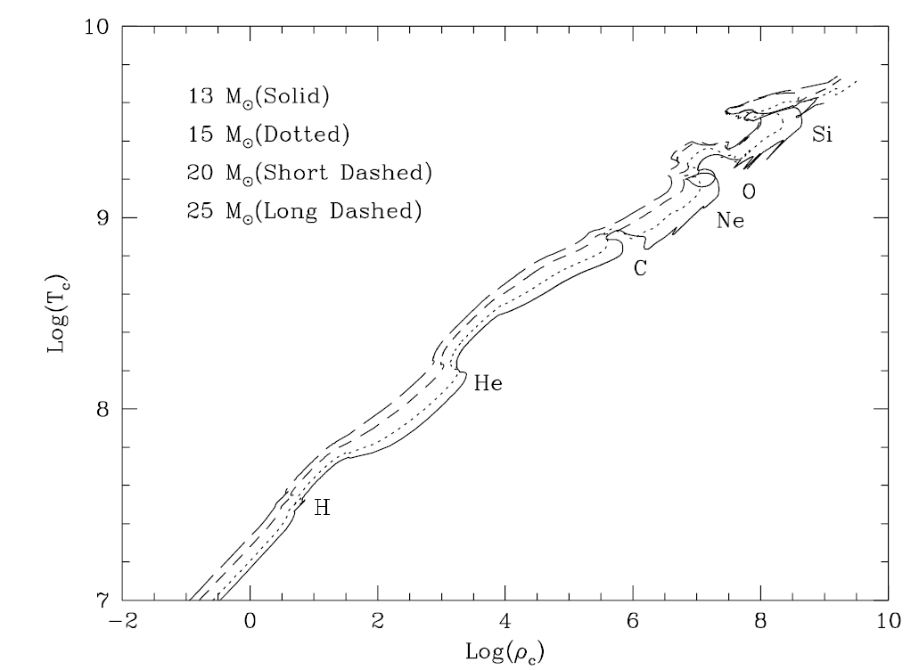
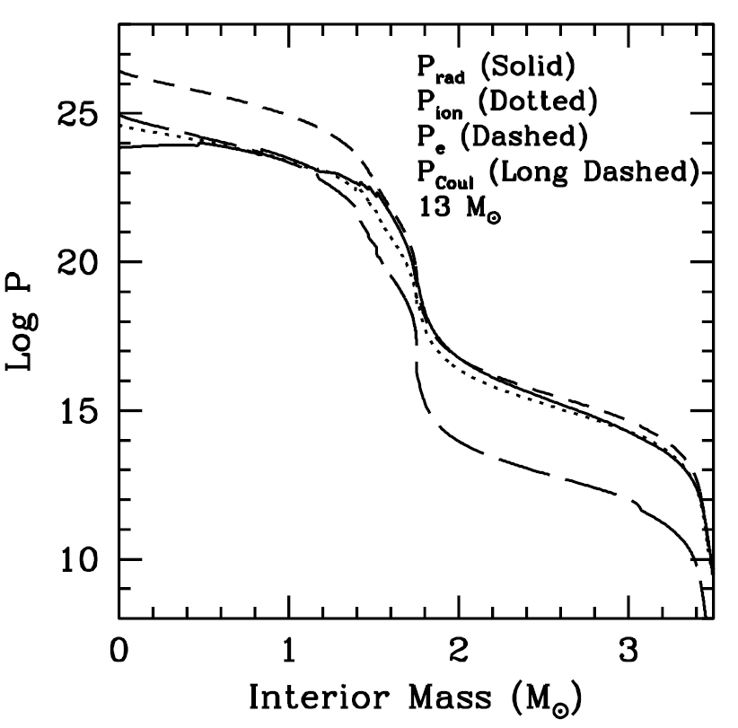
Succession of contraction and nuclear powered phases: the case of Massive Stars
Just before the C ignition and beyond, ρ_{c} > 10⁶ g/cm³ in the core
P_{e}/P_{tot} ~ 1

Slide 12
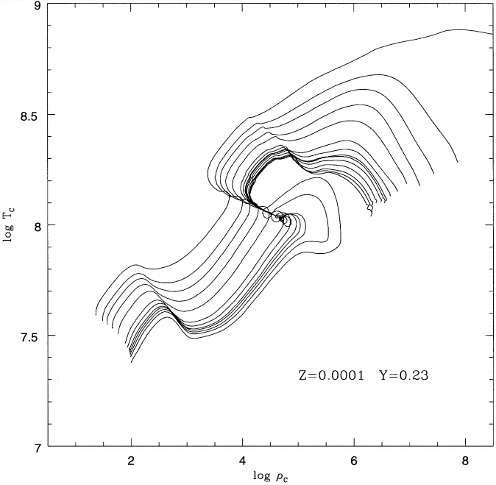
Succession of contraction and nuclear powered phases: the case of the Low-mass Stars
After the He burning, ρ_{c} > 10⁶ g/cm³ in the core
P_{e}/P_{tot} ~ 1
Elettron pressure large enough to stop core contraction
Cooling by plasma neutrinos
He
H
M=1 to 9

Slide 13
The final fate

Slide 14
Chandrasekhar mass limit: stable or unstable cores, this is the question!
At ρ > 10⁶ g/cm³ the gas pressure is dominated by degenerate electrons:
EOS
Politropic index:

Slide 15
Hydrostatic equilibrium for a politropic structure:
+
Lane-Emden equation

Slide 16
M-R relation from the Lane-Emden equation:
ξ_{s}=R/α is the first zero of the θ(ξ) function, solution of the LE equation:
Total mass (M) depends on central density (ρ_{c} ) or viceversa

Slide 17
Note that:
For γ=5/3 (non relativistic case):
R in 10⁹ cm and M in M¤ = 1.989 x 10³³ g
For instance, R=10⁹ cm and Y_{e}=0.5 → M=0.7 M¤

Slide 18
M does not depend on R or, only one mass value is possible
Represents the maximum mass for a degenerate core in hydrostatic equilibrium
Pure H → Y_{e}=1 → M_{Ch}=5.81
C-O White Dwarf → Y_{e}=0.5 → M_{Ch}=1.45
Fe core of a massive star → Y_{e}=0.46 → M_{Ch}=1.25
M_{Ch} larger in case of rotation

Slide 19
The evolution ends when the density in the core becomes large enough and high electron degeneracy develops. Then:
Core mass < Chandrasekhar mass. contraction stops ⇒ formation of a White Dwarf or
Core mass > Chandrasekhar mass indefinite contractions ⇒ core collapse

Slide 20
Stellar core evolution
Degenerate Fermi gas
Non-degenerate
Collapse or ignition
log P
ρ^{4/3}
M₂
relativistic
M₁
ρ^{5/3}
Non-relativistic
log ρ

Slide 21
Summary of single sta evolution:
Massive stars built up Fe core with mass close or exceeding the Ch limit. Electron captures trigger the collapse. A neutron star (or a black-hall) forms. Possibly, this process terminates with the bounce (and ejection) of the external envelope
Low and intermediate mass stars produce CO WDs. If in close binaries, mass accretion may lead to the Ch limit. Then, C ignites close to the center. After about 1000 yr of quiescent burning, a thermonuclear runaway starts, which power the explosion (deflagration or detonation). The WD is completely incinerated.
This scenario is essentially confirmed by observations

Slide 22
STELLAR EVOLUTION SUMMARY
Massive stars: H, He, C, Ne, O and Si →
Fe-core unstable because e-capture or photodisintegrations of nuclei → core collapse (SNE II,Ib,Ic)
M_{up}*
H, He, C
Super AGB → skip O ignition → O-Ne WD (SNE e-capture)
M_{up}
Low & intermediate mass: H, He,
AGB → skip C ignition because the high pressure of degenerate electrons → C-O WD (in close binaries → mass accretion → SNE Ia)

Slide 23
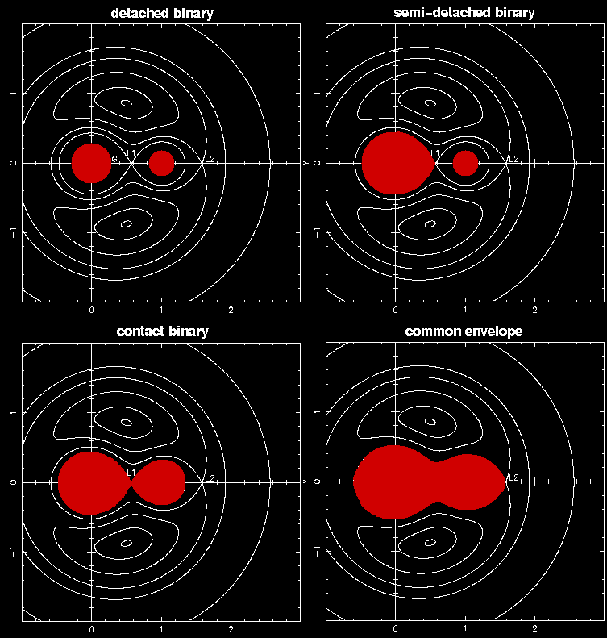
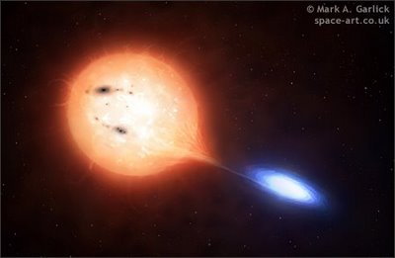
Close Binaries & Roche geometry
Equipotential surfaces in the orbital plane

Slide 24
Environment:
Type Ia in ellipticals as well in both halo and disk of spirals
Type II, Ib, Ic preferentially in disks of spirals
Parent stellar population:
Ia: both old and young SPs
II, Ib, Ic: only young SPs, with active star formation

Slide 25
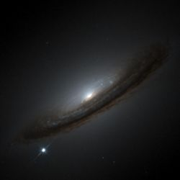
Type Ia Supernovae
2002bo in NGC 3190
Observed from Campo Imperatore

Slide 26
The Key Role of the ¹²C+¹²C

Slide 27
The ¹²C+¹²C determines several quantities
M_{up} and M_{up}*
SNe rate (type Ia, EC and II)
mass-distribution functions of compact objects: WDs, NSs and BHs
mass of iron-cores in core-collapse progenitors
physical and chemical conditions at the dynamical breakout in thermonuclear SNe
Synthesis of elements and Chemical evolution scenarios

Slide 28
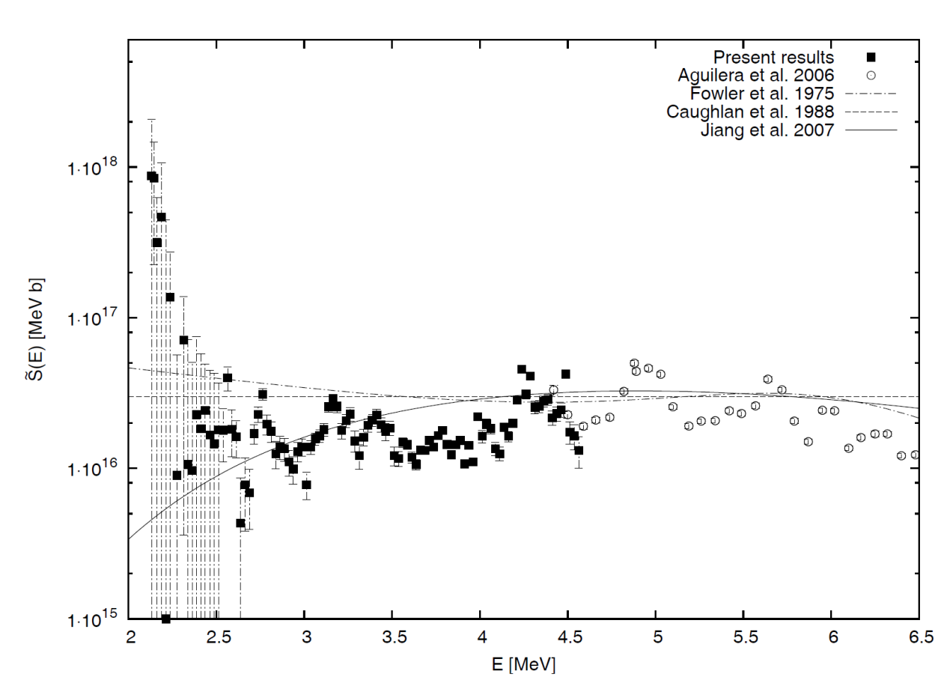
Experiments and theory
<S(E)>=1.4x10¹⁶ MeVb
Many narrow resonances (~every 400 KeV) superimposed to a non-resonant flat background
a narrow structure at 2.14 MeV, may increase the reaction rate by up to a factor of five
A sub-barrier fusion hindrance would also have significant effects (Gasques 2007, Jang 2007).
Spillane et al. 2012 (squares) Aguilera et al. 2006 (circles) Caughhlan et al. 1988 (dashed) Hindrance – Jiang et al. 2007 (solid)

Slide 29
What stellar energy range (?)
The ¹²C+¹²C determines the Temperature of the C burning, and, in turn, the location of the Gamow’s peak.
By assuming a flat S(E) extrapolation (CF88 like), the C ignition in massive stars occurs at T ≈ 0.6 GK and the Gamow’s peak is ΔE=1.7±0.35 MeV.
In case of hindrance, however, the rate (at low E) will be smaller, so that T and ΔE are shifted toward higher values.
On the contrary, a low-energy resonance would increase the rate, allowing smaller C burning T and E.

Slide 30
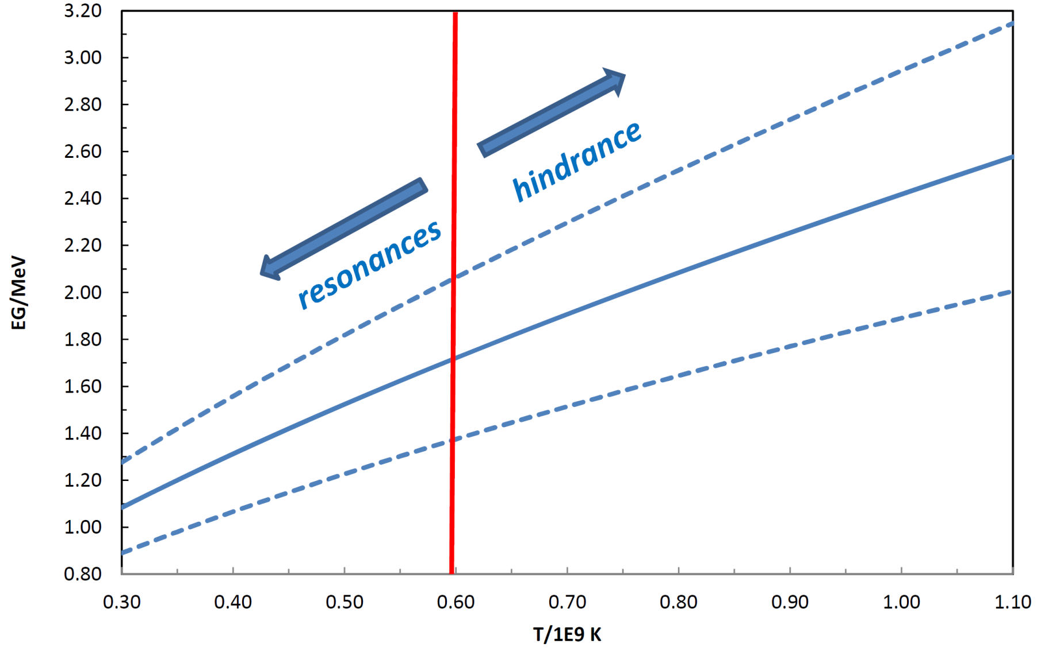
Gamow’s Peak vs T
CF88

Slide 31
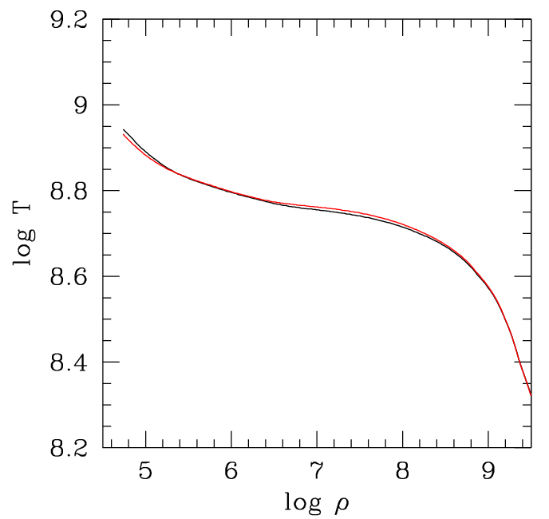
The C-ignition curve nuclear energy=neutrino energy loss
ε_{nuc}=|ε_{ν}|
n rate
Haft et al 1995 Itoh et al. 1996 Esposito et al. 2003
&
¹²C+¹²C CF88
Massive stars M>M_{up}
Accreting WD
SNe Ia

Slide 32
Impact of low-energy resonances: some examples

Slide 33
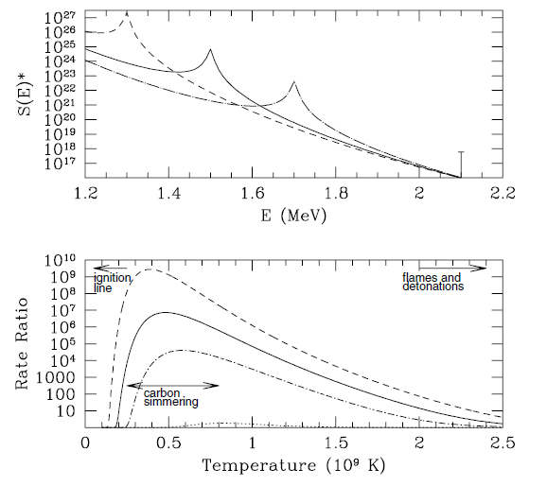
¹²C+¹²C: Low Energy resonances
E_{R (MeV)} ωγ_{(meV)}
1.3 16.0
1.5 9.2
1.7 4.1
maximum strenght not affecting
high energy rate (>2.1 MeV)
Spillane et al. 2007
LER at 2.1 MeV

Slide 34
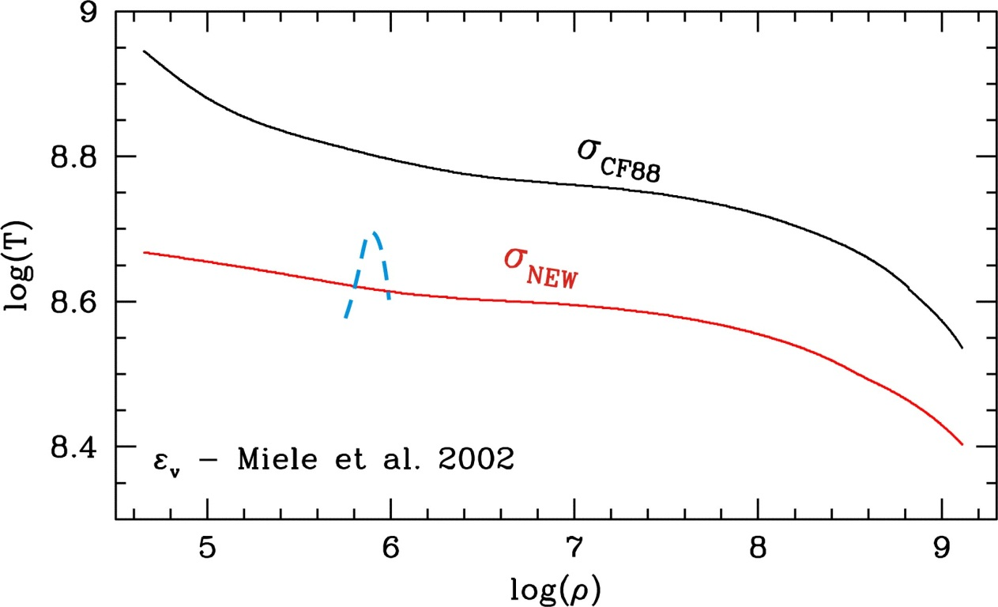
VARIATION OF THE IGNITION CURVE INCLUDING A 1.5 MeV RESONANCE
σ_{CF88} + 1.5 MeV res
M=7M without LER

Slide 35
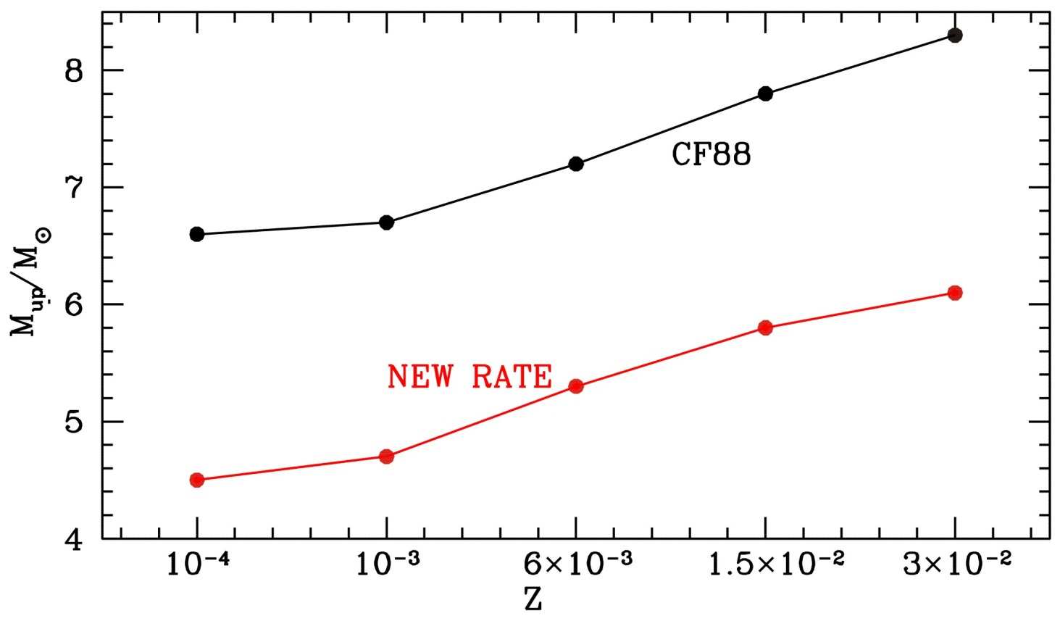
σ_{CF88} + 1.5 MeV res
ΔM_{up} ~ 2 M

Slide 36
SNe rates and ¹²C+¹²C
Owing to the steepness of the mass function, all supernova rates would significantly change:
For istance, a reduction of about 2 M_{ʘ} of M_{up} would reduce the type Ia frequency up to a factor of 4.
In contrast, core collapse SNe (EC SNe included) would be more frequent than expected.
Observational constraints: i) the minimum mass for CC SNe - Smart et al. 2009, 8.5 ± 1.5 M_{ʘ}

Slide 37
Impact on Nucleosynthesis
A variation of the C burning temperature would directly affect the nucleosynthesis.
An Example. 50% of the ¹²C+¹²C reactions:
¹²C(¹²C,p)²³Na → ¹²C(p,γ)¹³N
¹³N(β)¹³C → ¹³C(α,n)¹⁶O
s-process
Low T
¹³N(γ,p)¹²C
High T

Slide 38
Summary. Present uncertainties in the ¹²C+¹²C : Δm_{up} (ΔM_{up}*) ≈ 2 M_{ʘ} (conservative)
Astrophysical consequences
SNe rates (type Ia, e-capture and II)
Mass limits of SNe progenitors
Mass limits of WDs and their progenitors.
Contribution of Massive AGB (HBB) to the chemical evolution
s-process nucleosynthesis in C-shell of massive stars.

