Slide 1
A method for detection of known sources of continuous gravitational wave signals in non-stationary data
P.Astone, S.D’Antonio, S.Frasca, C.Palomba
GWDAW14 Rome, Jan,28,2010

Slide 2
Outline of the talk
Data preparation
Formulation of the problem
The signal and the noise
The algebra of the 5-vectors
The detection problem
The parameter estimation problem
The Coherence: reliability of the detection
Extension to sub-periods or more antennas analysis

Slide 3
Data preparation
Band extraction, by constructing the analytic signal, over bands of ~0.1Hz
Doppler and spin-down correction
Removal of residual time periods which are particularly noisy
Wiener weighting: we weight the noise data with the inverse of their local variance, to reduce the effect of non-stationary noise

Slide 4
The formulation of the problem
There are two cases:
we know the polarization parameter and so we should estimate the amplitude and the phase of the wave (2 d.o.f. problem). The detection of the phase and amplitude modulated signal is done with a matched filter in the space of the five signal Fourier components.
we don’t know the polarization parameters, so we should estimate also them (4 d.o.f. problem). The detection is more complex.

Slide 5
The wave
tensors in arial
If the polarization ellipse has semi-axes a ≥ b, with the convention to put b positive if the circular part is L (CCW) and negative if it is R (CW).
The two polarization parameters are , defined in the range -1≤η≤1
(0 if linear polarization)
and the polarization angle ψ (direction of the axis a of the ellipse)

Slide 6
Invariants and inverse problem
Invariants: functions which do not depend on the unknown parameter γ
First invariant
Second invariant
Inversion

Slide 7
The antenna response
fast modulation
slow modulation (phase and amplitude)
(α,δ) source coordinates, λ and a the latitude and azimuth of the antenna;
Ω·t = α-Θ, where Θ is the sidereal time.

Slide 8
The 5-vectors (the signal)
The “generator” 5-vector:
from 5 complex numbers it generates the time response
with -2 ≤ k ≤2
The two polarization signals 5-vectors A⁺ and A^{x} with components:
The signal 5-vector
The antenna response
(analytic signal)
scalar product

Slide 9
Basic problems:
Detect the presence of the signal
Signal parameters estimation
Reliability of the detection
Extension of the procedure to more antennas and/or to the analysis in sub-periods of time

Slide 10
The 5-vectors (the data)
The data 5-vector
The “real signal” 5-vector
w(t) is the “Wiener filter”, if it is used in order to optimize for the non-stationarity of the noise.

Slide 11
The 5-vectors (the signal)
The 5-vector of the signal could in principle be constructed analytically from this equation , but this is not what we do, because it is important to generate a signal with the whole procedure applied to the data, that is the same cuts, vetoes, Wiener weights.
We thus create the 5-vect S (case of 2 d.o.f.) or its two plus and cross components (case of 4 d.o.f.) and then operate on it exactly as we do on the noise.

Slide 12
Why use the 5-vectors ?
It is immediate to understand that operating with this framework gives a big gain in computation speed. This is mainly in the case of the simulation of many source injections, not precise frequency search (in fact the signal 5-vect
does not depend on the frequency), different analysis, and so on.
In the case of the matched filter for the Vela pulsar during VSR1 (the reduced data were about 10⁷ samples) the gain is of the order of 1 million. And without any loss in performances.
We should compute at the beginning only the three 5-vectors: the two for the basic signals (plus and cross) and one for the data.
Data 5-vect: the Fourier components at the 5 frequencies
Noise background 5-vect: from one FFT and a comb with the 5 lines we get many noise realization
Signal 5-vect: a linear combination of the two plus and cross 5 vectors:

Slide 13
The detection (2 d.o.f. case)
The matched filter is
where X is the 5-vect of the data and A is the 5-vect of the signal
Note that the filter is a 5-vector.
The signal at the filter output is only one complex number.

Slide 14
The detection (4 d.o.f. case)
The two basic observables are
The matched filter is the weighted mean of the two basic components
But we don not know a and b !

Slide 15
Detection statistics: basic observables
Basic observables
Variances in case of only noise
The distribution of a single observable (only noise)
The distribution of a single observable (noise+signal λ)

Slide 16
Detection statistics and its optimization
The detection statistics is a linear combination of the 2 observables
Some cases
simple mean (blue)
F statistics (red)
Best ROC statistics (green)
Best SNR statistics (black)

Slide 17
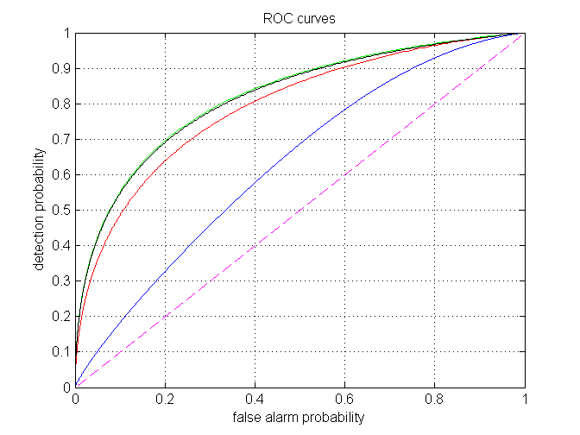
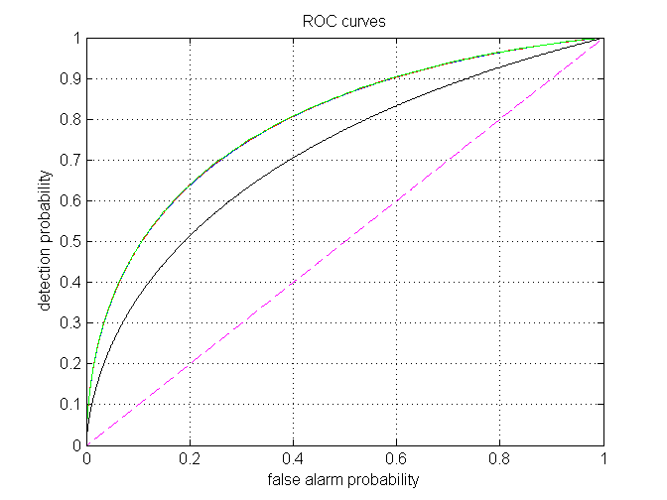
Detection statistics
simple mean (blue) F statistics (red)
Best ROC statistics (green) Best SNR statistics (black)
Ratio of the two modes: 3
Ratio of the two modes: 1

Slide 18
Detection statistics: the distribution
Exponential distributions mixtures:
if α=β
α=β is the F-stat case, that is equalization of the two plus and cross modes

Slide 19
Estimation of source parameters: basic relations

Slide 20
Estimation of source parameters
Estimation of the amplitude
Invariants
Estimation of η
Estimation of ψ
(these are independent on the absolute phase γ )
Estimation of the absolute phase

Slide 21
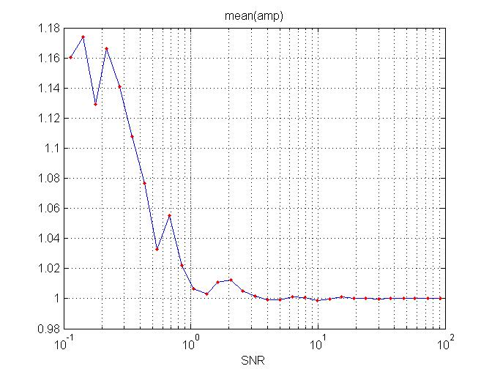
Estimation of the source parameters
Simulation for (η,ψ)=(0.3,30⁰) Antenna latitude 5⁰ Source declination -5⁰
Amplitude

Slide 22
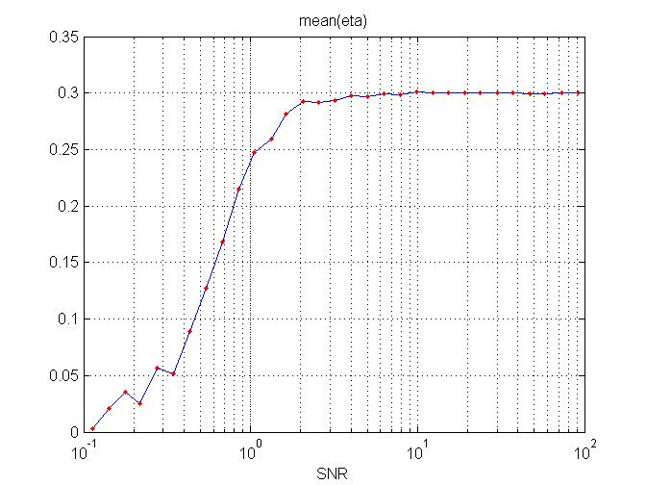
Estimation of the source parameters
Simulation for (η,ψ)=(0.3,30⁰) Antenna latitude 5⁰ Source declination -5⁰
η=0.3

Slide 23
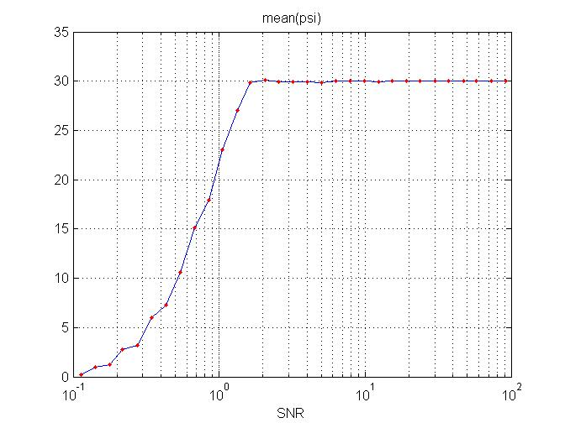
Estimation of the source parameters
Simulation for (η,ψ)=(0.3,30⁰) Antenna latitude 5⁰ Source declination -5⁰
ψ=30 deg

Slide 24
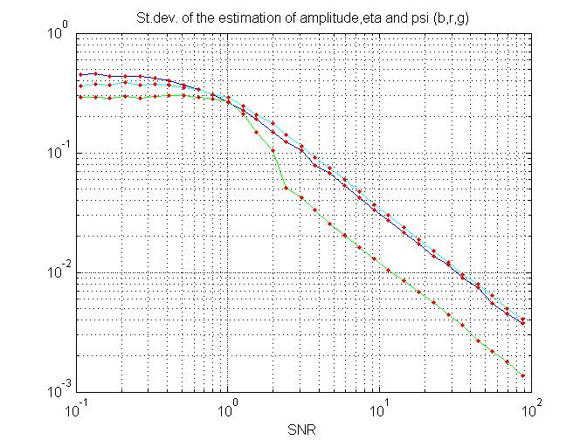
Estimation of the source parameters
Simulation for (η,ψ)=(0.3,30⁰) Antenna latitude 5⁰ Source declination -5⁰
Standard deviations
ψ green
η red
amp blue

Slide 25
Reliability of the detection: the coherence
Not the standard definition of coherence.
It indicates a coherence between the signal shape and the data.
It is not a function, but only a single number.
Noise only: it follows a beta distribution
(experimental result)
c does not depend on scaling factors on the signal. It depends only on the signal shape

Slide 26
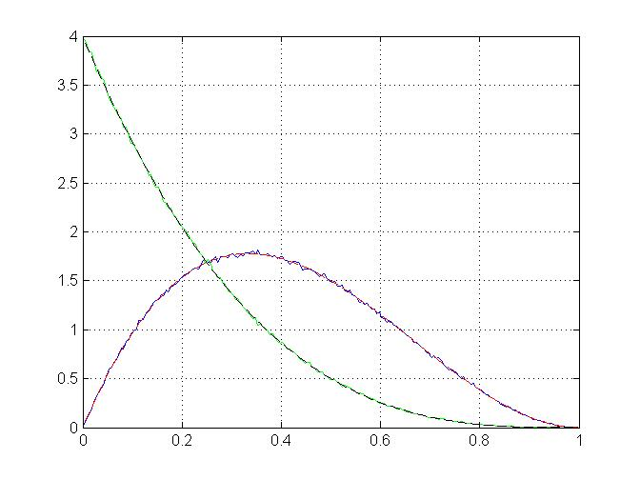
Reliability of the detection: the coherence
Green: 2 d.o.f.
Red: 4 d.o.f.
Distribution
absence of noise
coherence
In the 2 d.o.f. case the coherence is more stringent, in the 4 d.o.f. case
it is not so stringent

Slide 27
Extension of the method: use of the 5n-vectors
Detection with more than one antenna: each antenna produces 5 components for the signal vector and for the data vector
Sub-interval analysis: to enhance the reliability of the detection, the observation period can be divided in sub-periods, and each of them gives 5 components for the signal vector and for the data vector.
It should be useful to divide the observation time into small pieces to get more information from the analysis: e.g. is the signal always present or not ?

Slide 28
Use of the 5n-vectors (both 2 and 4 d.o.f.)
are 5n vectors (data, signal and noise) and defining
we have that
ρ remains the same, while -see next slide-

Slide 29
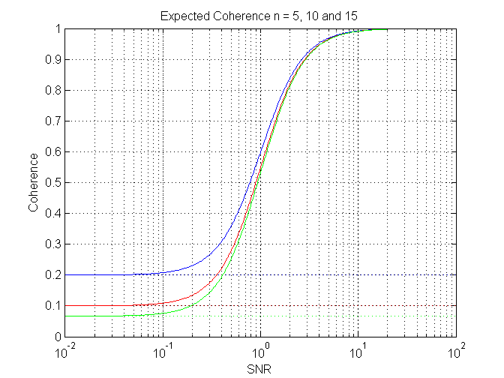
the coherence, using 5n-vect, in absence of signal decreases with n
Blue: n=5
Red: n=10
Green: n=15
For SNR<<1 c →1/n;
For high SNR c=1

Slide 30
Relation with the parameters of non axis-symmetric rotating pulsar
ι be the angle between the pulsar rotation axis and the line of sight from the detector
Semi-axis of the polarization ellipse (a and b in our formalism are normalized )
in this formalism the plus and cross
amplitudes depend on the angle ι
The linear polarization angle ψ is the same in both formalism

