Slide 1
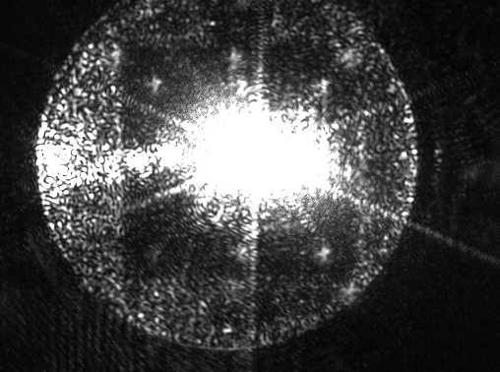
Back-scattered light noise in Virgo 2nd Science Run data
GWDAW-14th, Roma (Italy), January 26-29, 2010
Irene Fiori
(European Gravitational Observatory)
for The VIRGO Collaboration

Slide 2
Outline
Modeling of Back-Scattered light noise and Typical Upconversion patterns
Measurements and Mitigations (preparing VSR2)
Effects of Back-Scattered light noise in
VSR2 data

Slide 3
Modeling and typical patterns

Slide 4
Back-scattered light
Tiny fractions (some ppm) of ITF beam power are scattered by environmentally excited surfaces and recombine to ITF with a delayed phase which is modulated by the displacement motion of the scattering surface (optics, absorbing baffles, vacuum tank walls...)
Nonlinear noise in the phase of ITF signal.
→ Focus on
most relevant sources (after VSR1):
Optics on external benches
(few to hundreds of ppm)
Others:
Suspended detection bench
Baffles in central area
Brewster window(s)
Cryogenic-trap
NEB
End benches
(aux. photodiodes)
Injection bench
WEB
Laser
EIB
Brewster
window
Cryogenic-trap
Suspended detection bench
Detection bench
(main photodiodes)
EDB

Slide 5
Example of external End-Bench
Input mirror
End mirror
bench
× T_{NE}
A fraction ε of extracted beam power recombines into the arm optical cavity
× 2F/π
× T_{NE}
× ε
The scattered beam (A_{sc}) carries a delay (phase noise φ(t)) because its optical path is changed by the scattering surface motion x(t):
Total field
A_{sc}
Φ(t)
φ(t)
Phase noise added to the main beam:
Undisturbed Beam
A₀
Noise in GW signal:
K, depends on optical parameters
G ≡ K ⋅√ε
√ε, fraction of back scattered light

Slide 6
Upconversion “bumps”
Non linear for large displacements:
Typical scatterer has oscillatory motion: x(t) = A_{m}∙ sin( 2π f_{m}∙t )
( f_{m} = mechanical mode of optics mount, or bench; or periodic environmental sources, like ... sea waves)
h_{sc}(t) is frequency modulated by f_{m} with modulation index m = (4π/λ) A_{m}
As for FM signals:
J_{n}(m) = Bessel’s function of n^{th} order
Bandwidth:
Example: Noise from artificial excitation of End Bench legs mode f_{m} = 20Hz with increasing amplitudes: A_{m} ≈ 0.2 to 0.8 μm, f_{MAX} ≈ 60 to 240 Hz
→ Noise enters
Virgo detection band
( f_{MAX} >10Hz )
for A_{m} ⋅ f_{m} > λ /second

Slide 7
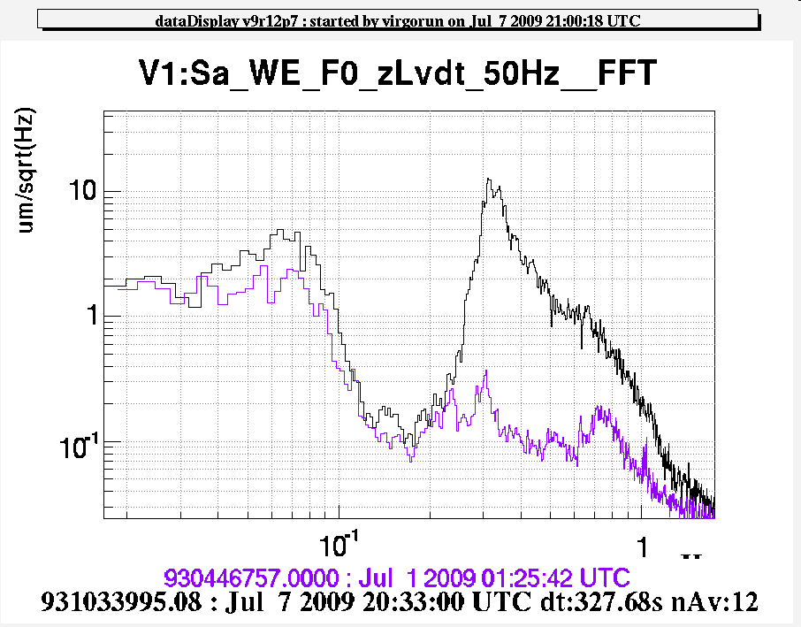
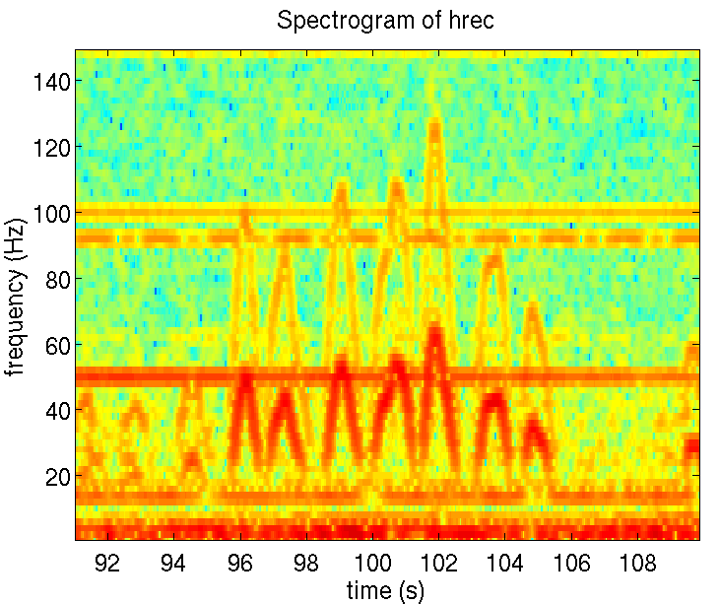
Upconversion “arches”
Easy to distinguish for slow f_{m} < 1Hz and wide A_{m}= few λ motion of scatterer
Example: case of very intense sea-activity, bench swings by several microns at microseism frequency f_{m} = 0.3Hz, A_{m} = up to 15 λ, → f_{MAX} = up to 60Hz
Bench displacement:
h_{sc}(t) completes one oscillation each time the optical path changes by λ/2, the number of turns per second changes as the scatterer velocity:
→ Velocity of West End Bench fits well arches shape.
Evidence for a “double bounce” scattering: h’_{sc}(t) oscillating twice faster.

Slide 8
Measurements and mitigations (preparing VSR2)

Slide 9
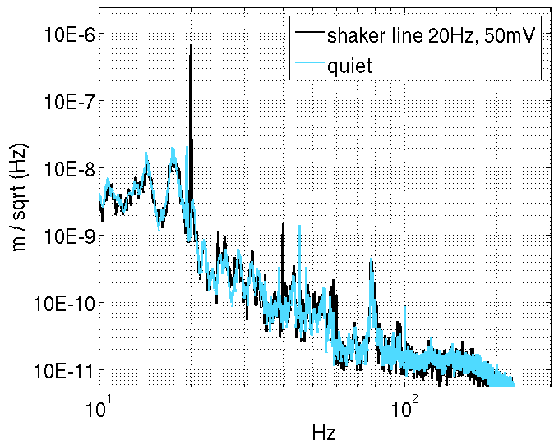
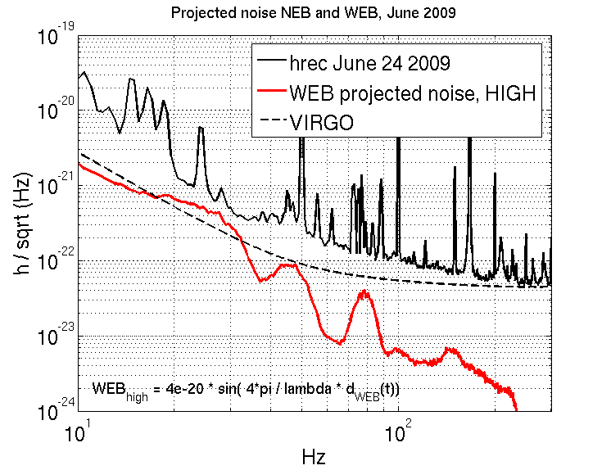
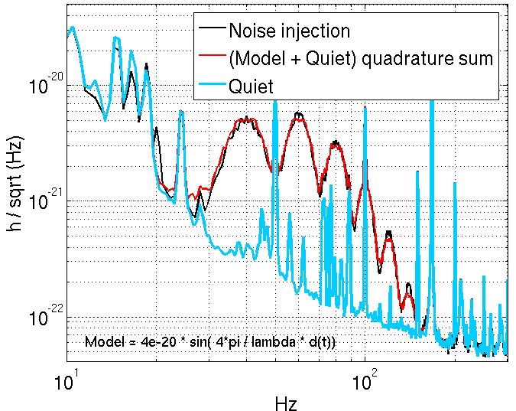
Measure and Project
Measure coupling of diffused light
at External Benches:
1) Excite bench (with shaker) and measure
bench displacement (seismometer on bench):
x(t)
2) Fit measured data with model:
→ extract G
3) Use this G to project noise from undisturbed
bench motion:

Slide 10
Diffused light noise, after VSR1:
March 27, 2008

Slide 11
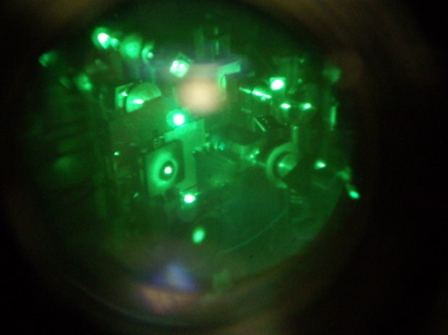
Mitigation
by Reducing diffused light fraction:
1) Located scattered beams and critical optical elements:
→ Inspections with IR camera viewers
→ Tapping on elements and listening to dark fringe
2) Measured scattering for individual optics (in Opt.Lab.):
Identified large scattering components (some beam dump and photodiode models scattering 100-1000 ppm),
Estimated ε
3) Cures:
Misaligned lenses and dump secondary beams
Replaced scattering objects
Cured small clippings
Cleaning of optics for dust particles
Increased beam size on optics
Improved beam dumps
More rigid mounts
 | NEB | WEB | EDB | EIB
G (x10⁻²⁰) before | 2.5 | 9 | 5 | 4
G (x10⁻²⁰) after (expected) | 0.15(*) (0.5) | 2.3 (2) | 1. (1) | <1 (negligible.)
(*) Includes contribution of reduced NE mirror Transmission
Reduction of √ε by typically a factor 5,
New measured G are in agreement with model prediction (G=K⋅ ε)

Slide 12
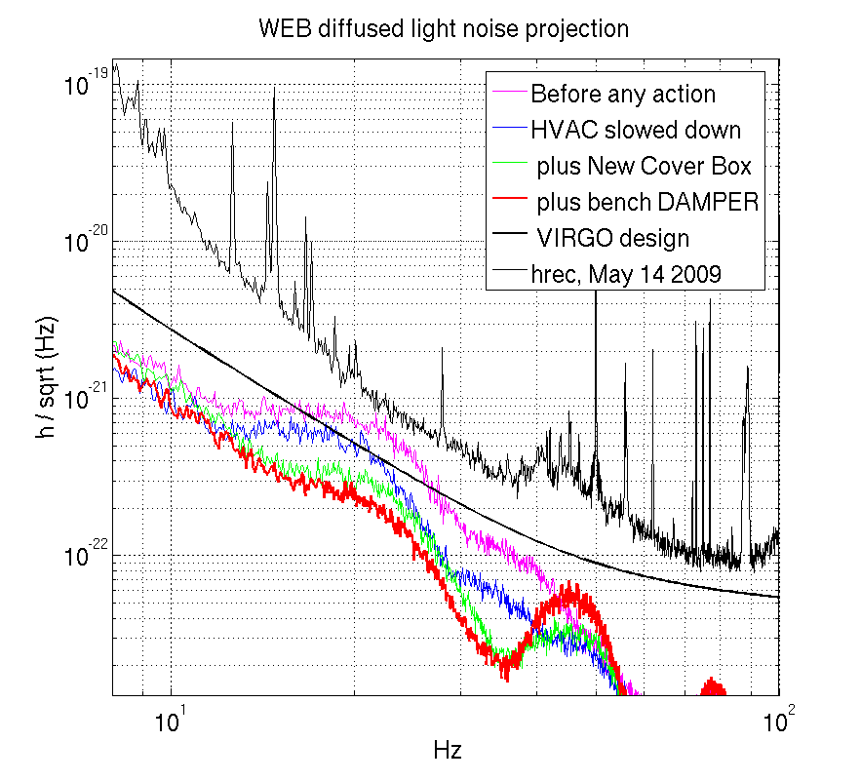
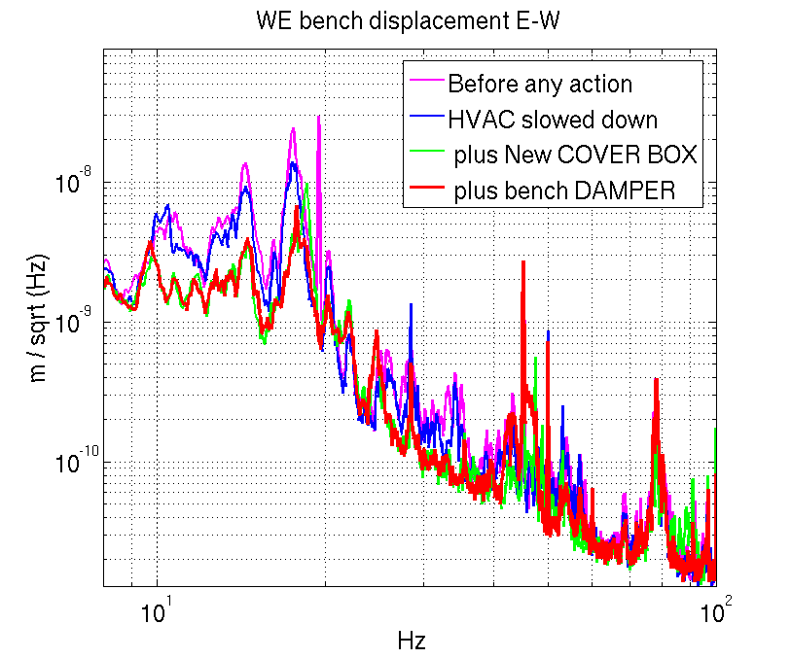
Mitigation
by Reducing bench motion:
Actions:
Reduced HVAC air flux
Improved bench cover (coupling less acoustic noise)
Mechanical damper to absorb energy of 20Hz bench mode
Isolation of turbo pumps fans (~ 45 Hz lines)

Slide 13
Effects of diffused light on VSR2 data

Slide 14
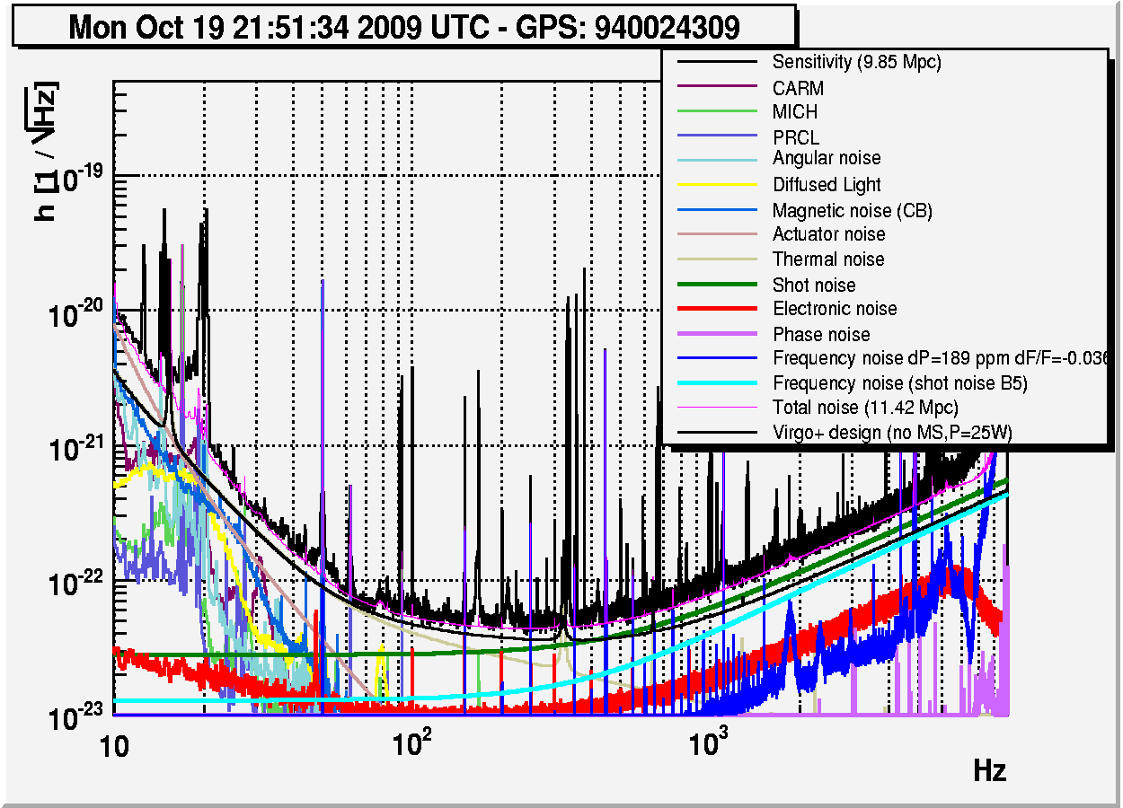
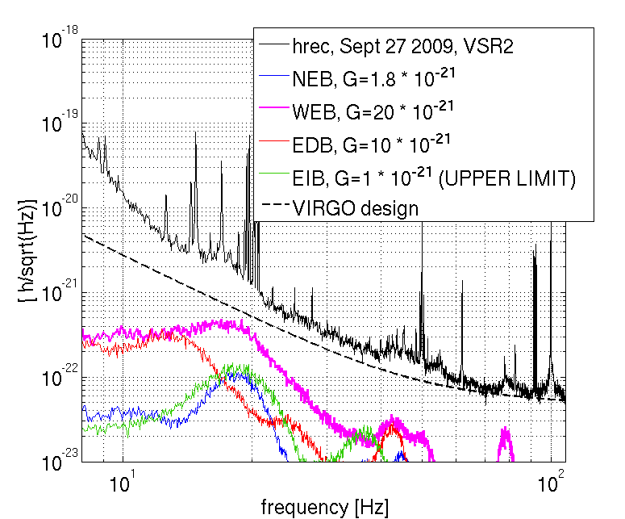
Diffused light in VSR2 noise budget:
Seismometers on benches measure x(t) and allow computing on-line projections
Virgo online noise budget
TOTAL
Diffused light noise
All external benches
Contributions by each bench:

Slide 15
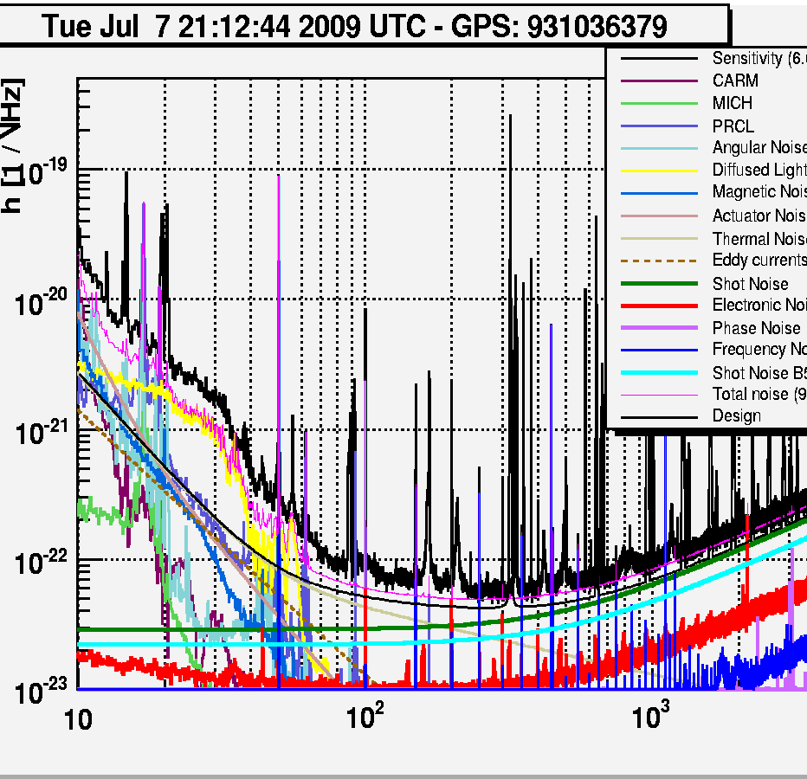
In case of intense sea activity:
In bad weather, large micro seismic noise (~10 μm @ 0.3 Hz)
>> Upconversion noise affects sensitivity up to ≈100Hz
Up-conversion model explains reasonably well h-rec noise increase.
Bench displacement
Miscoseism
Upconversion
shoulder
15

Slide 16
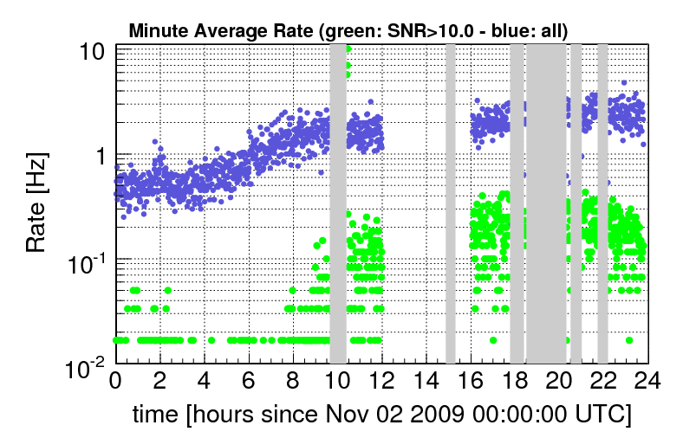
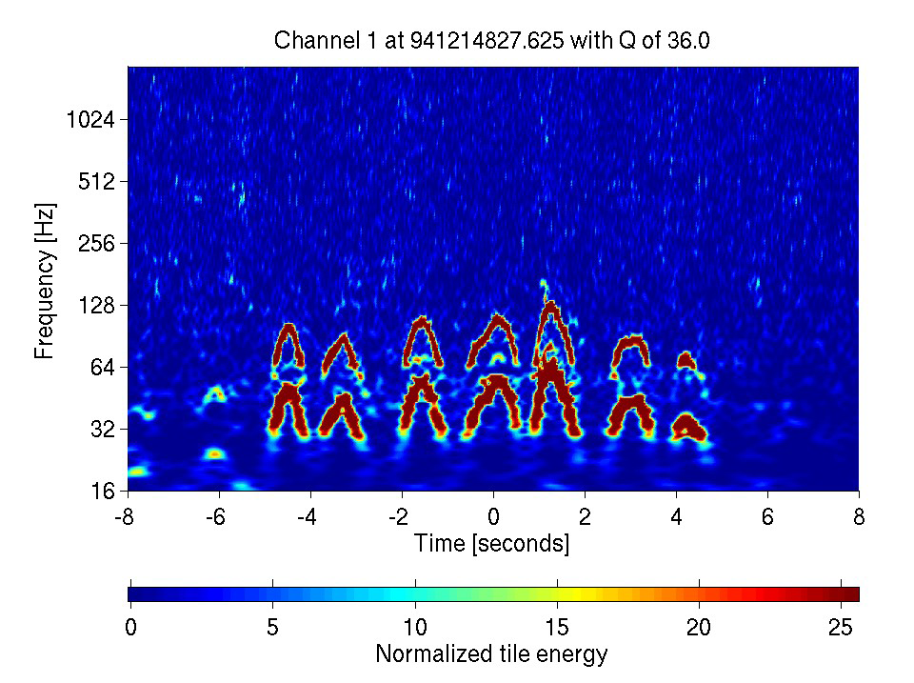
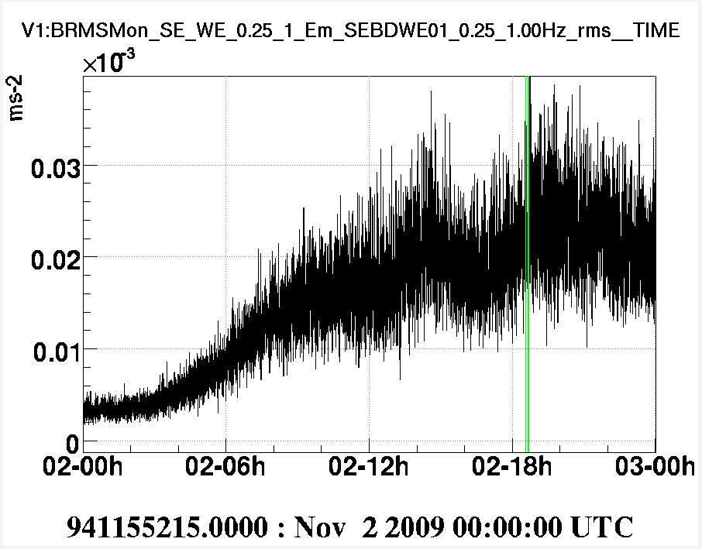
Increase of Glitch rate
Example of micro seismic event
in Omega scan monitor:
High SNR triggers increase:
Presently, (see F. Robinet’ s talk)
glitchy periods are FLAGGED using:
“band-RMS of benches seismic motion
in 0.25 to 1Hz” > threshold,
Average dead-time: ≈ 4% (VSR2)
(much larger during intense microseism periods)
→ New event-by-event veto procedure under study based on bench velocity.

Slide 17
A look to V+MS
The V+ upgrade with Monolithic Suspensions (to start in 2010) aims to ≈ 5 times better sensitivity from 10Hz to 100Hz .
Our validated back-scattered light model for External Benches allows to:
Quantify expected noise reduction (we expect a factor 20 less noise from
End Benches, because of the higher arm Finesse (50 to150) and reduced
Transmission of end mirror (40 to 3 ppm)),
Plan mitigations (we are preparing cures for identified scattered light
paths on EDB, we are preparing mitigation of environmental noise from
racks, pumps, HVAC).
Other scattering light locations have been identified (also during VSR2)
(walls of Cryogenic-trap, mirrors M1&M2 on suspended detection bench, output window of B1 beams), cures are being studied and prepared.
We expect microseism noise to be less critical for V+MS, but developing of more efficient veto procedures has to be pursued.

