Slide 1

3rd generation GW observatories:
Science potential and new technologies
Michele Punturo
INFN Perugia and EGO
On behalf of the Einstein Telescope Design Study Team
http://www.et-gw.eu/

Slide 2
3rd generation: Why ?
Precision Astronomy
Cosmology
?
Evolution of the GW detectors (Virgo example):
First detection
Initial astronomy
Test of “advanced” techs
UL physics
Advanced
detectors
Detection distance (a.u.)
Proof of the working principle
Upper Limit physics
enhanceddetectors
Commissioning
& first runs
Infrastructure realization and detector assembling
Same
infrastructure
Same
infrastructure
Same
infrastructure
Same
Infrastructure
(≥20 years old for Virgo, even more for LIGO & GEO600)
year
2003
2008
2011
2017
2022

Slide 3
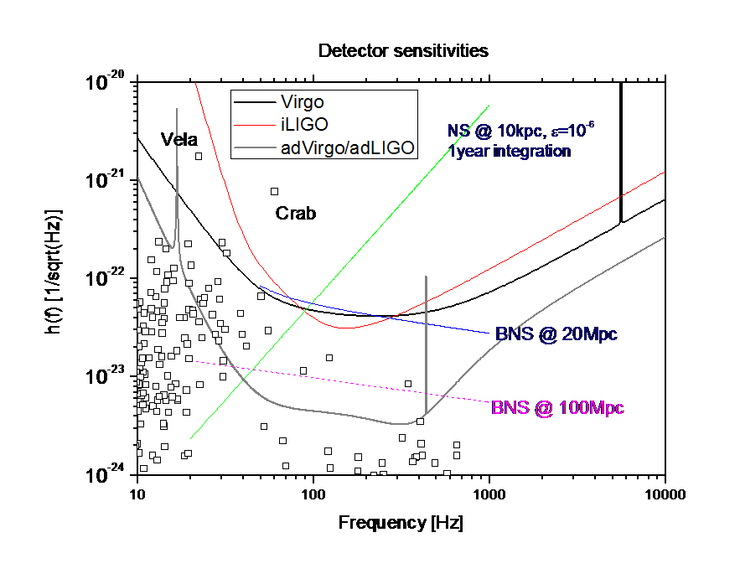
Advanced detectors
Advanced detectors are, for example, promising:
  A BNS detection rate of few tens per year (detection seems assured) with a limited SNR
  The beating of the spin-down limit for many known pulsars

Slide 4
Beyond Advanced Detectors
GW detection is expected to occur in the advanced detectors. The 3rd generation should focus on observational aspects:
Astrophysics:
  Measure in great detail the physical parameters of the stellar bodies composing the binary systems
    NS-NS, NS-BH, BH-BH
    Constrain the Equation of State of NS through the measurement
      of the merging phase of BNS
      of the NS stellar modes
      of the gravitational continuous wave emitted by a pulsar NS
  Contribute to solve the GRB enigma
Relativity
  Compare the numerical relativity model describing the coalescence of intermediate mass black holes
  Test General Relativity against other gravitation theories
Cosmology
  Measure few cosmological parameters using the GW signal from BNS emitting also an e.m. signal (like GRB)
  Probe the first instant of the universe and its evolution through the measurement of the GW stochastic background
Astro-particle:
  Contribute to the measure the neutrino mass
  Constrain the graviton mass measurement

Slide 5
Target Sensitivity
Target sensitivity of a new, 3rd generation “observatory” is the result of the trade off between several requirements
  Science targets
  Available technologies (detector realization)
  Infrastructure & site costs
  Infrastructure & site costs
  Available technologies (detector realization)
  Science targets
As starting point of our studies we defined two rough requirements:
  Improvement by a factor 10 the advanced sensitivities
  Access, as much as possible, to the 1-10Hz frequency range
Let see the new possibilities open by such as observatory

Slide 6
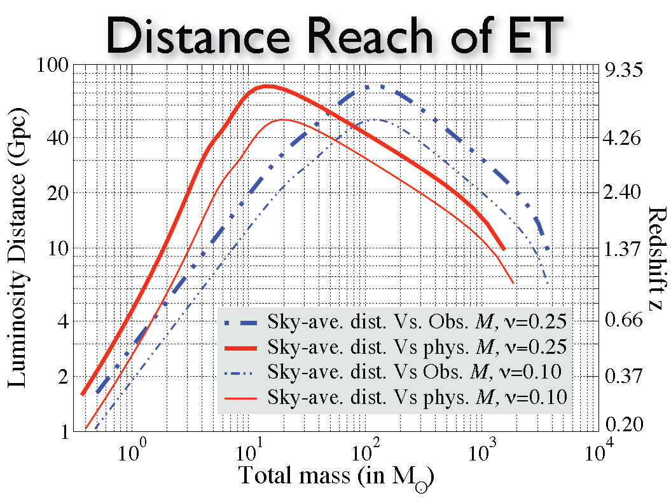
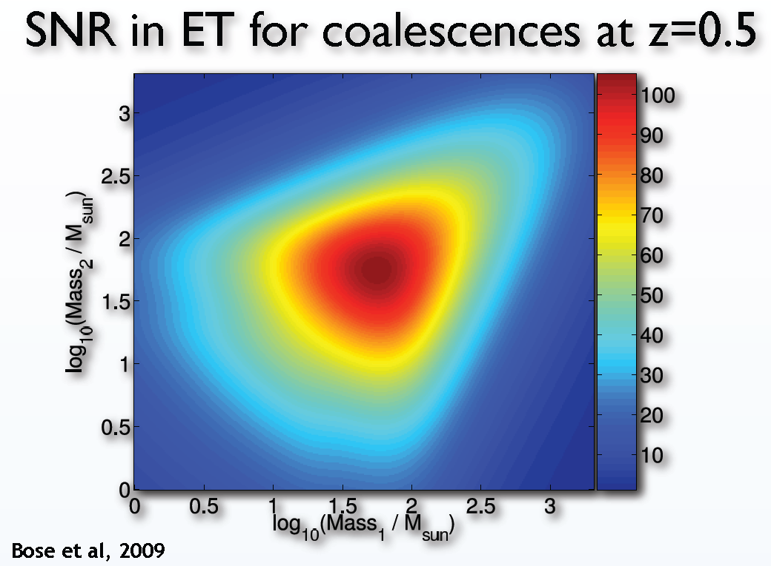
Binary System of massive stars
The new possibilities (for BS) of a 3rd generation GW observatory emerge from these two plots:
  Cosmological detection distance
  Frequent high SNR events

Slide 7
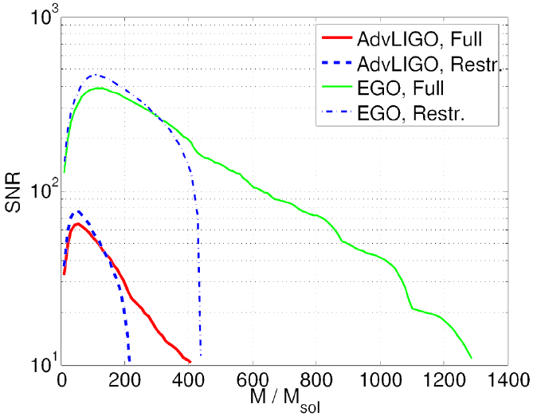
Frequent & high SNR evts.
Access to all the three phases of the coalescence with high SNR:
  Early inspiral phase
    Restricted Post-Newtonian (PN) modeling
  Plunge phase
    Full PN (higher harmonics!) approximation
    Numerical Relativity (NR) templates
    Equation Of State (EOS) modeling
  Merger or Ring-down phase
    Numerical Relativity modeling
    Quasi-Normal modes simulation & EOS constrains
Cross-verification of the different modeling
Higher harmonics:
  Improved BNS parameters determination
  Improved (or “simplified” sky location of the BNS source)
  Enrichment of the higher frequency content of the BS emission:
    Intermediate mass black holes within the detection band of terrestrial detectors
ET Full
ET Full
ET Restr.
ET Restricted
Van Den Broeck and Sengupta (2007)

Slide 8
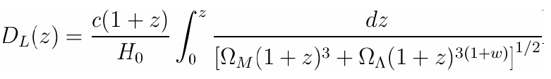
Cosmological detection distance
BNS are considered “standard sirens” (Schutz 1986) because, the amplitude depends only on the Chirp Mass and Effective distance
  Effective distance depends on the effective Luminosity Distance and the antenna pattern
Through the detection of the BNS gravitational signal, by a network of detectors, it is possible to reconstruct the luminosity distance D_{L}
But the ambiguity due to the red-shift (red-shifting of the GW frequency affects the reconstructed chirp mass and then the reconstructed D_{L}) requires an E.M. counterpart (GRB) to identify the hosting galaxy and then the red-shift z.
Knowing D_{L} and z it is possible to probe the adopted cosmological model:
Ω_{M}: total mass density
Ω_{Λ}: Dark energy density
H₀: Hubble parameter
w: Dark energy equation of state parameter

Slide 9
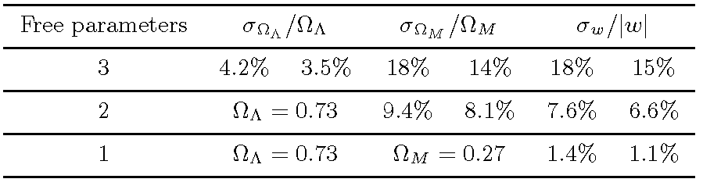
Cosmology with ET
Thanks to the huge detection range of a 3rd generation GW observatory and the consequent high event rate (~10⁶ evt/year) it has been evaluated for ET (Sathyaprakash 2009) a capability to constrains the cosmological parameters similar to the expected Dark Matter missions (JDEM):

Slide 10
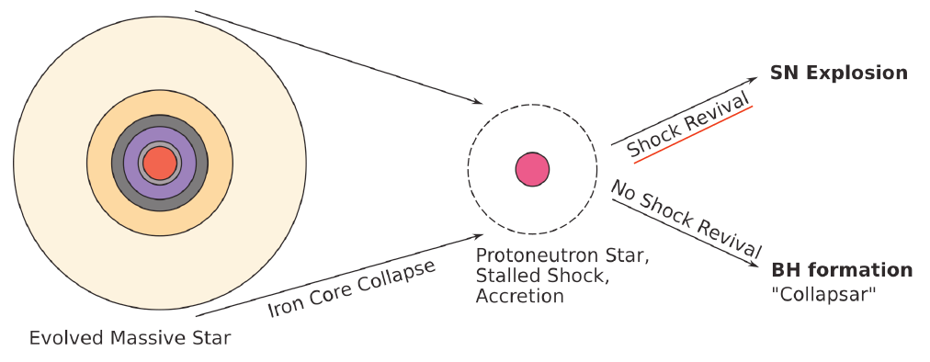
Supernova Explosions
Mechanism of the core-collapse SNe still unclear
  Shock Revival mechanism(s) after the core bounce TBC
GWs generated by a SNe should bring information from the inner massive part of the process and could constrains on the core-collapse mechanisms

Slide 11
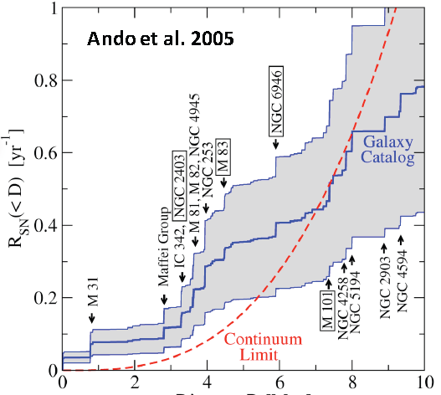
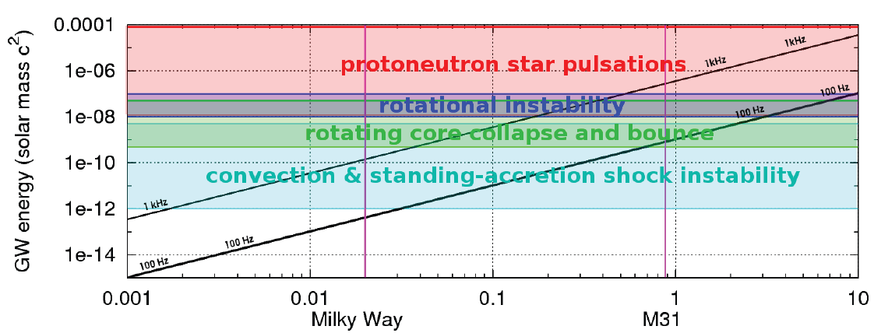
SNe rates with ET
Expected rate for SNe is about 1 evt / 20 years in the detection range of initial to advanced detectors
  Our galaxy & local group
To have a decent (0.5 evt/year) event rate about 5 Mpc must be reached
ET nominal sensitivity can promise this target
Distance [Mpc]
[C.D. Ott CQG 2009]
Distance [Mpc]
Notes:
The rate plot: Cumulative calculated core-collapse supernova rate versus distance. The dashed line is the continuum limit using the GALEX z = 0 star formation rate [6]. For our particular local volume, and its fortuitous enhancement, we use a
galaxy catalog; the stepped line is based on star formation rates for individual galaxies, and the band is the uncertainty.
Some major galaxies are indicated, and those in boxes have especially high optical supernova rates
The lower plot displays the minimum GW energy that a supernova core collapse is
required to radiate in order to be detectable by the Einstein telescope. We give two estimates
assuming that the GW signature is described by a sine-Gaussian burst waveform. We consider
two cases with a low-frequency f = 100 Hz and with high-frequency f = 1 kHz content. The
minimum GW energy is given as a function of the source distance. We also indicate the expected
range of radiated GW energy for several processes [C.D. Ott CQG 2009].

Slide 12
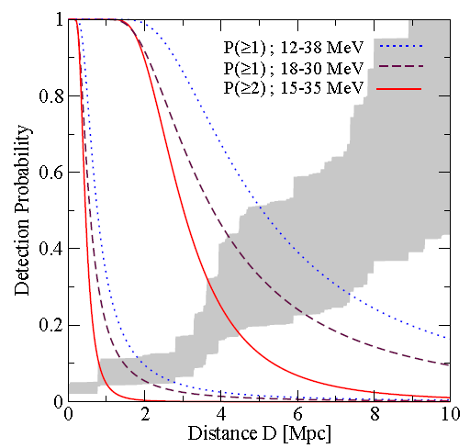
Neutrinos from SNe
SNe detection with a GW detector could bring additional info:
  The 99% of the 10⁵³ erg emitted in the SNe are transported by neutrinos
  If a “simultaneous” detection of neutrinos and GW occurs the mass of the neutrino could be constrained at 1eV level (Arnaud 2002)
Ando 2005
But looking at the detection range of existing neutrino detectors (<Local group limited) is discouraging
Some promising evaluation has been made (Ando 2005) for the next generation of Megaton-scale detectors
Super-K
Mton
Notes:
Probability of detecting at least one (dotted and dashed curves) or at least two (solid curves) supernova neutrinos
versus distance. Background considerations restrict the useful energy intervals, labeled here, and explained in the
text. The upper set of curves is for a 1-Mton detector, and the lower set for the 22.5 kton Super-Kamiokande; for another
detector size, scale the distance to compensate. The shaded band indicates the calculated cumulative supernova rate. The
probabilities for single background events are ≃ 0.4 (1-Mton) and ≃ 0.02 (Super-Kamiokande), independent of distance.

Slide 13

Neutron Stars (NS)
The EOS of the NS matter is still unknown
  Why it pulses? It is a neutron or a “strange” matter star?
GW could investigate the NS EOS detecting the signal produced in different processes:
  Coalescence of binaries
    Full NR simulation of the plunge and merger phase
  Asteroseismology
    Detecting the internal modes of the NS
  Continuous Wave (CW) emission of isolated NS

Slide 14
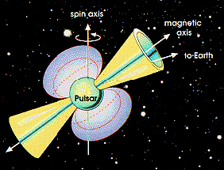
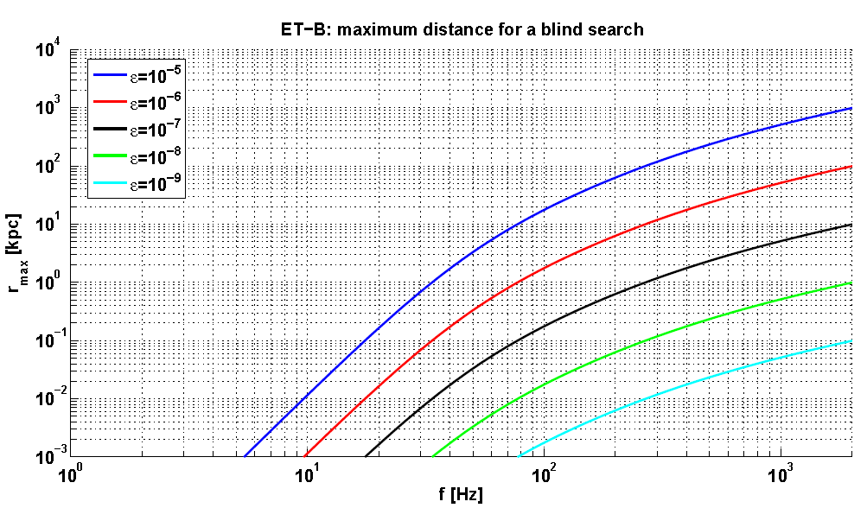
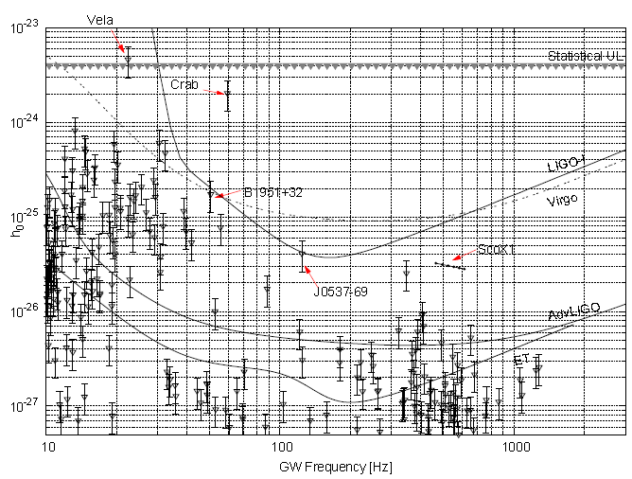
Continuous Wave
The ET improved sensitivity could boost the GW detection from a pulsar

Slide 15
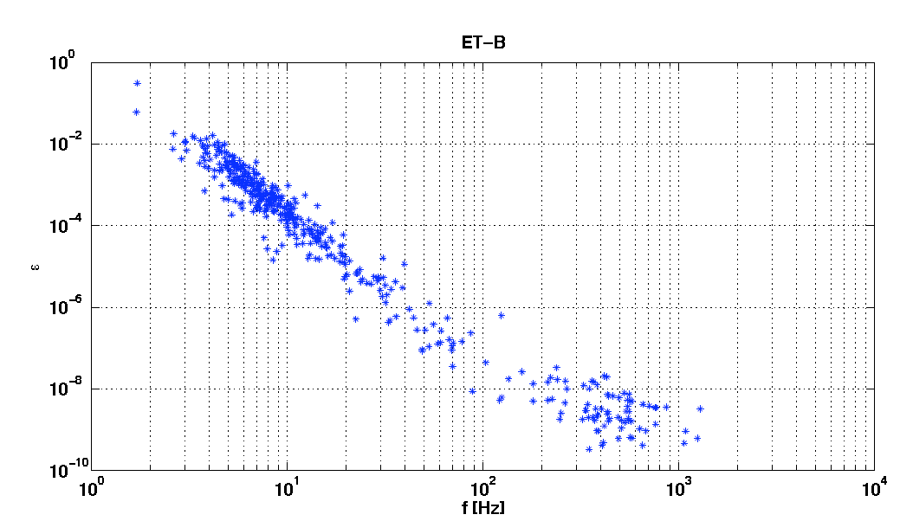
Continuous Waves in ET
Minimal detectable ellipticity ε could approach levels interesting to distinguish the core characteristics
  Solid cores could sustain ε up to 10⁻³;
  Crust could sustain ε up to 10⁻⁶ -10⁻⁷;
Minimum detectable ellipticity for known pulsars
10⁻²
10⁻⁴
ε
10⁻⁶
10⁻⁸
10⁻¹⁰

Slide 16
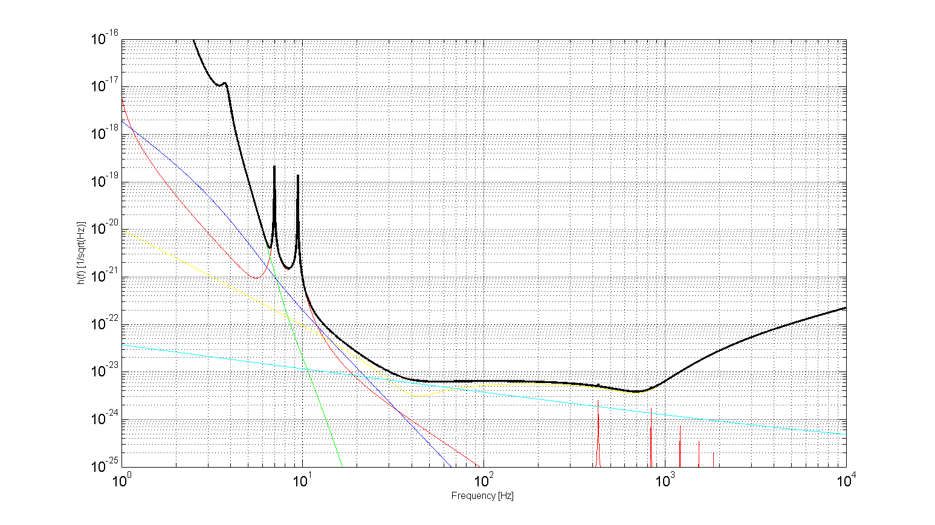
How to go beyond the 2nd generation?
10⁻¹⁶
Seismic
Newtonian
Seismic
Susp. Thermal
h(f) [1/sqrt(Hz)]
Quantum
Thermal
Quantum
Mirror thermal
3rd generation ideal target
10⁻²⁵
1 Hz
Frequency [Hz]
10 kHz

Slide 17
Stressing the current technologies
Obviously a certain improvement of the sensitivity of the advanced detectors could be achieved by stressing the “current” technologies:
  High power lasers (1kW laser, shot noise reduction)
  Larger mirrors and larger beams (lower thermal noise)
  Better coatings (lower thermal noise, lower scattering)
But these aren’t the key elements of
  the transition 2nd ⇒ 3rd generation
  the need of a new infrastructure

Slide 18
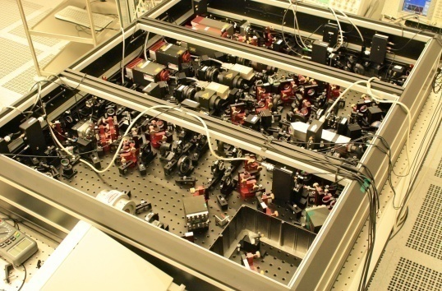
Squeezed Light
Squeezed light states (where the phase noise is lowered at the cost of the amplitude noise) injection in a GW detector does not seem anymore a 3rd generation technology, but it “risks” to become a noise reduction tool in the advanced detectors
  GEO is installing his squeezing bench (Feb’10)
  LIGO wants to make a test after S6
Latest achievements:
  10dB of squeezing @ λ=1064 nm and f=5MHz (Vahlbruch 2008)
  8.5dB of squeezing @ λ=1064 nm and f ~ 10Hz (private comm.)
  5.3dB of squeezing @ λ=1550 nm and f=5MHz (Mehmet 2009)
  Target of 10dB @ audio band and λ=1550 nm or λ=1064 nm seems “easily” achievable in the 3G framework

Slide 19
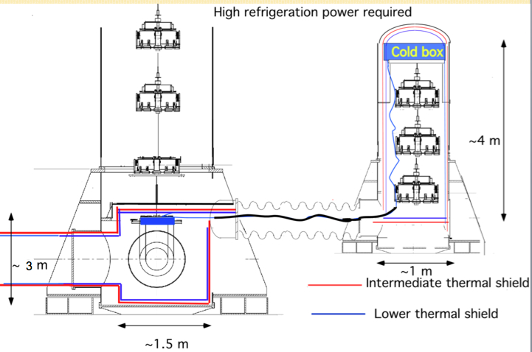
Cryogenics
Thermal noise reduction requires a big “jump”
  Optimization of the dissipations (Fluctuation-dissipation theorem) progresses are probably saturated
    Best substrates selected for advanced detectors
    Coating progresses expected to be “limited”
    Difficult to further increase the beam radius
    Monolithic fused silica suspensions close to the best achievable
  Need to profit of the equi-partition theorem: Cryogenics
    Direct reduction of the thermal noise
    New materials needed
    New optoelectronics needed
    New infrastructures needed

Slide 20
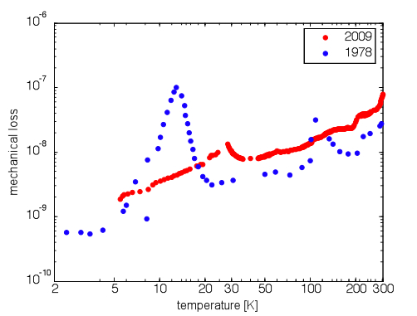
New substrate & suspension materials
Fused Silica unusable at cryo-temperatures
Sapphire and Silicon best candidates
Sapphire selected in LCGT
Silicon under study in ET
Jena Group 2009
McGuigan 1978
Silicon loss angle
Large and heavy Si-substrates are available
New opto-electronics needed
Coating problem remains
10⁻⁸
1.5μm

Slide 21
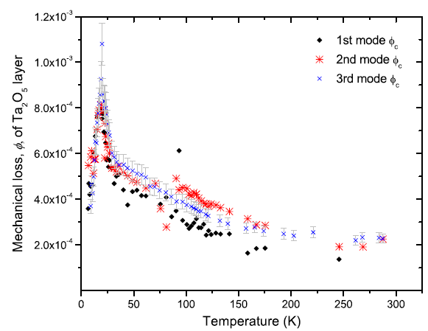
The coating problem
Advanced detector sensitivity will be dominated in the central region, more appealing for BNS coalescences, by coating thermal noise
To reduce that noise optimization of the layer geometry and tricky doping of the high refraction index material, probably, could do little more
We need a “jump”, but also cryogenics seems to promise a small improvement:
  Yamamoto, 2004 ⇒ losses are temperature independent
  Martin, 2008 ⇒ Doped Ta₂O₅ shows a
  peak at low T

Slide 22
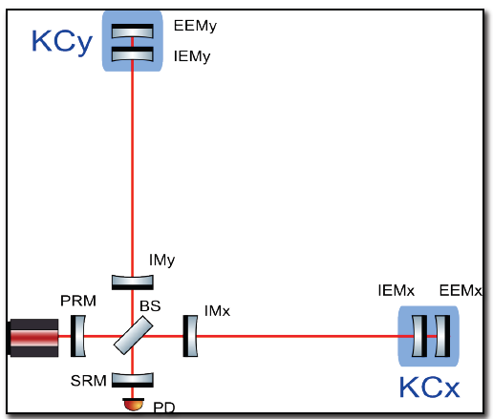
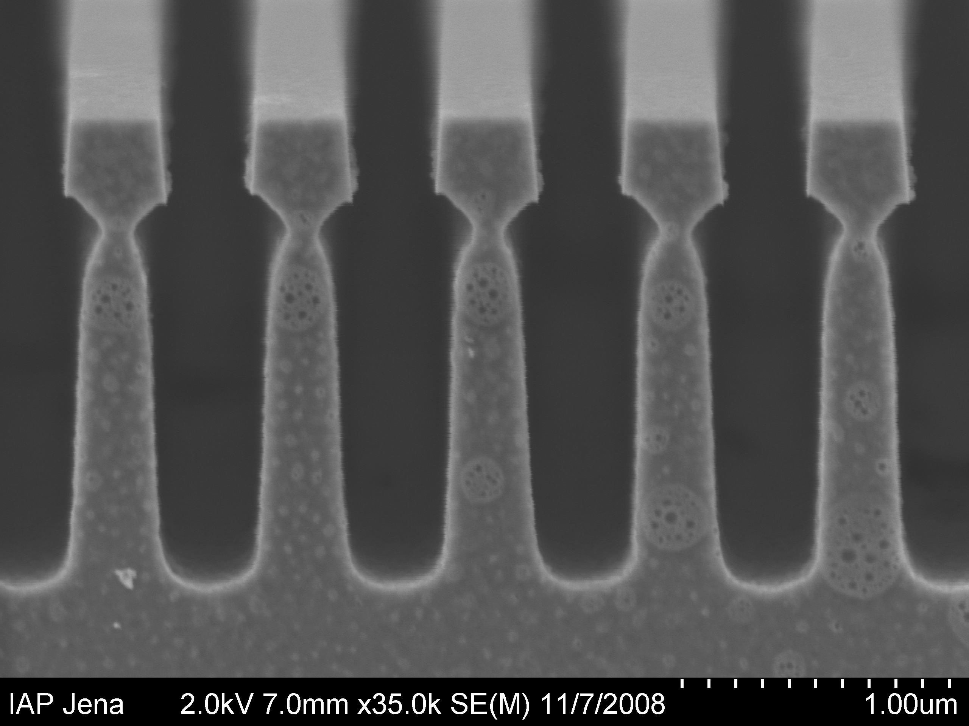
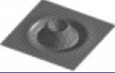
Evading the coating problem
New and still TBC ideas have been proposed to evade the coating problem:
  Reduce the coating layers keeping the high finesse requirements through the Khalili cavities (Khalili 2005)
    It has been evaluated a possible reduction by a factor 1.5 of the ET thermal noise (Hild 2009)
      Technical difficulties to be evaluated
Reduce or eliminate the coating by using the waveguide gratings (Brückner 2009)
Suppress the coating contribution by using flatter beams
  LG higher modes (i. e. LG33)

Slide 23
Access the very low frequency
The second, more challenging, requirement of a 3rd generation GW observatory is to access, as much as possible, the 1-10Hz frequency range
The “enemy” to fight is the seismic noise, that acts on the test masses
  Indirectly, through the suspension chain
  Directly, through the so-called gravity gradient noise
1
Virgo has implemented a seismic filtering chain
  The super attenuator (SA)
Advanced LIGO will implement an active filtering strategy
Are these solutions compliant with the 3G requirements?

Slide 24
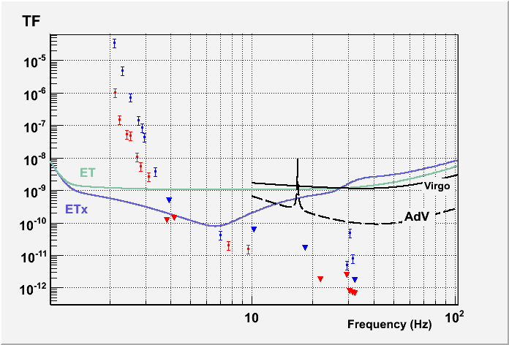
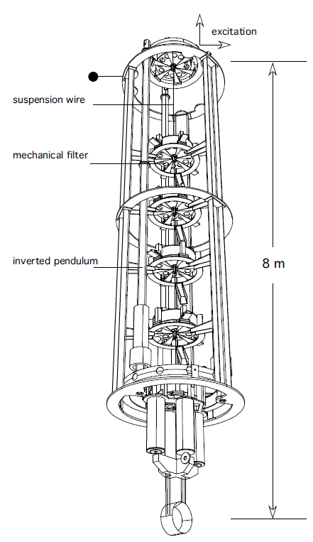
Measurements on Virgo SA
Transfer Function measurement through line injection on the top of the SA
(Braccini 2010)
Preliminary
Effect of the pre-isolation (IP) to be added
Paper accepted for pubblication on Astroparticle Physics
TF requirements build with 5×10⁻⁹/f² m/Hz^{½} seismic noise amplitude
3Hz

Slide 25
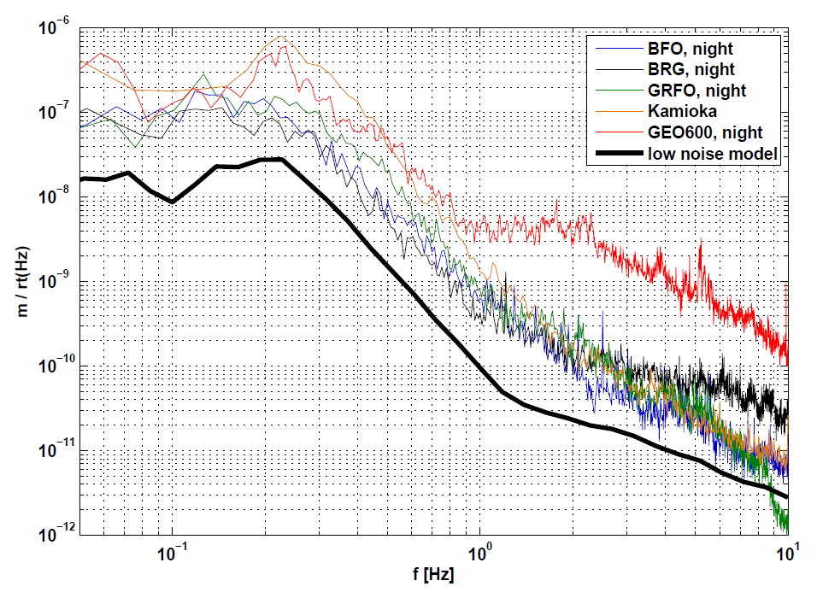
Underground site
Virgo SA filtering capabilities are compatible with the ET requirements from 3Hz, provided that x_{seims}< 5×10⁻⁹/f² m/Hz^{½}
  That is the seismic noise level in the Kamioka LCGT site candidate
We need an underground site:
new infrastructure!
Measurements in Europe:
BFO (Black Forest Observatory): -162m
BRG (Berggieshübel seism Observatory): -36m
GRFO (Graefenberg borehole station): -116m

Slide 26
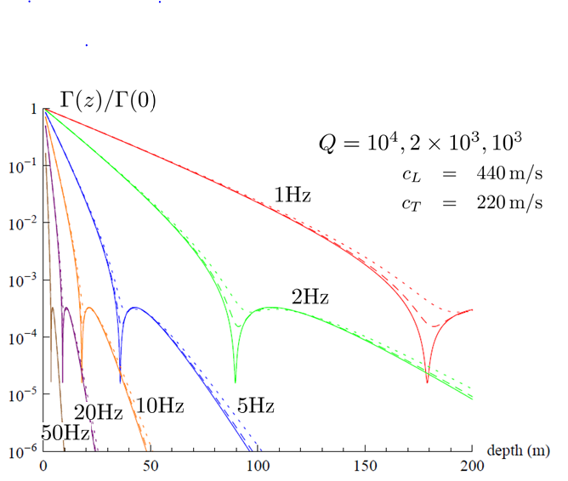
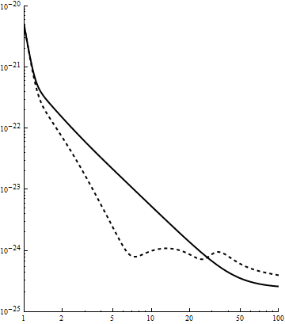
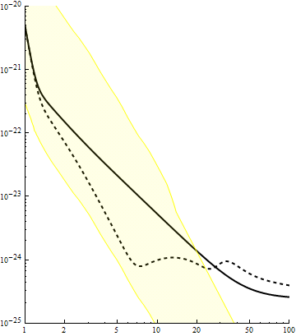
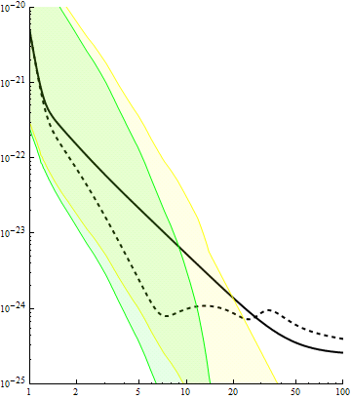
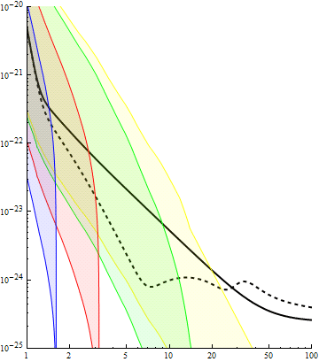
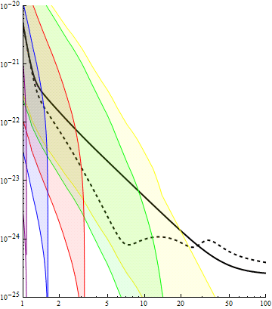
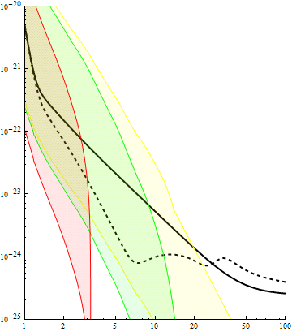
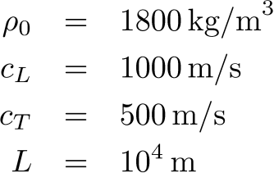
Gravity Gradient Noise reduction
An underground site permits also to suppress the GGN influence
G. Cella 2009
G. Cella 2009
Surface
-10 m
-50 m
-100 m
-150 m
ET-C
Additional noise subtraction schemes under study
ET-B

Slide 27
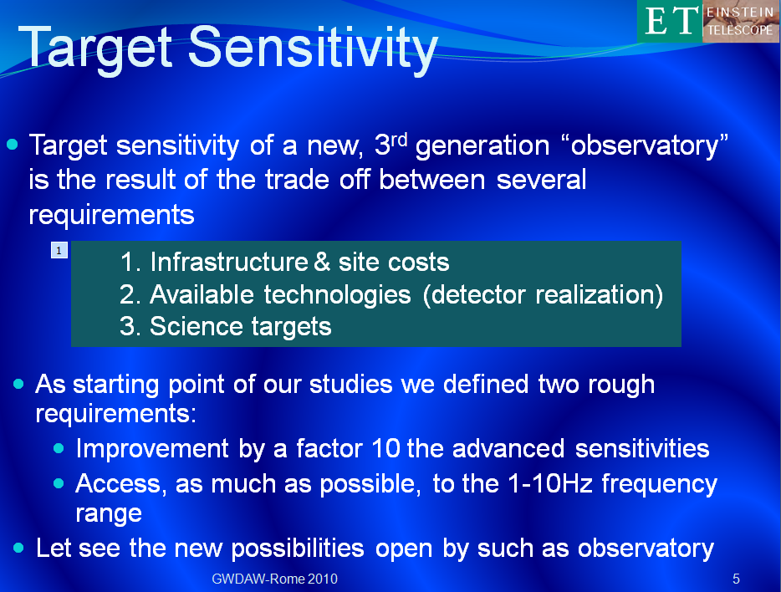
ET Sensitivity (ET-B)
As previously stated (slide #5), the target sensitivity is build through a series of compromises
Considering a list of “conventional” technologies and 10km arms it is “feasible” to have:
Very low frequency sensitivity still to be justified (refinement under evaluation)
Compatibility between high freq and low freq technologies probably too challenging
  Need of a multi-detectors solution
S. Hild 2008

Slide 28
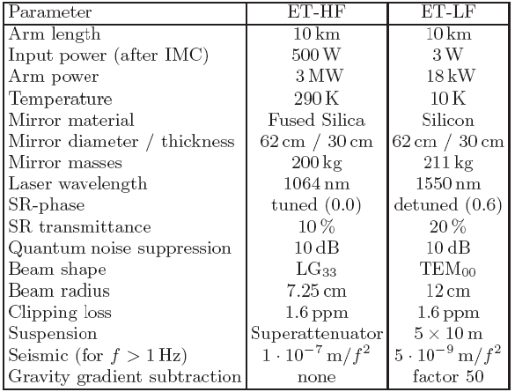
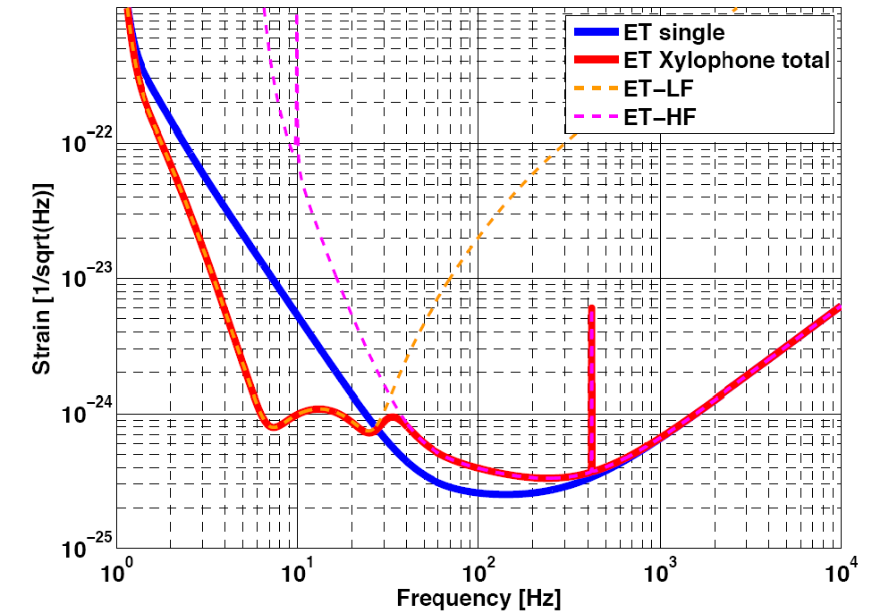
Xylophone design
In a Xylophone design (Shoemaker 2001, DeSalvo 2004) the sensitivity of an observatory is build through 2 or more detectors specialized in different frequency bands
  This could permit to separate the difficulties (i.e.) to realize a cryogenic detector compliant with several MW circulating in the FP cavities
S. Hild 2009
ET-C

Slide 29
New infrastructure
I hope to have convinced you that
  A 3rd generation GW observatory is a must for the GW community if we want to consolidate a new era for the GW astronomy
  We need to develop new technologies for our interferometers to go beyond the advanced detectors
  But, as first priority, we need new infrastructures to host the GW observatories for decades
The first lesson we learned is that the new infrastructure must be hosted in an underground site
  But, where?

Slide 30
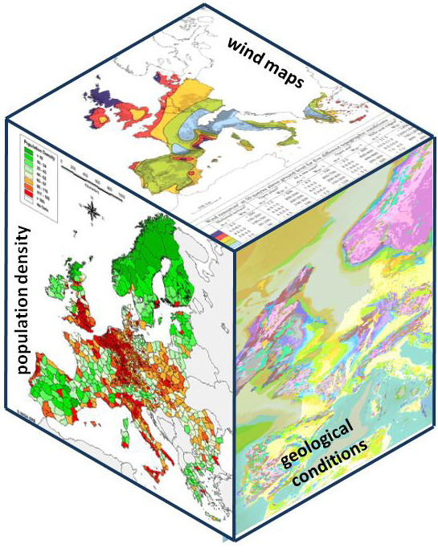
ET Site selection
The generation of a Site candidate list is a priority task in ET
  Scientific & political constrains must be evaluated
    “Cultural noise”, sub-soil characteristics, environmental conditions
    Support of the local institutions and authorities
    Costs, Costs, Costs, Costs, …..
In the cost optimization strategy, since we need to host a multi-detector installation, could the geometry of the observatory be optimized?

Slide 31


Geometry optimization
45° stream generated by virtual interferometry
Fully resolve polarizations
Null stream
L
Redundancy
L
45°
5 end caverns
7 end caverns
4×L long tunnels
6×L long tunnels
Fully resolve polarizations by virtual interferometry
Null stream
Equivalent to
Redundancy
60°
3 end caverns
3.45×L long tunnels
L
L’=L/sin(60°)=1.15×L
(Freise 2009)

Slide 32
Conclusions
The Einstein Telescope design study, supported by the European Commission in FP7 is the first step of the ET path
  We delivered the first intermediate report to the EC:
    http://www.et-gw.eu/et-scientific-reporting
Several other steps are needed to arrive to the construction
Several competitors in EU
To have a success probability we need the support of
  all the GW community
    Through the ET science team
  All the involved institutions
    Through the support of the needed design and R&D activities

