Slide 1



Status of Project
Marcello A. Giorgi
Università di Pisa & INFN Pisa
Warwick
April 14, 2009
Notes:
1
1

Slide 2
Outline
A bit of History.
A glance at Physics opportunity with .
Organizing the TDR effort.
Next steps.

Slide 3
is now in TDR Phase.
But a bit of HISTORY:
Several preparatory meetings from 2005 to form the community and to prepare the CDR, delivered in may 2007.
IRC appointed by the President of INFN in summer 2007 (Chair: John Dainton)
Preliminary meeting in Rome end July 2007 (committee with INFN management and proponents).
First review meeting in LNF Nov. 12-13 , 2007.
Final meeting before report to President of INFN in Rome, Apr. 29-30, 2008 .
IRC has delivered the report to the President of INFN on May 30,2008.

Slide 4
Comments on reviews
Link to meetings and reports:
  http://www.pi.infn.it/SuperB/reviews
Dainton committee →
Mini MAC
Very exciting project -- Committee is exhilarated by the challenge
Physics requirement of 10**36 cm-2 sec-1 or 75 ab-1/5yr is very demanding
Committee considers the SINGLE MOST ESSENTIAL ingredient for moving forward is the formation of a sanctioned management structure which formally incorporates a dedicated machine design team. The team members must have the strong support of their home institutions to work on the design. The team needs a designated leader, who is as close to full time as is possible
The Committee sees no glaring showstoppers wrt achieving the design performance. However, in several key areas, more work is needed before the design can be blessed

Slide 5
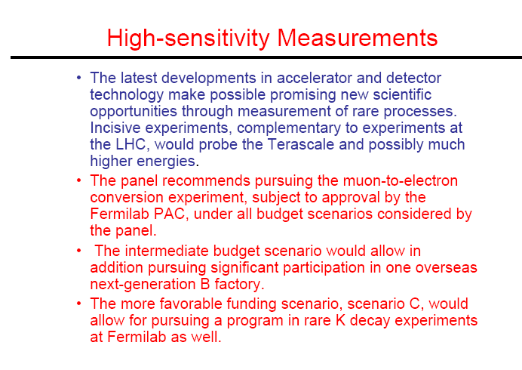
FROM P 5
(Report released May 2008)

Slide 6
From MiniMac
Mini Machine Advisory Committee
  Klaus Balewski (DESY)
  John Corlett (LBNL)
  Jonathan Dorfan (SLAC, Chair)
  Tom Himel (SLAC/ DESY)
  Claudio Pellegrini (UCLA)
  Daniel Schulte (CERN)
  Ferdi Willeke (BNL)
  Andy Wolski (Liverpool)
  Frank Zimmermann (CERN)
First meeting in July 16-17,2008
No glaring showstoppers
RECOMMENDATION:
Form a management structure!
Very exciting project -- Committee is exhilarated by the challenge
Physics requirement of 10**36 cm-2 sec-1 or 75 ab-1/5yr is very demanding
Committee considers the SINGLE MOST ESSENTIAL ingredient for moving forward is the formation of a sanctioned management structure which formally incorporates a dedicated machine design team. The team members must have the strong support of their home institutions to work on the design. The team needs a designated leader, who is as close to full time as is possible
The Committee sees no glaring showstoppers wrt achieving the design performance. However, in several key areas, more work is needed before the design can be blessed
MiniMac was appointed by the President
of INFN at end of June 2008
Link to meetings and reports:
  http://www.pi.infn.it/SuperB/reviews

Slide 7


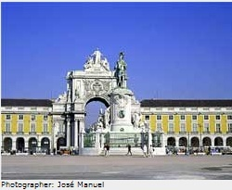
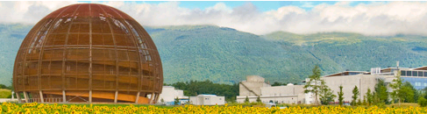
Presentations of the Project at ECFA meetings
Manchester (‘07) :
Lisbon (March’08) :
CERN (Nov28,2008):
REPORT BASED ON CDR
Some Highlight on Physics Program
Quick update on Detector
Accelerator : preliminary results from test on SuperB concepts in DaΦne upgrade at LNF.
The ECFA ad hoc Subcommittee: T.Nakada(chair),Y.Karyotakis,F.Linde,B Spaan attended the May2008 SuperB Workshop in Elba and met with INFN Management and SuperB proponents in October 2008.
Quick update at CERN on Physics Program and Detector
Accelerator test results
Update on Process and Organization for TDR
Notes:
7

Slide 8
ECFA report summary - 1
We consider that flavour physics should be seen as an important part of the European research programme of elementary particle physics, complementary to physics provided by the energy frontier experiments. For the coming ~5 years, LHCb will do this job in the b and c quark sectors. To follow-up this progress, collecting 50 ab−1 or more at Υ(4S) energy with e+e− storage rings by the end of the next decade would be a significant milestone, if this can be realised at a moderate cost.
The INFN Super Flavour Factory project team proposes a novel scheme to obtain luminosity of ≥1036 cm−2s−1, two orders of magnitude more than what has been achieved up to now, without increasing the beam currents. This is a distinct advantagefor some of the machine operation aspects and background to the experiment, as well as for the running cost of the machine. This idea of obtaining a high luminosity with tiny beam spots at the collision point based on very small emittance beams and crab waist collisions could revolutionize the design of the future colliders. Therefore, westrongly support the R&D effort to see if such a machine can really be built.

Slide 9
ECFA report summary –Part 2
The current tests at DAFNE are promising and we would like to congratulate the team for this impressive achievement. However, a substantial amount of work is still required for producing a Technical Design Report, which will be a base for establishing an international consortium for the realisation of the project. A strong core team of experienced accelerator physicists and engineers based at one location should be established already for the TDR work. Without it, contributions from the various interested laboratories cannot be effectively utilized. A strong team of experienced machine physicists will be needed also for the operation. This machine has to achieve its design luminosity in order to be truly competitive.
Given the complexity of the project, we feel that a clear plan containing realistic technical milestones and resource requirements together with a strategy how to obtain them is needed as a necessary condition for an approval of the project.
Such a plan should aim at obtaining an integrated luminosity of significantly more than 50 ab−1 by not much later than the end of the next decade. Given the very ambitious time scale, a clear decision taking process must be established soon.

Slide 10
project was presented at CERN Council
in European Session.
TDR phase was approved last
December 2008 by the Board of Directors of INFN.
The document will be ready before the end of 2010

Slide 11
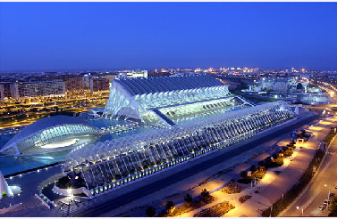
Physics
Physics goals have been discussed inside the SuperB community in the CDR published in May 2007 and in the proceedings of the Valencia SuperB Workshop in 2008 .It was reviewed in April 2008 by the IRC appointed by the President of INFN.

Slide 12
CDR signatures: some numbers
320 Signatures
About 85 institutions
174 Babar members
  65 non Babar exper.
Signatures breakdown by country

Slide 13

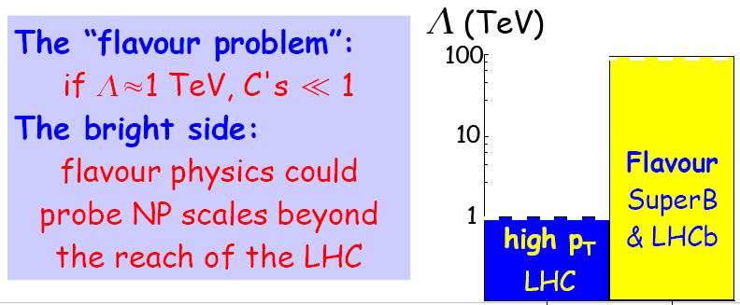
Beyond SM
Flavor Physics : search for NP through VIRTUAL EFFECTS
New Physics effects in Flavor could come from :
New Physics Scale Λ
Effective Flavor Violating couplings
See M.Ciuchini Talk at Orsay SuperB workshop. Feb.17,09

Slide 14
Physics Goals
Increase by O(10) the precision of BaBar &Belle (*)
Challenge CKM at the level of 1% (*)
τ LFV sensitivity improvement by a factor between 10 and 100.
Explore T-violation in τ .
Search for magnetic structure of τ .
Explore CPV in Charm.
Great new Spectroscopy exploration.
Beam Polarization option and possibility to run at charm threshold
It can be allowed with 75 ab⁻¹ in 5 years at Y(4s) and a few months at Charm threshold with peak lumi of 10 ³⁵ cm² s⁻¹.

Slide 15
COMPLEMENTARY: LHC and Flavour with 75 ab⁻¹
IF LHC DISCOVERS SUPERSYMMETRY
EXAMPLE FROM VALENCIA PROCEEDINGS
Red are LHC+EW constraints +
Blue is LHC alone

Slide 16
NOT ONLY LUMINOSITY !
SuperB Design has the unique possibility of running with one polarized beam and at charm threshold.
Polarization is expected to contribute to tau physics .
Low energy runs to add to potential discovery in Charm CP Violation.
In TDR these topics should be better addressed.

Slide 17
Specifications to hit the physics target
(NOT ONLY LUMINOSITY!)
L_{peak}≥10³⁶ cm⁻²s⁻¹ ( asymmetric 7.0+4.0 GeV E_{cm}= m_{Y(4s)}).
85% Polarization di e⁻ (7.0GeV) for τ :
T and CP Violation
BKG reduction in LFV, distinguish among LFV models.
τ g-2.
Option to run SuperB still with a luminosity of 10³⁵ cm⁻²s⁻¹ at charm threshold (4 .0 GeV ) . Pure DD_{bar}, no additional fragmentation.
High signal/bkg : optimal for channels with
Quantum Coherence: unique opportunity to measure D⁰-D⁰_{bar}relative phase.
~10⁹ DD /month at 10³⁵ cm⁻²s⁻¹ . (using
σ(e⁺e⁻→D⁰D⁰)~3.6 nb + σ(e⁺e⁻→D⁺D⁻)~2.8 nb ~ 6.4 nb as measured by CLEO-C)
Misure dipendenti dTime dependent measurements at4 GeV as for B sector at Y(4s) in BABAR and Belle. I will be only possible at SuperB.

Slide 18
Charm
EXAMPLE FOR CHARM
Charm events at threshold are very clean: pure DD, no additional fragmentation
High signal/bkg ratio: optimal for decays with neutrinos.
Quantum Coherence: new and alternative CP violation measurement wrt to ϒ(4S). Unique opportunity to measure D⁰-D⁰ relative phase.
Increased statistics is not an advantage running at threshold: cross-section 3x wrt 10GeV but luminosity 10x smaller.
SuperB lumi at 4 GeV = 10³⁵ cm⁻²s⁻¹ produces ~10⁹ DD pairs per month of running. (using Cleo-c cross-section measurement
σ(e⁺e⁻→D⁰D⁰)~3.6 nb + σ(e⁺e⁻→D⁺D⁻)~2.8 nb ~ 6.4 nb)
Time-dependent measurements at 4 GeV only possible at SuperB.

Slide 19
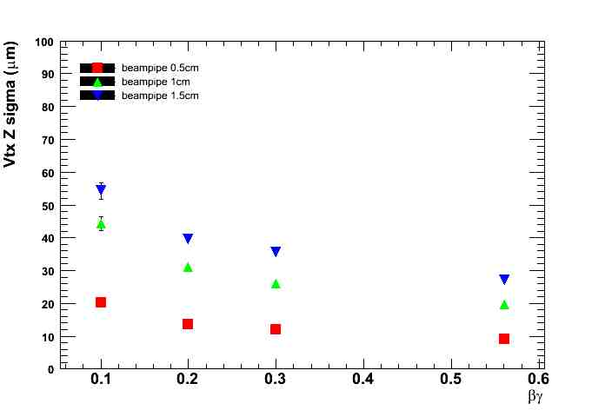
Time dependent measurements at DD threshold: only possible at SuperB
Proper time resolution dominated by decay vertex resolution.
  Production vertex precisely determined thanks to nm beamspot dimensions
SuperB lumi at 4 GeV = 10³⁵ cm⁻²s⁻¹
produces ~10⁹ DD per month
SuperB nominal boost
βγct = 0.28 × 120 μm ~ 30μm
Average flight distance similar to vertex resolution → σ_{t}~τ
βγ
Resolution is still adequate for time dependent measurements
Error on lifetime (wrt perfect resolution)

Slide 20
Crab Waist test was successful
DaΦne test in Frascati very successful, the luminosity has grown by more than a factor 3 as expected from simulations.
All the results agree with beam beam simulations, now also with strong-strong

Slide 21
expectation
With 7th year integrated Luminosity can grow at rate of ∼40 ÷ 60 ab⁻¹/year
>80ab-1 after 6 years
With more money a second interaction can be included in SuperB, without compromising on Luminosity!
2015?

Slide 22
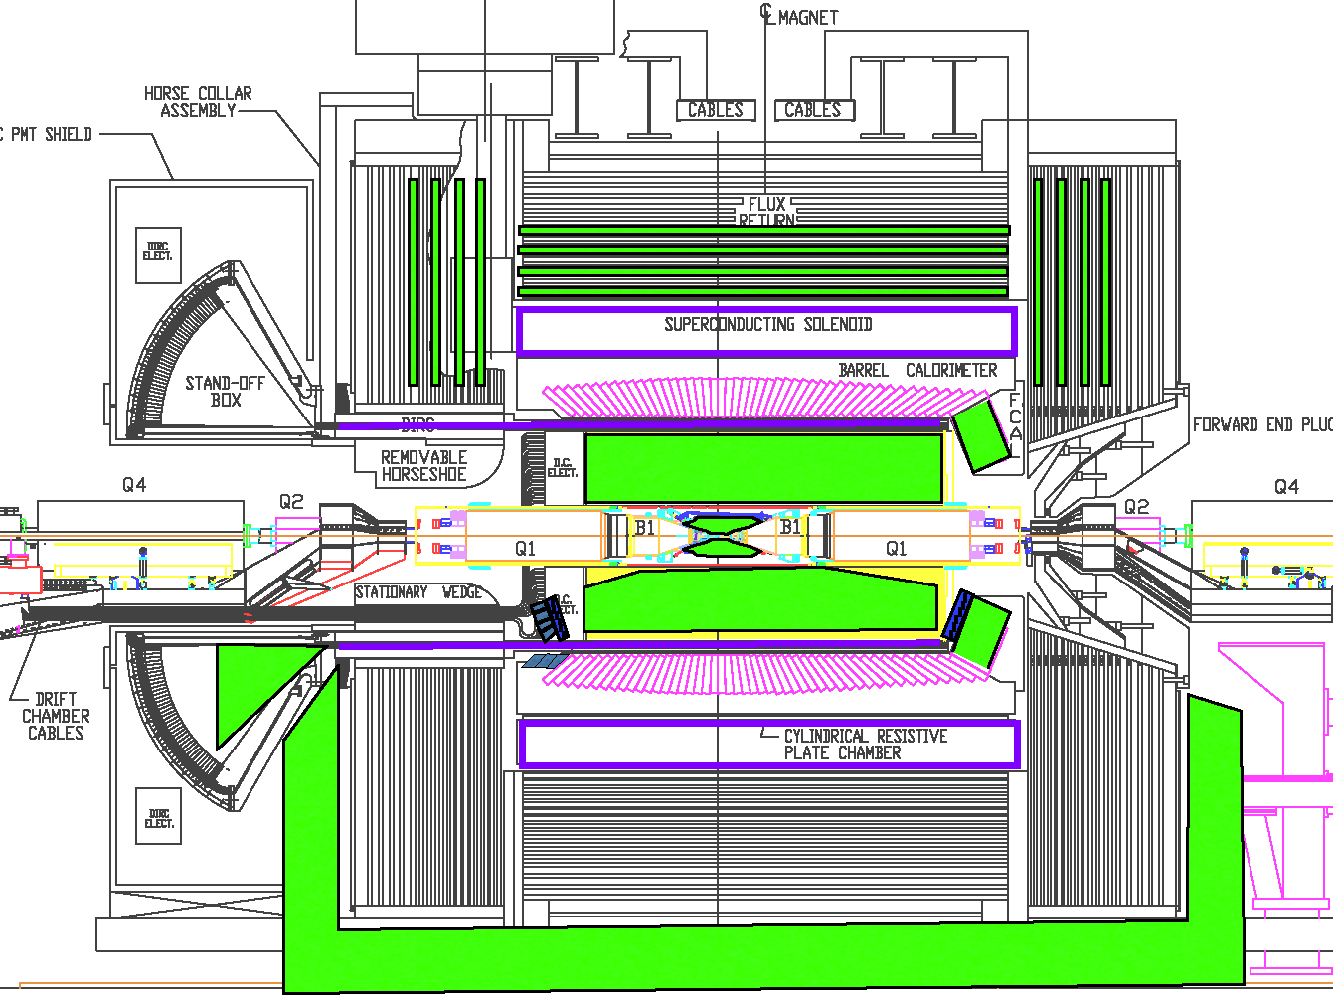
Detector Layout – Reuse parts of Babar (or Belle)
BASELINE
OPTION
28 Nov,2008
Marcello A.Giorgi
22
Notes:
22

Slide 23
Progress and Reuse
A lot of progress in Detector design including R&D.
An ad hoc committee on geometry set up by Coordinators.
Reuse in SuperB of BABAR and PEPII will be defined soon. About PEPII there was a constructive interactions between INFN management and the SLAC Directorate.
D&D Review on March 23-24 at SLAC.

Slide 24
ORGANIZATION

Slide 25
Organization Chart for TDR Phase
Oversight
Board
SuperB Project Office - TDR Phase
Director (M.Giorgi)
Deputy
Director 1
(D.Hitlin)
Deputy
Director 2
(D.Leith)
Deputy
Director 3
(G.Wormser)
International
Board of
Representatives
Administrative and scientific staff
Mini-DET
Mini-COMP
Mini-MAC
Accelerator Consortium
(J.Seeman )
Detector Collaboration
(F.Forti B.Ratcliff)
Local
Infrastructure
(S.Tomassini(?))
Computing
(M.Morandin)
Accelerator
R&D, Engineering
and Construction
Tunnel,
power,
water,
utilities,
………
Detector
R&D, Engineering
and Construction
Site computing system,
offline
Infrastructure,Facilities, Services
Parameters
R&D + Preparatory Studies
Optics
SVT
Offline Computing
Computing Model
Beam Dynamics
Linac
DCH
Polarization
Magnets
PID
Online Computing
RF/Feedback
Mech. Design
EMC
Damping Rings
IR/Final Focus
IFR
Electronics
Control System
Vacuum
Magnet
Trigger
Power Supplies
Transfer Lines
DAQ
Fluid Supplies
Alignment
Rad. Monitor
Rad. Protection
Diagnostics
Lum. Monitor
Accelerator
Technical Board
MDI
Detector
Technical Board

Slide 26
Steering Committee
Since 2006 a Steering Committee is in place
M.G. ( INFN Italy-Chair)
W.Gradl (Germany)
P.Harrison (UK)
D.Hitlin (USA)
H.Jawahery (USA)
D.Leith (USA)
E.Levichev(Russia)
F. Martinez-Vidal (Spain)
P.Raimondi (INFN Italy)
M.Roney (Canada)
G.Wormser (France)
+ Detector Coordinators +Accelerator Coordinators
This committee is in a restructuring phase and will evolve into the International board of representatives.

Slide 27
Detector (Proto) Technical Board
Detector Coordinators – B.Ratcliff, F. Forti
Technical Coordinator – W.Wisnieswki
SVT – G. Rizzo
DCH – G. Finocchiaro
PID – N.Arnaud, J.Va’vra
EMC – D.Hitlin → C.Cecchi, F.Porter
IFR – R.Calabrese
Magnet – W.Wisniewski
Electronics, Trigger, DAQ – D. Breton, U. Marconi
Online/DAQ –
Offline SW –
  Simulation coordinator – D.Brown
  Fast simulation – M. Rama
  Full Simulation – F. Bianchi
Rad monitor –
Lumi monitor –
Background simulation & Machine Detector Interface –– M.Boscolo, E.Paoloni +M.Sullivan

Slide 28
Detector R&D
Main parts of Babar to reuse
  Quartz bars of the DIRC
  Barrel EMC CsI(Tl) crystal and mechanical structure
  Superconducting coil and flux return yoke.
Sys | R&D | Engineering
SVT | Layer 0 thin pixels Low mass mechanical support | Silicon strip layers Readout architecture
DCH | High speed waveform digitizing | CF mechanical structure Gas speed, cell size
Barrel PID | Photon detection for quartz bars | Standoff box replacement
Forw PID | Time of flight option Focusing RICH option | Mechanical integration. Electronics
EMC | LYSO characterization Light detection | Readout electronics Forward EMC mechanical support
IFR | Fiber disposition in scintillator | Location of photo-detectors
ETD | High speed data link Radiation hard devices | Trigger strategy Bhabha rejection

Slide 29
Resources for Detector and Computing
Comment: We don’t consider at the moment the need for hiring engineers for detector outside the present institutions that are taking commitments in SuperB.
About experimentalists:we are verifying the interest of people already in SuperB, that have not yet chosen the detector subsystem . We estimate however the need to recruitment about 10 postdocs..
Computer manpower (mostly postdocs) are needed quite soon.

Slide 30
Accelerator responsibilities (already assigned)
Linac: Boni/Seeman
Parameters: Raimondi/ Seeman
Magnets: (LNF)/XX
Optics: Biagini/Wienands
Mechanical Design: Tomassini/XX
Beam Dynamics: Zobov/Novokhatski
IR/Final Focus: Sullivan/Raimondi
Polarization: Wienands/Wittmer
Vacuum: (LNF)/ XX
RF/Feedback: Drago/Bertsche
Damping Rings/Transfer Lines: Guiducci
Alignment: Sgamma/XX
Control System: Stecchi/ XX
Diagnostics: Serio/XX
Power Supplies: Ricci/ XX
Fluids: Pellegrino/ XX
Rad. Protection: Esposito/ XX
Beyond Italy and USA the inventory of available resources is in progress and the assignment of responsibilities is not yet final.
From a recent meeting in France we know that a total of 8.5 FTE for accelerator are available from Annecy,Orsay and Saclay.
Recruitment is going on:
8 FTE from Novosibirsk
We expect soon to finalize the participation from UK and Canada.

Slide 31

Accelerator and Facilities Contributors (in progress)
Project Oversite | Seeman
 | Raimondi
Accelerator Physics | Raimondi
 | Variola
Magnets | Sanelli
Mechanical design | Tomassini
 | Kharakh
Reused components | Sullivan
 | MacFarlane
 | Kharakh
Parameters | Raimondi
 | Seeman
Diagnostics | Serio
 | Wittmer
Power supplies | Ricci
Beam dynamics | Zobov
 | Novokhatski
 | Nikitin
Beam dynamics (alread | Zobov
 | Novokhatski
 | Nikitin
 | Boscolo
 | Demma
Vacuum | Clozza
 | Lollo
 | Kharakh
RF/Feedback | Drago
 | Bertsche
Alignment | Sgamma
Control system | Stecchi
Cooling systems | Pellegrino
Parameters | Raimondi
 | Seeman
Radiation monitoring | Esposito
Polarization | Wienands
 | Cai
IR/Final Focus | Sullivan
 | Raimondi
 | Paoloni
Damping rings and transport lines | Guiducci
 | Yocky
Beam-beam simulations | Piminov
 | Levichev
 | Shatilov
Mechanical design | Tomassini
 | Kharakh
Reused components | Sullivan
 | MacFarlane
 | Kharakh
Parameters | Raimondi
 | Seeman
Diagnostics | Serio
 | Wittmer
Power supplies | Ricci

Slide 32
Accelerator and Facilities Contributors
Italy area coordinator | Marica Biagini | LNF INFN
 | Pantaleo Raimondi | LNF INFN
UK area coordinator | Gabriele Bassi | Cockroft
France area coordinator | Alessandro Variola | IN2P3 LAL
United States area coordinator | Michael Sullivan | SLAC
 | John Seeman | SLAC
Russia area coodinator | E. Levichev | BINP
Project oversite | John Seeman | SLAC
 | Pantaleo Raimondi | LNF INFN
Accelerator physics overview | Pantaleo Raimondi | LNF INFN
 | Alessandro Variola | Orsay
 | Uli Wienands | SLAC
Alignment | Sgamma | LNF INFN
Beam-beam simulations | Piminov | BINP
 | E. Levichev | BINP
 | D. Shatilov | BINP
 | Mikhail Zobov | LNF INFN
Beam dynamics | Alexander Novokhatski | SLAC
 | Manuela Boscolo | LNF INFN
 | Theo Demma | LNF INFN
 | Mauro Pivi | SLAC
 | Olivier Napoly | IRFU-LAPP
 | J. M. DeConto | IN2P3 LAL
 | A. Chance | IRFU Saclay
Control system | Stecchi | LNF INFN
Cooling systems | Pellegrino | LNF INFN
Cryogenics | J. Wiesend | SLAC
Damping rings and transport lines | Susanna Guiducci | LNF INFN
 | Gerry Yocky | SLAC
Diagnostics | Mario Serio | LNF INFN
 | Walter Wittmer | SLAC
Dynamic Aperture | E. Levichev | BINP
 | Gerry Yocky | SLAC
Interaction region and final focus | Michael Sullivan | SLAC
 | Pantaleo Raimondi | LNF INFN
 | Eugenio Paoloni | Pisa
 | Simona Bettoni | CERN
Linac-Injection | Roberto Boni | LNF INFN
 | John Seeman | SLAC
Low Level RF | Tourres | CNRS LPSC
Machine detector interface | Michael Sullivan | SLAC
Magnets | Sanelli | LNF INFN
 | Miro Preger | LNF INFN
 | Nanyang Li | SLAC
Mechanical design and systems | Sandro Tomassini | LNF INFN
 | David Kharakh | SLAC
 | Francesco Sgamma | LNF INFN
 | Giancarlo Sensolini | LNF INFN
 | Marco Esposito | LNF INFN
Optics-lattice-tuning | Marica Biagini | LNF INFN
 | Walter Wittmer | SLAC
 | Uli Wienands | SLAC
 | Martin Donald | SLAC
 | Yuri Nosochkov | SLAC
 | Andy Wolski | Cockroft
Parameters | Pantaleo Raimondi | LNF INFN
 | John Seeman | SLAC
PEP-II reused components | Michael Sullivan | SLAC
 | David MacFarlane | SLAC
 | David Kharakh | SLAC
Polarization | Uli Wienands | SLAC
 | S. Nikitin | BINP
 | Yunhai Cai | SLAC
 | Alex Chao | SLAC
 | M. Baylac | IN2P3
 | J. M. DeConto | IN2P3
 | Gomez | CNRS LPSC
Positron source | A. Variola | IN2P3 LAL
 | F. Poirier | IN2P3 LAL
 | R. Chehab | IN2P3 LAL
 | J. Bonis | IN2P3 LAL
 | G. Lemeur | IN2P3 LAL
 | F. Touze | IN2P3 LAL
Power supplies | Ricci | LNF INFN
 | A. Di Lira | SLAC
Radiation monitoring | Esposito | LNF INFN
RF and feedback | Allesandro Drago | LNF INFN
 | Kirk Bertsche | SLAC
IR stabilization | A. Jaremie | CNRS LAPP
Vacuum | Clozza | LNF INFN
 | Lollo | LNF INFN
 | David Kharakh | SLAC
 | C. Prevost | IN2P3 LAL
 | B. Mercier | IN2P3 LAL

Slide 33
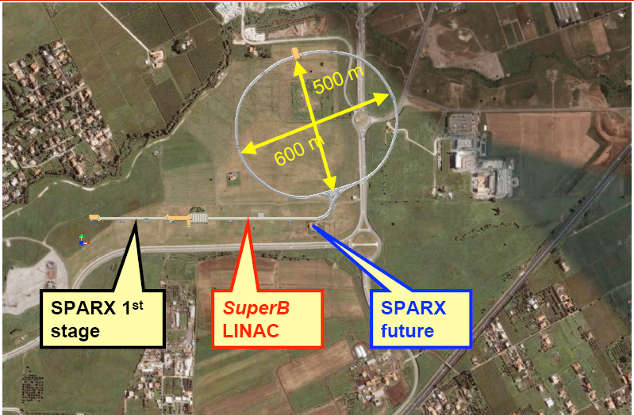
SuperB on Tor Vergata site
SuperB rings

Slide 34
Meanwhile in KEK…
We have understood that in KEK are now considering an alternative design not entirely based on “BRUTE FORCE”. Nanobeams are considered in a scheme that is named “italian” or “half-italian”.
It is a good news for us since it is a further validation of SuperB approach.
I invited A.Suzuki or a person designated by him from KEK to come to our next general meeting and discuss with us their new strategy towards SuperKEKB.

Slide 35
NEXT EVENTS
LNF April 23-24,2009 –MiniMac (J.Dorfan)
Perugia June 16-20- General Meeting (Claudia Cecchi is the meeting coordinator).
SLAC October 5-9 – General Meeting
Intermediate document ready by December 2009.

Slide 36
END

Slide 37
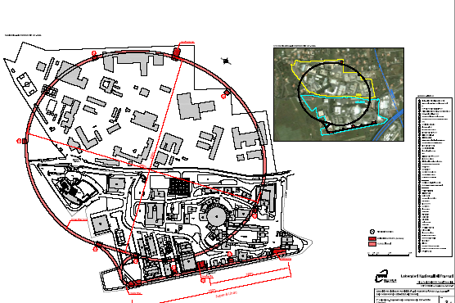

Slide 38
