Slide 1




Spectroscopy at‾PANDA
Diego Bettoni
INFN, Ferrara, Italy
Workshop on New Physics with SuperB
University of Warwick, UK, 16 April 2009

Slide 2
Outline
Introduction
‾PANDA at FAIR
  Experimental Setup
  The ‾PANDA Physics Program
  Physics Performance
Summary and Outlook

Slide 3
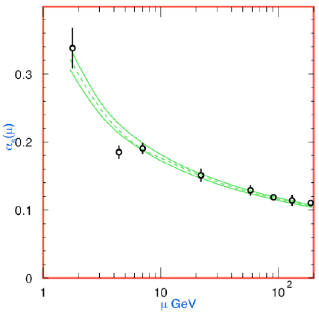
QCD
The modern theory of the strong interactions
is Quantum Chromodynamics (QCD), the
quantum field theory of quarks and gluons
based on the non abelian gauge group SU(3).
It is part of the Standard Model.
Confinement
At high energies, where the strong coupling
constant α_{s} becomes small and perturbation
theory applies, QCD is well tested.
Asymptotic
freedom
In the low-energy regime, however, QCD
becomes a strongly coupled theory, many
aspects of which are not understood.

Slide 4
Theoretical Approaches to non-perturbative QCD
Potential models. Bound systems of heavy quarks can be treated in the framework of non-relativistic potential models, with forms which reproduce the asymptotic behaviour of QCD. Masses and widths are obtained by solving Schrödinger’s equation.
Lattice QCD (LQCD)
  The QCD equations of motions are discretized on a 4-dimensional space-time lattice and solved by large-scale computer simulations.
  Enormous progress in recent years (e.g. gradual transition from quenched to unquenched calculations).
  Ever increasing precision, thanks also to sinergies with EFT.
Effective Field Theories (EFT)
They exploit the symmetries of QCD and the existence of hierarchies of scales to provide effective lagrangians that are equivalent to QCD for the problem at hand.
  With quark and gluon degrees of freedom (e.g. Non Relativistic QCD or NRQCD)
  With hadronic degrees of freedom (e.g. Chiral Perturbation Theory).

Slide 5
Examples of Theory Calculations
Four quark for the X(3872)
LQCD Glueball Spectrum
Maiani et al., PRD71(2005)014028
LQCD + NRQCD
Charmonium Spectrum
Morningstar und Peardon, PRD60 (1999) 034509

Slide 6
Experimental Measurements
Spectroscopy of QCD bound states. Precision measurement of particle spectra to be compared with theory calculations. Identification of the relevant degrees of freedom.
  light quarks, c‾c, b‾b
  D meson
  baryon
Search for new forms of hadronic matter: hybrids, glueballs, multiquark states ...
Hadrons in nuclear matter. Origin of mass.
Hypenuclei.
Study of nucleon structure.
  Form Factors
  GDAs
Spin physics.

Slide 7
Experimental Techniques
e⁺e⁻ collisions
direct formation
two-photon production
initial state radiation (ISR)
B meson decay
(BaBar, Belle, BES, CLEO(-c), LEP ...)
+ low hadronic background
+ high discovery potential
- direct formation limited to vector states
- limited mass and width resolution for
non vector states
- high hadronic background
+ high discovery potential
+ direct formation for all (non-exotic) states
+ excellent mass and width resolution
for all states
‾pp annihiliation
(LEAR, Fermilab E760/E835, ‾PANDA)
Hadroproduction
(CDF, D0, LHC)
Electroproduction
(HERA)

Slide 8
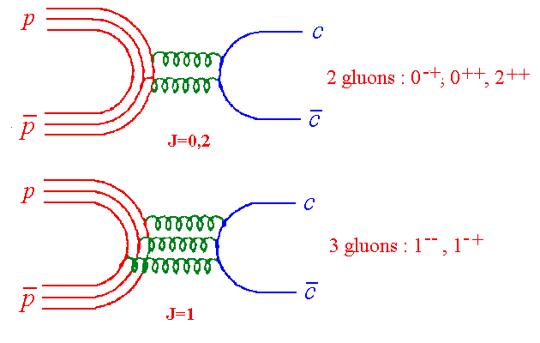
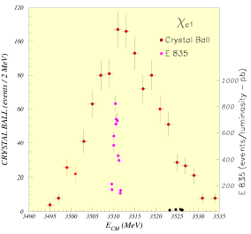
‾pp Annihilation
In ‾pp collisions the coherent
annihilation of the 3 quarks in
the p with the 3 antiquarks in
the‾p makes it possible to form
directly states with all non-exotic
quantum numbers.
The measurement of masses and
widths is very accurate because it
depends only on the beam parameters,
not on the experimental detector
resolution, which determines only the
sensitivity to a given final state.

Slide 9
Hybrids and Glueballs in ‾pp Annihilation
n‾ng
s‾sg/c‾cg
Production
p
G
p
H
p
H
_
_
_
all J^{PC} available
p
M
p
M
p
M
Formation
p
p
p
_
G
_
H
_
H
only selected J^{PC}
p
p
p
Gluon rich process creates gluonic excitation in a direct way
  c‾c requires the quarks to annihilate (no rearrangement)
  yield comparable to charmonium production
  even at low momenta large exotic content has been proven
  Exotic quantum numbers can only be achieved in production mode

Slide 10
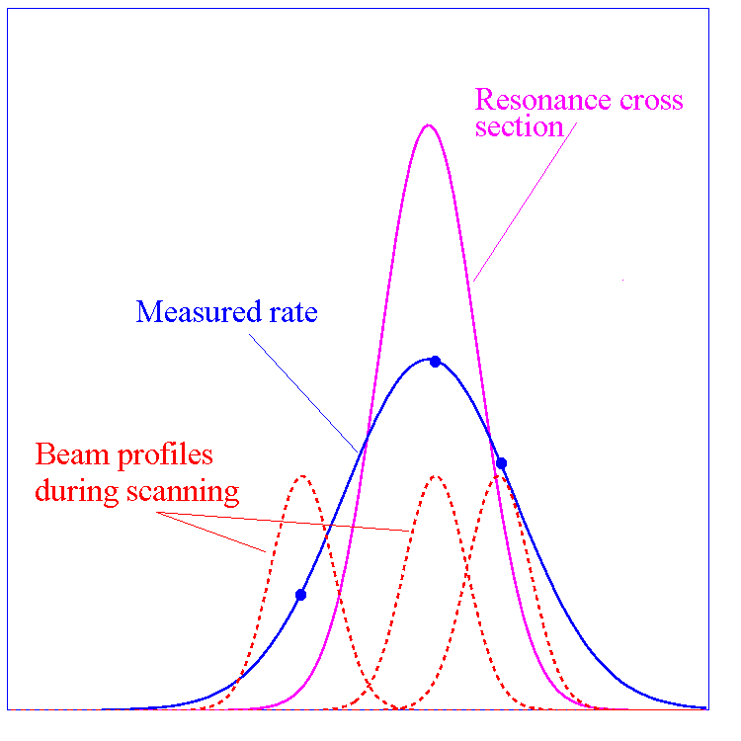
Experimental Method
The cross section for the process:
‾pp → R → final state
is given by the Breit-Wigner formula:
The production rate ν is a convolution of the
BW cross section and the beam energy distribution function f(E,ΔE):
The resonance mass M_{R}, total width Γ_{R} and product of branching ratios
into the initial and final state B_{in}B_{out} can be extracted by measuring the
formation rate for that resonance as a function of the cm energy E.

Slide 11
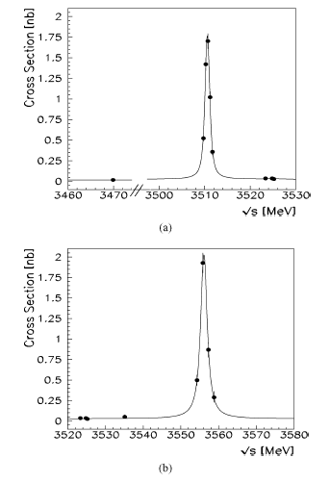
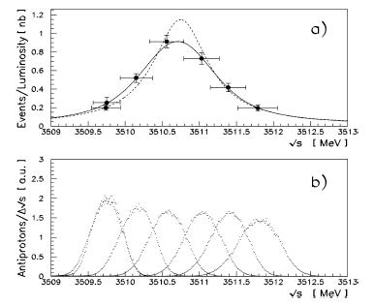
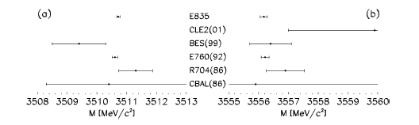
Example: χ_{c1} and χ_{c2} scans in
Fermilab E835
χ₁
χ₂

Slide 12
‾PANDA at FAIR
Experimental Setup
The ‾PANDA Physics Program
Physics Performance

Slide 13
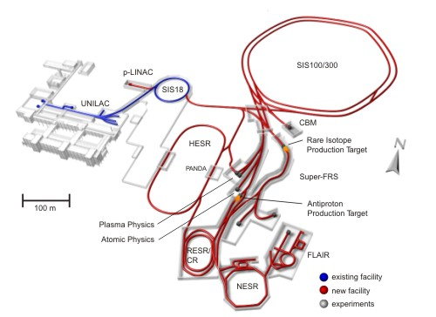
The FAIR Complex

Slide 14
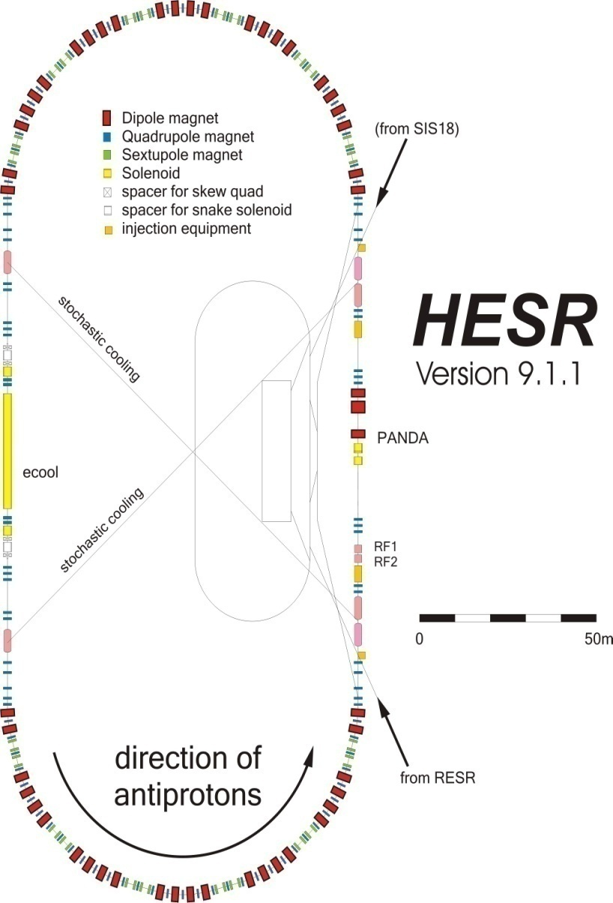
High-Energy Storage Ring
Production rate 2x10⁷/sec
P_{beam} = 1 - 15 GeV/c
N_{stored} = 5x10¹⁰ p
Internal Target
_
High resolution mode
δp/p ~ 10⁻⁵ (electron cooling)
Lumin. = 10³¹ cm⁻² s⁻¹
High luminosity mode
Lumin. = 2 x 10³² cm⁻² s⁻¹
δp/p ~ 10⁻⁴ (stochastic cooling)

Slide 15
‾PANDA Detector
Detector Requirements
(Nearly) 4π solid angle coverage
(partial wave analysis)
High-rate capability
(2×10⁷ annihilations/s)
Good PID (γ, e, µ, π, K, p)
Momentum resolution (≈ 1 %)
Vertex reconstruction for D, K⁰_{s}, Λ
Efficient trigger
Modular design
Pointlike interaction region
Lepton identification
Excellent calorimetry
  Energy resolution
  Sensitivity to low-energy
  photons

Slide 16
















Collaboration
At present a group of 410 physicists
from 53 institutions of 16 countries
Austria – Belaruz - China - France - Germany –India - Italy – Netherlands
Poland – Romania - Russia – Spain - Sweden – Switzerland - U.K. – U.S.A..
Basel, Beijing, Bochum, IIT Bombay, Bonn, Brescia,
IFIN Bucharest, Catania, Chicago, Cracow, IFJ PAN Cracow, Cracow UT, Dresden, Edinburg, Erlangen, Ferrara, Frankfurt, Genova, Giessen, Glasgow, GSI,
FZ Jülich, JINR Dubna, Katowice, KVI Groningen, Lanzhou, LNF, Lund, Mainz, Minsk, ITEP Moscow, MPEI Moscow,
TU München, Münster, Northwestern, BINP Novosibirsk, IPN Orsay, Pavia, Piemonte Orientale, IHEP Protvino,
PNPI St. Petersburg, KTH Stockholm, Stockholm, U Torino, INFN Torino, Torino Politecnico, Trieste, TSL Uppsala, Tübingen, Uppsala, Valencia, SINS Warsaw, TU Warsaw, SMI Wien
http://www.gsi.de/panda

Slide 17
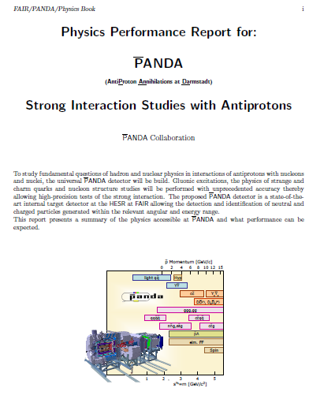
Recent Activities
Electromagnetic Calorimeter TDR written
Crystals funded
Dipole magnet and forward Čerenkov funded
Magnet TDR written
Tracking TDR in progress
First version of ‾PANDA Physics Book completed.
ArXiV:0903.3905.

Slide 18
‾PANDA Physics Program
QCD BOUND STATES
  CHARMONIUM
  GLUONIC EXCITATIONS
  HEAVY-LIGHT SYSTEMS
  STRANGE AND CHARMED BARYONS
NON PERTURBATIVE QCD DYNAMICS
HADRONS IN THE NUCLEAR MEDIUM
NUCLEON STRUCTURE
  GENERALIZED DISTRIBUTION AMPLITUDES (GDA)
  DRELL-YAN
  ELECTROMAGNETIC FORM FACTORS
ELECTROWEAK PHYSICS

Slide 19
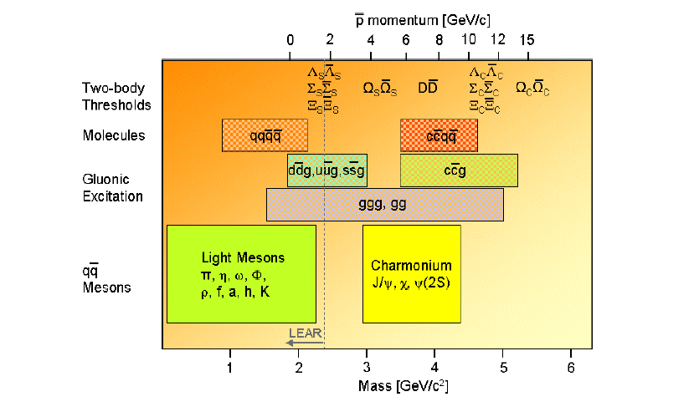
QCD Systems to be Studied in ‾PANDA

Slide 20
QCD Bound States
The study of QCD bound states is of fundamental importance for a
better, quantitative understanding of QCD. Particle spectra can be
computed within the framework of non-relativistic potential models,
effective field theories and Lattice QCD. Precision measurements are
needed to distinguish between the different approaches and identify the
relevant degrees of freedom.
Charmonium Spectroscopy
Gluonic Excitations
Heavy-Light Systems
Strange and Charmed Baryons

Slide 21
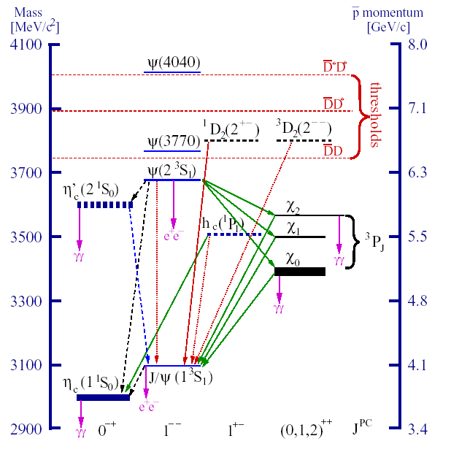
Charmonium Spectroscopy
Main issues
All 8 states below threshold observed,
some (precision) measurements still
missing:
  h_{c} (e.g. width)
  η_{c}(1S)
  η_{c}(2S) (small splitting from ψ(2S)
The region above open charm threshold
must be explored in great detail:
  find missing D states
  explain newly discovered states
  (c‾c or other)
  confirm vector states seen in R

Slide 22
Charmonium at ‾PANDA
At 2×10³²cm⁻²s⁻¹ accumulate 8 pb⁻¹/day (assuming 50 % overall efficiency) ⇒ 10⁴÷10⁷ (c‾c) states/day.
Total integrated luminosity 1.5 fb⁻¹/year (at 2×10³²cm⁻²s⁻¹, assuming 6 months/year data taking).
Improvements with respect to Fermilab E760/E835:
  Up to ten times higher instantaneous luminosity.
  Better beam momentum resolution Δp/p = 10⁻⁵ (GSI) vs 2×10⁻⁴ (FNAL)
  Better detector (higher angular coverage, magnetic field, ability to detect hadronic decay modes).
Fine scans to measure masses to ≈ 100 KeV, widths to ≈ 10 %.
Explore entire region below and above open charm threshold.
Decay channels
  J/ψ+X , J/ψ → e⁺e⁻, J/ψ → μ⁺μ⁻
  γγ
  hadrons
  D‾D
Precision measurement of known states
Find missing states (e.g. D states)
Understand newly discovered states
Get a complete picture of the dynamics of
the ‾cc system.

Slide 23
Hybrids and Glueballs
The QCD spectrum is much richer than that of the quark model as the
gluons can also act as hadron components.
Glueballs states of pure glue
Hybrids q‾qg
Spin-exotic quantum numbers J^{PC} are
powerful signature of gluonic hadrons.
In the light meson spectrum exotic
states overlap with conventional states.
In the c‾c meson spectrum the density
of states is lower and the exotics can
be resolved unambiguously.
π₁(1400) and π₁(1600) with J^{PC}=1⁻⁺.
π₁(2000) and h₂(1950)
Narrow state at 1500 MeV/c² seen by
Crystal Barrel best candidate for glueball ground state (J^{PC}=0⁺⁺).
m²(ηπ⁰) [GeV²/c⁴]
m²(ηπ⁻) [GeV²/c⁴]

Slide 24
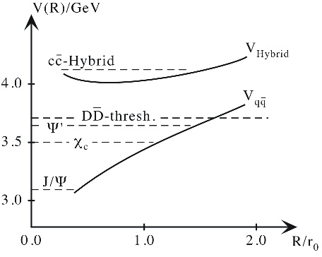
Charmonium Hybrids
Bag model, flux tube model constituent gluon model and LQCD.
Three of the lowest lying c‾c hybrids have exotic J^{PC} (0⁺⁻,1⁻⁺,2⁺⁻)
⇒ no mixing with nearby c‾c states
Mass 4.2 – 4.5 GeV/c².
Charmonium hybrids expected to be much narrower than light hybrids (open charm decays forbidden or suppressed below DD** threshold).
Cross sections for formation and production of charmonium hybrids similar to normal c‾c states
(~ 100 – 150 pb).
Excited gluon flux
Π
CLEO
Σ
One-gluon exchange

Slide 25
Charmonium Hybrids
Gluon rich process creates
gluonic excitation in a direct way
  ccbar requires the quarks to annihilate (no rearrangement)
  yield comparable to
  charmonium production
2 complementary techniques
  Production
  (Fixed-Momentum)
  Formation
  (Broad- and Fine-Scans)
Momentum range for a survey
  p → ~15 GeV

Slide 26
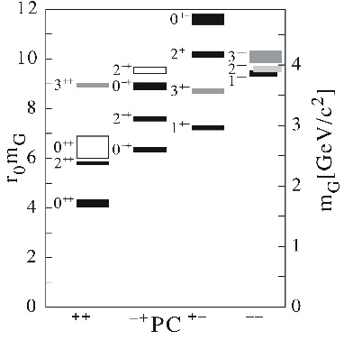
Glueballs
Detailed predictions of mass spectrum
from quenched LQCD.
  Width of ground state ∼ 100 MeV
  Several states predicted below 5 GeV/c², some exotic (oddballs)
  Exotic heavy glueballs:
    m(0⁺⁻) = 4140(50)(200) MeV
    m(2⁺⁻) = 4740(70)(230) MeV
    predicted narrow width
Can be either formed directly or
produced in ‾pp annihilation.
Some predicted decay modes φφ, φη,
J/ψη, J/ψφ ...
Morningstar und Peardon, PRD60 (1999) 034509
Morningstar und Peardon, PRD56 (1997) 4043
The detection of non-exotic glueballs is not trivial, as these states mix with
the nearby q‾q states with the same quantum numbers, thus modifying the
expected decay pattern.

Slide 27
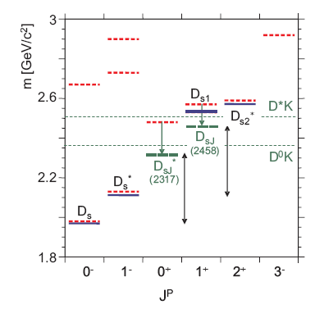
Open Charm Physics
New narrow states D_{sJ} recently discovered at B factories do not fit theoretical calculations.
At full luminosity at ‾p momenta larger than 6.4 GeV/c PANDA will produce large numbers of D‾D pairs.
Despite small signal/background ratio (5×10⁻⁶) background situation favourable because of limited phase space for additional hadrons in the same process.

Slide 28
Baryon Spectroscopy
In ‾pp collisions a large fraction of the inelastic cross section is associated to channels with a baryon-antibaryon pair in the final state.
This opens up the opportunity for a comprehensive baryon spectroscopy program at PANDA.
Example: ‾pp →‾ΞΞ cross section up to 2 μb, expect sizeable population of excited Ξ states. In PANDA these excited states can be studied by analyzing their various decay modes e.g. Ξπ, Ξππ, Λ‾K, Σ‾K, Ξη ...
Ω baryons can also be studied, but cross sections lower by approximately two orders of magnitude.

Slide 29
Non-perturbative QCD Dynamics
In the quark picture hyperon pair production either involves the creation
of a quark-antiquark pair or the knock out of such pairs out of the
nucleon sea. Hence, the creation mechanism of quark-antiquark pairs
and their arrangement to hadrons can be studied by measuring the
reactions of the type ‾pp → ‾YY, where Y denotes a hyperon. By
comparing several reactions involving different quark flavours the OZI
rule, and its possible violation, can be tested for different levels of
disconnected quark-line diagrams separately.

Slide 30
Hadrons in Nuclear Matter
Partial restoration of chiral symmetry in
nuclear matter
  Light quarks are sensitive to quark condensate
Evidence for mass changes of pions and kaons has been deduced previously:
  deeply bound pionic atoms
  (anti)kaon yield and phase space distribution
(c‾c) states are sensitive to gluon condensate
  small (5-10 MeV/c²) in medium modifications for low-lying (c‾c) (J/ψ, η_{c})
  significant mass shifts for excited states:
  40, 100, 140 MeV/c² for χ_{cJ}, ψ’, ψ(3770) resp.
D mesons are the QCD analog of the H-atom.
  chiral symmetry to be studied on a single light quark
  theoretical calculations disagree in size and sign of mass shift (50 MeV/c² attractive – 160 MeV/c² repulsive)
vacuum
nuclear medium
π⁻
π
25 MeV
π⁺
K⁺
K
100 MeV
K⁻
D
D⁻
50 MeV
D⁺
Hayaski, PLB 487 (2000) 96
Morath, Lee, Weise, priv. Comm.

Slide 31
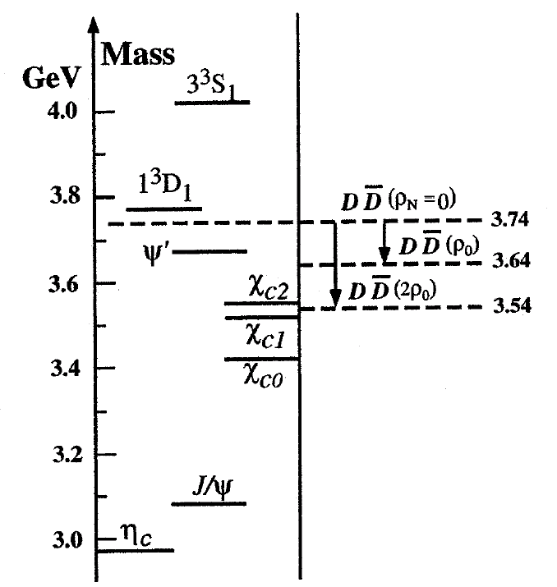
Charmonium in Nuclei
Measure J/ψ and D production cross section in ‾p annihilation on a series of nuclear targets.
J/ψ nucleus dissociation cross section
Lowering of the D⁺D⁻ mass would allow charmonium states to decay into this channel, thus resulting in a dramatic increase of width
  ψ(1D) 20 MeV → 40 MeV
    ψ(2S) .28 MeV → 2.7 MeV
⇒Study relative changes of yield and width of the charmonium states.
In medium mass reconstructed from dilepton (c‾c) or hadronic decays (D)

Slide 32
Hypernuclear Physics
Hypernuclei, systems where one (or more) nucleon is replaced by one
(or more) hyperon(s) (Y), allow access to a whole set of nuclear states
containing an extra degree of freedom: strangeness.
Probe of nuclear structure and its possible modifications due to the hyperon.
Test and define shell model parameters.
Description in term of quantum field theories and EFT.
Study of the YN and YY forces (single and double hypernuclei).
Weak decays (Λ→πN suppressed, but ΛN→NN and ΛΛ→NN allowed ⇒ four-baryon weak interaction)
Hyperatoms
Experimentally: in 50 years of study 35 single, 6 double hypernuclei established

Slide 33
Production of Double Hypernuclei
Kaons
2.
Slowing down and capture
of Ξ⁻ in
secondary target nucleus
_
trigger
_
Ξ
p
3 GeV/c
Ξ⁻ capture:
Ξ⁻ p → ΛΛ + 28 MeV
Ξ⁻
Ξ⁻(dss) p(uud) → Λ(uds) Λ(uds)
γ
1.
Hyperon-
antihyperon
production
at threshold
Λ
Λ
γ
+28MeV
3.
γ-spectroscopy with Ge-detectors

Slide 34
Nucleon Structure Using
Electromagnetic Processes
The electromagnetic form factors of the proton in the time-like region can be extracted from the cross section for the process:
‾pp → e⁺e⁻
  Moduli of form factors using angular distribution
  Extend q² range
  Improve accuracy of measurement
Hard Scattering Processes (‾pp → γγ)
(test of factorization)
Transverse parton distribution functions in Drell-Yan production.

Slide 35
Physics Performance

Slide 36
Monte Carlo Simulations
Event generators with accurate decay models for the individual physics channels as well as for the relevant background channels (e.g. Dual Parton Model, UrQMD, ...).
Particle tracking through the complete ‾PANDA detector by using the GEANT4 transport code.
Digitization which models the signals of the individual detectors and their processing in the frontend electronics.
Reconstruction and identification of charged and neutral particles, providing lists of particle candidates for the physics analysis.
Kalman Filter for charged particle tracking.
High-level analysis tools which allow to make use of vertex and kinematical fits and to reconstruct decay trees.

Slide 37
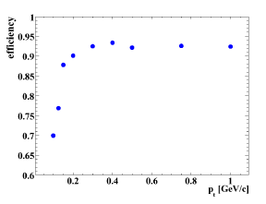
Monte Carlo Performance
Energy thresholds in the Calorimeters
track reconstruction
efficiency at 60⁰.
 | Central (PbWO₄) | Forward (Shashlik)
single crystal | 3 MeV | 8 MeV
Cluster | 10 MeV | 15 MeV
Max | 20 MeV | 10 MeV

Slide 38
Particle ID
Particle ID:
dE/dx
  MVD,STT
Calorimeter information
DIRC counter
Muon detector
 | VeryLoose | Loose | Tight | VeryTight
e | 20 % | 85 % | 99 % | 99.8 %
μ | 20 % | 45 % | 70 % | 85 %
π | 20 % | 30 % | 55 % | 70 %
K | 20 % | 30 % | 55 % | 70 %
p | 20 % | 30 % | 55 % | 70 %
K VeryTight Efficiency and contamination
e VeryTight Efficiency and contamination

Slide 39
Charmonium Decays to J/ψ
‾pp → ‾cc → J/ψ + X, J/ψ → e⁺e⁻, (μ⁺μ⁻)
Tagged by lepton pair with invariant mass equal to M(J/ψ ).
Main background source: misidentified π⁺π⁻ pairs.
Electron analysis:
  two electron candidates: one Loose one Tight.
  kinematic fit to J/ψ hypothesis with vertex constraint.
  P(fit) > 0.001.
Additional cuts for exclusive
final states:
  ‾pp → J/ψπ⁺π⁻
  ‾pp → J/ψπ⁰π⁰
  ‾pp → χ_{c1,c2}γ→J/ψγγ
  ‾pp → J/ψγ
  ‾pp → J/ψη

Slide 40
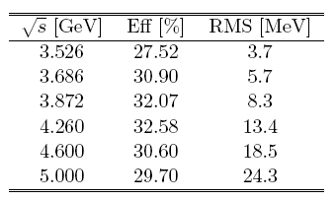
‾pp → J/ψ π⁺π⁻ → e⁺e⁻ π⁺π⁻
J/ψ selection
two pion candidates (VeryLoose)
vertex fit to J/ψπ⁺π⁻
Main background process:
‾pp → π⁺ π⁻ π⁺ π⁻
Estimated background
cross section < 10 pb

Slide 41
‾pp → J/ψ π⁰π⁰ → e⁺e⁻ π⁰π⁰
Main background process:
‾pp → π⁺ π⁻ π⁰ π⁰
Estimated S/B 25

Slide 42

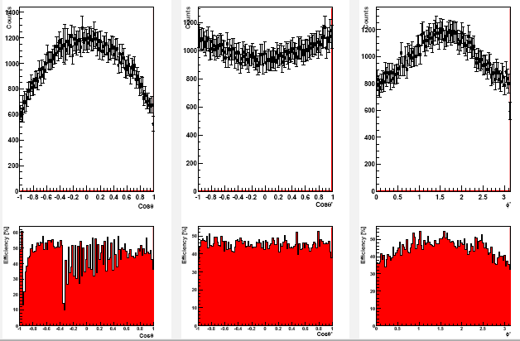
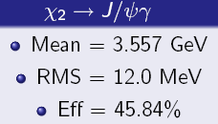

Slide 43
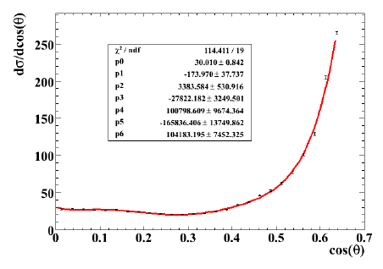
h_{c} → η_{c}γ → 3γ
Pair 2 γs to form η_{c} mass (γ₁γ₂).
4C fit to h_{c} candidate.
N_{γ}=3.
CL (4C fit) > 10⁻⁴:
0.4 GeV < E_{γ} < 0.6 GeV.
|cosθ| < 0.6 .
M(γ₁γ₃),M(γ₂γ₃) > 1 GeV.

Slide 44
h_{c} → η_{c}γ → 3γ
In high-luminosity mode
(L = 2×10³²cm⁻²s⁻¹) expect
20 signal events/day.

Slide 45
h_{c} → η_{c}γ → φφγ → 4Kγ
φ candidates: K pairs in
appropriate mass window.
4C fit to beam-momentum
CL (4C) > 0.05
η_{c} invariant mass [2.9, 3.06] GeV .
E_{γ} [0.4, 0.6] GeV
φ mass [0.99, 1.05] GeV
no π⁰ in event
σ∼345 nb
σ∼60 nb
σ< 3 nb
σ∼30 μb
DPM estimate
In high-luminosity mode
(L = 2×10³²cm⁻²s⁻¹) expect
92 signal events/day.

Slide 46

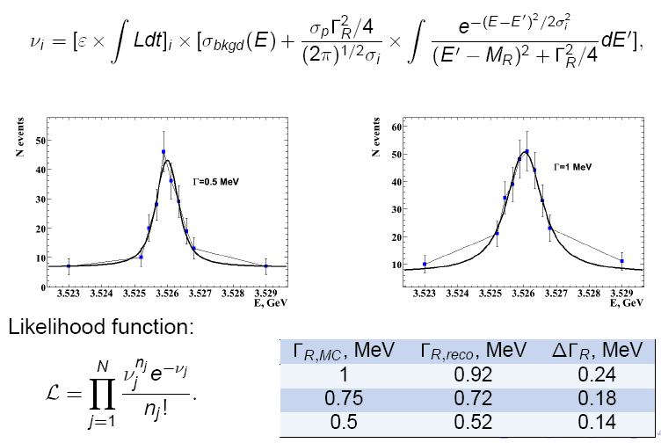
Sensitivity to h_{c} Width Measurement
signal efficiency ε=0.24
each point corresponds
to 5 days of data taking

Slide 47
‾pp →‾DD
Charmonium states above open charm threshold
Charm spectroscopy
Search for hybrids decaying to ‾DD
Rare D decays (and CP violation)
Main issue: separation of charm signal from large hadronic background
Cross section estimates: Breit-Wigner, with ‾pp BR scaled from ψ

Slide 48
Event Selection
Loose mass window cut before vertex fitting Δm = ±0.3 GeV/c².
Minimum 6 charged tracks.
All decay particles must form a common vertex.
4C kinematic fit to constrain beam energy and momentum:
CL > 5×10⁻².
K/π selection Loose (LH > 0.3).
Only one combination per event.

Slide 49
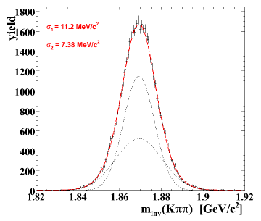
Signal Efficiency
after 5C fit (D⁰ mass constraint)
overall efficiency
ε(signal) = 40 %
overall efficiency ε(signal) = 27.4 % (4C fit)
overall efficiency ε(signal) = 24.0 % (5C fit)

Slide 50
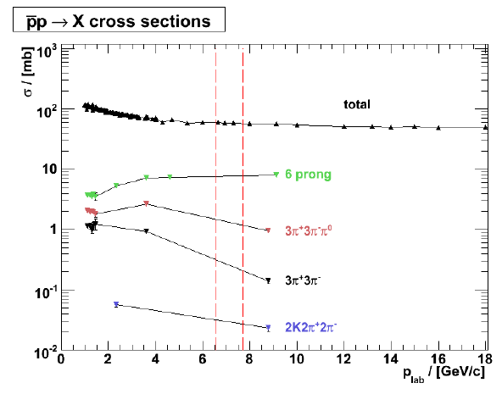
Background Studies

Slide 51
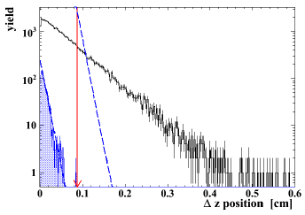
2K4π Background
Two-dimensional cut on
D± momentum reduces
2K4π background by
factor 26.
p_{T} vs p_{L} signal
p_{T} vs p_{L} 2K4π background
Cut on Δz of D± decay vertex:
Δz > 0.088 cm S/B = 1 ε(signal) = 7.8 %
For the D^{*+}D^{*-} channel the analysis gives
S/B = 1/3. An additional cut on the Δz of
the D⁰ decay vertex gives S/B=3/2, bringing
the signal efficiency from 24 % to 12.7 %.

Slide 52
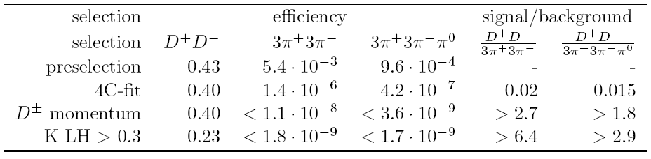
Non Strange Background

Slide 53
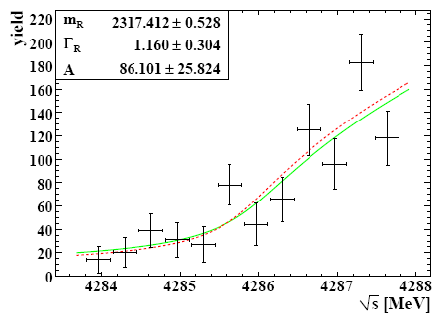
Measurement of the D*_{s0}(2317) Width
The production cross section around threshold depends on the total width.
input
output

Slide 54
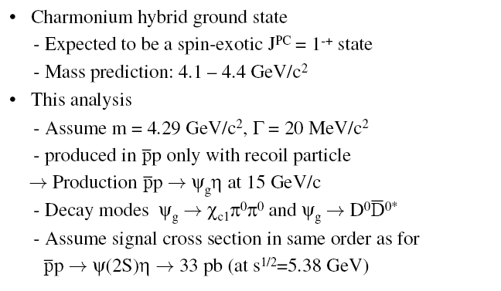
Charmonium Hybrids Simulation

Slide 56
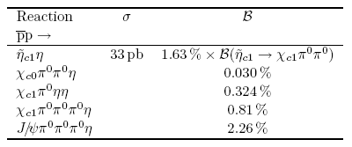
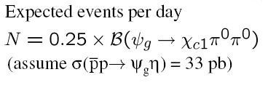
Reconstruction efficiency
6.83 % for J/ψ → e⁺e⁻

Slide 57
χ_{c1}π⁰π⁰ background studies
110-10100R

Slide 58
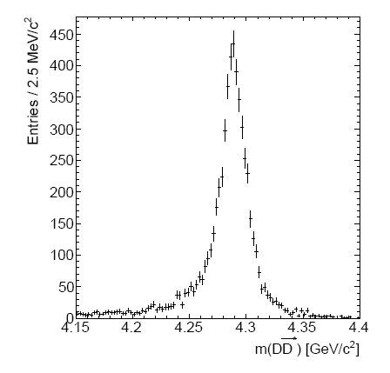

D⁰‾D^{0*}η Decay mode
Signal reconstruction
efficiency 5.17 %
background rejection > 1.6×10⁵

Slide 59
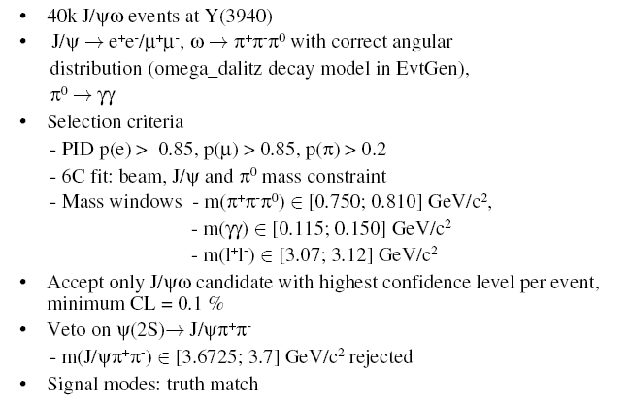
Y(3940) →J/ψω → e⁺e⁻π⁺π⁻π⁰

Slide 60
Reconstruction efficiency
14.7 % for J/ψ → e⁺e⁻
132

Slide 61
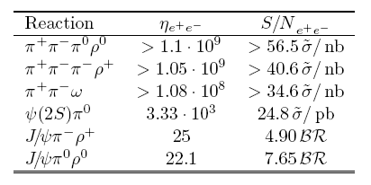
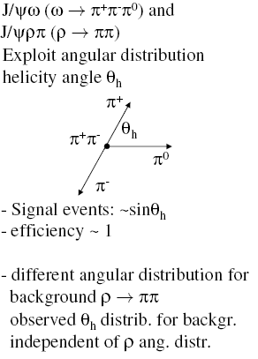
J/ψω background studies

Slide 62
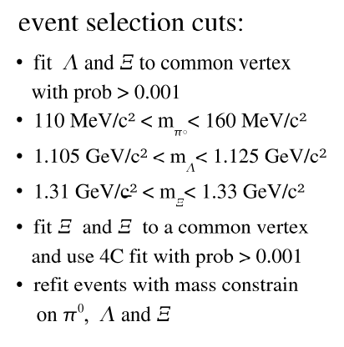

Slide 63
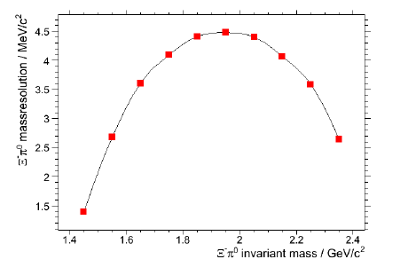

Slide 64
‾pp →‾ΛΛ
Antihyperon-hyperon production in antiproton-proton collisions gives
access to spin degrees of freedom.
∼10⁶ MC events analysed at
1.64 GeV/c, 4 GeV/c, 15 GeV/c
dσ/dΩ experimental input
Polarisation: sin2θ_{CM}

Slide 65
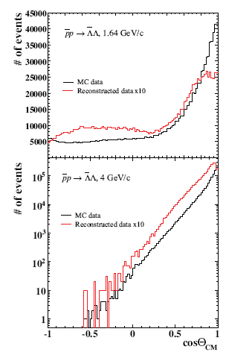
Angular Distributions
0.24
0.14

Slide 66
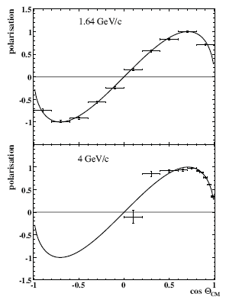
Polarisations

Slide 67
Backgrounds and Yields

Slide 68
‾pA → J/ψX

Slide 69
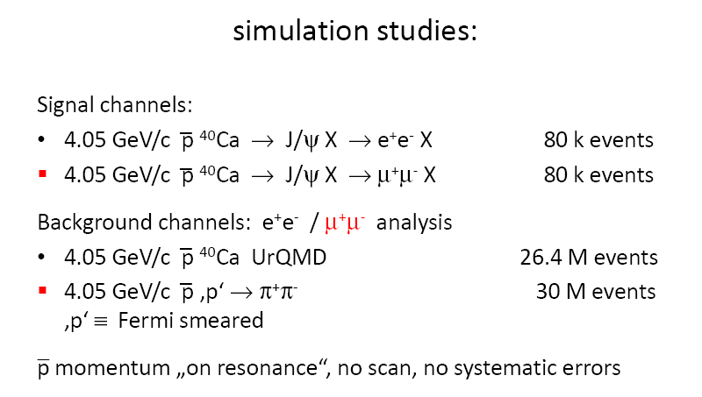

Slide 70
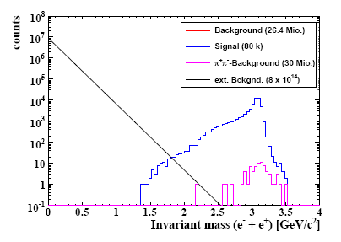
Required rejection factor of the
order of 10⁶ achieved !!!

Slide 71
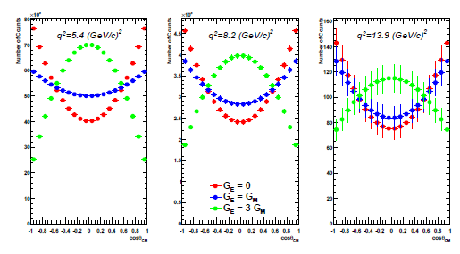
Proton Timelike Form Factors
The PANDA experiment will determine the moduli of the proton form factors in
the time-like region by measuring the angular distribution of the process
‾pp → e⁺e⁻
in a q² range from 5 (GeV/c)² up tp 14 (GeV/c)² . A determination of the form
factor up to a q² of 22 (GeV/c)² will be possible by measuring the total cross
section.

Slide 72
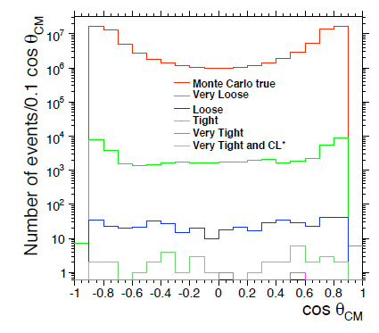
Background Rejection
Very large background coming mainly from two-body hadronic final states, like
‾pp → π⁺π⁻, with a cross section up to 10⁶ times larger.
Background rejection done with particle identification (using information from all
subdetectors) and kinematic fitting.
Monte Carlo simulations show that a
total rejection factor of the order
of 10¹⁰ is achieved.

Slide 73
Signal Efficiency

Slide 74
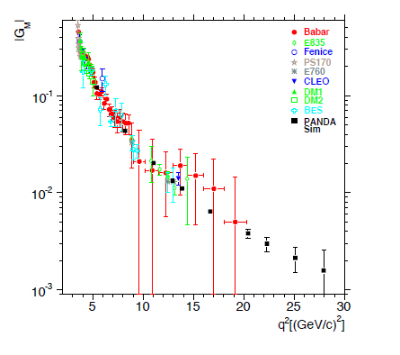
Impact of ‾PANDA data

Slide 75
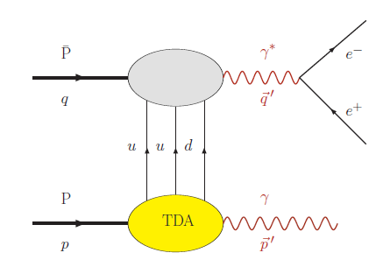
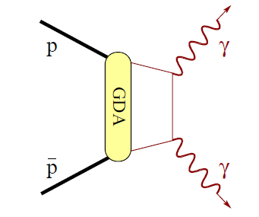
Other Timelike Processes in ‾PANDA
‾pp → γγ
‾pp → e⁺e⁻γ
Handbag approach
Test of Factorisation
Determine TDA
(Transition Distribution Amplitude)
Measure FF in unphysical region

Slide 76
Summary and Outlook
The HESR at the GSI FAIR facility will deliver‾p beams of unprecedented quality with
momenta up to 15 GeV/c (√s ≈ 5.5 GeV). This will allow ‾PANDA to carry out the following
measurements:
SPECTROSCOPY
High-resolution charmonium spectroscopy in formation experiments
Study of gluonic excitations (hybrids and glueballs) and other exotica (e.g. multiquark)
Study of hadrons in nuclear matter
Open charm physics
Hypernuclear physics
NUCLEON STRUCTURE
Proton Timelike Form Factors
Crossed-Channel Compton Scattering
Drell-Yan
The performance of the detector and the sensitivity to the various physics channels have
been estimated reliably by means of detailed Monte Carlo simulations:
Acceptance
Resolution
Signal/Background
The simulations show that the final states of interest can be detected with good efficiency
and that the background situation is under control.

