Slide 1

A logo for RD50
RD50
Phone meeting 31.5.2016
Michael Moll

Slide 2
RD50 logo
Please take an unbiased look at the logos
Take into account that these are partly draft proposal which might need fine tuning
In case several Logos are grouped, we will re-iterate to find the best out of the group at a later stage

Slide 3
RD50 logo competition
[1]
[2]
Comments:
Wafer photo to be exchanged with an RD50 wafer
Proprietary rights on Olympic Rings to be checked

Slide 4
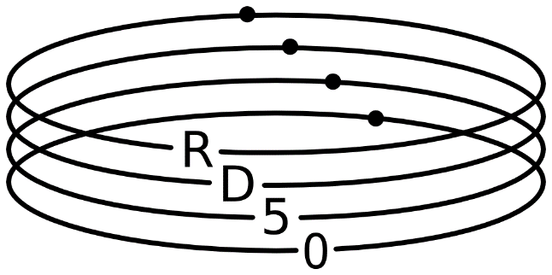

RD50 logo competition
[3]
[4]
[5]
[6]

Slide 5

RD50 logo competition
[7]

Slide 6
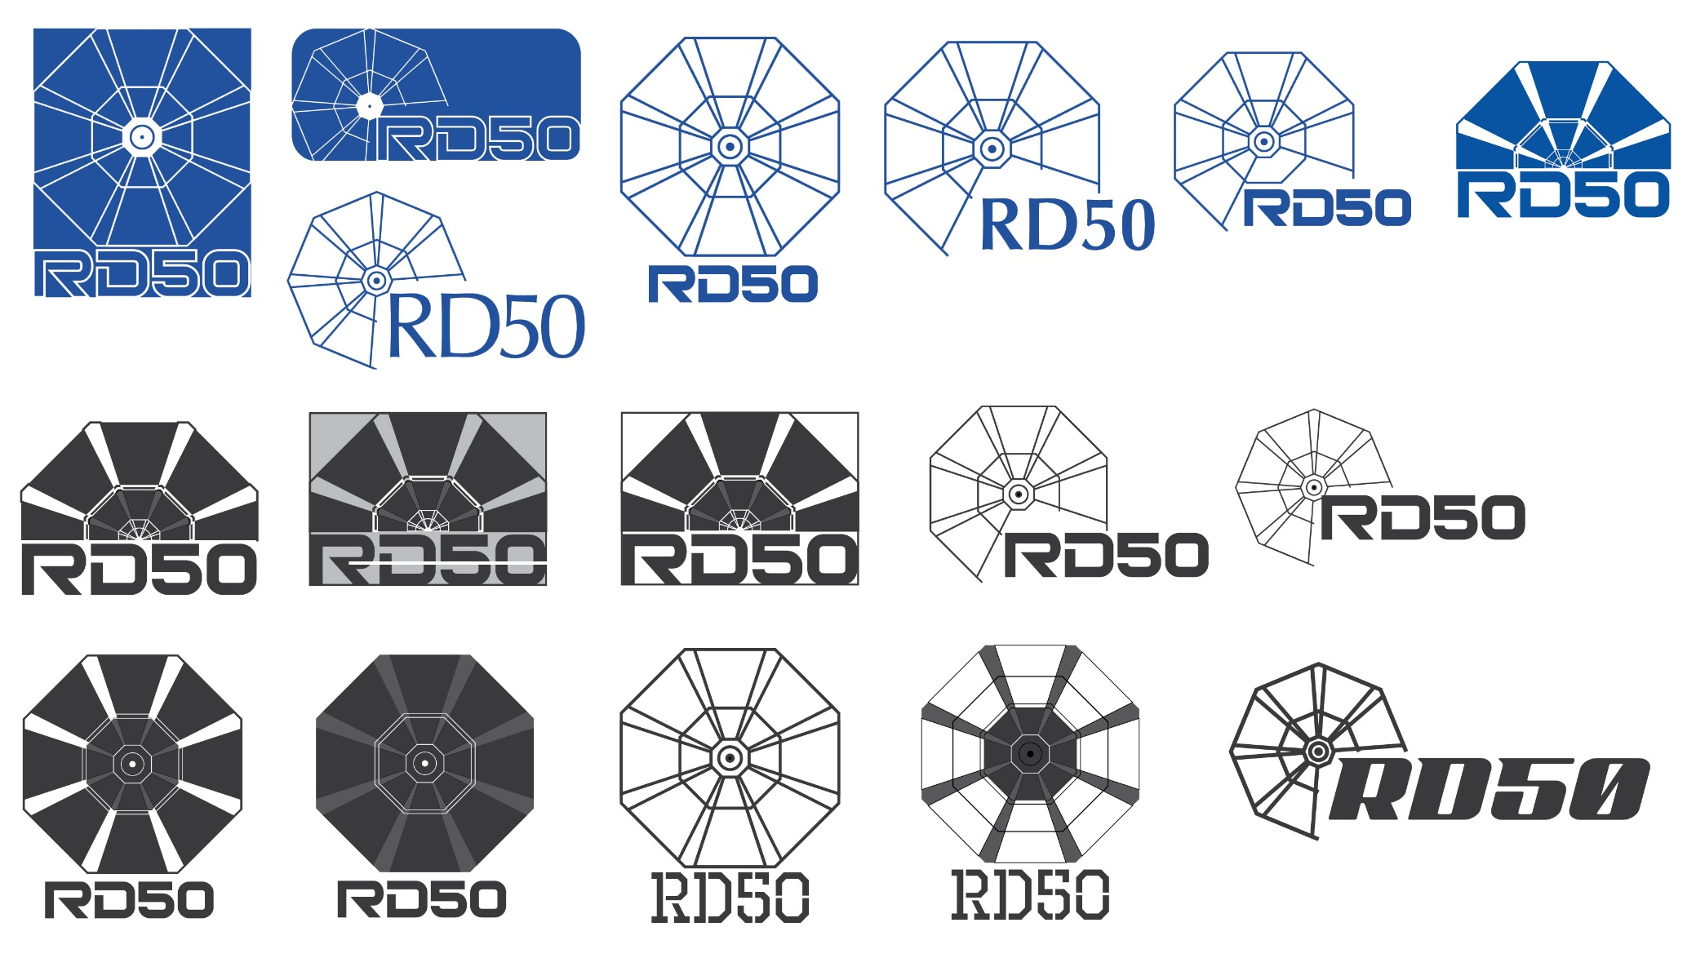
RD50 logo competition
[8]

Slide 7
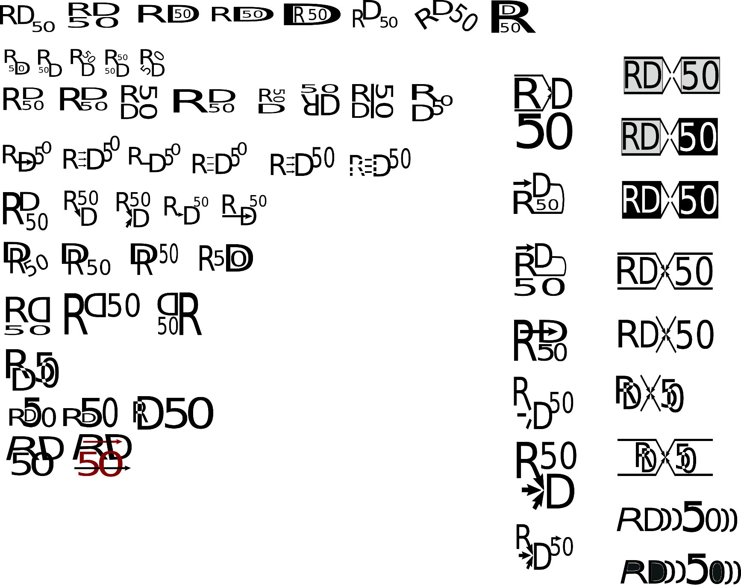
RD50 logo competition
[9]

Slide 8
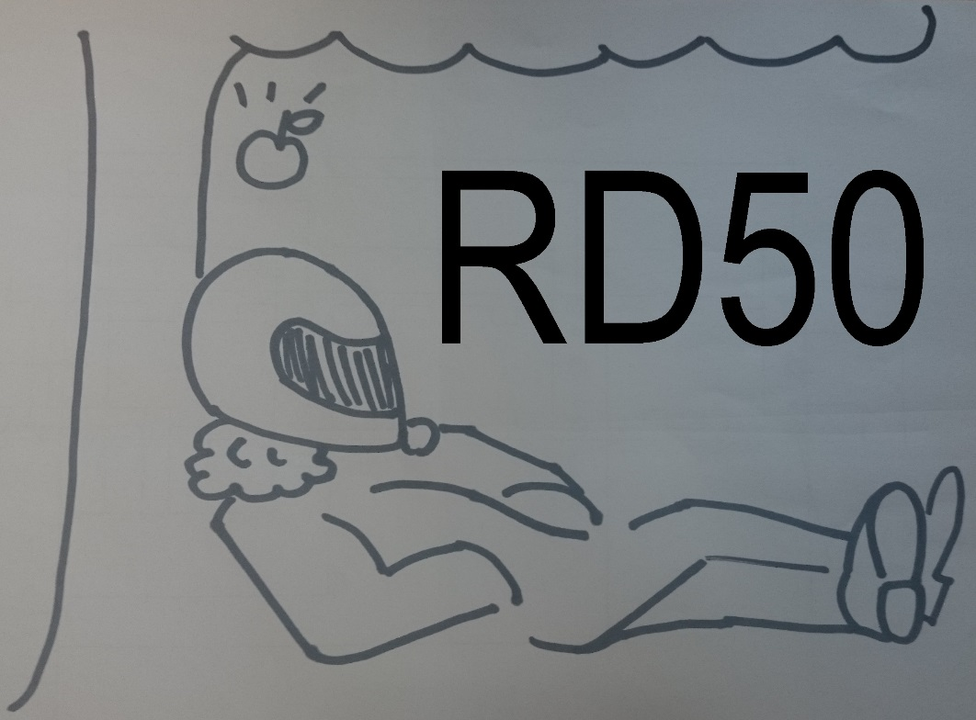
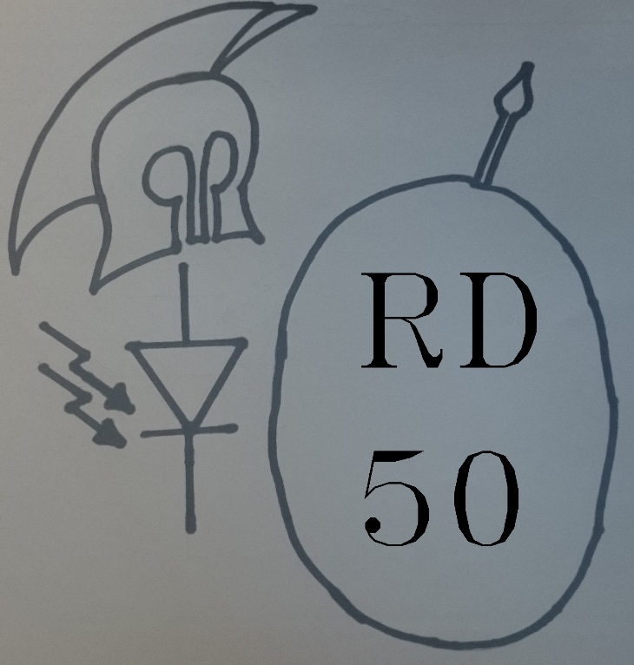
RD50 logo competition
[10] “Newton” and “Roman”

Slide 9
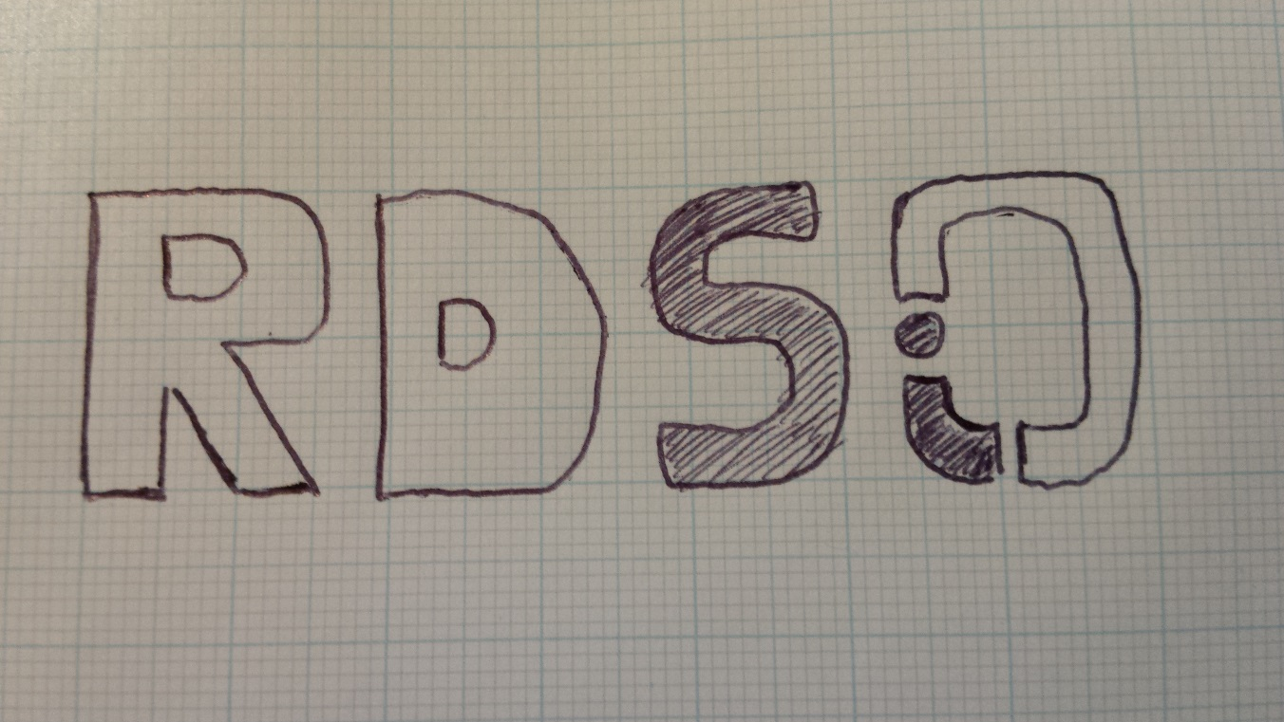
RD50 logo competition
[11] Si symbol included

