Slide 1
E-TCT measurements of irradiated HV-CMOS test structures
I. Mandić¹, G. Kramberger¹, V. Cindro¹, A. Gorišek¹, B. Hiti¹, M. Mikuž^{1,2}, M. Zavrtanik¹, et al.
¹Jožef Stefan Institute, Ljubljana, Slovenia
²Faculty of Mathematics and Physics, University of Ljubljana, Slovenia

Slide 2
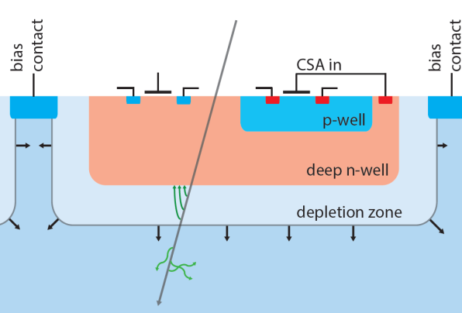
TCT measurements with HVCMOS structures made on different substrate
resistivities from different foundries:
AMS: 20 Ohm-cm
G. Krambergeret al, Charge collection studies in irradiated
HV-CMOS particle detectors, 2016 JINST11 P04007
I. Perić et al. , Active pixel sensors in high-voltage CMOS
technologies for ATLAS, 2012 JINST 7 C08002.
……..
X-FAB :100 Ohm-cm, Silicon On Insulator, SOI
S. Fernandez-Perez et al., Charge collection properties of a depleted monolithic active pixel
sensor using a HV-SOI process, 2016 JINST 11 C01063
T. Hemperek et al, A Monolithic Active Pixel Sensor for ionizing
radiation using a 180 nm HV-SOI process, NIMA 796(2015)8-12
LFoundry: 2000 Ohm-cm, with and without back plane processing
Piotr RYMASZEWSKI et al., Prototype Active Silicon Sensor in 150nm HR-CMOS
technology for ATLAS Inner Detector Upgrade, 2016 JINST 11 C02045
All devices are made on p-type substrates
These samples are being investigated as candidates for HV-CMOS detectors for trackers at HL-LHC
From: S. Fenandez-Perez, TWEPP 2015
electronics
Buried oxide

Slide 3
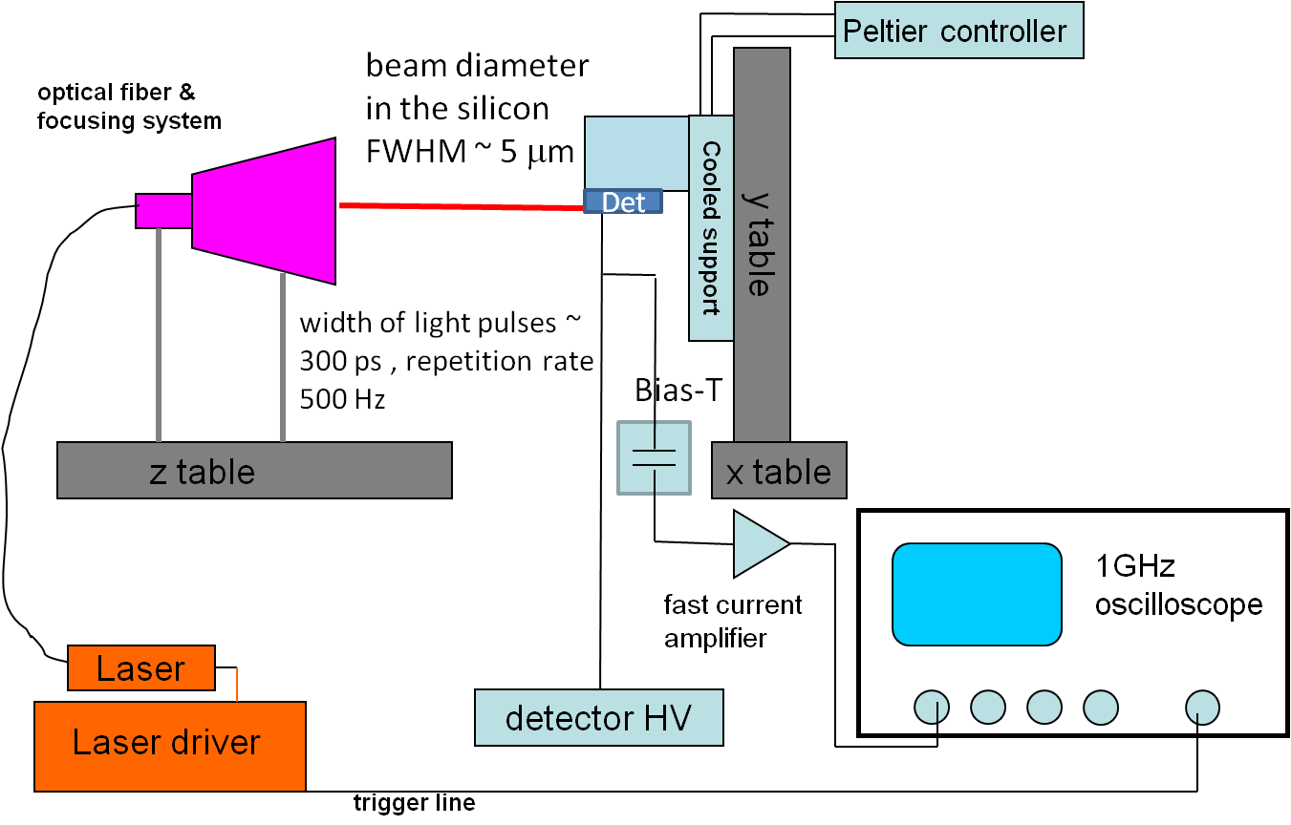
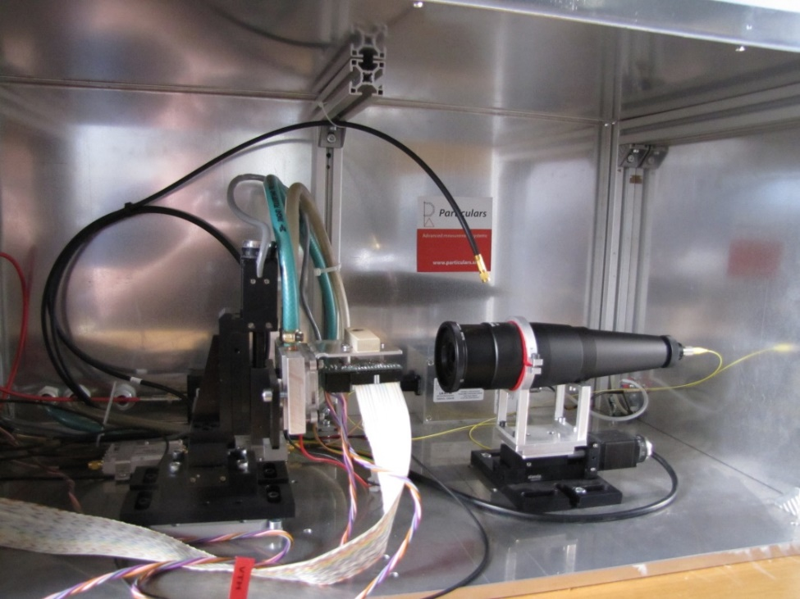
Edge TCT
( more details: www.particluars.si )
Detector connection scheme:
TCT measurements with passive pixels (no amplifier in the n-well)
➔ collecting electrode connected to amplifier
Substrate (p-type)
HV
scope
GND
y
Beam direction
x
Pixels (n-well)

Slide 4
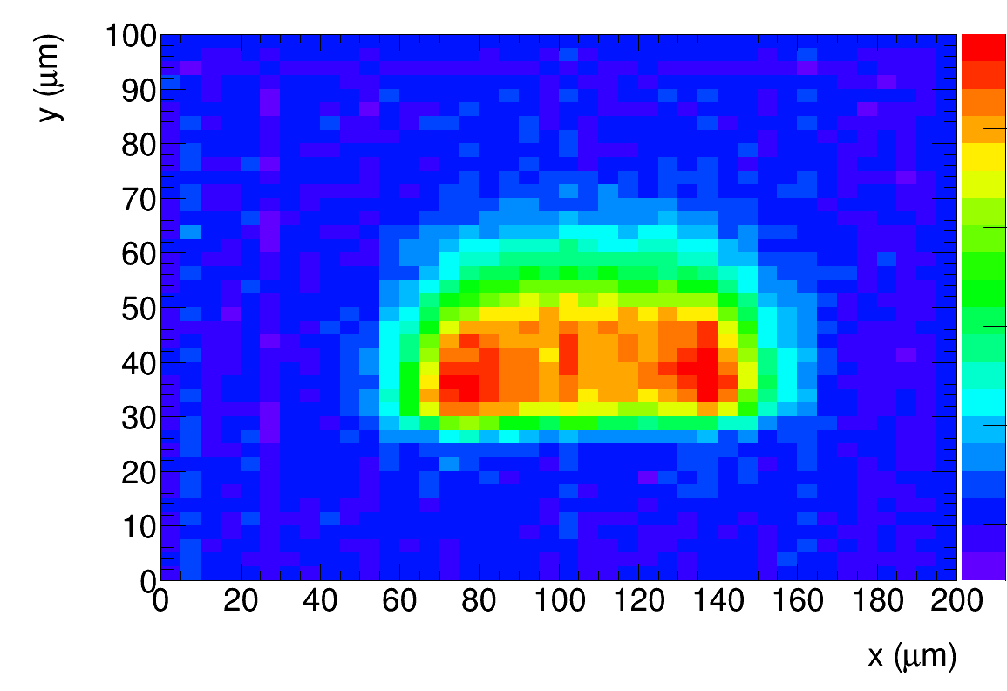
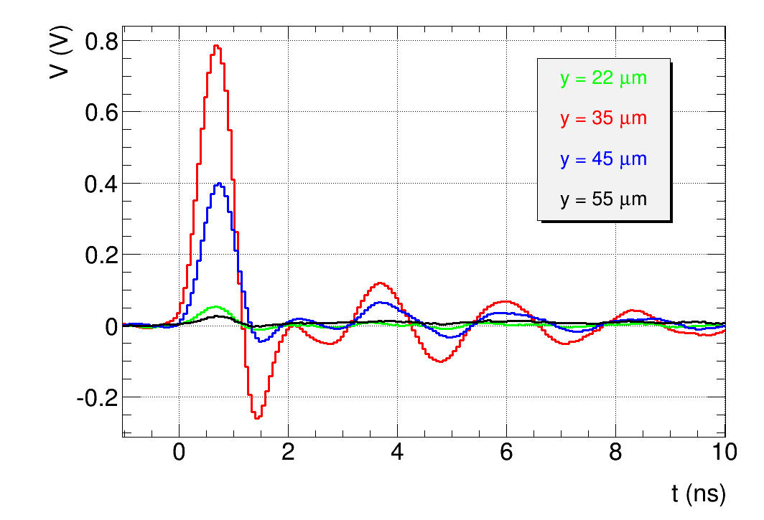
Edge-TCT
Scan across pixel:
2.5 µm steps in y
5 µm steps in x
CHESS1, not irraidated
Charge (25 ns), Bias = 120 V
Depth
Laser beam direction
Chip surface
Induced current after laser pulse
Charge:
integral of induced current pulse

Slide 5
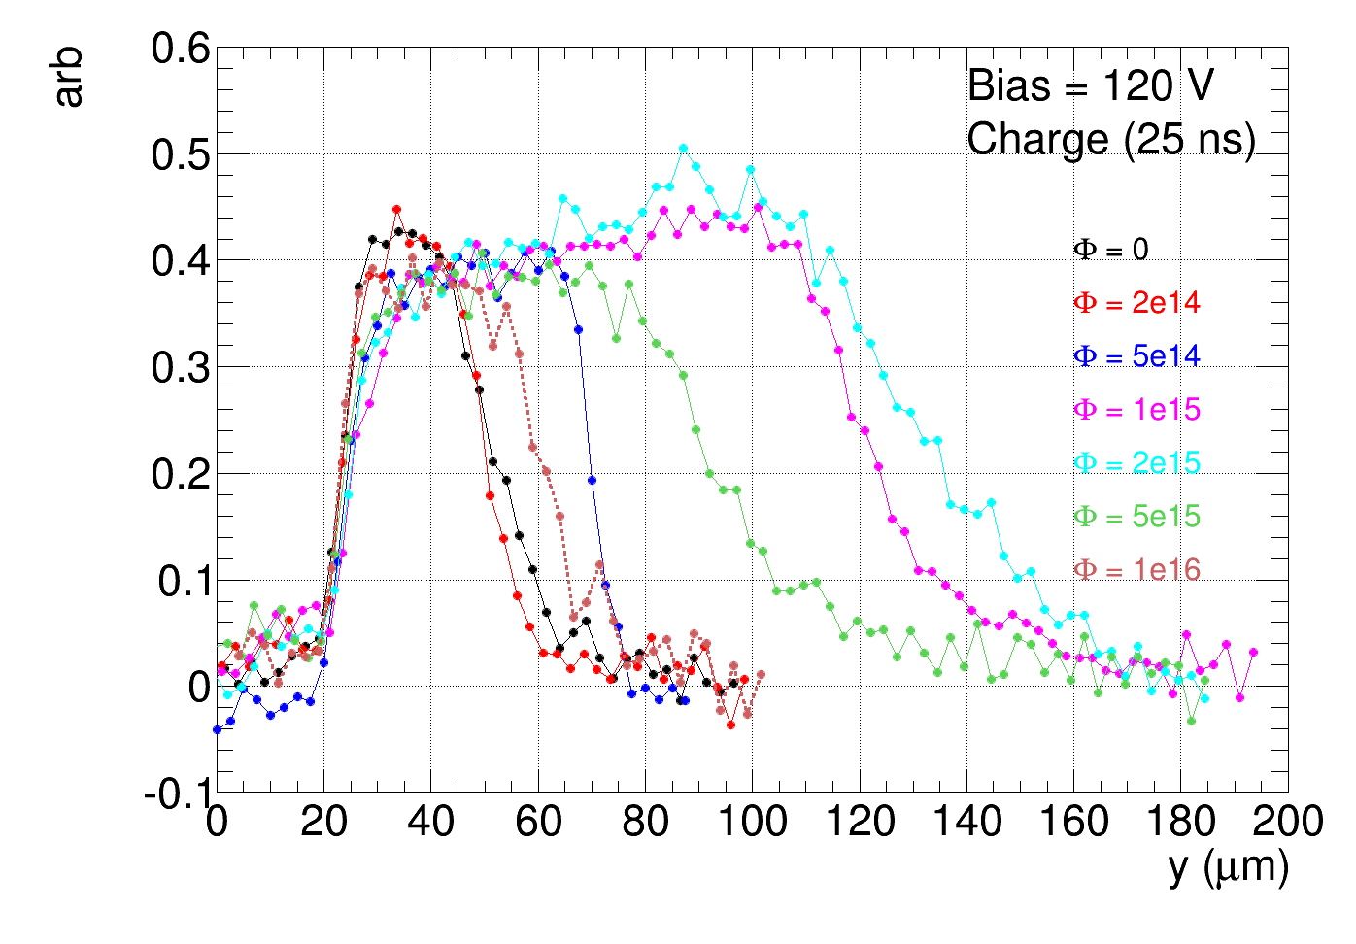
Charge collection profile, AMS (20 Ωcm)
Reactor neutrons, steps: 2e14, 5e14, 1e15, 2e15, 5e15, 1e16
Scan direction
Chip surface
Depth
charge collection width increases with fluence up to ~ 2e15 n/cm²
➔ initial acceptor removal
charge collection width falls with fluences above ~ 2e15 n/cm²
➔ initial acceptor removal finished, space charge concentration increases with irradiation
at 1e16 charge collection width still larger than before irradiation

Slide 6
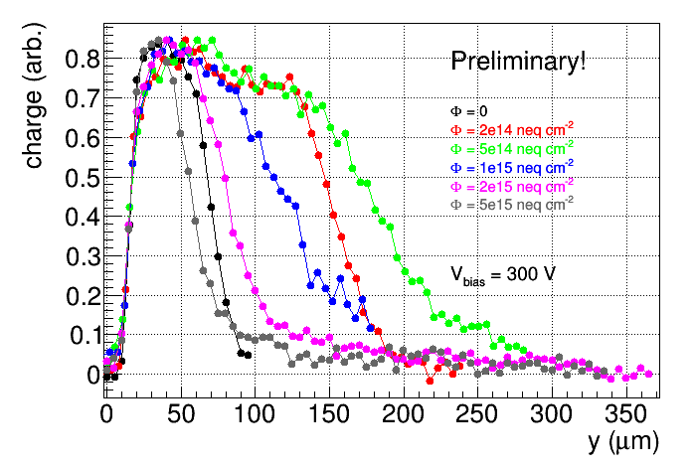
Charge collection profile, Xfab (100 Ωcm)
Reactor neutrons, fluence steps: 2e14, 5e14, 1e15, 2e15, 5e15
chip surface
large increase of charge collection region at lower fluence than AMS
at 5e15 charge collection region narrower than before irradiation, but still 40 µm at 300 V

Slide 7
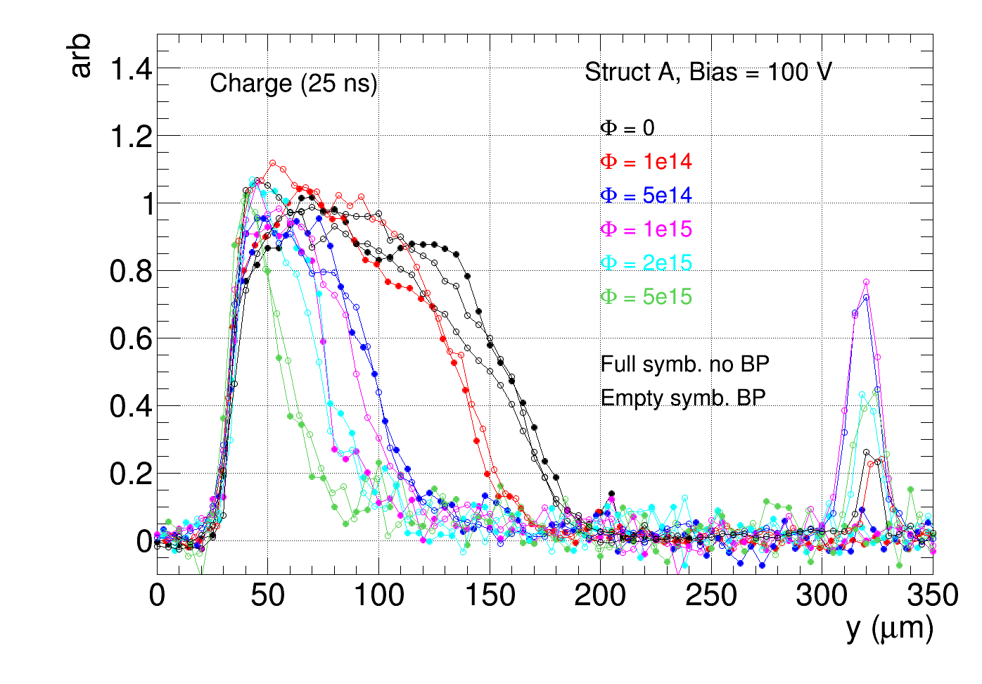
Charge collection profile, LFoundry (2000 Ωcm)
Reactor neutrons, fluence steps: 1e14, 5e14, 1e15, 2e15, 5e15
no increase of charge collection width after irradiation seen
no significant difference between samples with and without back plane (BP)

Slide 8
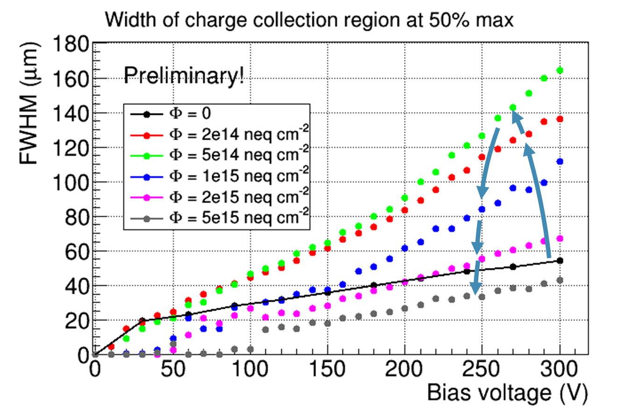
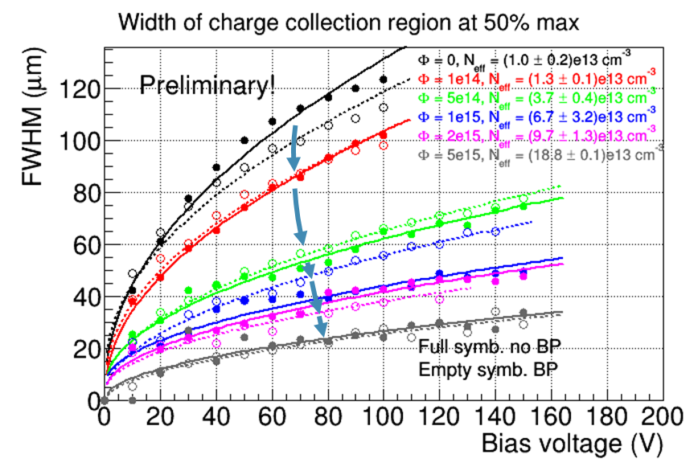
Charge profile width vs. bias voltage
Xfab
AMS chess1
Fit:
w₀ and N_{eff} free parameters
works for AMS and LFoundry
X-FAB: can’t fit with sqrt(V_{bias})
estimate N_{eff} from width at 300 V
AMS: large increase of width at low bias
Xfab: “knee” at low bias
0 width up to 100 V at 5e15
LFoundry

Slide 9
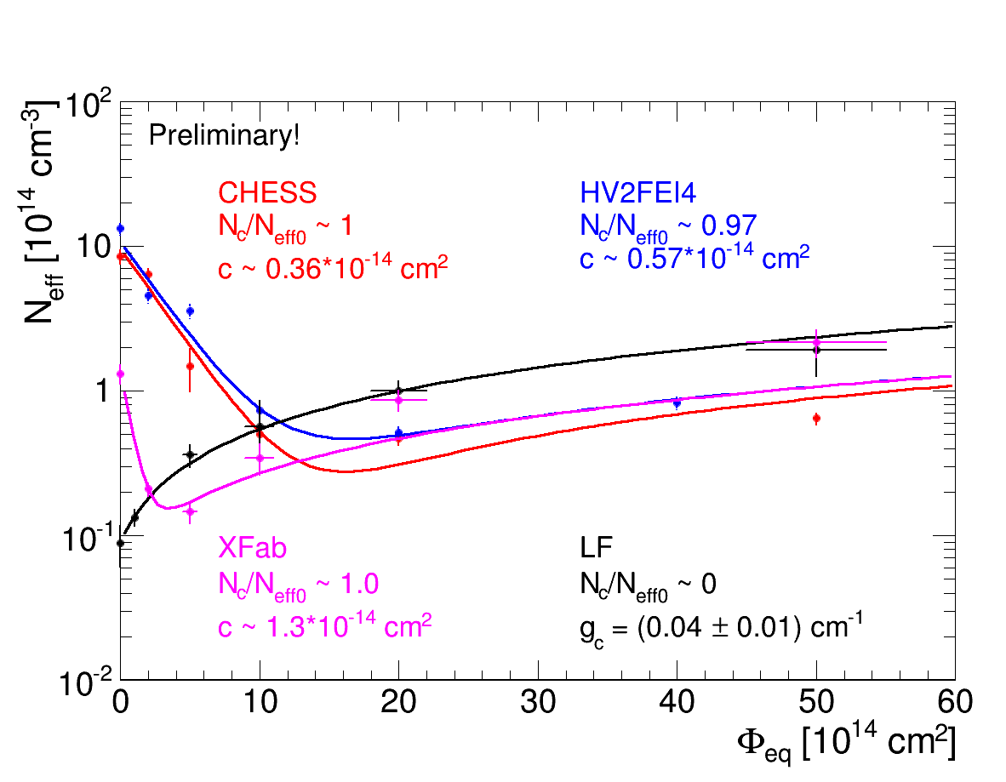
N_{ef} vs fluence
Radiation introduced deep
acceptors: g ~ 0.02 cm⁻¹
AMS and XFab:
acceptor removal
Fit:
N_{c},N_{eff0} and c free parameters, g fixed
LFoundry: no removal (N_{c} ~ 0), fit:
N_{eff0} and g free
AMS
(CHESS and HV2FEI4)
from:
G. Kramberger et al.,
2016 JINST11 P04007

Slide 10
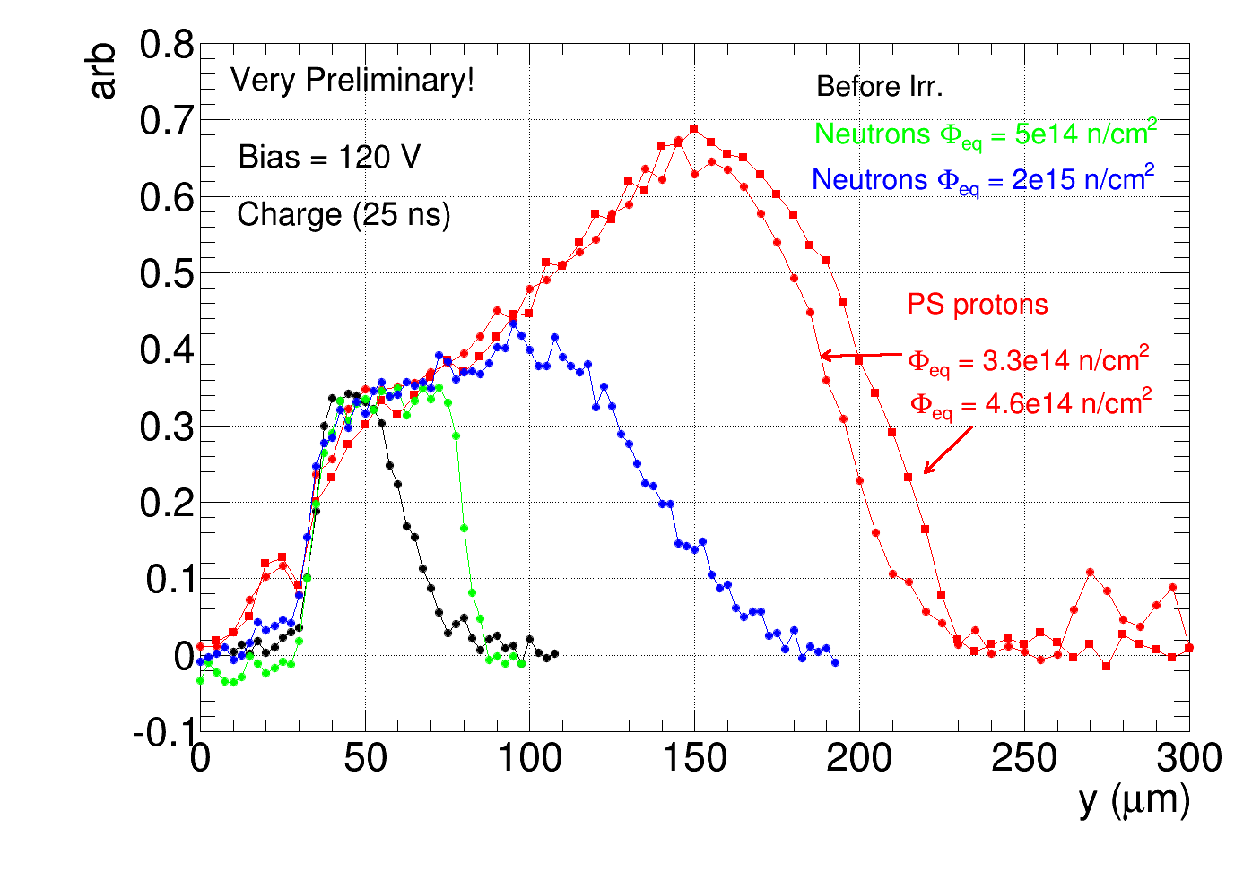
AMS CHESS1 chips (20 Ωcm) irradiated with PS protons
24 GeV protons, 1 MeV eq. fluences : 3.3e14 n/cm² and 4.6e14 n/cm²
➔ larger width than the largest after neutrons (at 2e15 n/cm²)

Slide 11
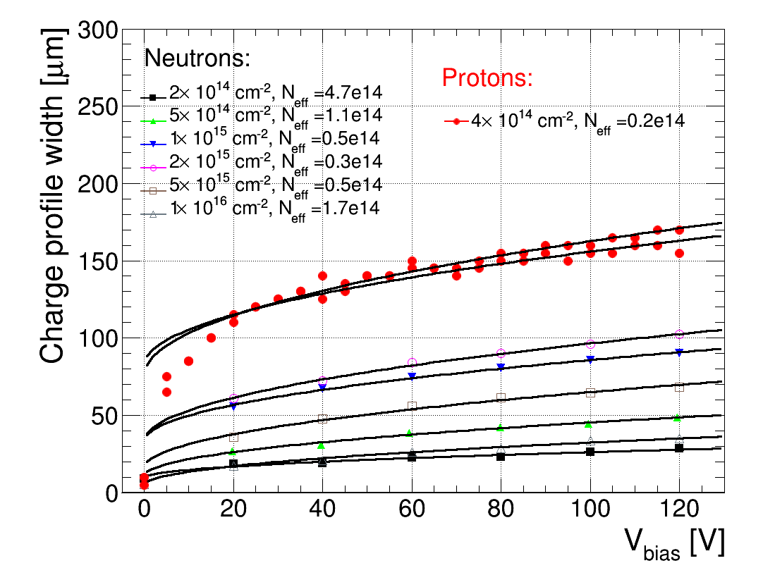
Irradiation with PS protons
fit compatible with N_{eff} ~ 2e13 cm⁻³
less than after ~2e15 n/cm² reactor neutrons (N_{eff} ~ 3e13 cm⁻³)
→ faster initial acceptor removal
→ large rise of profile width low bias
neutrons
Very fast rise at
low bias voltage

Slide 12
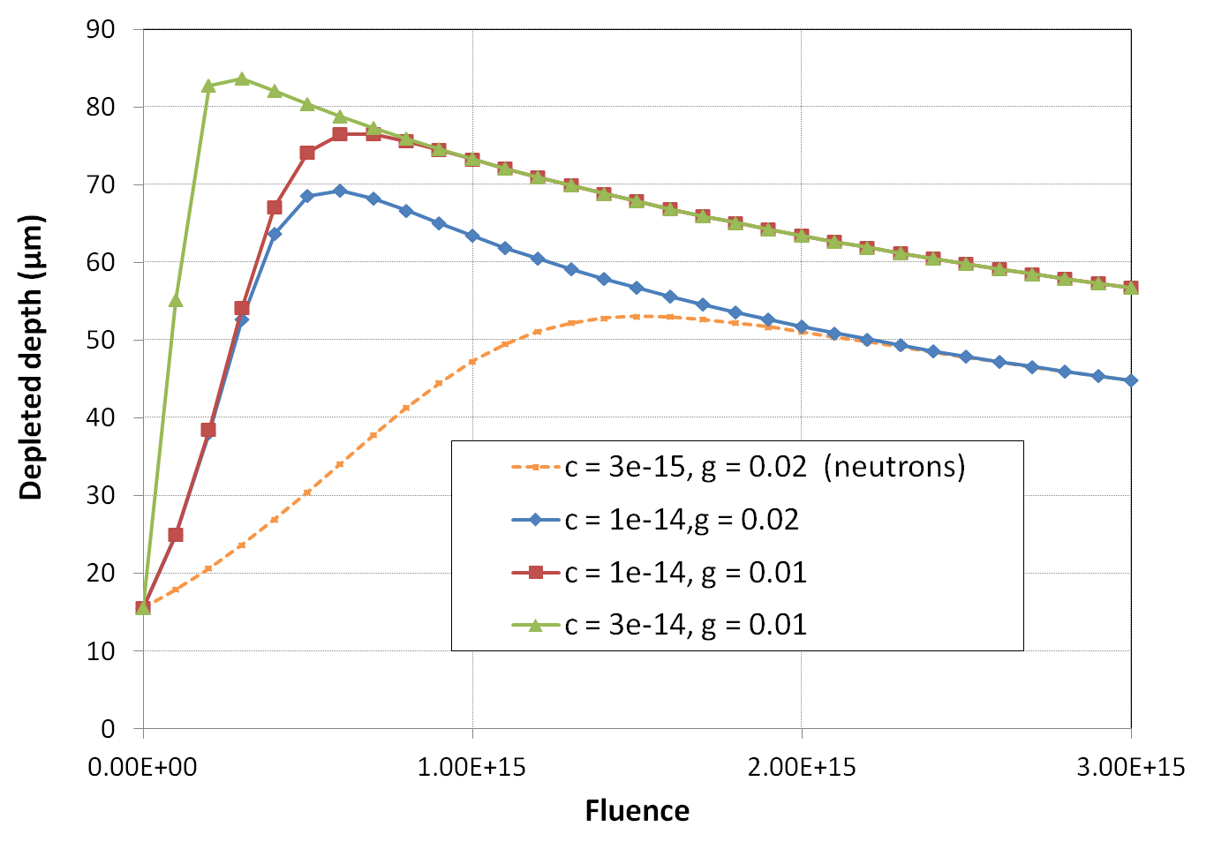
Irradiation with PS protons
Larger depleted depth (lower N_{eff}) at lower fluence than after neutron irradiation:
➔ larger acceptor removal constant c (and smaller g_{c} ) after proton irradiation
➔ measurements in agreement with M. Fernandez et al.
E-TCT with HVCMOSv3, (AMS 180 nm, 10 Ohm-cm)
irradiated with PS protons and neutrons:
M. Fernandez, RD50 meeting, December 2015:
Calculate depletion depth from N_{eff} using:
Bias = 120 V
This work,
protons 80 V
Neutrons: c = 3e-15 cm², g_{c} = 0.02cm⁻¹
Protons would fit c ~ 1e-14 cm² or larger

Slide 13
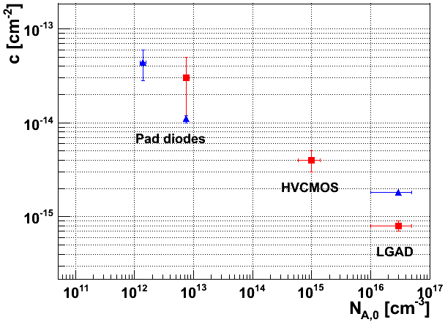
Acceptor removal
G. Kramberger et al, 10th Trento Meeting, Feb. 17-19, 2015
Blue marker – charged hadron irradiated
Red marker – neutron irradiated
X-FAB, neutrons
c [cm²]
AMS, PS protons
AMS, neutrons
AMS (20 Ωcm, N_{A0} ~ 10¹⁵ cm⁻³): c ~ 4·10⁻¹⁵ cm², N_{c}/N_{eff0} ~ 1, PS protons: c ~ 1·10⁻¹⁴ cm⁻²
X-FAB (100 Ωcm, N_{A0} ~ 10¹⁴ cm⁻³ ): c ~ 1.3·10⁻¹⁴ cm², N_{c}/N_{eff0} <~ 1
LFoundry (2000 Ωcm, N_{A0} ~ 6·10¹² cm⁻³ ), acceptor removal not observed in this study
➔ deep acceptor introduction rate comparable or faster than removal rate
➔ initial acceptor concentration low → difficult to observe reduction of a small value
➔ removal not complete N_{c}/N_{eff0} < 1 and/or small c to be observed in this measurement

Slide 14
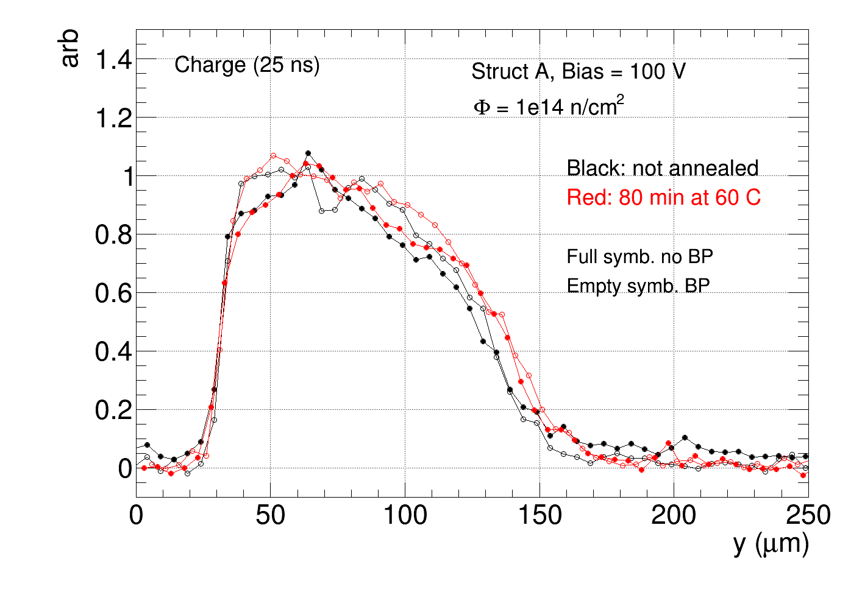
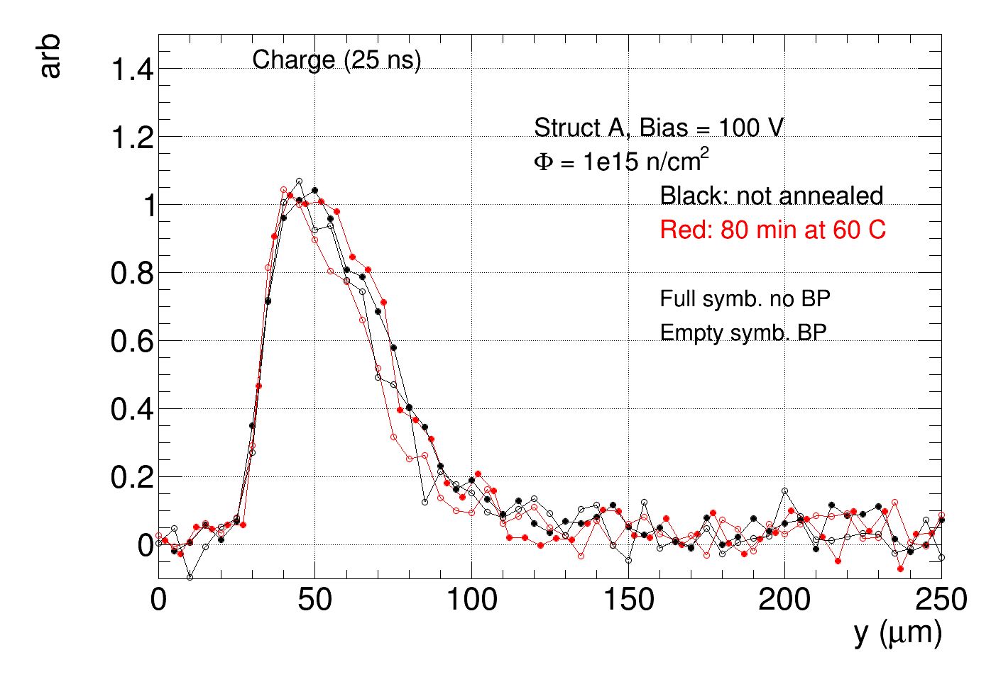
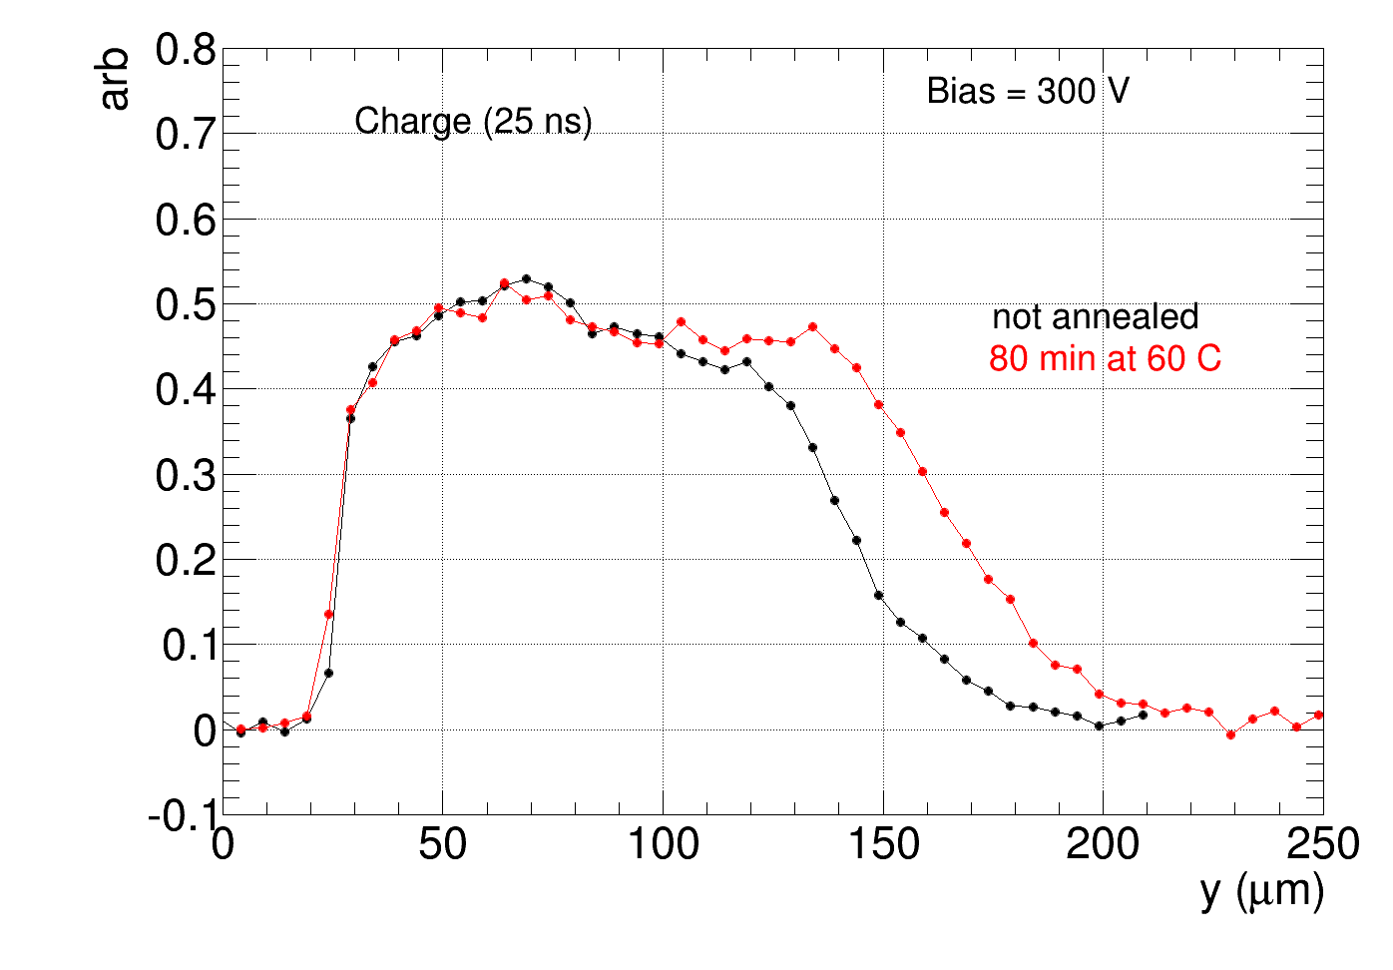
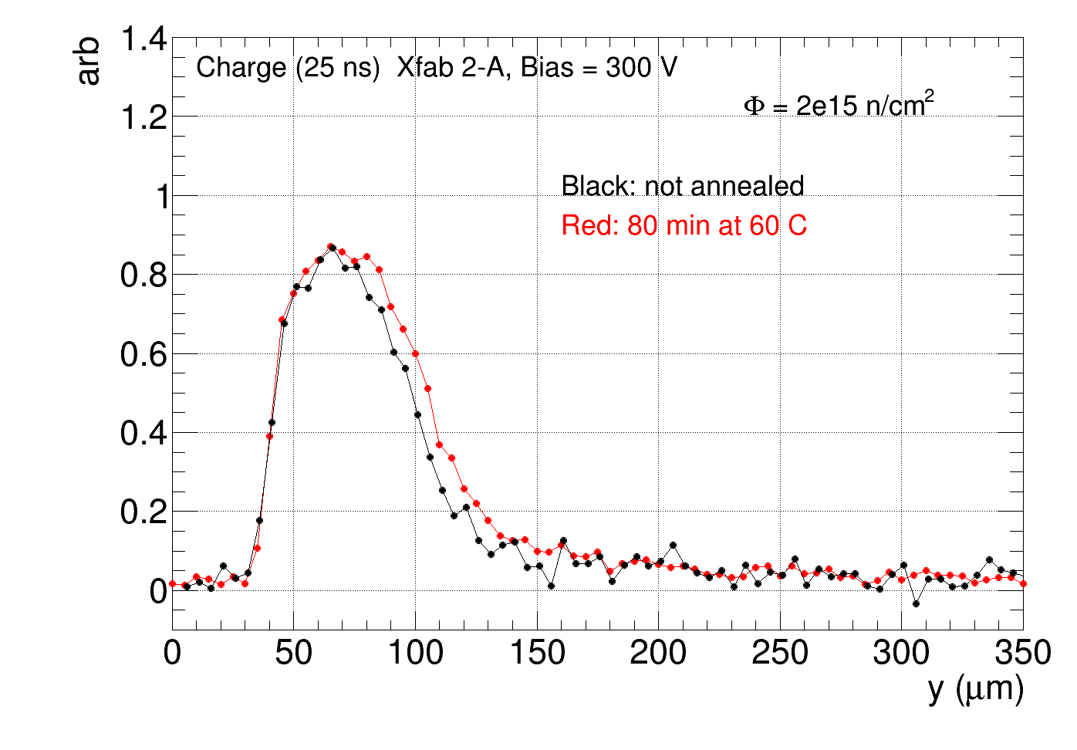
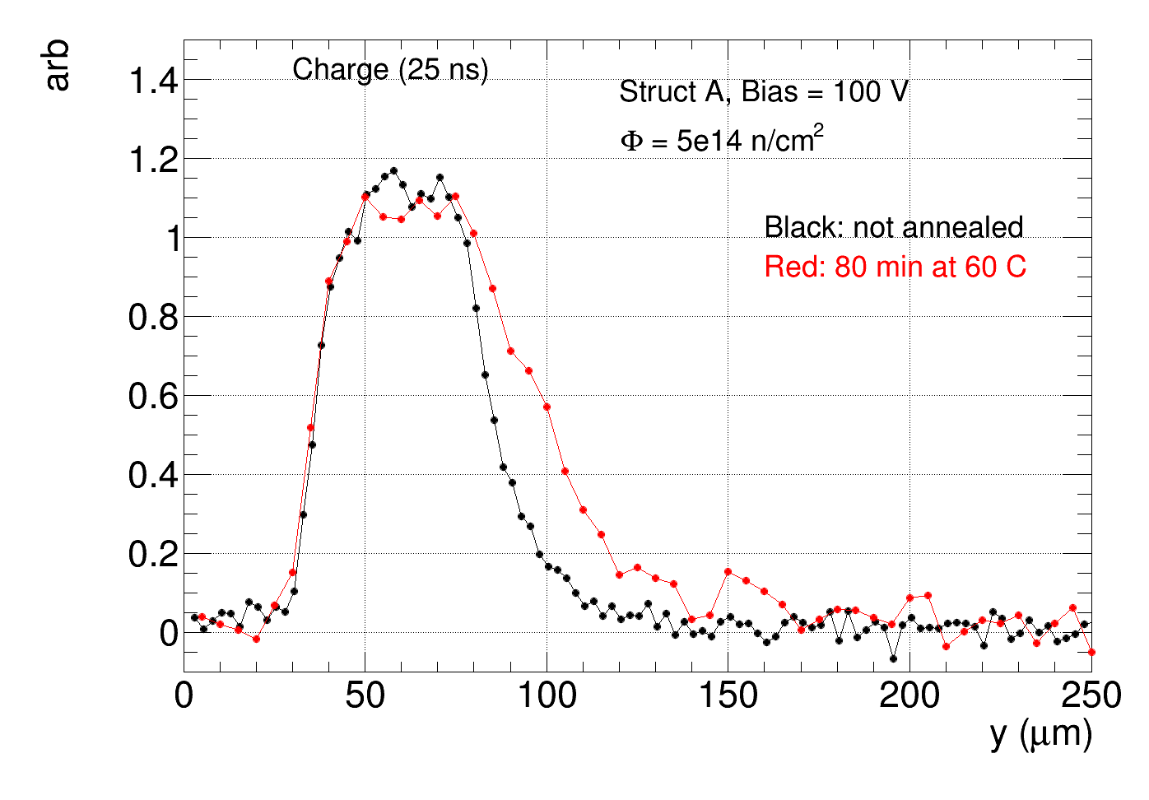
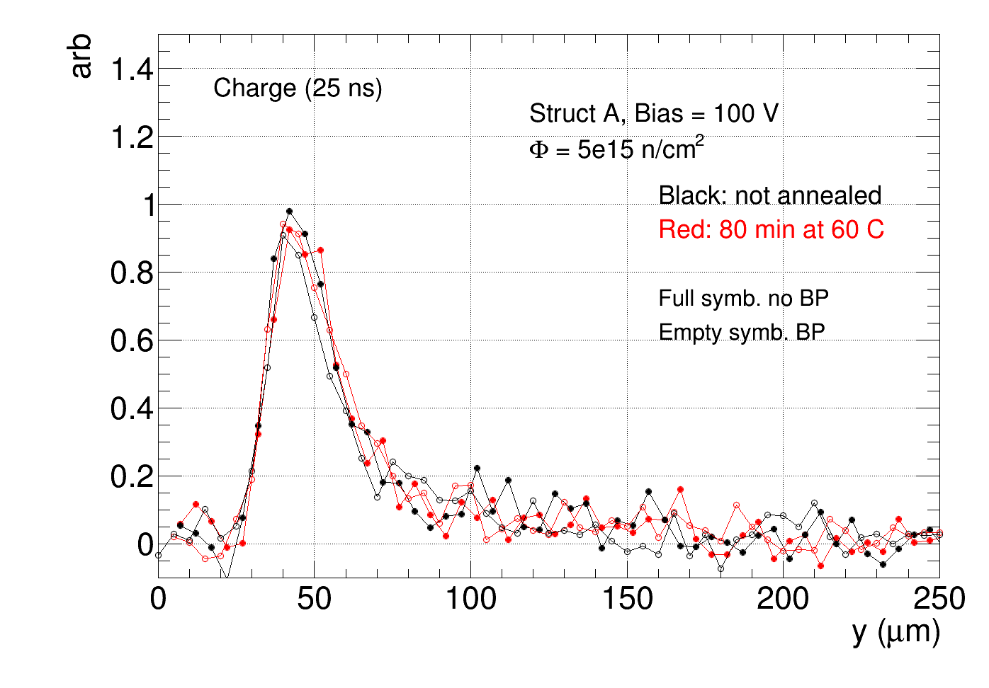
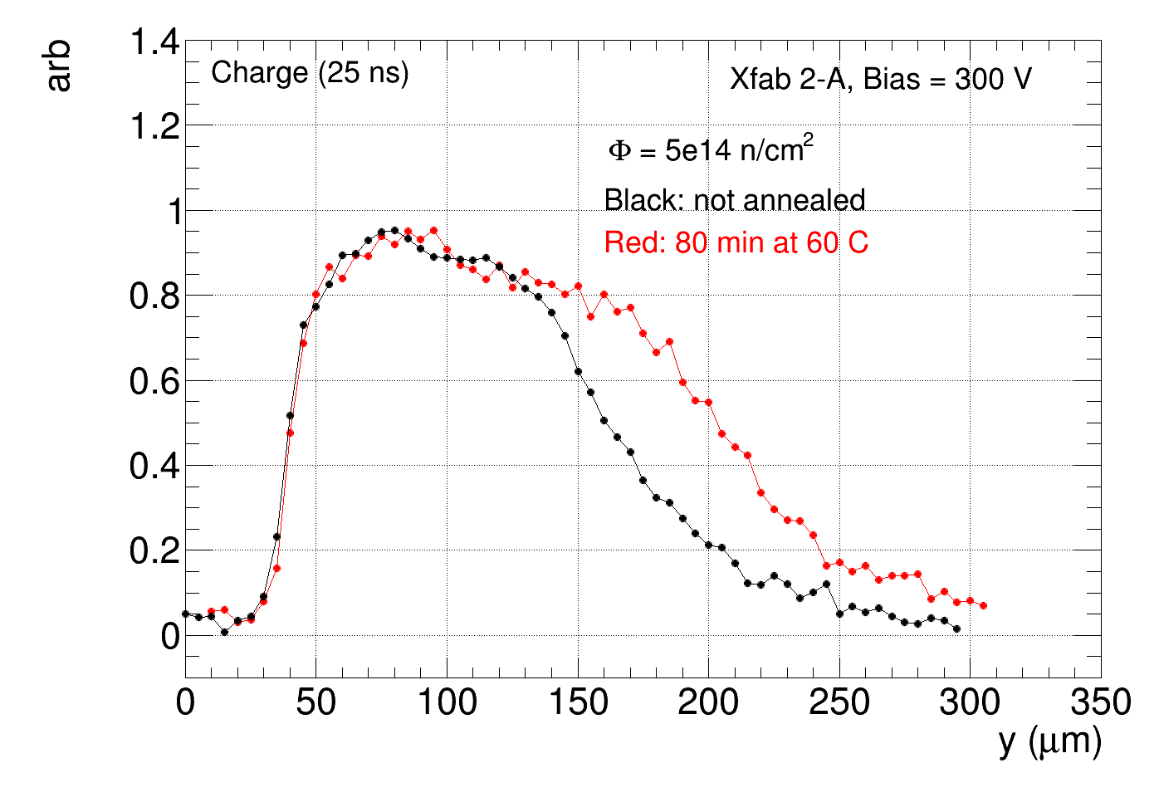
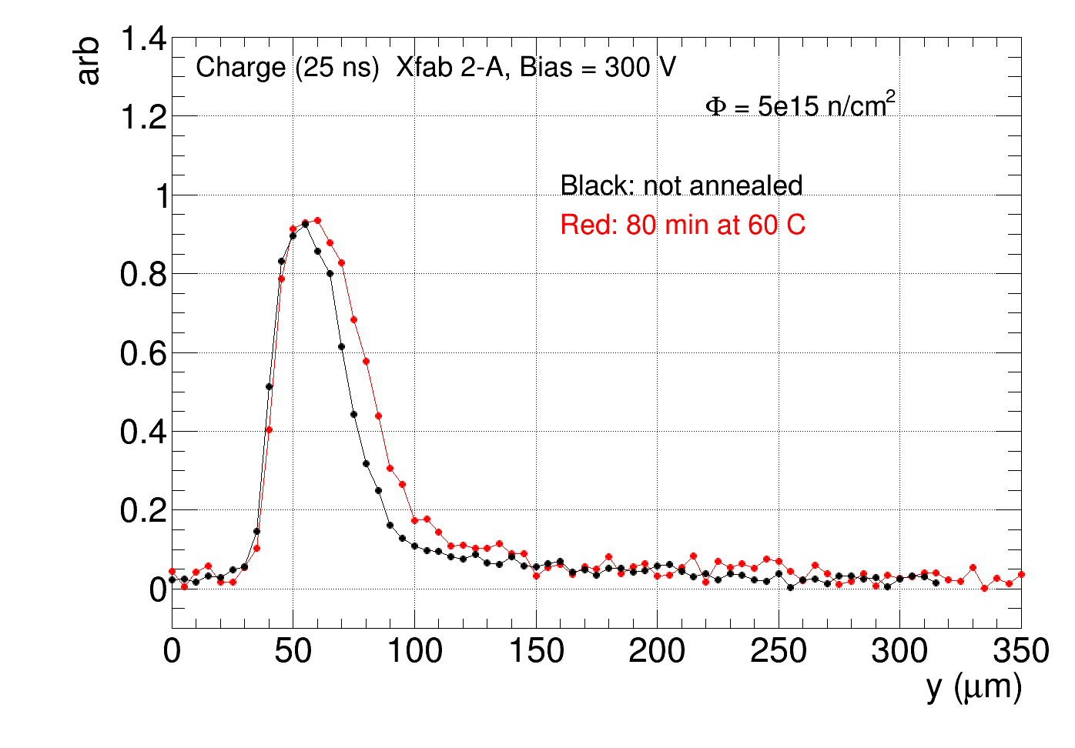
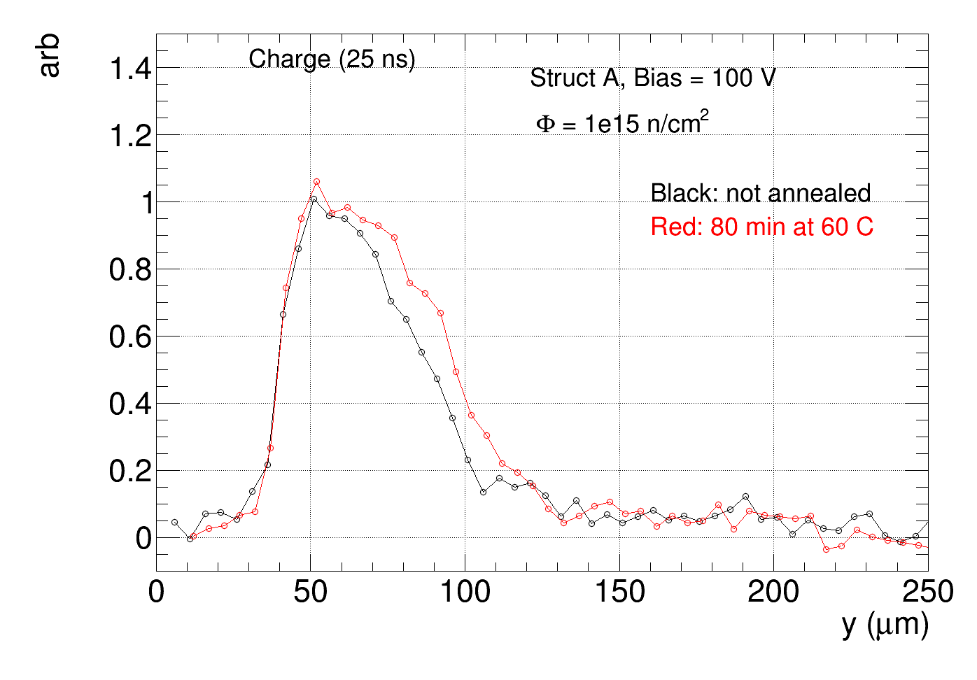
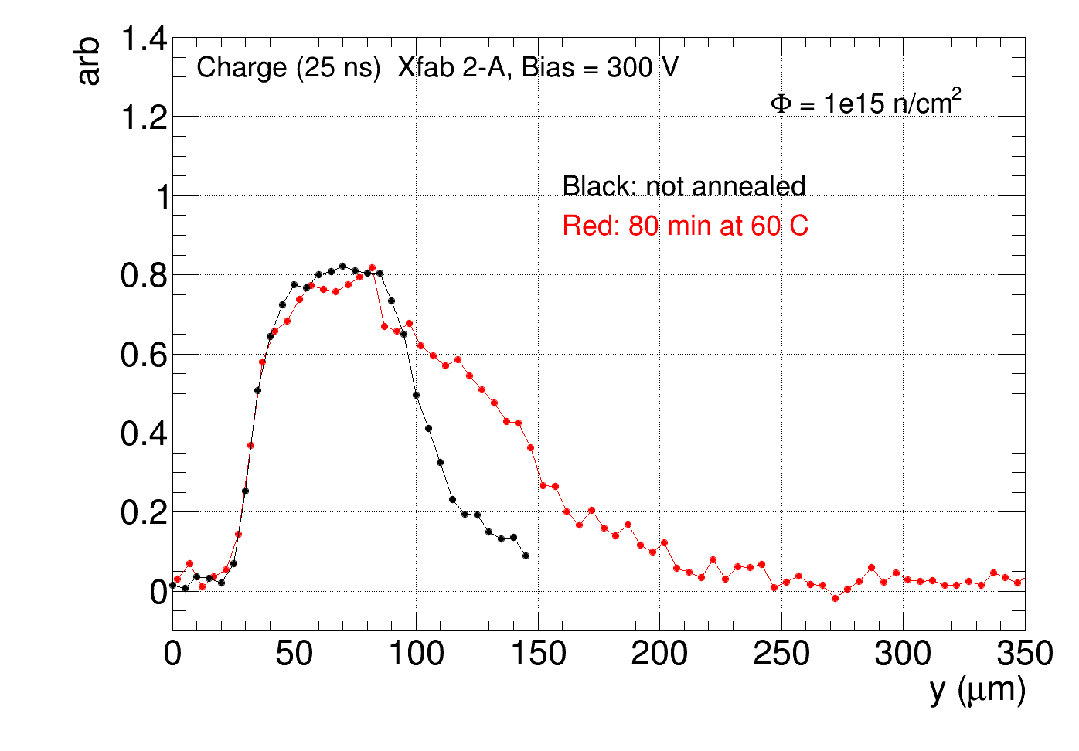
Charge collection profile - annealing
Measurement before and after 80 minutes at 60 C
→ 10% to 20 % increase of charge collection width after annealing
Lfoundry:
Xfab
2e15
2e15
1e14
2e14
5e14
5e15
5e14
5e15
1e15
1e15

Slide 15
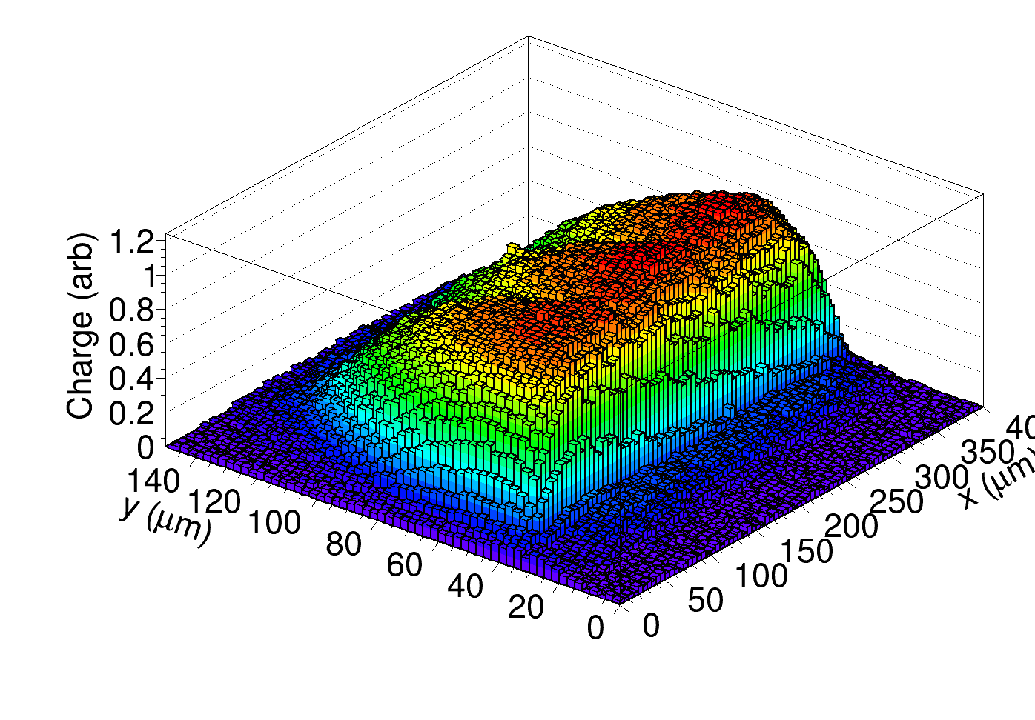
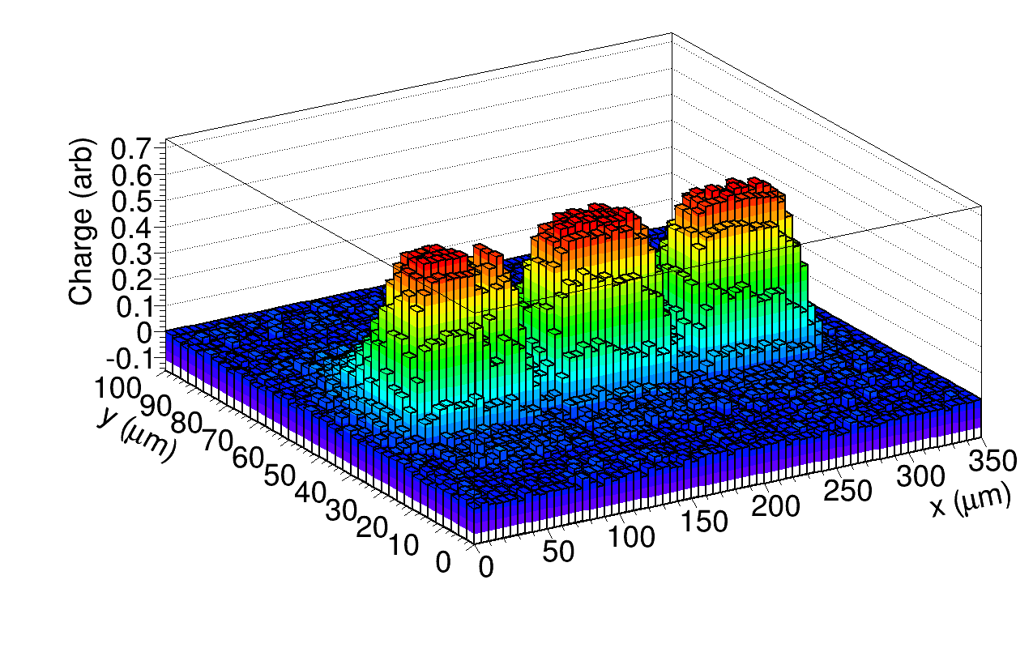
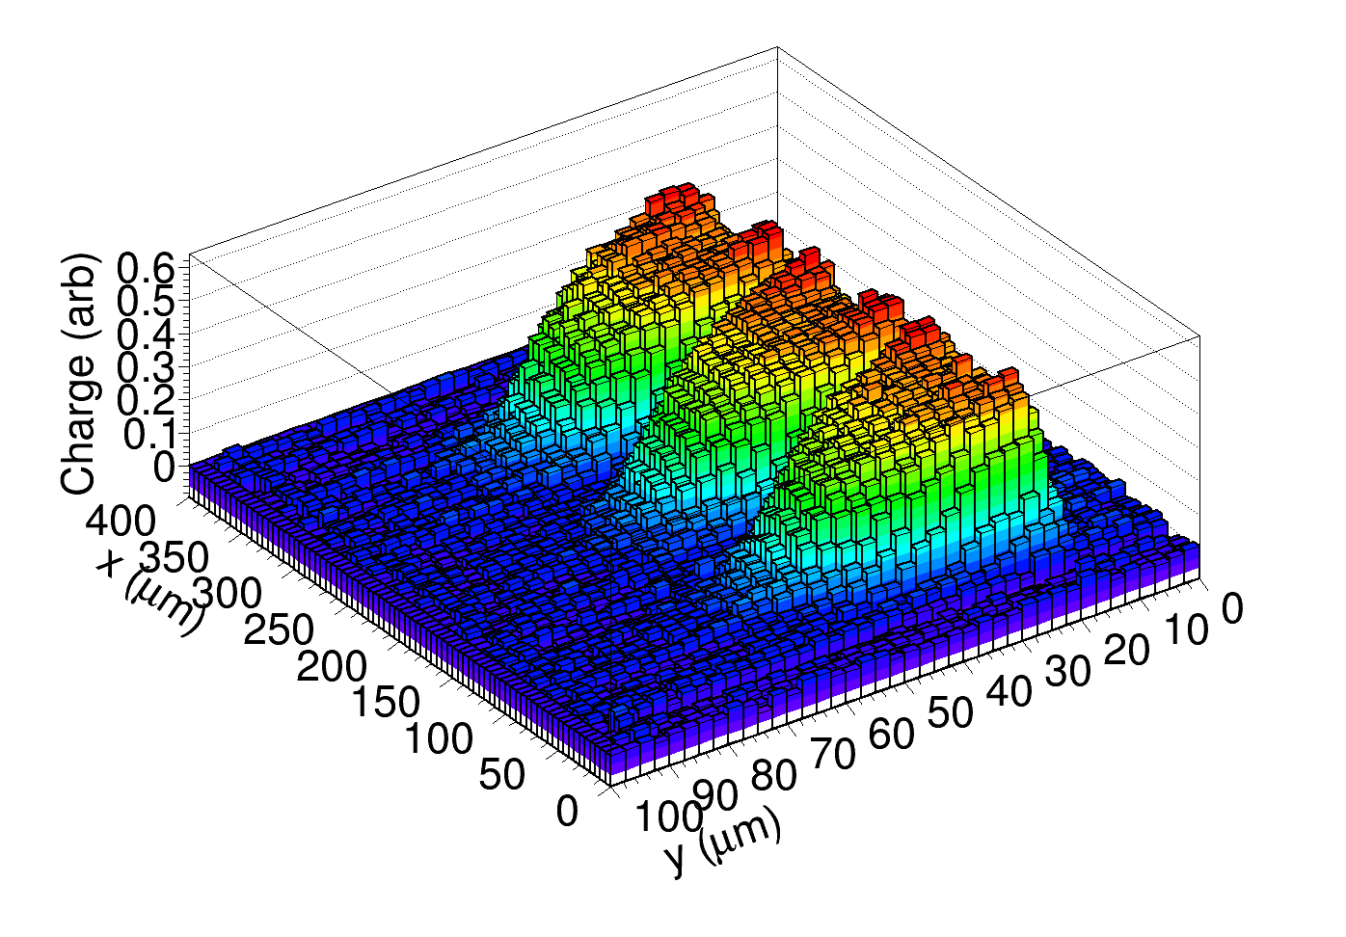
Scan across pixel array: AMS (20 Ωcm)
Bias = 120 V, all 9 pixels connected to readout, charge (25 ns)
2e15
Not irradiated
Depth
Chip surface
gaps before irradiation
guard ring gaps smaller after 2e15
gaps better seen again after 1e16
1e16
to HV and readout
(via Bias-T)
Beam
to ground

Slide 16
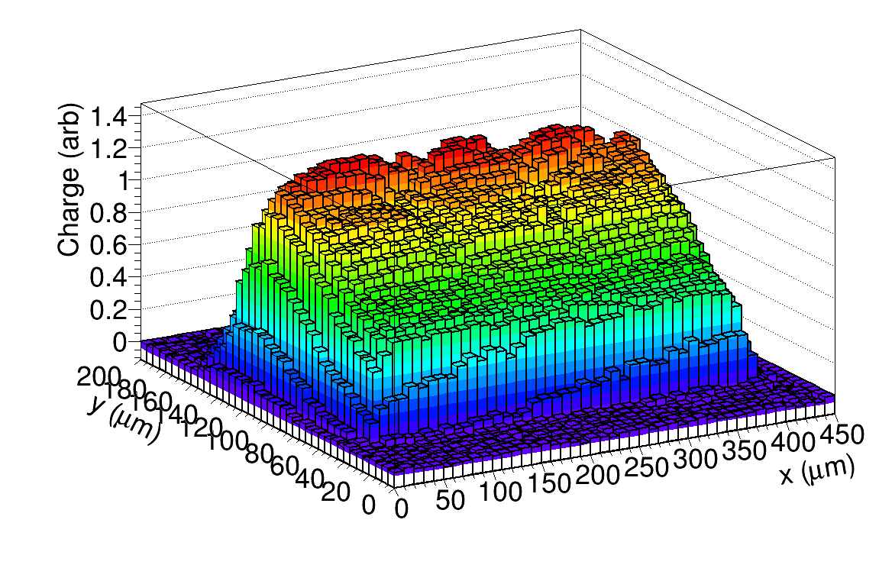
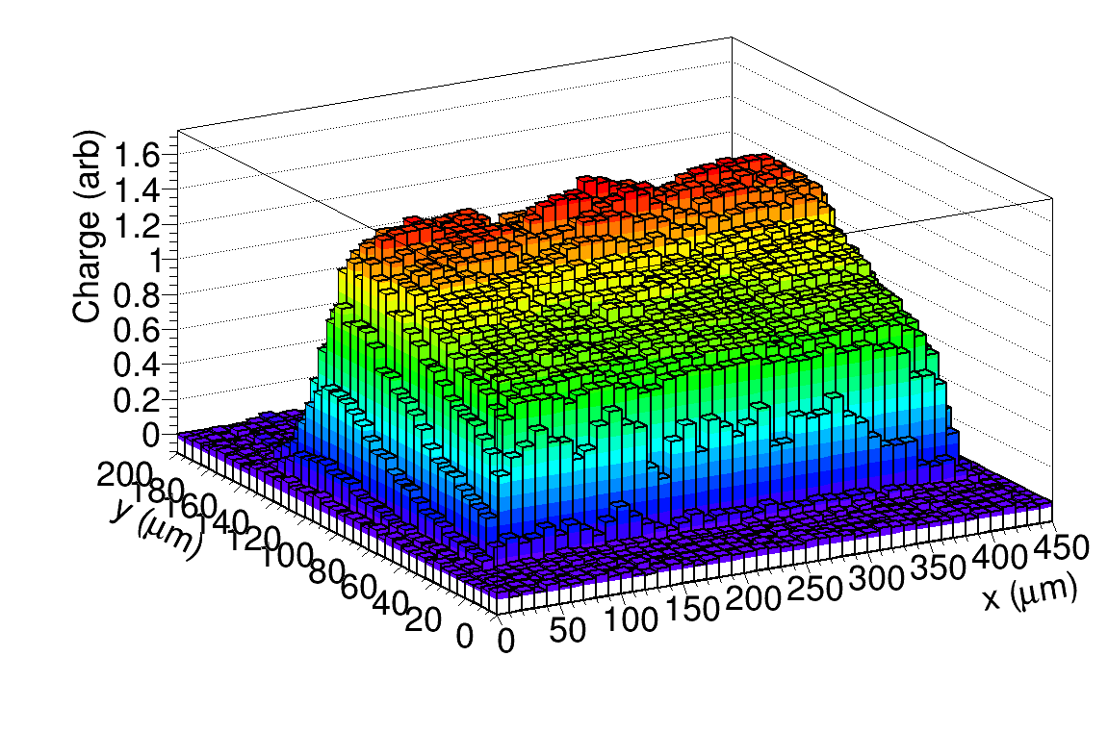
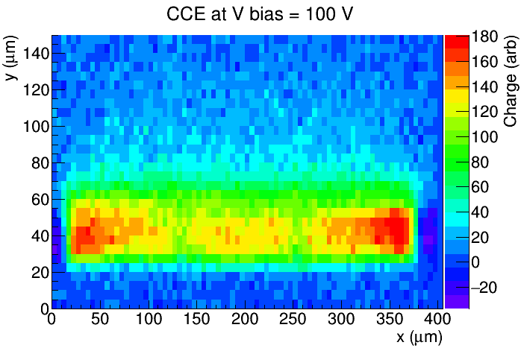
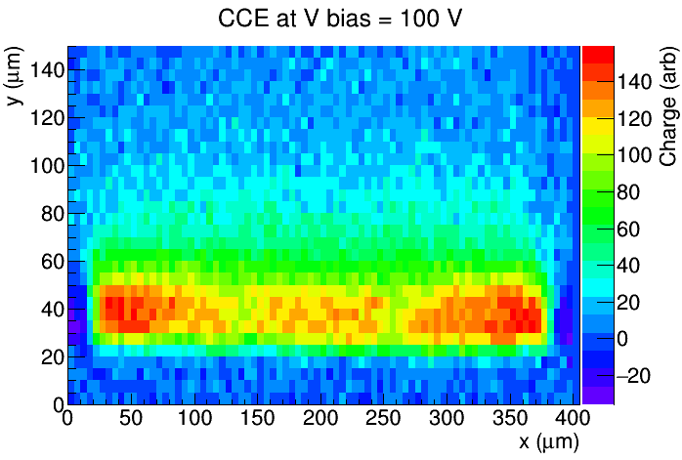
LFoundry, Structure F, all pixels read out
➔ no significant efficiency gaps between pixels
➔ no large difference between BP and no BP devices
Structure F, 3x3 pixels,
125 µm x 33 µm
Laser
No BP, 40 V, Φ = 0
BP, 40 V, Φ = 0
Depth
Chip surface
No BP, 5e15
BP, 5e15

Slide 17
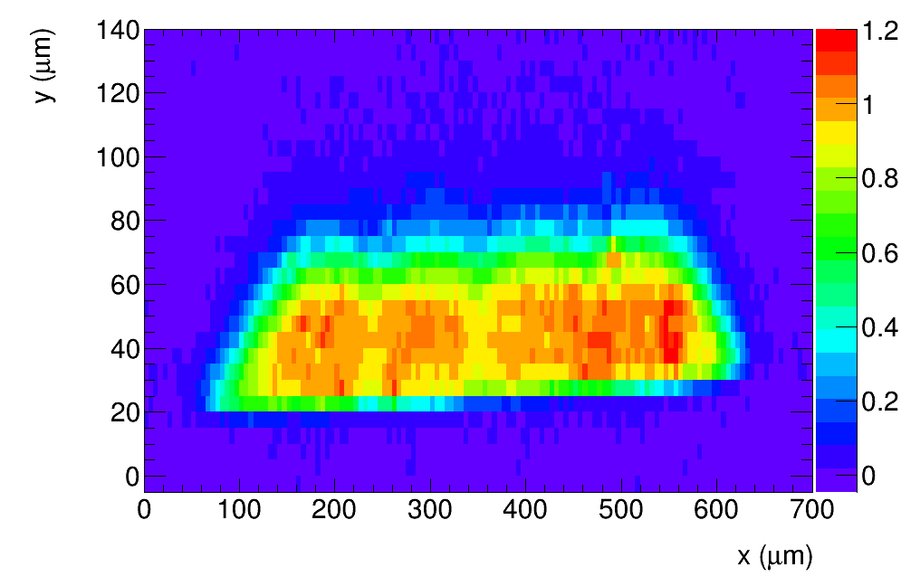
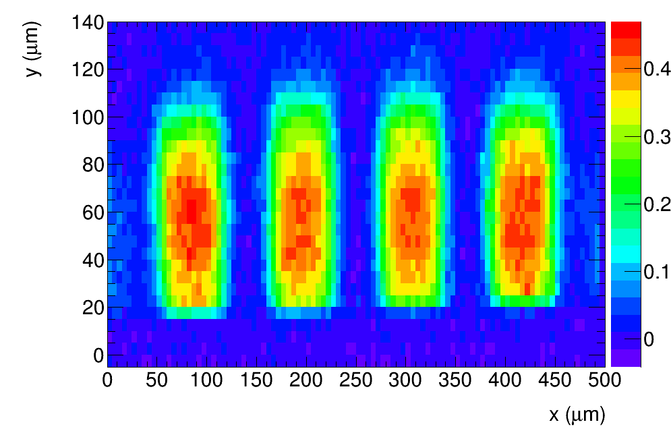
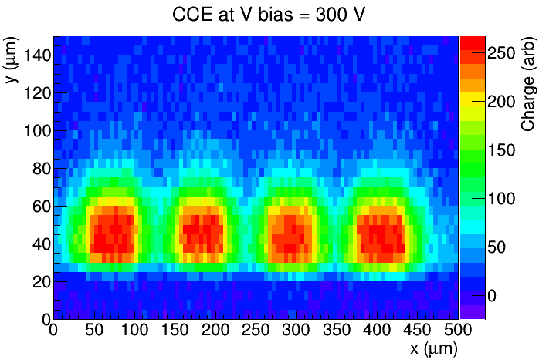
X-FAB: 100 Ωcm, 4x4 pixel array, Bias = 300 V
Efficiency gaps between pixels after irradiation
→ nuch smaller gaps at 500 ns integration
Before irradiation
2e14
scope
HV
HV
→ gaps less evident after high fluence
Buried oxide
5e15
Low charge
High charge
→ carriers drift to the oxide between n-wells
➔ behaves as “parasitic AC coupled electrode”
→ more detail showed at Trento workshop, Paris 2016:
https://indico.cern.ch/event/452766/contributions/1117348/

Slide 18
Summary
Edge-TCT measurements with passive test structures made on 3 different substrate resistivities:
AMS : 20 Ωcm, X-FAB: 100 Ωcm, LFoundry: 2000 Ωcm
→ charge collection profiles measured up to 1e16 n/cm²
→ significant charge collection width after highest fluence in all samples
AMS and X-FAB: large increase of charge collection width after irradiation with neutrons
→dependence of charge collection width with fluence consistent with effective acceptor removal
→ acceptor removal in X-FAB faster than in AMS → faster removal at larger initial resistivity
AMS: large increase of charge collection width after irradiation with PS protons
→ increase larger and at lower fluence than for neutrons
→ faster acceptor removal and smaller deep acceptor introduction rate
→ fast increase of charge collection width, faster than sqrt(V) at low bias voltage (seen also after
neutron irradiation)
LFoundry: charge collection width decreases with increasing fluence
→ introduction of deep acceptors faster than removal of initial acceptors
removal not complete N_{c}/N_{eff0} < 1 and/or too slow
compensated material? (donoros and acceptors removed at different rate ➔ we only see the sum)
→ no significant difference between samples with and without back plane contact
→ no significant efficiency gaps between pixels
X-FAB: large efficiency gaps between pixels after irradiation (at 25 ns integration times)
→ low efficiency between n-wells due to parasitic charge collection

