Slide 1




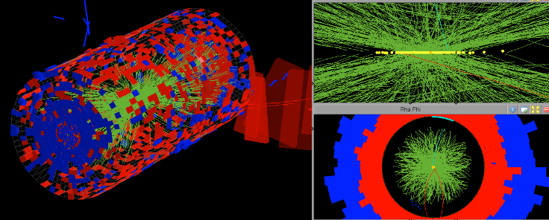
First measurements on “NitroSil” diodes
Alexander Dierlamm, Pawel Kamiński, Kevin Lauer, Alexander Lawerenz, Ralf Röder, Tobias Wittig
Image credit: Andre Holzner

Slide 2
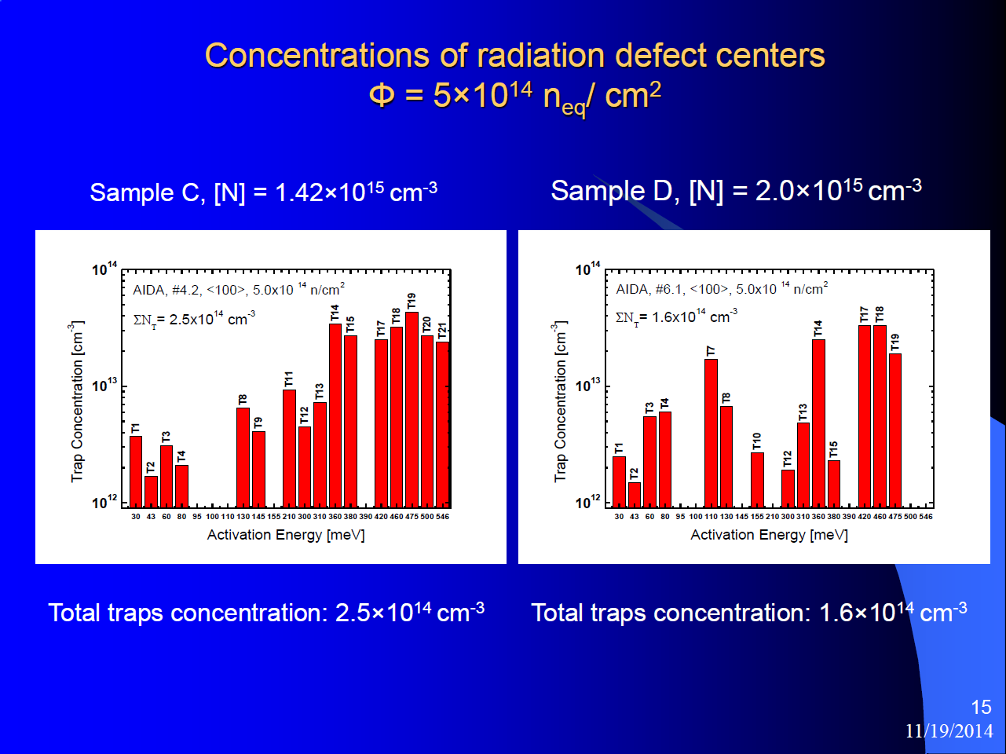
Introduction
The “NitroSil” project evaluates the improvement of radiation hardness of nitrogen doped silicon
Material:
  6mm x 6mm diodes made from n-type FZ, FZ:O and FZ:N wafers (300µm)
Irradiations are preformed at JSI (neutrons) and KIT (23MeV protons)
Here I concentrate on diodes irradiated and measured at KIT!

Slide 3
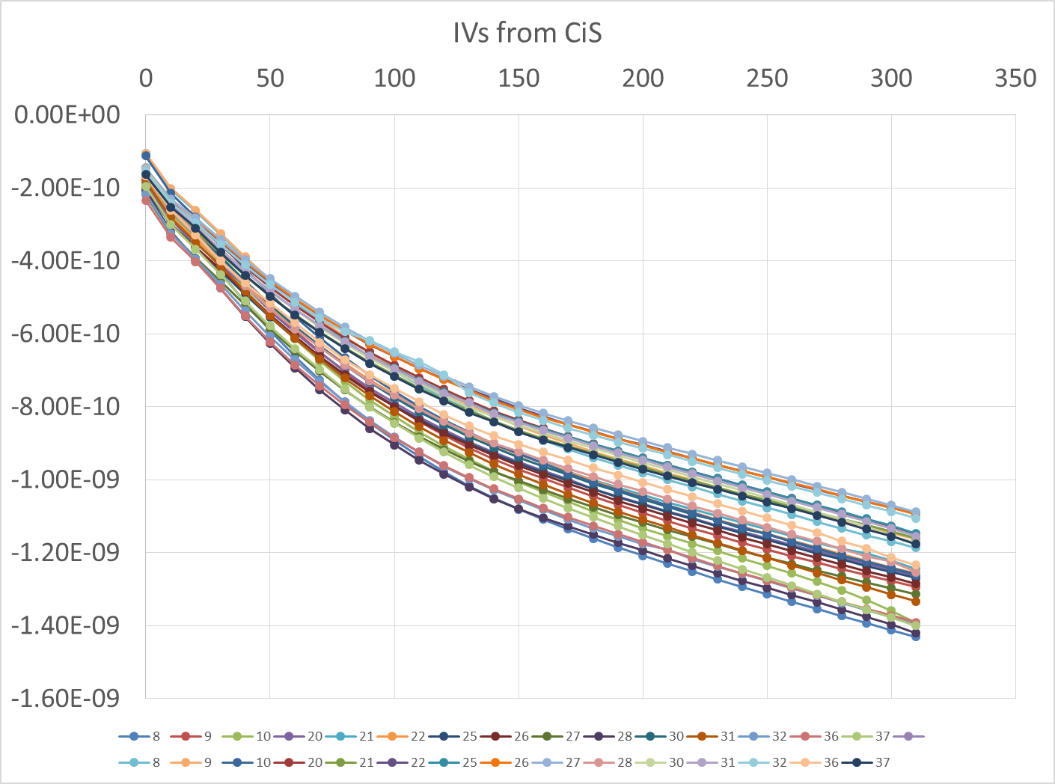
Initial characterization
Currents < 1.5nA@250V
U_{break} > 400V
U_{fd} ~ 145V
FZ:N

Slide 4
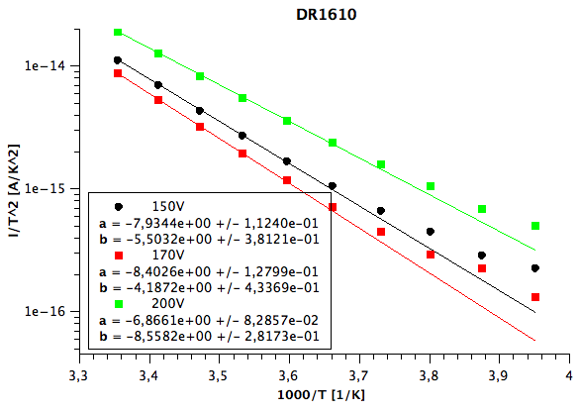
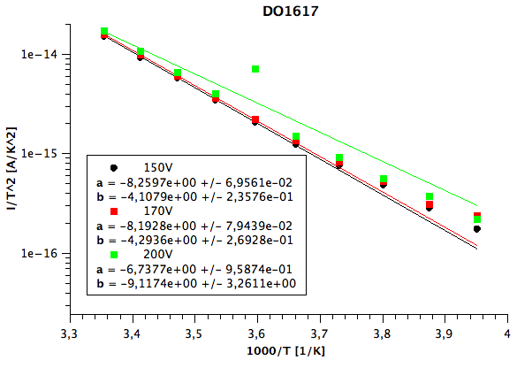
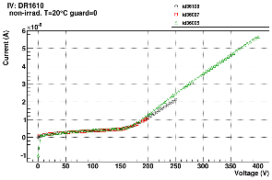
I vs. T
+20°C
I vs. T might reveal off mid-gap defects generating current, if E_{eff} differs from 1.21eV
Deviation from linear slope at low T hints to surface currents on all materials
In general, E_{eff} higher than 1.21eV (~1.4eV)
  FZ:N shows largest E_{eff} of 1.48eV
0°C
-20°C
I~T²exp(-E_{eff}/(2 k_{B} T))
Diode | U in V | E in eV
DR1610 | 150 | 1.37
DR1610 | 170 | 1.45
DR1610 | 200 | 1.18
DO1617 | 150 | 1.42
DO1617 | 170 | 1.41
DO1617 | 200 | 1.16
DN161 | 150 | 1.48
DN161 | 170 | 1.48
DN161 | 200 | 1.48

Slide 5
Irradiations
For the NitroSil project KIT irradiated 5 sets of up to 10 diodes with 23MeV protons
  Set 1 (5 diodes): 0.5x10¹⁴n_{eq}/cm²
  Set 2 (10 diodes): 1.0x10¹⁴n_{eq}/cm²
  Set 3 (10 diodes): 5.0x10¹⁴n_{eq}/cm²
  Set 4 (10 diodes): 1.0x10¹⁵n_{eq}/cm²
  Set 5 (10 diodes): 5.0x10¹⁵n_{eq}/cm² (1 irradiation session to come)
Irradiation was performed cold (<-20°C); practically no annealing

Slide 6
Characterization after irradiation
Set 2: 1.0x10¹⁴n_{eq}/cm²
  Currents very similar (~1.5µA@150V)
    alpha: ~7.8x10⁻¹⁷ A/cm (guard ring floating, no annealing…)
  U_{fd}
    ~135V for FZ:N and FZ:O
    ~150V for FZ

Slide 7
Characterization after irradiation
Set 3: 5.0x10¹⁴n_{eq}/cm²
  Currents very similar (~7.5µA@600V)
    alpha: ~7.8x10⁻¹⁷ A/cm (guard ring floating, no annealing…)
  U_{fd}
    ~700V for FZ:N and FZ:O
    ~640V for FZ

Slide 8
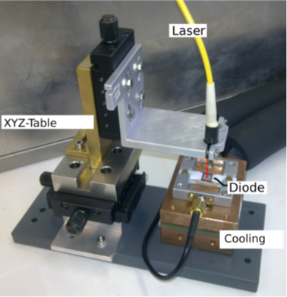
TCT measurements
IR laser to extract CCE and compare among the different materials
In preparation…

Slide 9
Summary and Outlook
Irradiated diodes of FZ, FZ:O and FZ:N material in hands
First measurements done
  Quality of diodes very good
  Differences in currents and full depletion voltages not large up to now
Next:
  Complete initial IV and CV measurements
  Add annealing steps
  Perform TCT measurements to extract CCE

Slide 10
Acknowledgment
The studies were partially supported by the Polish Centre for Research and Development within the framework of the NitroSil project (ID: 208346) financed by the Program for Applied Research under Contract No. PBS2/A9/26/2014.

Slide 11




Status “NitroStrip” Project
Alexander for the NitroStrip Collaboration
Image credit: Andre Holzner

Slide 12
Introduction
“NitroStrip” is the extension of the “NitroSil” project, which studies the mitigation of radiation damage in silicon by introduction of nitrogen
“NitroSil” concentrated on production of FZ:N wafers, defect measurements which High-Resolution Photoinduced Transient Spectroscopy (HRPITS) and characterization of diodes
“NitroStrip” will perform charge collection measurements on strip sensors

Slide 13
Status of “NitroStrip”
The RD50 Project “NitroStrip” has been approved!
n-type wafers (300µm) for sensor production are at D&T Microelectronics
  6x FZ
  6x FZ:N
  6x FZ:O (oxygenation of wafers finished at D&T)
  6x MCz
RD50-C masks with small modifications are used to mainly produce mini-strip sensors (80µm pitch, ~1cm length, 26 per wafer)
  masks are produced and ready to use
Production will start soon, but last ~3-4 months due to heavy load of production line and holiday period…

Slide 14
“NitroStrip” activities
Activity | Institute | Leader
Mask design | CNM | G. Pellegrini
Oxygenation and processing | D&T Microelectronics | J. Rafi
Electrical characterization | CERN, UFR, UHH, KIT | S. Kühn
CC measurements | CERN, UFR, KIT | A. Dierlamm
TCT measurements | CERN, UHH, KIT | M. Moll
TSC measurements | UHH | E. Fretwurst
e-TCT measurements | CERN | M. Moll
Irradiations | KIT, CERN | A. Dierlamm
Estimated project costs: 26.5k€
Granted RD50 funds: 18.5k€

Slide 15
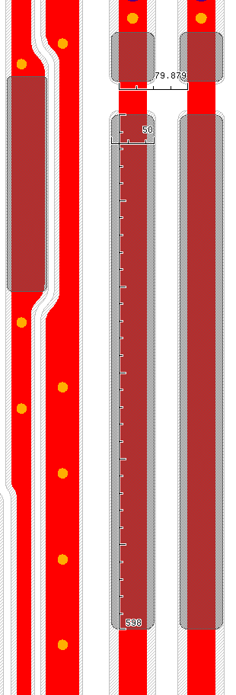
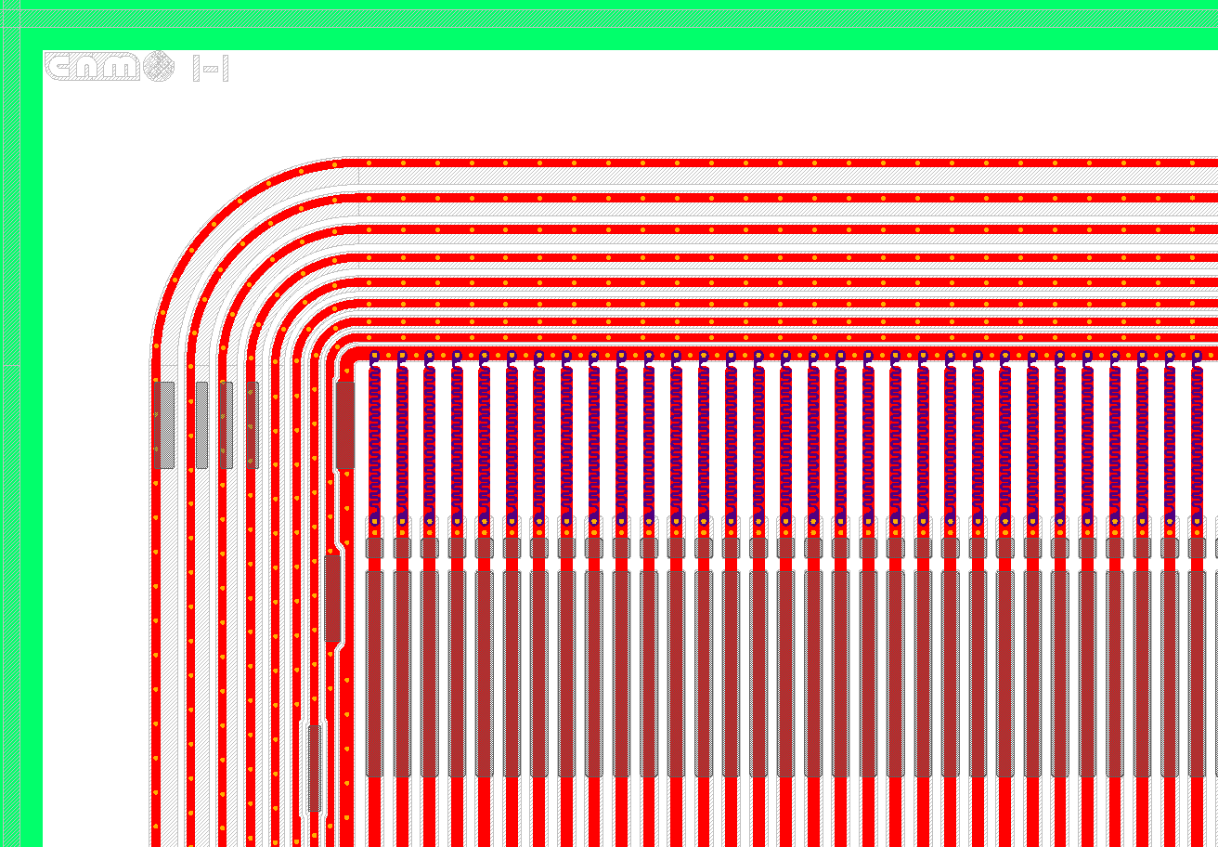
Mask details
Metal strips with overhang (11µm)
Wider wire-bond pads (50µm)

Slide 16
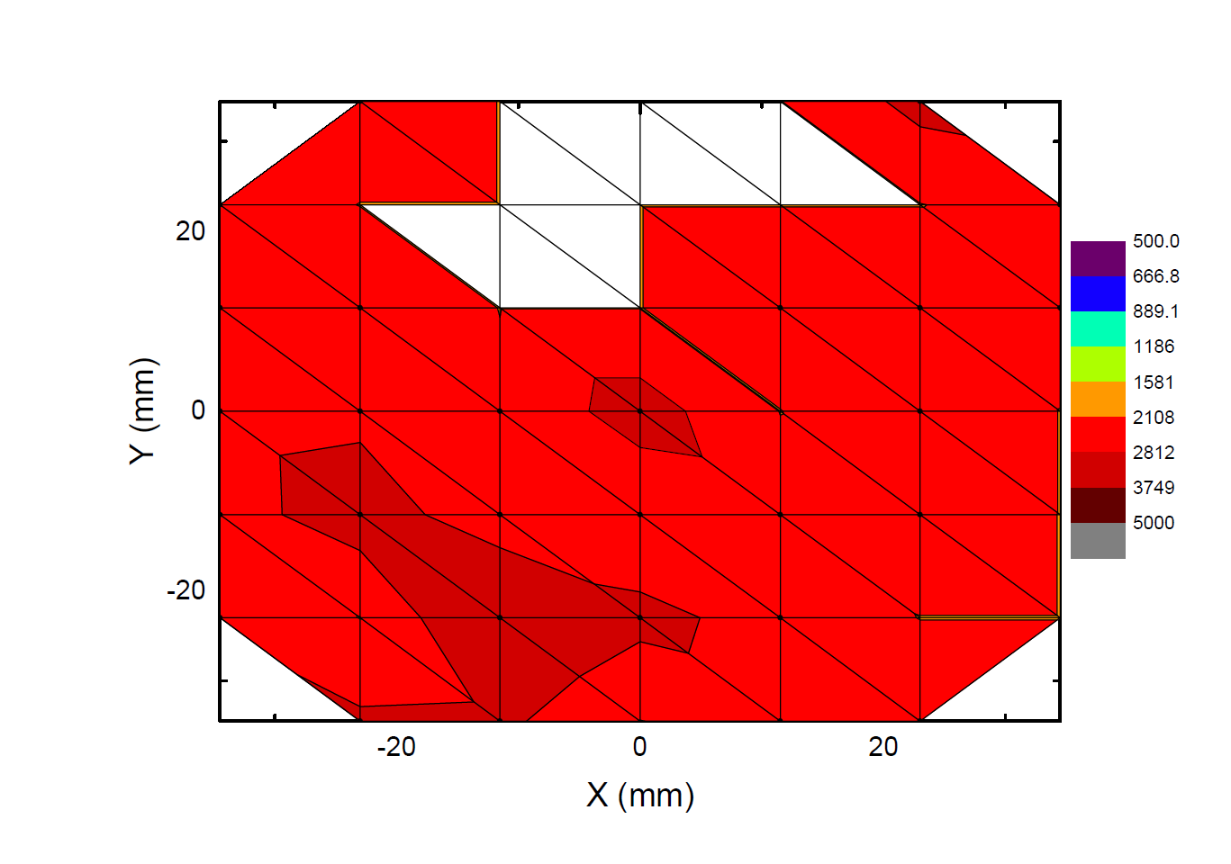
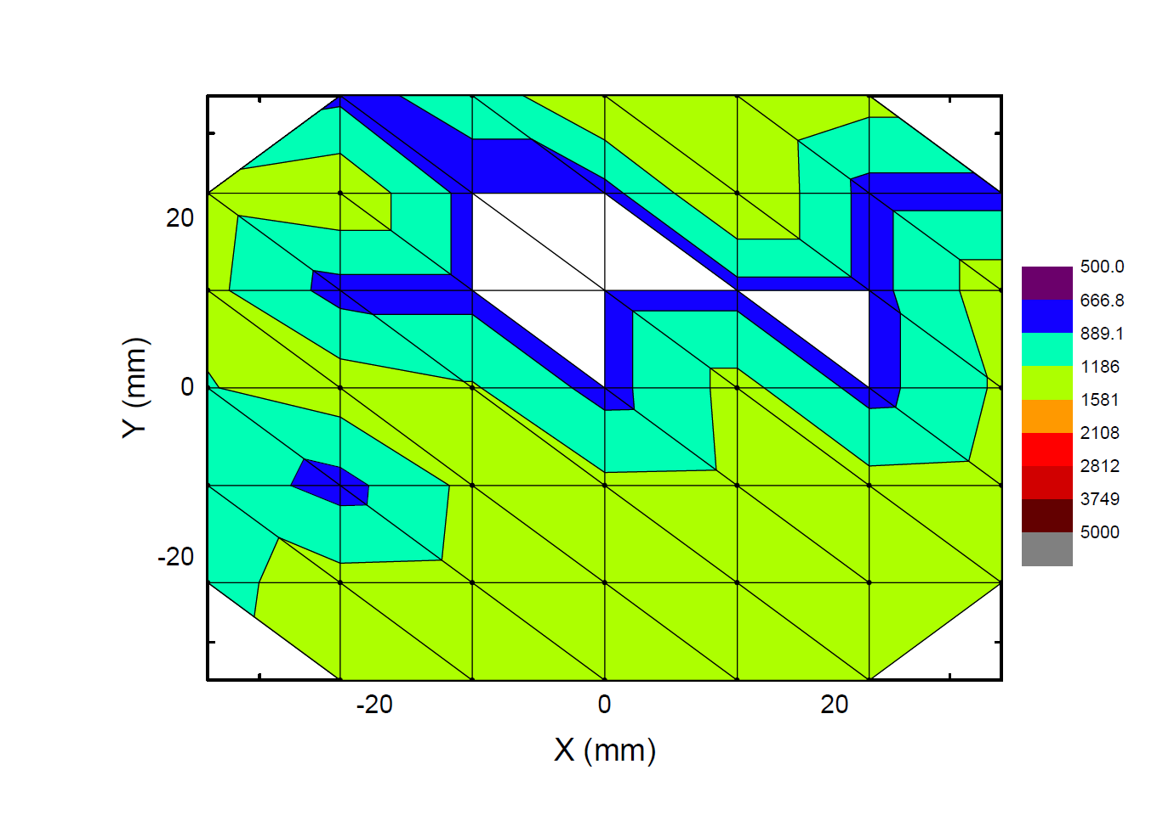
Oxygenation results
12h @1150ºC in O2 (Oxygenation) + 48h @1150ºC in N2 (Diffusion)
Resistivity reduced to ~50%
  Already observed previously
Microelectronics Reliability 40 (2000) 791±794
Before
After Oxygenation
(-50%)

Slide 17
Irradiation plans
Materials:
  FZ, FZ:N, FZ:O, MCz
  4x6 wafers: ~150 strip sensors and 120 diodes for each material
Fluences:
  1x10¹³ (diodes only for TSC,) 1x10¹⁴, 5x10¹⁴, 1x10¹⁵, 5x10¹⁵n_{eq}/cm²
Particles:
  25MeV protons (KIT)
  24 GeV protons (CERN)
  reactor neutrons (JSI)
  Co-60
Initial program:
  2 sensors (plus 2 diodes) each irradiated with single particle type
    Total: 4 x 4 x 4 x 2 = 128 sensors (1/4 of production)

Slide 18
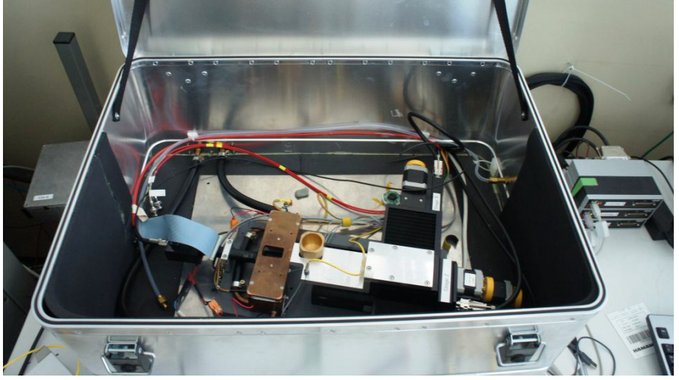
Measurements
ALiBaVa setup @ KIT
Sensor characterization
  IV, CV on all
  Strip measurements on samples
Read out strip sensors with
  ALiBaVa setup
  Sr90 source
  @ -20°C
CC, cluster size, noise
  vs. voltage
  vs. annealing
  min. steps: initial, 2w@RT, 20w@RT
Min. program ~2 days per sensor!
ALiBaVa setup @ KIT

Slide 19
Outlook
Wafer production will start soon
Production time ~3-4 months
Initial characterizations in autumn
…

Slide 20
spares

Slide 21
Materials from
Microelectronics Reliability 40 (2000) 791±794

Slide 22
Reminder V distribution

