Slide 1

Progress
in Ultra-Fast Silicon Detectors
Hartmut F.-W. Sadrozinski
SCIPP, Univ. of California Santa Cruz, CA 95064, USA
Measurement of the LGAD gain with 3 different methods
Development of a UFSD test station based on ⁹⁰Sr β
Measurement of the timing resolution of 75µm thick LGADs

Slide 2
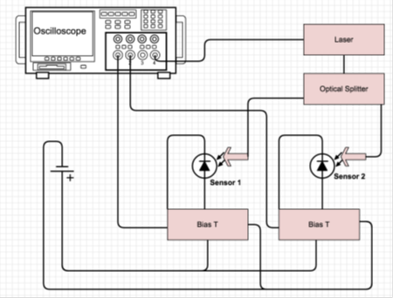
Gain Measurement: 3-ways (Luke Hibbard)
Motivated by the presentation of Sofia Otero Ugobono at the 27th RD50 Meeting
Compare the determination of gain by 3 different charge collection methods of two LGAD from wafers 7 & 8 of CNM run 6474:
α from the back, works only for depleted sensors
and exposed back side
β has low signal-to-noise for thin sensors,
use separate detector to trigger only on
high energy β.
IR laser (needs opening in metal)
uses detector w/o gain for comparison

Slide 3
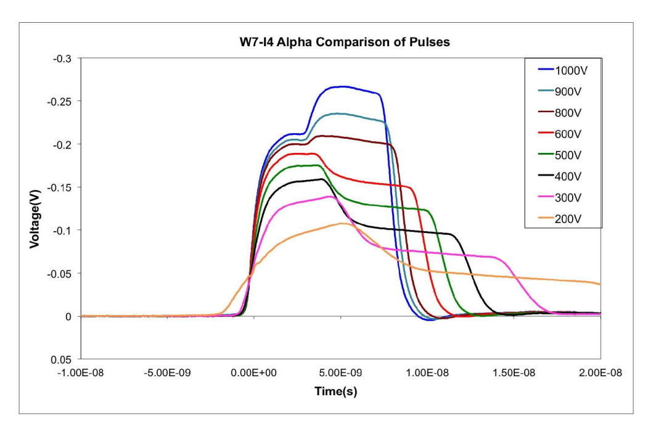
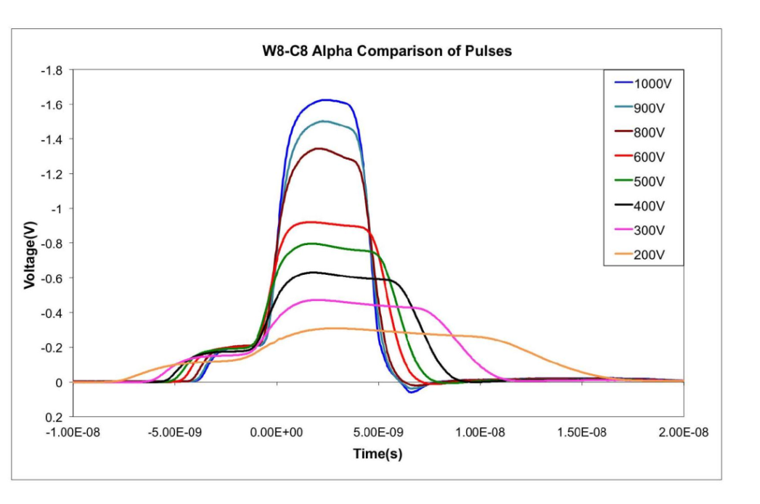
Gain Measurement: α Back
α from the back exhibits characteristic shape
of initial electrons+multiplication holes.
Gain can be read-off directly.
(Irradiated LGAD need simulation
for gain extraction)

Slide 4
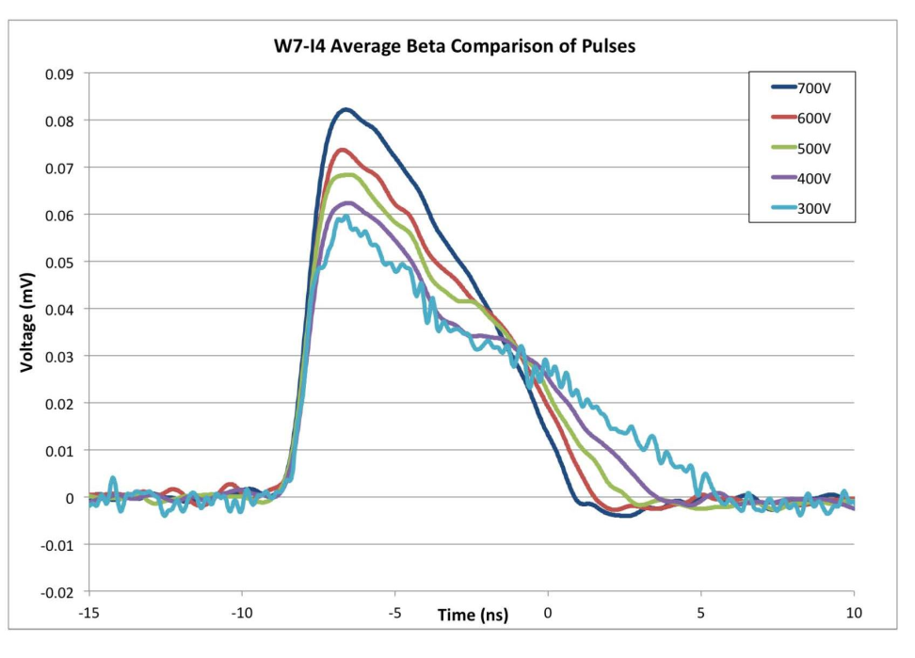
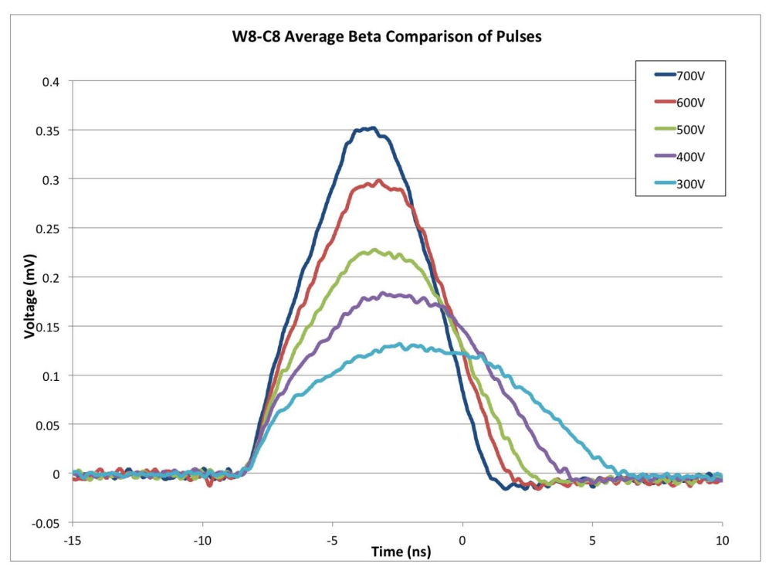
Gain Measurement: β from ⁹⁰Sr
β exhibits a shape mixing early initial
electrons and late multiplication holes.
Gain measured through the collected
charge and can be verified by comparison
with non-gain device.
(Irradiated LGAD need simulation
for gain extraction)

Slide 5
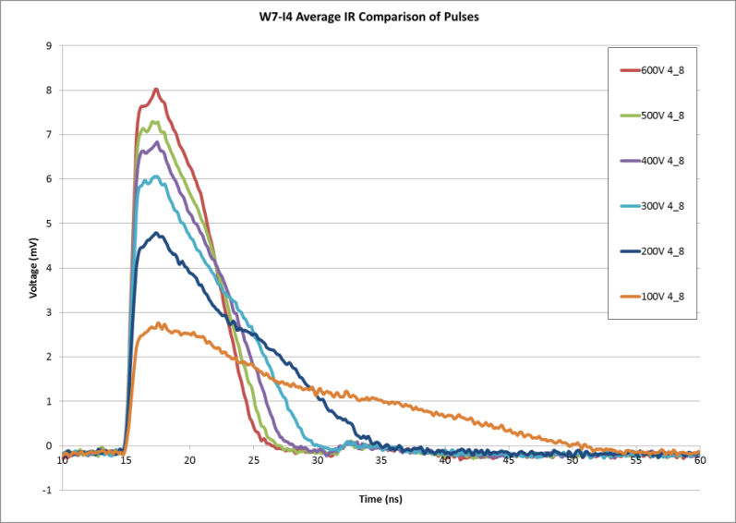
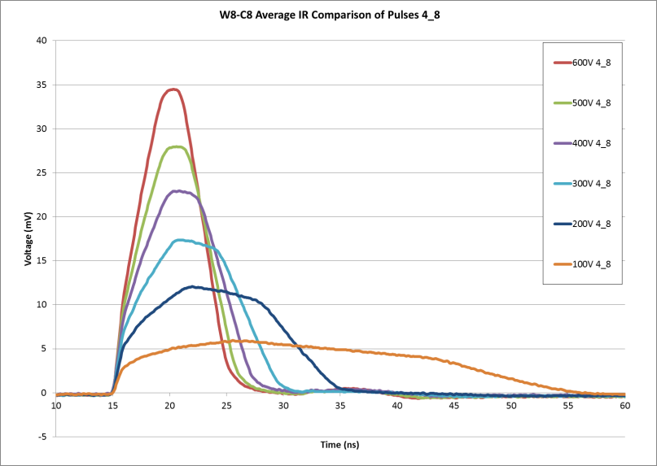
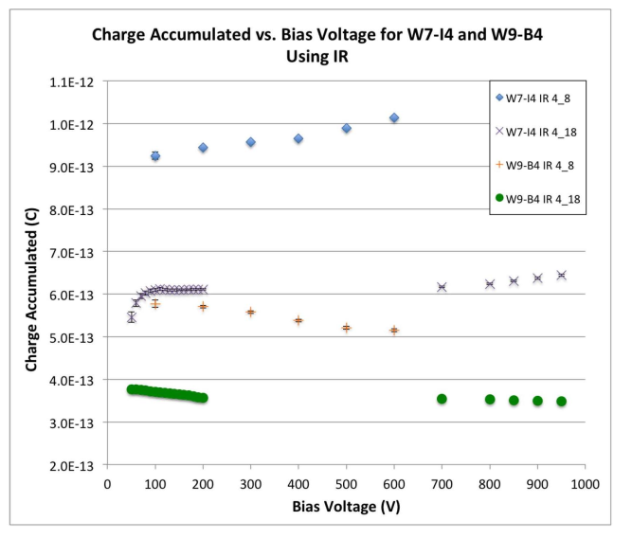
Gain Measurement: IR Laser
Particulars TCT set-up
IR similar to β exhibits a shape mixing early
initial electrons and late multiplication holes.
Gain measured through the comparison of the collected charge with non-gain device.
Very different pulse
heights from different
days result in
same gain!

Slide 6
Gain Measurement: 3-ways (Luke Hibbard)
Good agreement between β, IR gain measurements.
α back shows systematic uncertainty depending on the method used to extract the gain (comparison with no-gain sensors vs. ratio of total charge / initial electron charge)

Slide 7
Conclusions on Gain Measurements
Find good agreement between α, β, IR gain measurements pre-rad
Different methods have different restrictions
  α back needs depleted sensors and no support wafers like epi or SoI
  but it is self-calibrating
  evaluation of α front is in the works
  β is reliable when compared to no-gain sensor, still needs correction from simulations
  IR requires second no-gain sensor for comparison to suppress dependence on laser intensity, couplings etc
Need to extend this to post-rad detectors, most likely will require pulse shape analysis

Slide 8

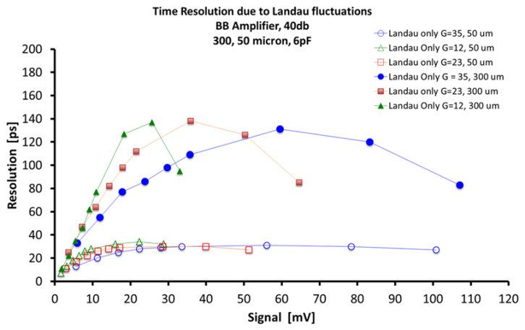
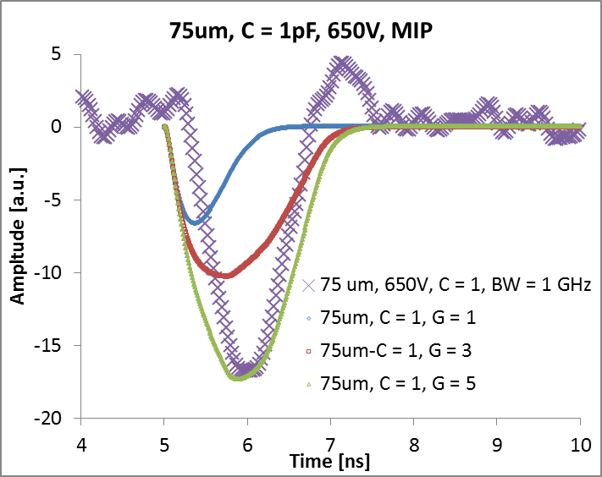
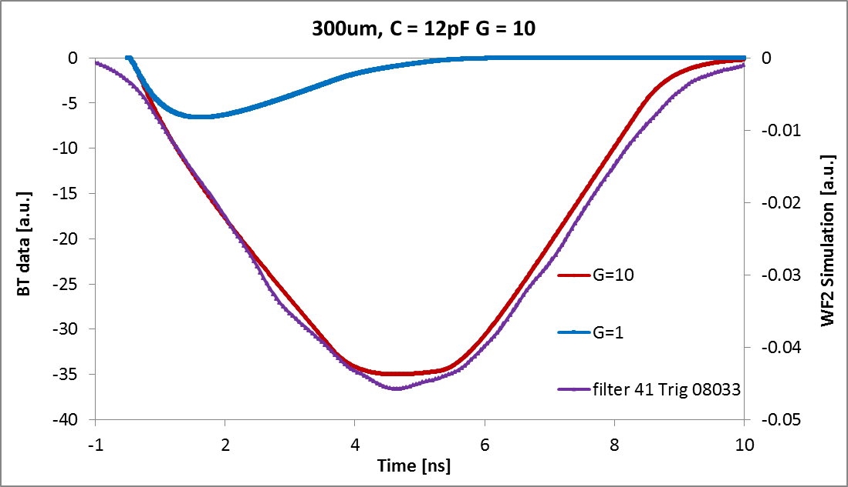
LGAD Timing Resolution
The timing resolution in silicon sensors can be expressed as the sum of four terms
time walk σ_{TW}, time jitter σ_{J}, Landau fluctuations σ_{L} and TDC binning σ_{TDC}:
The first two terms are inversely proportional to the slope dV/dt
-> need fast (i.e. thin sensors) and large pulses (i.e. gain) .
One reason for thin sensors and low thresholds are the Landau fluctuations seen in beam tests and simulated with WF2:
Weightfield2 (WF2) simulations of 75 and 300µm LGAD reproduce the observed pulse shapes
75 µm LGAD, β‘s
G ~ 5, τ_{Rise} = 500ps
300 µm LGAD, 120 GeV π’s
G ~ 10, τ_{Rise} = 5ns
WF2: N. Cartiglia et al,

Slide 9
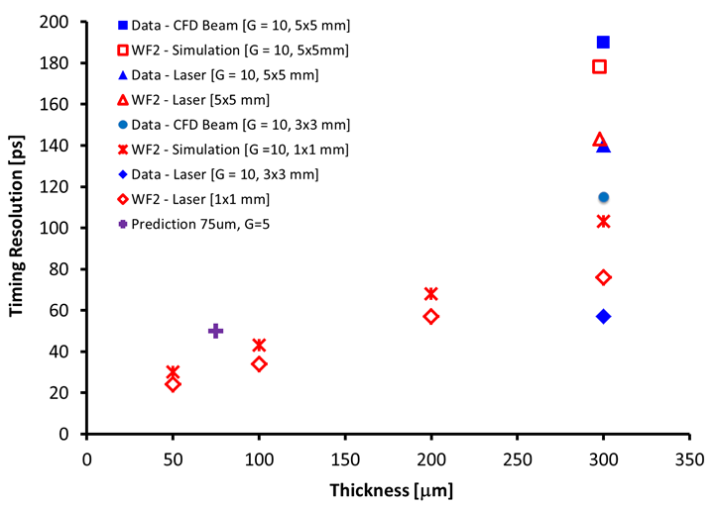
Slew-rate (Slope) dV/dt
Good agreement for the timing resolution between data (beam test & laser) and simulations Weightfield2 (WF2) for 300um LGAD thickness.
For 300um LGAD with gain G=10,
the timing resolution has been measured:
test beam (120 GeV π’s): 120ps,
laser: 57ps.
For 75um LGAD with gain G=5, scaling dV/dt
results in expected timing resolution 50 ps
We now have new timing data
from two 75µm LGAD with Gain G=5.
We used a ⁹⁰Sr β telescope with
an ultra-fast Quartz & SiPM trigger.

Slide 10
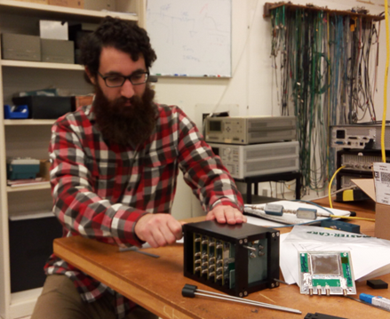
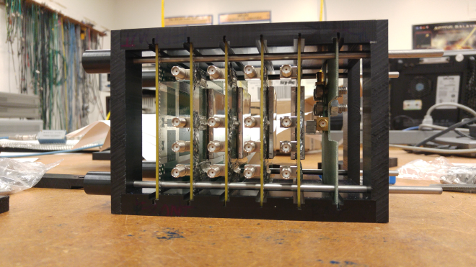
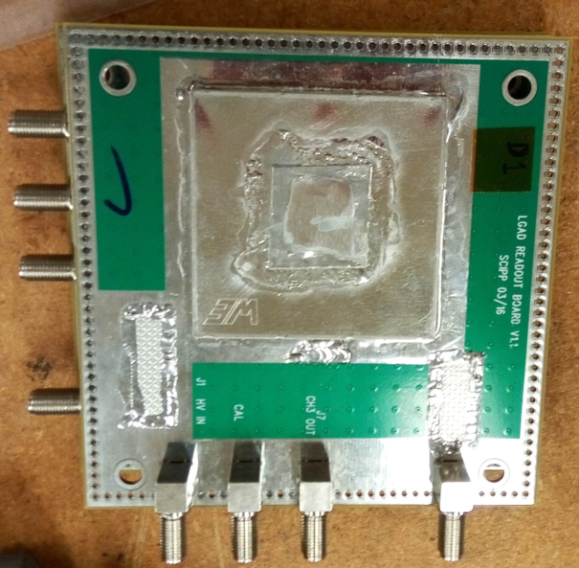
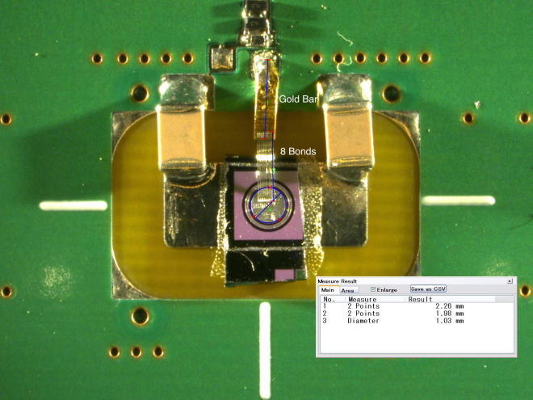
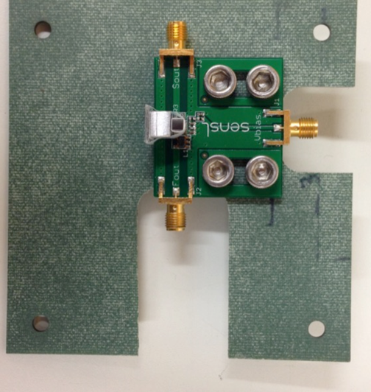
⁹⁰Sr β Telescope (A. Zatserklyaniy, Z. Galloway)
Stack of LGAD planes and the trigger plane
Self-shielded LGAD
Quartz-SiPM Trigger
Reduced Inductance

Slide 11
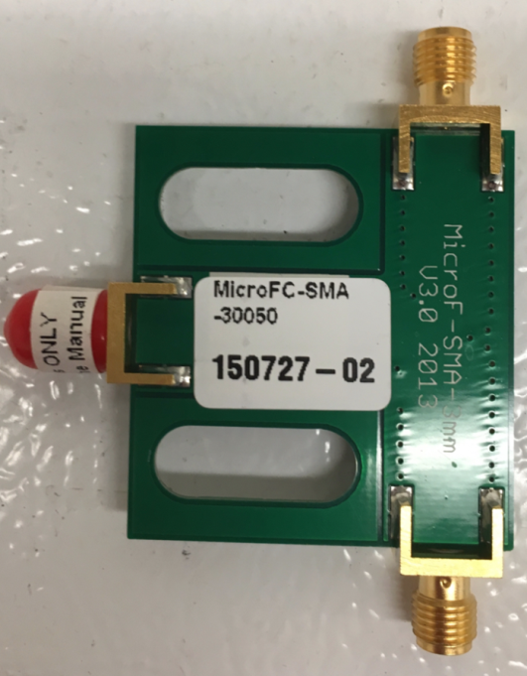
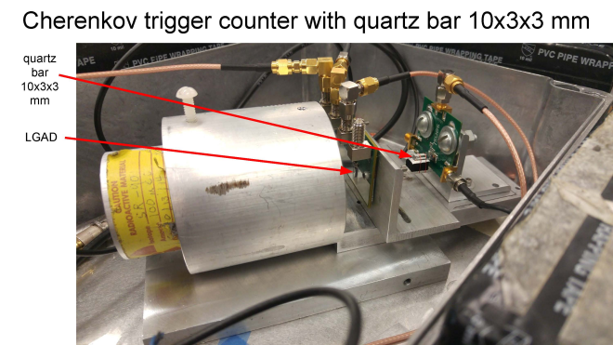
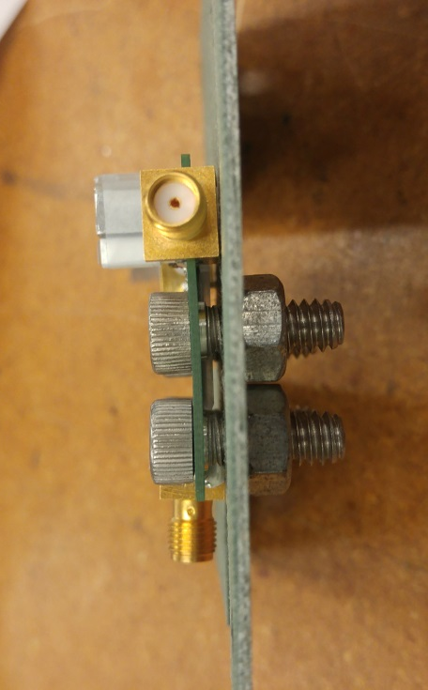
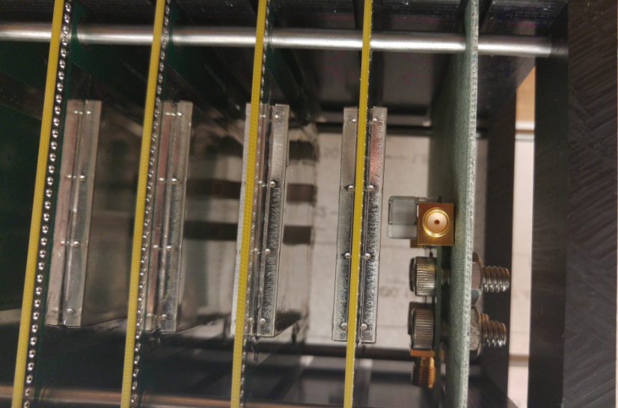
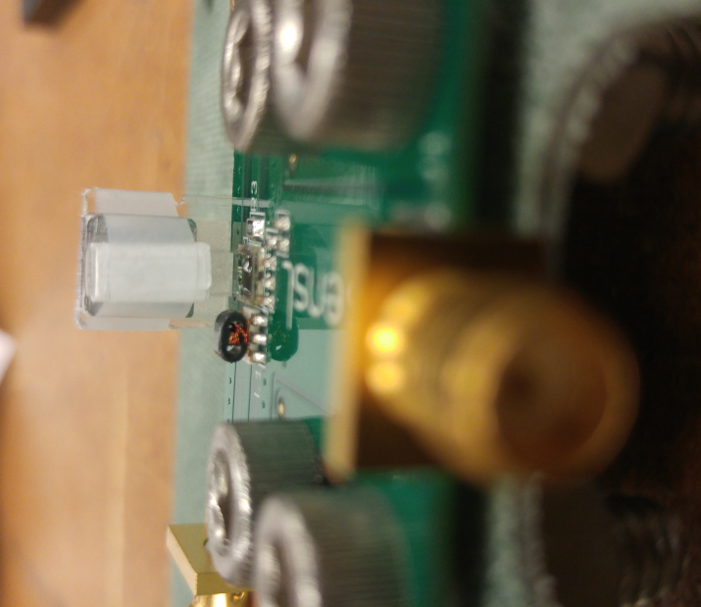
Ultra-Fast Trigger counter
Sensl S-MicroC series evaluation board
http://sensl.com/downloads/ds/DS-MicroCseries.pdf
Trigger: 3x3x10 mm Quartz & SiPM
sensl MicroFC-SMA-30050r
3mmx3mmx10mm quartz block

Slide 12
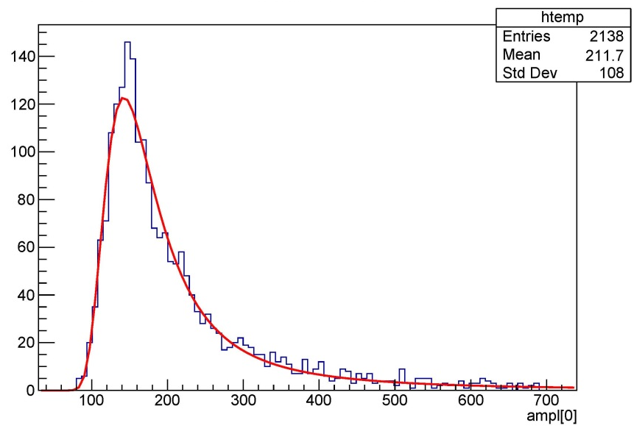
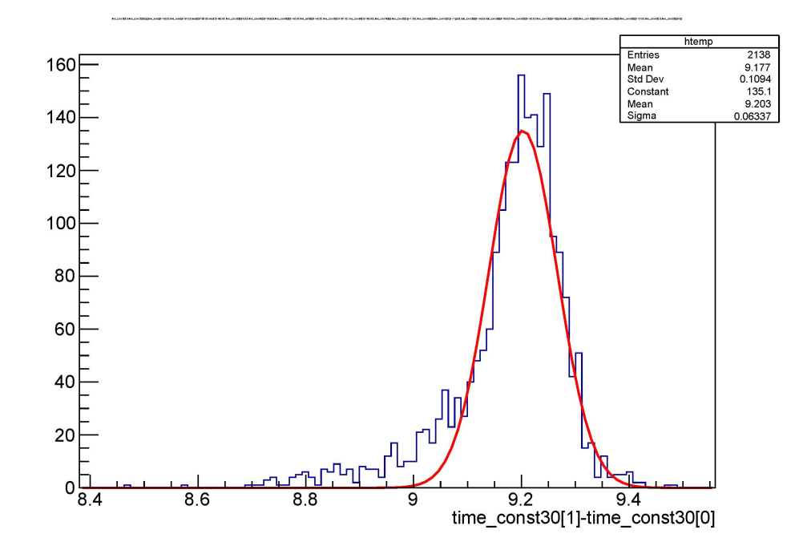
75µm LGAD (6827-W11) in ⁹⁰Sr β-source
Recall timing resolution:
time walk σ_{TW}, is compensated for in both LGAD and trigger with CFD at ≈ 40%
Landau fluctuations σ_{L} are small for thin sensor.
Might be able to get a first evidence of the effect of the TDC binning σ_{TDC}
Data show Landau distribution:
Time difference between one LGAD & trigger:
75µm LGAD (G=5) , β‘s
σ_{Time}= 63ps (Preliminary)

Slide 13
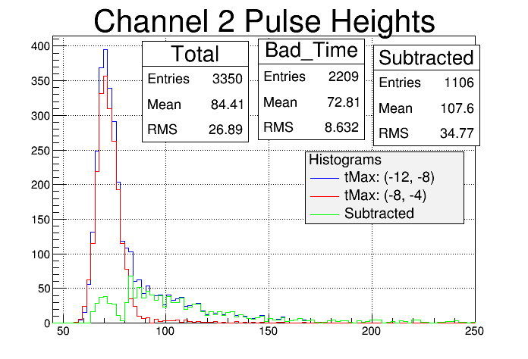
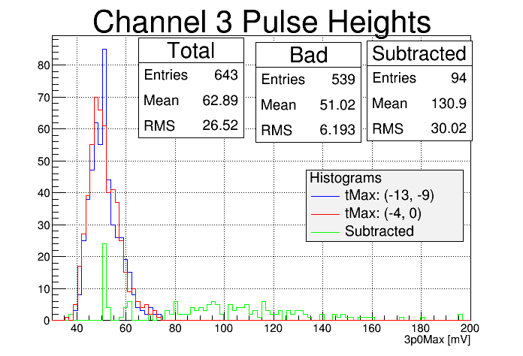
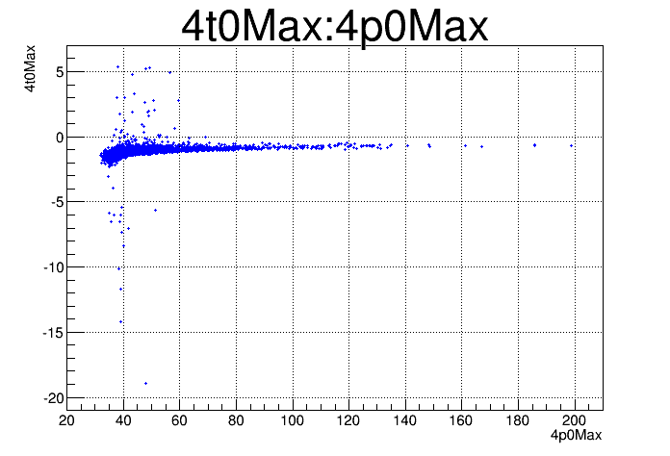
2 LGAD’s: Pulse Height of Maximum
Time vs Pulse height
LGAD #1: arms the trigger
blue: all events
red: side bands
green: subtraction
Time vs Pulse height
LGAD #2: not in trigger
blue: all events
red: side bands
green: subtraction
Time vs Pulse height
Trigger
has to be treated like data, correct for time walk (CFD)

Slide 14
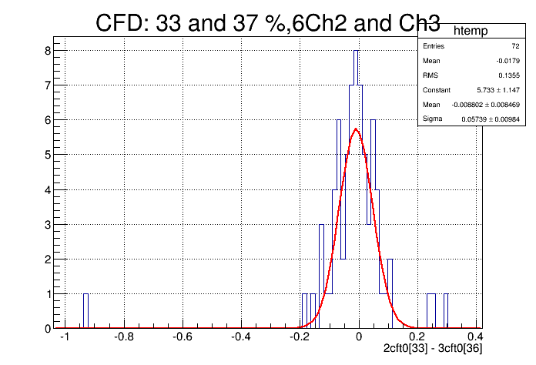
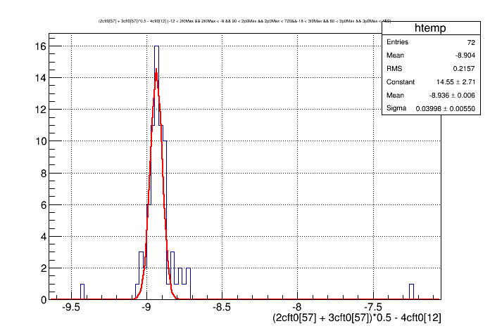
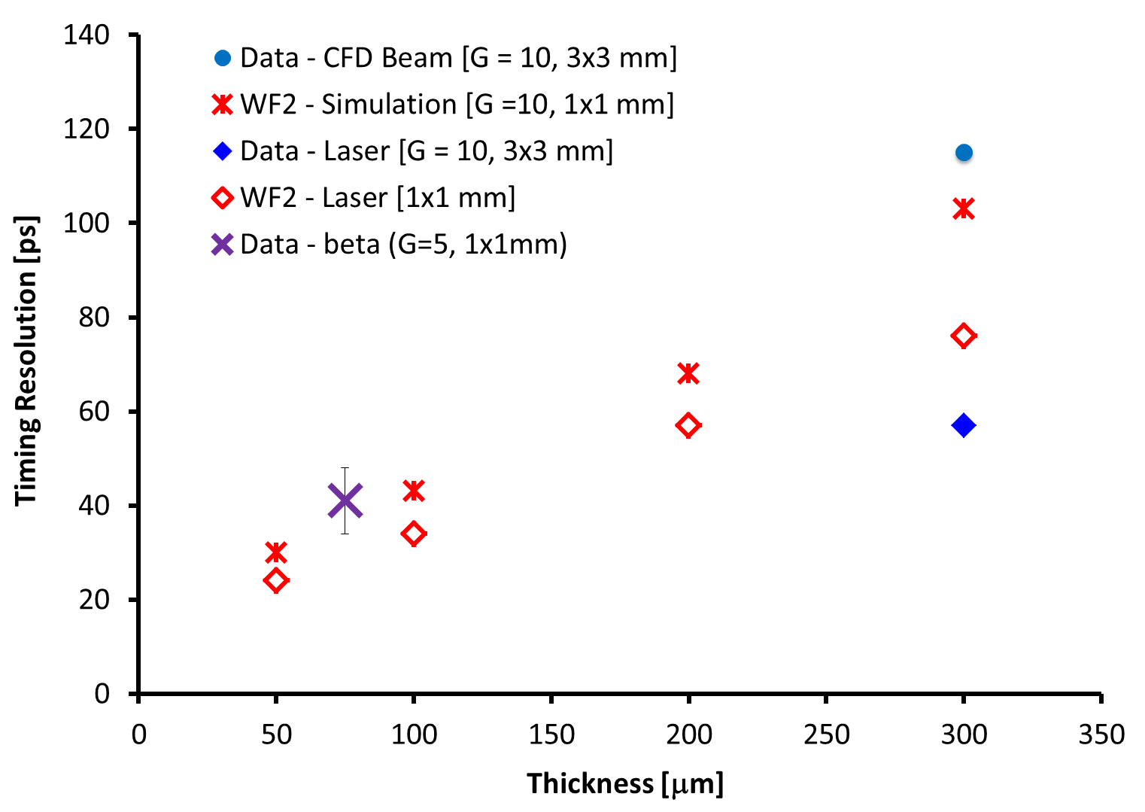
β Coincidence Data of 2 Thin LGAD
Plot time differences between:
between 2 LGADs average:
57±9ps
2. between average of 2 LGADs and trigger:
40±6 ps
Timing Resolution (preliminary)
using Scope (sampling 20GS/s = 50ps) :
LGAD (75µ,G=5) , σ_{Time}= 41±7ps
using SamPic (sampling 6.4 GS/s=156ps):
LGAD (75µ,G=5) , σ_{Time}= 85ps
Quartz&SiPM Trigger:σ_{Time}= 28ps

Slide 15
Conclusions
On two non-irradiated LGAD with gain of 10 and 2, respectively, we compared 3 different methods to extract the gain and found consistent answers.
We developed a laboratory test set-up based on a ⁹⁰Sr source and a fast trigger counter of 20-30 ps timing resolution to
  develop and test readout modules for beam tests
  evaluate DAQ systems beyond the DigScope for fast sensors:
  is 10GS/s of SamPic good enough?
  measure the timing resolution of LGAD:
  for LGAD of gain = 5 and 75µm thickness we find
  a timing resolution of ~ 40ps, consistent with the 50ps predicted by WF2
We are looking forward testing the new generation of thin LGAD
from CNM and FBK being presented at this meeting.
Thanks to the contributors to this work (next slide) and the organizers of this RD50 Collaboration Meeting.

Slide 16
Contributors
A. Anker, J. Chen, V. Fadeyev, P. Freeman, Z. Galloway, B. Gruey, H. Grabas, L. Hibbard,
C. Labitan, Z. Liang, R. Losakul, Z. Luce, N. Maher, S. N. Mak, C. W. Ng,
H. F.-W. Sadrozinski, A. Seiden, E. Spencer, M. Wilder, N. Woods, A. Zatserklyaniy
SCIPP, Univ. of California Santa Cruz, CA 95064, USA
B. Baldassarri, N. Cartiglia, F. Cenna, M. Ferrero
Univ. of Torino and INFN, Torino, Italy
G. Pellegrini, S. Hidalgo, M. Baselga, M. Carulla,
P. Fernandez-Martinez, D. Flores, A. Merlos, D. Quirion
Centro Nacional de Microelectrónica (CNM-CSIC), Barcelona, Spain
Students in bold

Slide 17
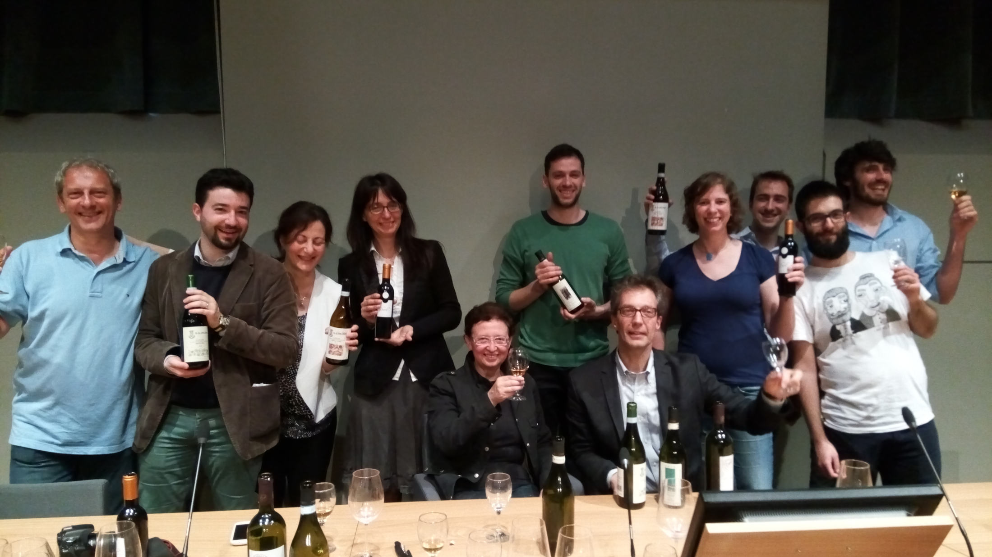
Your hosts hard at work!

