Slide 1
Radiation Damage TCAD Analysis of
Low Gain Avalanche Detectors
F.R. Palomo¹, M. Carulla², S. Hidalgo² ,G. Pellegrini² ,I. Vila^{3,}
rogelio@zipi.us.es
salvador.hidalgo@csic.es
¹Departamento Ingeniería Electrónica, Escuela Superior de Ingenieros
Universidad de Sevilla, Spain
²Instituto de Microelectrónica de Barcelona, Centro Nacional de Microelectrónica, Barcelona, Spain
³Instituto de Física de Cantabria, Santander, Spain

Slide 2
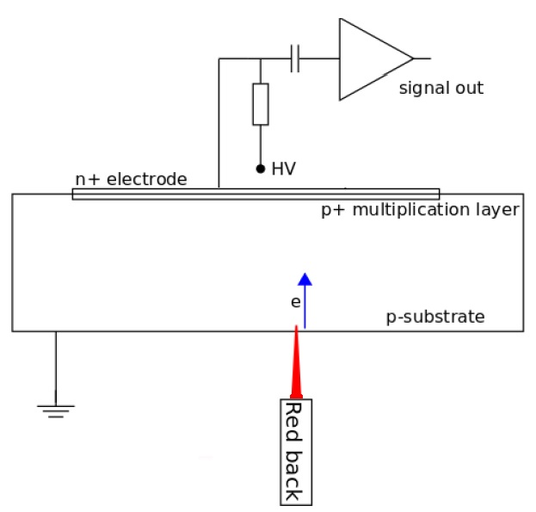
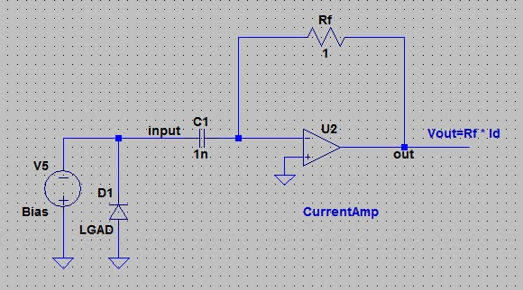
Sentaurus TCAD Simulation SetUp
Mixed Simulation Setup:
Red Pulsed Laser: 670 nm, 10 μm spot, 1e4W/cm², 50 ps, BackIllumination at Device Center
ReadOut: gain unity current amplifier (Rf=1), AC (1 nF) coupled
2D detector model: 1 μm in Z direction, 3 mm in X direction,
300 μm in Y direction)
Simulation
Setup
ReadOut Simulation Setup
z
Red Pulsed
Laser
x
y
Collector
Ring
P-Stop
C-Stop
Low Gain Avalanche Detector (LGAD)
cross-section
Doping profiles under confidenciality rules

Slide 3
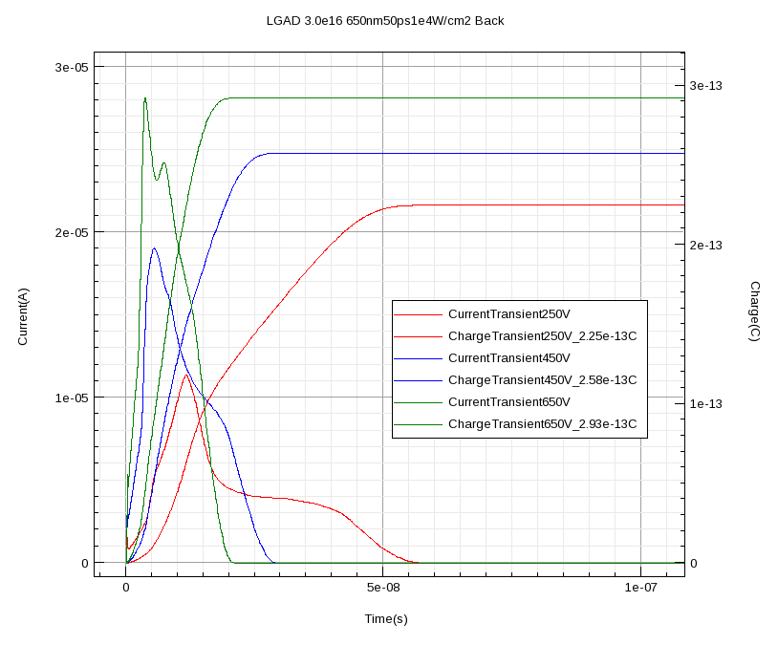
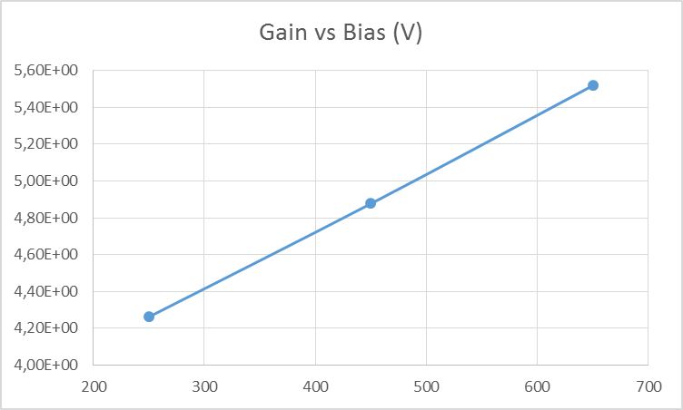
LGAD
5,52
4,88
4,26
LGAD current transient, variable bias
& Total transient charge
Gain=(Q_{LGAD}/Q_{PiN} )|_{bias}
LGAD Bias Analysis: 250V, 450V, 650V, Gain shows a linear increase with bias
The equivalent PiN is an LGAD device without Pwell (gain well)

Slide 4
Radiation Damage Models
CMS Proton Model
Four damage models
Pennicard Model φ =1e12 up to 1e14 n_{eq}/cm²
CMS Proton and Neutron model φ = 1e14-1e15 n_{eq}/cm²
Delhi Model Proton φ = 1e14-1e15 n_{eq}/cm²
New Perugia Model φ =1e12 up to 2e16 n_{eq}/cm²
CMS Neutron Model
Simulation of Silicon Devices for the CMS Phase II Tracker Upgrade CMS Note 250887
New Perugia
Pennicard Model
N(cm⁻³)=η_{int} x φ
Simulations of radiation-damaged 3D detectors for the Super-LHC, D.Pennicard et al. NIMA 592(1-2), 2008, pp16-25
Delhi Model
N(cm⁻³)=g_{int} x φ
Modeling of radiation damage effects in silicon detectors at high fluences
HL-LHC with Sentaurus TCAD, D.Passeri et al, NIMA 824 (2016), 443-445
Combined effect of bulk and Surface damage on strip insulation properties of proton irradiated n+-p silicon strip sensors, R.Dalal et al. JINST 2014 9 P04007

Slide 5
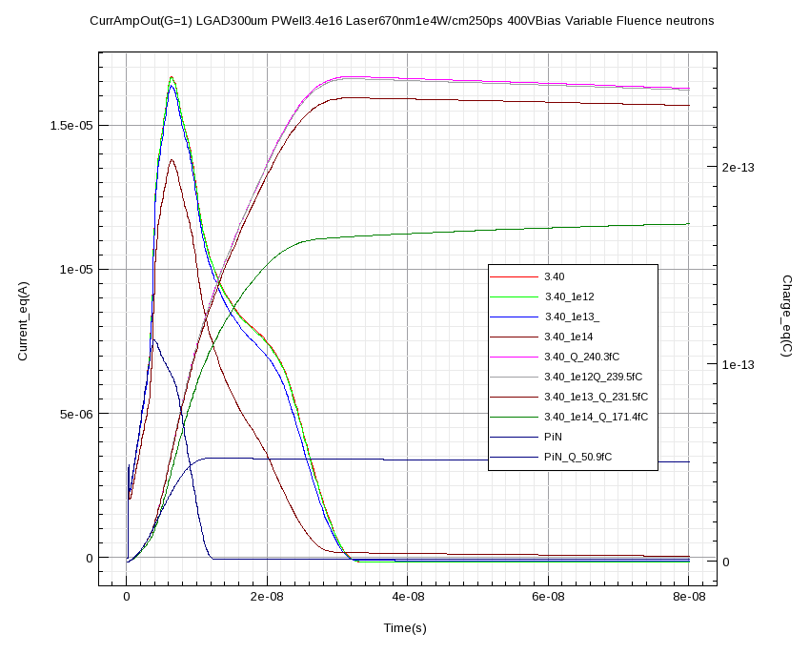
LGAD
Pulsed red laser transient, current amp readout (gain=1)
Pennicard Damage Model
LGAD 400V Bias
Fluence | Gain
0 | 4,80
1e12 | 4,72
1e13 | 4,54
1e14 | 3,36
Pennicard model valid up to 1e14 n_{eq}/cm².
It shows that LGAD does not experiment a significative gain reduction up
to 1e14. At 1e14, gain decreases 29%.
## Putting traps in Silicon region only
## Trap concentrations found from Petasecca model and modified by
D. Pennicard, Fluence=1E14
Physics (material="Silicon") {
# Putting traps in silicon region only
# Modified Perugia model with trapping times at reported value
Traps (
(Acceptor Level EnergyMid=0.42 fromCondBand Conc=1.1613E14 Randomize=0.29 eXsection=9.5E-15 hXsection=9.5E-14) #Conc=Fluence*1.1613
(Acceptor Level EnergyMid=0.46 fromCondBand Conc=0.9E14 Randomize=0.23 eXsection=5E-15 hXsection=5E-14 ) #Conc=Fluence*0.9
(Donor Level EnergyMid=0.36 fromValBand Conc=0.9E14 Randomize=0.31 eXsection=3.23E-13 hXsection=3.23E-14 ) #Conc=Fluence*0.9
)
}
(Reference PiN Charge 50.9 fC)

Slide 6
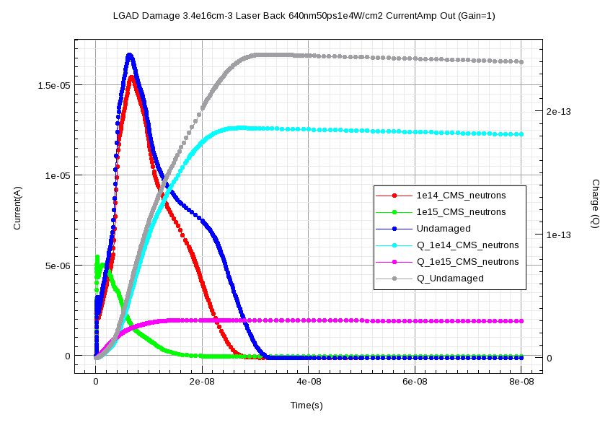
LGAD
Pulsed red laser transient, current amp readout (gain=1)
CMS Neutron Damage Model
Fluence | Charge (fC) | Gain
0 | 244,0 | 4,80
1e14 | 186,1 | 3,66
1e15 | 30,7 | 0,60
## Putting traps in Silicon region only
## Trap concentrations found from CMS Two level neutrons
#Fluence=1E14
Physics (material="Silicon") {
# Putting traps in silicon region only
Traps (
(Acceptor Level EnergyMid=0.525 fromCondBand Conc=1.55E14 eXsection=1.2E-14 hXsection=1.2E-14)
(Donor Level EnergyMid=0.48 fromValBand Conc=1.395E14 eXsection=1.2E-14 hXsection=1.2E-14)
)
}
PIN DIODE
Non Irradiated

Slide 7
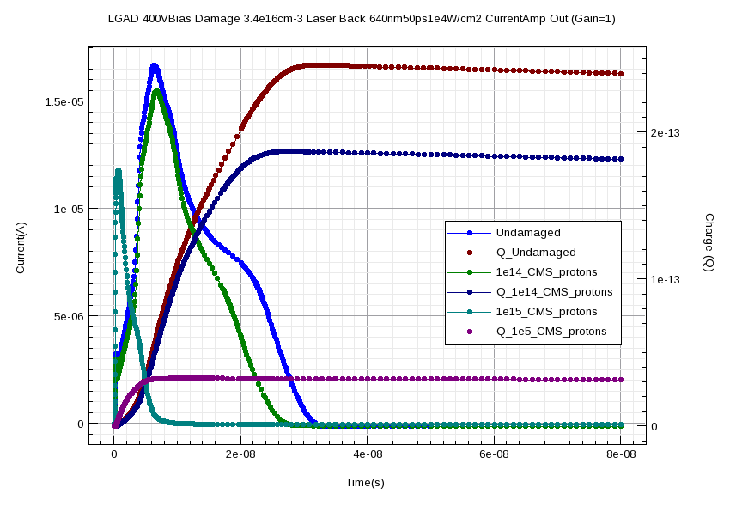
LGAD
Pulsed red laser transient, current amp readout (gain=1)
CMS Proton Damage Model
Fluence | Charge (fC) | Gain
0 | 244,0 | 4,80
1e14 | 186,7 | 3,67
1e15 | 24,6 | 0,48
## Putting traps in Silicon region only
## Trap concentrations found from CMS Two level protons
#Fluence=1E14
Physics (material="Silicon") {
# Putting traps in silicon region only
Traps (
(Acceptor Level EnergyMid=0.525 fromCondBand Conc=1.8344E14 eXsection=1E-14 hXsection=1E-14)
(Donor Level EnergyMid=0.48 fromValBand Conc=1.6390E14 eXsection=1E-14 hXsection=1E-14)
)
}
PIN DIODE
Non Irradiated

Slide 8
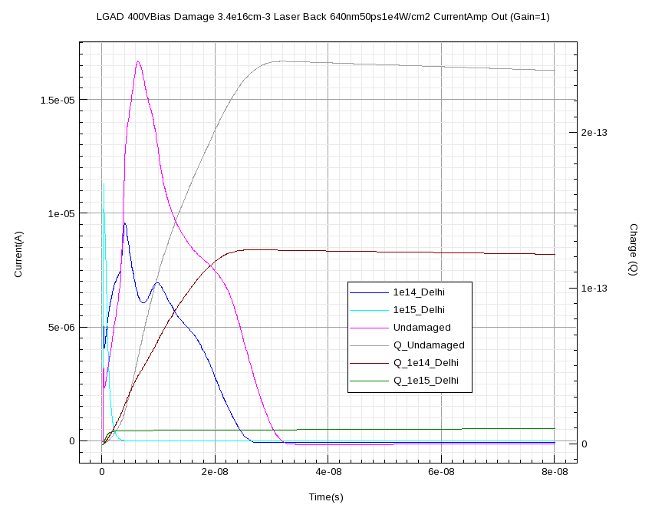
LGAD
Pulsed red laser transient, current amp readout (gain=1)
Delhi Damage Model
Fluence | Charge (fC) | Gain
0 | 244,0 | 4,80
1e14 | 124,6 | 2,45
1e15 | 9,4 | 0,18
## Putting traps in Silicon region only
## Trap concentrations found from Delhi Two level
#Fluence=1E14
Physics (material="Silicon") {
# Putting traps in silicon region only
Traps (
(Acceptor Level EnergyMid=0.51 fromCondBand Conc=4E14 eXsection=2E-14 hXsection=3.8E-15)
(Donor Level EnergyMid=0.48 fromValBand Conc=3E14 eXsection=2E-15 hXsection=2E-15)
)
}
PIN DIODE
Non Irradiated

Slide 9
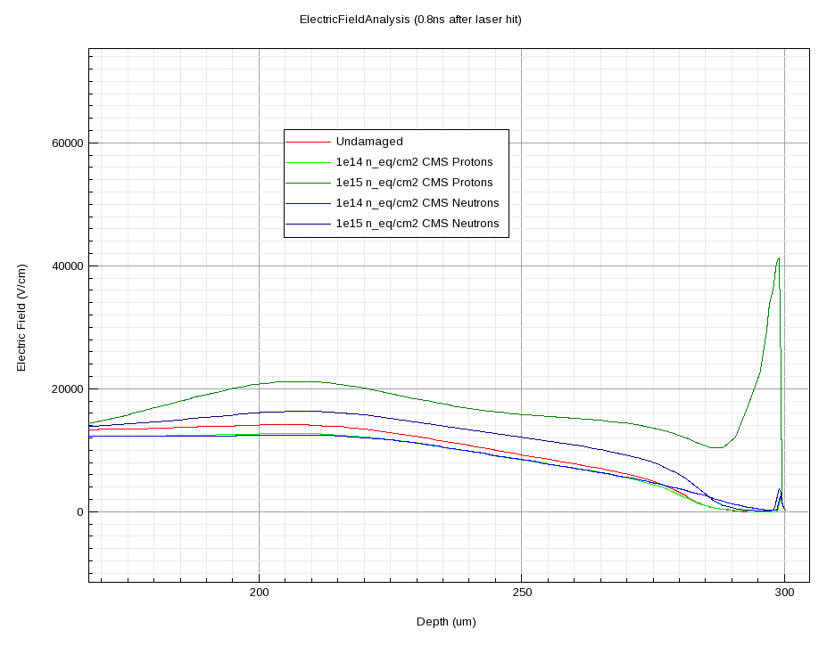
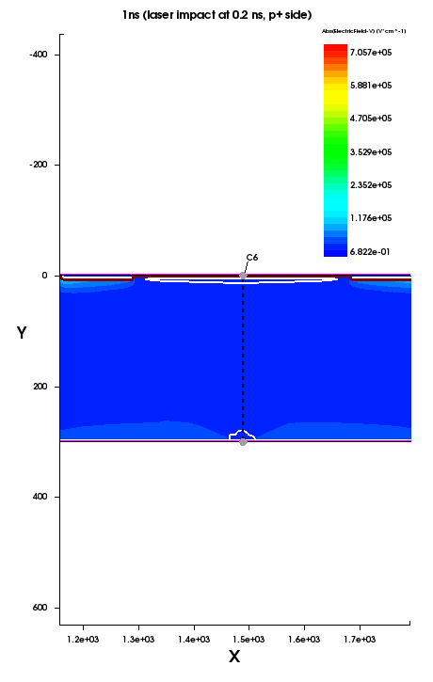
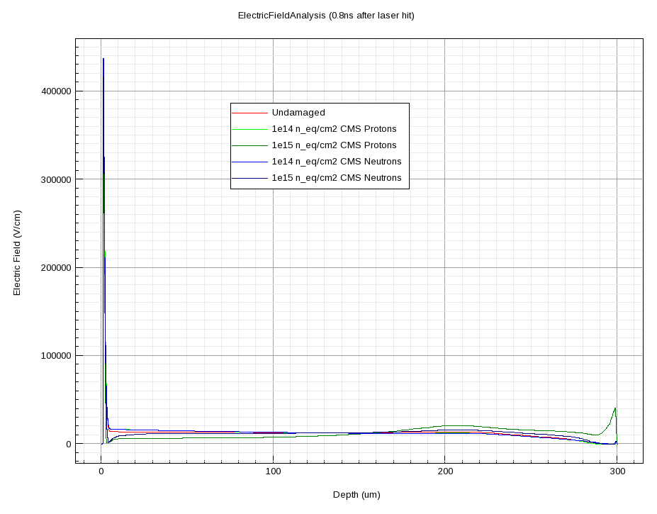
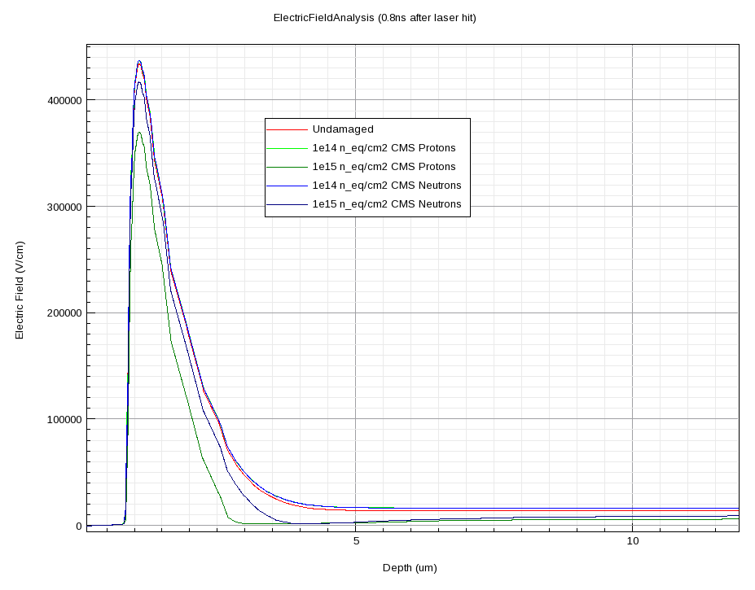
LGAD
All Models show a similar panorama
CMS Model
Electric Field along Y axis
Back side detail
1e15
Front side
Back side
Front side detail
At 1e15 a double junction appears at P+ volumen (device back side)
1e15
Electric Field Profiling

Slide 10
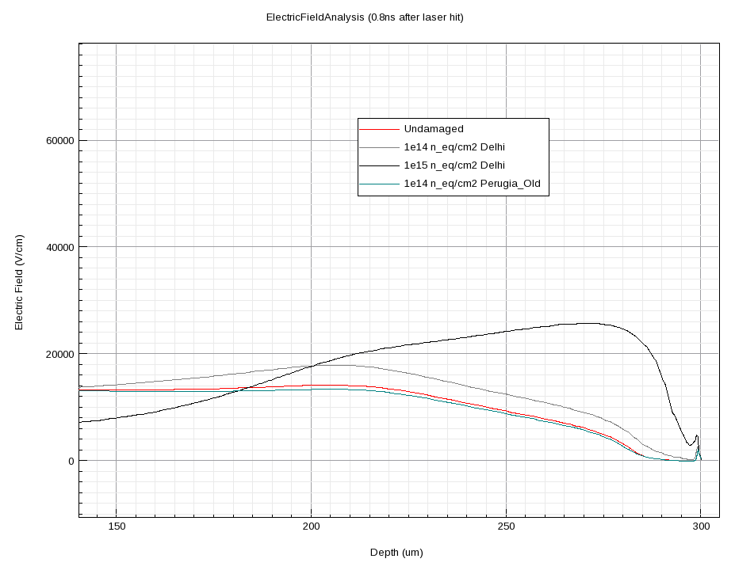
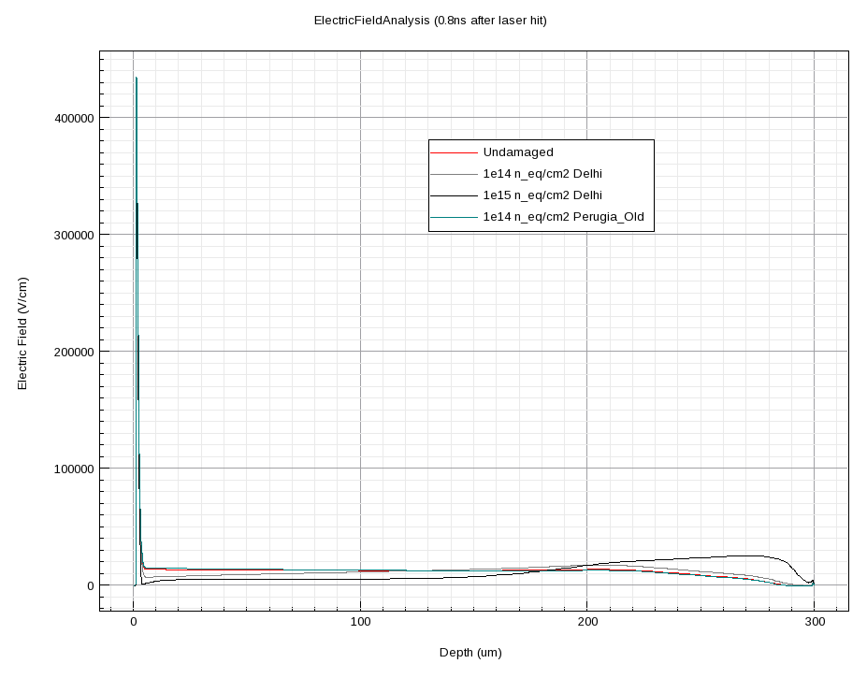
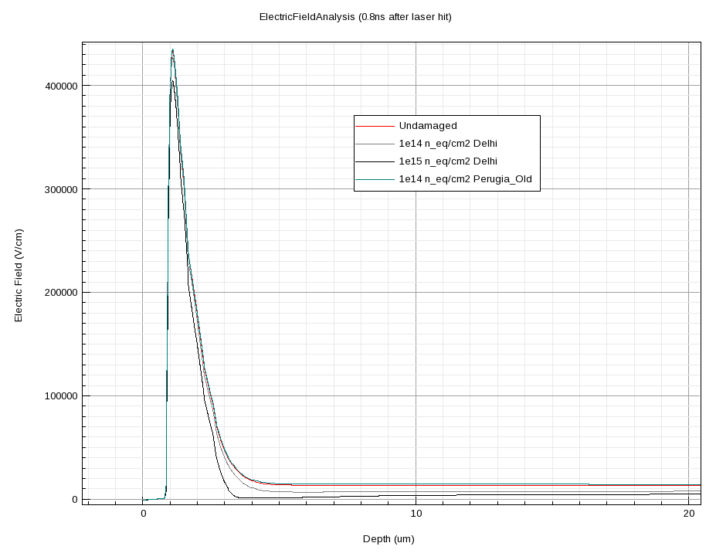
LGAD
Delhi Models
Electric Field along Y axis
Front side
Back side detail
1e15
Back side
Front side detail
At 1e15 a double junction appears
at P+ volume
Electric Field Profiling
1e15

Slide 11
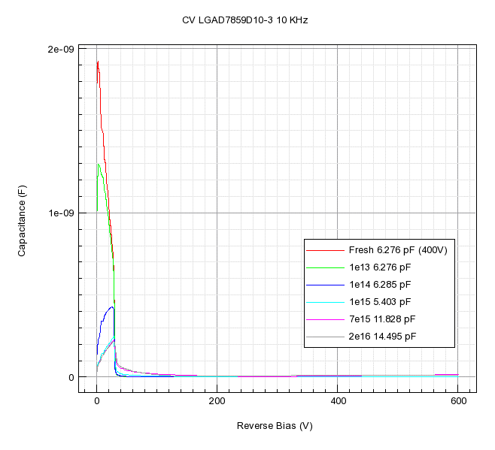
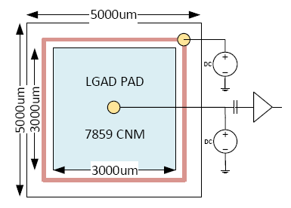
LGAD7859D10-3
CV analysis
This LGAD is fully depleted past 70V
Capacitance shows a clear increase beyond 1e15 n/cm²
1/C² formula is not clear beyond 1e14
Now, we analyze a real device, the PAD LGAD7859D10-3
It has JTE’s, 300 μm thickness one extraction ring.
CV Analysis with:
New Perugia Model:
Fresh
2. 1e13-1e14-1e15-7e15-2e16 n/cm²
Temperature = 20ºC

Slide 12
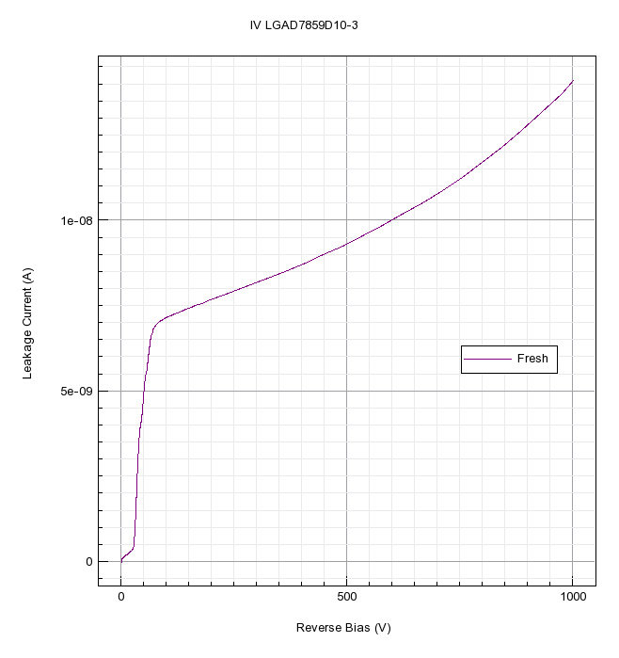
LGAD7859D10-3
CV analysis
IV Analysis with:
New Perugia Model:
Fresh
2. 1e13-1e14-1e15-7e15-2e16 n/cm²
Temperature = 20ºC
IV plots show problems starting at 1e15, the leakage grows a lot and even the general curve is different. This is coincident with the previous models.

Slide 13
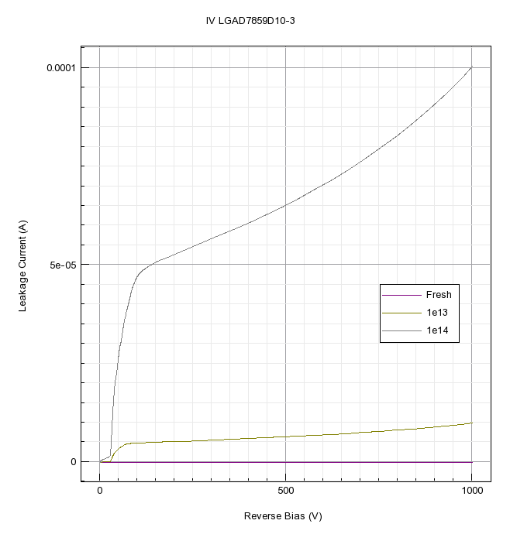
LGAD7859D10-3
CV analysis
IV Analysis with:
New Perugia Model:
Fresh
2. 1e13-1e14-1e15-7e15-2e16 n/cm²
Temperature = 20ºC
IV plots show problems starting at 1e15, the leakage grows a lot and even the general curve is different. This is coincident with the previous models.

Slide 14
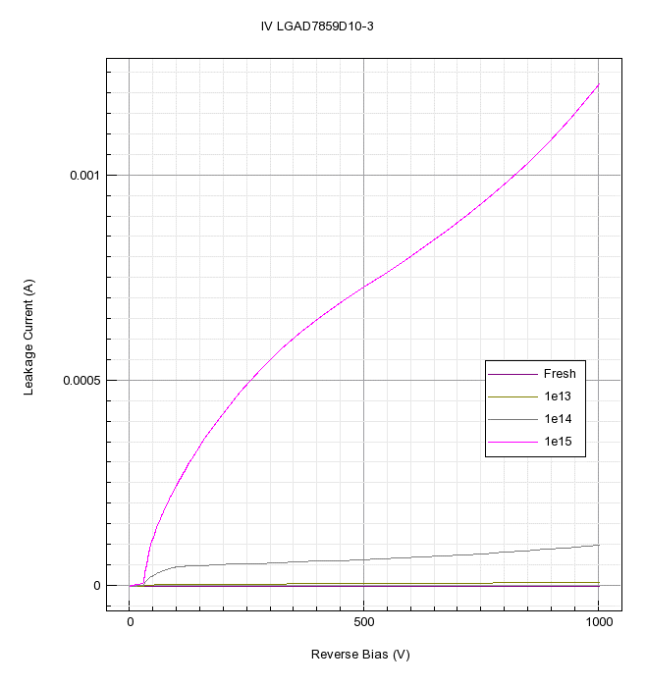
LGAD7859D10-3
CV analysis
IV Analysis with:
New Perugia Model:
Fresh
2. 1e13-1e14-1e15-7e15-2e16 n/cm²
Temperature = 20ºC
IV plots show problems starting at 1e15, the leakage grows a lot and even the general curve is different. This is coincident with the previous models.

Slide 15
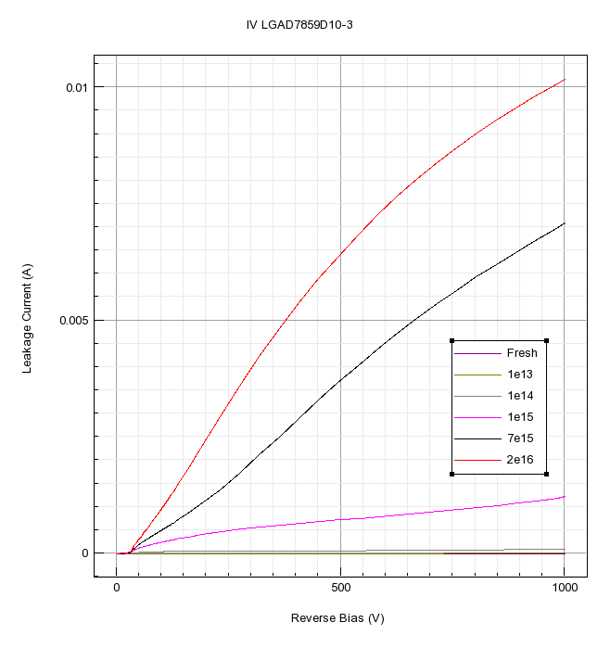
LGAD7859D10-3
CV analysis
IV Analysis with:
New Perugia Model:
Fresh
2. 1e13-1e14-1e15-7e15-2e16 n/cm²
Temperature = 20ºC
IV plots show problems starting at 1e15, the leakage grows a lot and even the general curve is different. This is coincident with the previous models.

Slide 16
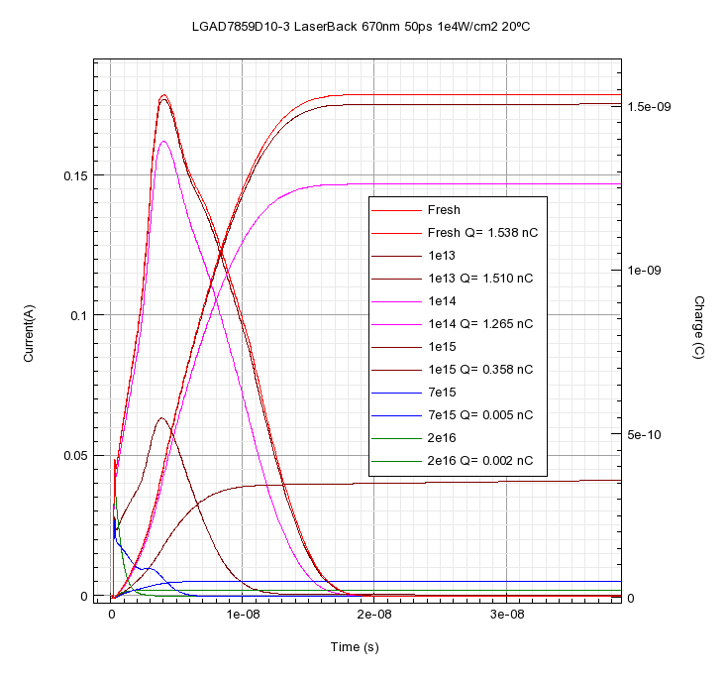
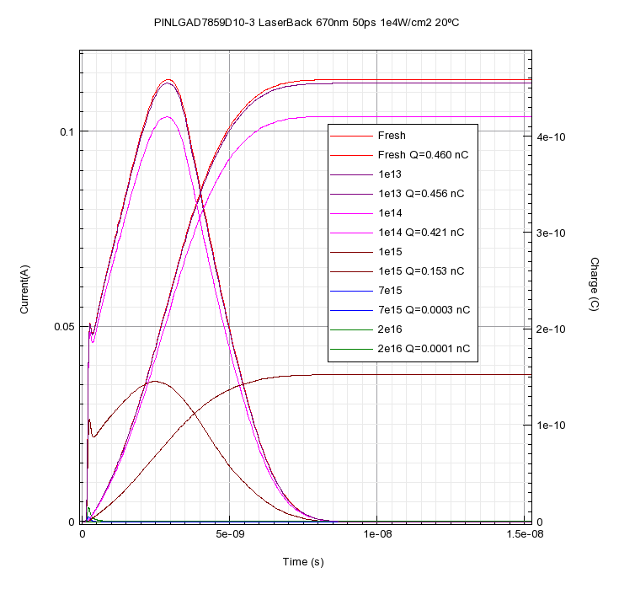
Laserback LGAD7958D10-3 20ºC
Equiv. PIN Detector,
700V bias (an LGAD without mult.P layer)
Fluence n/cm² | Charge LGAD (nC) | Charge PIN (nC) | Gain Q_{lgad}/Q_{pin}
0 | 1,538 | 0,460 | 3,34
1e13 | 1,510 | 0,456 | 3,31
1e14 | 1,265 | 0,421 | 3,00
1e15 | 0,358 | 0,153 | 2,34
7e15 | 0,005 | FAIL | ---
2e16 | 0,002 | FAIL | ---
Refined models show same conclusions: beyond 1e15 n/cm² the 300 μm LGAD has problems (but for PIN are worst!)
LGAD Detector
300 μm
700V bias
(We compare LGAD and PIN at same fluence to obtain a practical Gain Definition)

Slide 17
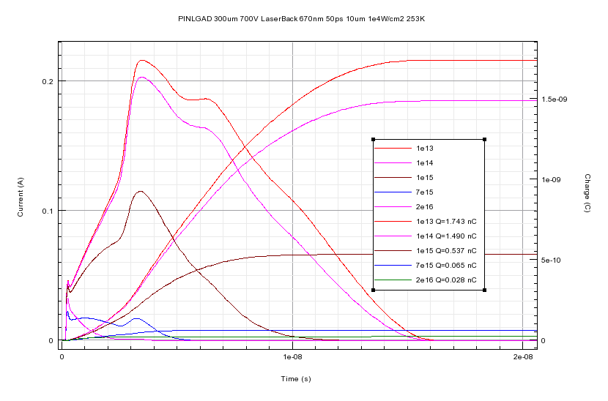
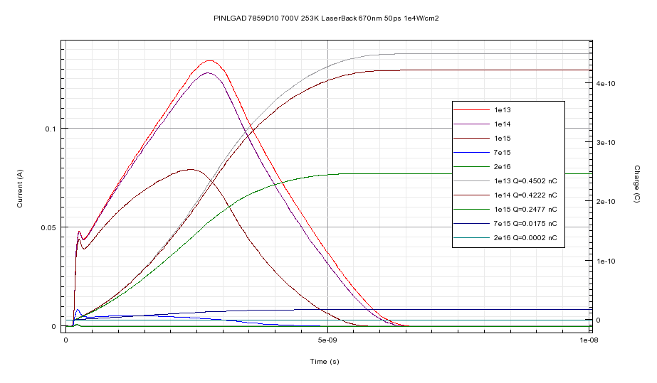
Laserback LGAD7958D10-3 -20ºC
PIN Detector
700 V bias
(LGAD without
mult. P Layer)
Fluence n/cm² | Charge LGAD (nC) | Charge PIN (nC) | Gain Q_{lgad}/Q_{pin}
1e13 | 1,743 | 0,4502 | 3,87
1e14 | 1,454 | 0,4222 | 3,53
1e15 | 0,561 | 0,2477 | 2,17
7e15 | 0,065 | 0,0175 | 3,61
2e16 | 0,028 | FAIL | ---
Lowering to 253 K improves the radiation hardness, as expected, but avoid false friends (7e15 case, PIN is failing)
LGAD Detector
300 μm
700V bias
(We compare LGAD and PIN at same fluence to obtain a practical Gain Definition)

Slide 18
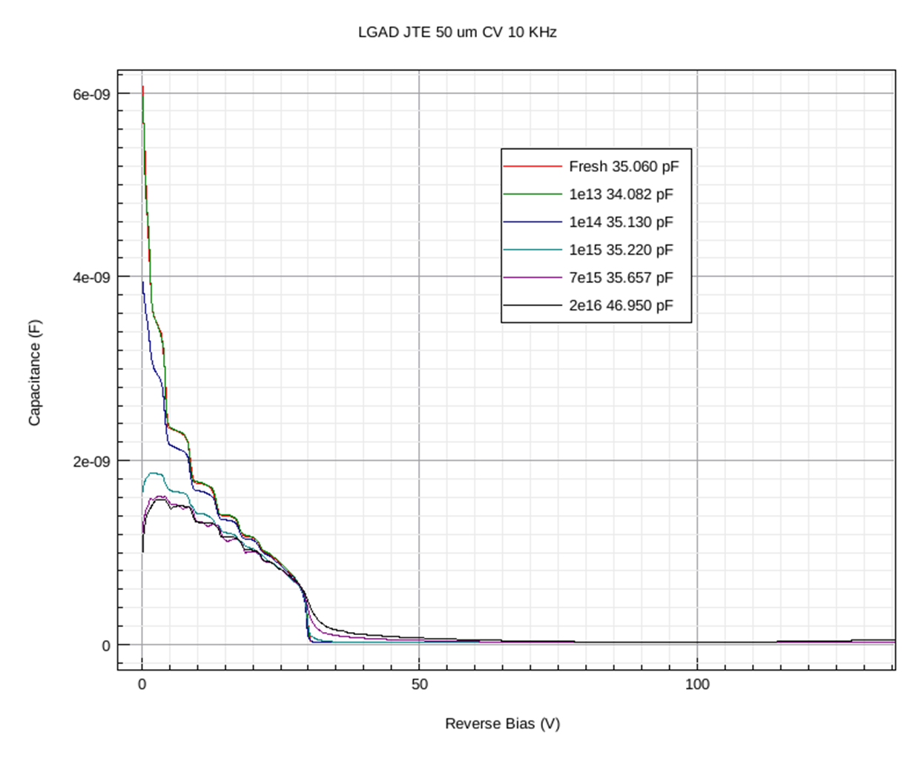
LGAD7859D10-3 50 μm thickness
CV analysis
This LGAD is fully depleted past 35V
Capacitance shows a moderate increase beyond 7e15 n/cm²
1/C² formula is not clear beyond 7e15
Displacement damage scalates down with decreasing device thickness, so let’s explore that avenue: we have gain so signal volumen reduction is compensated by the linear avalanche. The CV for fluence panoplia shows a full depleted device beyond 40V in a thinned LGAD7859 (50 μm thickness).
New Perugia Model:
Fresh
2. 1e13-1e14-1e15-7e15-2e16 n/cm²
Temperature = 20ºC

Slide 19
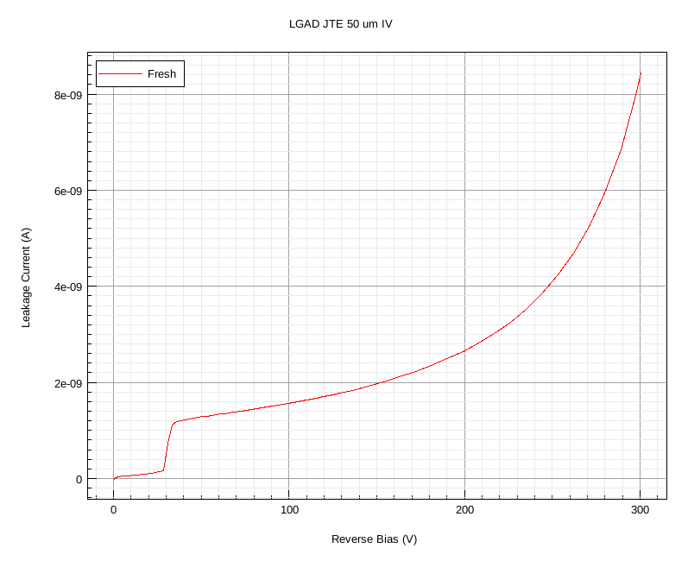
50 μm IV
IV Analysis with:
New Perugia Model:
Fresh
2. 1e13-1e14-1e15-7e15-2e16 n/cm²
Temperature = 20ºC
IV plots shows a promising behaviour even at 7e15 n/cm². These are good news so it’s worth to look at the simulated back laser experiments.

Slide 20
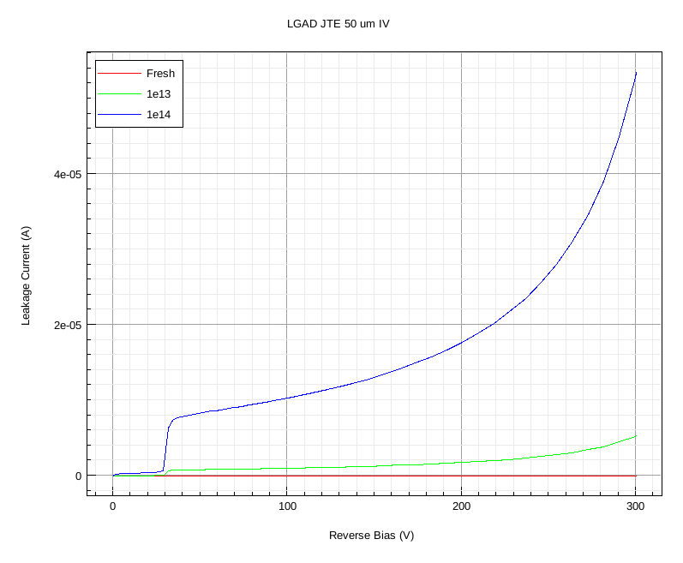
50 μm IV
IV Analysis with:
New Perugia Model:
Fresh
2. 1e13-1e14-1e15-7e15-2e16 n/cm²
Temperature = 20ºC
IV plots shows a promising behaviour even at 7e15 n/cm². These are good news so it’s worth to look at the simulated back laser experiments.

Slide 21
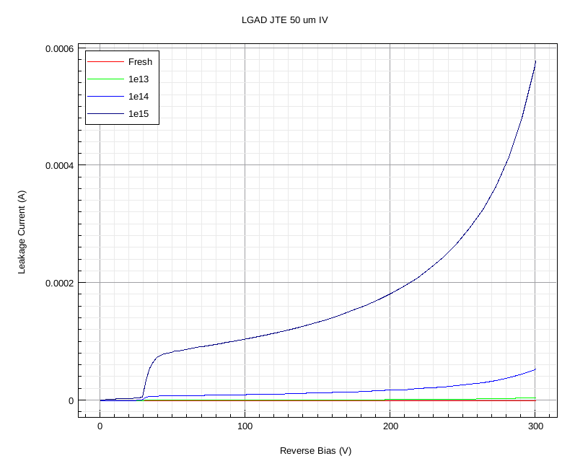
50 μm IV
IV Analysis with:
New Perugia Model:
Fresh
2. 1e13-1e14-1e15-7e15-2e16 n/cm²
Temperature = 20ºC
IV plots shows a promising behaviour even at 7e15 n/cm². These are good news so it’s worth to look at the simulated back laser experiments.

Slide 22
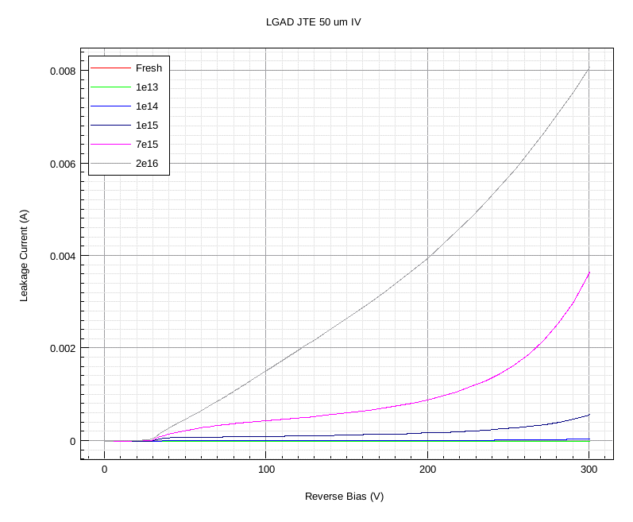
50 μm IV
IV Analysis with:
New Perugia Model:
Fresh
2. 1e13-1e14-1e15-7e15-2e16 n/cm²
Temperature = 20ºC
IV plots shows a promising behaviour even at 7e15 n/cm². These are good news so it’s worth to look at the simulated back laser experiments.

Slide 23
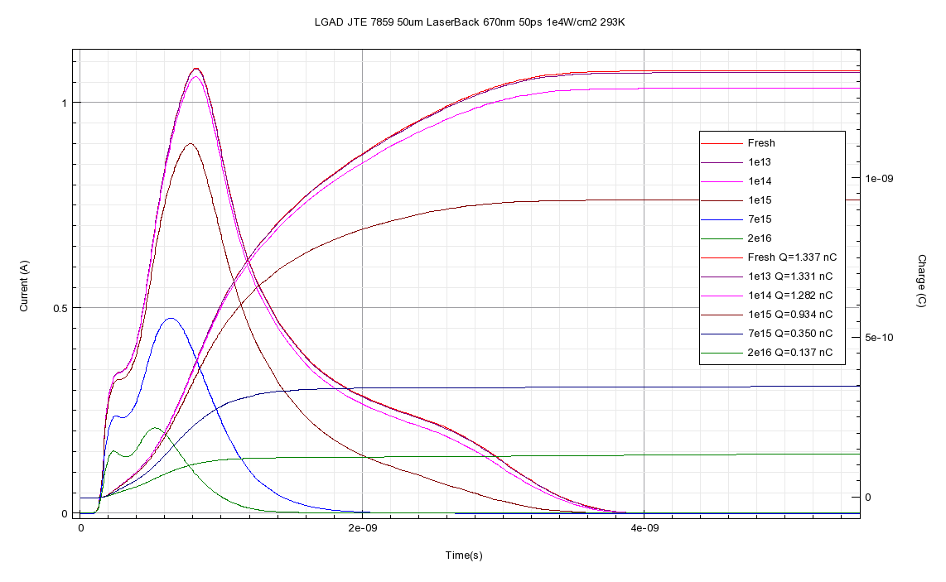
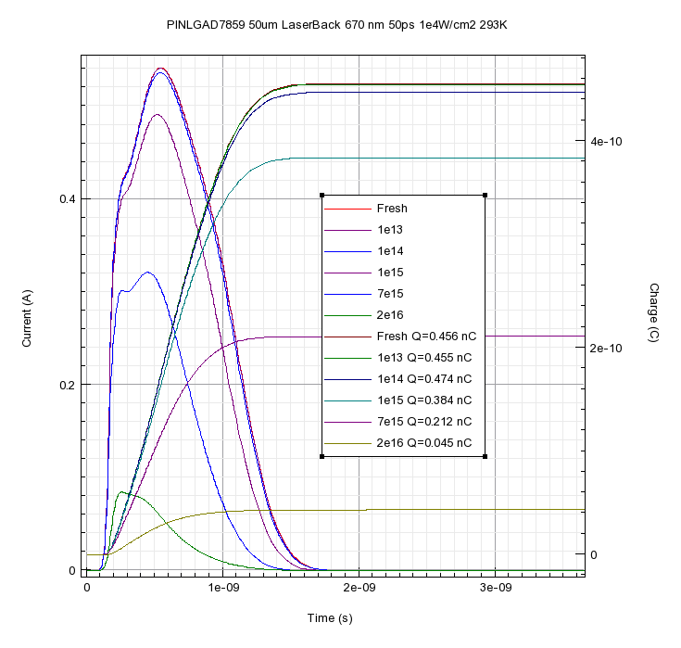
Laserback 50 μm (thinned) LGAD7958D10-3 20ºC
Equiv. PIN Detector,
150V bias
LGAD Detector
50 μm
150V bias
Fluence n/cm² | Charge LGAD (nC) | Charge PIN (nC) | Gain Q_{lgad}/Q_{pin}
0 | 1,337 | 0,456 | 2,93
1e13 | 1,331 | 0,455 | 2,93
1e14 | 1,282 | 0,474 | 2,74
1e15 | 0,934 | 0,384 | 2,43
7e15 | 0,349 | 0,212 | 1,65
2e16 | 0,137 | 0,045 | 3,04
Thinning the LGAD it is a game changer for radiation hardness if we trust Synopsys TCAD. Experiments will tell.
(We compare LGAD and PIN at same fluence to obtain a practical Gain Definition)

Slide 24
Conclusions
LGAD model from CNM, with JTE, guard rings,
p-stops and c-stops.
The 300 μm device withstand radiation damage up to 1e14 n_{eq}/cm², fails approaching 1e15 n_{eq}/cm²
Main fail mechanism: double junction
The 50 μm device withstand radiation damage
beyond 7e15 n_{eq}/cm², moderate fail at 2e16 n_{eq}/cm².
Could it be the solution?, Experiments will tell

Slide 25
Thanks for your attention
fpalomo@us.es

