Slide 1

Silicon sensors with internal gain:
Optimizing for charged particle fast timing
Characterization of
Deep Diffused APDs (non-irradiated) devices from RMD
RD50
RD50 Workshop June 2016, Torino, Italy
Ashutosh Bhardwaj (Delhi), Ranjeet Dalal¹ (Delhi), Marco Fernandez Garcia (Santander), Geetika Jain (Delhi), Changuo Lu (Princeton), Michael Moll (CERN), Kirti Ranjan (Delhi), Sofia Otero Ugobono (CERN), Sebastian White (Princeton, CERN)
OUTLINE:
Concept of Deep Diffused APDs (“Hyperfast Detectors”)
First measurements: Study on homogeneity of response
Simulation of charged particle fast timing
Outlook

Slide 2
Concept of Deep Diffused APD
Deep Diffused APD from RMD (Radiation Monitoring Devices Inc.)
  n-type NTD-doped silicon from Topsil
  Grooving wafer
  Deep diffusion of p-type dopants
    Gallium used as dopant
  Etching of surface layer
[2006, McClish et al., IEEE TNS, 53, 3049 ]
[2004, McClish et al., IEEE TNS]

Slide 3
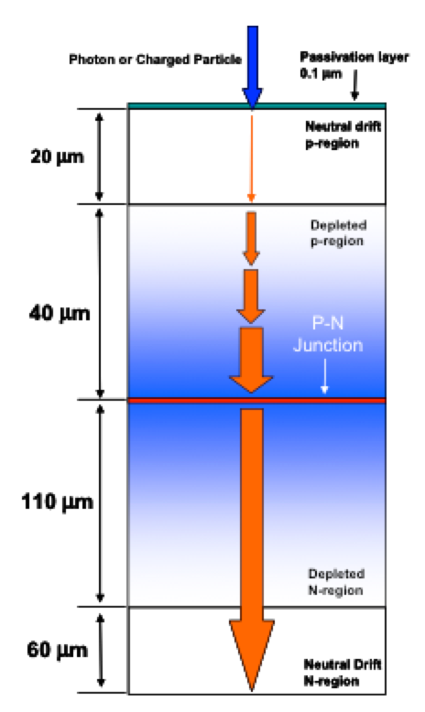
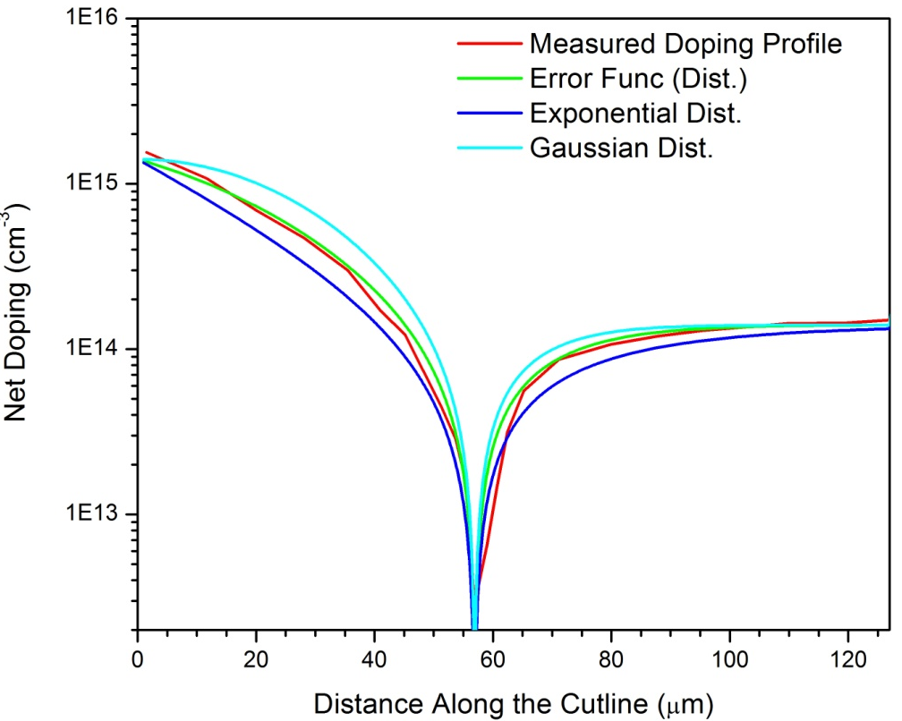
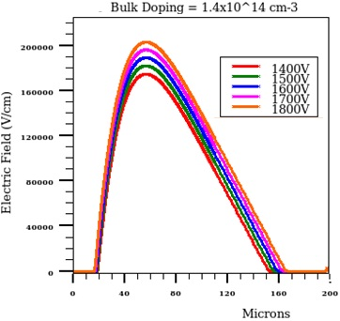
Charge Multiplication and Gain
Deep Diffused APDs
  Amplification deep inside the bulk of the sensor
  Requires high voltage (1700-1800V)
  Delivers high gain and fast response time
[2015, N.Cartiglia, DESY seminar]
Comparison:
Reach-through APD; LGAD
TCAD Simulations
  Doping profile based on measured
  data (literature) used to simulate E-Field

Slide 4
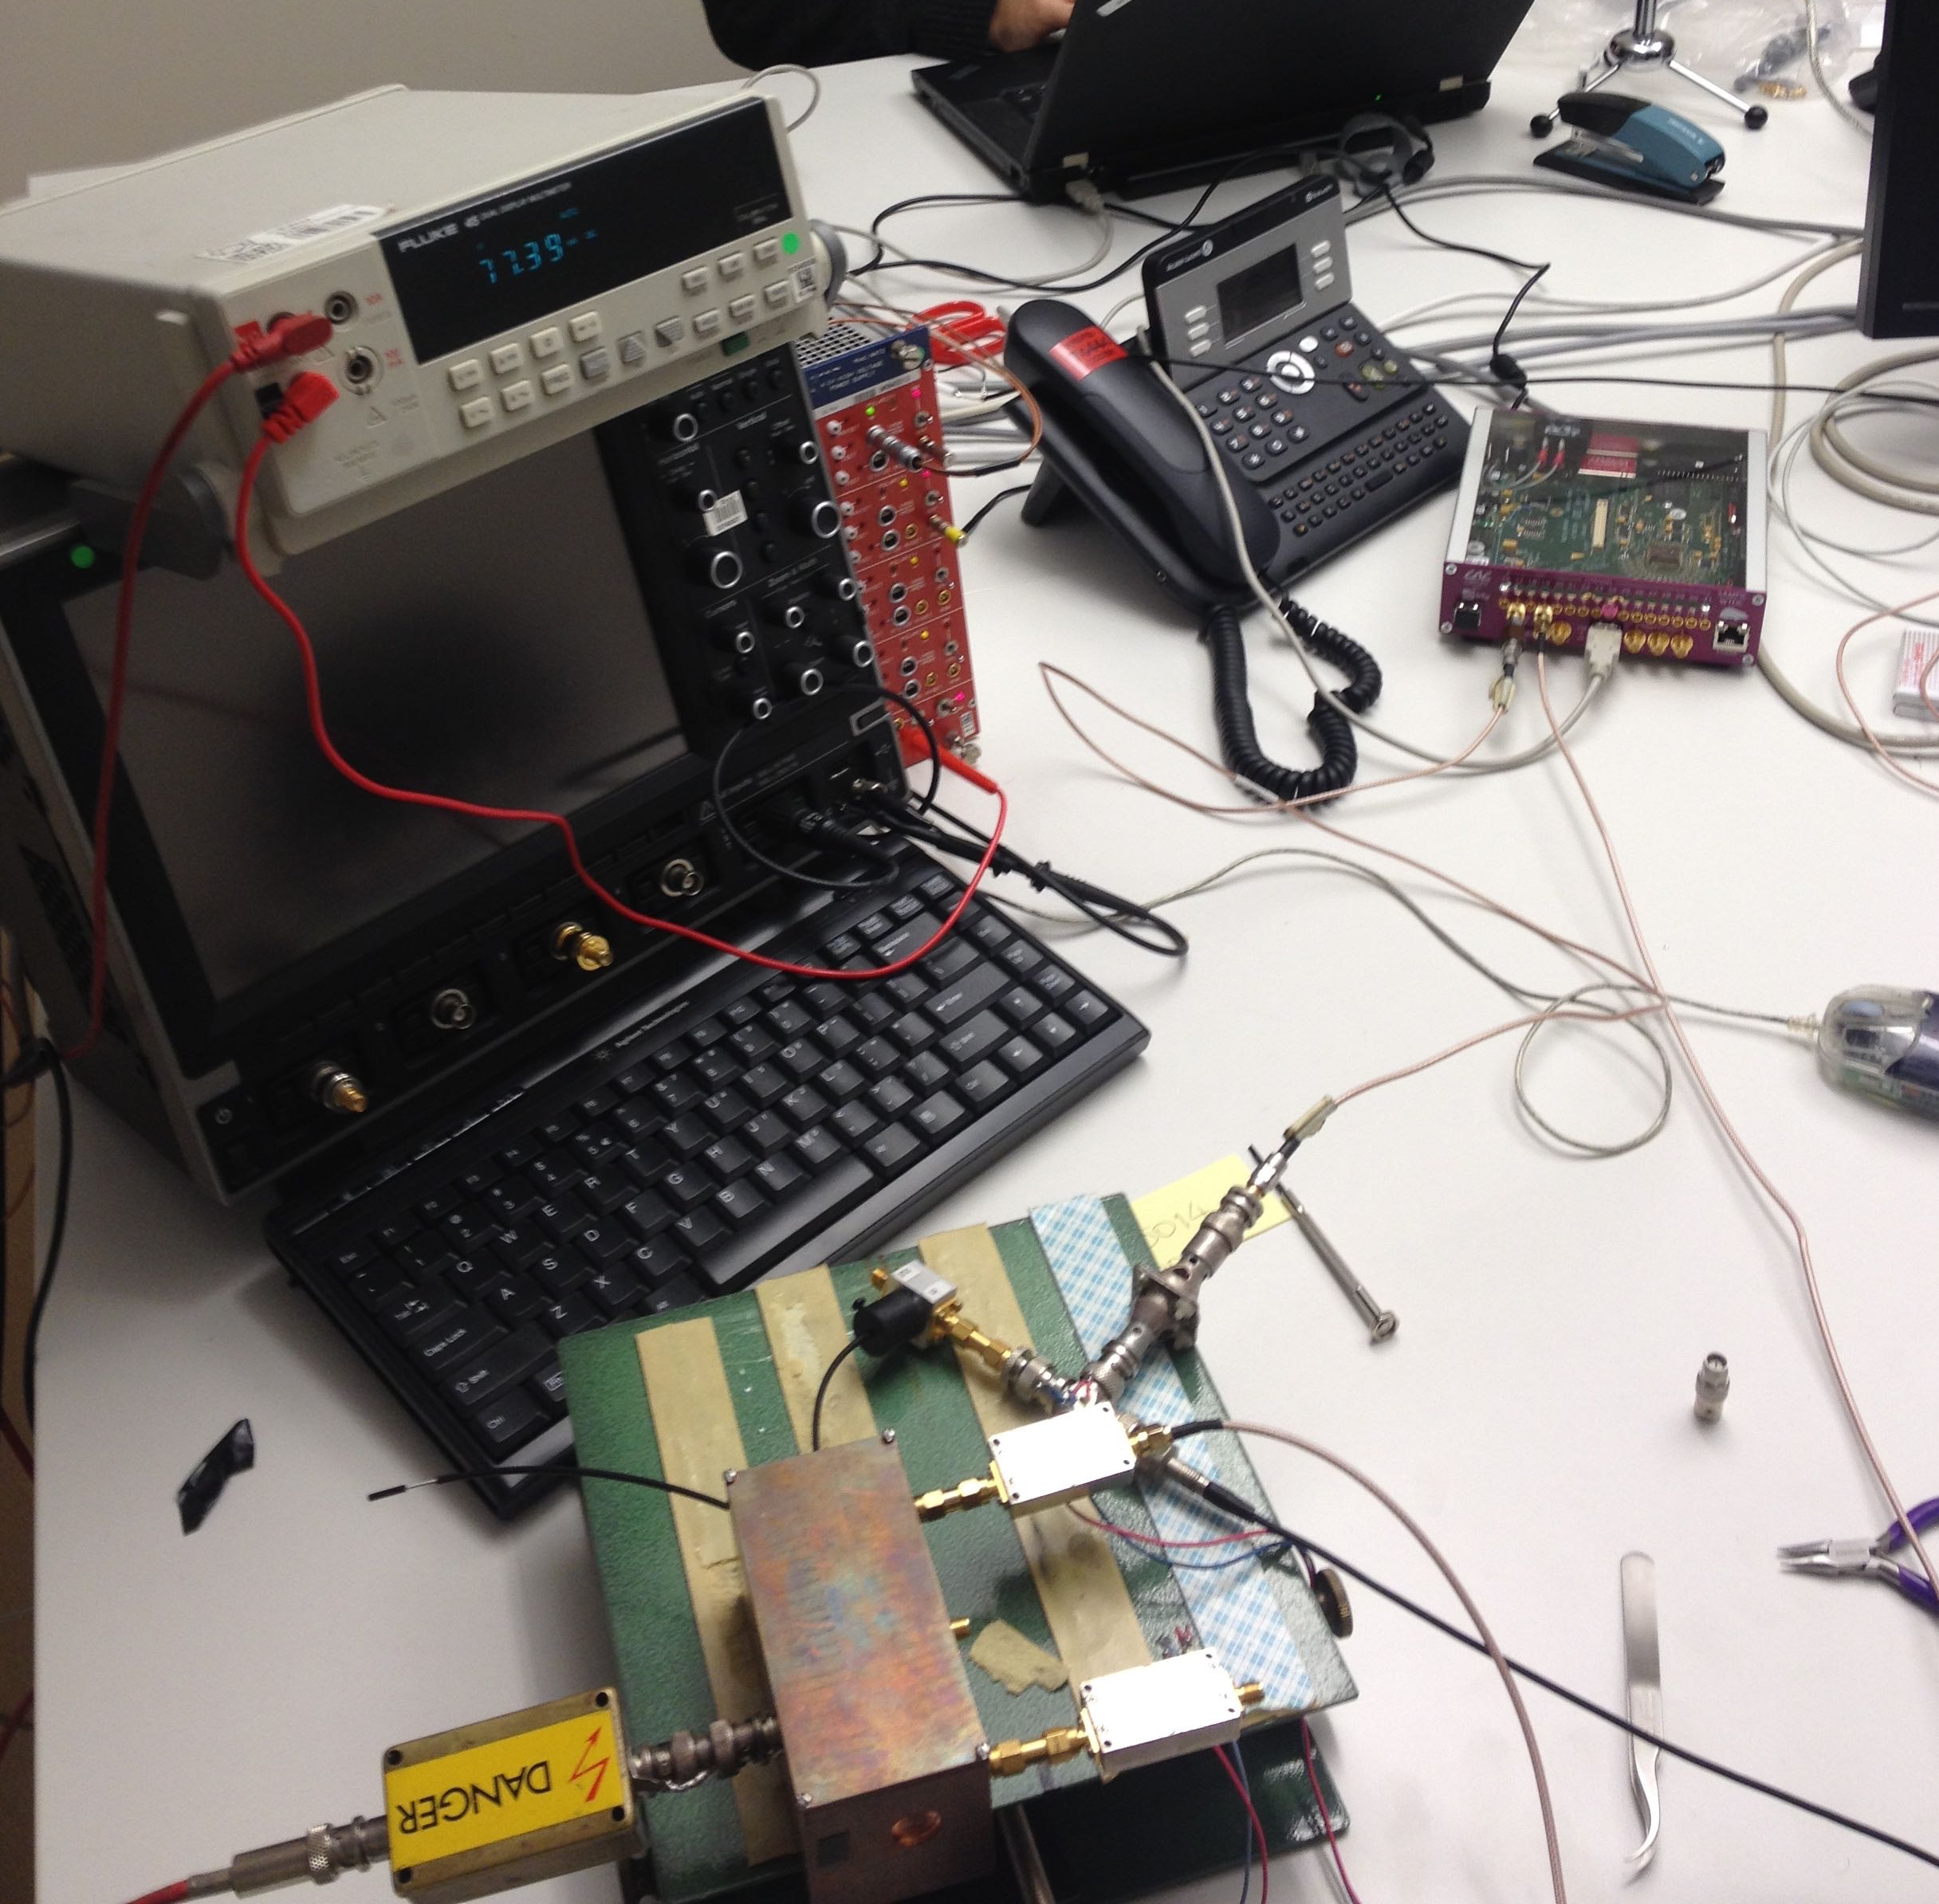
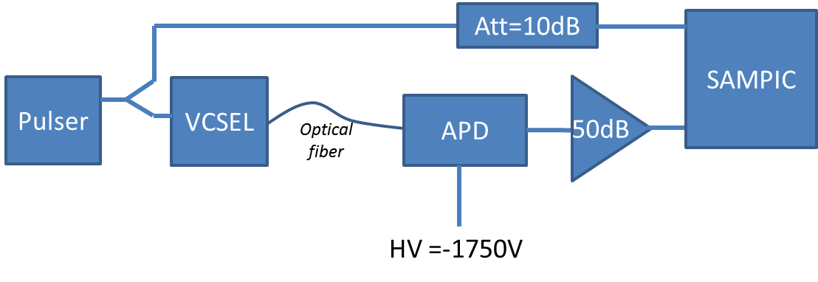
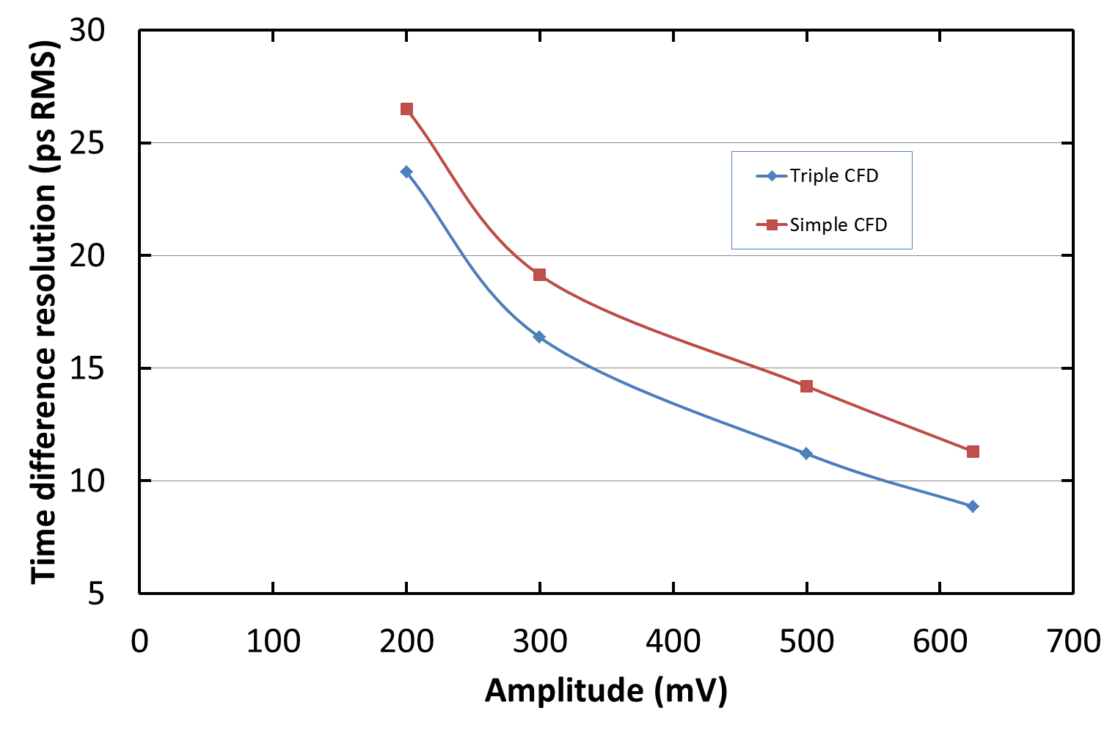
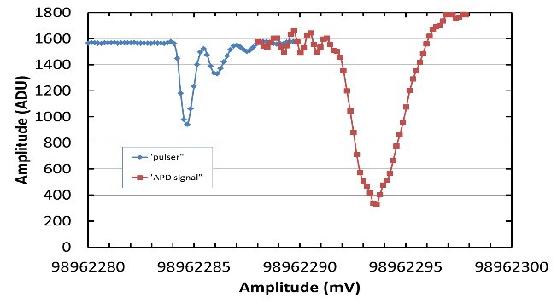
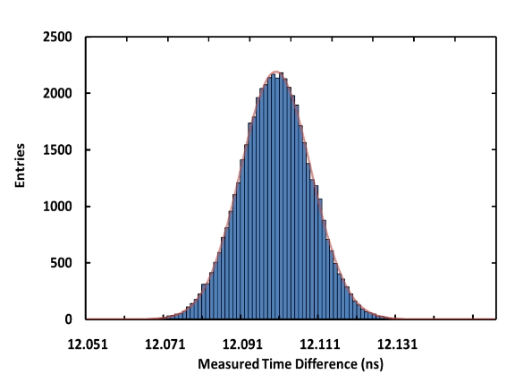
Motivation: Time resolution
References to previous work
  By SAMPIC team and S.White [D.Brenton et al., Elba conference 2015]
    RMD Mesh-APD
    VCSEL, 980nm; Amplifier: Wenteq, 50dB (316) gain
    SAMPIC system (Sampling rate = 6.4 GSample/s )
~ 1 MIP
~ 15ps
  More details on previous work and collaboration working on the subject :
    S.White, CERN Detector Seminar, 25.09.2015 [ https://indico.cern.ch/event/439571/ ]

Slide 5
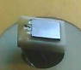

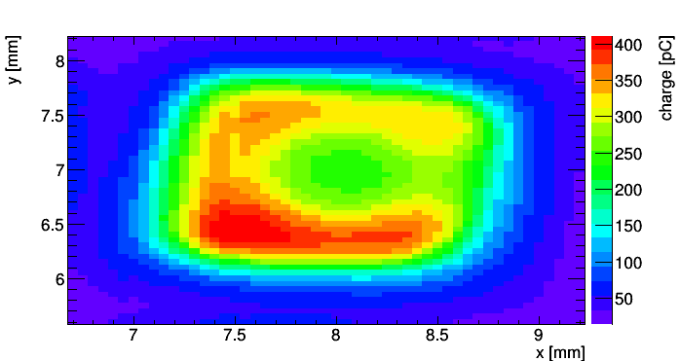
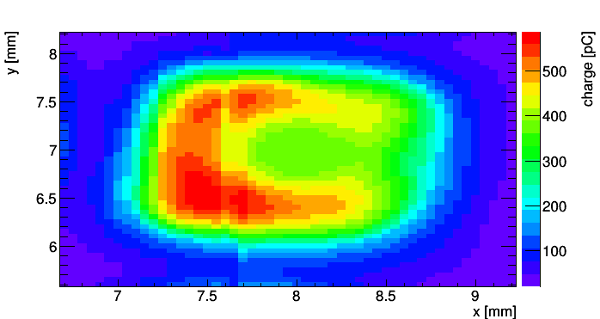
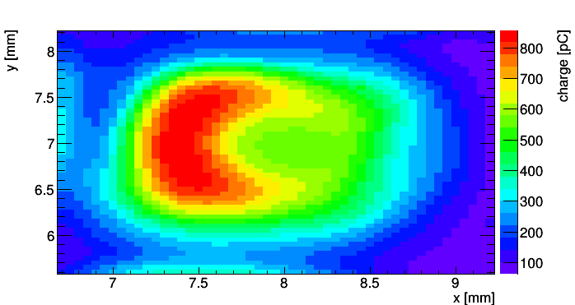
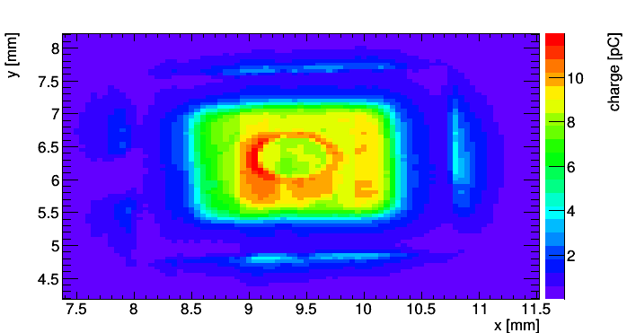
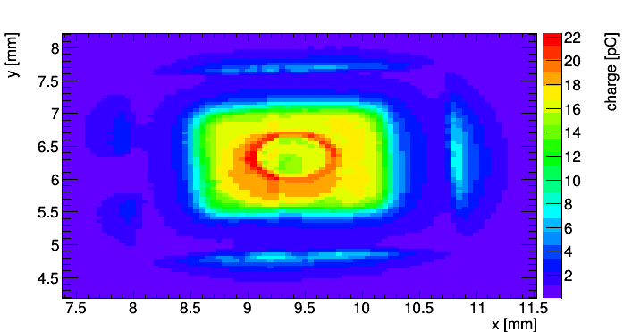
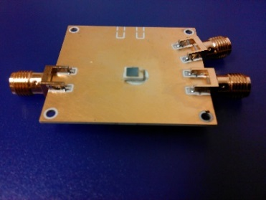
Homogeneity of response (Charge)
Homogeneity scan on 2 RMD devices
  2mm x 2mm RMD Deep Diffused APDs
  TCT with IR (1064 nm) pulsed laser
  - integration of pulse over 25ns
Sample 01 [mounted not planar to PCB]
1700 V
1750 V
1800 V
Sample 02
1700 V
1750 V
Note: Different amplifier setting for sample 01 and 02 (arb. Charge values given)

Slide 6
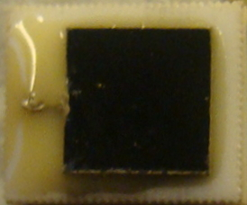
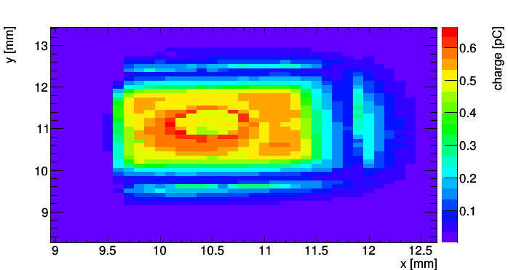
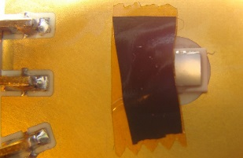
“Charge collection” outside active area
Signal observed outside active are of device
1700 V – IR laser
The glue around the sensor causes the laser to reflect and enter the APD, thus explaining the charge collection observed outside the sensor.
Signal disappears when Glue covered with tape

Slide 7
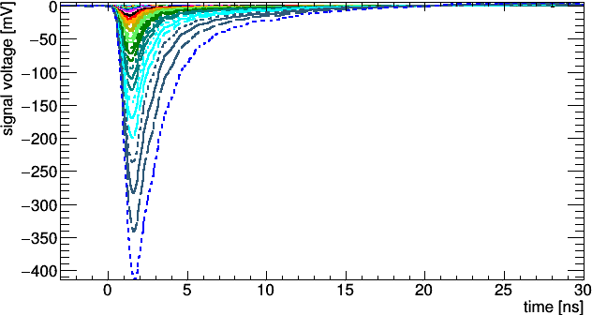
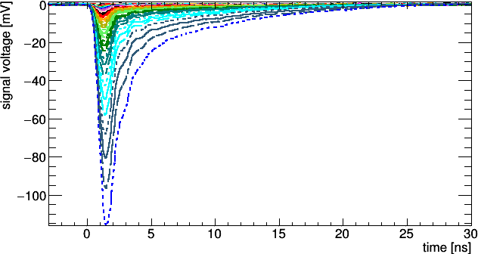
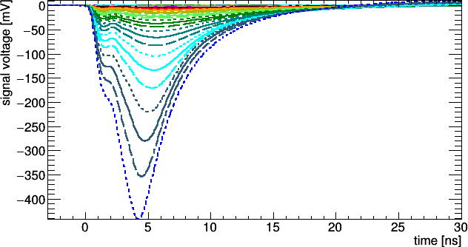
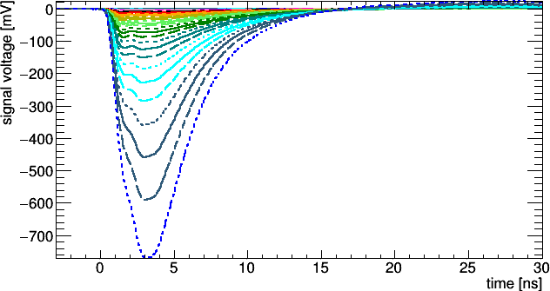
Pulse shapes
Measurements: 10-1800V (10V steps)
IR laser pulses
Red laser pulses (front illumination); “electron injection”
Sample 01
Sample 02
Sample 01
Sample 02

Slide 8
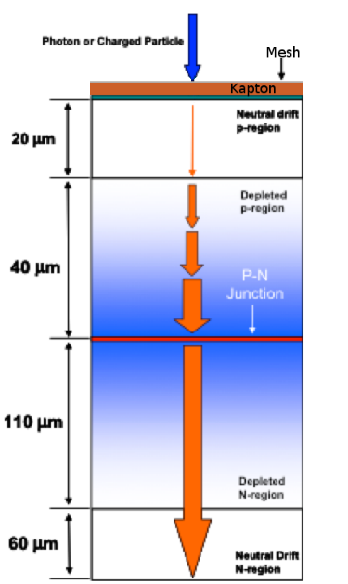
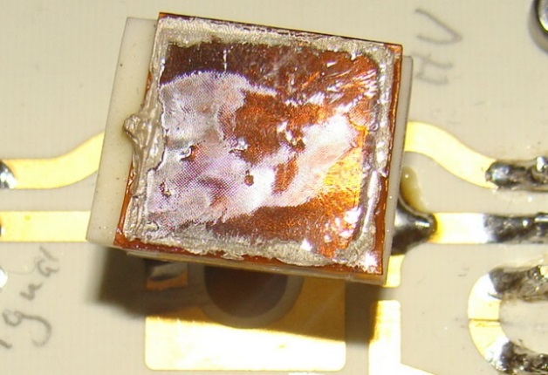
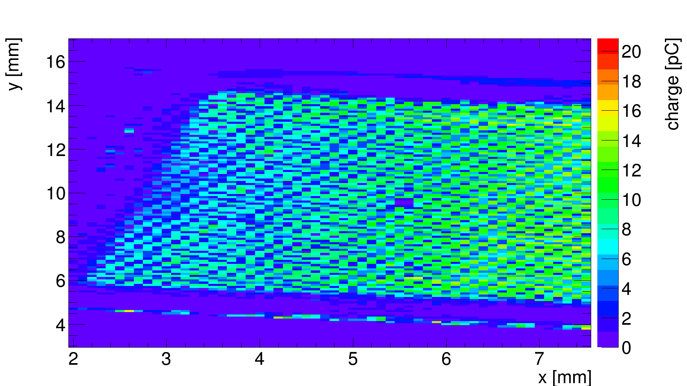
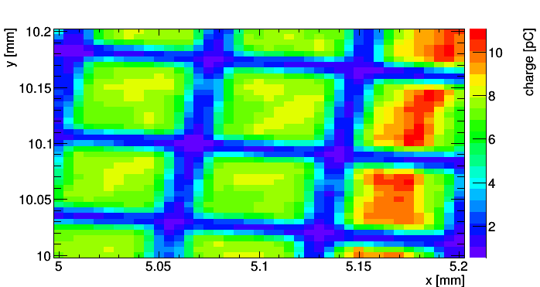
APD with mesh for readout
Proposed configuration for fast timing
  Deep Depleted APD with mesh readout (“Hyperfast Detectors”) [White at al. ]
  2 Kapton layer thicknesses tested
  (2 and 5 mil, i.e. 51 and 127 μm)
  IR and Red laser scans performed at -1776V
Mesh: connected to amplifier
-1776 V
GND
Low resolution scan (100μm)
High resolution scan (100μm)
49 μm
15 μm
57 μm
15 μm
  Irradiation and further test to be done.

Slide 9
TCAD simulations (Silvaco)
Device: Deep Diffused APD
  200 μm thick APD (p-in-n) represented in simulator by 1x1x200 µm³ volume
  Error function deep diffused p-doping profile; bulk n-doping: 1.4 x 10¹⁴ cm⁻³
  Junction at depth of 57 μm
  TCT with three different laser wavelength (670nm, 980nm, 1060nm)
  External circuit (Bias T) implemented for transient simulation
  Carrier lifetime set to 100μs; Charge integration for gain plots: 20ns
Increasing bias:
field extending
towards n-side
p⁺
n
~15µm on front side not depleted

Slide 10
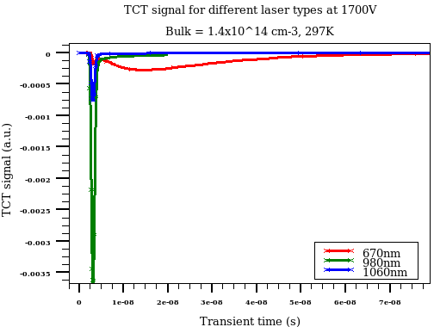
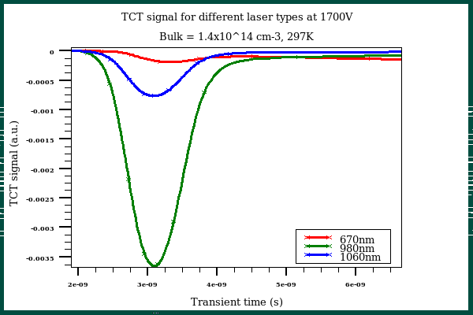
TCT simulation
TCT (front side illumination) [670nm, 980nm, 1060nm]
  Very fast initial peak for all wavelengths due to drift component of current
    For charge created in depleted layer
  Large (and slow) diffusion component for 670nm
    almost all charge deposited in un-depleted layer on front side (needs diffusion)

Slide 11
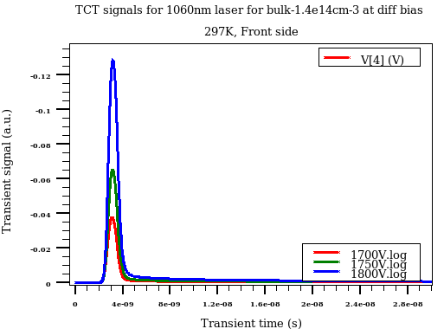
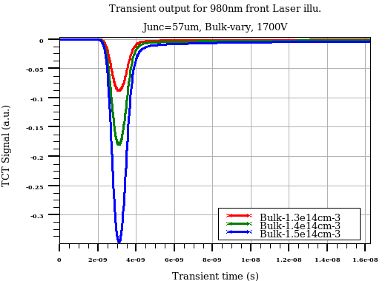
TCT simulation
TCT (front side illumination)
  Very strong dependence on applied voltage and bulk doping concentration!
  Simulation predicts pulse length of 2-3ns
    Measurements showed slightly larger pulse length (approx. 4ns)
Voltage dependence
Dependence on bulk doping

Slide 12
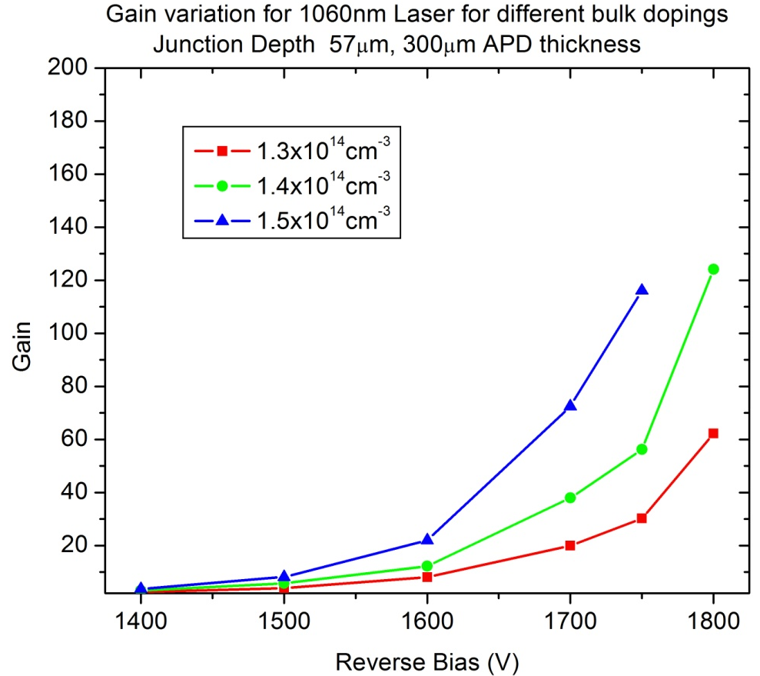
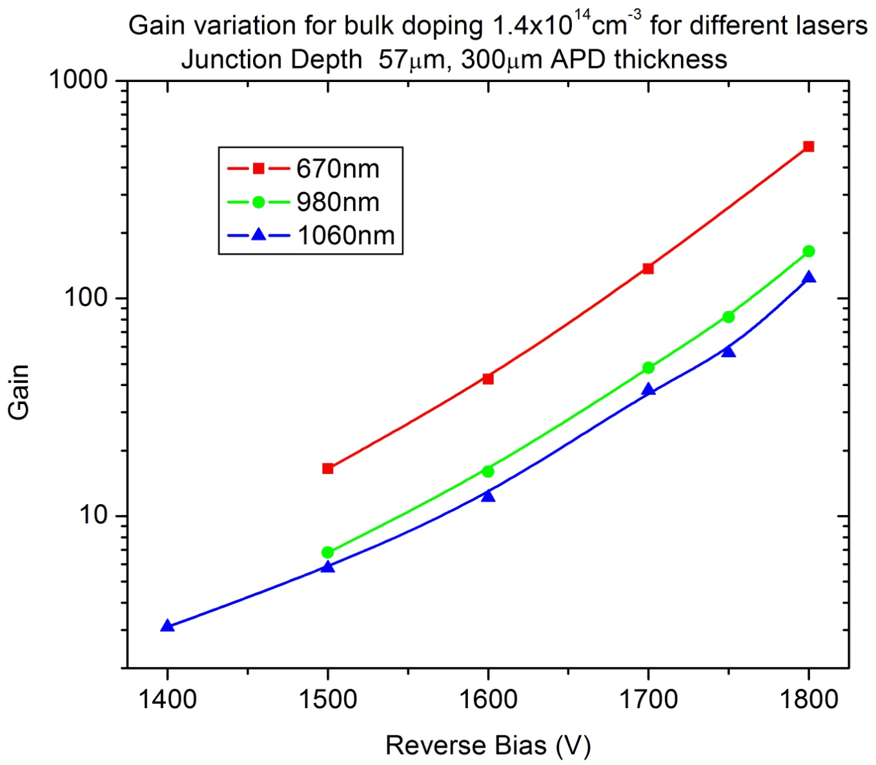
TCT simulation
Gain predictions
  Gain defined as:
  Signal with impact ionization / signal without impact ionization (It’s a simulation ☺)
  Higher bulk doping results in higher gain
    less depleted volume with higher E-Field
  Highest gain for lowest wavelength
    (higher fraction of generated carriers undergo amplification)
200μm APD thickness
200μm APD thickness

Slide 13
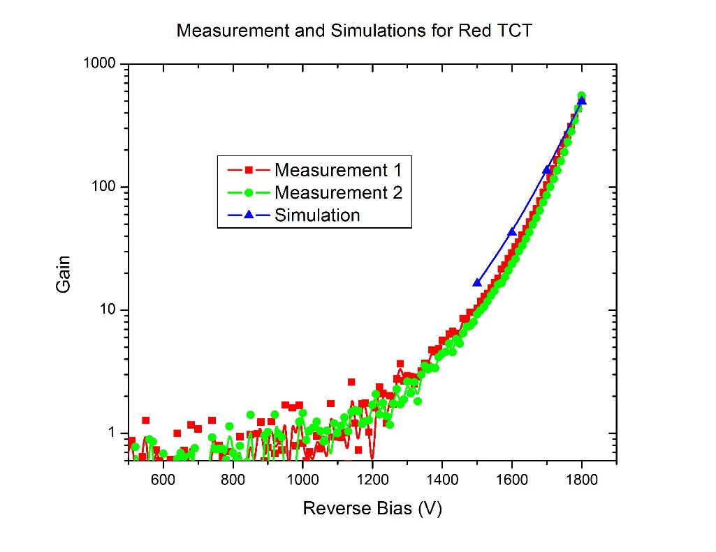
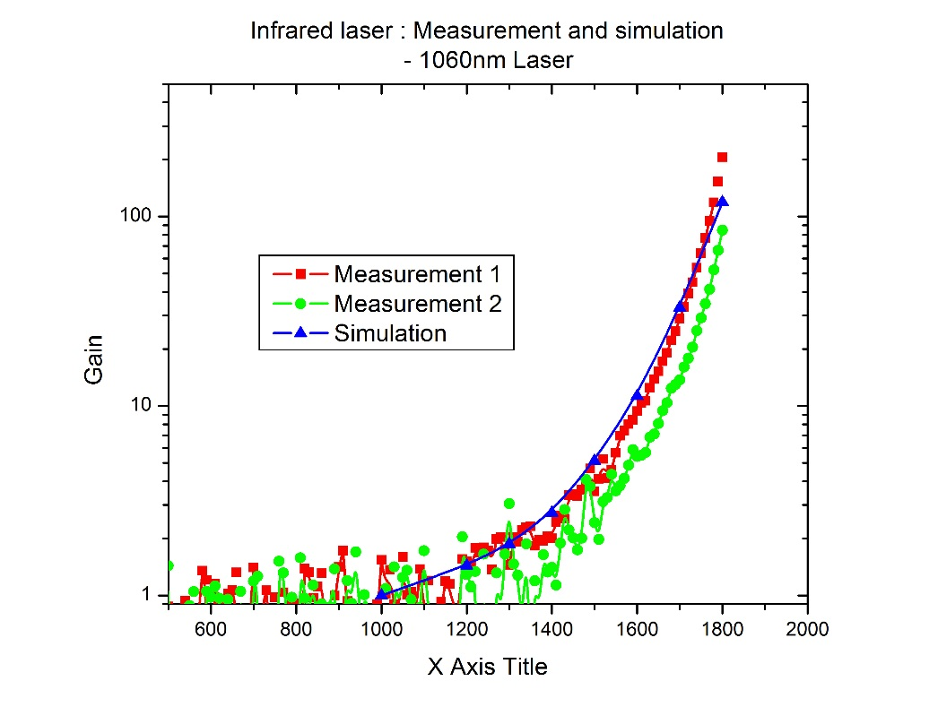
TCT simulation
Simulated gain versus measured gain
  Gain for measured data (IR, red laser) defined as integrated signal / <integrated signal (1000V)>
preliminary
preliminary
Simulation reproduces data trend (gain vs. voltage) quite well
  Need to normalize simulation data and measured data in same way
  Test measurements at 480nm provide a signal while the simulation with the present TCAD device model would give no signal at all for 480nm: Indication that the surface layer to the front is thinner than in the model, which however for the infrared laser measurements/simulations has no impact.

Slide 14
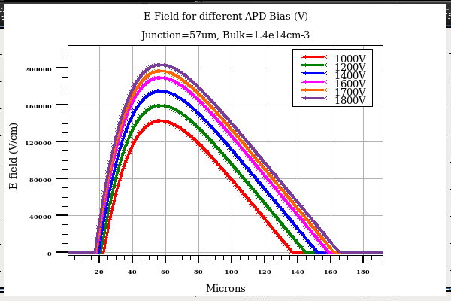
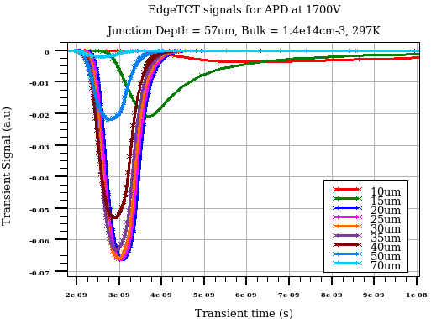
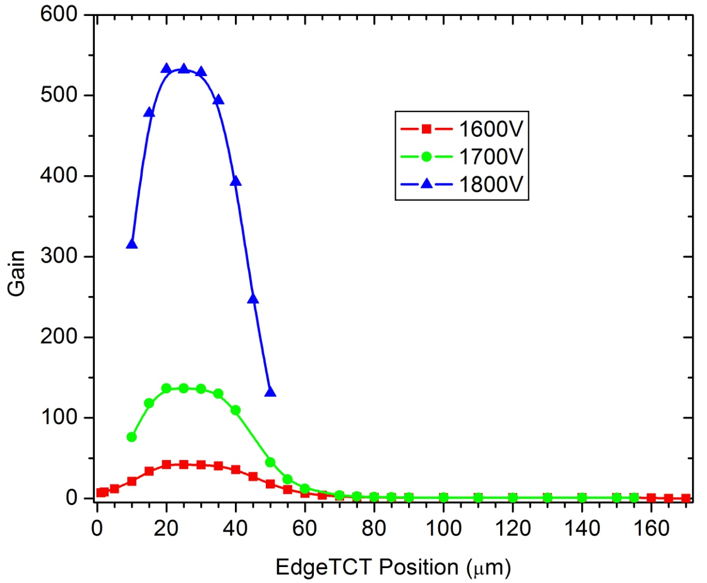
Simulation: Edge-TCT configuration
Simulation parameters:
  Laser 1060nm, beam width 1 µm,
  1ps risetime
  Depth position 1µm to 170µm (5 µm step)
  Junction depth: 57mm;
  Bulk doping (n-type): 1.4e14cm-3
5 μm
170 μm

Slide 15
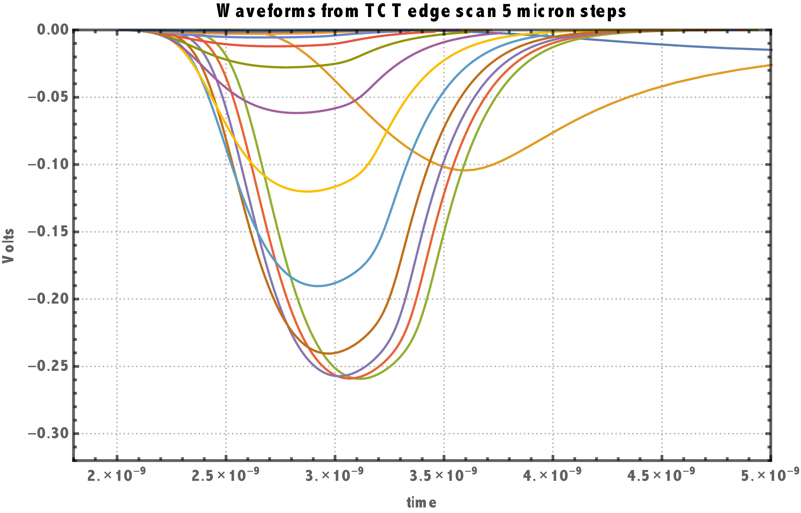
Simulating energy-loss fluctuations
Calculations based on two simulations:
  TCAD edge-TCT simulation
    provides wave forms for charges generated for every 5 μm slice of the detector.
  Bichsel charged particle energy straggling calculations
    Theory and Fortran code by H.Bichsel [Bichsel, Straggling in thin silicon detectors, 1988,Rev. Mod. Phys. 60, 663 ]
    Provides probability density function for a slice of 5 μm silicon
1 GeV muon,
5μm silicon
[PDF provided by Su Dong, Stanford, USA]
Histogram based on PDF
PDF
Voltage: 1800 V
16 positions (16 slices)
Deposited Charge
[KeV/5μm silicon]

Slide 16
Simulating energy-loss fluctuations
Note that the Bichsel PDF for thin sensors is not a Landau Distribution !
  For 5 μm Silicon & 1 GeV muon
Histogram from Landau
[PDF provided by Su Dong, Stanford, USA]
1 GeV muon,
5μm silicon
    based on [[Bichsel, 988,Rev. Mod. Phys. 60, 663 ]
Landau fitted to Bichsel PDF
Bichsel PDF
Deposited Charge
[KeV/5μm silicon]

Slide 17
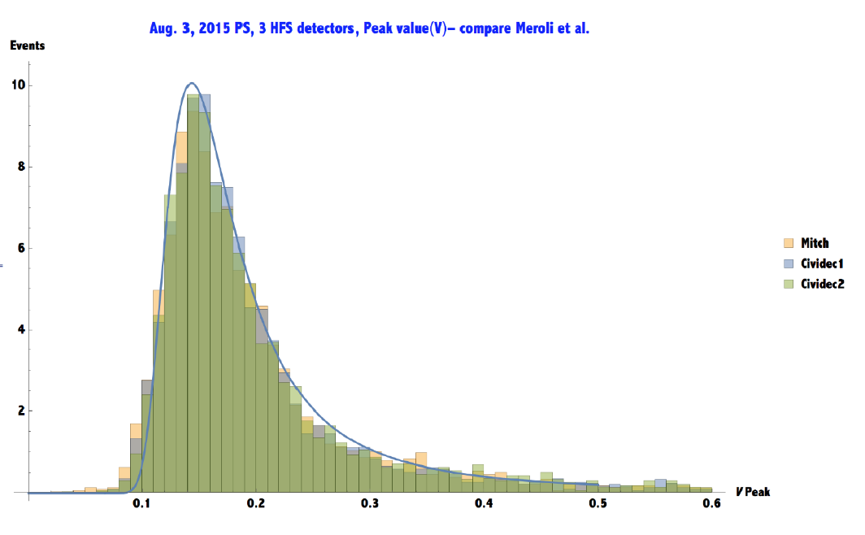
Simulating energy-loss fluctuations
Comparison of test beam data versus simulation [pulse heights distribution]
  Full size sensors
1 GeV muon
preliminary
6 GeV pions, test-beam 2015

Slide 18
Simulating energy-loss fluctuations
Comparison of test beam data versus simulation [pulse heights distribution]
1 GeV muon
preliminary
6 GeV pions, test-beam 2015

Slide 19
Simulating energy-loss fluctuations
Comparison of results [Prelimary]
  Comparing the different PDFs (Landau and Bichsel) result in significantly different time jitter
  Landau: 47 ps
  Bichsel: 30 ps
  Conclusion: Comparison with test-beam data needed.
preliminary
preliminary

Slide 20
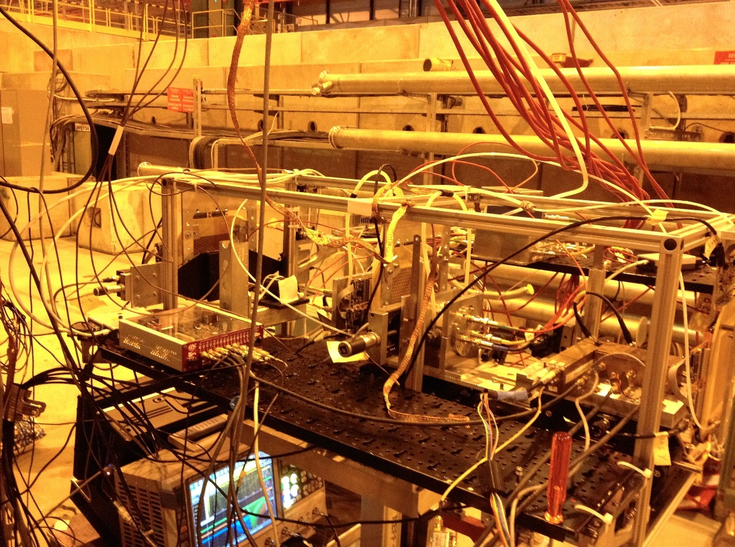
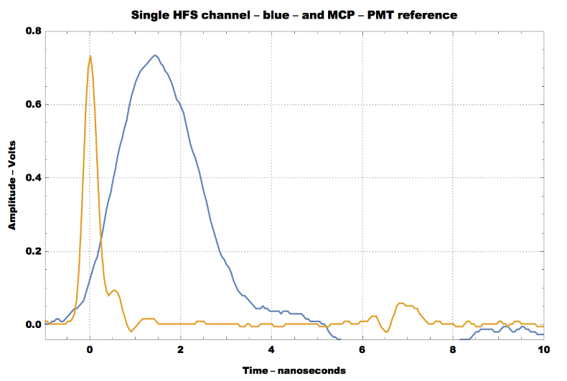
Test beam ongoing
Sunday 5.6.2016
  Sensors with Sampic readout installed …. data for next RD50
1. Signal trace @ 1800V and 50 dB preamp with MCP-PMT signal
2. Setup showing both the Si telescope on right and the SAMPIC on the left

Slide 21
Conclusions and Outlook
Previous works showed excellent timing performance ~15ps
First measurements on Deep Diffused APDs performed at CERN SSD
  Some in homogeneities (up to factor 2) for collected charge seen over active surface
  ToDo: Perform same scan for time jitter
Wider multiplication zone then in LGAD/standard APD devices
  Increased multiplication zone with high bias leads to the good timing performance
  ToDo: Understand optimum configuration of deep diffusion vs. bulk doping
First simulation study on time jitter arising from energy-loss fluctuations performed using TCAD wave forms (e-TCT) and Bichsel or Landau PDFs
  Bichsel distribution vs. Landau distribution results in less time jitter
All results obtained on non-irradiated devices
  Need to perform irradiation tests to study feasibility for high radiation environments!

Slide 22
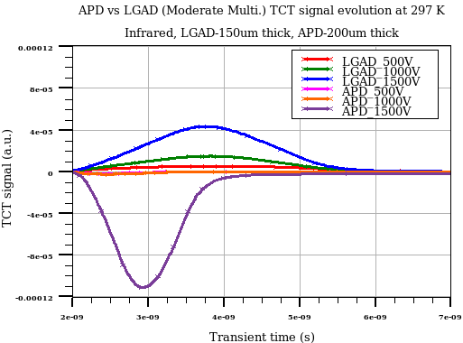
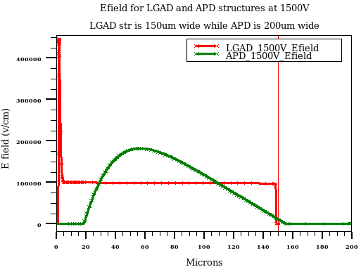
Comparison: LGAD – DD APD
TCAD simulation
  LGAD structure (with peak p-well doping of 9.75e16 cm-3, see R.Dalal last RD50) and thickness of 150 µm is used for simulation
  APD structure of 200 µm is used (depletion width ~ 140 µm)
TCT signal evolution of APD and LGAD is compared
  TCT peak for LGAD is peaking after 1.8 ns (for example see blue curve for 1500V)
  TCT signal peak for APD is peaking after ~ 0.9 ns after laser fire
  Electrons from bulk have to move to front side p-well region for charge multiplication but in APD charge multiplication is happening around junction region.

Slide 23
E field for different bias
E-field as function of bias
  With increase in bias, Depletion region mainly expand in backside bulk
  Should not expect much improvement with bias for front diffusion component !
  No multiplication beyond about 100 micron depth (this number depends on bias)

