Slide 1
Status of LGAD RD50 projects at CNM

Slide 2
Outline
Gallium Implantation to Enhance the Radiation Hardness of LGAD DetectorsCarbon doping.
Strip sensors made of N-rich Silicon (See A. Dierlamm´s Talk).
Measurement of the Doping Profile in Low-Gain Avalanche Detectors (see H. Sadrozinski´s talk).
Investigation of the properties of thin LGAD(See M. Carulla´s talk and N. Cartiglia´s talk).
Investigation of acceptor removal in boron doped silicon wafers and LGAD. To be submitted.

Slide 3
Rd50 funded project
The aim of this RD50 Common Project is to enhance the radiation hardness of Low-Gain Avalanche Detectors (LGAD) .
Dopants such as Ga or Al form complexes with radiation-induced defects, which may have less impact on device performance, when compared to the boron related defect (B_{i}-O_{i}) complex.

Slide 4
Reference
Ref: A. Khan et al., “Strategies for improving radiation tolerance of Si space solar cells”, Solar Energy Materials & Solar Cells 75 (2003) 271–276.
R_{C} = 0.04 cm⁻¹ for Ga
R_{C}= 0.08 cm-¹ for Al
R_{C}= 0.15 cm-¹ for B

Slide 5
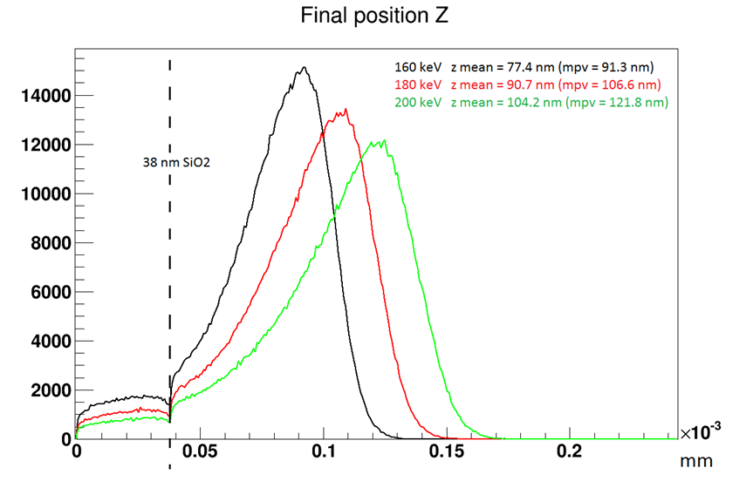
Wafer | Implantation
 | Ion | Energy (keV) | Dose(at/cm^2)
1 | Ga | 160 | 1,00E+14
2
3 |  |  | 1,00E+15
4
5 |  | 180 | 1,00E+14
6
7 |  |  | 1,00E+15
8
9 |  | 195 | 1,00E+14
10
11 |  |  | 1,00E+15
12
13 | B | 70 | 1,00E+15
14
15
GEANT4
Pn diodes without multiplication!
Gallium has lower penetration than Boron, but higher diffusion (with annealing)

Slide 6
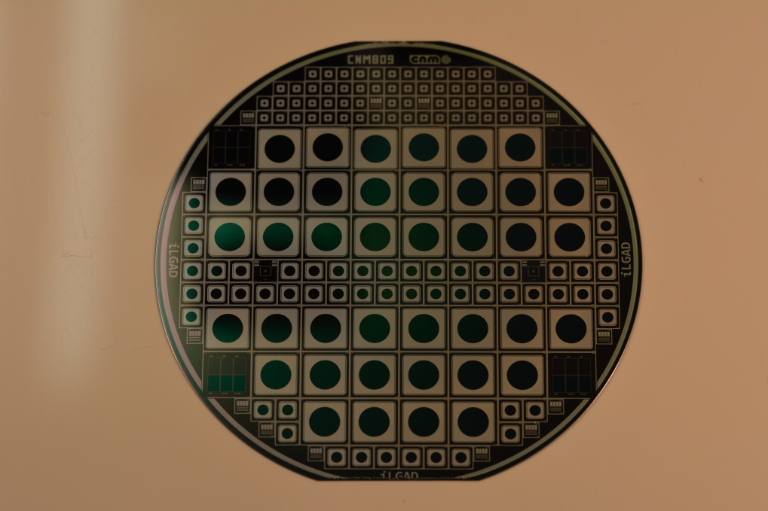
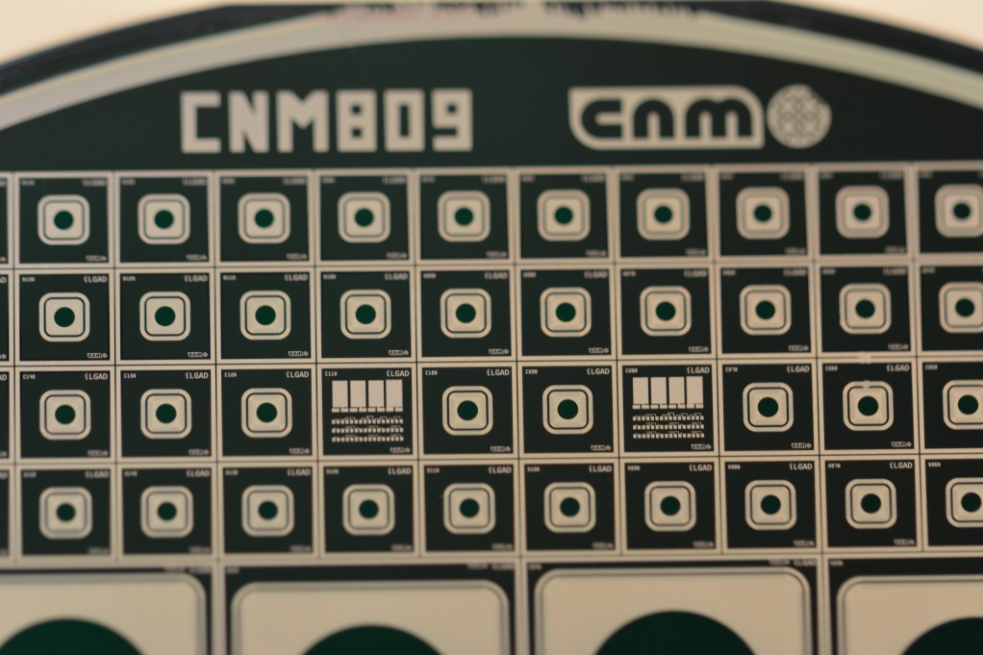
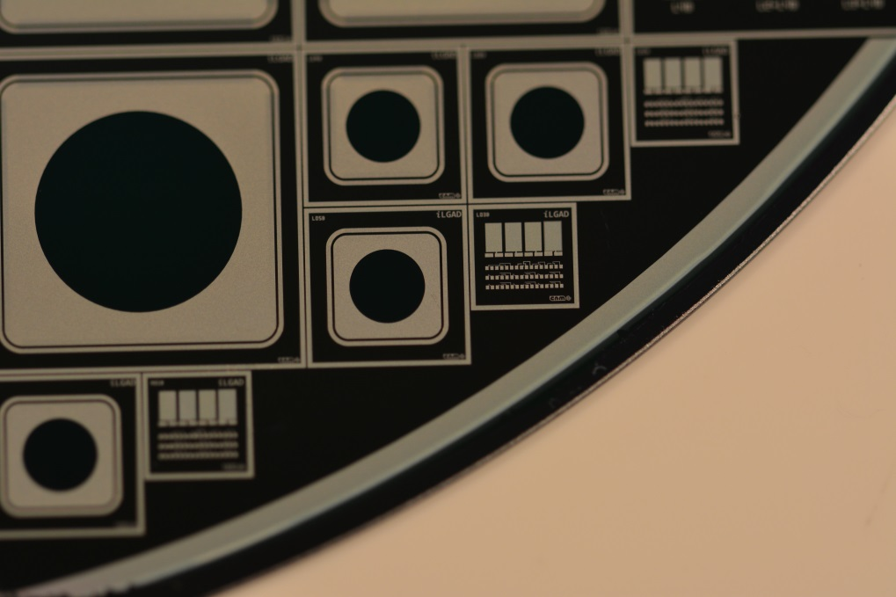
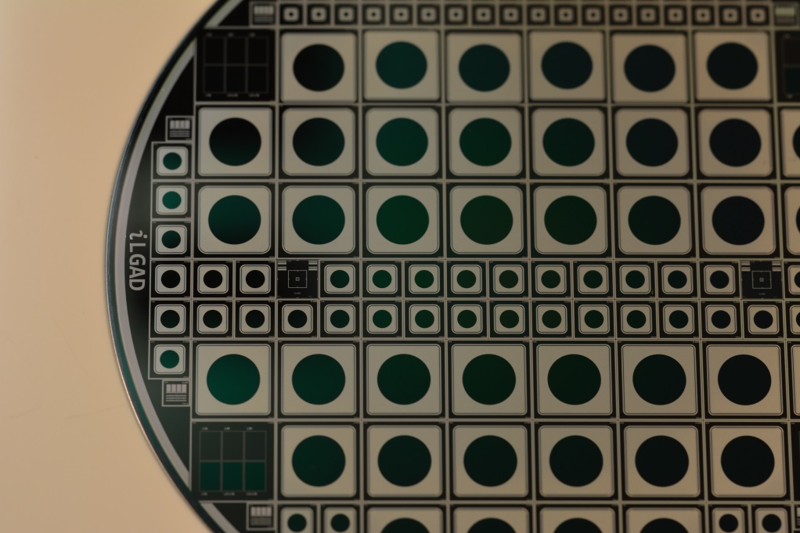

Slide 7
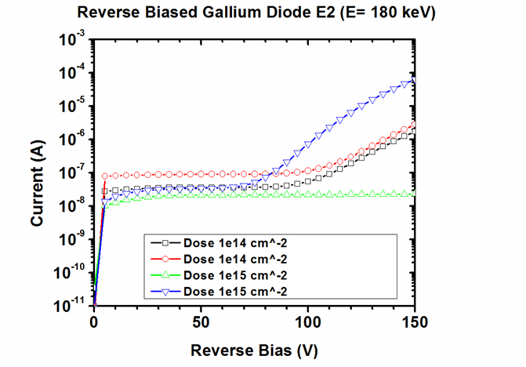
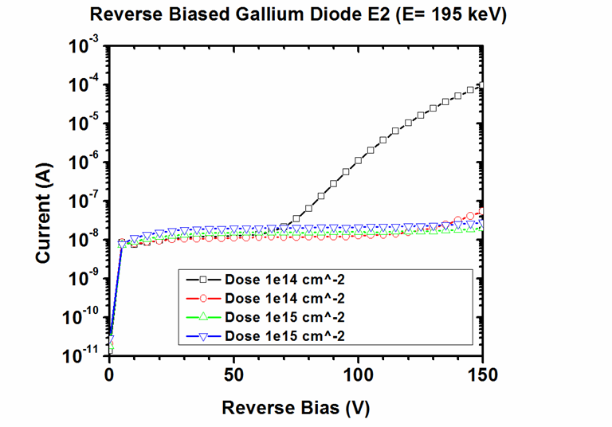
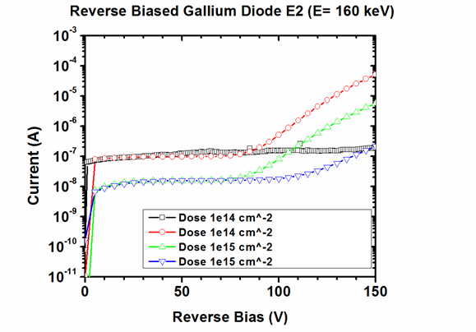
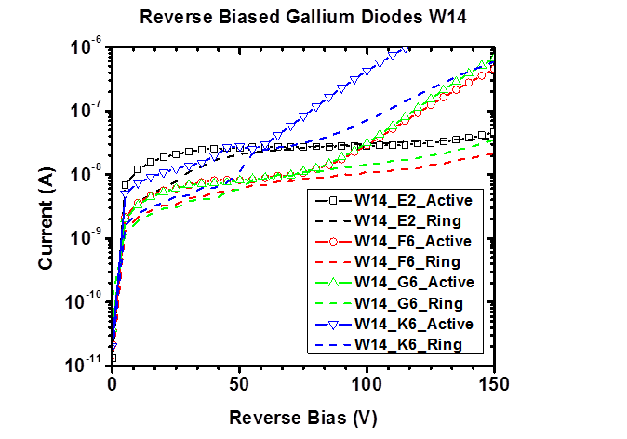
IV
Boron

Slide 8
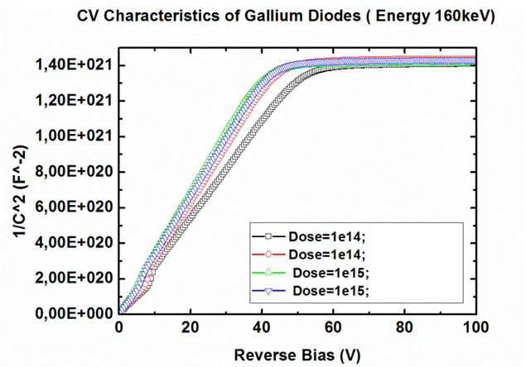
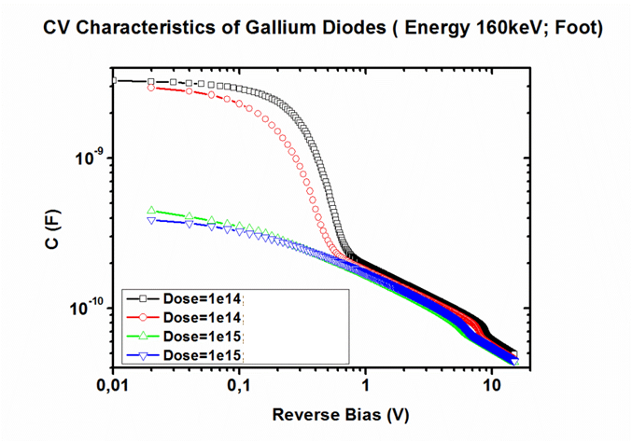
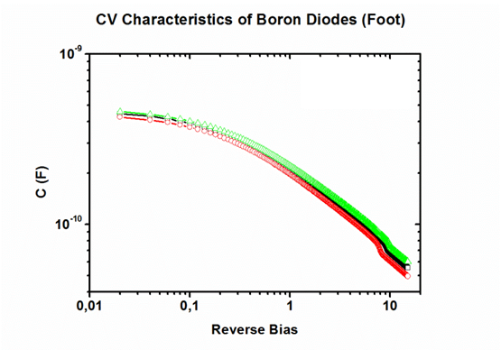
CV measurements

Slide 9
Conclusion and future work do be done (Ga)
Wafers are being diced in these days. They should be ready by next Friday. We should discuss distribution of samples.
Detectors work well as standard boron doped pn diodes.
4-point probe technique to measure Ga doping concentration (before and after irr.)
SIMS measurements to extrapolate doping profiles.
Calibration of simulation model for Ga implantation.
Irradiation of diodes with neutron and proton (electrons ?)to calculate removal constant to be compared to Boron doped devices.

Slide 10
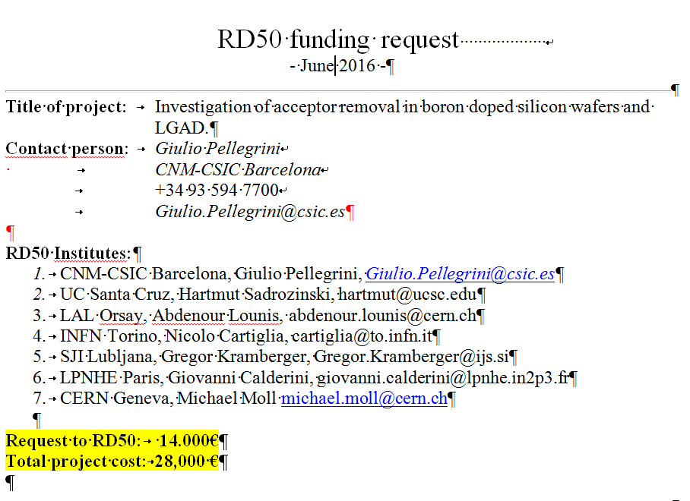
Investigation of acceptor removal in boron doped silicon wafers and LGAD
We want to use two different technological approaches.
Diffusion of C in silicon wafer (bare wafers and n-p diodes)
Implantation of C in the multiplication junction.

Slide 11
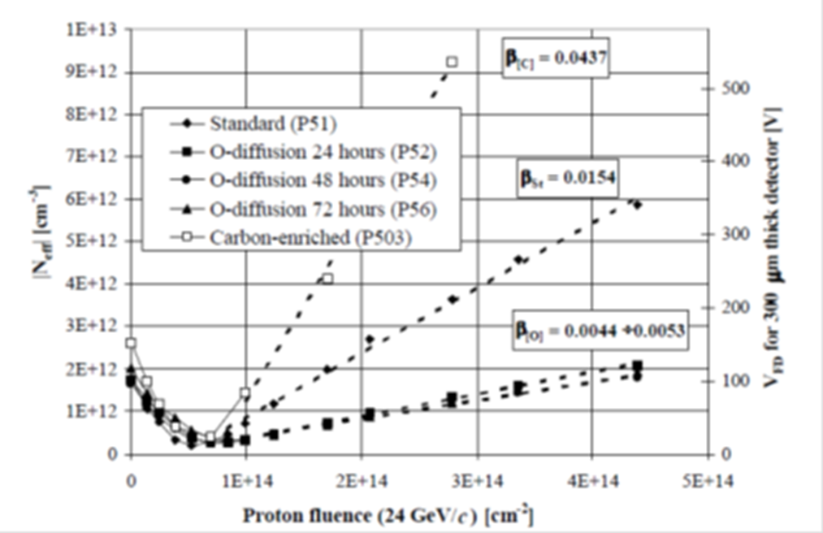
Plan for Acceptor Removal study
The main idea is that carbon co-doping can reduce the concentration of B-O defects, as a result of the formation of more energetically favorable carbon-oxygen (C-O) complexes.
E. Donegani, Comparison between n-type and p-type sensors,RD50 meeting, 01.12.2015 CERN.
RD48- 3rd status report 31-12-1999

Slide 12
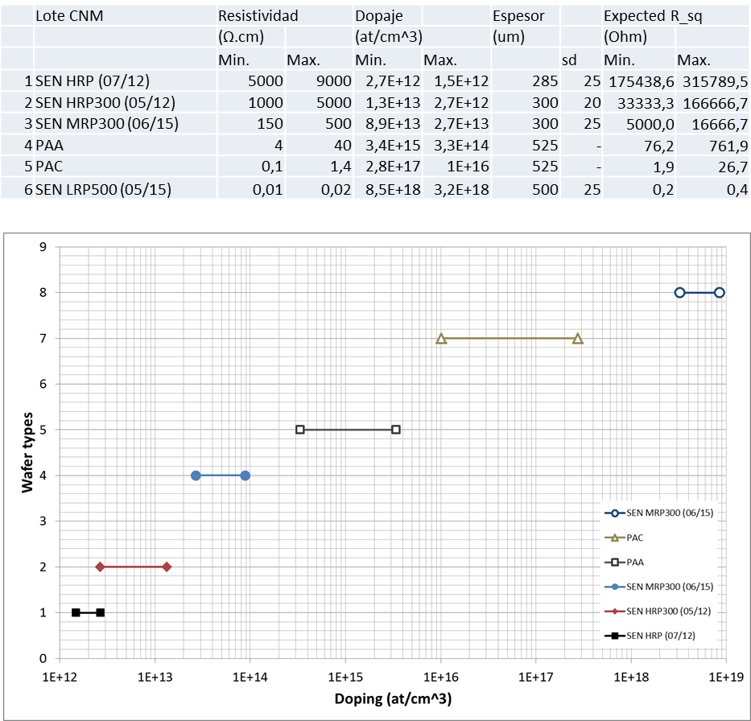
Wafer selections at CNM
Note: FZ and CZ wafers have different initial C and O concentrations.

Slide 13
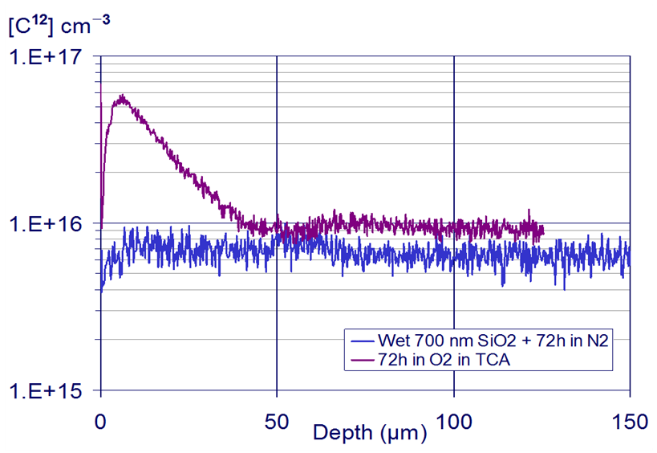
Fabrication plan
We will use 4x6 wafers with different resistivities (total 28 wafers).
2x6 wafers will be “doped” in chlorine (DCE dichloroethane) gas to diffuse C into the bulk [1].
Expected concentration of [O] and [C] after diffusion.
[1] L. Fonseca et al., Silicon wafer oxygenation from SiO2 layers for radiation hard detectors, Microelectronics Reliability 40 (2000) 791-794.

Slide 14
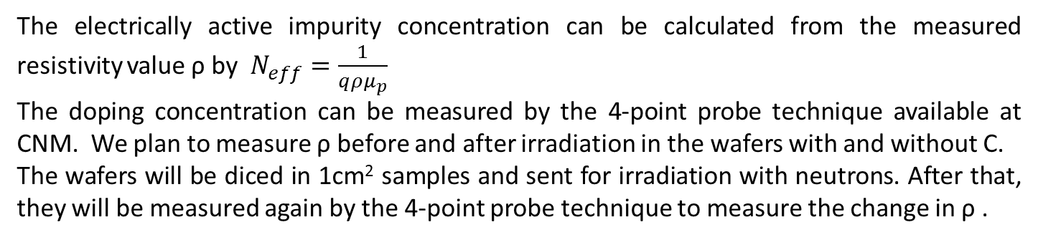
RUN CARBON DOPING
Wafers | Type | Thickness (um) | Diffusion Time | Resistivity (Ohm*cm) | Conc at/cm-3
1-2 | SEN HRP (07/12) | 285 | 72h | > 5000 | < 2e12
3-4 | SEN HRP300 (05/12) | 300 | 72h | > 1000 | < 1e13
5-6 | SEN MRP300(06/15) | 300 | 72h | > 500 | < 2e13
9-10 | PAA | 500 | 72h | > 10 | < 1e15
11-12 | PAC | 525 | 72h | > 0,1 | < 3e17
13-14 | SEN LRP500(05/15) | 500 | 72h | > 0,01 | < 8,5e18
The electrically active impurity concentration can be calculated from the measured resistivity value ρ by $N_{eff}=\frac{1}{qρμ_{p}}$
The doping concentration can be measured by the 4-point probe technique available at CNM. We plan to measure ρ before and after irradiation in the wafers with and without C.
The wafers will be diced in 1cm² samples and sent for irradiation with neutrons. After that, they will be measured again by the 4-point probe technique to measure the change in ρ .
R. Wunstorf et al., Investigations of donor and acceptor removal and long term annealing in silicon with different boron/phosphorus ratios, NIM A A 377 (1996) 228-233.
Yichao Wu et al., Suppression of boron-oxygen defects in Czochralski silicon by carbon co-doping, Applied Physics Letters 106, 102105 (2015); doi: 10.1063/1.4914889

Slide 15
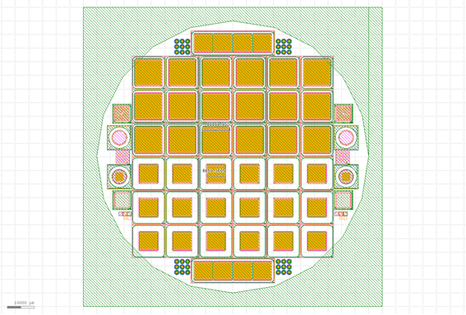
Diodes
The remaining 2x6 wafers (1 set of wafers doped with C) will be processed to make standard n-p diodes.
This will be an alternative method to measure Neff before and after irradiation with CV plots.
For the high doped wafers the method may be difficult due to the low electrical breakdown expected in the diodes (See simulation below).
Bulk doping
Simulation
Mask cnm_629

Slide 16
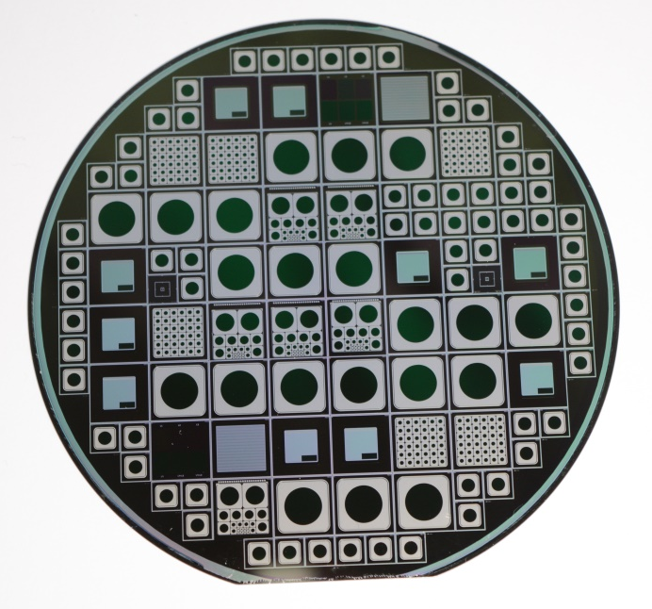
Implantation of C in LGAD
The last process that we want to explore at CNM is to enrich with C atoms only the multiplication layer of the LGAD devices. This could be achieved by implanting C only in the first 5-6 um of the wafer surface.
Standard mask used in the past for LGAD devices.
An optimization with simulation software tools like Silvaco and Sentaurus is necessary before starting the process.
Carbon’s high efficiency in trapping
silicon self-interstitials can cause the
reduction of boron diffusion in C-rich
silicon samples and this can lead to a
change in the multiplication layer of LGAD
sensors during the fabrication process.

