Slide 1
Design consideration on thin LGAD sensors
What is the correct gain?
What is the correct thickness?
Use the LGAD CT-PPS demonstrator to answer these questions

Slide 2
What is the correct gain?
The answer at the root of the LGAD approach is:
The correct gain is the MINIMUM gain that does the job
Why?
Gain has obvious drawback in terms of much higher noise, higher leakage current, higher thermal load, segmentation, early breakdown…: you don’t want to have more gain than you need.

Slide 3
A demonstrator of UFSD capability
LGAD UFSD are one of the 2 the official choices (with diamond )
of CMS CT-PPS timing detectors: installation in the Christmas Shutdown.
This will be the first LGAD demonstrator
LHCC May 2016

Slide 4
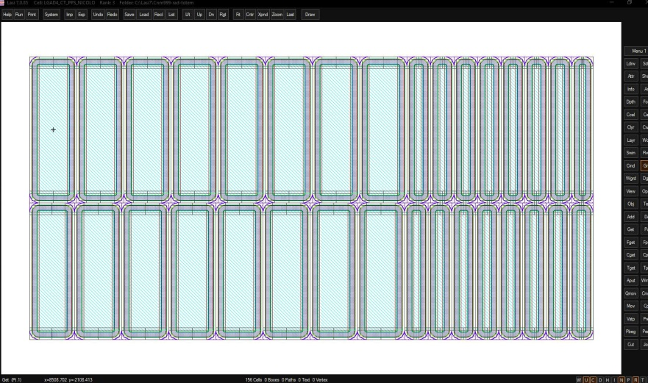
Layout of detector planes
4 (6) planes per station (qualitative sketch):
180º turn
Beam
No cracks aligned:
2 (3) planes facing the beam
2 (3) turned by 180º

Slide 5
CT-PPS timing with UFSD silicon sensors
  Sensors: Final design for CT-PPS
    50 micron thick, segmented, gain~ 10
  Delivery June 2016
Electronics: custom made for CT-PPS
  ASIC: 8 ch, 40 mW, amplif-comp chip
    Designed completed, submitted
    Delivery Summer 2016
    Board: 32 ch, LVDS out to HPTCD
  Discrete components
    Circuit design completed
    Production Summer 2016
    Board: 12 ch, analog output to NINO
Beam

Slide 6
UFSD-based CT-PPS Timing system
Pursuing two different solutions
1) Baseline CT-PPS solution: UFSD + pre-amp + NINO + HPTDC:
NINO
HPTDC
inside RP
UFSD
Sensor
Surface mounted
Time of Arrival
Time over Threshold
2) Advanced solution: UFSD + Custom ASIC + HPTDC:
HPTDC
inside RP
UFSD
Sensor
Custom ASIC

Slide 7
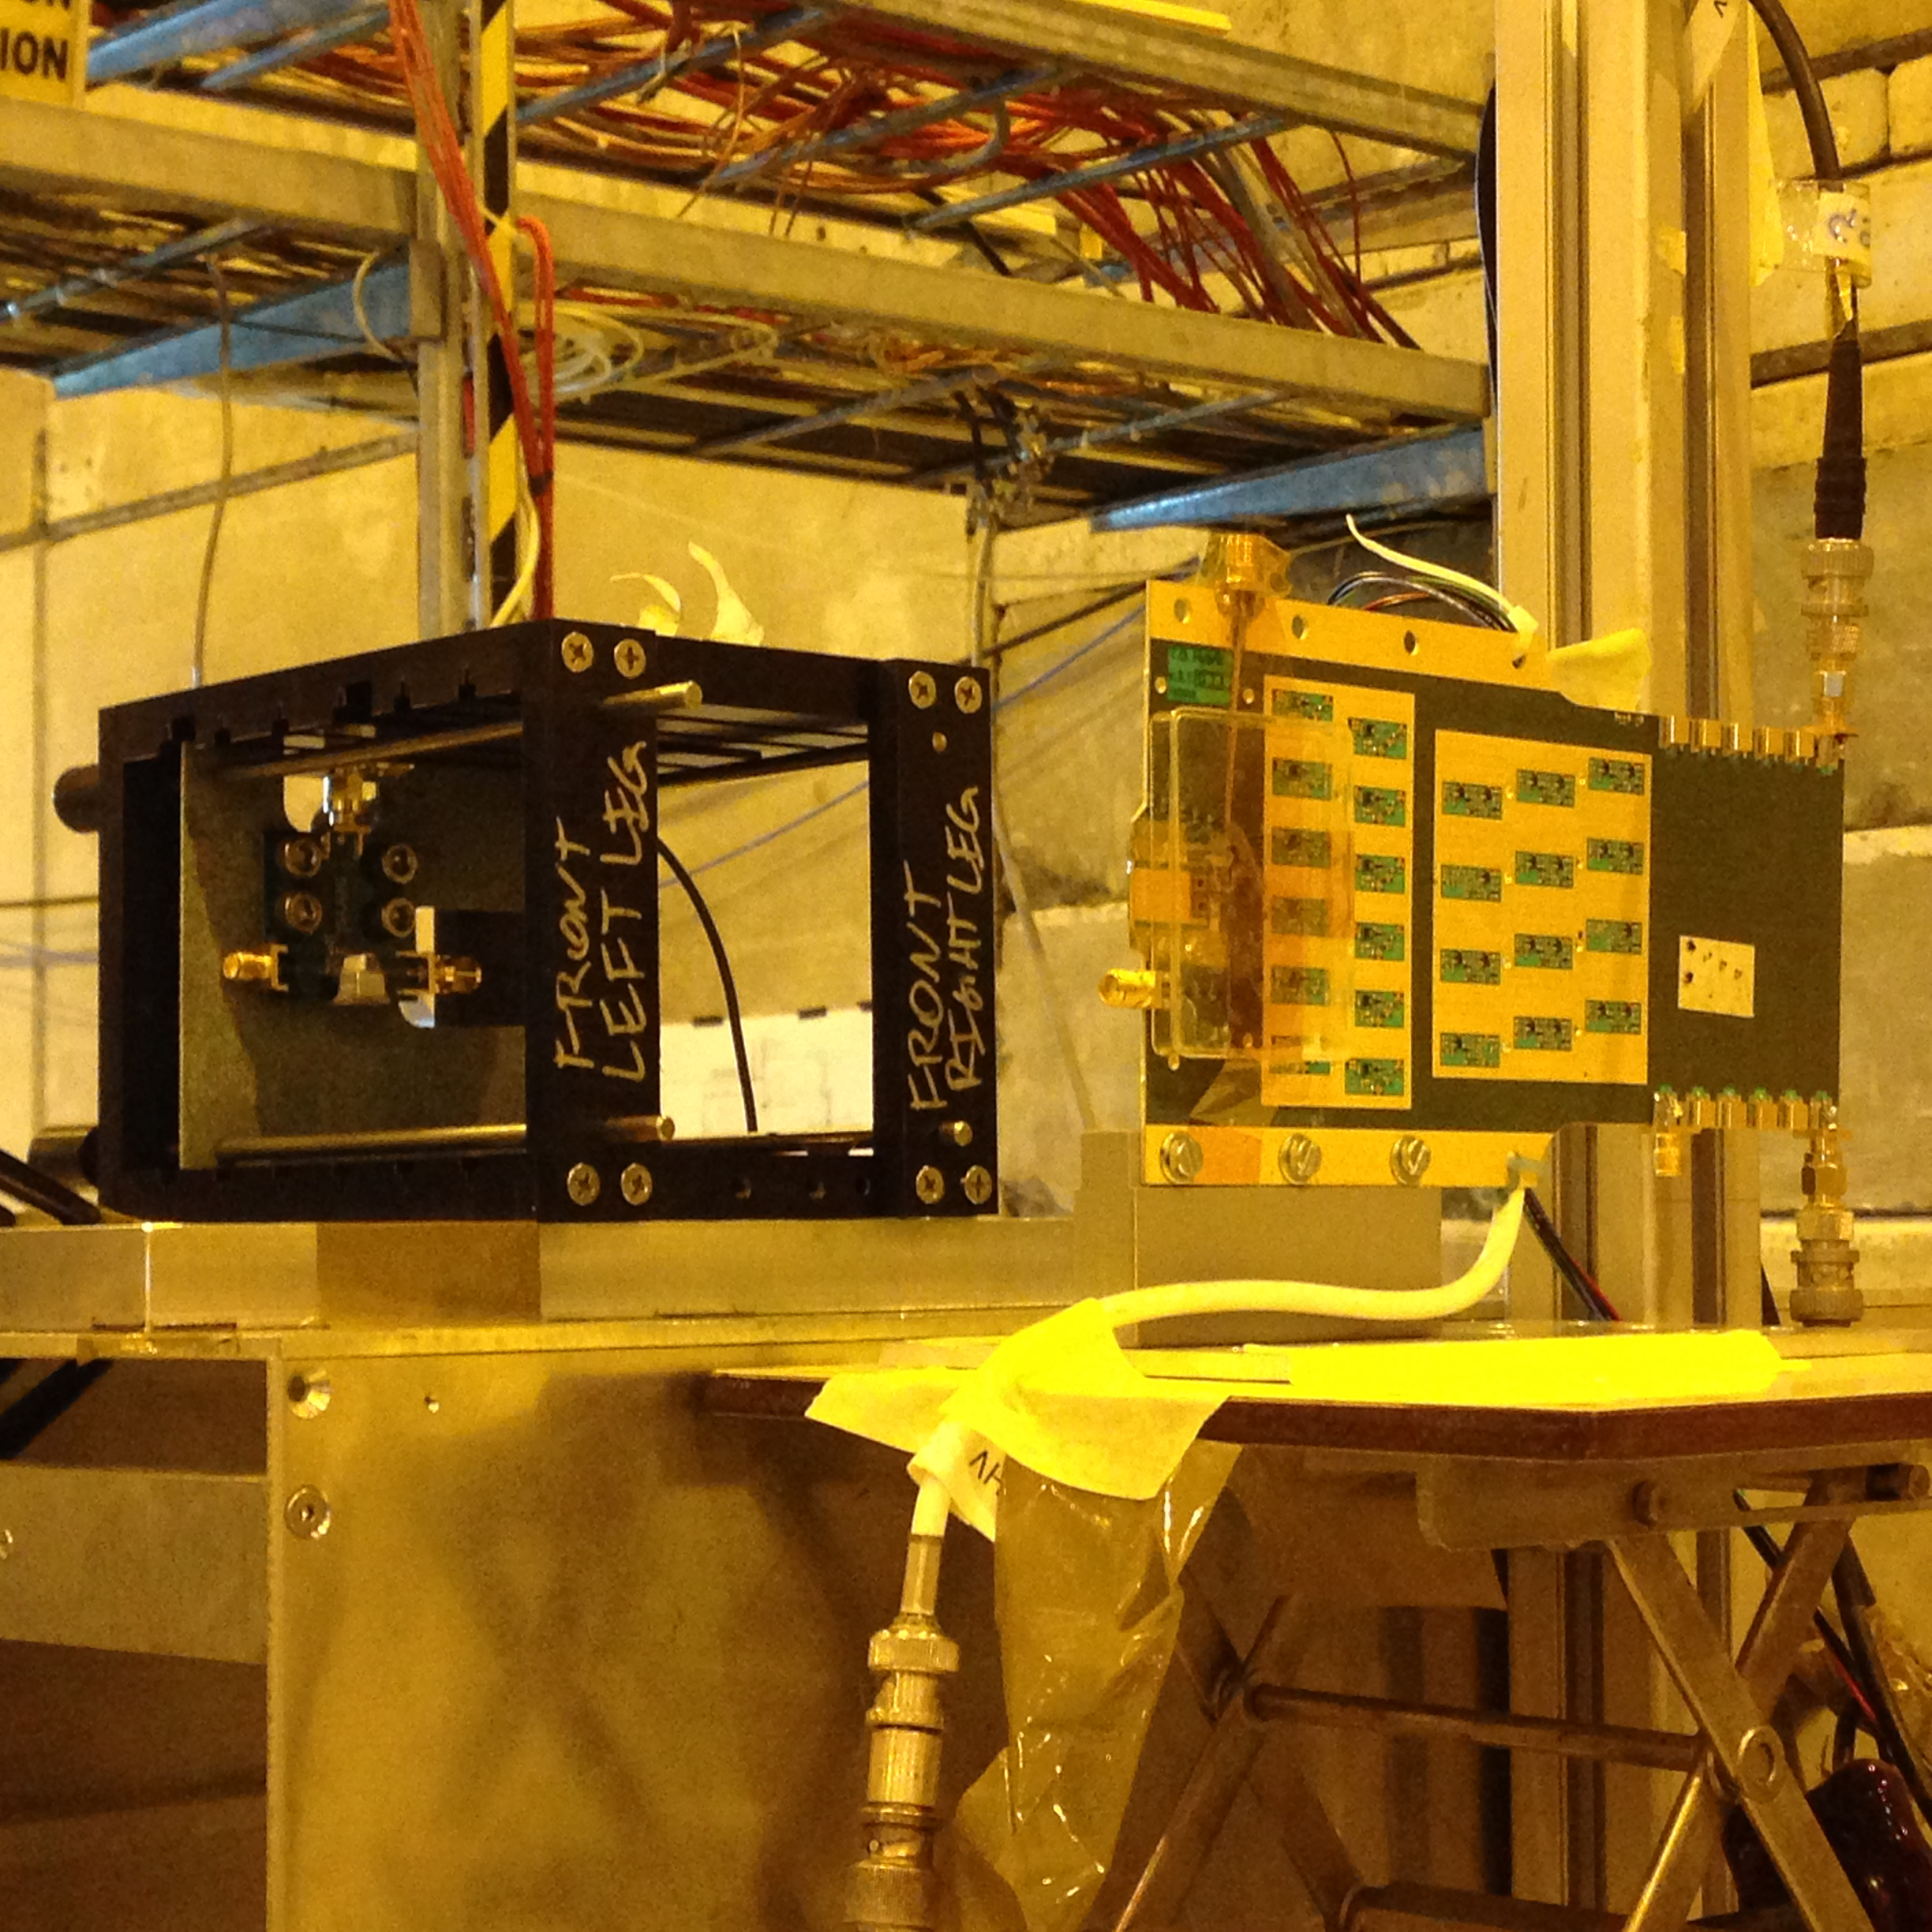
CT-PPS timing with UFSD silicon sensors
Test beam with final CT-PPS geometry and 300 micron sensors.
CT-PPS board with UFSD sensors
UFSD sensors
Best result with 300 micron sensors: ~ 100 ps.
Very promising result, next step is to repeat it with 50 micron sensors.

Slide 8
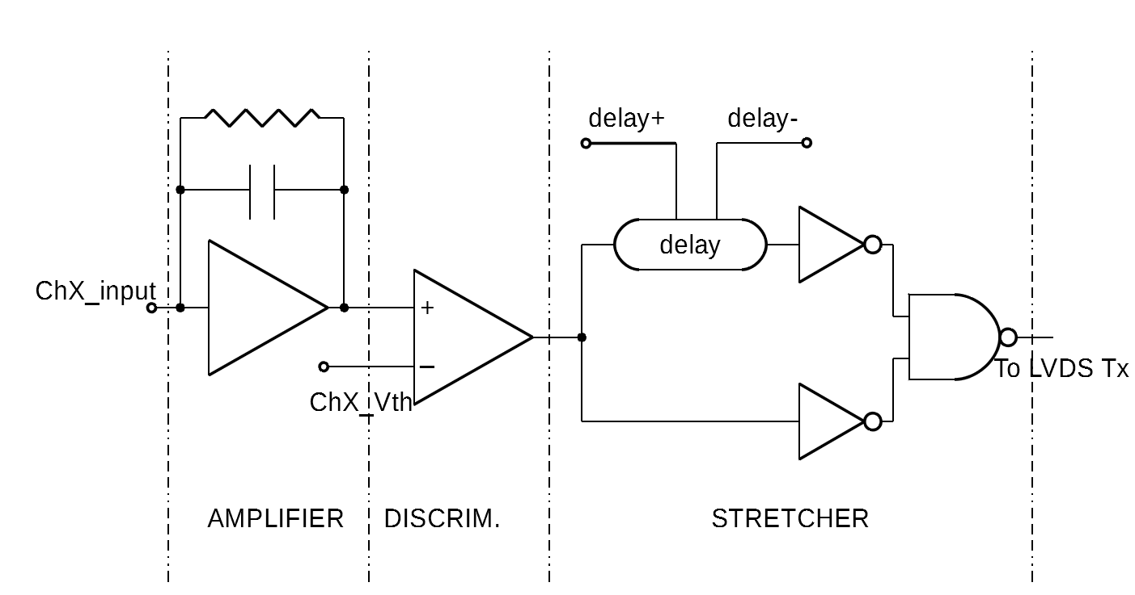
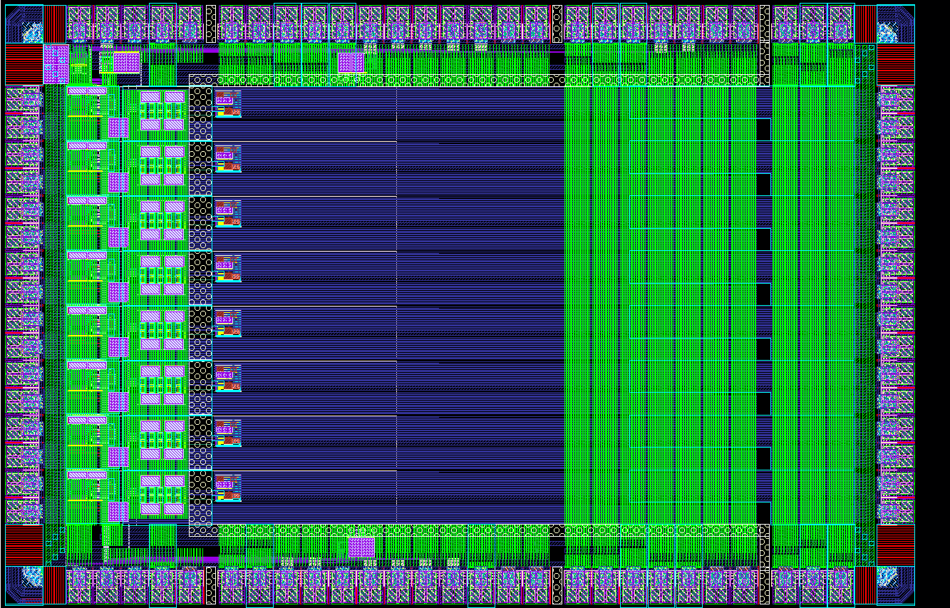
TOFFEE: fully custom made chip for LGAD read-out
LVDS HPTDC
0-100% rise time = 3 ns
tau: ~ 1.2 ns
I/O domain
Analog Input (8ch, 16pads)
LVDS Output (16lines)

Slide 9
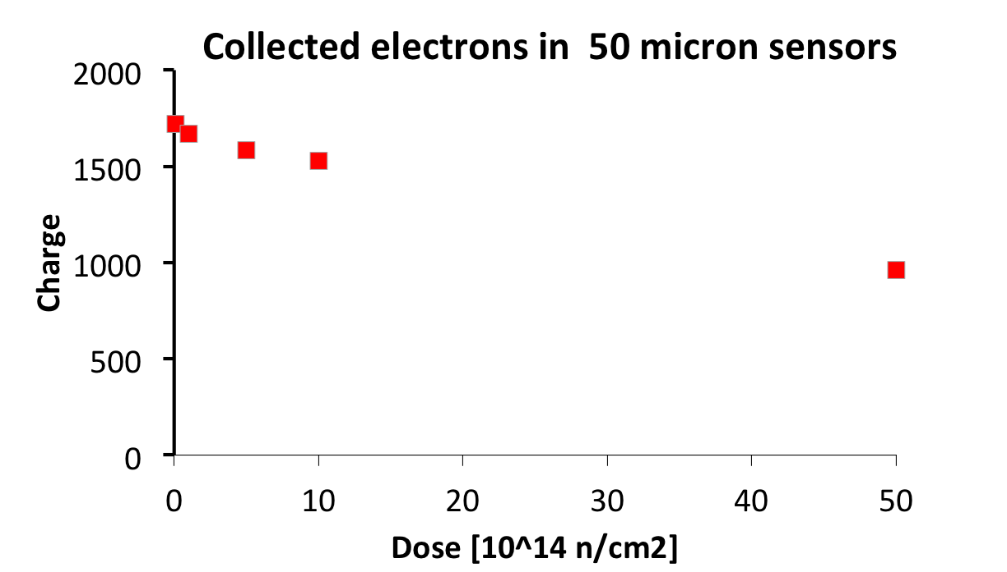
Charge collection in 50 micron vs dose
How much charge do we need to have excellent time resolution?
Let’s say 50-60k electrons (7-10 fC).
10% less electrons
50% less electrons
We need more gains as trapping becomes more important

Slide 10
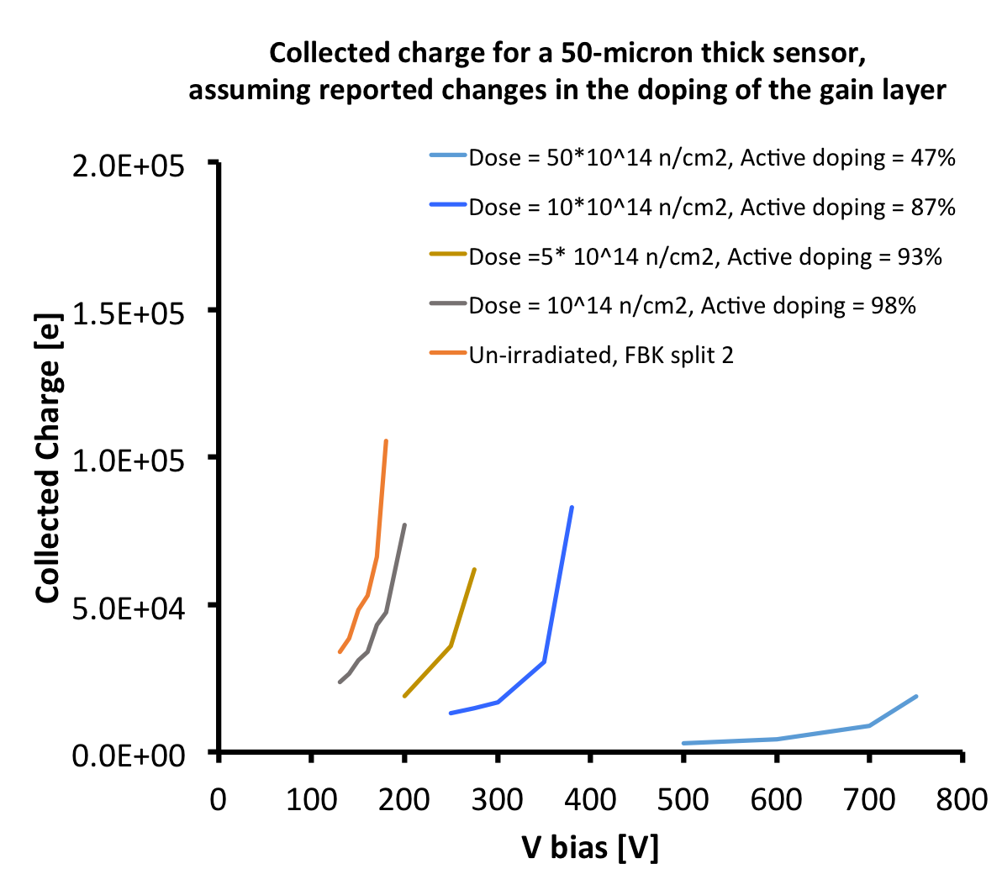
Charge collection: how to keep 50k electrons with irradiation
Good signal
If there is the same change in gain layer doping as measured in 300 micron sensors, than we need to increase the voltage up to 350 – 400 V to compensate.

Slide 11
Can we use a thicker sensor in CT-PPS?
The thickness of the sensor and its gain need to be evaluated depending on the electronics and the application.
Integration time ~ electron collection time
For the specific case of CT-PPS:
TOFFEE: integration time ~ 1.2 ns
Thicker: 100 micron vs 75 micron vs 50 micron
More charge && Less capacitance
More leakage current ➔ compensated by less gain ➔ Shot noise goes up or down?
More trapping
Currently we keep the thickness of 50 micron, however we are looking into thicker sensors.

Slide 12
Conclusion
CT-PPS: demonstrator of LGAD-UFSD capability.
We are approaching the important milestone in the LGAD development of being used for timing in an experiment.
Did we select the best possible gain-thickness combination for the CT-PPS?
The current design uses:
50 micron && Gain 10-15 && integration time = 1.2 ns
As we gain experience we will re-evaluate the design.
We already have 75 micron sensors in production and100 micron silicon wafers ready

