Slide 1


Development of ultra-low optical and mechanical loss aSi coatings using novel ECR ion beam deposition
Optical absorption of amorphous silicon coatings
Stuart Reid / Iain Martin (UWS/GU)
Ross Birney ¹, Des Gibson¹, Jim Hough², Sean MacFoy¹, Iain Martin², Peter Murray², Stuart Reid ¹, Raymond Robie², Sheila Rowan², Jessica Steinlechner², Simon Tait¹, Zeno Tornasi², David Vine¹
¹SUPA, Institute of Thin Films, Sensors and Imaging, University of the West of Scotland,
²SUPA, Institute for Gravitational Research, University of Glasgow
LIGO-G1601200

Slide 2
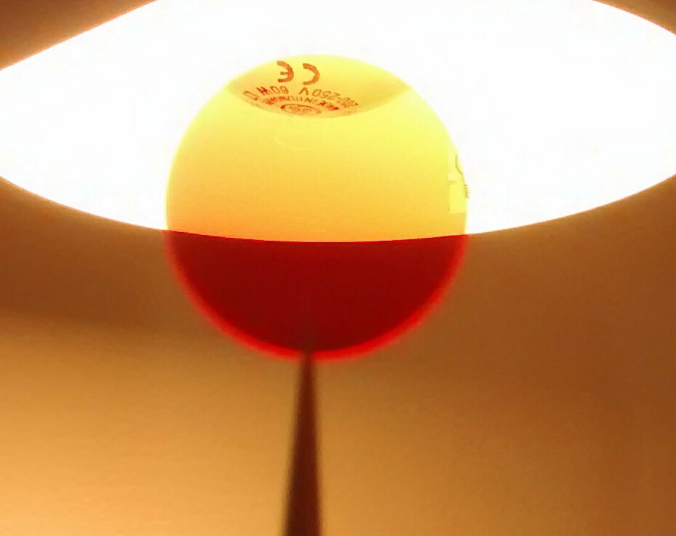
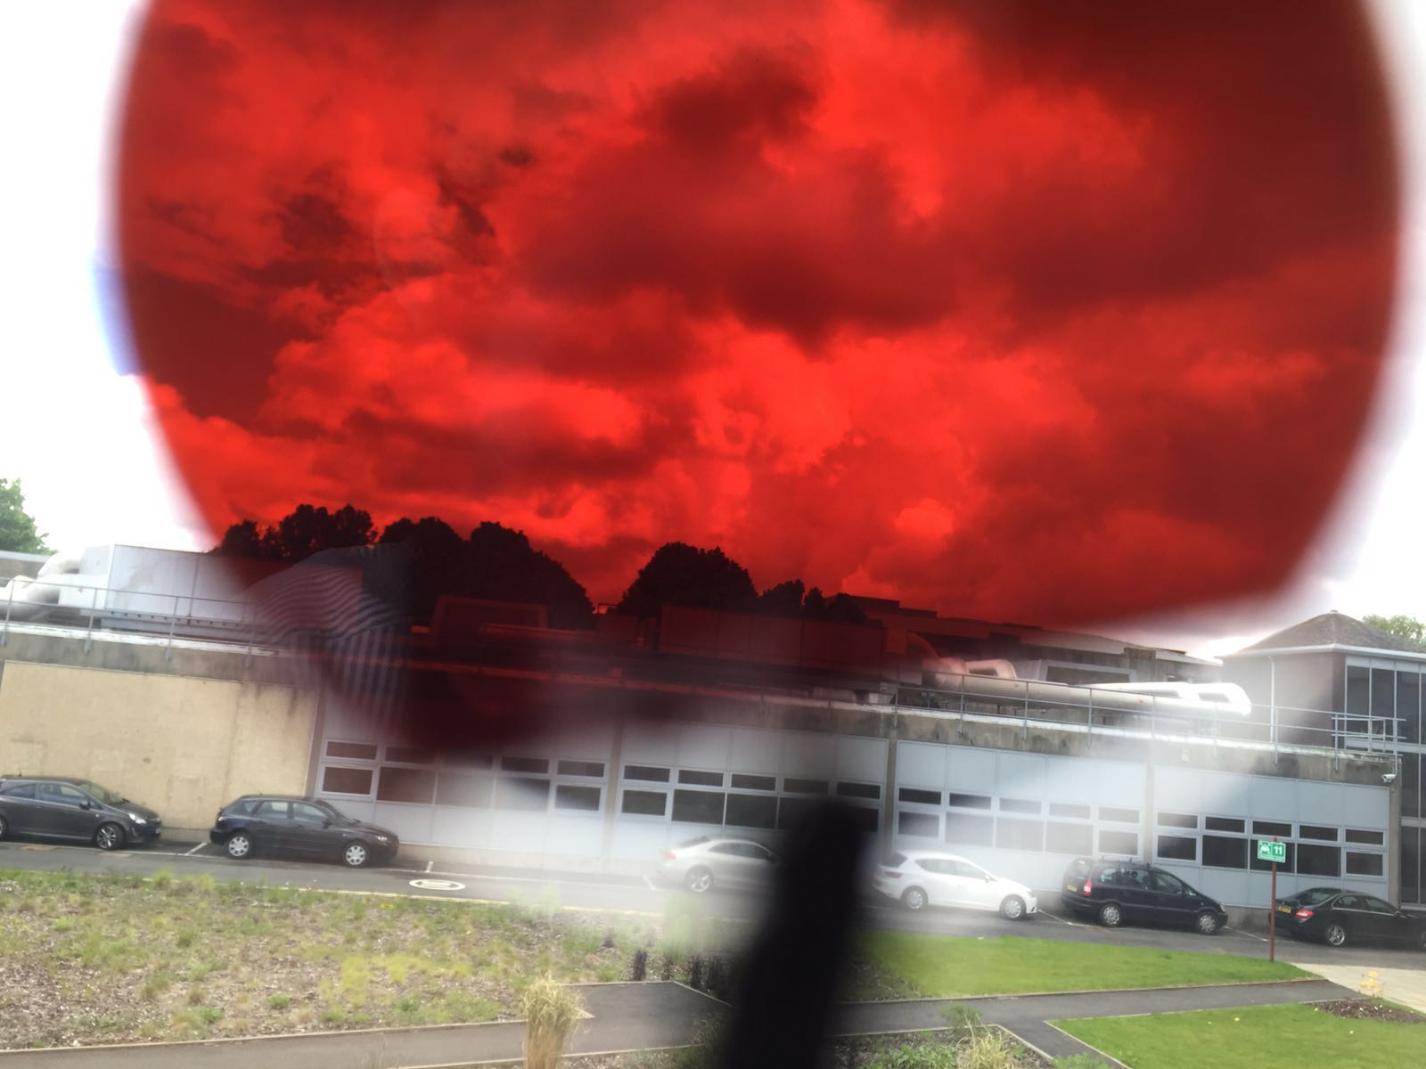
“Take home message”
Recent results from UWS/UG suggest:
It is possible to reduce optical absorption in IBS aSi coatings, whilst maintaining low φ.
Heated deposition of IBS aSi films likely to gain similar benefits in atomic structure/mechanical loss as heated e-beam deposition (as observed by Berkley group).

Slide 3
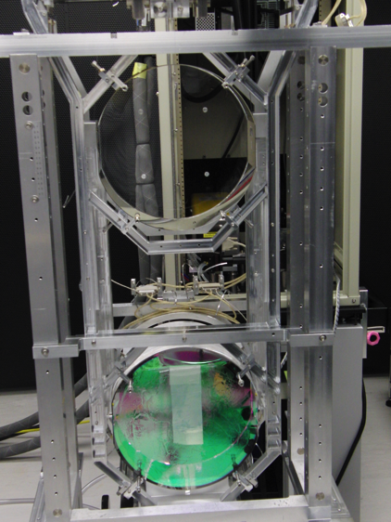
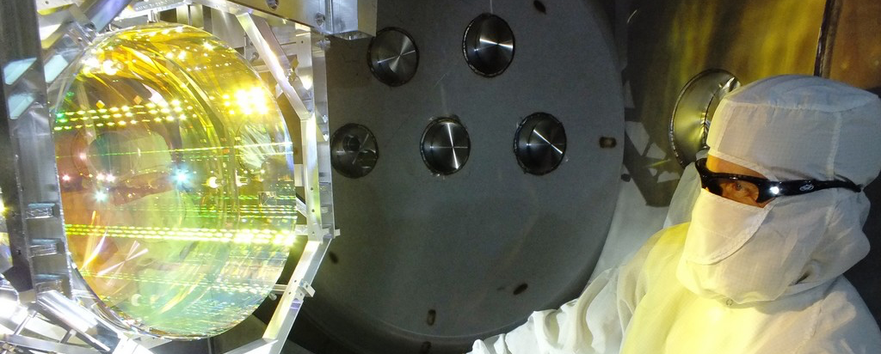
Background
Original requirements for aLIGO (at 1064nm):
Absorption < 0.5 ppm required (goal < 0.3 ppm)
Scatter < 2 ppm required (goal < 1 ppm)
ITM transmission: (5 ± 0.25) × 10-3.
ETM transmission: < 10 ppm (goal < 5 ppm)
Test Mass HR matching = 2 (T1-T2)/(T1+T2)
< 1 × 10-2 required (goal 5 × 10-3)
AR reflectivity: 200 ± 20 ppm
Mechanical loss: 3 × 10⁻⁵ (goal 1 × 10⁻⁴)
Likely requirements for aLIGO+ and beyond?
IBS
???

Slide 4


PVD (Physical vapour deposition)
The continued challenges in PVD technology
-> Uniform deposition on large area : difficult
-> Multi component deposition: even more difficult
Evaporation
Magnetron sputtering
Ion Beam Deposition
(IBD)
Pulsed Laser Deposition
(PLD)
+
_
ions
substrate
substrate
substrate
substrate
Deposition profile/conditions is somewhat fixed and
limited by the geometry of the process

Slide 5
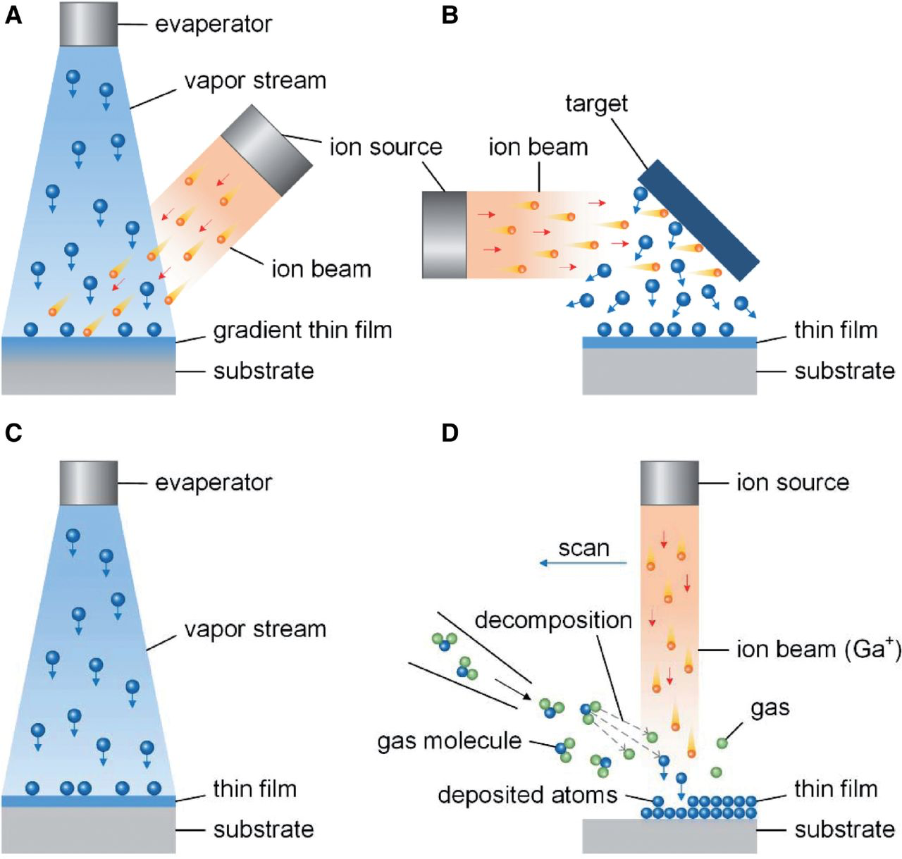
Ion beam deposition (IBD)

Slide 6

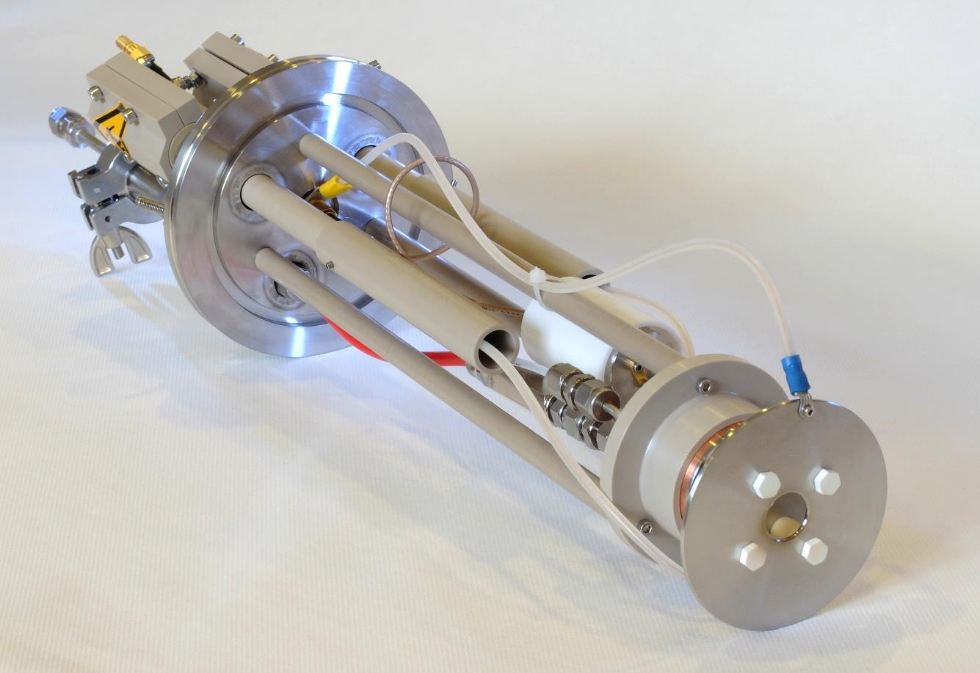
ECR ion source at UWS

Slide 7
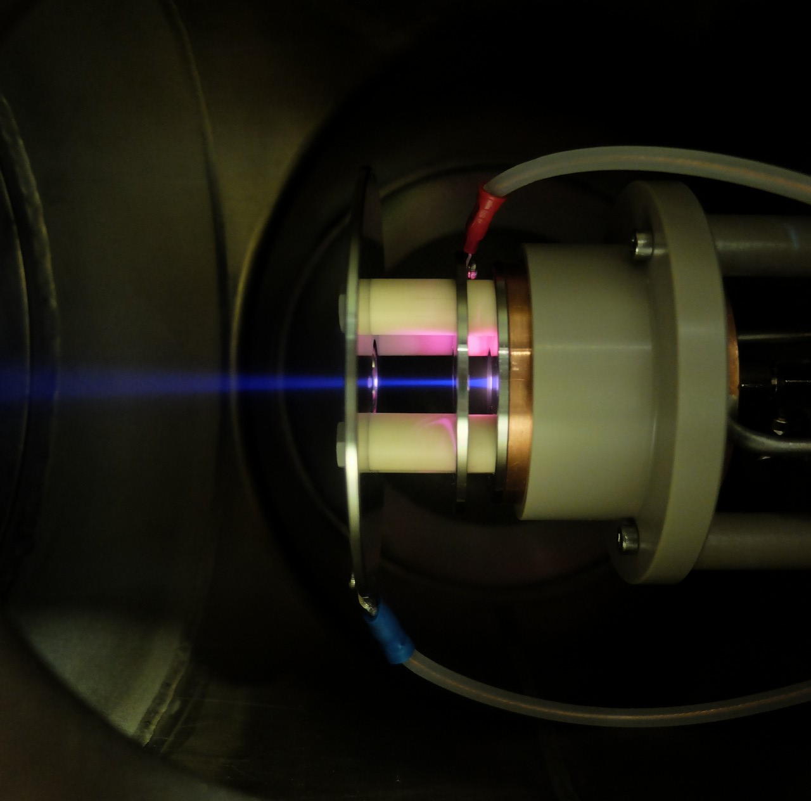
Development of ECR-IBD
ECR plasma cavity
(microwave)
Divergent Ar ion beam
focus
ground

Slide 8
Development of ECR-IBD
Compact λ/4 microwave cavity
filament-free
maintenance free
low current
extraction potential 0-20 kV
B_{z}
B_{max}
B_{ECR}
Extraction plane
Area of maximum
power
coupling
Antenna
Couplers
Forward diffusion
inside the magnetic field
z
~ l / 4 ~ 3 cm at 2.45 GHz

Slide 9
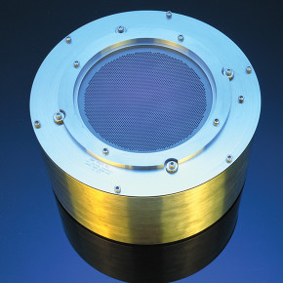
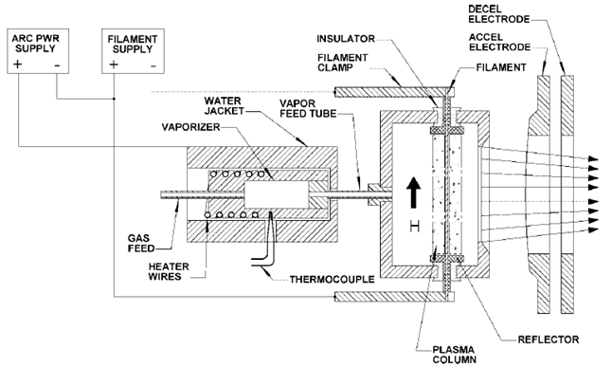
Comparison to standard IBS
Filament and extractor grid provide high-current
(possible contamination and expensive running costs)
50 to 1500eV and 75 to 700mA (for Veeco 16cm RF)

Slide 10
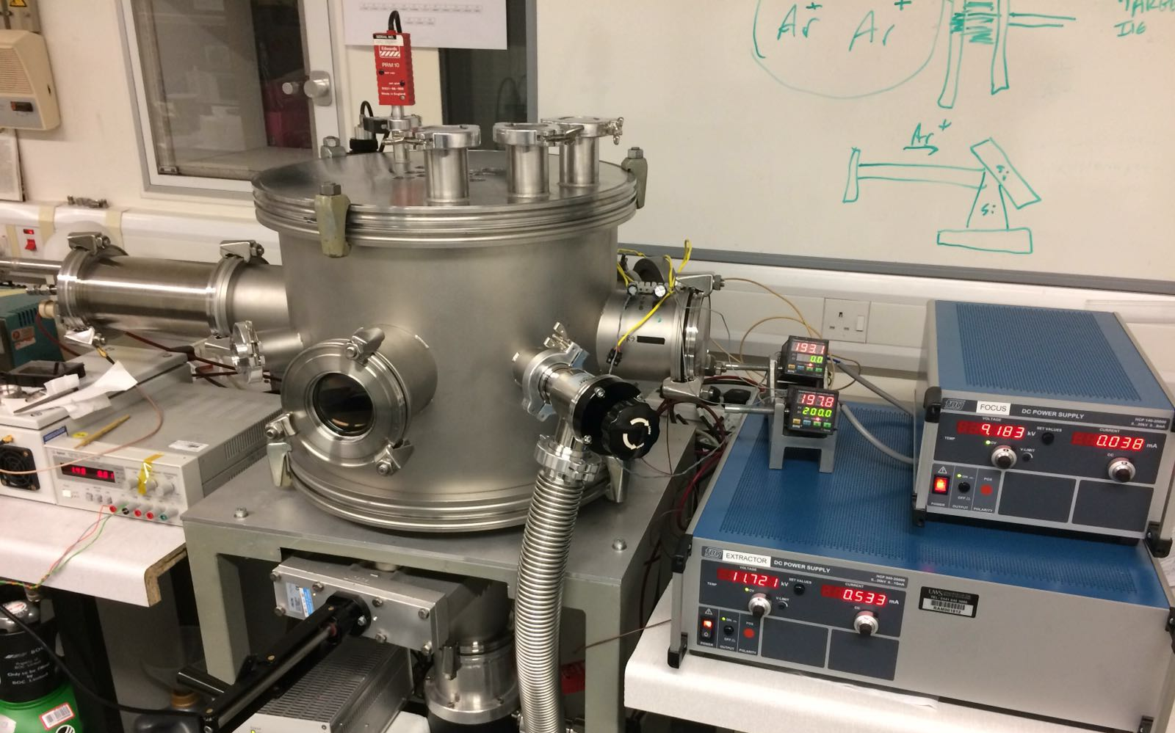
Development of ECR-IBD

Slide 11
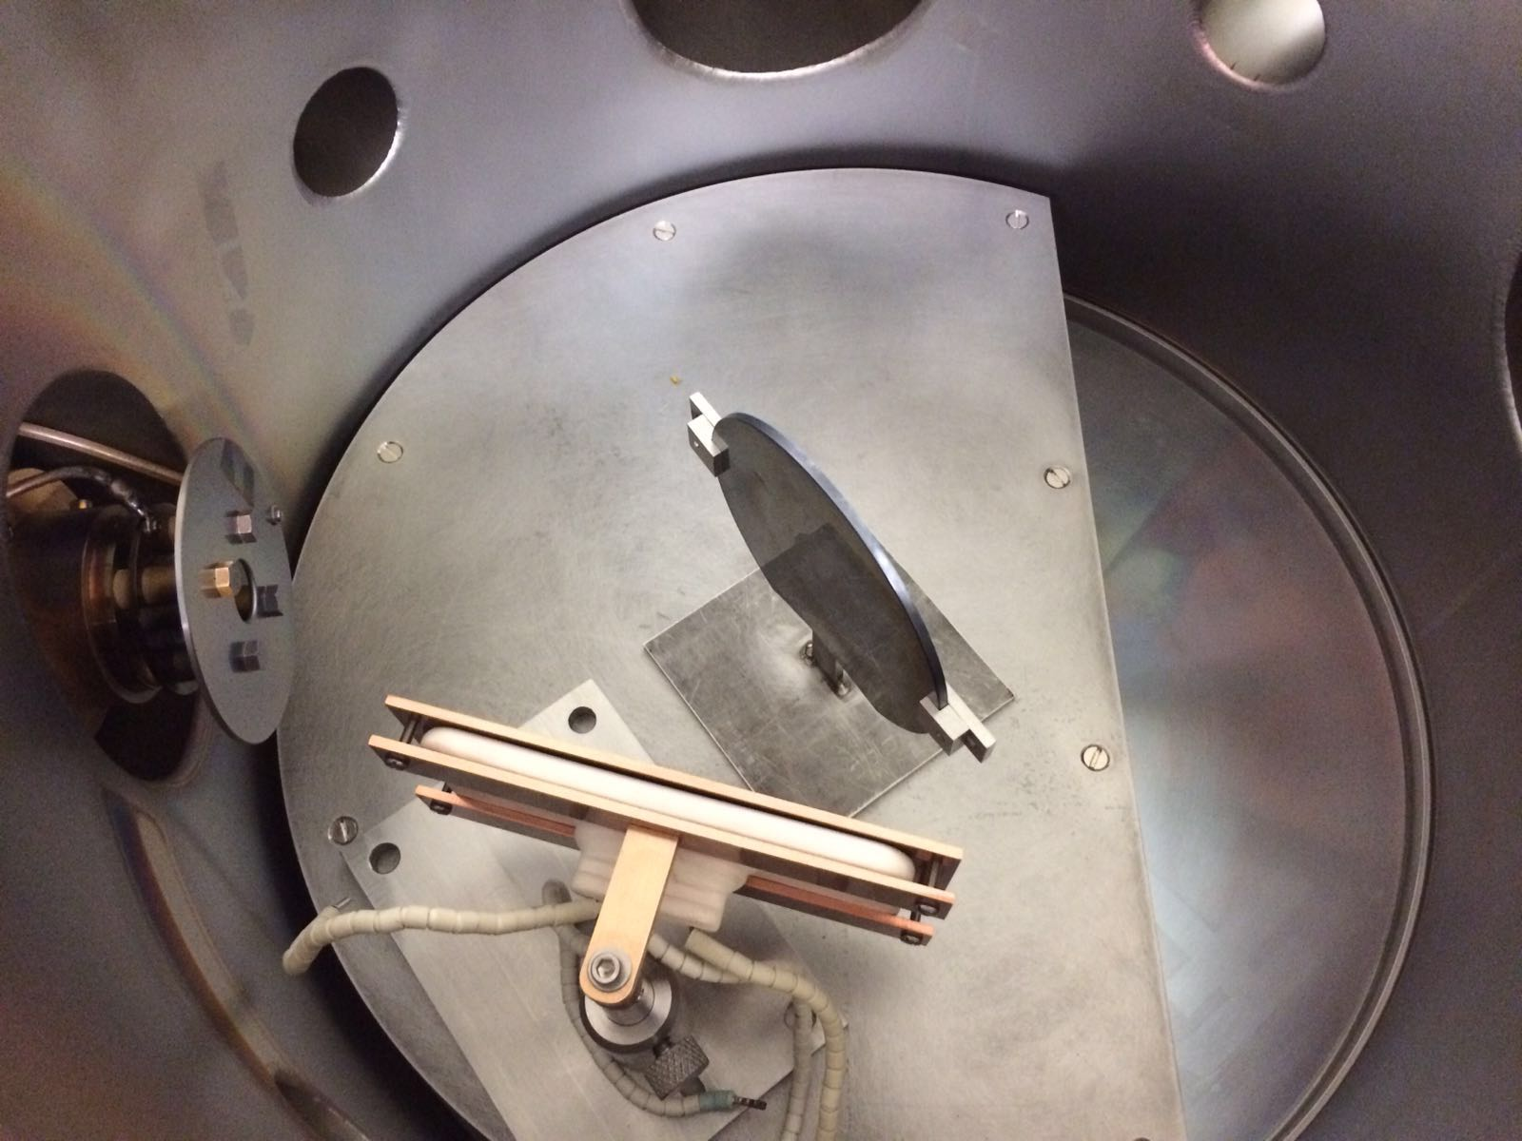
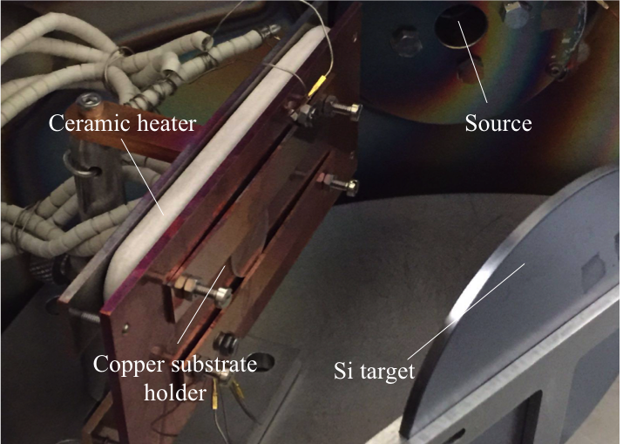
Development of ECR-IBD

Slide 12

Absorption measurements - Glasgow
Photo-thermal commonpath interferometry (PCI)
A. Alexandrovski et al. Proc. SPIE 3610, Laser Material Crystal Growth and Nonlinear Materials and Devices, 44 (May 26, 1999);
Pump beam,
1550 nm
detector
sample
Probe beam,
1620 nm
Lock-in amplifier
Slides courtesy of J. Steinlechner (IGR, Glasgow)

Slide 13
Absorption measurements - Glasgow
Δn
Pump beam changes refractive index of an element in the probe beam
Slides courtesy of J. Steinlechner (IGR, Glasgow)

Slide 14
Absorption measurements - Glasgow
We measure this phase difference by imaging the plane 1 Rayleigh range from the intersection point
(virtual detection plane)
Δn
The wavefront from this element is different from the rest of the beam
Pump beam changes refractive index of an element in the probe beam
Slides courtesy of J. Steinlechner (IGR, Glasgow)

Slide 15
Absorption measurements - Glasgow
Getting absorption by comparing signal to calibration substrate with known absorption
We measure this phase difference by imaging the plane 1 Rayleigh range from the intersection point
(virtual detection plane)
Δn
The wavefront from this element is different from the rest of the beam
Pump beam changes refractive index of an element in the probe beam
Slides courtesy of J. Steinlechner (IGR, Glasgow)

Slide 16
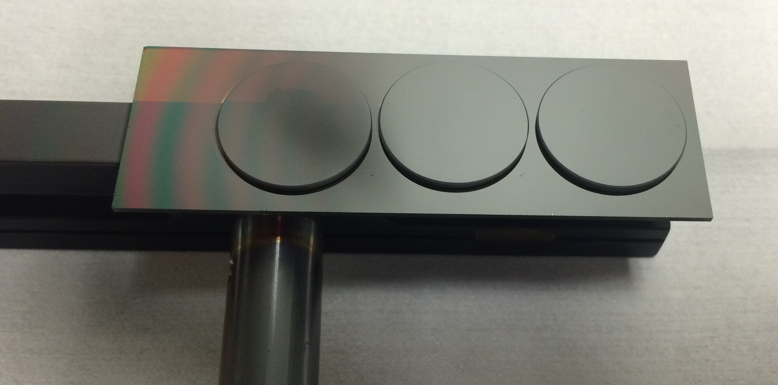
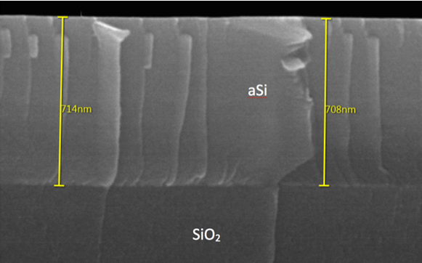
aSi coatings fabricated using ECR-IBD
20mm JGS3 silica witness samples
(optical characterisation and absorption)
Cross-section SEM image

Slide 17
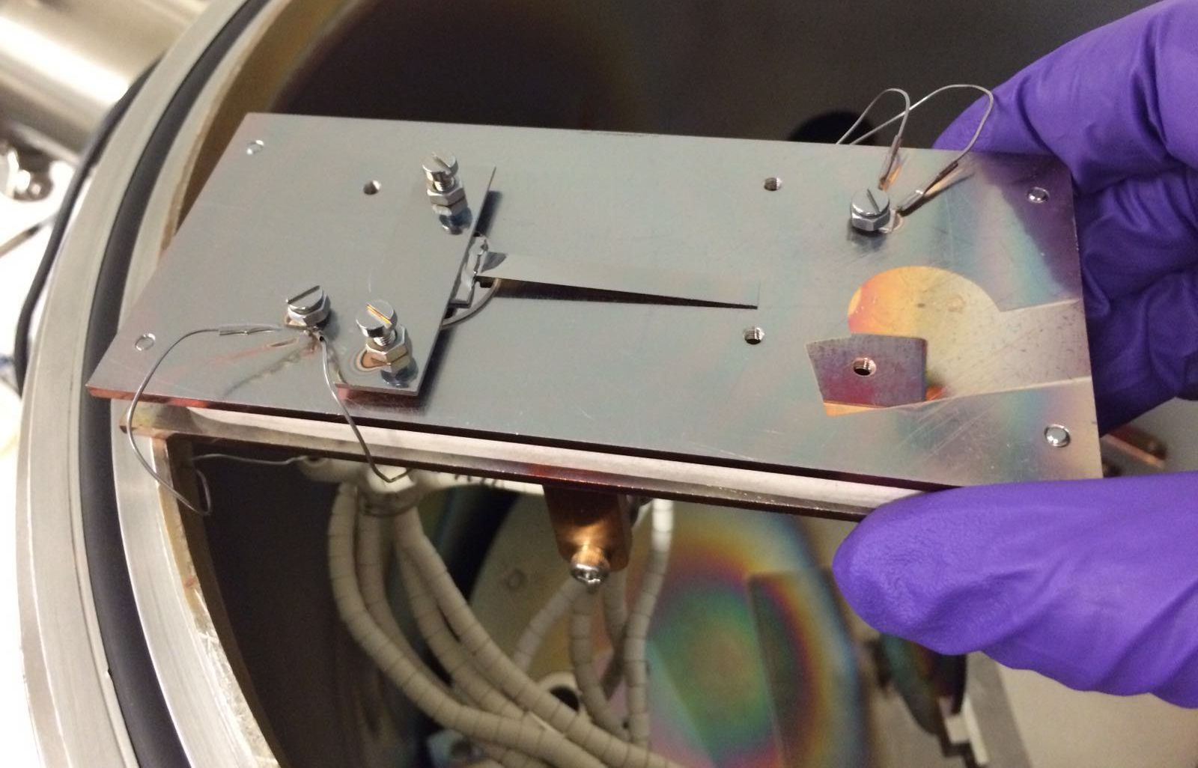
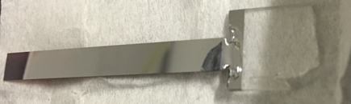
aSi coatings fabricated using ECR-IBD
silica cantilevers, coated with aSi

Slide 18
Absorption measurements on aSi – 1550 nm
Description
1000 ppm
1550 nm
Absorption significantly lower than for ATF coatings
Refractive index ~3.4 from transmission measurements
UWS measured on a ~660 nm layer
ATF measured on a 500 nm layer
→ both scaled to HR coating
< 20* ppm
* measurement limited by substrate absorption

Slide 19
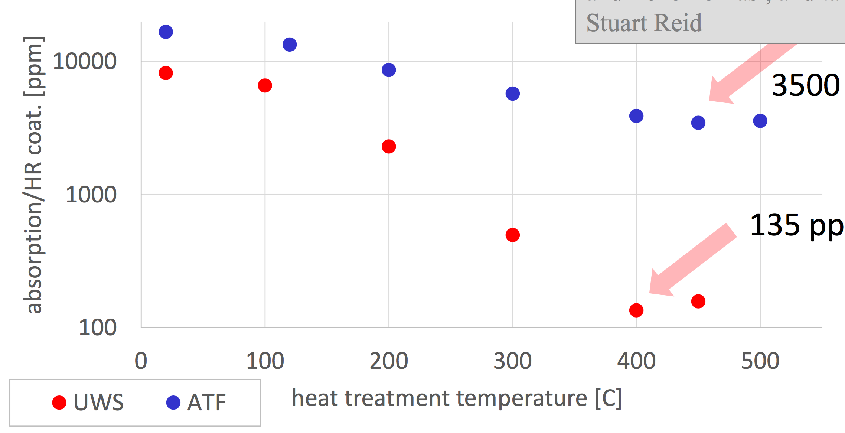
Absorption measurements on aSi – 1064 nm
ppm
m

Slide 20
Mechanical loss
Description
Initial mechanical loss measurements on silica cantilevers

Slide 21
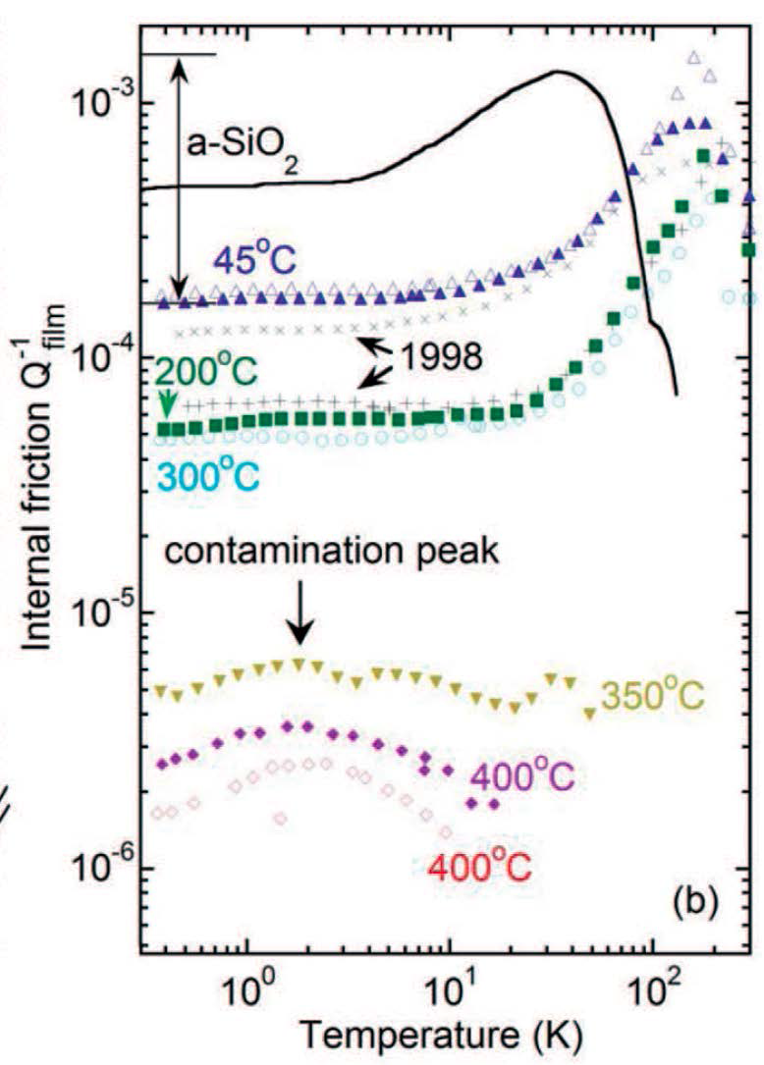
Berkeley high temperature deposition
Description
As discussed by M. Fejer yesterday (see G1601192-v1)
Heated deposition reduces mechanical loss much further than post- heat treatment alone.
~10⁻⁴ vs ~10⁻⁶
Surface mobility during deposition:
- sound velocity approaches asymptote
- distribution of bond angles narrows
- density increasing
- Heat capacity approaches bulk silicon value
Open question – similar benefits for IBS?
annealed 350C
deposited 350C
X. Liu, F. Hellman, et al, PRL 113, 025503 (2014)

Slide 22
High-temperature deposition
Description

Slide 23
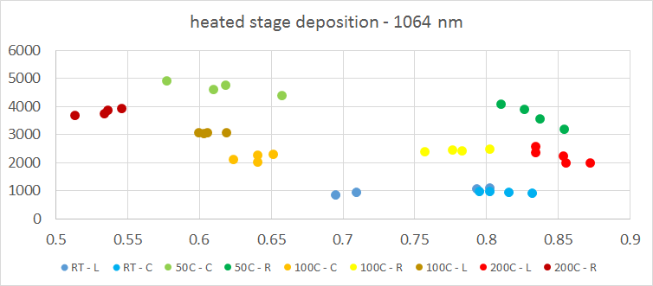
High-temperature deposition - absorption
Description
Random spread in absorption – no clear benefit in heated deposition in initial tests
Strong evidence that room temperature coatings have been contaminated – strangely reducing the absorption further – however index also lower than expected

Slide 24
High-temperature deposition – mechanical loss
Description
So what happens???

Slide 25
High-temperature deposition – mechanical loss
Description
Difficult (but good!) problem:
uncoated cantilever – annealed twice at 400C
coated cantilever – annealed at 400C
φ_{coated} = 1.64x10⁻⁶
φ_{uncoated} = 1.86x10⁻⁶
250s ringdown
1550Hz
150s ringdown
1550Hz
φ_{coating} = 8.6x10⁻⁶

Slide 26
High-temperature deposition – mechanical loss
Description

Slide 27
High-temperature deposition – mechanical loss
Likely factor 25 reduction in loss achievable
Annealing the 200C aSi coating at 400C, measurement approaching experimental uncertainty, at the level of 1x10⁻⁵.

Slide 28
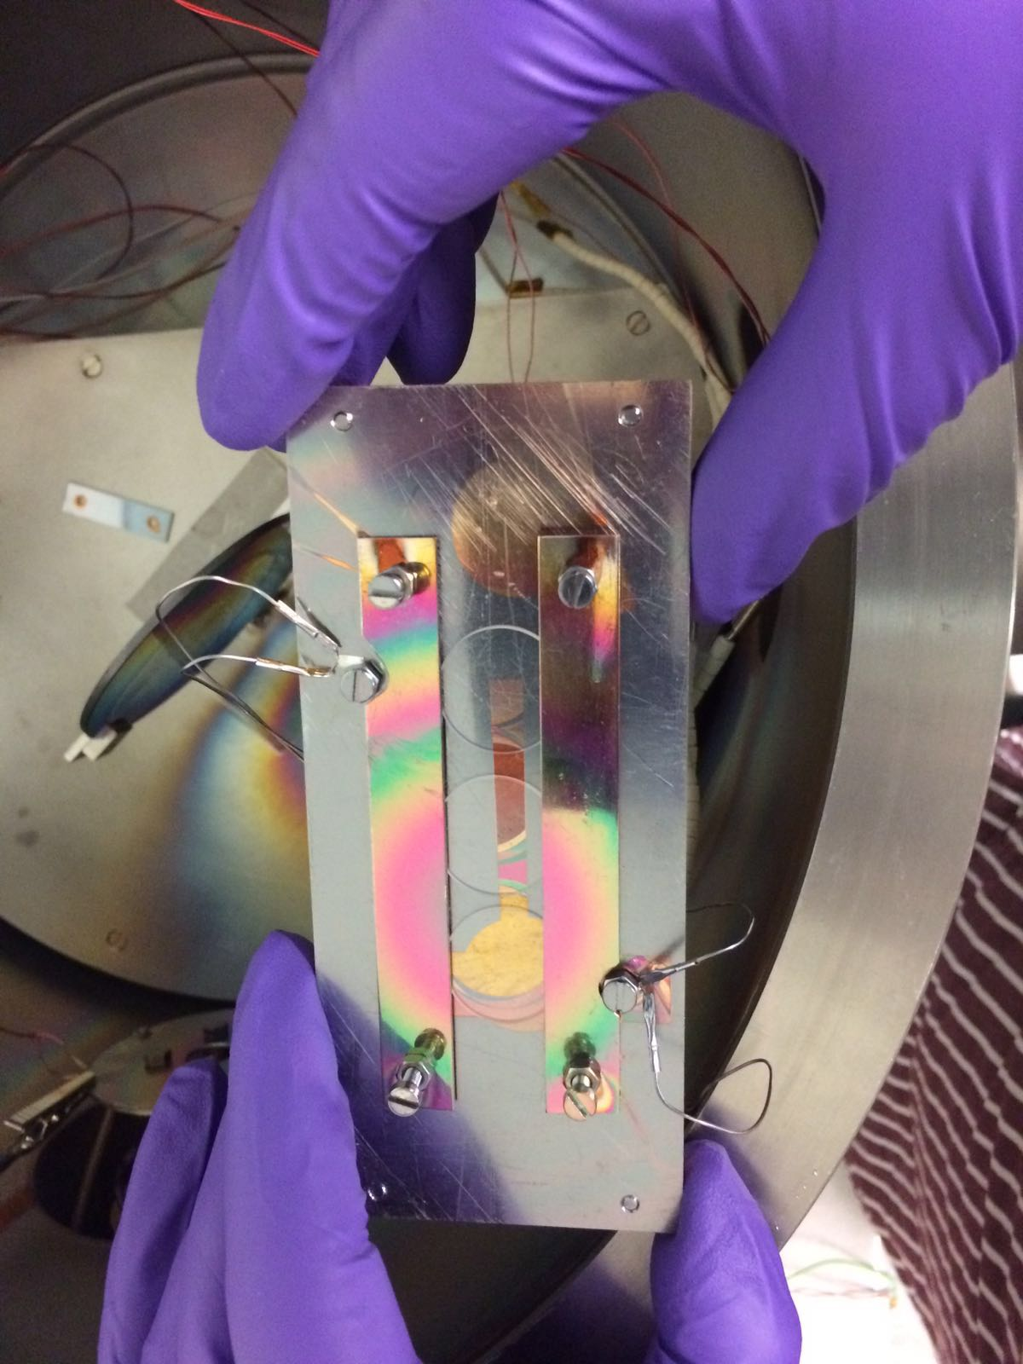
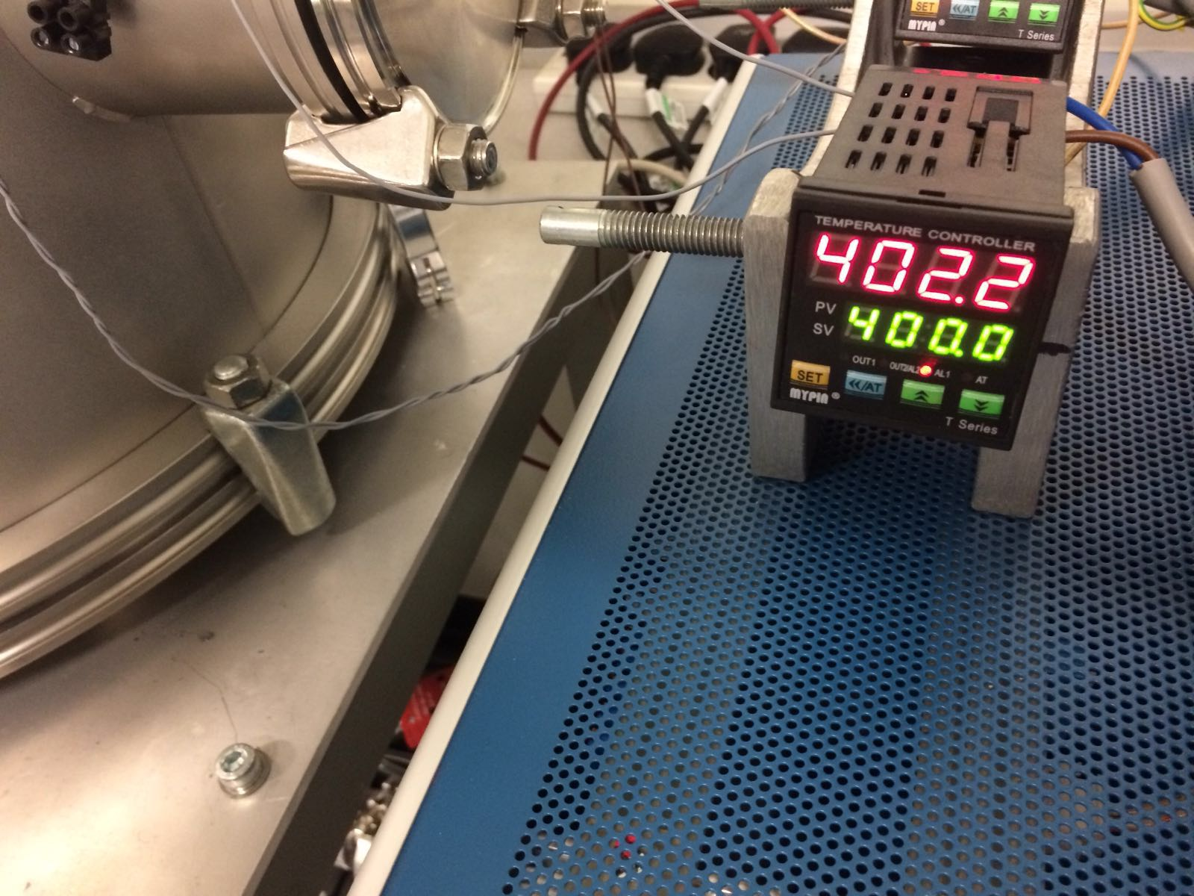
High-temperature deposition – mechanical loss
Description
Results are on the way!

Slide 29
Characterisation – bandgap associated absorption
Description
Tauc plot – UWS aSi

Slide 30
Characterisation – bandgap associated absorption
Description
Tauc plot – UWS aSi
Average bandgap energy 1.4eV (commonly reported 1.1-1.5eV for a-Si)

Slide 31
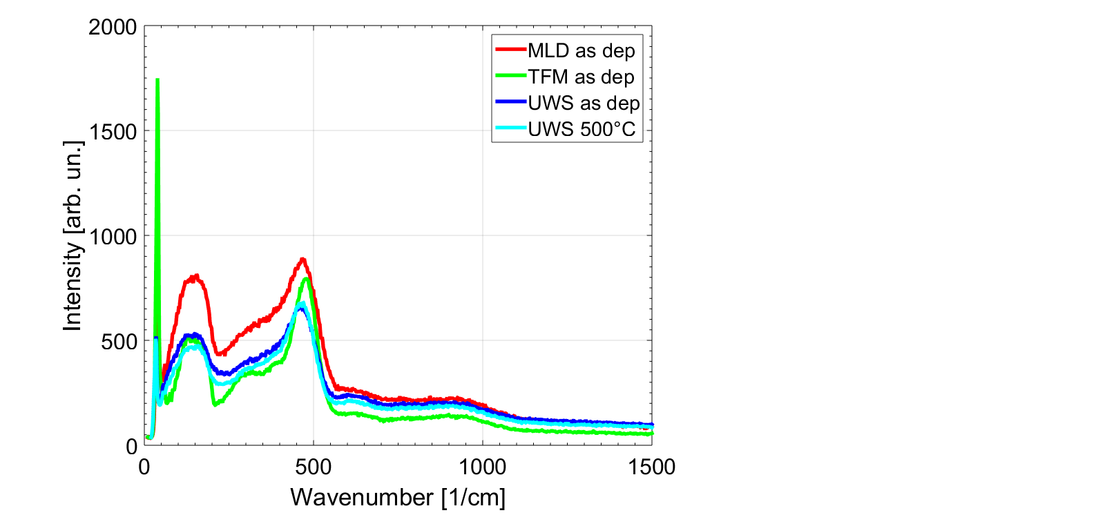
Characterisation – Raman
See poster by Zeno Tornasi (Glasgow)

Slide 32
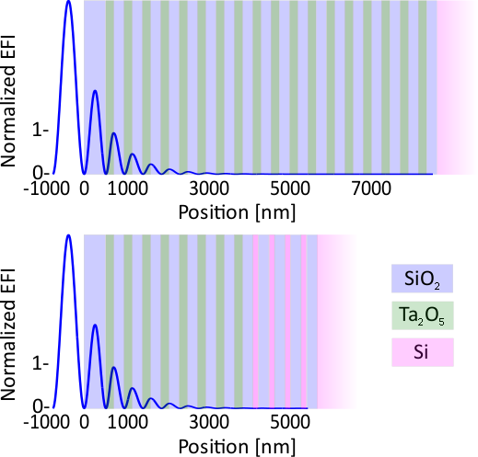
Thermal noise
Description
We can use a multi material design
Some bilayers of SiO₂ and Ta₂O₅ are used to reduce the laser power
In lower layers amorphous silicon can be used to improve thermal noise due to a high refractive index and low loss
Jessica Steinlechner

Slide 33
What does this mean for thermal noise?
… if we want less than 1ppm absorption from the aSi:
Description
At 1064 nm RT:
We need 8 bilayers of SiO₂ and Ta₂O₅ to reduce the laser power
For an ITM with T= 1.4% we can’t improve the coating using aSi in lower layers
For an ETM with T = 6 ppm we need
4 bilayers of SiO₂ and aSi
Thermal noise improvement* compared to a pure SiO₂ and Ta₂O₅ coating:
Room temperature:
ITM: - 0%
ETM: - 28%
total: -18%
Almost no improvement by reducing mechanical loss further (limited by silica loss and ITM thermal noise)
21.5%
5x10⁻⁵
Jessica Steinlechner
*Loss for aSi: 1.2e-4 measured on UWS aSi coatings at room temperature

Slide 34
What does this mean for thermal noise?
… if we want less than 1ppm absorption from the aSi:
Description
At 1550nm RT:
We need 5 bilayers of SiO₂ and Ta₂O₅ to reduce the laser power
For an ITM with T= 6000 ppm we need 2 bilayers of SiO₂ and aSi
For an ETM with T = 6 ppm we need 5 bilayers of SiO₂ and aSi
Thermal noise improvement* compared to a pure SiO₂ and Ta₂O₅ coating:
120 K 20 K
ITM: -21% -20%
ETM: -38% -36%
total: -32% -31%
Jessica Steinlechner
*Loss for aSi: values from commercial coatings; no cryogenic measurements on UWS coatings

Slide 35
Conclusion from UWS + GU investigations using ECR-IBD
Description
aSi attractive high-index material choice for aLIGO+ and beyond
  Optical absorption of 20ppm for HR stack feasible
  (reason due to unique dep parameters – low dep rate + high ion energy)
  Mechanical loss ~ 5x10⁻⁵ (room temp deposition + heat treatment at 400C)
Heated deposition
  First evidence that heated substrates + ion-beam deposition can reduce mechanical loss below that achievable through same temperature post-deposition annealing
  Mechanical loss ~1x10⁻⁵ for aSi deposited at 200C then heat treated to 400C
Future work
  Complete studies on aSi deposited at elevated temperatures
  Investigate effect of elevated temperature on Ta₂O₅
  Investigate effect of shifting bandgap absorption edge in aSi through doping (H, Al, N etc) – with particular relevance to 1064nm use.

Slide 36

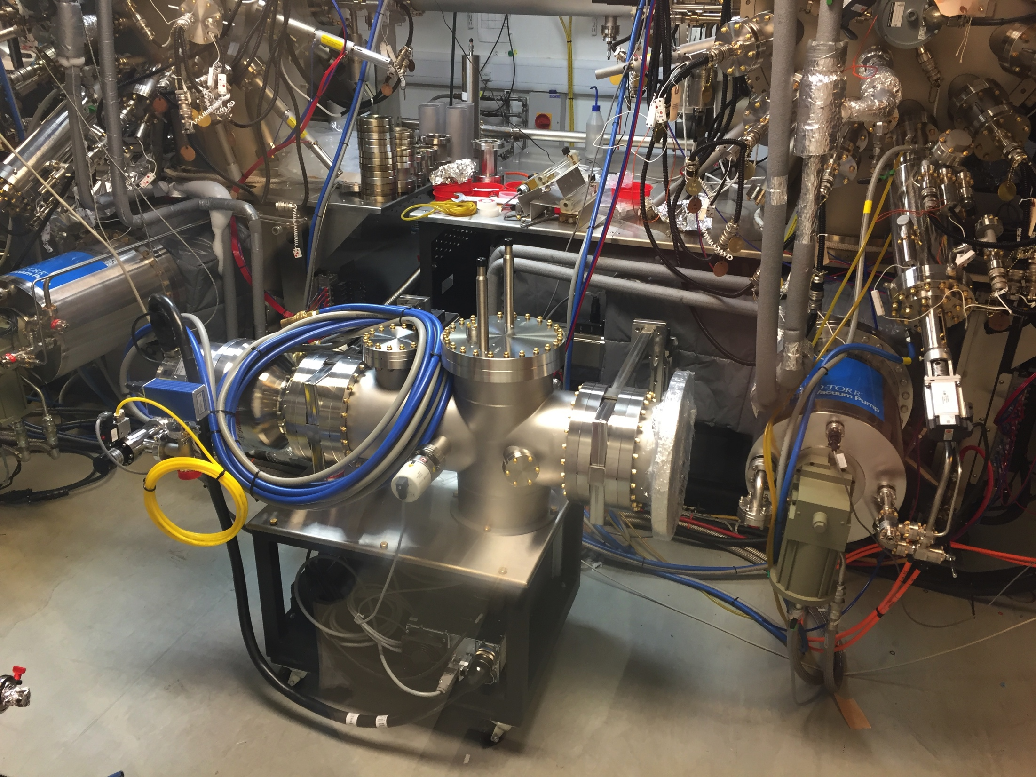

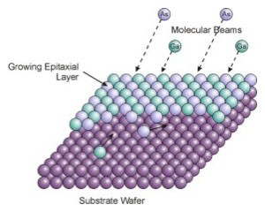
Towards a more ordered future…
Description

Slide 37
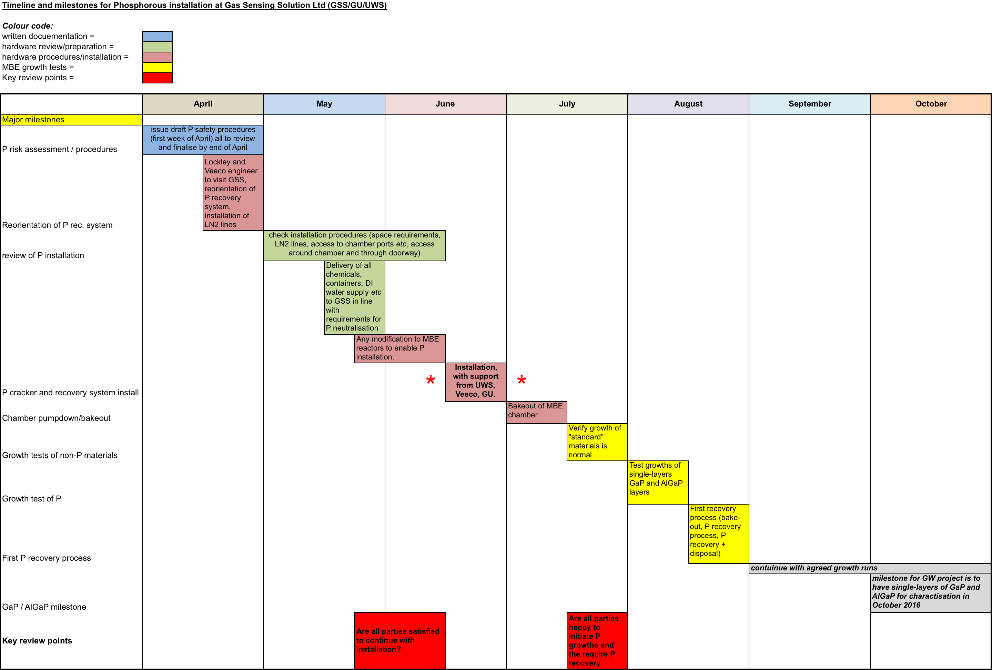
MBE developments (UWS+GU+Stanford+GSS)
Plan to develop AlGaP interference coatings on silicon
Key milestones:
March 2016: all equipment delivered (P cracker, P recovery system, auxillary equip.)
June 2016: installation of P cracker and recovery system
August 2016: test growths of AlGaP begin

Slide 38
Conclusion from UWS + GU investigations using ECR-IBD
Description
aSi attractive high-index material choice for aLIGO+ and beyond
  Optical absorption of 20ppm for HR stack feasible
  (reason due to unique dep parameters – low dep rate + high ion energy)
  Mechanical loss < 1x10⁻⁴ (room temp deposition + heat treatment at 400C)
Heated deposition
  First evidence that heated substrates + ion-beam deposition can reduce mechanical loss below that achievable through same temperature post-deposition annealing
  Mechanical loss ~1x10⁻⁵ for aSi deposited at 200C then heat treated to 400C
Future work
  Complete studies on aSi deposited at elevated temperatures
  Investigate effect of elevated temperature on Ta₂O₅
  Investigate effect of shifting bandgap absorption edge in aSi through doping (H, Al, N etc) – with particular relevance to 1064nm use.
  Further low temperature absorption and thermal noise evaluation.

