Slide 1
Introduction to thermal noise workshop and goals
AMORPHOUS COATINGS:
STRUCTURE AND MODELLING
AMORPHOUS COATINGS:
CHARACTERIZATION
CRYSTALLINE COATINGS
09:00
09:00
15:30
INTRODUCTION
PRESENTATION OF NEW RESULTS
PRESENTATION OF NEW RESULTS
INTRODUCTION AND DISCUSSION
BY G. COLE
10:35
10:35
16:30
COFFEE BREAK
COFFEE BREAK
11:00
11:00
DISCUSSION
DISCUSSION
12:30
12:30

Slide 2
Structural studies
M. Feyer: Amorphous dielectric coatings
R. Bassiri: Atomic structure investigations of amorphous coatings
C. Billman: Modeling coating thermal noise for gravitational wave detectors
E. Coillet: New results on losses correlation with structure

Slide 3
Coatings characterization
M. Granata: Amorphous optical coatings for gravitational-wave interferometers
S. Reid: Development of ultra-low optical and mechanical loss aSi coatings using novel ECR ion beam deposition
I. Martin/S. Reid: Optical absorption of amorphous silicon coatings
M. Lorenzini: Thermoelastic damping in silicon and metallic discs: the mode shape dependent branching effect

Slide 4
Posters

Slide 5
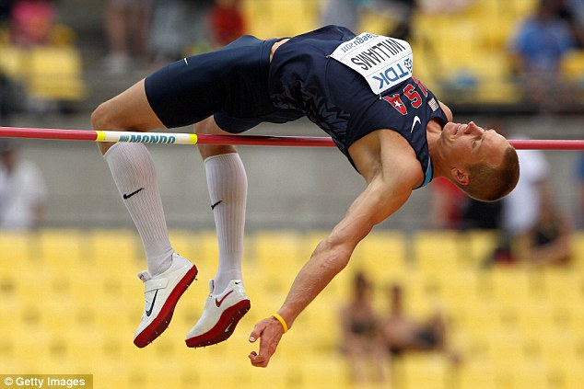
18:00 Wednesday
What are the coatings available in 5 to 10 years time?
Will we be stuck with coatings?
Where do we put the threshold ?….

