Slide 1
SEMILEPTONİC B_{C} TO P-WAVE CHARMONIA (X_{C0} , X_{C1} , h_{C}) TRANSITION WITHIN QCD SUM RULES H.Sundu, K.Azizi, M.Bayar
Presented by
Dr. HAYRİYE SUNDU
KOCAELI UNIVERSITY , TURKEY

Slide 2
CONTENTS
Introduction
Sum Rules for the B_{c} → S(AV)lν transition form factors
Heavy quark effective theory limit of the form factors
Numerical analysis
Conclusion

Slide 3
INTRODUCTION
Why did we study B_{c} meson?
Considerable interest in its spectroscopy
the possibility of the experimental study of the charm-beauty system
A plenty number of B_{c} events will be produced at LHC

Slide 4
INTRODUCTION
The B_{c} meson carries a dinstinctive signature
The B_{c} meson decay channels are expected to be very rich in comparison with other B mesons
The B_{c} meson provides more accuracy and confidence in the understanding of the QCD dynamics

Slide 5
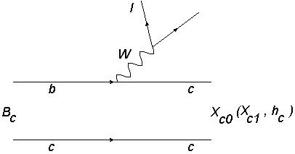
Sum Rules for the B_{c} → S(AV)lν transition form factors
B_{c} → X_{c0} (X_{c1,} h_{c})lν transition at tree level
ν

Slide 6
Sum Rules for the B_{c} → S(AV)lν transition form factors
Matrix elements of the B_{c} → X_{c0} (X_{c1,} h_{c})lν

Slide 7
Sum Rules for the B_{c} → S(AV)lν transition form factors
Philosophy of the QCD sum rules
We see the internal structure of the hadron
We see it from the outside

Slide 8
Sum Rules for the B_{c} → S(AV)lν transition form factors
In technique language, we start with the main object in QCD sum rules so called the correlation function

Slide 9
Sum Rules for the B_{c} → S(AV)lν transition form factors
Phenomenological or physical side:
The vacuum to the hadronic state matrix elements can be parameterized in terms of the leptonic decay constants as

Slide 10
Sum Rules for the B_{c} → S(AV)lν transition form factors
The phenomenological side of the correlation functions are obtained as:

Slide 11
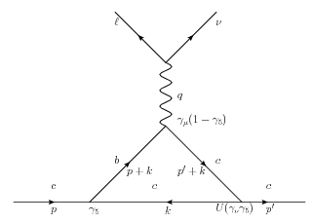
Sum Rules for the B_{c} → S(AV)lν transition form factors
On the QCD side, the correlation functions can be calculated by the help of the OPE in the deep space-like region

Slide 12
Sum Rules for the B_{c} → S(AV)lν transition form factors
Each П^{per} function is written in terms of the double dispersion representation:

Slide 13
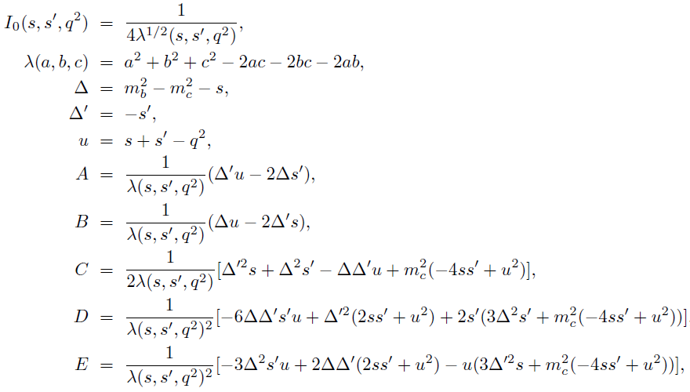
Sum Rules for the B_{c} → S(AV)lν transition form factors

Slide 14
Sum Rules for the B_{c} → S(AV)lν transition form factors
The QCD sum rules for the form factors f₁(q²) and f₂(q²) for the B_{c} → X_{c0} ℓν can be acquired:
The form factors f_{V} , f₀, f₊ and f₋ for B_{c} →( X_{c1} , h_{c} ) ℓν decays are also obtained as:

Slide 15
Sum Rules for the B_{c} → S(AV)lν transition form factors
The differential decay width for B_{c} → X_{c0} ℓν is obtained as follows :

Slide 16
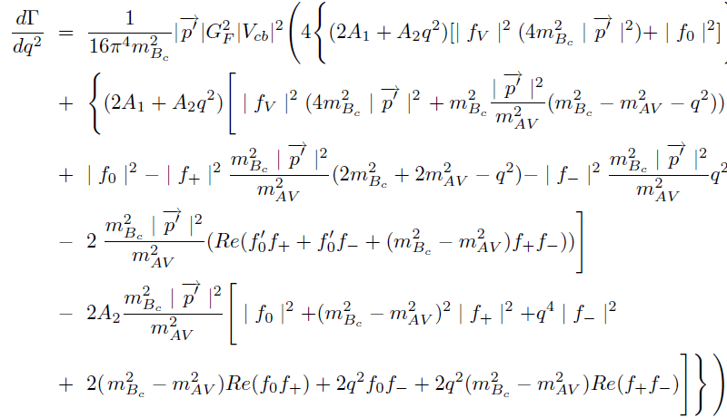
Sum Rules for the B_{c} → S(AV)lν transition form factors
The differential decay width corresponding to B_{c} →( X_{c1} , h_{c} ) ℓν decays are acquired as:

Slide 17
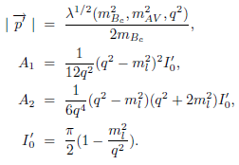
Sum Rules for the B_{c} → S(AV)lν transition form factors

Slide 18
Heavy quark effective theory limit of the form factors
In this section, we calculate the heavy quark effective theory (HQET) limits of the transition form factors for B_{c} → X_{c0}( X_{c1} , h_{c} ) ℓν . For this aim, we use the parameterization
the new integration variables take the following form:
The leptonic decay constants are rescaled:

Slide 19
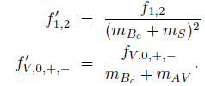
Heavy quark effective theory limit of the form factors
To evaluate the form factors in HQET, we also need to redefine the form factors in the following form:
After standard calculations, we obtain the y-dependent expressions of the form factors f₁' for
B_{c} → X_{c0} ℓν transition as follows:

Slide 20
Numerical analysis
Numerical values:

Slide 21
Numerical analysis

Slide 22
Numerical analysis

Slide 23
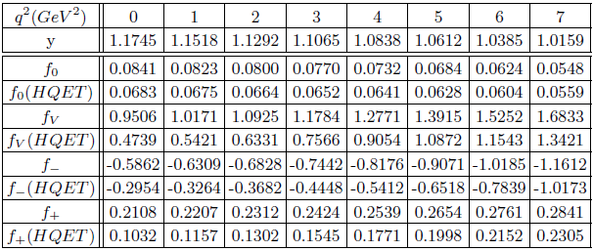
Numerical analysis

Slide 24
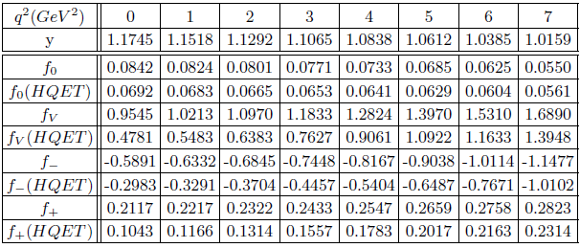
Numerical analysis

Slide 25
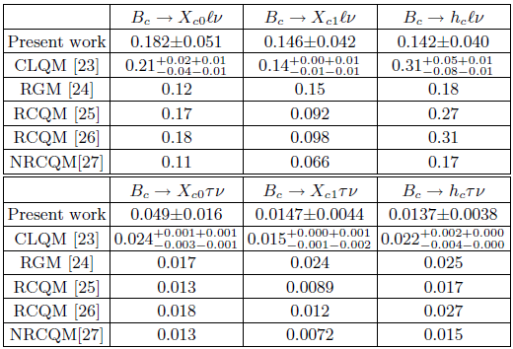
Numerical analysis

Slide 26
Conclusion
In conclusion, using the QCD sum rules approach, we investigated the semileptonic B_{c} → X_{c0} (X_{c1,} h_{c})lν decays. The q² dependencies of the transition form factors were calculated. The HQET limits of the form factors were also evaluated and compared with original form factors. The obtained results were used to estimate the total decay widths and branching ratios of these transitions. These results can be tested in the future experiments.

Slide 27
THANKS

