Slide 1
Springs & Antisprings (the monolithic geometric antispring approach)
G. Cella – INFN sez. Pisa

Slide 2
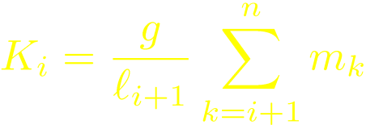
Seismic attenuation principle
A chain of oscillators
Horizontal attenuation: a chain of pendula is the natural solution
Solving for the transfer function we get, above the resonances, (equal lengts, optimal case)

Slide 3
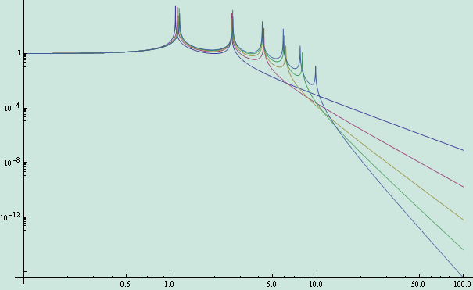
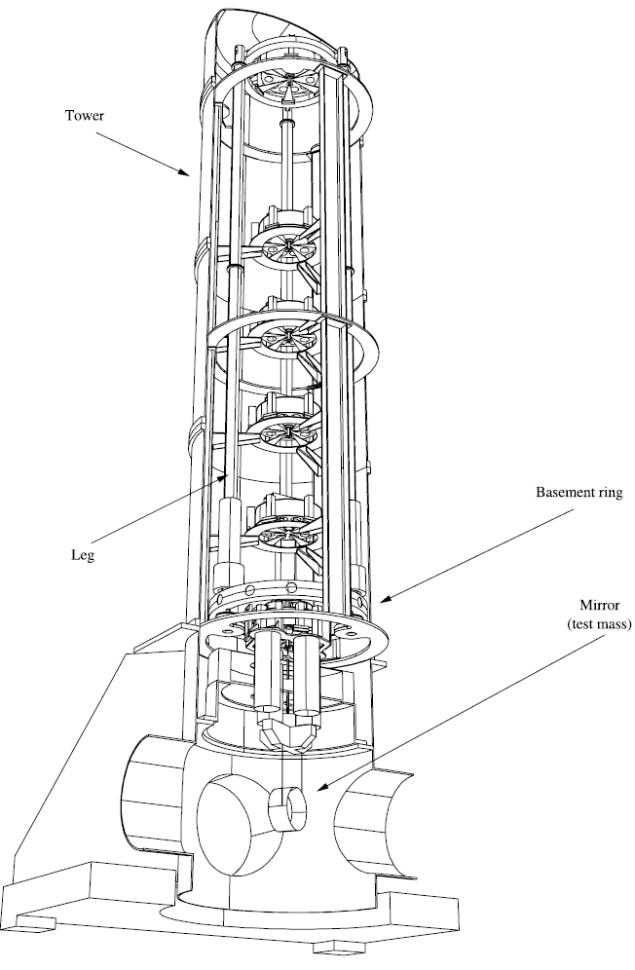
Vertical attenuation
Same approach?
Pendula no more available
Springs. But they must substain heavy loads
How to obtain low resonant frequencies?

Slide 4
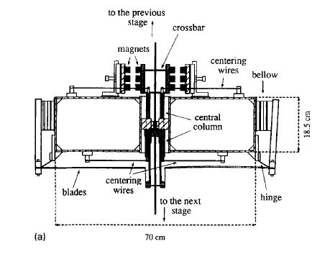
Antisprings
Suppose we find a spring with (which is, an antispring)
In parallel with a traditional spring with we obtain
In principle it can be tuned near zero .....
The VIRGO solution, implemented using magnets as antisprings.

Slide 5
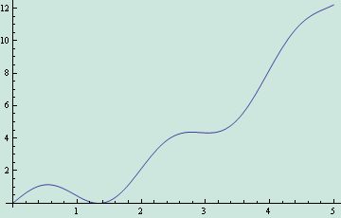
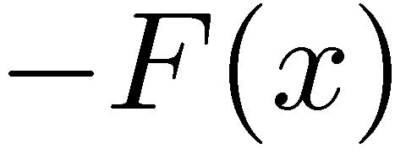
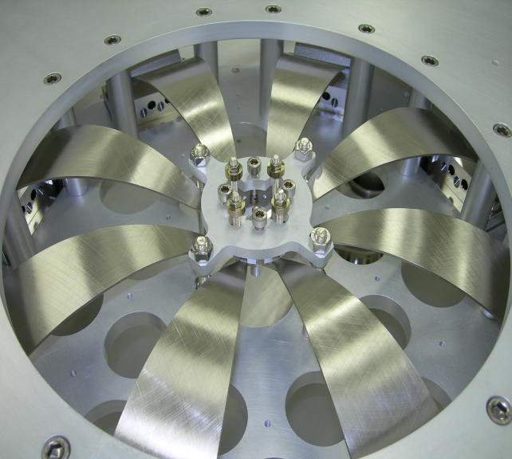
Monolithic Geometric Anti Springs
A different approach:
Use mechanical effects only
Exploit the non linearity of the apparatus to find a “good” working point, which means:
Low stiffness
High static force
Is this possible?

Slide 6
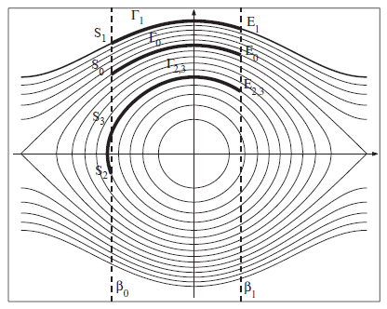
MGAS: low frequency modelization
Do not take into account inertia effects (low frequency)
Write the energy of the system
Formally: a pendum (with “time” dependent mass)
Large number of interesting configurations.

Slide 7
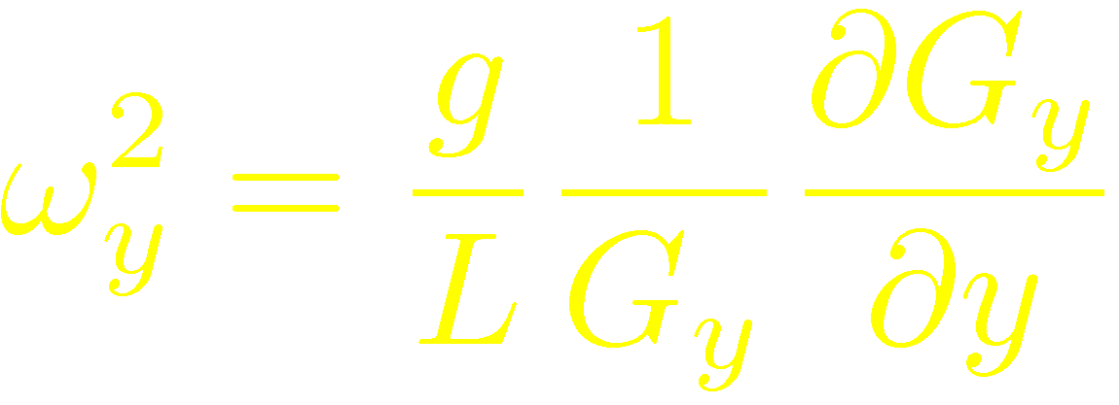
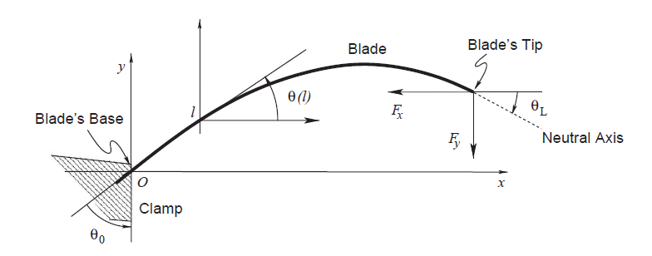
Static vertical load
Study of
Saddle point: something interesting around there?
Yes, because

Slide 8
Vertical resonance frequency (I)
Study of
Resonance frequency goes to zero near a “critical” curve
Critical curve is a separatrix between a monostable and bistable regime

Slide 9
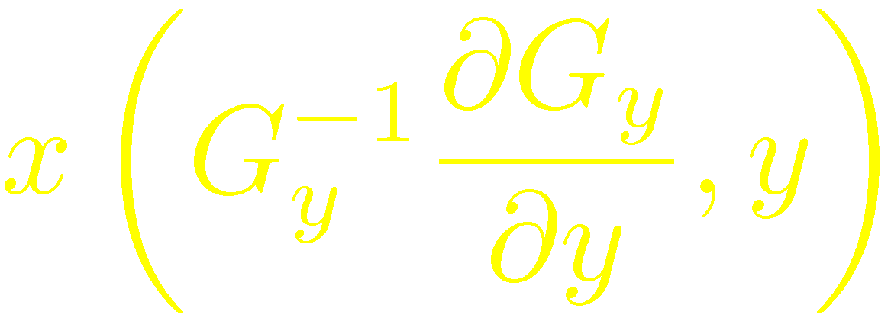
Vertical resonance frequency (II)
Study of
A line of “near zero frequency” working points
Robust configurations near them

Slide 10
Thermal stability
We can define thermal variation coefficients for each quantity of interest.
Tuning is possible, they can be reduced
Tuning can be difficult very near a critical point

Slide 11
Universality
Results are quite robusts: interesting configurations can be obtained with
a large range of boundary conditions
several different blade profiles
This freedom can be exploited to optimize the design
minimization of the stress
thermal stability
reduction of nonlinear effects

Slide 12
Results: measured transfer function
Measurements shows high frequency features not taken into account in the previous modelization:
Blade inertia
Internal modes
In the case considered, these are relevant above 10 Hz

Slide 13
Results: two filter chain
The behaviour is as expected.
Percussion point effects can be corrected (to some extent)

Slide 14
Seismic attenuation: expected behaviour of a chain

Slide 15
Conclusions
MGAS filters are a viable alternative to the magnetic solution
Clean design
Scalable
Good thermal and mechanical stability
Some applications
SAS filters for TAMA
Optical bench isolation system in LIGO
Accelerometers
Work is continuing about that in LIGO
References:

