Slide 1
Suspension Thermal Noise modeling
Michele Punturo

Slide 2
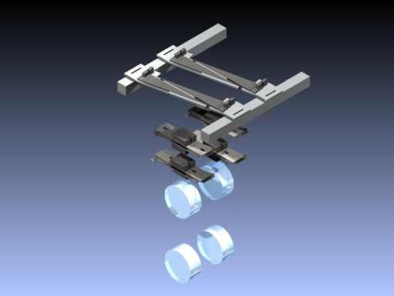
Suspension thermal noise in GWINC
In the advanced Virgo current modeling the suspension wires have a ribbon geometry (GWINC heritage)
We need to use the cylindrical geometry (implemented in GWINC)
In the Virgo sensitivity curve the suspension thermal noise is modeled by a single pendulum stage
In advanced (and ET) we need to model all the last stage
GWINC implements it, but for a different geometry

Slide 3
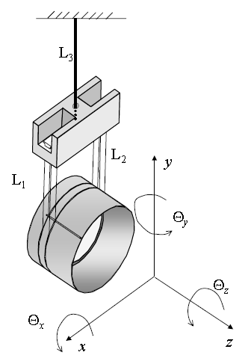
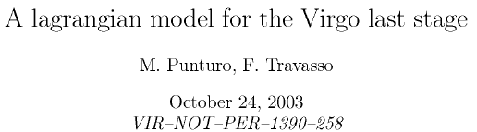
Some reference
In this presentation we consider:
  Index i=1 ⇒ Mirror
  Index i=2 ⇒ Reference mass
  Index i=3 ⇒ Marionette
All the geometrical computations are extracted from:
For reference and cross-checks are also useful:
  E. Majorana, Y. Ogawa, PLA 233 (1997) , 162-168
  M. Punturo, VIR-NOT-PER-1390-240 (2003)

Slide 4
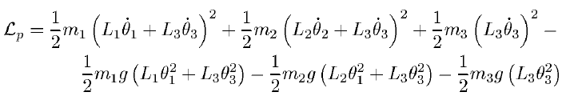
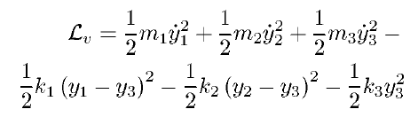
Lagrangian modeling
Pendulum oscillation
Vertical oscillation

Slide 5
Pendulum equation of motion
Solving the Eulero-Lagrange equations
it is possible to find the equation of motion
“In angle”
“In displacement”

Slide 6
Matrix equations
The previous system of equations can be generalized and written in matrix format:
Where, in the pendulum case
and d²/dt² is the double derivative operator

Slide 7
… Matrix equations
If we consider a thermal stochastic force and we pass to the frequency domain:
The transfer function is:
The impedance matrix is:

Slide 8
Application of the FDT
Application of the Fluctuation-Dissipation Theorem:
How to implement it?
Since all the computation tools (Matlab. Mathcad,…) implement the matrix algebra it is better to leave as it is
  Valid for any pendulum geometry
  It is easy to compute the fluctuations of the other bodies

Slide 9
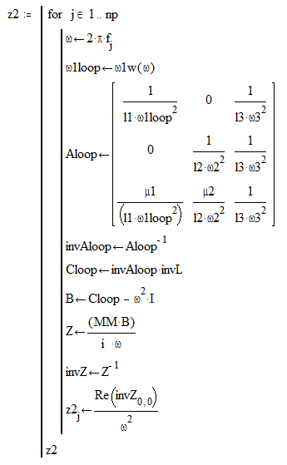
Example of the Mathcad code
Example of the compactness of the code using matrix algebra

Slide 10
Explicit computation
If the term <x>₁₁ is explicitly computed:
To be compared with a simple pendulum:

Slide 11
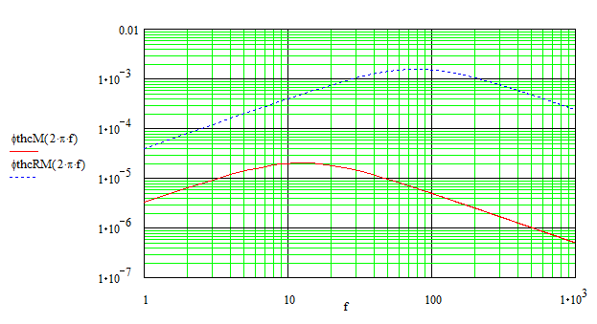
How dissipation is introduced
Fused silica suspension wires:
A.M. Gretarsson et al, PLA 270 (2000), 108-114
RM steel suspension wire
(r=300 μm)
Cagnoli G and Willems P A Phys. Rev. B, 65, 17
Mirror FS suspension wire (r=200μm)

Slide 12
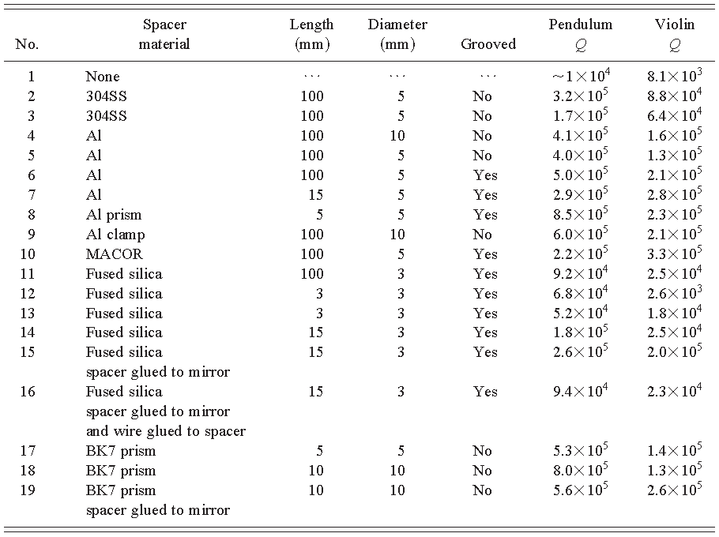
Dilution factor
Losses only in the elastic force:
Should we do it also for the RM wires?
  φ_{th}(max)~10⁻³, Dilution factor ~ 200, but Q_{max}=10⁴ (G. Cagnoli et al, RSI, 71 (5), 2206)
  If, to be conservative, we consider Q_{RM}=10³ – 10⁴ any frequency dependence of the losses for the RM can be neglected

Slide 13
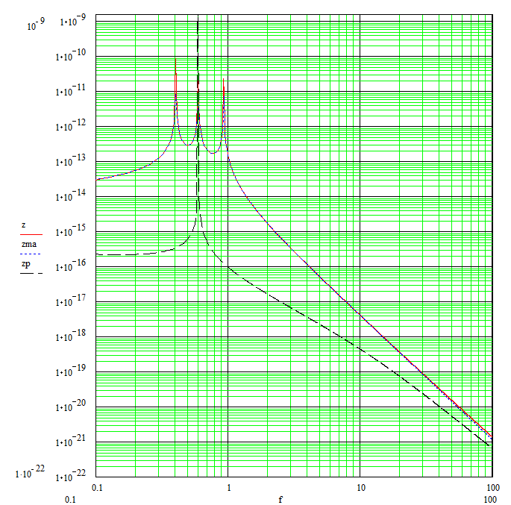
Payload thermal noise
m/sqrt(hz)
Payload thermal noise
Pendulum thermal noise

Slide 14
Effect of the Marionette losses

Slide 15
Effect of the RM losses

Slide 16
Effect of the Mirror suspension losses
Thermoelastic effect is by far the dominant component with r=300μm
The thermoelastic effect is minimized if r~400μm

Slide 17
…Effect of the Mirror suspension losses
Simple pendulum noise benefits of this new selection, but the payload thermal noise is totally insensitive

Slide 18
Strategy
To benefit of the improvements in thermal noise, we need to optimize the losses both on the RM and on the Marionette
Are we sure that to search for the minumum of the thermoelastic is a good strategy, anyhow?

Slide 19
Vertical Fluctuations
The formalism adopted for the pendulum modes works equally for the vertical fluctuation

Slide 20
Vertical frequencies
The Mirror (1) and RM (2) natural vertical frequencies are easy to compute:
The elastic constant of the marionette suspension is, instead, dominated by the magnetic anti-spring compliance. To evaluate it a natural frequency of 0.4Hz is hypotized

Slide 21
Dissipations
Dilution Factor don’t help the vertical mode
The dissipation component in ω₃ could be huge (10⁻²-10⁻¹) because of the magnetic suspension and the so-called junction box
The dissipation component in ω₂ could be large (10⁻³-10⁻²) because of the friction between the wires and the RM grows
These numbers are (in some sense) confirmed by the Q measured by P. Ruggi in the Virgo payload

Slide 22
Horizontal-to-Vertical coupling
Earth Radius limit
Typical good value
Typical normal value

Slide 23
Total suspension thermal noise
Parameters:
Payload
Simple pendulum
Vertical

Slide 24
Role of the mirror suspension wire tickness
R₁=400μm
R₁=300μm

Slide 25
GWINC – Lagrangian model comparison

Slide 26
What is the effect in Virgo
This new model affects also the evaluation of the nominal Virgo sensitivity.
Because of the reduced pendulum Q the impact is smaller, but not completely negligible

Slide 27
Conclusions
A more complete model is presented
  Further steps possible considering the angular modes
An important effect on the low frequency sensitivity could occur
If the results of this model are confirmed (see next talks) it is important to further increase the efforts to optimize the design of the payload to minimize the dissipation effects of the other components of the payload.
An effort to understand the effects on the current Virgo sensitivity should be done.

Slide 28
Discussion points
Implementation in GWINC
Angular fluctuations
How to evaluate the many dissipation parameters
Measure the Vertical-Horizontal coupling
Extract from here an optimization strategy
Use the model also for the seismic transfer function

