Slide 1
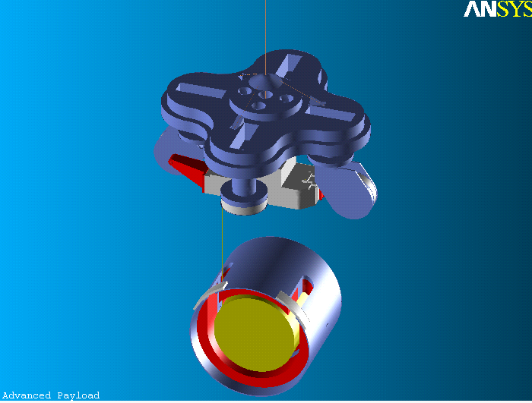
The Thermal Noise of Virgo Advanced Payload
Paola Puppo
INFN – Rome
Thermal Noise Meeting – “Sapienza”-Rome - February 26th 2008

Slide 2
Scientific motivations
In the advanced VIRGO configuration is foreseen:
to use heavier mirrors
40 kg mass (reference solution)
60 kg mass.
In the advanced VIRGO configuration is not foreseen:
to change the SA
Implications:
Take into account the actual payload requirements;
Adapt the weight of all the payload components in order to
be compliant with the SA suspension: we must preserve the overall weight.
But what about the thermal noise?

Slide 3
Payload
The role of the Last Stage Suspension is to compensate the residual seismic noise and to steer the optical components maintaining the relative position of the interferometer mirrors.
Components and roles:
Marionette: Mirror control with coil-magnet actuator between F7 and marionette;
Reaction Mass (RM): Mirror steering with coil-magnet actuator between RM and mirror; Mirror protection;
Requirements:
Materials:
UHV compatible;
Amagnetic;
No electrostatic charges;
Internal Frequencies above Virgo bandwidth;
Low frequencies of the system below Virgo bandwidth;
Compatibility with SuperAttenuator and lower part of the tower:
Weights
Shape

Slide 4
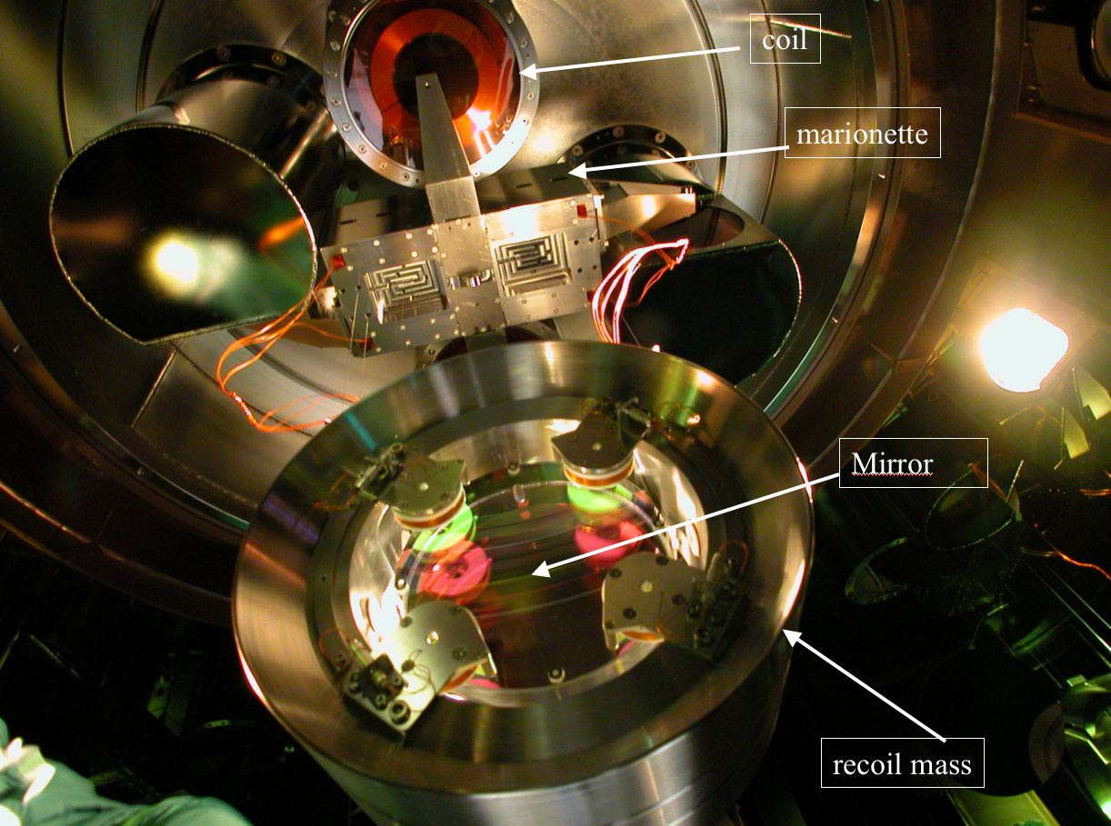
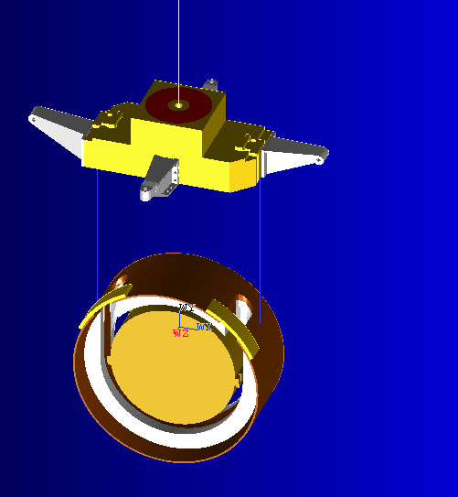
Specifications
Virgo
F7 legs and coils: 84 kg
Marionette (AISI316L): 110 kg
Reaction Mass(Al6063): 50 kg
Mirror (Suprasil): 21 kg
Overall payload weight: 181 kg
Virgo +
Marionette (AISI316L+Peek): 110 kg
Reaction Mass (AISI316L+Peek): 50 kg
Mirror (Suprasil): 21 kg
Overall payload weight: 181 kg

Slide 5
Advanced Payload
Marionette (Virgo+ like, monolithic suspensions compliant)
Reaction Mass
Mirror
Marionette Reaction Mass (MRM) (R&D)
→ marionette steering
→ no bechers, no filter 7 legs
→ compliant with bigger diameter mirrors (e.g. BS)
Other elements suspended to the marionetta or to the MRM – see non-degenerate recycling cavities configuration
→ compliant with SA (overall allowed mass 180 kg)

Slide 6
Advanced Payload (Virgo-like configuration):
mirror mass
Acting on the shapes we can adjust the weights (we can play with some geometric parameters)
1. 40 kg mirror, 200 mm thick, 350 mm diam.
Marionette (Virgo+ like, monolithic suspensions compliant) (100 kg)
Reaction Mass (40 kg)
Total payload weight: 180 kg
Marionette Reaction Mass (MRM) (New coils): max 84 kg.
2. 60 kg mirror, 300 mm thick, 350 mm diam (challenging!)
Marionette (Virgo+ like, monolithic suspensions compliant) (90 kg)
Reaction Mass (40 kg) (Can we accept a double displacement on the RM respect to the mirror? See the TC requirements. We can share the weight with the marionette…(50,80))
Total payload weight: 190 kg
but we can gain 10kg from MRM
Marionette Reaction Mass (MRM) (New coils): max 74 kg.
the ratios between the masses change, what about the thermal noise?

Slide 7
Thermal Noise Model for the Last Stage Suspension
Branched system
Marionette (M₁, β₁=M₁/τ₀₁)
Mirror (M₂, β₂=M₂/τ₀₂)
Reaction Mass (M₃, β₃=M₃/τ₀₃)
Equations of motion with thermal stochastic forces
*RSI v70,1999,”Suspension Last Stage…”
Impedance Matrix
Stochastic Thermal forces
related to the uncoupled thermal forces

Slide 8
Thermal Noise Model for the Last Stage Suspension: Normal Modes Treatment
1. Normal Modes
Eigenvalues equation:
Normal frequencies
Equation of the modes:
Eigenvectors

Slide 9
Thermal Noise Model for the Last Stage Suspension: Normal Modes Treatment
2. Decay times of the normal modes
The uncoupled decay times can contain both the viscous and the internal losses
E. Majorana, P. Tricarico, “Decay Times of an N-Normal-Mode System”, Il Nuovo Cimento, Sept 1993

Slide 10
Thermal Noise Model for the Last Stage Suspension: Normal Modes Treatment
3. Thermal Noise of the 2° oscillator (Mirror)
Normal modes mass matrix
Uncoupled oscillators mass matrix

Slide 11
Thermal Noise Model for the Last Stage Suspension: Normal Modes Treatment
3. Thermal Noise of the 2° oscillator (Mirror)
The calculation is quite complex…
we have to remember that the stochastic thermal forces of the free oscillators are uncorrelated
We find:
The functions T_{ni}(ω) contain the crossterms which makes the difference with the “naive treatment”

Slide 12
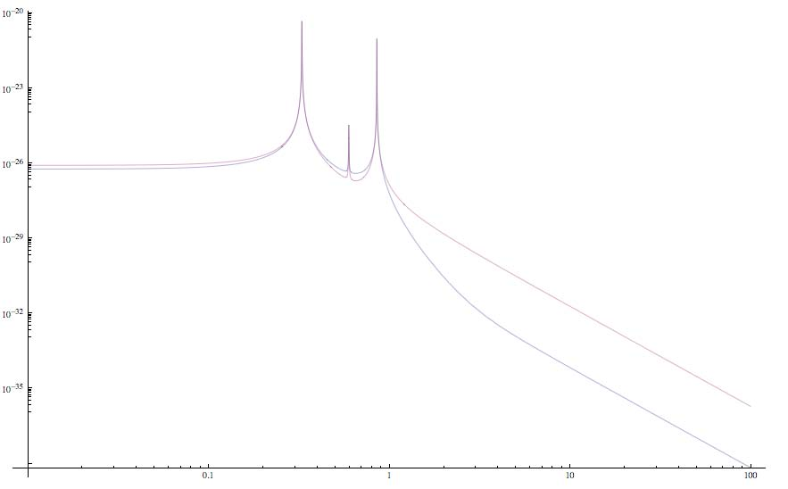
Comparison between the naive and modal treatment
Naive
Modal
Hz
The effect of the crossterm is more evident above the modal frequencies and it must be taken into
account to obtain a correct evaluation of the thermal noise*
The normal mode treatment is in complete agreement with the FDT treatment
* E. Majorana, Y. Ogawa, “Mechanical thermal noise in coupled oscillators”, Phys.Lett. A, Aug. 1977

Slide 13
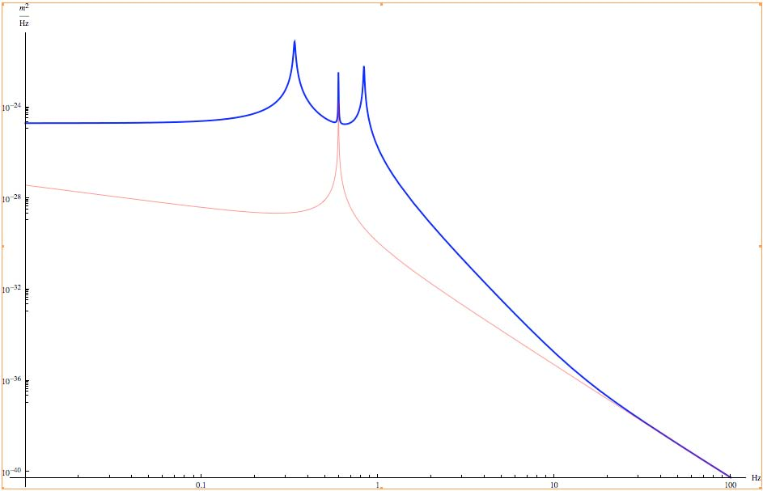
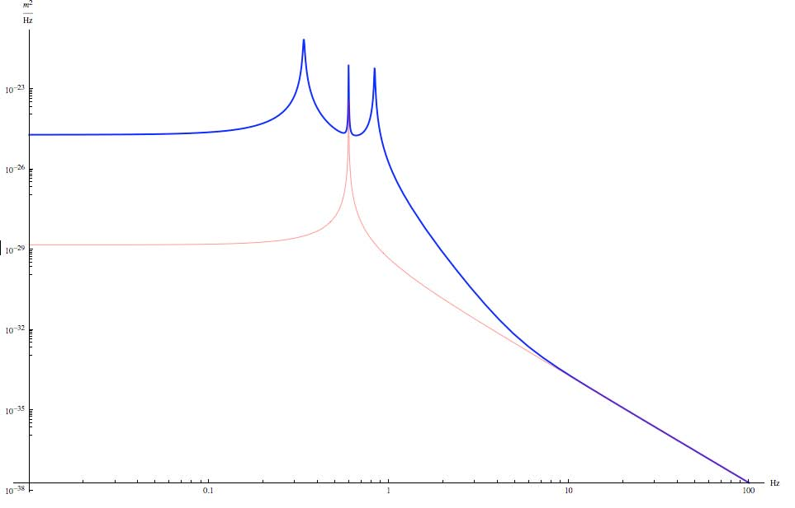
Virgo
Marionette (AISI316L): 110 kg
Reaction Mass(Al6063): 50 kg
Mirror (Suprasil): 21 kg
Measured Modes
ν₁=0.446 Hz; Q₁=50
ν₂=0.6 Hz; Q₂=10000-200000
ν₃=0.979 Hz; Q₃=70
VIR-NOT-ROM-1390-242 and
VIR-NOT-ROM-1390-239
Using the measures of the Q’s we can infer informations on the
quality factor of the uncoupled oscillators
Computation
Marionette (AISI316L): 110 kg (Q=30)
Reaction Mass(Al6063): 50 kg (Q=10000-150000)
Mirror (Suprasil): 21 kg (Q=10⁶)
Q₋=50
Q₀=14000-200000
Q₊=90
We want the pendulum thermal noise at 10Hz
Thermal of the branched
(Q₂=10000, Qmir viscous)
Thermal of the mirror pendulum
Worst case
(Q₂=10000, Qmir internal)

Slide 14
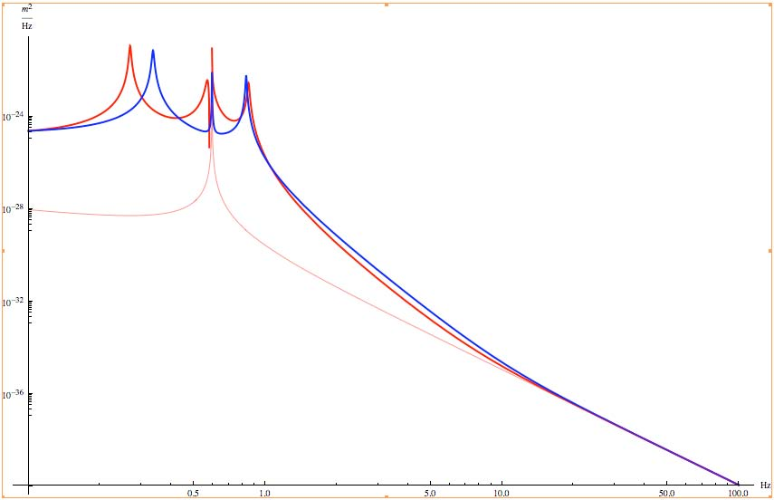
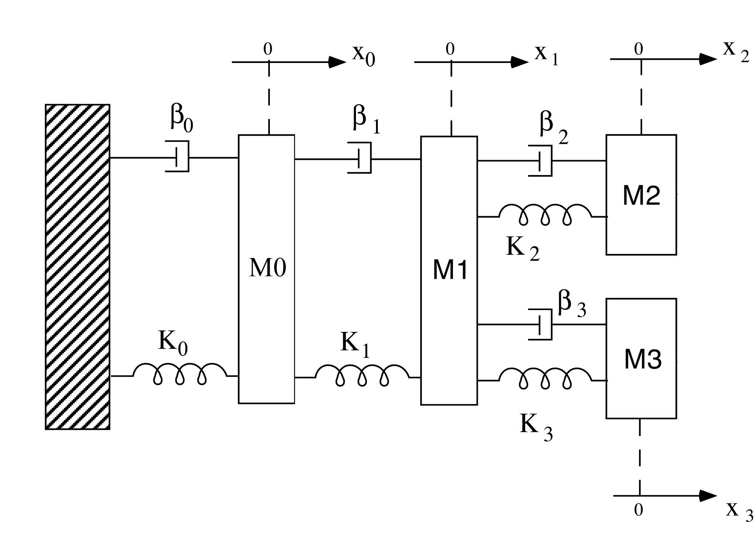
Thermal Noise of the pendulum with F7 (or MRM)
The F7 doesn’t spoil the thermal noise (Q_{F7}=30)
Branched
Branched+F7
The ratio don’t change by changing the losses of the Reaction Mass
The ratio do change considerably with losses of the Marionetta

Slide 15
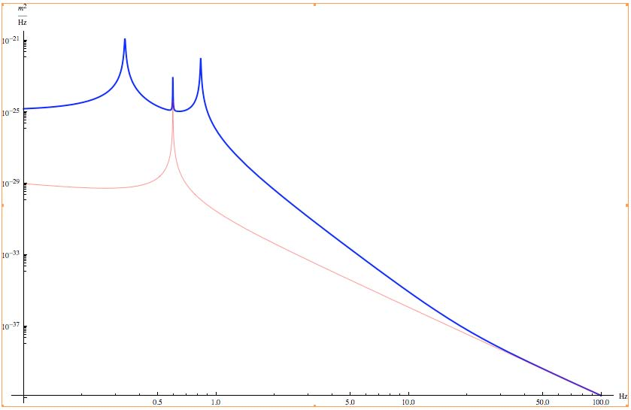
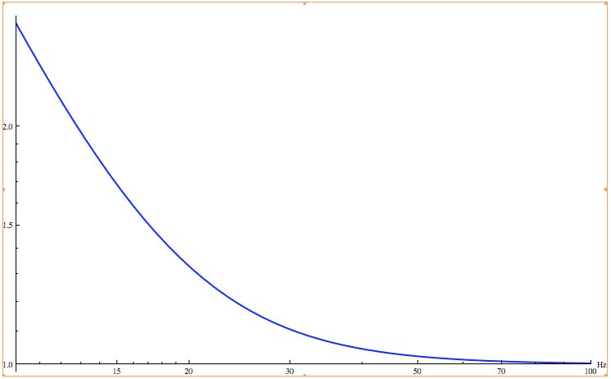
Marionette 110 kg (Q=50) Reaction Mass 50 kg (Q=100000) Mirror (Suprasil): 21 kg (φ=10⁻⁷)
Virgo+
Behavior of the ratio with frequency

Slide 16
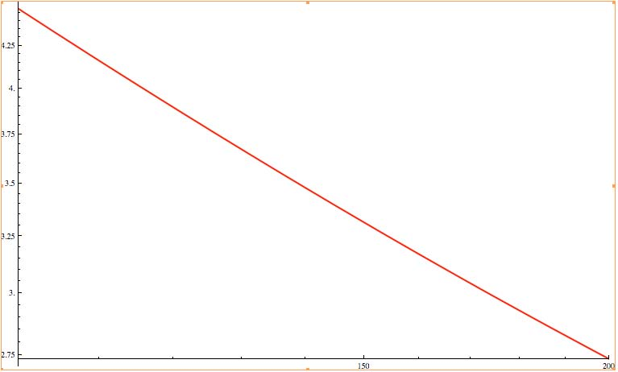
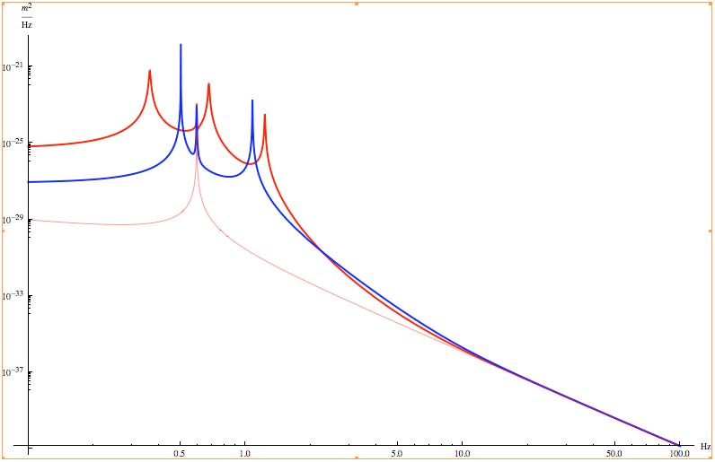
Virgo+
We can play with the marionette mass
Qmario=100
M(kg)
Possible solution: Increase the juction box mass of about 30 kg at level of the junction box of the marionette cable and improve the coupling between the marionette and the intermediate mass
Marionette 110 kg (Q=1000) Reaction Mass 50 kg (Q=100000) Mirror (Suprasil): 21 kg (φ=10⁻⁷)
Mintermediate=30kg, (Q=30)

Slide 17
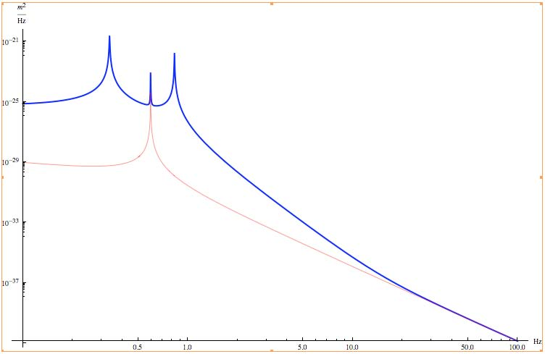
Virgo Advanced (reference)
Marionette 100 kg (Q=100)
Reaction Mass 40 kg (Q=100000)
Mirror 40 kg (φ=10⁻⁷)

Slide 18
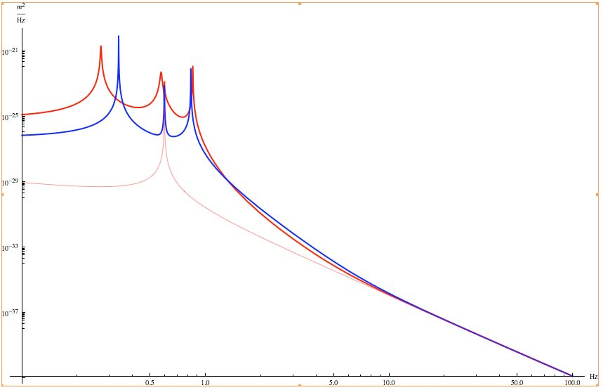
AdV: the MRM is helpful in filtering the coupling with the F7
F7: 85 kg (Q=30)
Marionette 100 kg (Q=1000)
Reaction Mass 40 kg (Q=100000)
Mirror 40 kg (φ=10⁻⁷)

Slide 19
Conclusions
In the thermal noise of the mirror pendulum
the losses of the marionette stage play a crucial role;
the marionette mass plays a crucial role;
Virgo: the setup is at the limit of the mirror steel wires losses;
Virgo+ and AdV: the coupling of the marionette to F7 will be improved with respect to the present one;
How could we decrease the losses?
Increase the Marionette Mass → see SA load issues
Add intermediate mass between the Marionette and F7 (MRM for example)
Act on losses
weak points on F7:
Electrical cabling passing around the marionetta wire
Magnetic antisprings and centering wires: probably they add viscous damping on vertical d.o.f.
Crossbar positioning: can we reduce the coupling between the vertical and horizontal degrees of freedom?
Geometric Antisprings (GAS ): the measured Q of the vertical mode is about 1000 (private communication)
The GAS are less tunable for the load mismatching

