Slide 1
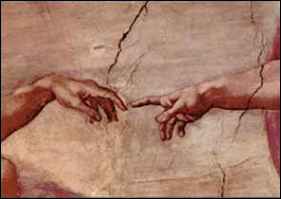
Why this session?
Giovanni Losurdo
AdV Coordinator

Slide 2
ADVANCED VIRGO (AdV)
Advanced Virgo Preliminary Design submitted to funding agencies Oct 08
PROJECT GOALS
Upgrade Virgo to a 2nd generation detector. Sensitivity: 10x better than Virgo
Be part of the 2nd generation GW detectors network: up in data taking with Advanced LIGO
Now under review:
started Nov 08, to end May 09
External Review Committee: B.Barish (chair), G.Cantatore, P.Dargent, H.Lück, C.Salomon, G.Tino
Advanced Virgo Reference Design and Project Execution Plan to be released before the end of the review
EGO Council decision on funding expected on July 09

Slide 3
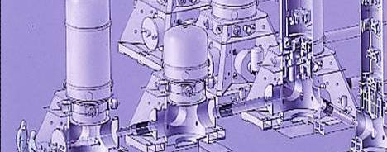
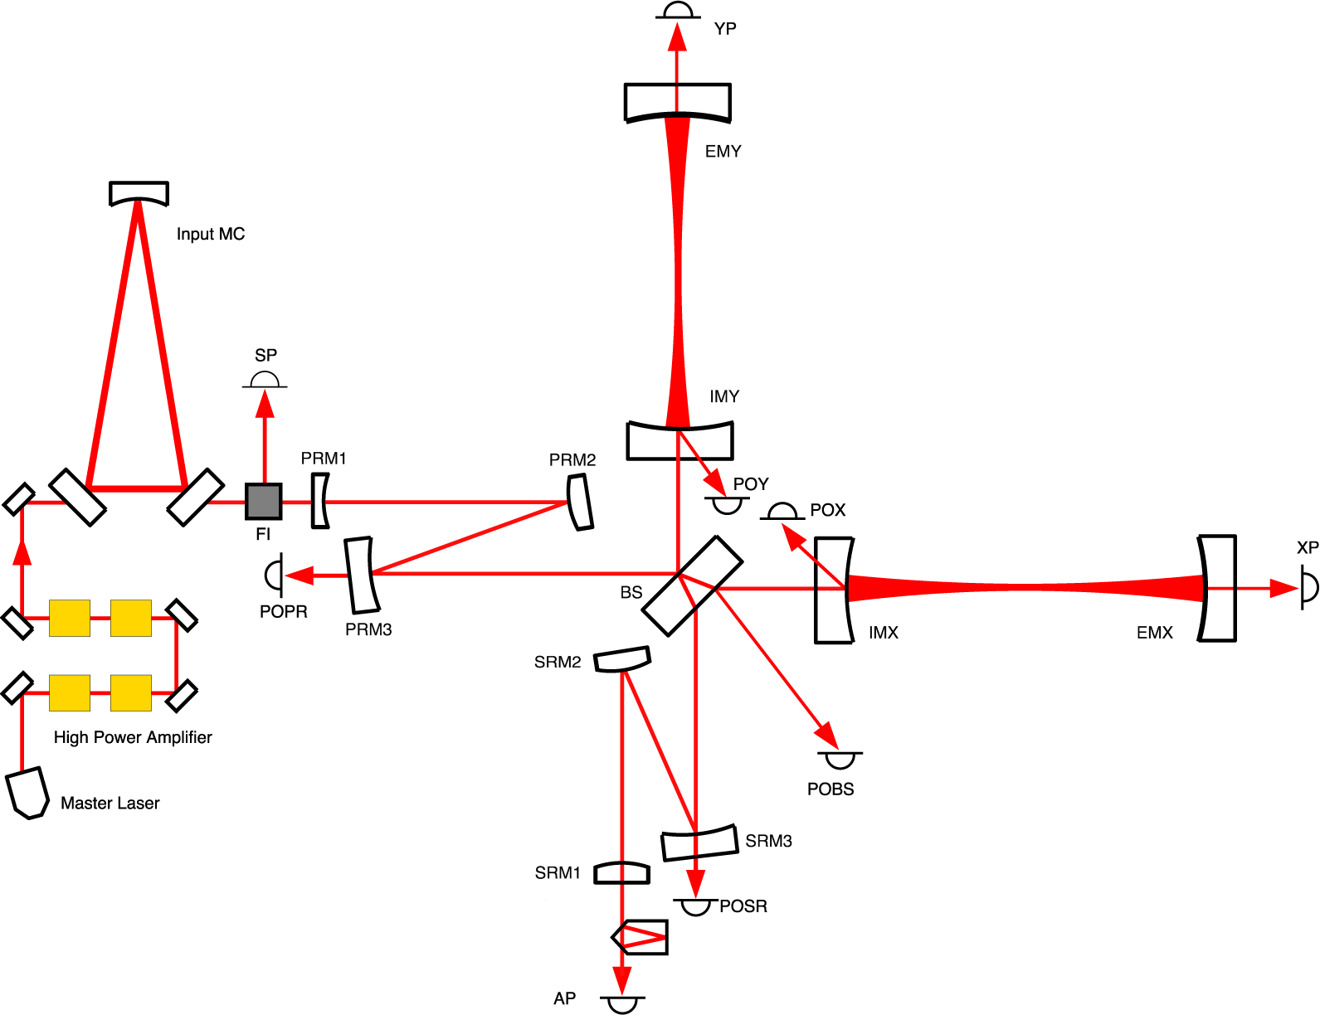
AdV PRELIMINARY DESIGN
Larger central links
Cryotraps
Heavier mirrors
Higher finesse
3km FP cavities
Waist in the
cavity center
High power laser
Non degenerate
rec. cavities
Monolithic
suspensions
Signal Recycling (SR)

Slide 4
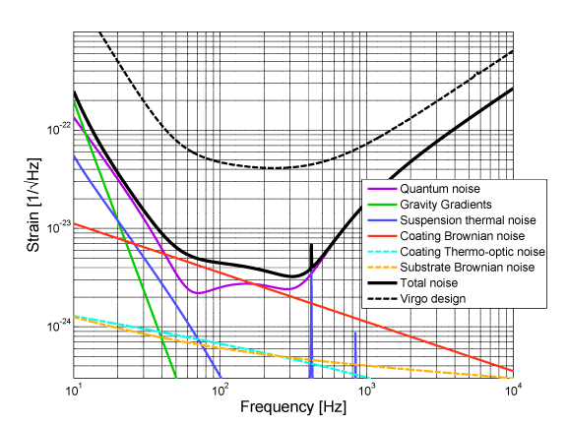
AdV PRELIMINARY SENSITIVITY
LIGO’s GWINC has been adapted and used to compute the reference sensitivity curve
SUSPENSION thermal noise
COATING brownian noise

Slide 5
AdV PRELIMINARY SENSITIVITY
SUSPENSION THERMAL NOISE – Simplified model
Recoil losses not considered (simple pendulum model)
Ribbons (optimized tapered fibers expected to be better)
SUSPENSION THERMAL NOISE – Next steps
Modelling of the full payload
Talks by Punturo and Puppo
Modelling of the optimized tapered fiber
Talk by Piergiovanni

Slide 6
AdV PRELIMINARY SENSITIVITY
MIRROR THERMAL NOISE
Main contribution: coating brownian noise
Substrate brownian and coating thermooptic are negligible
MIRROR THERMAL NOISE – Next steps
Fine tuning of the models wrt AdV optical configuration
Look at BS thermorefractive noise and coating noise of recycling mirrors
Talk by S.Hild

Slide 7
AdV REFERENCE SENSITIVITY
The effort towards a more accurate modelling of the thermal noise sources in AdV has started. First open discussion in this workshop
This will contribute to the completion of the AdV Reference Design
Steering the design choices (i.e. the payload)
Allowing to compute the AdV reference sensitivity curve
All contributions are very welcome!

